Slide 1
TLR5
Ian Antunes Ferreira Bahia
Notes:
toll like receptor 5

Slide 2
Topics
Receptor structure
Known ligands
Induced response (related cells)
Associated human diseases
GWAS
Notes:
Alepontillo@usp.br

Slide 3
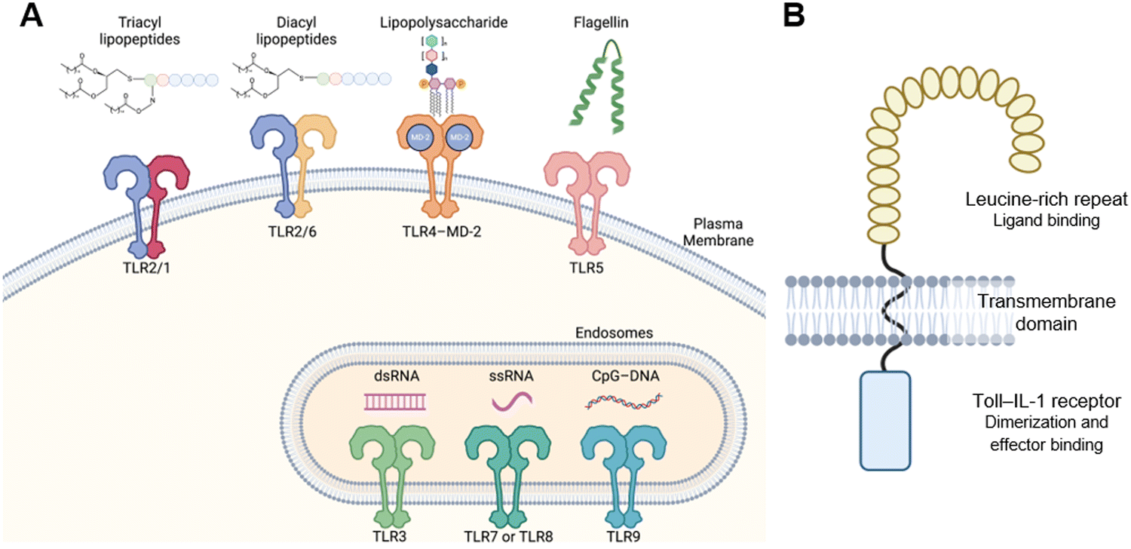
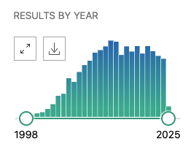
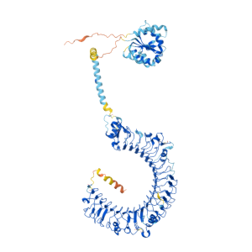
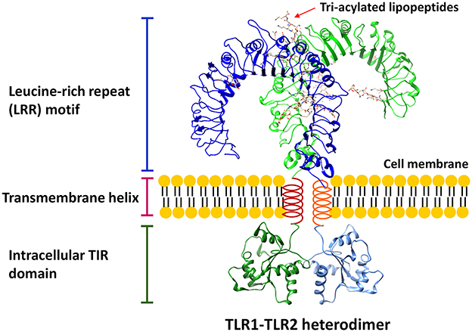
Receptor Structure
.I
TLR5 = Toll-Like Receptor 5
2267 results in PubMed
TLR5 is a type I transmembrane protein.
LRR domains responsible for recognizing PAMPs.
Font: PubMed, “TLR5”
keyword search.
Font: Taku Tsukidate, et al, 2023
.II
.III
Font: https://www.genecards.org/cgi-bin/carddisp.pl?gene=TLR5
Font: Wei Gao, et al, 2017
Notes:
https://www.rcsb.org/structure/3J0A

Slide 4
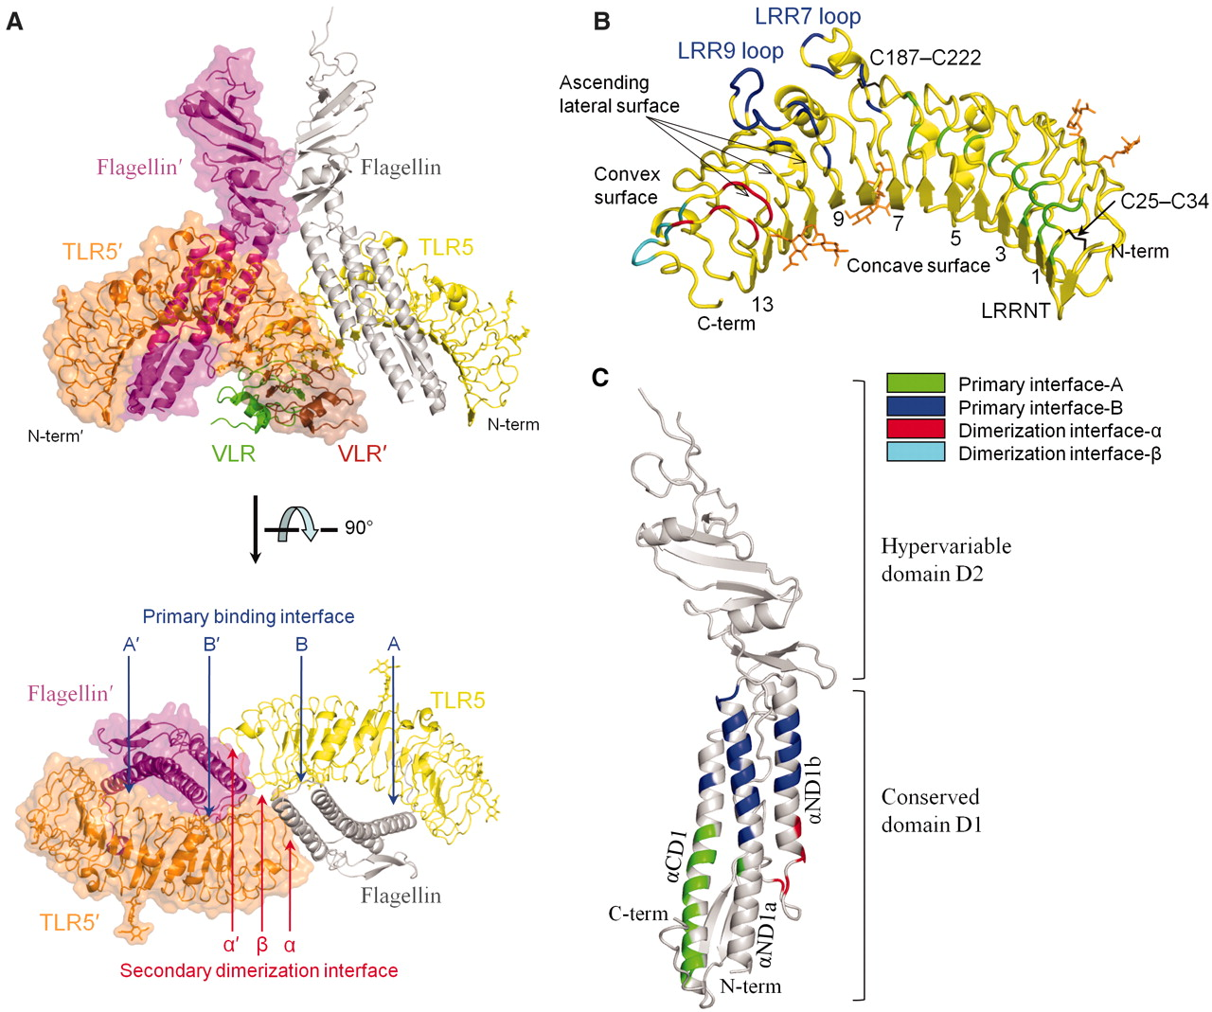
Know Ligands
The primary ligand is flagellin.
The monomeric protein that constitutes bacterial flagella, found in nearly all motile bacteria.
That interaction is crucial for the innate immune system's detection of motile bacteria.
Other possible ligands:
Lipopolysaccharides (LPS)
Components of Escherichia coli Secretion System
Zymosan
Font: Sung-il Yoon, et al, 2013
Fonts: LPS = USP Dissertation, Alexandra, 2007. / E.coli secretion system = USP Tesis, Lucas, 2012. / Zymosan = Todd M. Schaefer, et al, 2004.

Slide 5
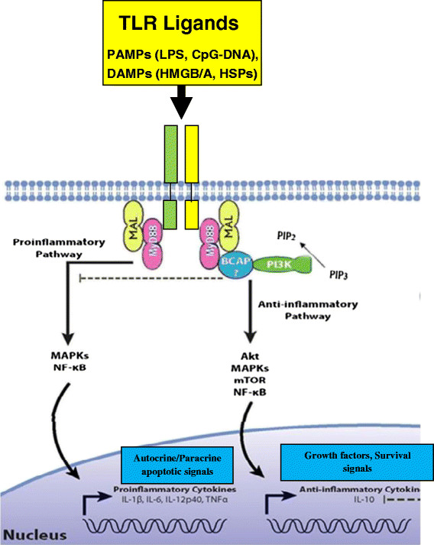
Induced Response
Binding of flagellin to TLR5 activates the MyD88-dependent signaling pathway, leading to:
Activation of the transcription factor NF-κB.
Production of pro-inflammatory cytokines, such as TNF-α and IL-6.
TLR5 is expressed in various immune system cells, including:
Intestinal epithelial cells.
Macrophages.
Dendritic cells.
Font: Fatemeh Pourrajab, et al, 2015

Slide 6
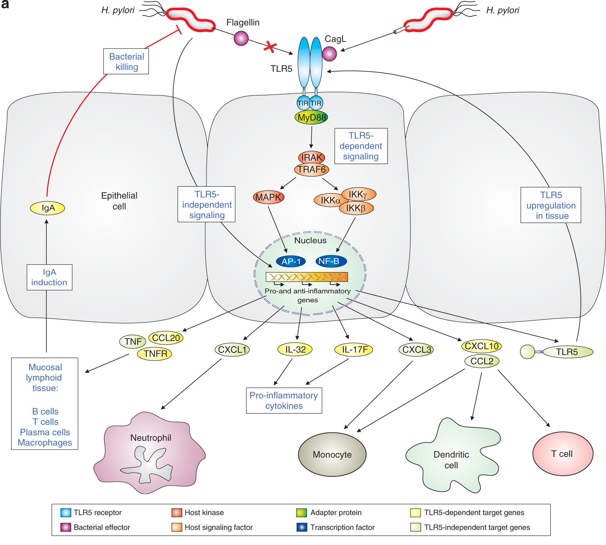
Associated Human Diseases
Inflammatory Bowel Diseases (IBD)
TLR5 expression on intestinal epithelial cells is vital for maintaining the composition of the gut microbiota.
TLR5-deficient mice develop spontaneous colitis and metabolic syndrome, associated with altered gut microbiota.
Osteoclastogenesis and Bone Loss
Activation of TLR5 by flagellin can promote the formation of osteoclasts and bone loss, especially in inflammatory conditions like rheumatoid arthritis.
Cancer
Gastric Cancer
Cervical Cancer
Ovarian Cancer
Font: Suneesh Kumar Pachathundikandi, et al, 2019
Font: Osteoclastogenesis = Hyunil Ha, et al, 2008; Rheumatoid Arthritis = Hatem A. Elshabrawy, et al, 2017. / Cancers = Tianwen Xu, et al, 2017; Sijuan Tian, et al, 2018; Mingfu Zhou, et al, 2009.

Slide 7
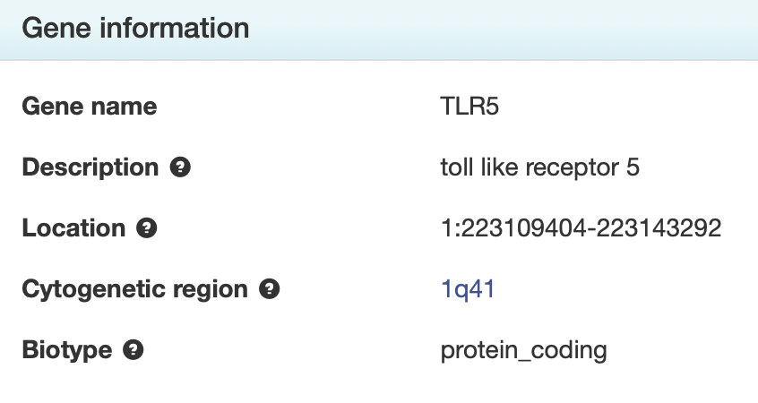
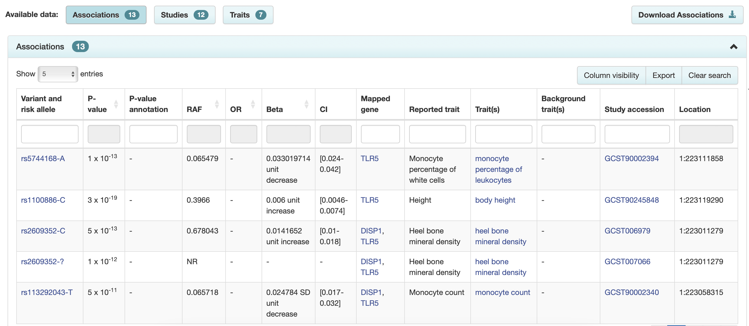
GWAS
Notes:
https://www.frontiersin.org/journals/genetics/articles/10.3389/fgene.2022.1083578/full
https://platform.opentargets.org/target/ENSG00000187554

Slide 8
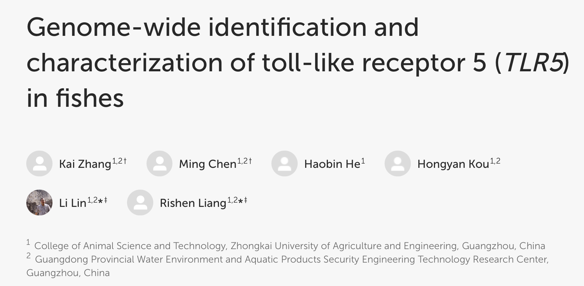
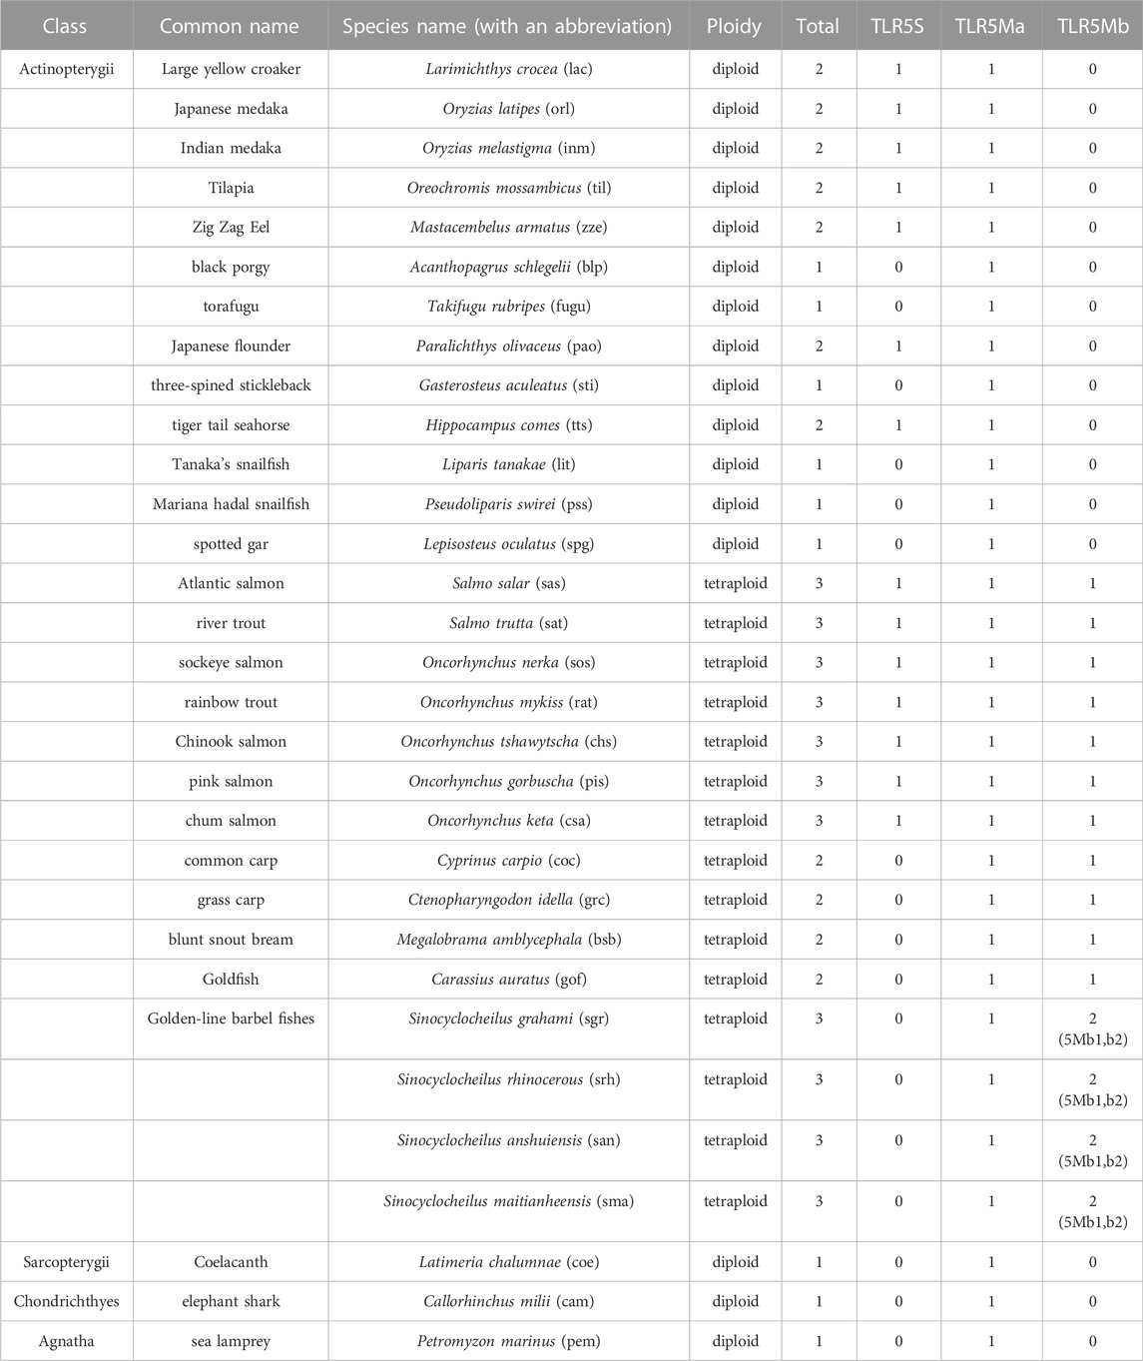
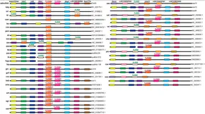
GWAS
Font: Kai Zhang, et al, 2023
Notes:
https://www.frontiersin.org/journals/genetics/articles/10.3389/fgene.2022.1083578/full

Slide 9
GWAS / Open Targets Genetics
Notes:
https://www.frontiersin.org/journals/genetics/articles/10.3389/fgene.2022.1083578/full
https://platform.opentargets.org/target/ENSG00000187554

Slide 10
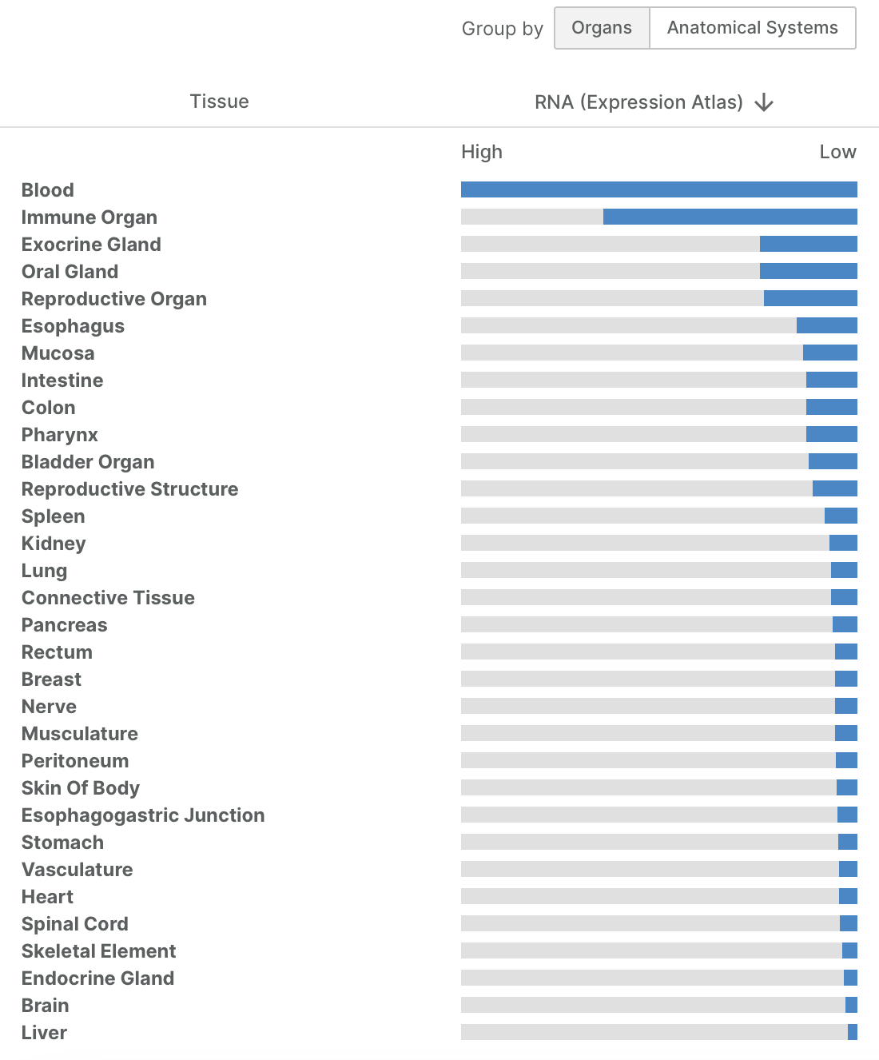
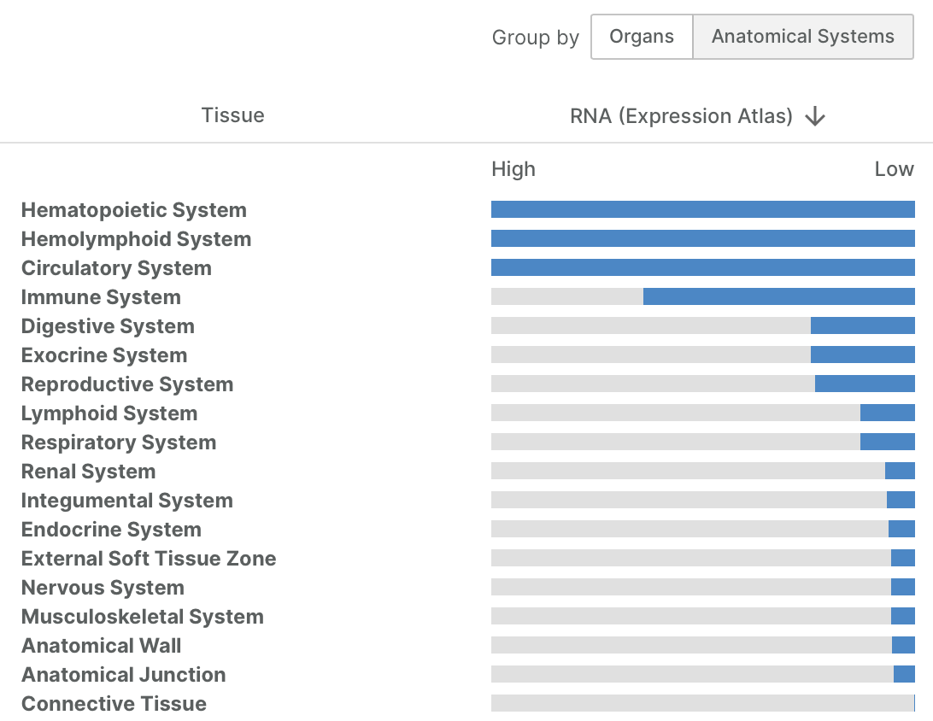
GWAS / Open Targets Genetics
Notes:
https://www.frontiersin.org/journals/genetics/articles/10.3389/fgene.2022.1083578/full
https://platform.opentargets.org/target/ENSG00000187554

Slide 11
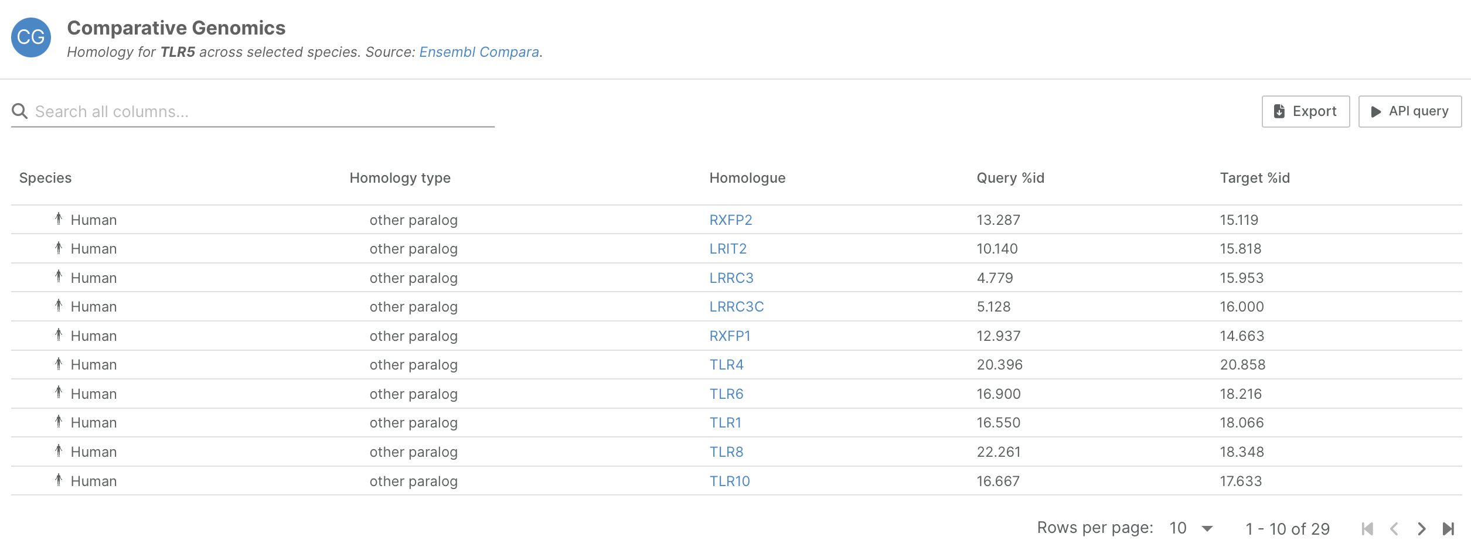
GWAS / Open Targets Genetics
Notes:
https://www.frontiersin.org/journals/genetics/articles/10.3389/fgene.2022.1083578/full
https://platform.opentargets.org/target/ENSG00000187554

Slide 12
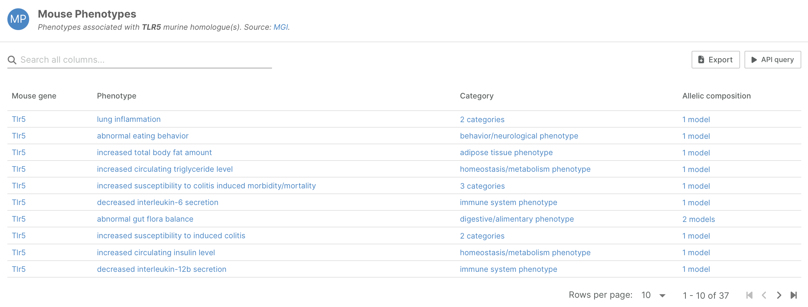
GWAS / Open Targets Genetics
Notes:
https://www.frontiersin.org/journals/genetics/articles/10.3389/fgene.2022.1083578/full
https://platform.opentargets.org/target/ENSG00000187554

Slide 13
References
Yoon, S. I., Kurnasov, O., Natarajan, V., Hong, M., Gudkov, A. V., Osterman, A. L., & Wilson, I. A. (2012). Structural basis of TLR5-flagellin recognition and signaling. Science, 335(6070), 859-864. DOI: 10.1126/science.1215584​
Hayashi, F., Smith, K. D., Ozinsky, A., Hawn, T. R., Yi, E. C., Goodlett, D. R., & Aderem, A. (2001). The innate immune response to bacterial flagellin is mediated by Toll-like receptor 5. Nature, 410(6832), 1099-1103. DOI: 10.1038/35074106​
Rhee, S. H., Im, E., Riegler, M., Kokkotou, E., O'Brien, M., & Pothoulakis, C. (2005). Pathophysiological role of Toll-like receptor 5 engagement by bacterial flagellin in colonic inflammation. Proceedings of the National Academy of Sciences, 102(38), 13610-13615. DOI: 10.1073/pnas.0502274102​
Kawai, T., & Akira, S. (2010). The role of pattern-recognition receptors in innate immunity: update on Toll-like receptors. Nature Immunology, 11(5), 373-384. DOI: 10.1038/ni.1863​
Gewirtz, A. T., Vijay-Kumar, M., Brant, S. R., Duerr, R. H., Nicolae, D. L., & Cho, J. H. (2006). Dominant-negative TLR5 polymorphism reduces adaptive immune response to flagellin and negatively associates with Crohn's disease. The American Journal of Physiology-Gastrointestinal and Liver Physiology, 290(6), G1157-G1163. DOI: 10.1152/ajpgi.00471.2005​
Ha, H., Lee, J. H., Kim, H. N., Kwak, H. B., Kim, H. M., Lee, S. E., Rhee, J. H., Kim, H. H., & Lee, Z. H.(2008). Stimulation by TLR5 modulates osteoclast differentiation through STAT1/IFN-β1. The Journal of Immunology, 180(3), 1382-1389. DOI: 10.4049/jimmunol.180.3.1382​
Elshabrawy, H. A., Essani, A. E., Szekanecz, Z., Fox, D. A., & Shahrara, S. (2017). TLRs, future potential therapeutic targets for RA. Autoimmunity Reviews, 16(2), 103-113. DOI: 10.1016/j.autrev.2016.12.003​
Pachathundikandi, S. K., Tegtmeyer, N., Arnold, I. C., Lind, J., Neddermann, M., Falkeis-Veits, C., Chattopadhyay, S., Brönstrup, M., Tegge, W., Hong, M., Sticht, H., Vieth, M., Müller, A., & Backert, S.(2019). T4SS-dependent TLR5 activation by Helicobacter pylori infection. Nature Communications, 10(1), 5717. DOI: 10.1038/s41467-019-13506-6​
Zhang, K., Chen, M., He, H., Kou, H., Lin, L., & Liang, R. (2023). Genome-wide identification and characterization of Toll-like receptor 5 (TLR5) in fishes. Frontiers in Genetics, 13, 1083578. DOI: 10.3389/fgene.2022.1083578​
Schäfer, T. M., DeSouza, K., Fahey, J. V., Beagley, K. W., & Wira, C. R. (2004). Toll-like receptor (TLR) expression and TLR-mediated cytokine/chemokine production by human uterine epithelial cells. Immunology, 112(4), 428-436. DOI: 10.1046/j.1365-2567.2004.01898.x​
Pourrajab, F., Yazdi, M. B., Babaei Zarch, M., Babaei Zarch, M., & Hekmatimoghaddam, S. (2015). Cross talk of the first-line defense TLRs with PI3K/Akt pathway in preconditioning therapeutic approach. Molecular and Cellular Therapies, 3(1), 4. DOI: 10.1186/s40591-015-0041-7​
Tsukidate, T., Hespen, C. W., & Hang, H. C. (2023). Small molecule modulators of immune pattern recognition receptors. RSC Chemical Biology, 4, 1014-1036. DOI: 10.1039/d3cb00096f​
Gao, W., Xiong, Y., Li, Q., & Yang, H. (2017). Inhibition of Toll-like receptor signaling as a promising therapy for inflammatory diseases: A journey from molecular to nano therapeutics. Frontiers in Physiology, 8, 508. DOI: 10.3389/fphys.2017.00508​
USP Works:
Cassado, A. A. (2007). The role of TLRs in the immune response: A focus on TLR5. University of São Paulo, Brazil.
Ferreira, L. G. (2013). TLR5 and bacterial secretion systems: A molecular perspective. University of São Paulo, Brazil.
15. Sites:
GWAS = https://www.ebi.ac.uk/gwas/genes/TLR5
GeneCard = https://www.genecards.org/cgi-bin/carddisp.pl?gene=TLR5
Open Targets Genetics = https://genetics.opentargets.org/gene/ENSG00000187554
PubMed = https://pubmed.ncbi.nlm.nih.gov/?term=TLR5

