Slide 1
The role of social networks in political mobilization and protest in Russia

Slide 2
Recent studies of social media and its impact on political participation
Social media in election campaigns in order to shape voters’ behavior (e.g. Vitak et al., 2011; Hong and Nadler, 2012)
Political mobilization during “Arab spring” events (e.g. Eltantawy and Wiest, 2011; Mejias, 2011; Tufekci, 2011)
“Occupy” actions (e.g. Skinner, 2011)
Political protest in Moldova and Iran (e.g. Morozov 2011)

Slide 3
New factors of electoral cycle 2011-2012
Politicization of new social groups: youth, middle class
Use of social media for political agitation
Wide-spread distribution of information about electoral fraud
Arrangement of protest and statist meetings and demonstrations

Slide 4
Questions
What was the role of social media in politicization of youth and middle class?
What techniques of political mobilization were used?
What were the outcomes of political mobilization?

Slide 5
Data and method (I)
Object of analysis: protest and statist segments (set of groups) of the social network “Vkontakte”
Subject of analysis: political communication within the framework of above segments
Methods: network analysis, content analysis, event analysis

Slide 6
Data and method (II)
Groups selection criteria:
1) attitude to V. Putin and D. Medvedev (support/disapproval);
2) attitude to political party “United Russia” and its policy (support / disapproval);
3) attitude to opposition leaders (A. Navalny, S. Udaltsov, B. Nemtsov, I. Yashin) (support / disapproval);
4) evaluation of parliamentary and presidential elections (legitimate / illegitimate);
5) attitude to protest actions (support / disapproval).
50 most popular groups in each segment
Links and reposts on the walls of the groups

Slide 7
Statist segment

Slide 8
Protest segment

Slide 9
Key parameters:
Parameter | Statist | Protest
Density | 0,046 | 0,053
Average degree | 4,52 | 5,2
Centralization | 0,15 | 0,1

Slide 10
Core of statist segment
Readers of Nikolay Starikov’s books
March of Success!
We are against Tunisian scenario for Russia!
Citizens’ of Russia Professional Union
National Interests Protection Front
V.V. Putin’s informational support

Slide 11
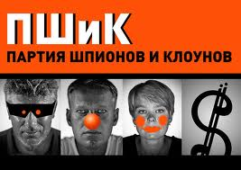
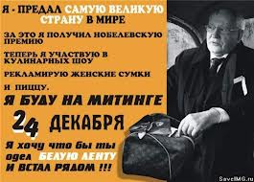
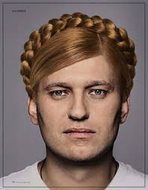

Slide 12
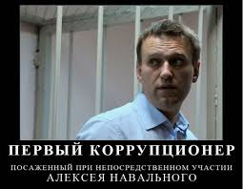
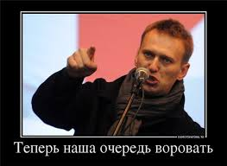

Slide 13
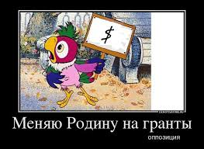
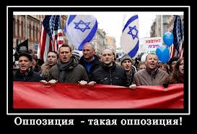

Slide 14
Core of protest segment
When this group gets 1000000 members…
I am opposite to Putler’s gang
Dissenters’ March
We are opposite to political monopoly
Mikhail Khodorkovsky: group of support
The people against “United Russia”

Slide 15
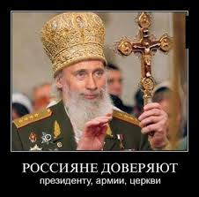

Slide 16
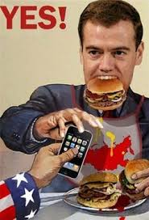
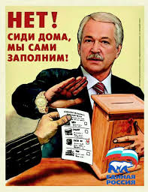

Slide 17
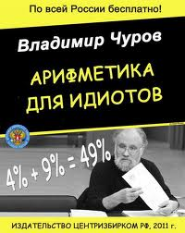
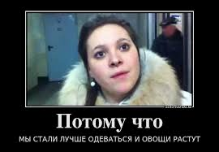
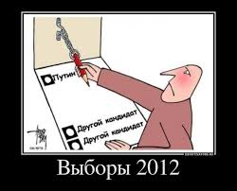

Slide 18
Mobilization techniques
Cross-links with network’s other most prestigeous actors;
Maximization of links with other groups;
Permanent content update in order to stimulate participants’ activity and make the group a source of valuable information;
Connection between group’s online and offline activities;
Reposting materials from various Internet resources outside the social network platform;
Applying additional motivating factors: use of opinion leaders’ authority, replication of popular stereotypes, memes etc.

Slide 19
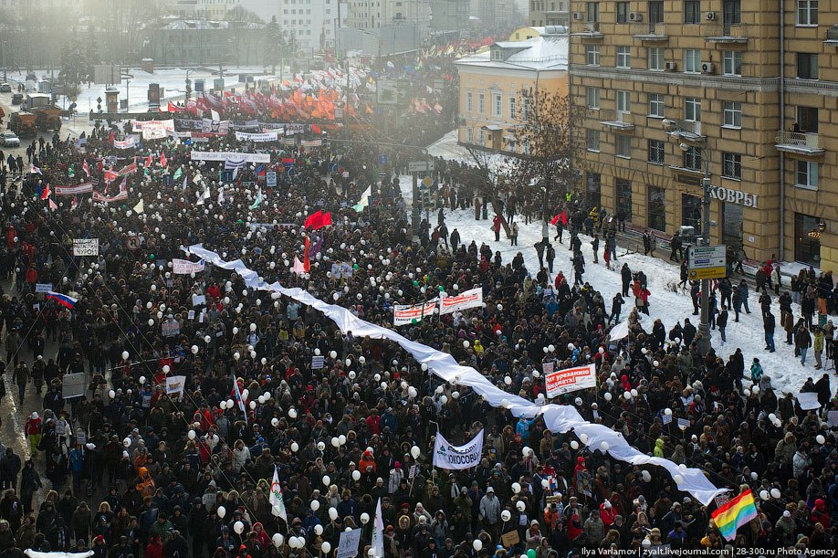

Slide 20
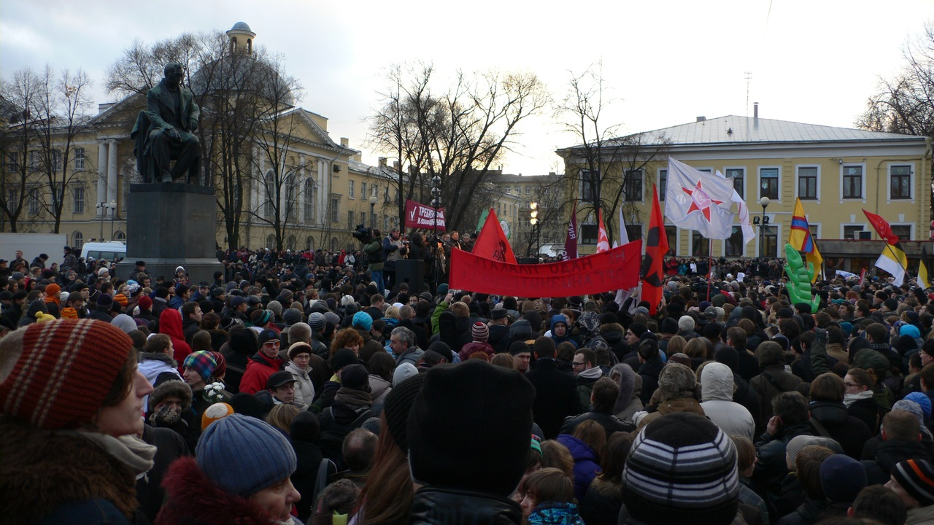

Slide 21
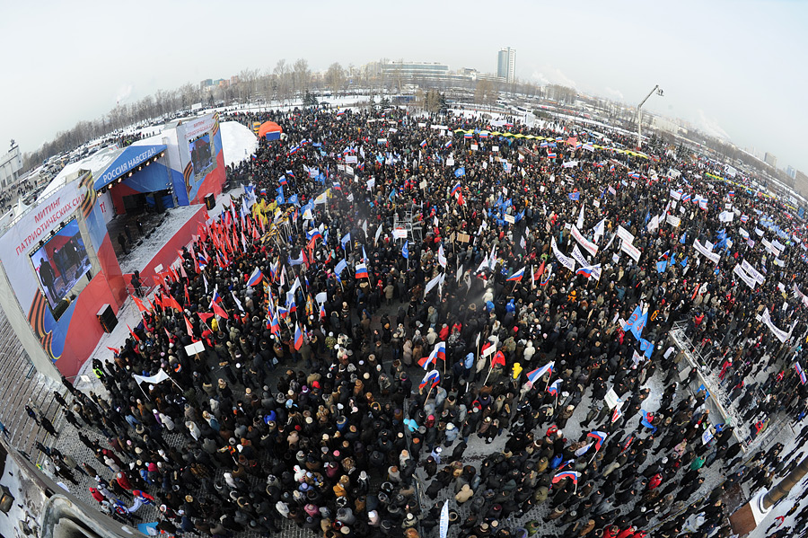

Slide 22
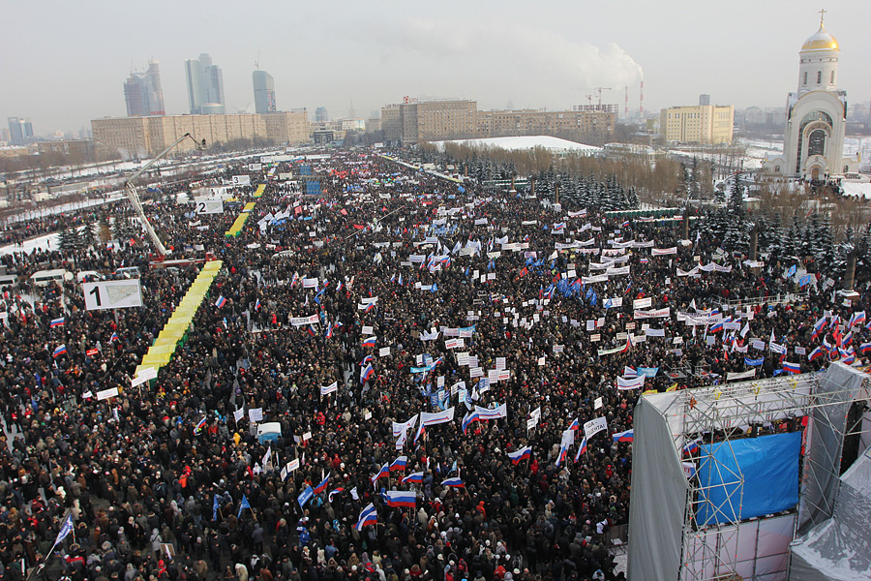

Slide 23
Protest segment of Vkontakte (September 2013)

Slide 24
From protest to civic participation
“Observers of Saint Petersburg”
“Municipal Saw”
“We follow the communal sphere”
“Just elections”
“Beautiful Petersburg”
“No.More.Garbarge”
“Bicyclization”
“Let’s do!”

Slide 25
Discussion and Outlook
Social media seems to be an effective tool for political mobilization of youth in Russia
After the end of electoral cycle protest activity continued and a number of civic initiatives and NGOs appeared in big cities where protest actions were popular
Russian society is ideologically divided

Slide 26
Thank you
Questions are welcome

