Slide 1
Regimes Internacionais em Perspectiva Comparada – BRI0045
Cristiane Lucena

Slide 2
Nike
LIFE MAGAZINE. 1996. Disponível em: https://www.originallifemagazines.com/product-category/life-magazines/life-magazines-1990s/life-magazines-1996/.

Slide 3
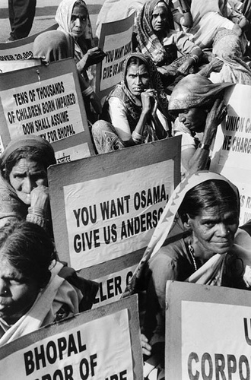
Bhopal
2008 Protest. Disponível em: https://pt.globalvoices.org/2010/06/16/india-veredito-da-tragedia-de-bhopal-muito-pouco-muito-tarde/.

Slide 4
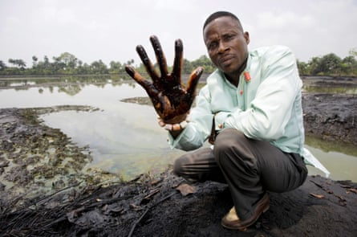
Shell na Nigéria
Shell's complicity. Disponível em: https://www.amnesty.org.uk/shell-criminal-enterprise

Slide 5
Yahoo! na China
Shi Tao journalist. Disponível em: https://alchetron.com/Shi-Tao-%28journalist%29
The Washington Post. Disponível em: https://www.washingtonpost.com/archive/politics/2005/09/11/yahoo-says-it-gave-china-internet-data/af7a59f6-4b67-4458-bd95-9a6b2c5c2c10/

Slide 6
Alto Comissariado das Nações Unidas para Direitos Humanos
"Guiding Principles on Business and Human Rights: Implementing the United Nations ‘Protect, Respect and Remedy’ Framework"
The Human Rights Council endorsed the Guiding Principles in its resolution 17/4 of 16 June 2011

Slide 7
Guiding Principles on Business & Human Rights
31 princípios
THE STATE DUTY TO PROTECT HUMAN RIGHTS
THE CORPORATE RESPONSIBIlITY TO RESPECT HUMAN RIGHTS
ACCESS TO REMEDY

Slide 8
Princípios
1. States must protect against human rights abuse within their territory and/or jurisdiction by third parties, including business enterprises. This requires taking appropriate steps to prevent, investigate, punish and redress such abuse through effective policies, legislation, regulations and adjudication.

Slide 9
Princípios
11. Business enterprises should respect human rights. This means that they should avoid infringing on the human rights of others and should address adverse human rights impacts with which they are involved.

Slide 10
A Relatoria sobre Empresas e Direitos Humanos
https://www.youtube.com/watch?v=Th88pvZYa-4

