Slide 1
Digital servitization business models in ecosystems: A theory of the firm
Kohtamäki, M., Parida, V., Oghazi, P., Gebauer, H., & Baines, T. (2019).
Journal of Business Research, 104, 380-392

Slide 2
How does digital servitization shape business model configurations, and which research directions should be taken based on the interplay between digital servitization business models and theories of the firm within ecosystems and platforms? Como a servitização digital molda as configurações do modelo de negócios e quais direções de pesquisa devem ser tomadas com base na interação entre os modelos de negócios da servitização digital e as teorias da empresa dentro de ecossistemas e plataformas?
Digital servitization business models in ecosystems: A theory of the firm

Slide 3
Principais construtos
Digital servitization as the transition toward smart product-service-software systems that enable value creation and capture through monitoring, control, optimization, and autonomous function. To gain value from digital servitization, firms must capitalize on three dimensions of digital offerings (i.e., products, services, and software), which should work together.
Digital servitization business models, we start with the product-service-software offering that reflects well the company's solution strategy (Ehret & Wirtz, 2017; Kohtamäki, Partanen, Parida, & Wincent, 2013). This strategy is evident in the offerings, and the construction of the business model builds on the value proposition.

Slide 4
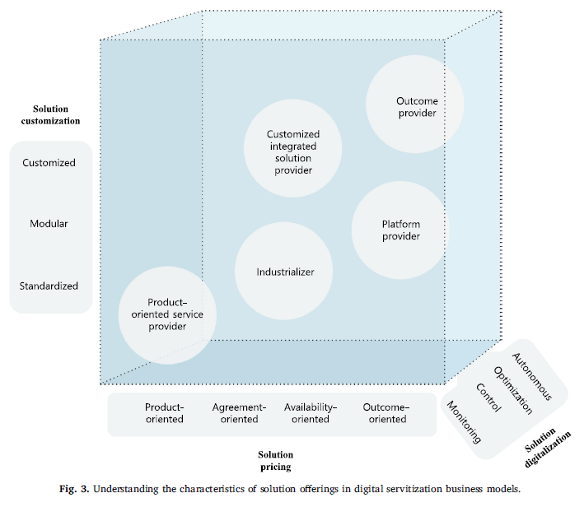
3 dimensions used to construct offerings in digital servitization:
solution customization (from standardization to customization of offerings; Kowalkowski et al., 2015; Mathieu, 2001; Matthyssens & Vandenbempt, 2010),
solution pricing (from product-oriented to outcome-oriented; Gebauer, Saul, Haldimann, & Gustafsson, 2017; Parida, Sjödin, Wincent, & Kohtamäki, 2014),
solution digitalization (from monitoring to autonomous solutions; Porter & Heppelmann, 2015; Fig. 3). These are the core characteristics of smart solutions that digital servitization business models are built on.
5 specific business models (Huikkola & Kohtamäki, 2018; Kowalkowski, Windahl, Kindström, & Gebauer, 2015).
product-oriented service provider (provides products and add-on services.)
Industrializer (emphasizes product and service modularity to improve efficiency despite increasing demands by customers to customize offerings)
customized integrated solution provider (offer integrated product-service solutions)
platform provider (digitally enabled service business model where the company is a platform provider that connects various providers and customers)
outcome provider (solution providers that sell outcomes instead of products or services)

Slide 5
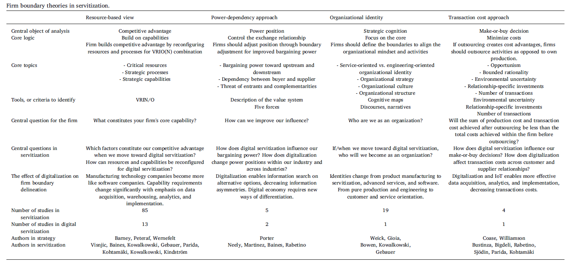
4 theories of the firm to understand digital servitization business models within ecosystems.

Slide 6
Research Directions
1 Digital Servitization
2 Resource-based view
3 Organizational identity
Research Direction 1a: The literature on digital servitization should study the interplay between servitization, the IoT, and different theories of the firm.
Research Direction 1b: The interplay between theories of the firm may shed light on the business model configurations in digital servitization and therefore deserve further attention in future studies.
Research direction 2a: The literature on digital servitization should explain how digital capabilities in servitization generate competitive advantage and what types of configurations of resources and processes they require. We call for studies on strategic capabilities in digital servitization.
Research direction 2a: Research is needed on the role of dynamic capabilities in resource reconfiguration for digital servitization
Research direction 3a: Research on digital servitization should explain how digital servitization transforms the identity of a manufacturing company. We call for research on the profound effect of digital servitization on the organizational identity and culture of manufacturing companies.
Research direction 3b: Research is needed on the paradoxical tensions between product, service, and software organizations and organizational identities in solution providers
4 Power approach
5 Transaction cost approach
Research direction 4a: Digital servitization studies should examine how digitalization transforms bargaining power in different sections of value systems and ecosystems and how manufacturers increase their power using digitalization
Research direction 4b: Future research is needed to explore not only how digitalization enables value creation but also how manufacturers shift their value capture from product-centric, to service-centric, and further to data-centric.
Research direction 5a: The servitization literature lacks studies of the role of transaction costs in servitization. The digital servitization literature has so far neglected the effect of digitalization on transaction costs in downstream and upstream interactions. We call for studies that explore how digitalization transforms collaboration in servitization ecosystems.
Research direction 5b: The creation of ecosystems for autonomous smart solutions entails significant transaction costs as developers must configure and integrate technologies, routines, and business models between multiple firms within the ecosystem. More researchis needed on the role of transaction costs in these collaborations and on appropriate governance structures for these collaborations

Slide 7
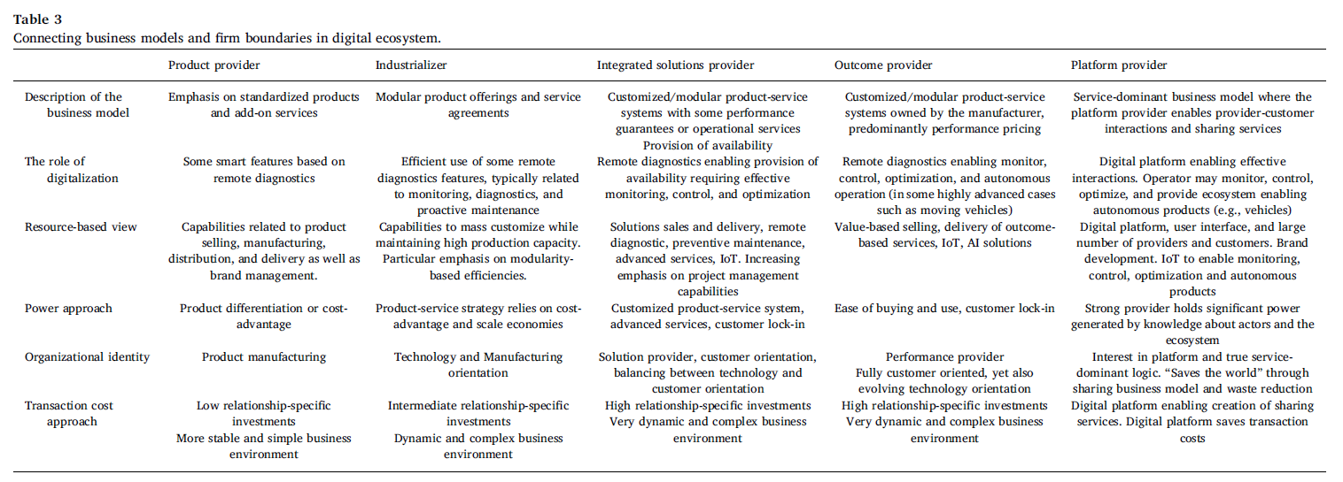
5 business models and their configurations based on the four theories

Slide 8
Research Directions
6 Product-oriented service provider
7 Industrializer
8 Customized integrated solution provider
Research direction 6a: Because the digital servitization research domain lacks empirical studies of smart solutions and advanced services, digital servitization scholars should analyze the role of digitalization in developing these companies, their offerings, and capabilities, as well as the role of digitalization in developing these companies.
Research direction 6b: Considering the product-oriented focus of these companies, studies should focus on how IoT applications can shape future business models and how the IoT affects the role of services in the future
Research direction 7a: The digital servitization literature fails to provide detailed micro-level empirical evidence of the role of modularity in digital servitization or servitization in general. Future research should provide more detailed empirical findings on modularity and related routines in digital servitization, particularly concerning industrializers.
Research direction 7b: The configuration of the product, service, and software modules to ensure better service and digital content needs clarifying. What should constitute a core module and how is it possible to benefit from such a modular approach
Research direction 8a: The digital servitization literature broadly neglects changes in business model configurations of customized integrated solution providers. More empirical evidence is required to understand how digitalization shapes the ability of customized integrated solution providers to engage with other ecosystem actors to deliver higher value to customers.
Research direction 8b: A related issue has to do with how to codevelop business models with ecosystem partners. How is it possible to co-create and capture value over extended contracted duration of the solution?
9 Outcome provider
10 Platform provider
Research direction 9a: The literature on outcome-based business models is still relatively scarce, and the role of digitalization in these models seems to be understudied. Thus, more empirical research on the role of digitalization in outcome-based business models is needed. There is a need for further research on outcomes in these business models (e.g., energy savings) and the increasing role of sustainability in these business models.
Research direction 9b: A key challenge for outcome solution providers is to deliver the promised performance over time (e.g., three or more years of contracts). There is currently a poor understanding of how to manage digitalization-enabled governance mechanisms during this implementation phase.
Research direction 10a: The literature on platform-based business models is modest or almost nonexistent in the digital servitization literature. Thus, we call for the digital servitization literature to tap into platform business models. Further research is also needed on the role of sustainability in the provision of platform-based business models.
Research direction 10b: The management or orchestration of multiactor business models needs further investigation. We also call for empirical studies that capture process insights into how providers transition toward becoming platform providers

Slide 9
Contribuições Teóricas
Our first contribution is the review of the servitization literature. Drawing on previous studies (Kowalkowski et al., 2015), we provide a definition and conceptualization of digital servitization.
Second, we extend the dialogue on digital servitization by presenting a typology of five business models (Huikkola & Kohtamäki, 2018; Kowalkowski et al., 2015).
The third and perhaps most important contribution is the use of four theories of the firm (industrial organization, the resource-based view, organizational identity, and the transaction cost approach) to understand the configurations of the five identified digital servitization business models.

Slide 10
Contribuições PRÁTICAS
From a practical perspective, this paper sheds light on how digital servitization can emerge within an ecosystem from the perspective of a firm boundary. More specifically, we provide three key contributions to managers responsible for digitalization and servitization initiatives within manufacturing companies.
First, we recommend that managers recognize the linkages between servitization and digitalization because they work best together. We foresee challenges and missed opportunities for value creation and value capturing if firms overlook the use of these concepts together.
Second, we present five digital servitization business models. These business models are unique in relation to the level of offer configuration, servitization, and digitalization. We recommend that managers critically evaluate which business model best fits their internal capabilities and external market environment because all these business models have the potential to generate revenue and growth. However, for long-term competitiveness, we foresee the need to move toward a more advanced offering with customization, outcome-oriented, and autonomous characteristics.
Finally, we urge companies to recognize that, in increasingly competitive and turbulent market environments, they must work and experiment with multiple business models. Being locked into a single business model, no matter how profitable, can create deep-rooted rigidity. Thus, continuously exploring business model innovation, such as through servitization and digitalization, is critical for survival.

