Slide 1
Dynamic capabilities for ecosystem orchestration:
A capability-based framework for smart city innovation initiatives
This study investigates how firms can develop dynamic capabilities to orchestrate ecosystem innovation and, thus, gain from it.
Objetivo da pesquisa
Discente
Jacqueline de Almeida Barbosa Franco
SEP5843 Tópicos avançados de servitização

Slide 2
Problemas de pesquisa:
To help us understand how firms orchestrate ecosystem innovation, we adopted Teece's (2007) division of dynamic capabilities – i.e., sensing, seizing, and reconfiguring – as synthesizing concepts to create the three overarching themes: ecosystem sensing capabilities, ecosystem seizing capabilities, and ecosystem reconfiguring capabilities.
1) How can companies organize business processes to be able to continuously create and profit from ecosystem innovation?
2) Ênfase na gestão estratégica, ou seja, capacidade da empresa adaptar, integrar, reconfigurar as competências organizacionais internas e externas.

Slide 3
PRINCIPAIS ABORDAGENS E CONCEITOS EXPLORADOS:
Innovation Ecosystem: An innovation ecosystem can be defined as the “alignment structure of the multilateral set of partners that need to interact in order for a focal value proposition to materialize” (Adner, 2017, p. 42).
Smart city initiatives: Can be seen as “improv[ing] urban performance by using data, information and information technologies (IT) to provide more efficient services to citizens, to monitor and optimize existing infrastructure, to increase collaboration amongst different economic actors and to encourage innovative business models in both the private and public sectors” (Marsal-Llacuna et al., 2015, p. 618).
Bussiness models: The purpose is to encourage new business models in order to transform the smart city concept, and to maintain it. (Adner, 2017; Hurmelinna-Laukkanen and Nätti, 2018; Walrave et al., 2018).
Dynamic Capabilities: “the firm's processes that use resources – specifically the process to integrate, reconfigure, gain, and release resources – to match and even create market change (Eisenhardt and Martin, 2000, p. 1107; Teece, p. 1319).

Slide 4
MÉTODO DE PESQUISA E CRITÉRIOS PARA DEFINIÇÃO DOS CASOS
1) Case involved an innovation ecosystem; that is to say, multiple actors collaborating to offer a value proposition to the market. The case had to provide access to the ecosystem leader, a customer, and at least two other ecosystem actors (e.g., sub-supplier, technical provider, municipality).
2) The innovation ecosystem should be developing a smart city initiative, and the value proposition must be enabled through a digital technology – for example, a digital platform to store, monitor, and optimize energy distribution.
3) All cases had to have a goal to achieve sustainability benefits with their smart city initiatives; for example, to become more energy and resource efficient.

Slide 5
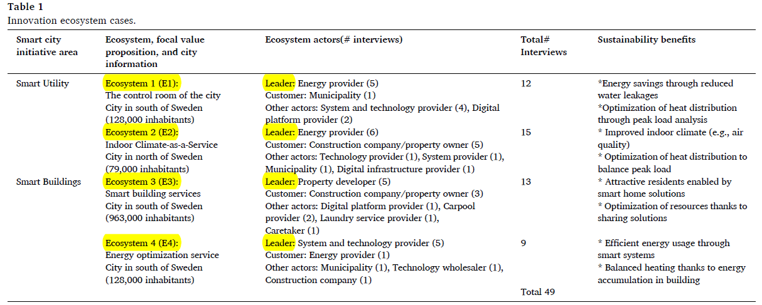
CARACTERIZAÇÃO DOS CASOS E BENEFÍCIOS SUSTENTÁVEIS

Slide 6
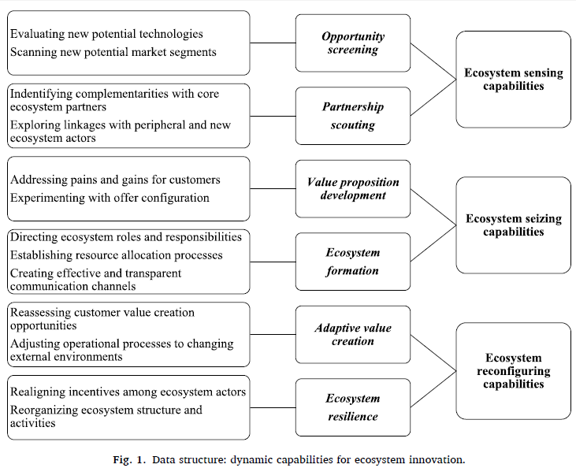
Seis subtemas foram agrupados representando as rotinas do líder do ecossistema às quais cada atividade de codificação (Estrutura teórica). estava conectada.
Sub-rotinas específicas subjacentes aos recursos de detecção, captura e reconfiguração do líder do ecossistema
Capabilidades Dinâmicas (Teece, 2007).

Slide 7
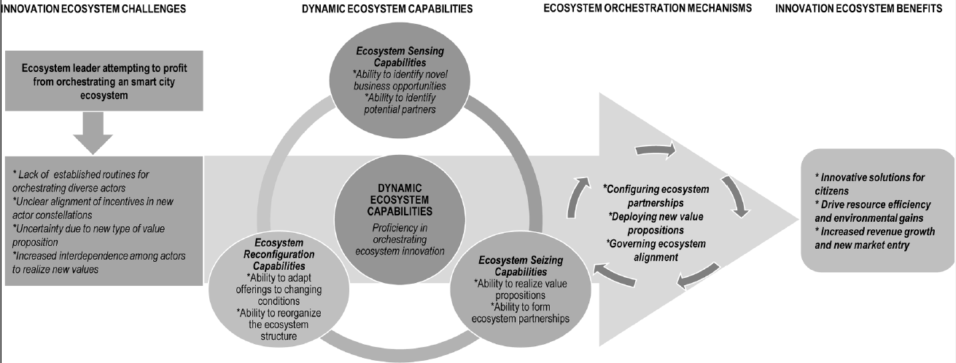
Estrutura de capabilidades para explicar como os líderes de ecossistemas aplicam recursos dinâmicos de ecossistemas para mitigar os desafios dos ecossistemas de inovação e obter benefícios de inovação sustentável em smart cities.
Fig. 2 . Estrutura dinâmica de capabilidade do ecossistema.

Slide 8
FINDINGS
We find that ecosystem innovation is highly dependent on continuous adaptation to the evolving nature of customer needs, emerging technologies, and new entrants.
We find that successful ecosystem leaders (i.e., case firms from E1, E3, and E4) develop dynamic capabilities in order to lead with the demands of ecosystem coordination and management.
In contrast, the ecosystem leader in E2 that try to create a new innovative value proposition and viable ecosystem but were missing capabilities such as complementary competence acquired through partnerships.
The analysis reveals that sensing, seizing, and reconfiguring capabilities, routines, and processes on the part of an ecosystem leader facilitates ecosystem-innovation orchestration through the process of value creation and capture with ecosystem partners.

Slide 9
Ecosystem Innovation
Case 1
Case 2
Case 3
Case 4
Try, but never advancing further than meeting with potential ecosystem actors to discuss new offerings such as ‘Indoor-Climate-as-a-Service’.
Ecosystem 1, 3 and 4, can be considered successful in their smart city initiatives and innovation ecosystem efforts; each was able to develop a new innovative value proposition and create a viable ecosystem that could deliver it to the market.

Slide 10
THEORETICAL AND PRACTICAL IMPLICATIONS
Theoretical and practical implications relating to ecosystem innovation, dynamic capabilities, digital servitization, and smart city ecosystems.
1) Proposes a general description of dynamic ecosystem capabilities and their micro-foundations.
2) Illustrates how ecosystem innovation is accomplished through the deliberate ecosystem orchestration through concrete mechanisms which leverage on the combination of dynamic ecosystem capabilities.
3) Contribute by empirical insights on the debate on the role of dynamic ecosystem capabilities for ensuring profitable smart cities initiatives.

