Slide 1
Case: Plastic Packaging Supply Network in Brazil
Upstream
near to natural resource extraction
Mediumstream
near to brandowner
Downstream
near to user or consumer

Slide 2
Case: Plastic Packaging Supply Network in Brazil
Upstream
near natural resource extraction
Mediumstream
near to brandowner
Downstream
near user or consumer

Slide 3
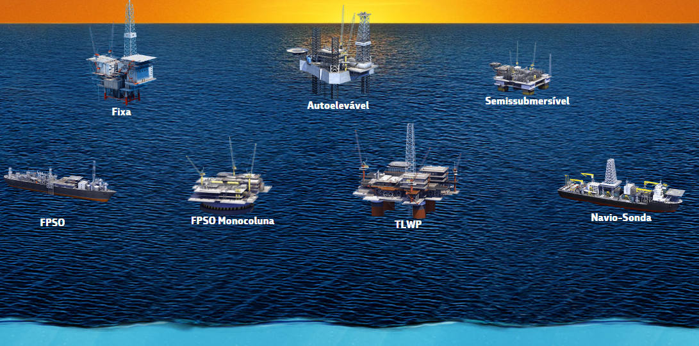
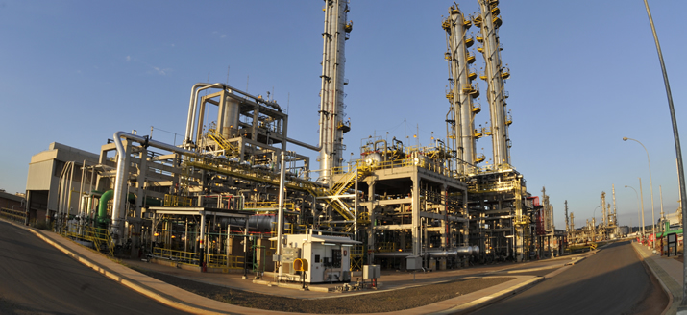
Case: Plastic Packaging Supply Network in Brazil
Oil – large multinational company

Slide 4
Case: Plastic Packaging Supply Network in Brazil
Upstream
near natural resource extraction
Mediumstream
near to brandowner
Downstream
near user or consumer

Slide 5
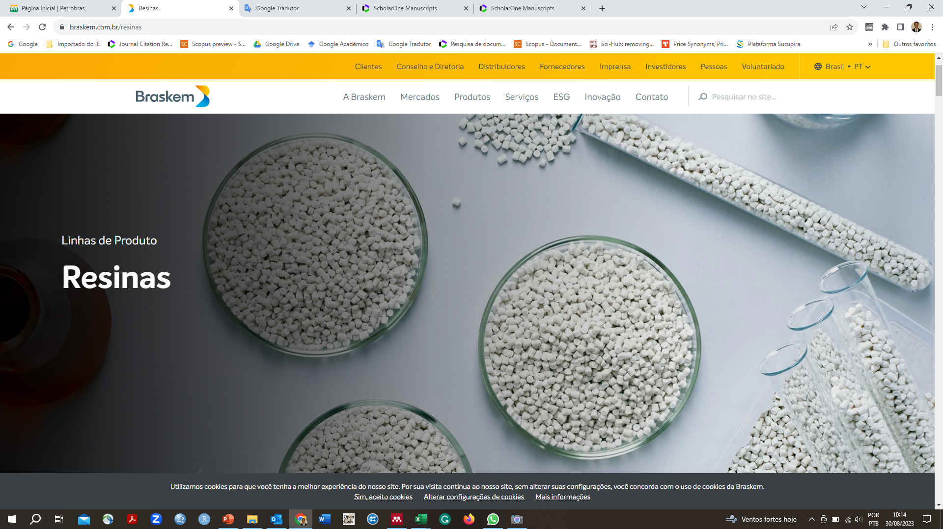
Case: Plastic Packaging SN
Raw material (resin) producer – large multinational company

Slide 6
Case: Plastic Packaging Supply Network in Brazil
Upstream
near natural resource extraction
Mediumstream
near to brandowner
Downstream
near user or consumer

Slide 7
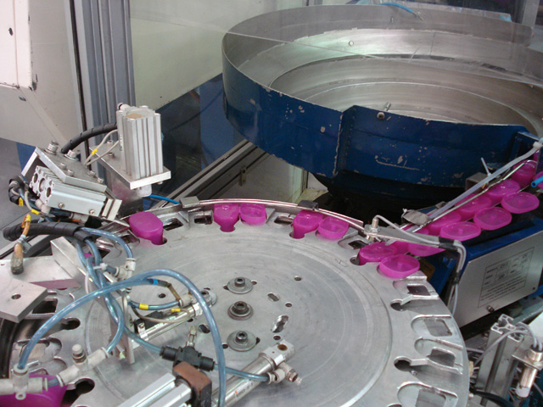
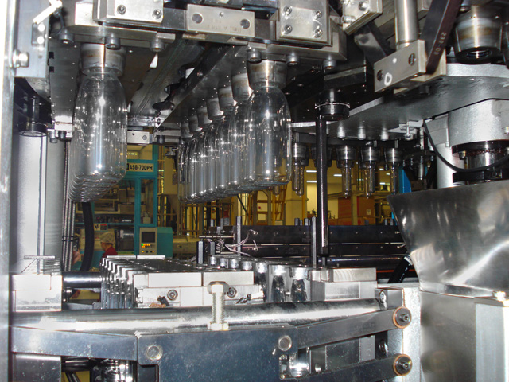
Case: Plastic Packaging SN
Packaging producer – medium national company

Slide 8
Case: Plastic Packaging Supply Network in Brazil
Upstream
near natural resource extraction
Mediumstream
near to brandowner
Downstream
near user or consumer

Slide 9
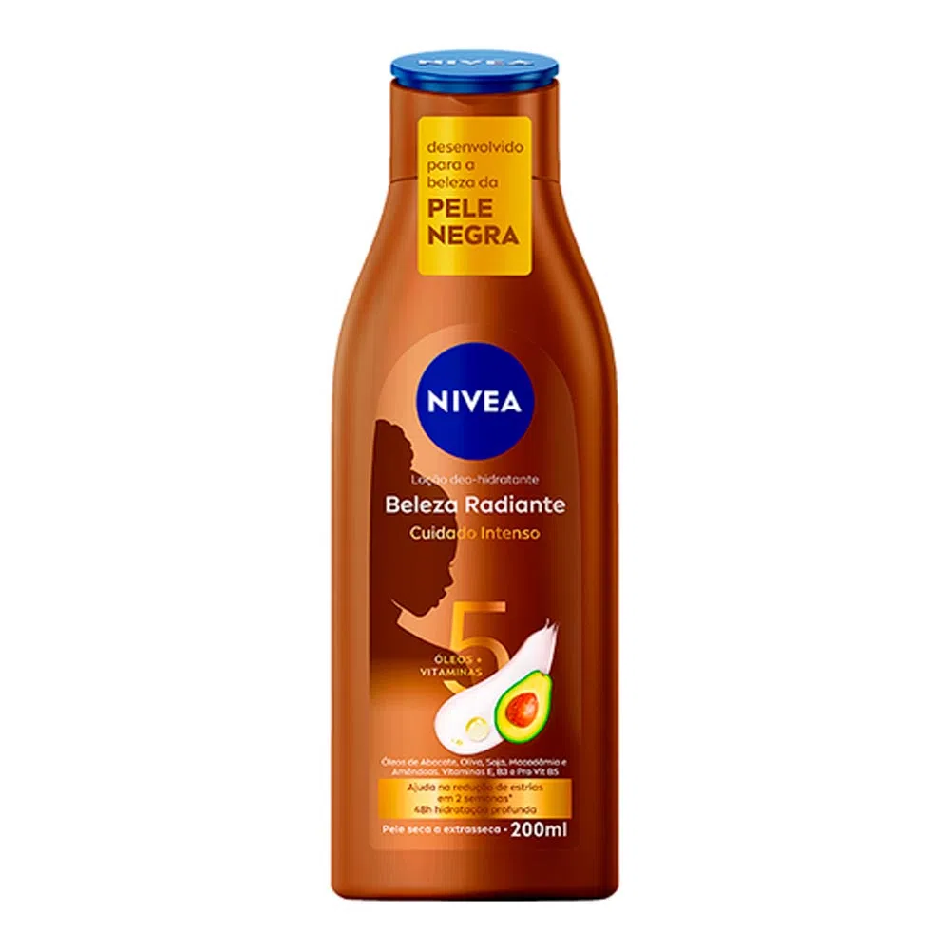
Case: Plastic Packaging SN
Brand owner (focal company) – large multinational company

Slide 10
Case: Plastic Packaging Supply Network in Brazil
Upstream
near natural resource extraction
Mediumstream
near to brand-owner
Downstream
near user or consumer

Slide 11
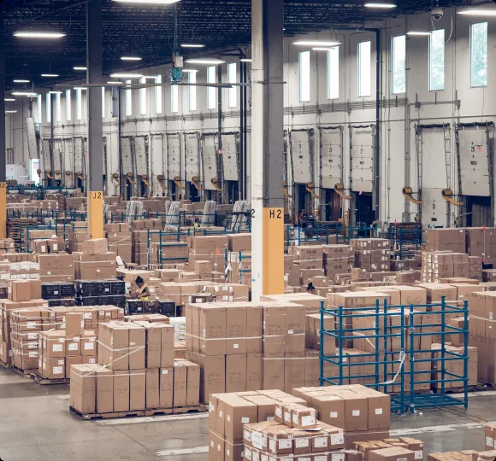
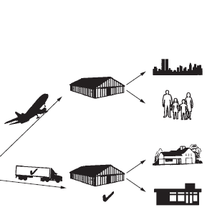
Case: Plastic Packaging SN
Distributors– large or medium national or multinational companies

Slide 12
Case: Plastic Packaging Supply Network in Brazil
Upstream
near natural resource extraction
Mediumstream
near to brand-owner
Downstream
near user or consumer

Slide 13
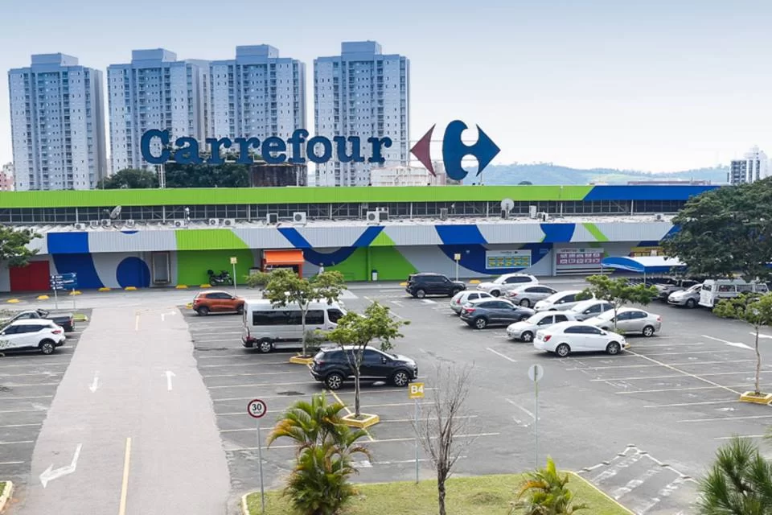
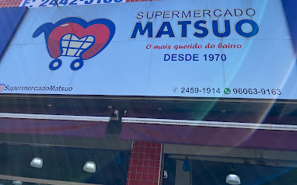
Case: Plastic Packaging SN
Retailers– large, small or medium national or multinational companies

Slide 14
Case: Plastic Packaging Supply Network in Brazil
Upstream
near natural resource extraction
Downstream
near user or consumer

Slide 15
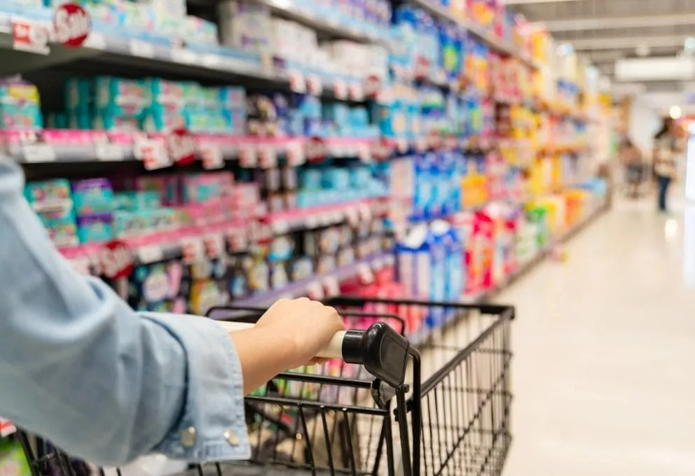
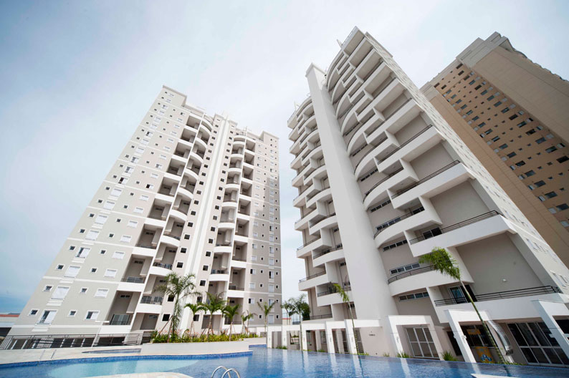
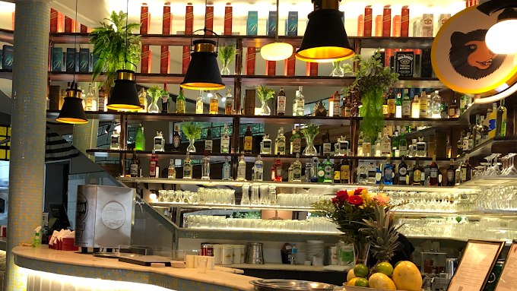
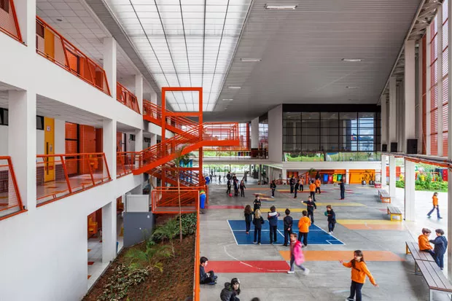
Case: Plastic Packaging SN
Users or consumers
People
Condominiun
Restaurants
Schools/Universities

Slide 16
Case: Circular - Plastic Packaging Supply Network in Brazil
Upstream
near natural resource extraction
Mediumstream
near to brand-owner
Downstream
near user or consumer

Slide 17
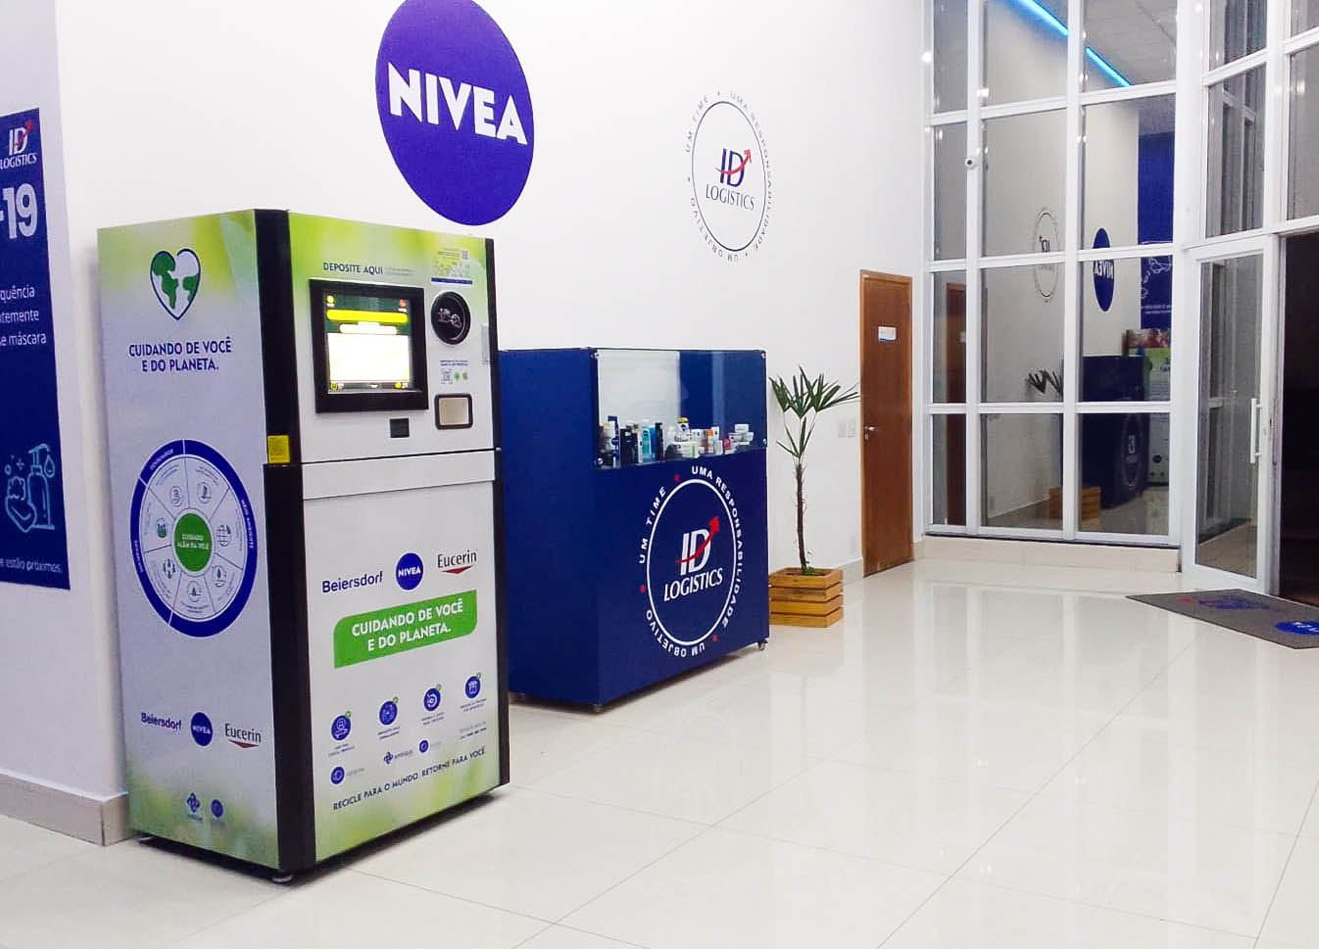
Case: Circular -Plastic Packaging SN
Recovering and preparing packaging to reuse – small or médium national company

Slide 18
Case: Plastic Packaging Supply Network in Brazil
Upstream
near natural resource extraction
Mediumstream
near to brandowner
Downstream
near user or consumer

Slide 19
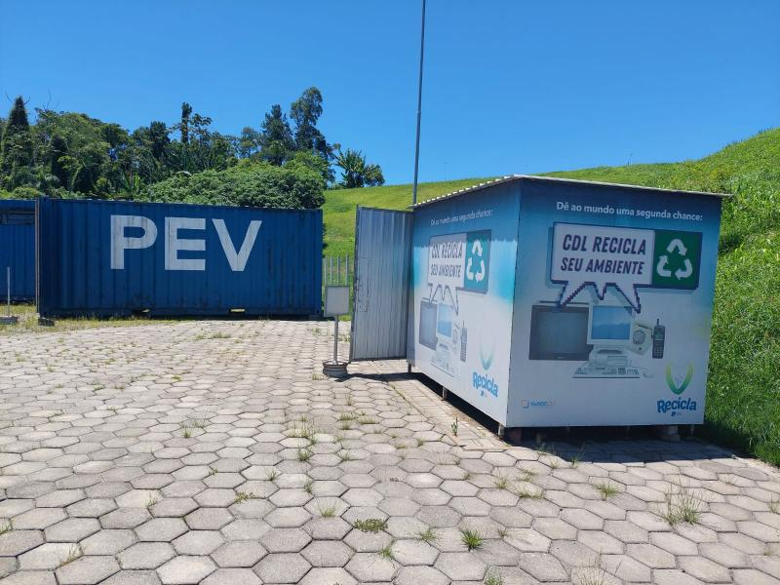
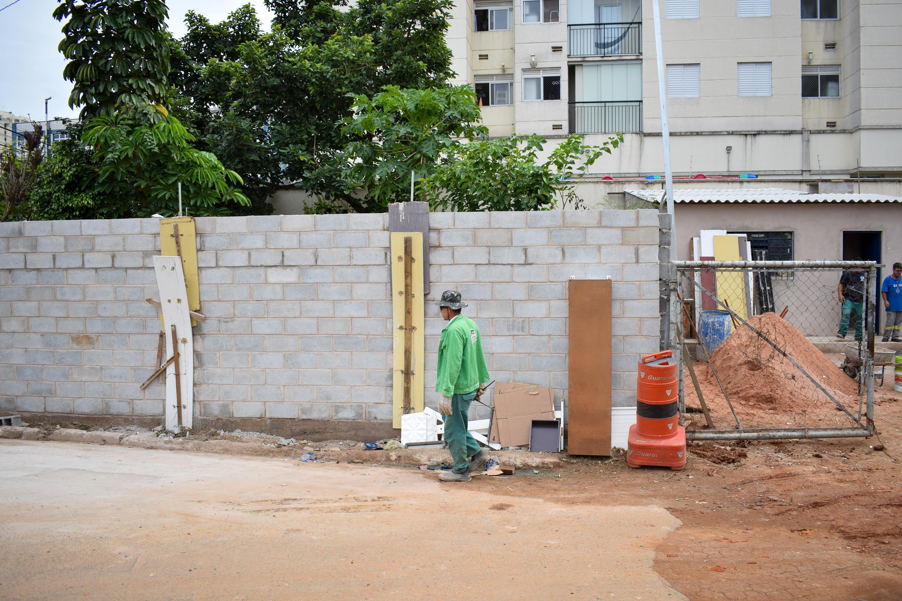
Case: Plastic Packaging SN
Volunteer Deliver Points (PDV)

Slide 20
Case: Plastic Packaging Supply Network in Brazil
Upstream
near natural resource extraction
Mediumstream
near to brand-owner
Downstream
near user or consumer

Slide 21
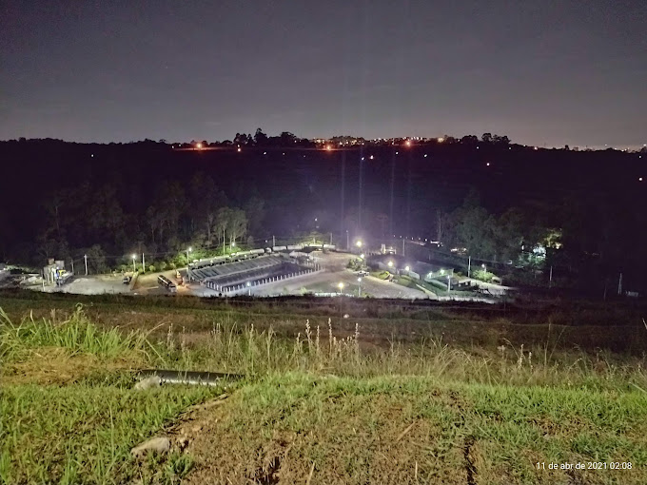
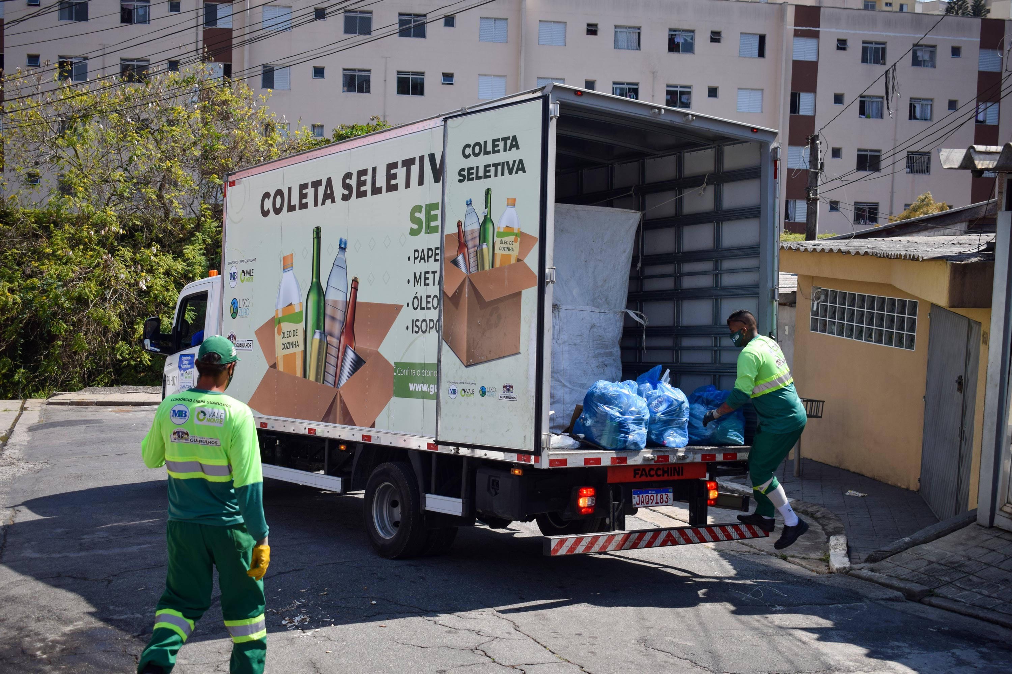
Case: Cardboard Box Supply Network in Brazil
Government waste collectors service

Slide 22
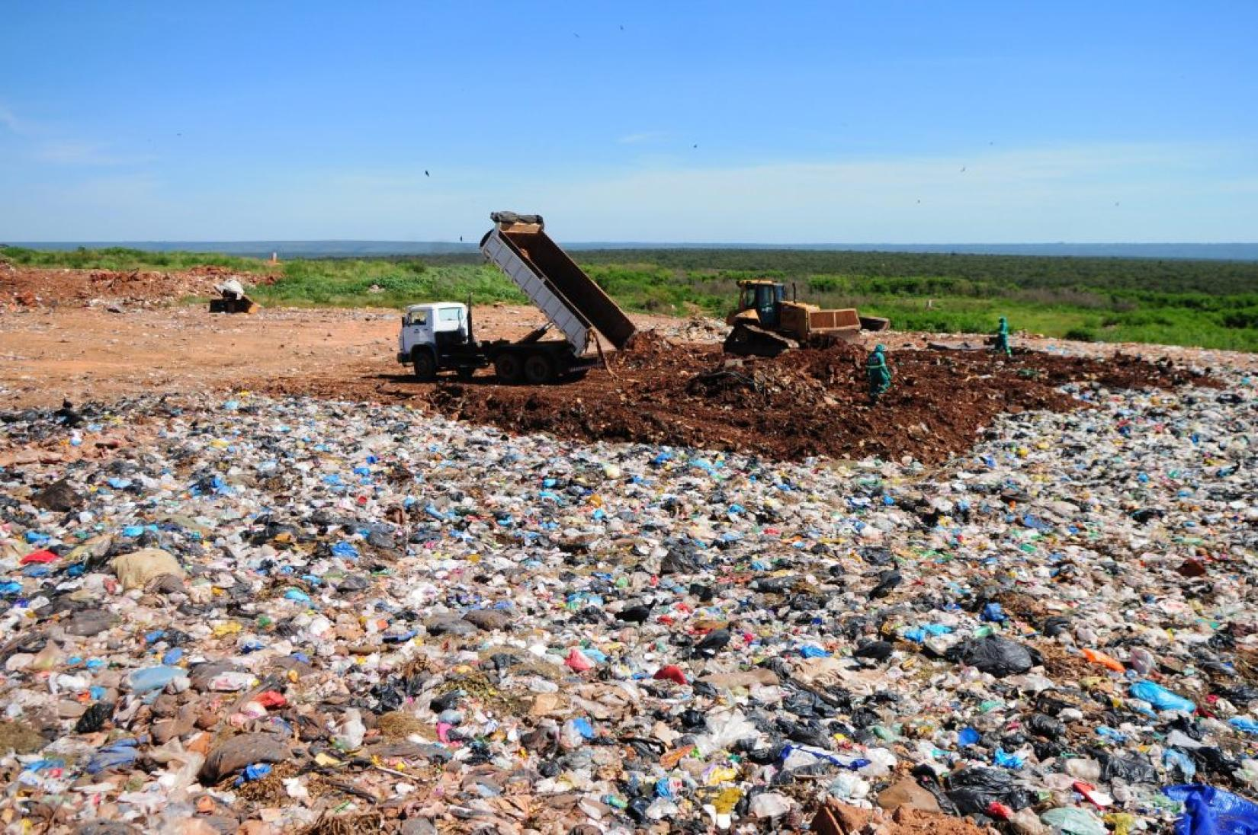
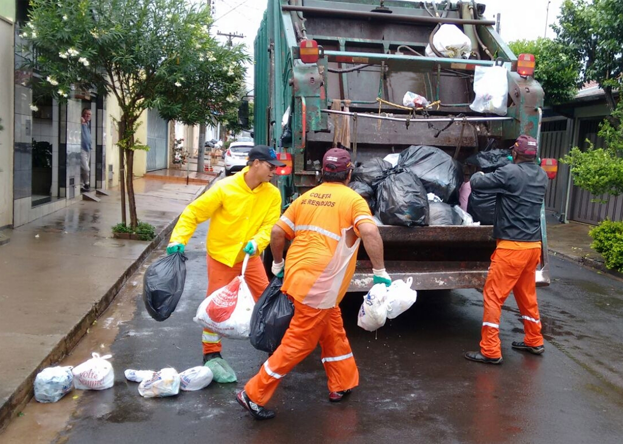
Case: Plastic Packaging SN
Government waste collectors service

Slide 23
Case: Circular - Plastic Packaging Supply Network in Brazil
Upstream
near natural resource extraction
Mediumstream
near to brand-owner
Downstream
near user or consumer

Slide 24
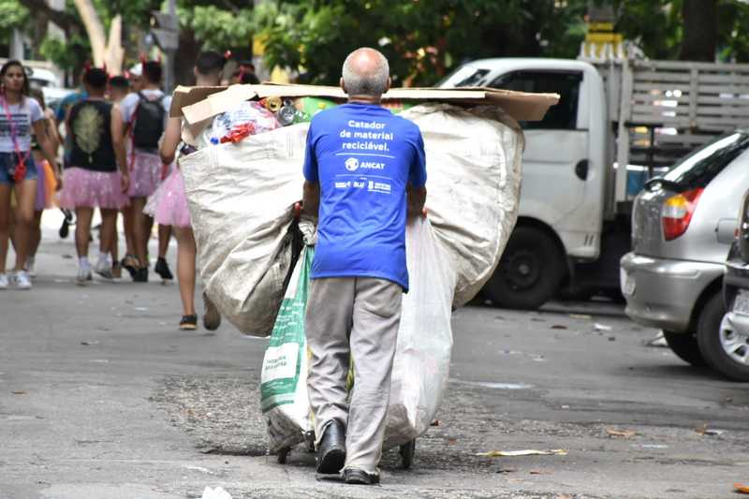
Case: Circular - Plastic Packaging Supply Network in Brazil
Individual waste picker

Slide 25
Case: Circular - Plastic Packaging Supply Network in Brazil
Upstream
near natural resource extraction
Mediumstream
near to brand-owner
Downstream
near user or consumer

Slide 26
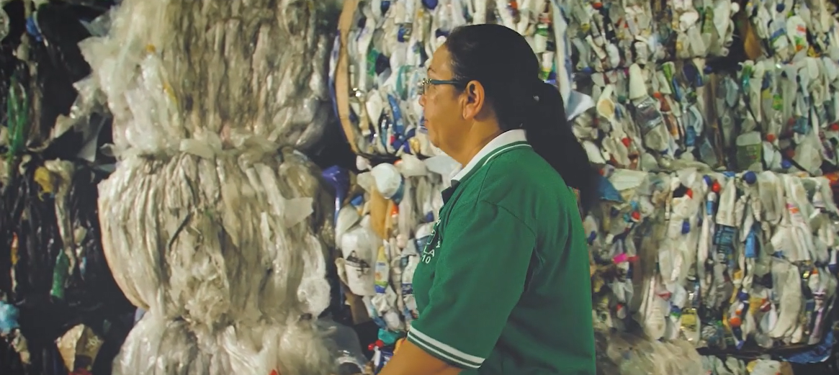
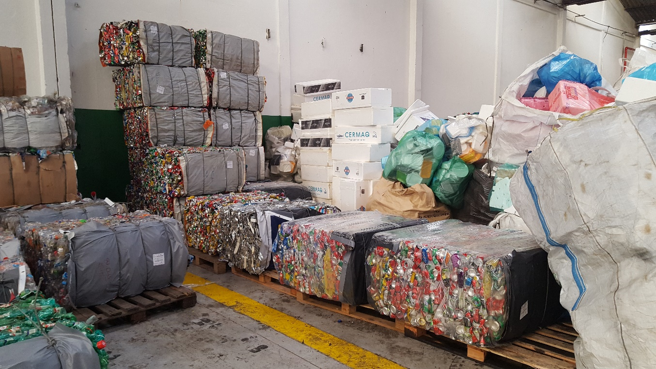
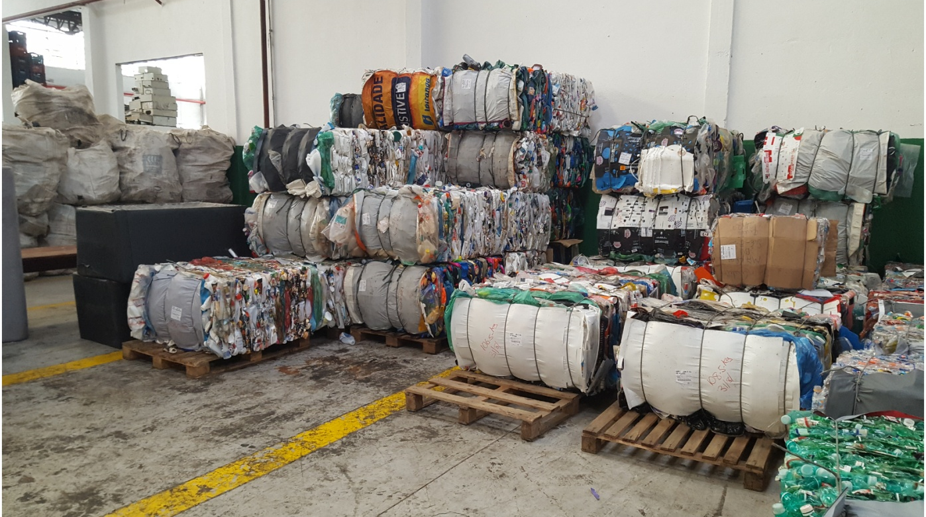
Case: Circular - Plastic Packaging Supply Network in Brazil
Waste picker cooperative

Slide 27
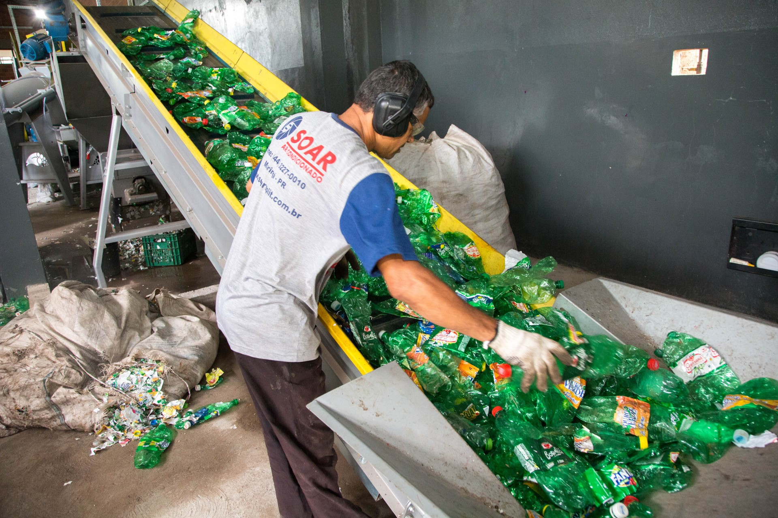
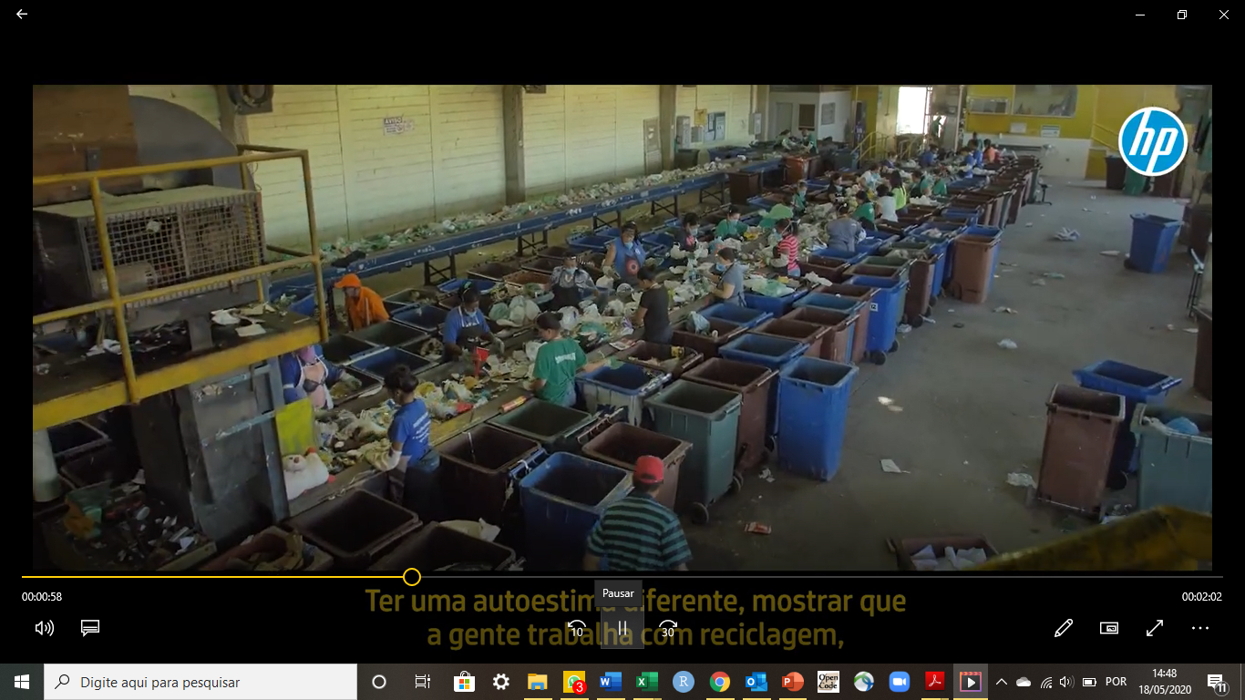
Case: Circular - Plastic Packaging Supply Network in Brazil
Waste picker cooperative

Slide 28
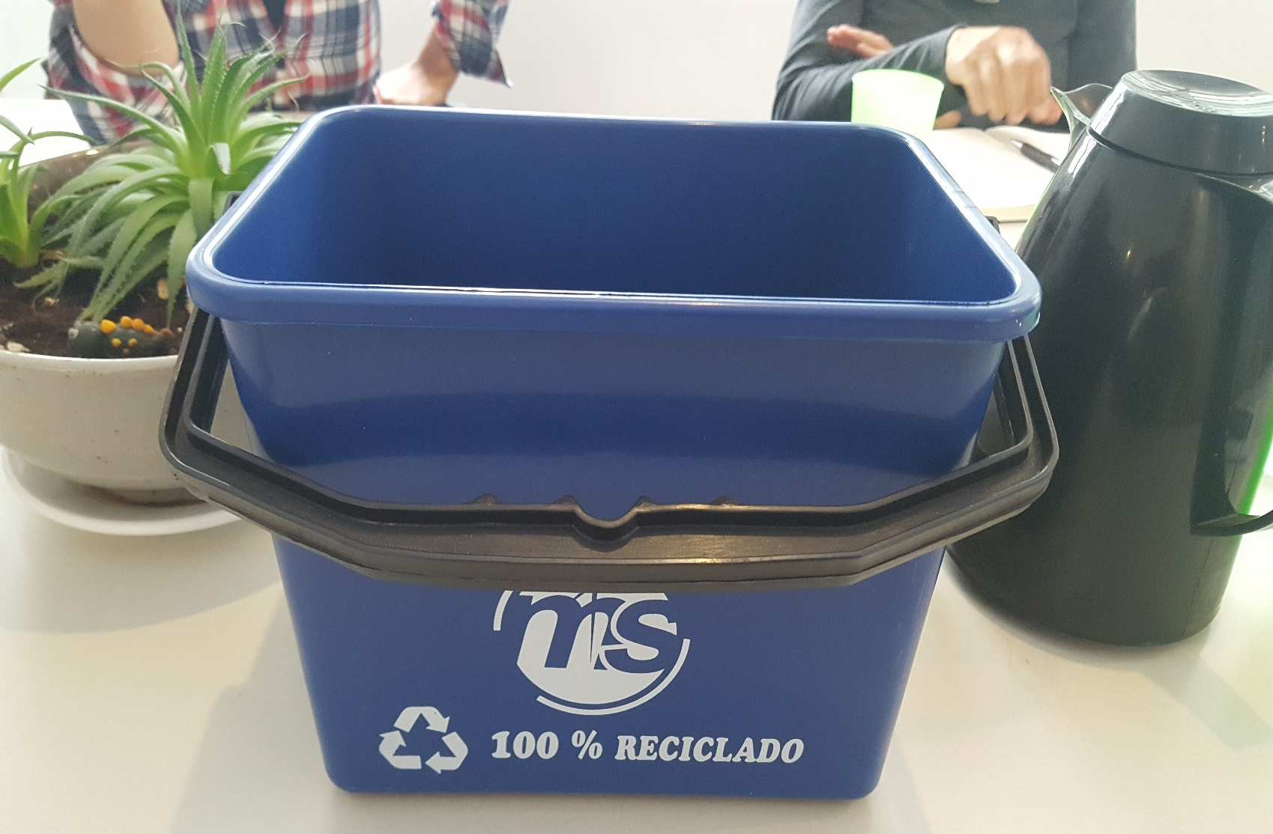
Case: Circular - Plastic Packaging Supply Network in Brazil
Waste picker cooperative

Slide 29
Case: Circular - Plastic Packaging Supply Network in Brazil
Upstream
near natural resource extraction
Mediumstream
near to brand-owner
Downstream
near user or consumer

Slide 30
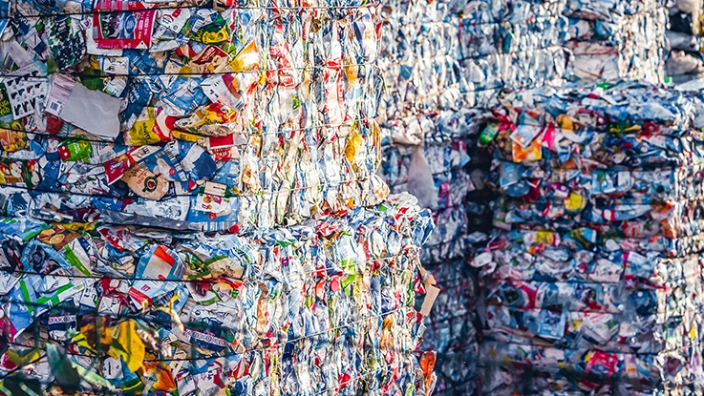
Case: Circular - Plastic Packaging Supply Network in Brazil
Scrap dealers and volume aggregators

Slide 31
Case: Circular - Plastic Packaging Supply Network in Brazil
Upstream
near natural resource extraction
Mediumstream
near to brand-owner
Downstream
near user or consumer

Slide 32
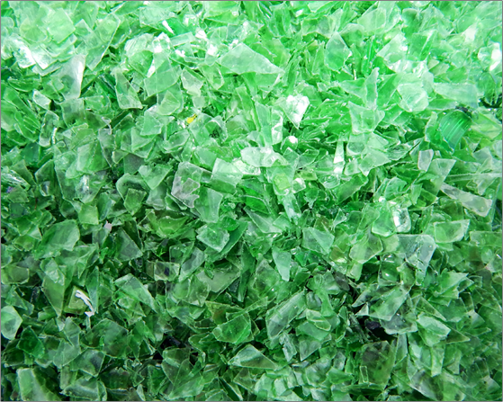
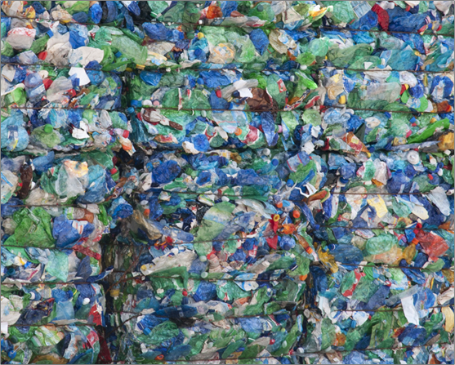
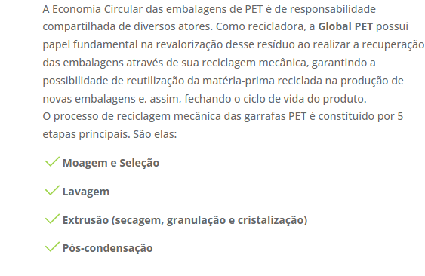
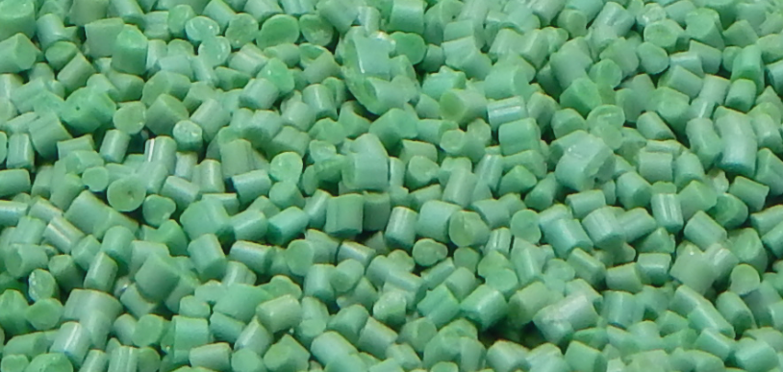
Case: Circular - Plastic Packaging Supply Network in Brazil
Recyclers – medium national companies

Slide 33
Case: Circular - Plastic Packaging Supply Network in Brazil
Upstream
near natural resource extraction
Mediumstream
near to brand-owner
Downstream
near user or consumer

Slide 34
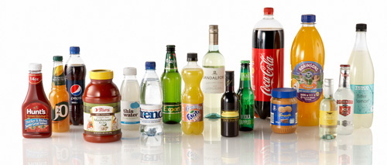
Case: Circular - Plastic Packaging Supply Network in Brazil
Connection with other supply chains and different industries as Food

Slide 35
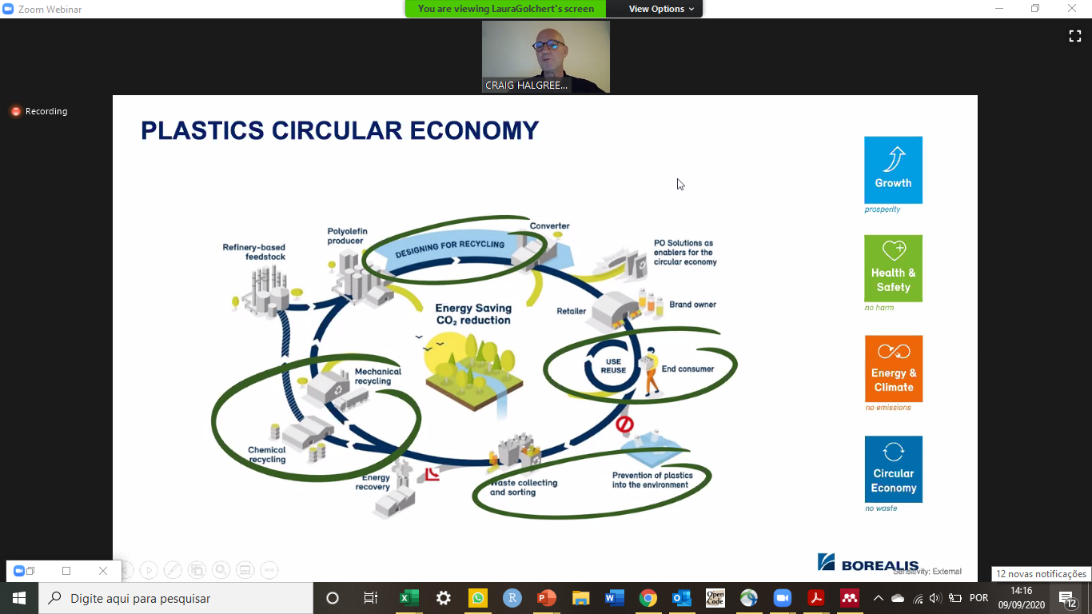
Case: BASF, Borealis, British Petroleum, Basell, Sabic and Total in Switzerland

Slide 36
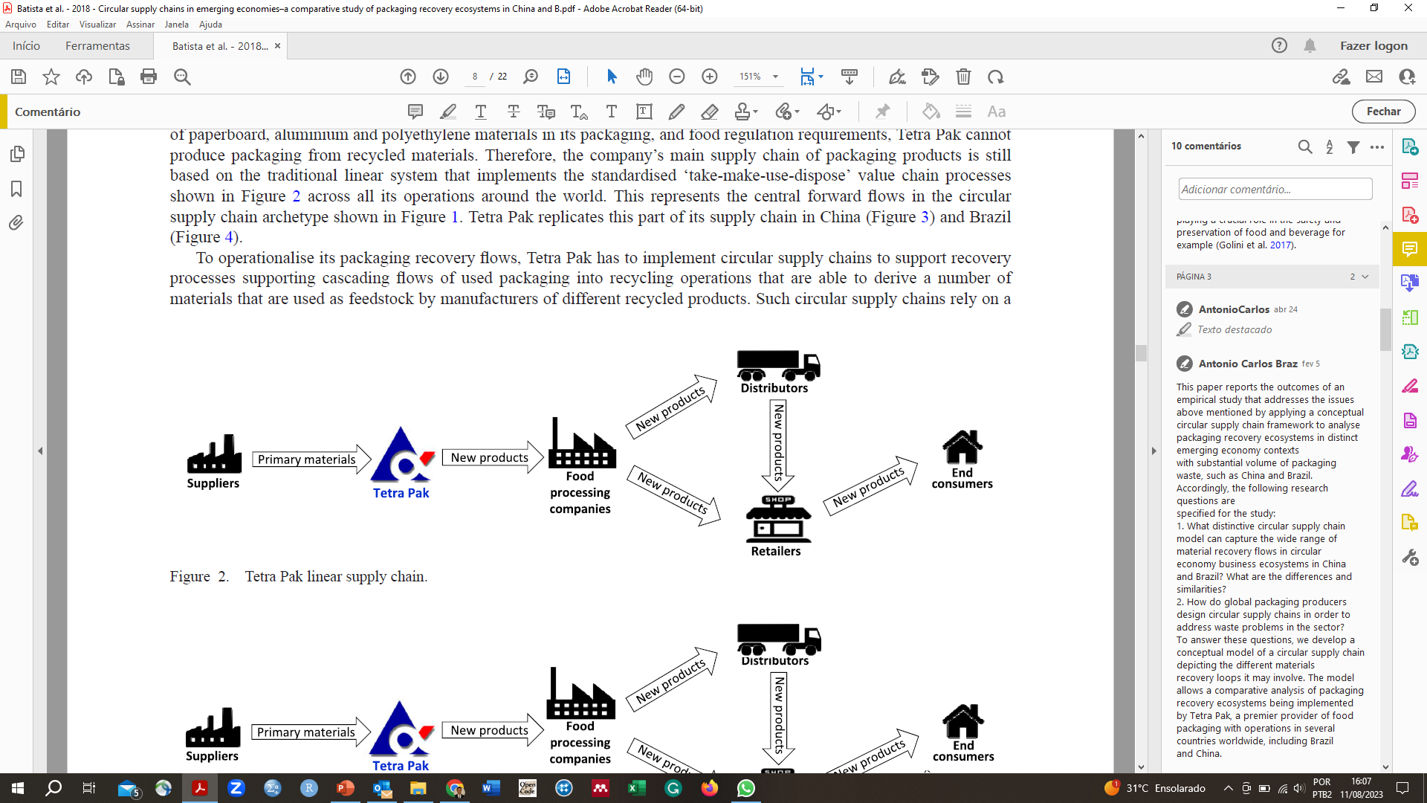
The traditional/linear supply chain

Slide 37
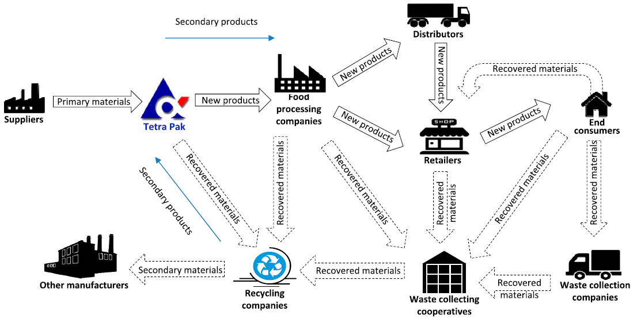
Circular supply chain configuration in Brazil

Slide 38
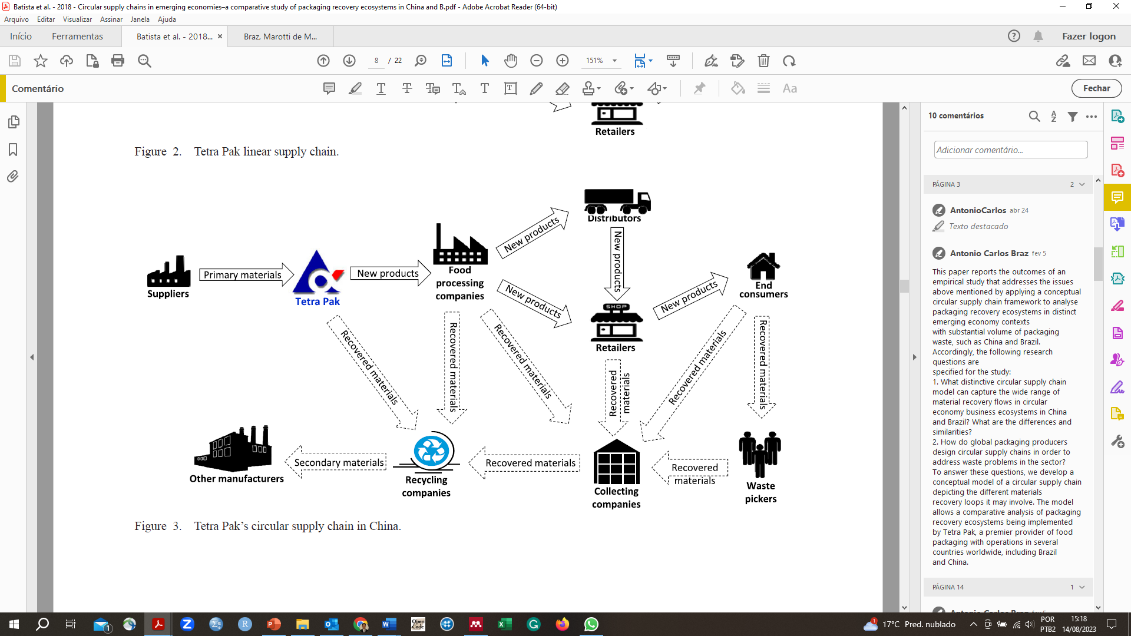
Circular supply chain configuration in China

Slide 39
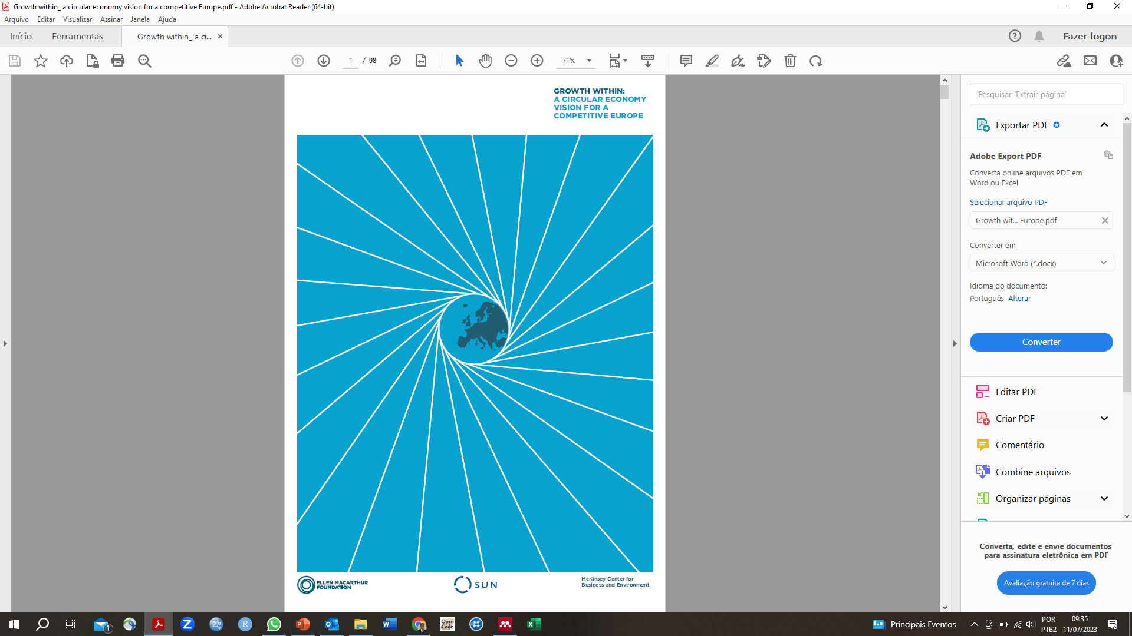
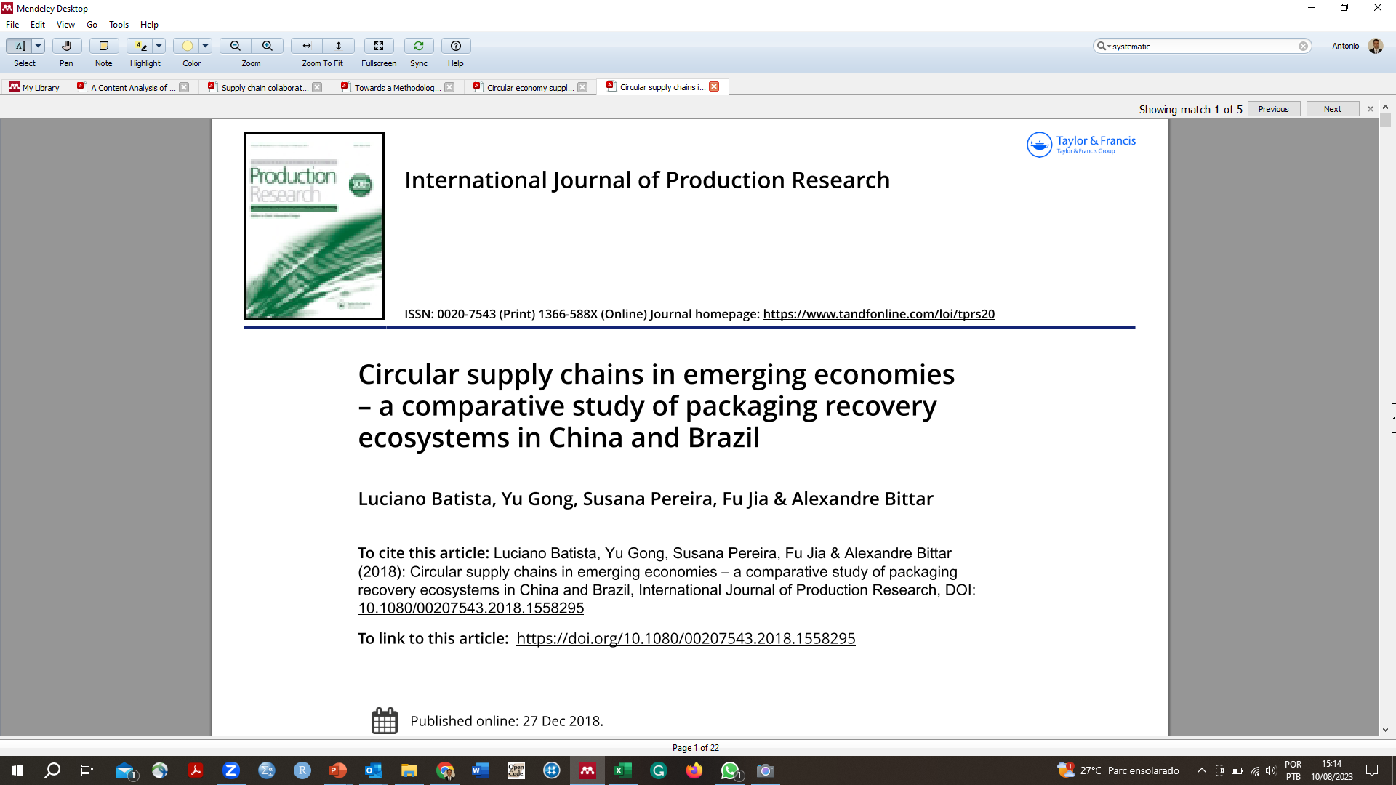
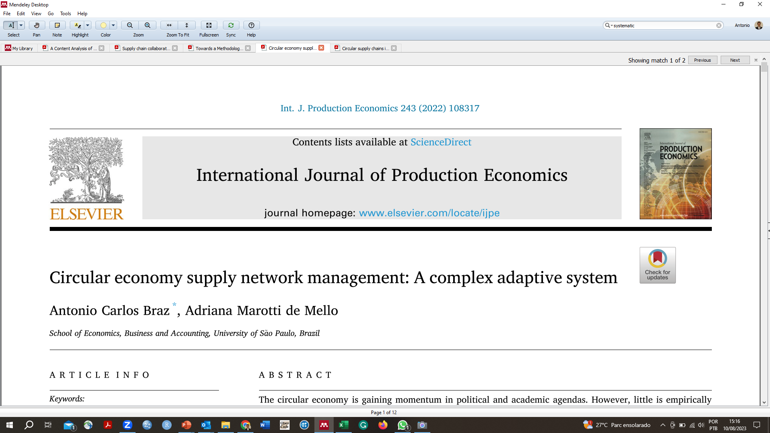
Main references
Contact: abraz@alumni.usp.br

