Slide 1
PMR 5251
Assessment of Mechanical Behavior of Materials using Machine Learning Approach
Profa.Dra. Izabel Fernanda Machado and
Profa. Dra. Larissa Driemeier
Profa. Izabel Machado - machadoi@usp.br
Profa. Larissa Driemeier - driemeie@usp.br

Slide 2
Stress–Strain Relationships and Behavior
The three major types of deformation that occur in engineering materials are elastic, plastic, and creep deformation.
Elastic deformation is associated with the stretching, but not breaking, of chemical bonds.
In contrast, the two types of inelastic deformation involve processes where atoms change their relative positions, such as slip of crystal planes or sliding of chain molecules.
If the inelastic deformation is time dependent, it is classed as creep, as distinguished from plastic deformation, which is not time dependent.

Slide 3
Stress–Strain Relationships and Behavior
In engineering design and analysis, equations describing stress–strain behavior, called stress–strain relationships, or constitutive equations, are frequently needed.
Deformation Models

Slide 4
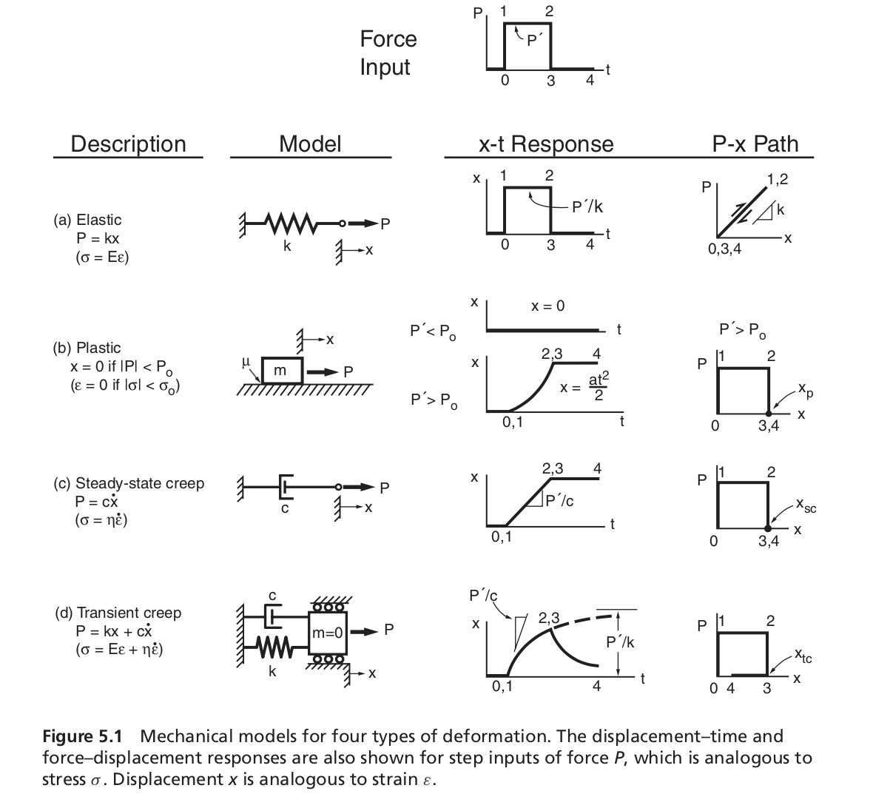
Stress–Strain Relationships and Behavior
Creep: These models are expressed in terms of stress and strain, so that springs deform according to ε = σ/E and dashpots according to ε ̇ = σ/η.
Elastic deformation

Slide 5
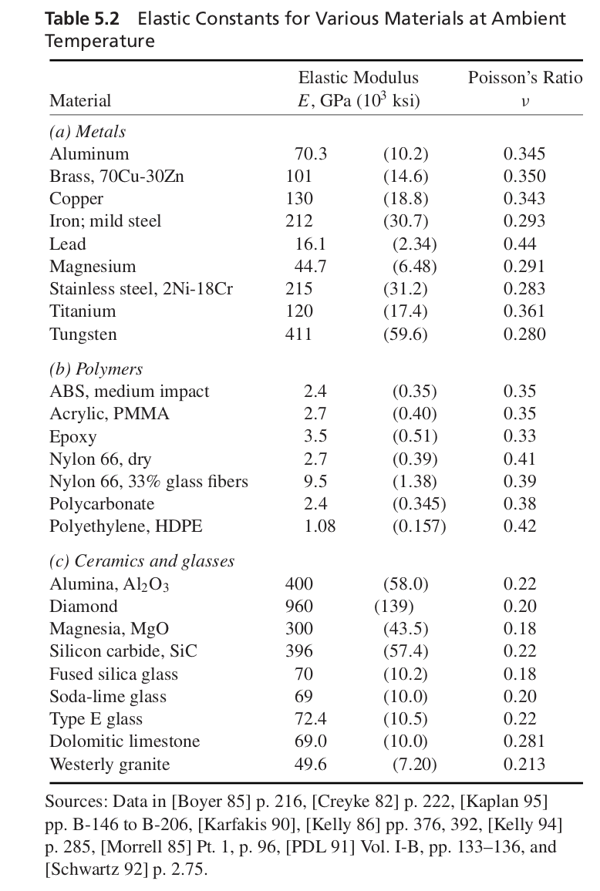
Stress–Strain Relationships and Behavior

Slide 6
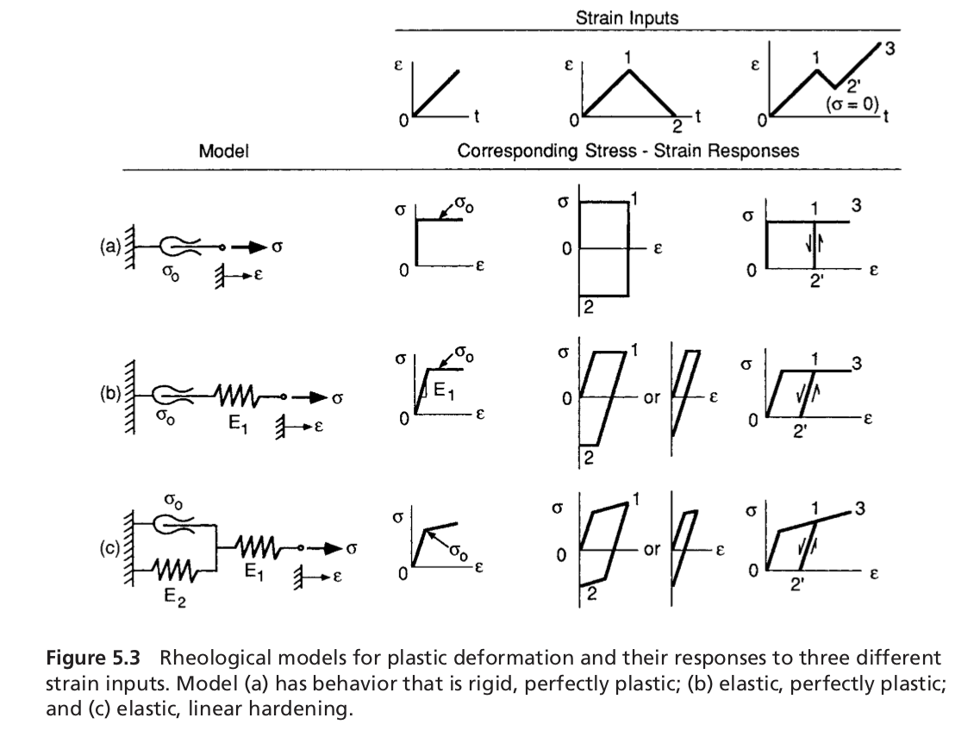
Stress–Strain Relationships and Behavior
Plastic Deformation Models

Slide 7
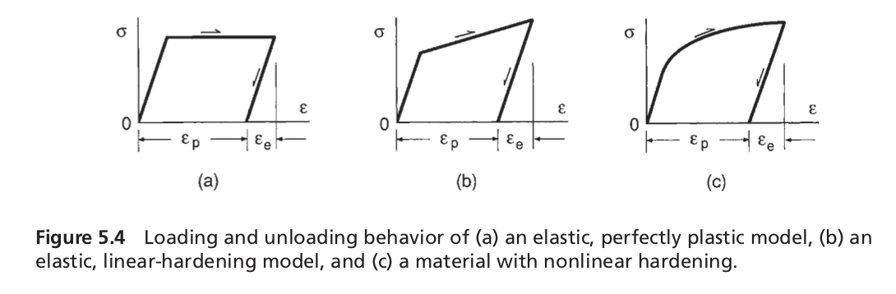
Stress–Strain Relationships and Behavior
Plastic Deformation Models

Slide 8
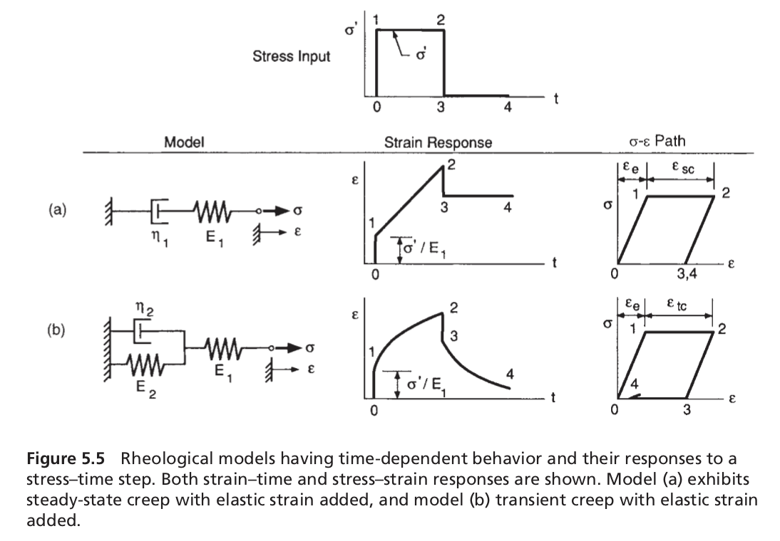
Stress–Strain Relationships and Behavior
Creep Deformation Models
Significant time-dependent deformation occurs in engineering metals and ceramics at elevated temperature. This also occurs at room temperature in low-melting-temperature metals, such as lead, and in many other materials, such as glass, polymers, and concrete.
These models are expressed in terms of stress and strain, so that springs deform according to ε = σ/E and dashpots according to ε ̇ = σ/η. The constant stress σ′ is applied

Slide 9
Stress–Strain Relationships and Behavior
Relaxation Behavior
Two types of time-dependent behavior were presented. These are creep, which is the accumulation of strain with time, as under constant stress, and recovery, which is the gradual disappearance of creep strain that sometimes occurs after removal of the stress.
A third type of behavior is relaxation, which is the decrease in stress when a material is held at constant strain.

Slide 10
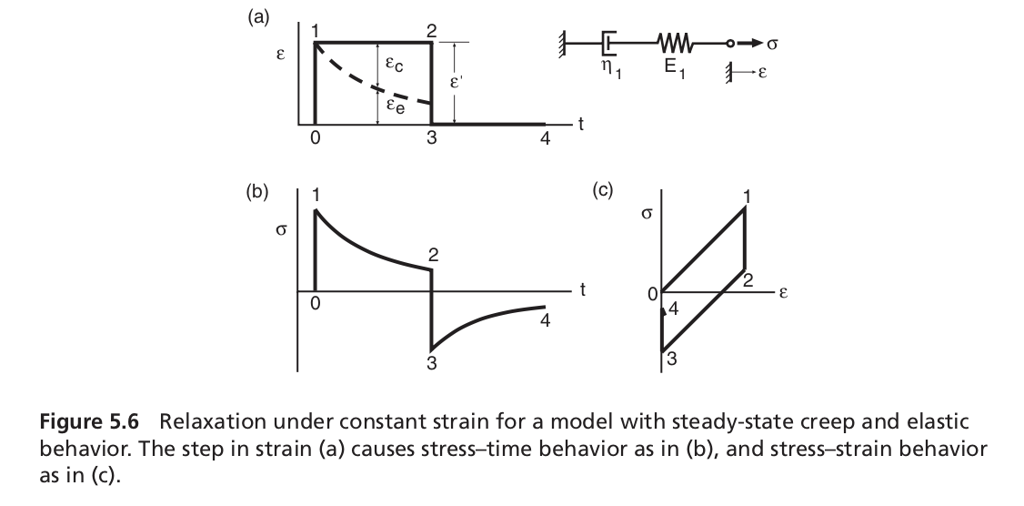
Stress–Strain Relationships and Behavior
Relaxation Behavior
Relaxation is illustrated for the steady-state creep plus elastic strain model

Slide 11
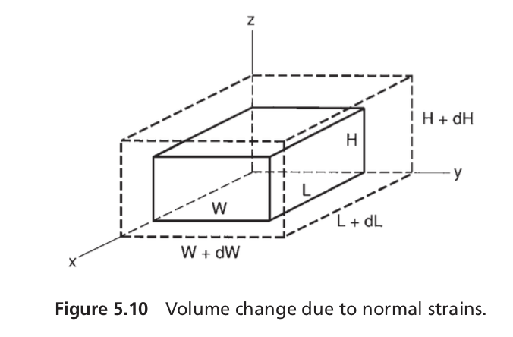
Stress–Strain Relationships and Behavior
Volumetric Strain and Hydrostatic Stress
In stressed bodies, small volume changes occur that are associated with normal strains. Shear strains are not involved, as they cause no volume change, only distortion.

Slide 12
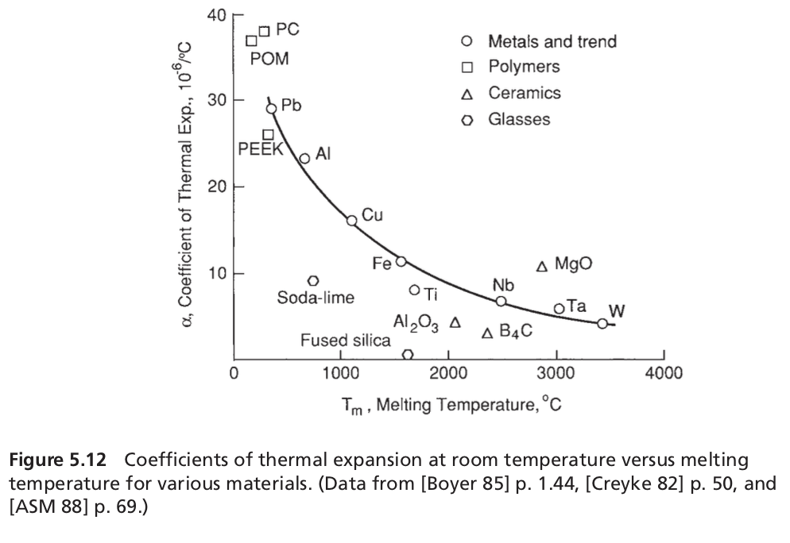
Stress–Strain Relationships and Behavior
Thermal Strains
Thermal strain is a special class of elastic strain that results from expansion with increas- ing temperature, or contraction with decreasing temperature.
ε = α (T − T₀) = α (△T )

Slide 13
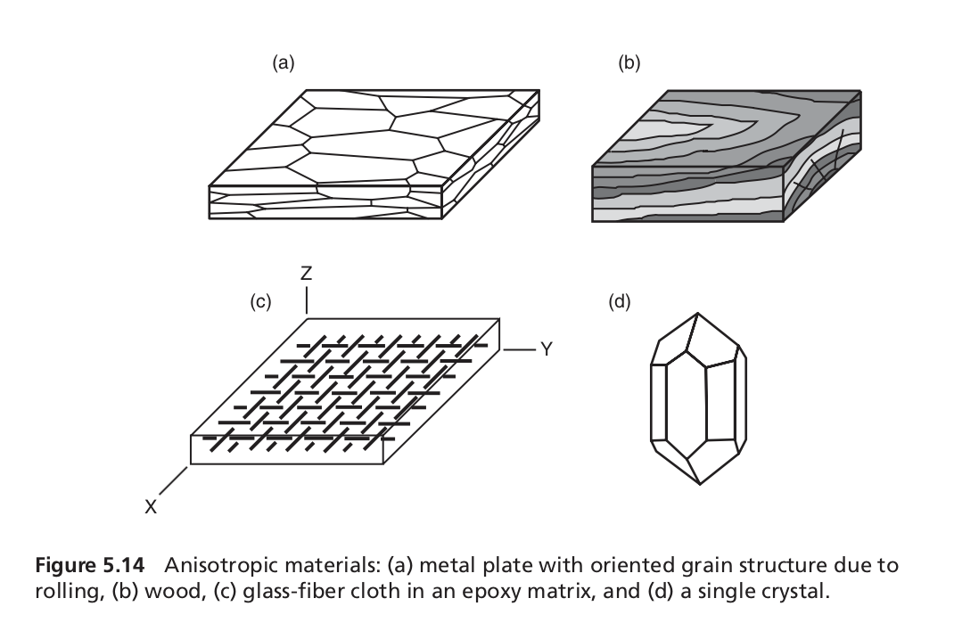
ANISOTROPIC MATERIALS
Microstructure

Slide 14
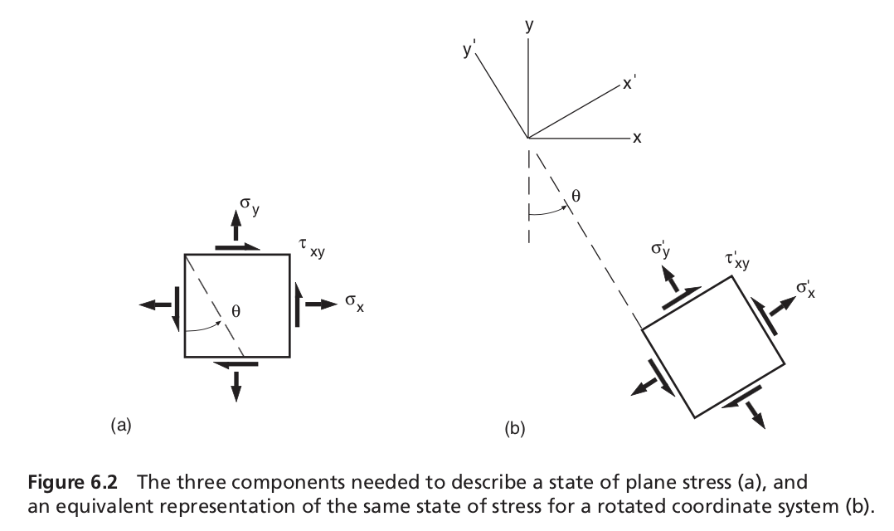
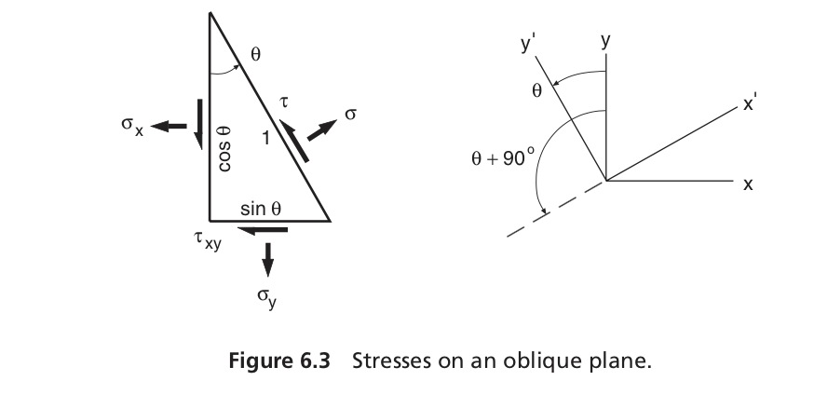
Review of Complex and Principal States of Stress and Strain
We may obtain the values of the stress components in the new coordinate system by considering the freebody diagram of a portion of the element, as indicated by the dashed line in Fig. 6.2(a). The resulting freebody is shown in Fig. 6.3.
Summing forces in the x-direction, and then in the y-direction, gives two equations:
σ cosθ −τ sinθ −σx cosθ −τxy sinθ = 0
σ sinθ +τ cosθ −σy sinθ −τxy cosθ = 0

Slide 15
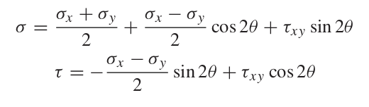
Solving for the unknowns σ and τ , and also invoking some basic trigonometric indentities:

Slide 16

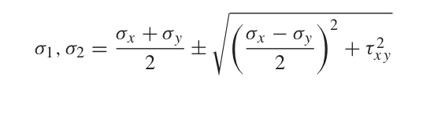
Principal Stresses
Maximum and minimum values of σ and τ are of special interest and can be obtained by analyzing the variation with θ.
Taking the derivative dσ/dθ and equating the result to zero gives the coordinate axes rotations for the maximum and minimum values of σ
Two angles θn separated by 90◦ satisfy this relationship. The corresponding maximum and minimum normal stresses, called the principal normal stresses, are

Slide 17
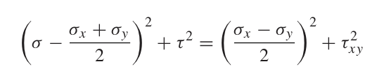
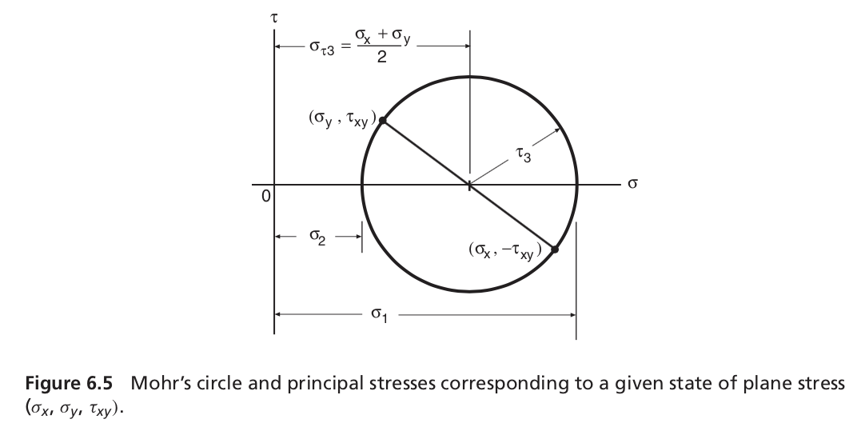
Mohr’s Circle

Slide 18
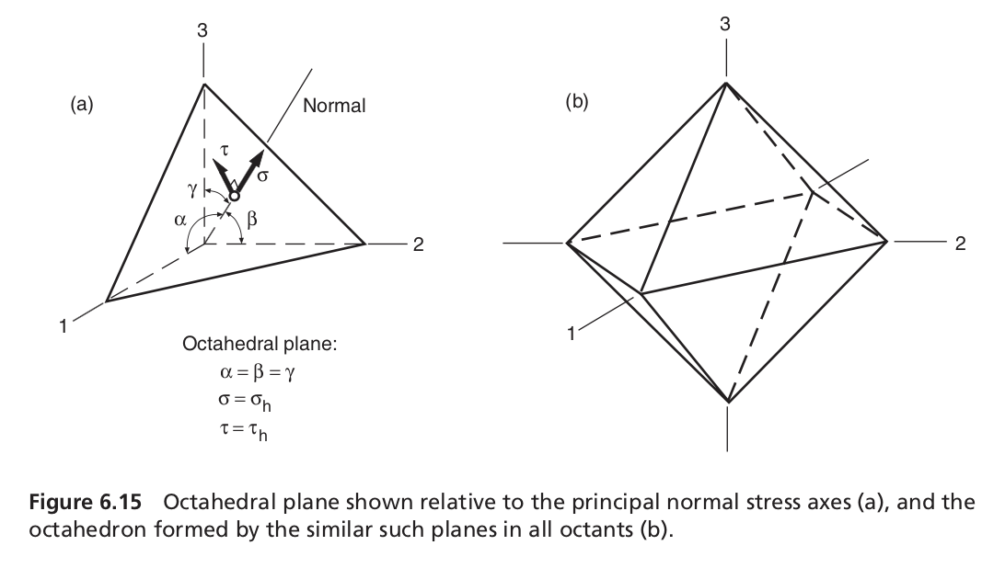

STRESSES ON THE OCTAHEDRAL PLANES
For the special case where α = β = γ , the oblique plane intersects the principal axes at equal distances from the origin and is called the octahedral plane. Based on equilibrium of forces, the normal stress on this plane can be shown to be the average of the principal normal stresses:

Slide 19
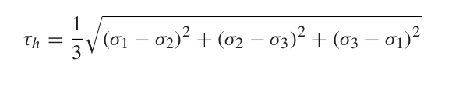
STRESSES ON THE OCTAHEDRAL PLANES
Equilibrium also permits the shear stress on the same plane, called the octahedral shear stress, to be evaluated:

Slide 20
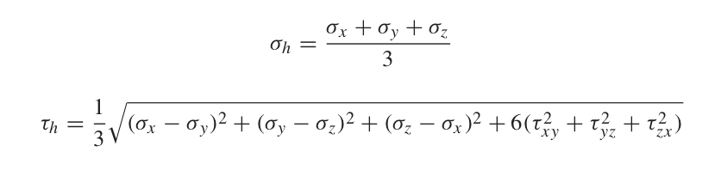
Substitution of the general form of the invariants and manipulation then gives

Slide 21
Yielding under Combined Stresses
The terms flow criterion, yield criterion, and failure criterion have different meanings. Failure criterion has its historical origin in applications where the onset of plastic deformation indicated failure.
However, in deformation-processing operations this is obviously not the case, and plastic flow is desired. Yield criterion applies only to materials that are in the annealed condition. It is known that, when a material is previously deformed by, for instance, rolling, its yield stress increases due to work-hardening. (Meyers)
The term flow stress is usually reserved for the onset of plastic flow in a previously deformed mater- ial. Failure criterion is applied to brittle materials, in which the limit of elastic deformation coincides with failure.

Slide 22
Maximum-Stress Criterion (Rankine)
According to the maximum-stress criterion, plastic flow takes place when the greatest principal stress in a complex state of stress reaches the flow stress in uniaxial tension.
Since σ₁ > σ₂ > σ₃, we have
σ₀(tension) < σ1 < σ₀ (compression),
where σ₀ is the flow stress of the material.

Slide 23

Maximum-Shear-Stress Criterion (Tresca)
Plastic flow starts when the maximum shear stress in a complex state of deformation reaches a value equal to the maximum shear stress at the onset of flow in uniaxial tension (or compression). The maximum shear stress is given by

Slide 24
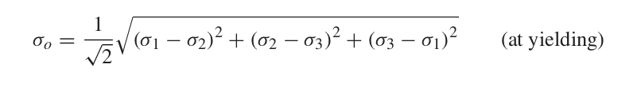
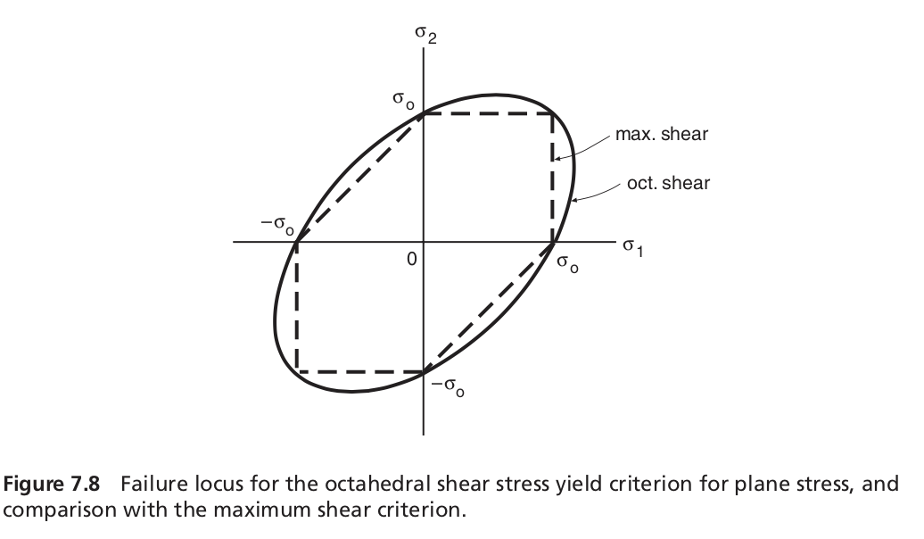
Maximum-Distortion-Energy Criterion (von Mises)
Octahedral shear stress yield criterion, also often called either the von Mises or the distortion energy criterion

Slide 25
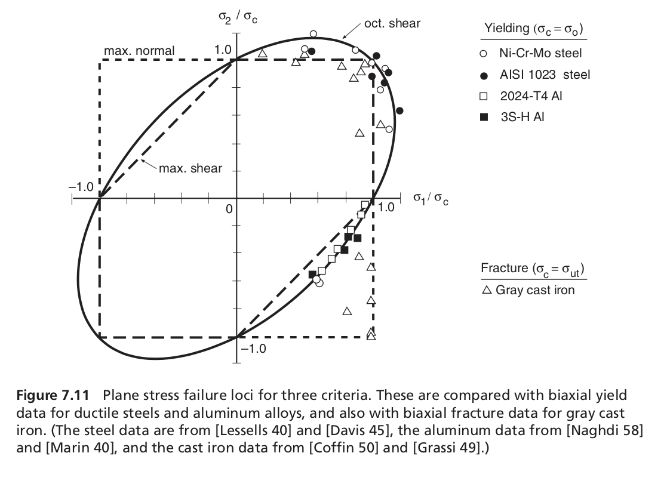

Slide 26
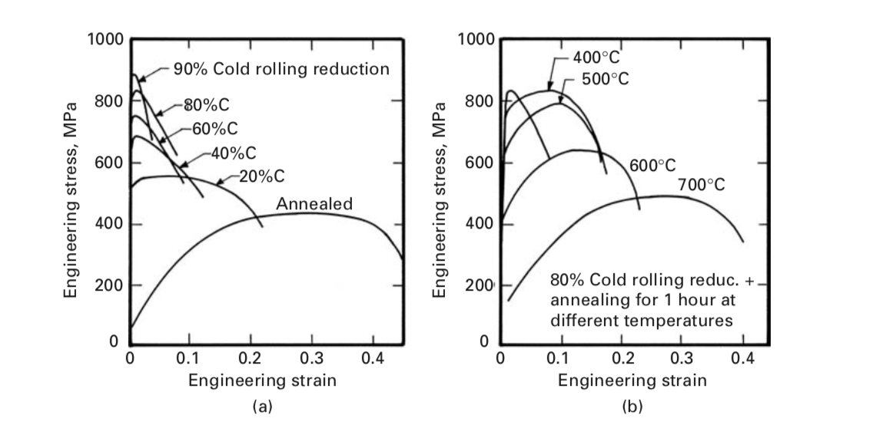
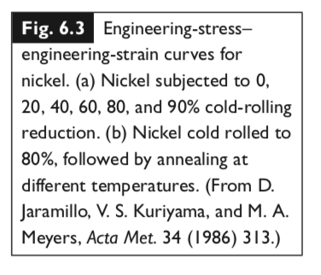
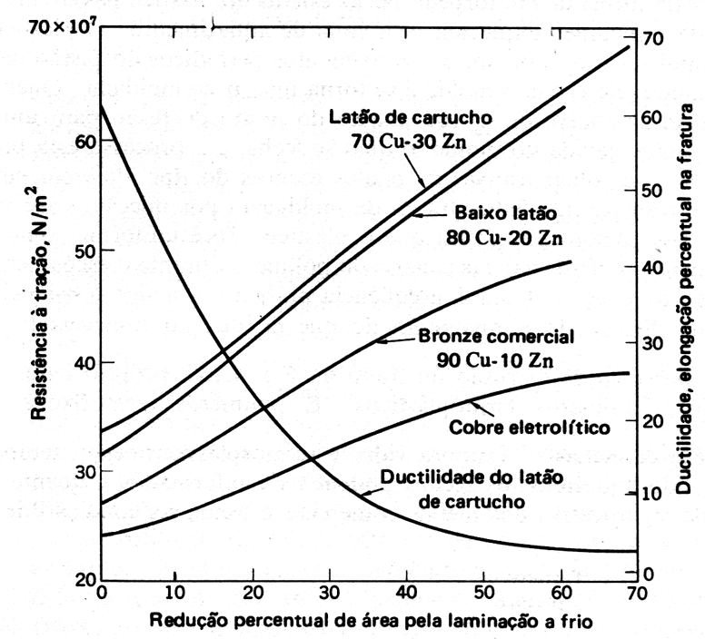
Work-hardening
Aumento da resistência à tração e diminuição de ductilidade de chapas de cobre e ligas de cobre após encruamento.

Slide 27
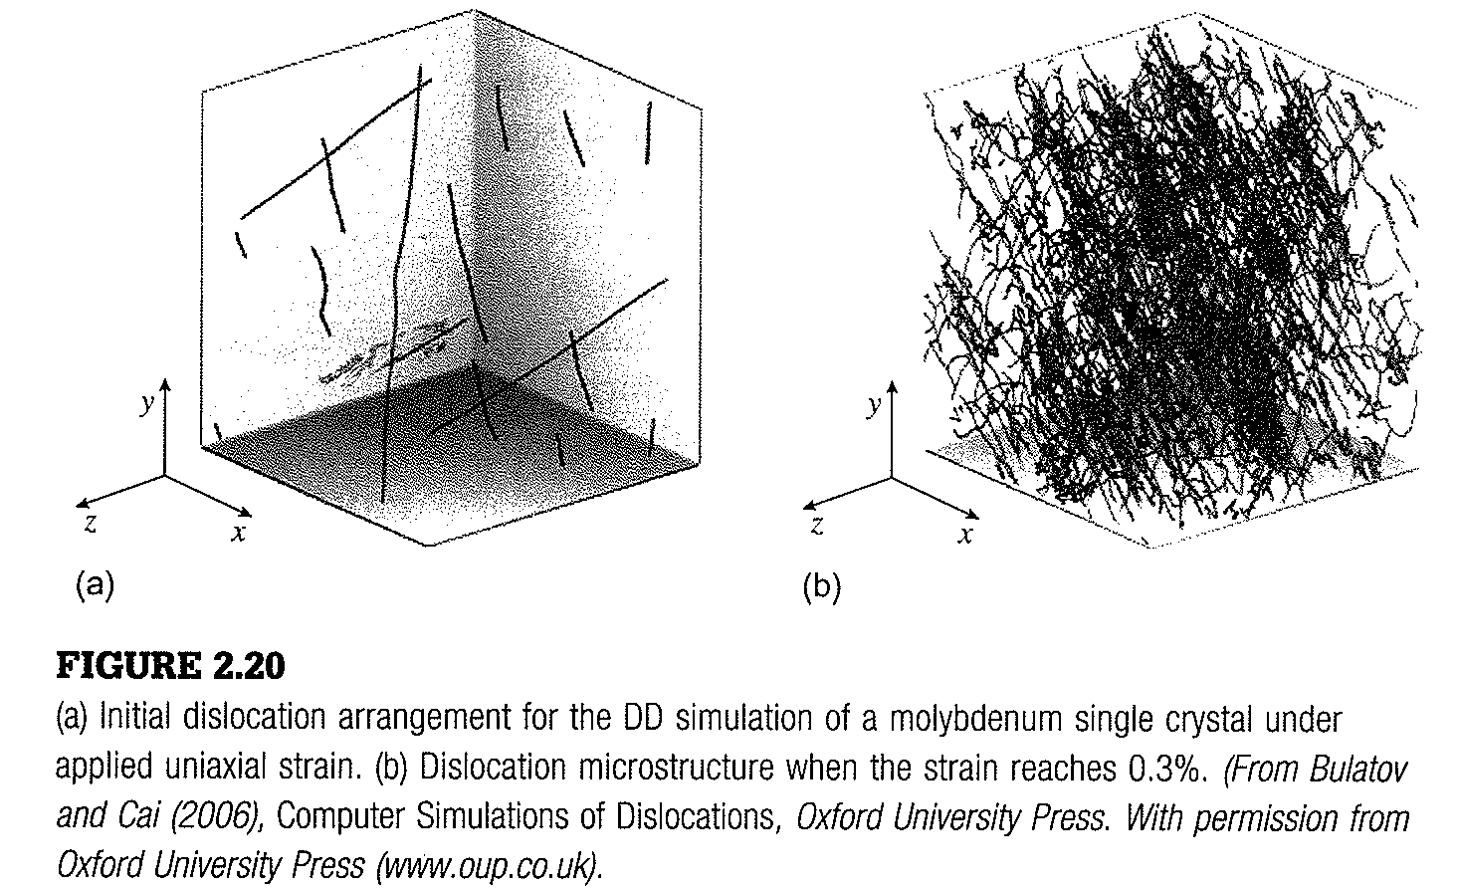
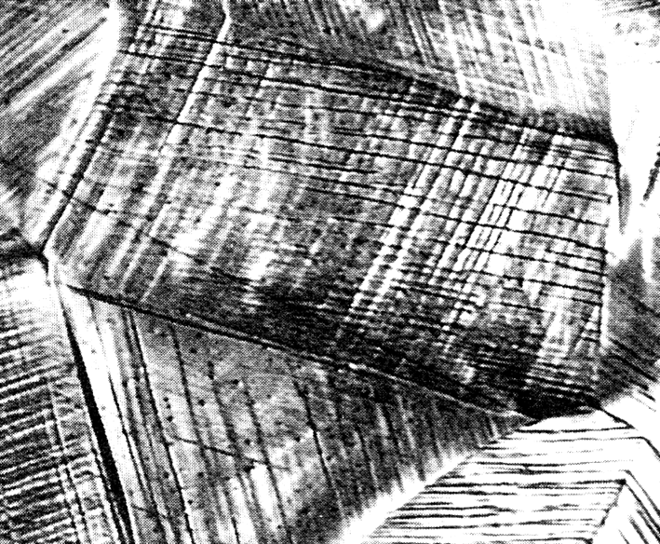
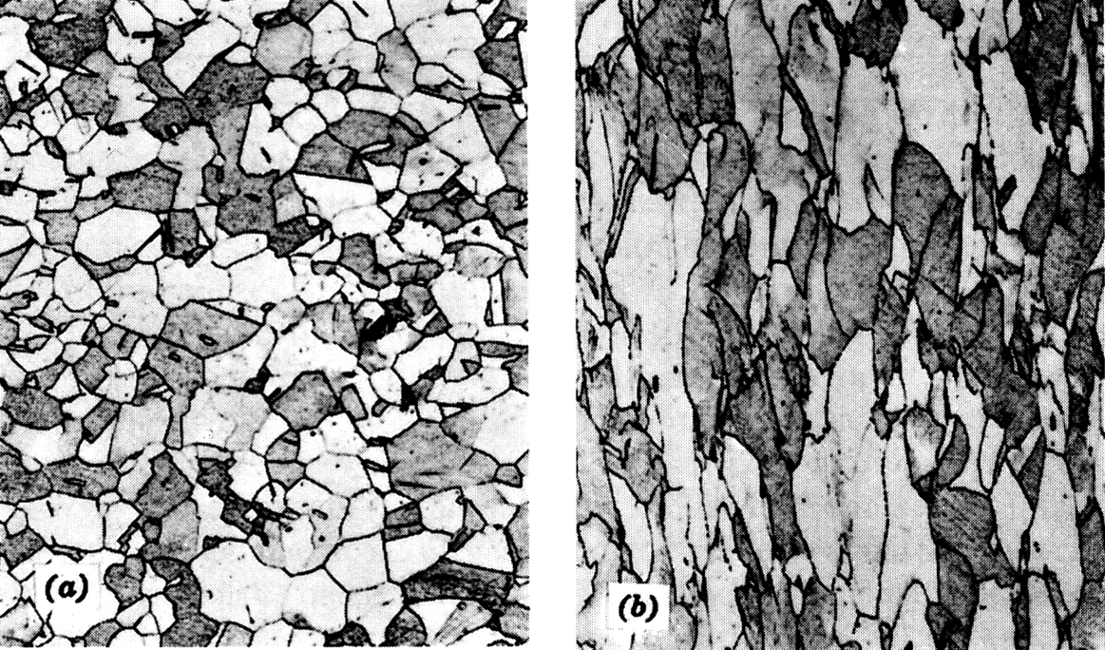
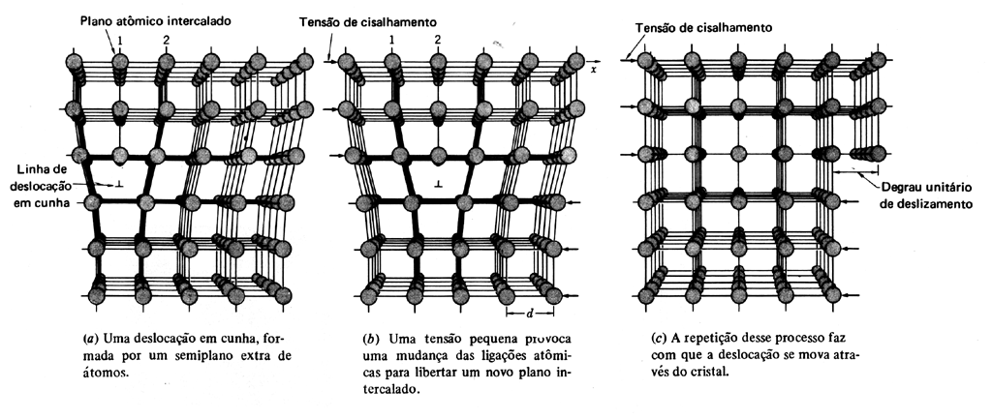
Work-hardening

Slide 28
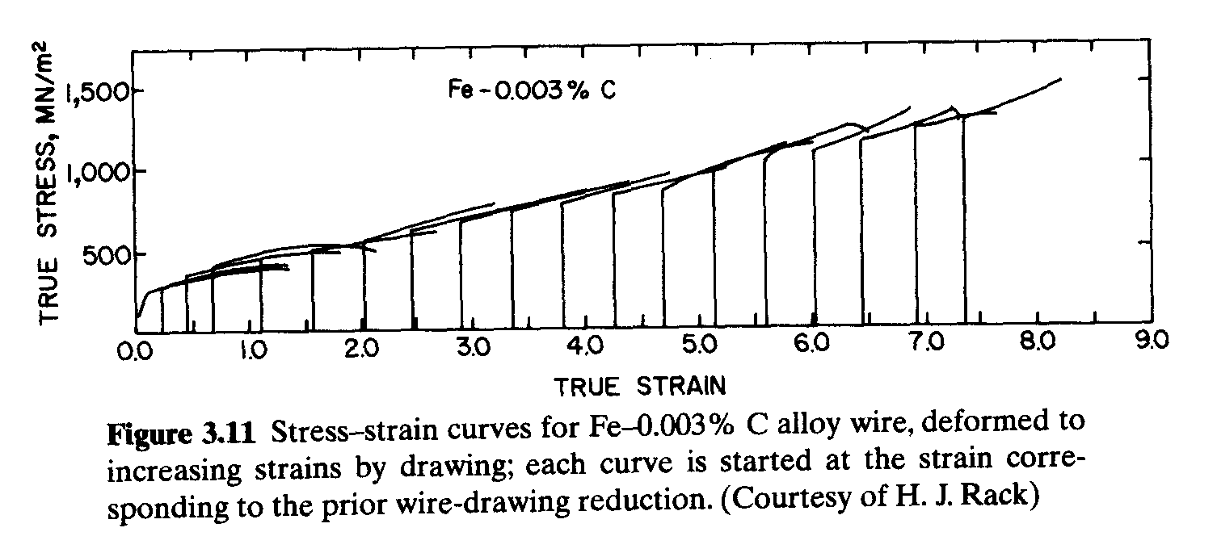
Work-hardening

Slide 29
Coeficiente de encruamento
Uma boa representação do encruamento que ocorre durante a deformação plástica está relacionada com o coeficiente de encruamento (n).
n é menor do que 1, neste caso diz-se que o encruamento é parabólico. Assumindo que o limite de escoamento é σ₀. K é uma constante e o coeficiente n dependem do material e da temperatura de deformação. n varia entre 0,2 e 0,5 e K varia entre G/100 a G/1000. G é módulo de cisalhamento.

Slide 30
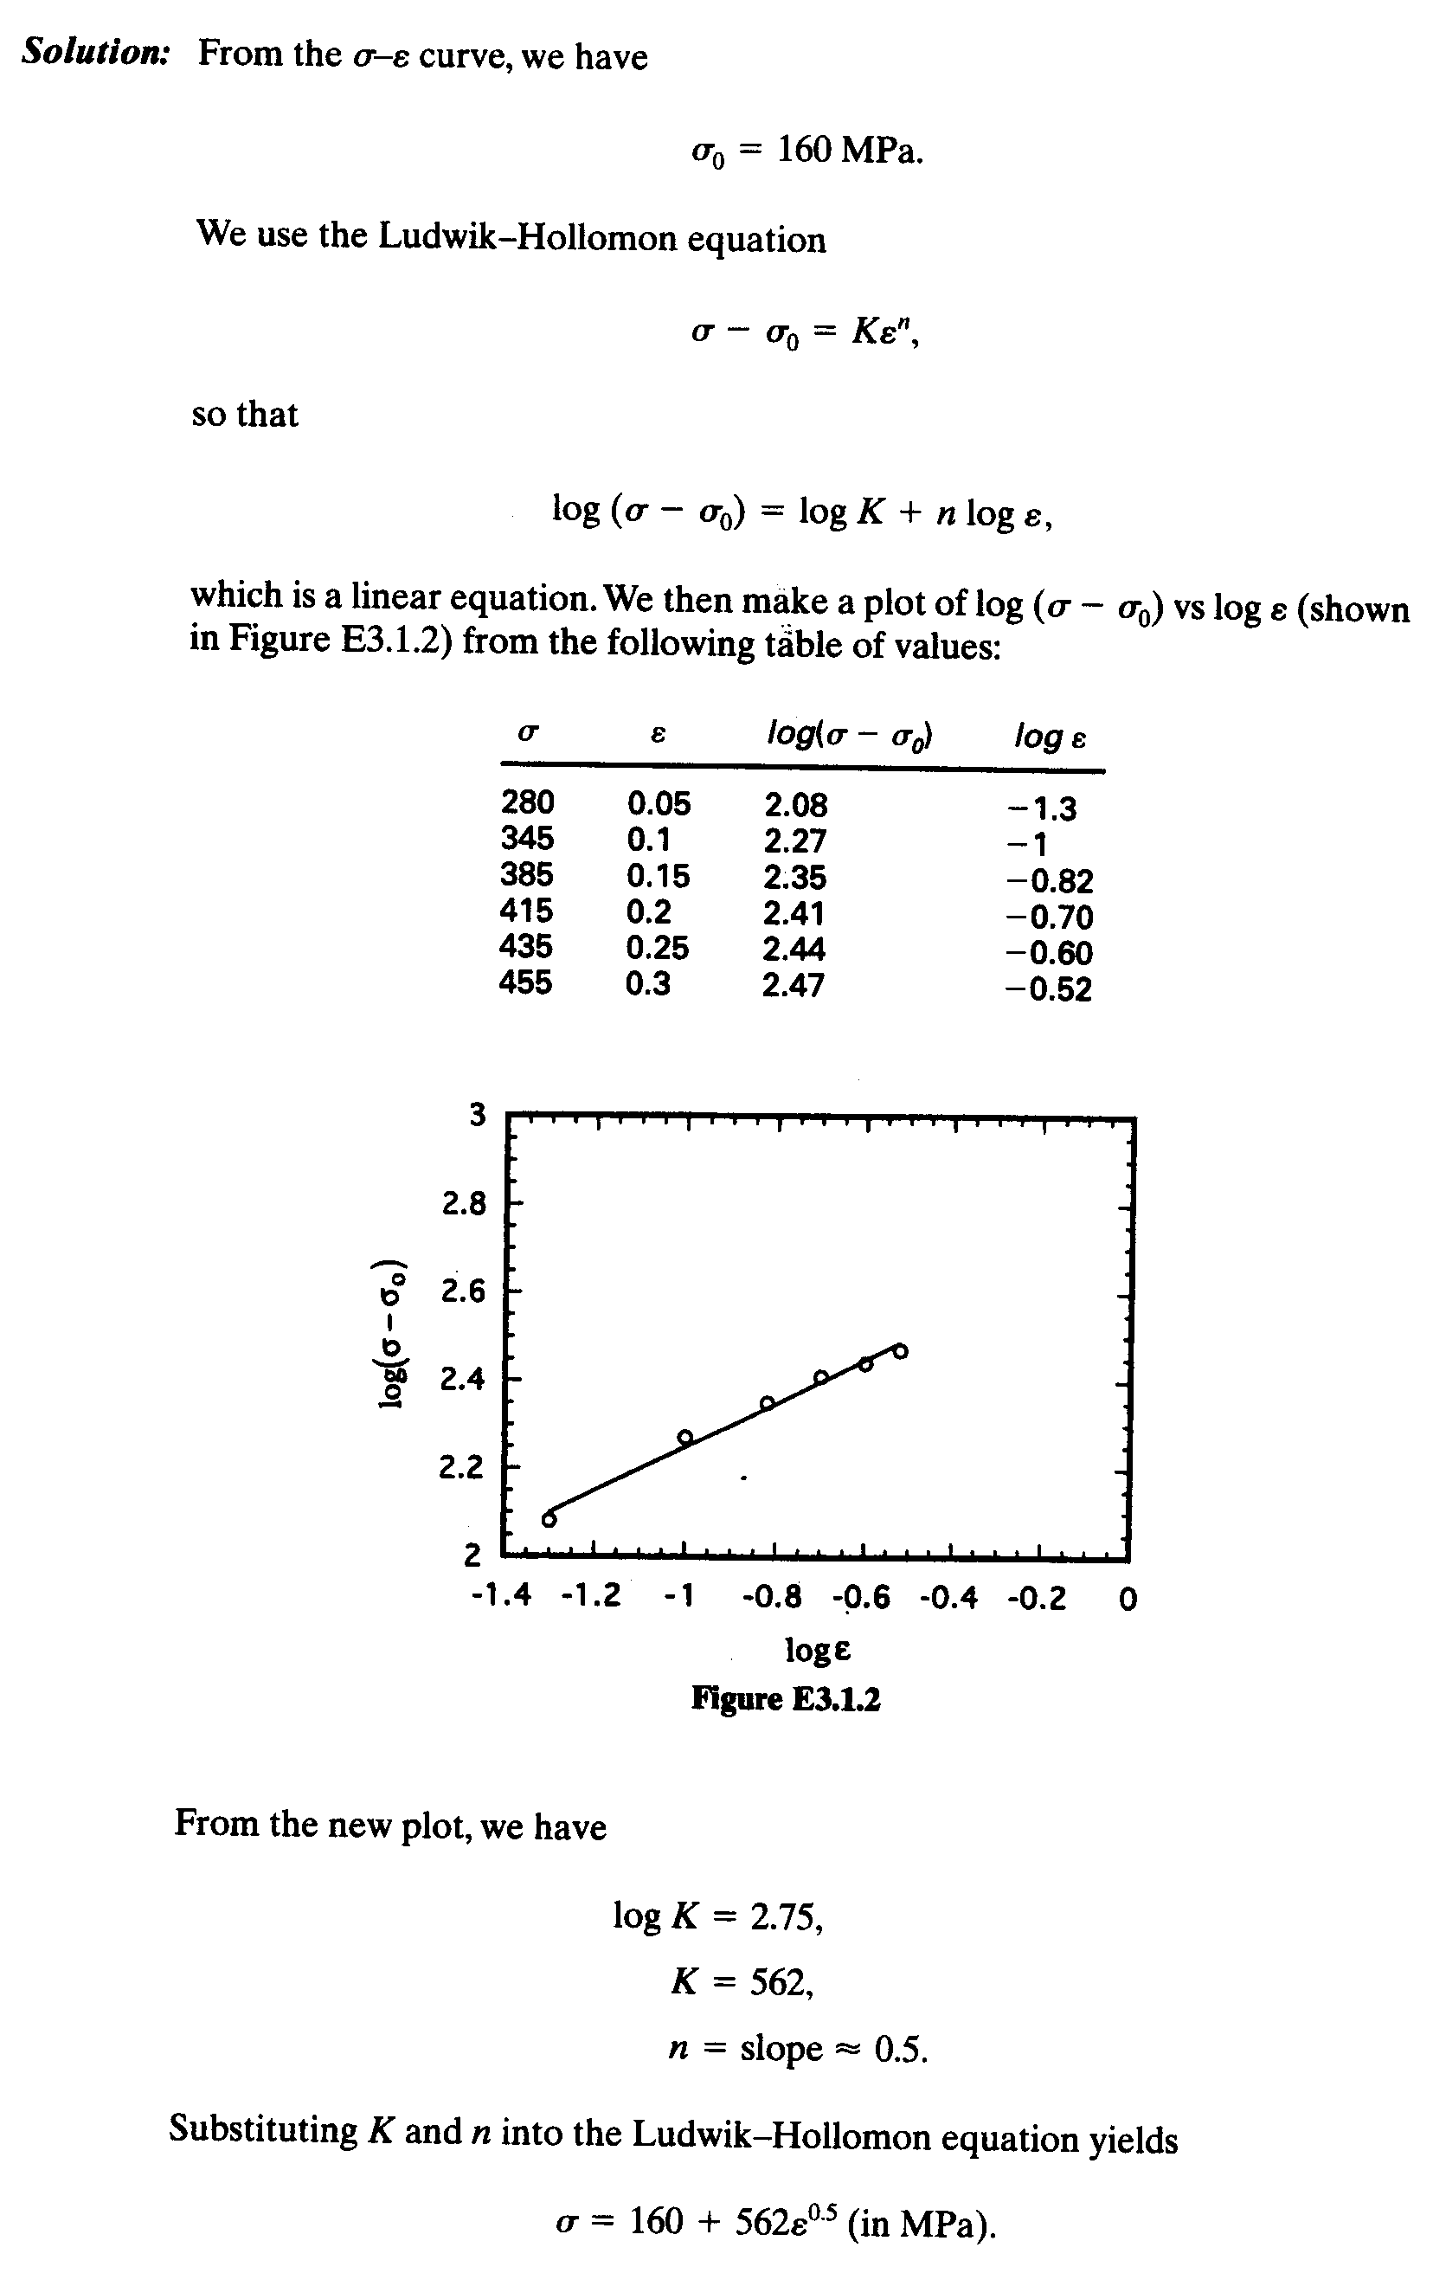
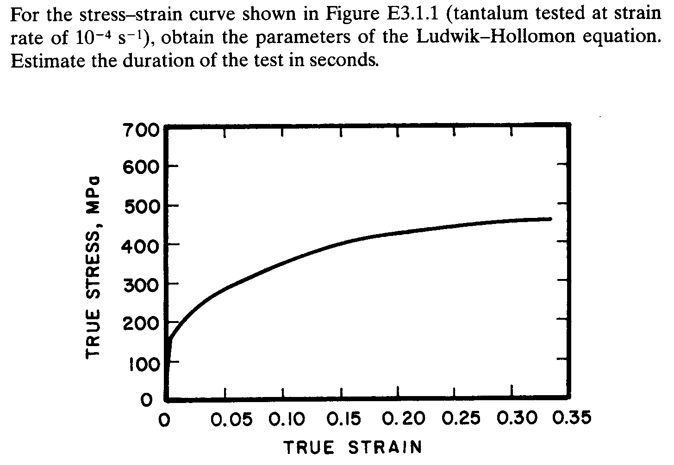
Work-hardening

Slide 31
Materiais, quando submetidos a carregamentos cíclicos, podem inicialmente responder plasticamente e, após uma determinada quantidade de ciclos de carregamento, passar a ter uma resposta perfeitamente elástica. A esta transição de comportamento se dá o nome de shakedown
Uma das aplicações que pode se beneficiar de uma análise shakedown é o contato roda-trilho de uma ferrovia.
Work-hardening
Referência: ESTUDO NUMÉRICO DO EFEITO DE PROPRIEDADES MECÂNICAS E DO ATRITO
NO FENÔMENO DE SHAKEDOWN
ESTUDO DE CASO: CONTATO ESFERA-PLANO SUBMETIDO A CARREGAMENTO CÍCLICO : RODRIGO PEREIRA GONÇALVES

Slide 32
Work-hardening
A primeira passagem de um carregamento que exceda o limite elástico do material de um ou de ambos os corpos em contato dá origem a três efeitos separados, cada um dos quais tende a inibir a deformação plástica em ciclos de carregamento subsequentes e contribuem para o acontecimento do shakedown (KAPOUR e JOHNSON, 1992):
(i) Tensões residuais são introduzidas;
(ii) O material pode encruar e;
(iii) A área de contato pode mudar, possibilitando uma redução na pressão de contato.
Outro parâmetro que influencia no fenômeno shakedown é o atrito. De maneira geral, um tribossistema que possui um maior coeficiente de atrito tende a apresentar um menor limite shakedown

Slide 33
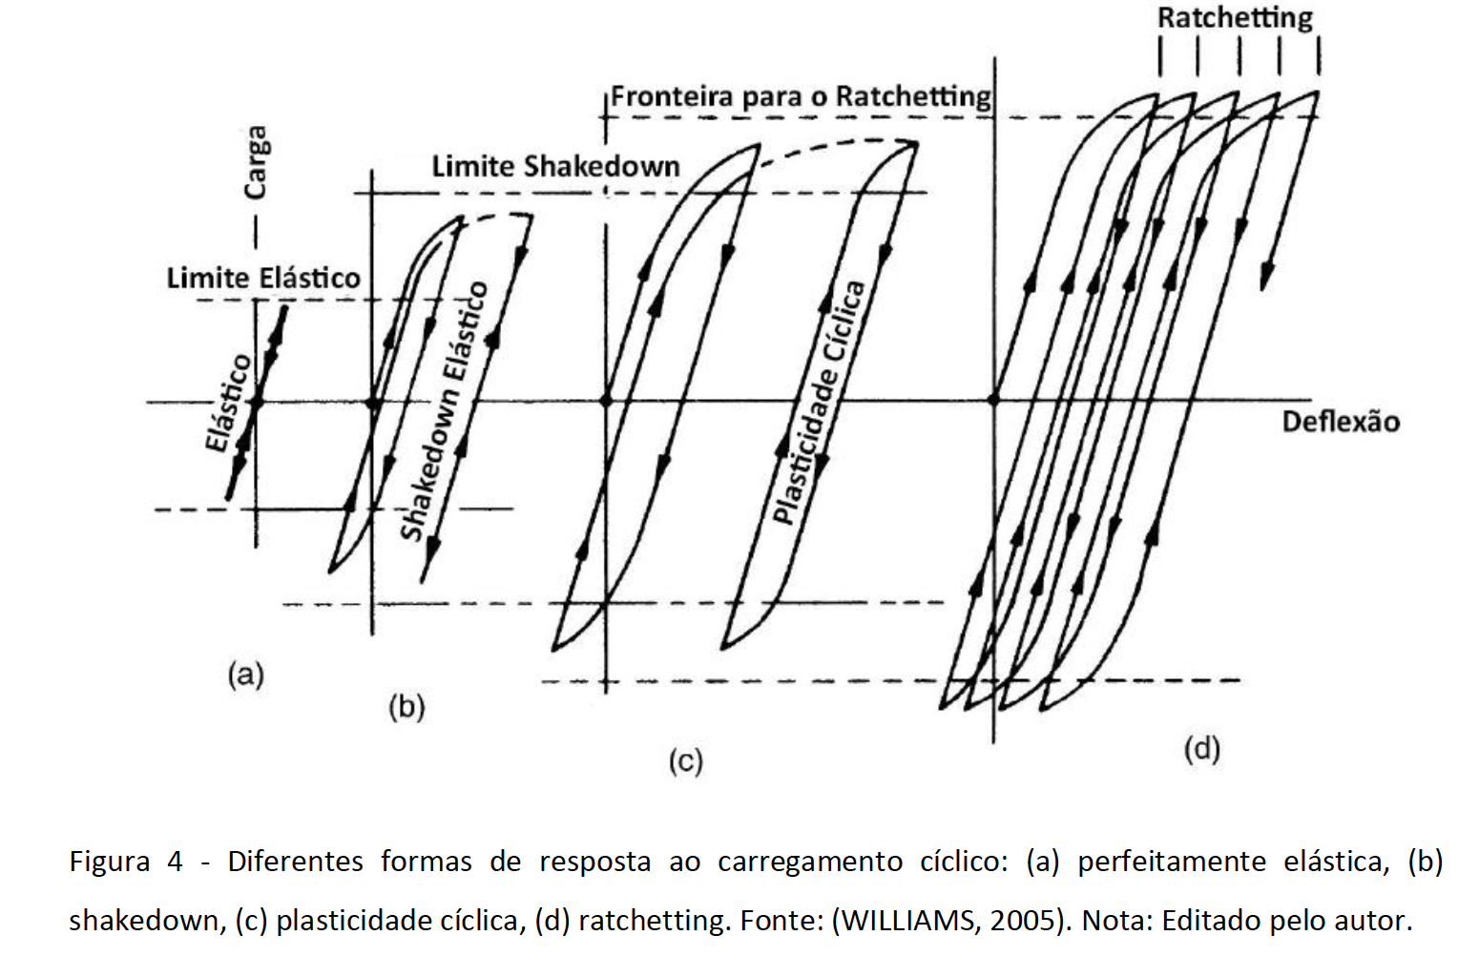
Work-hardening

Slide 34
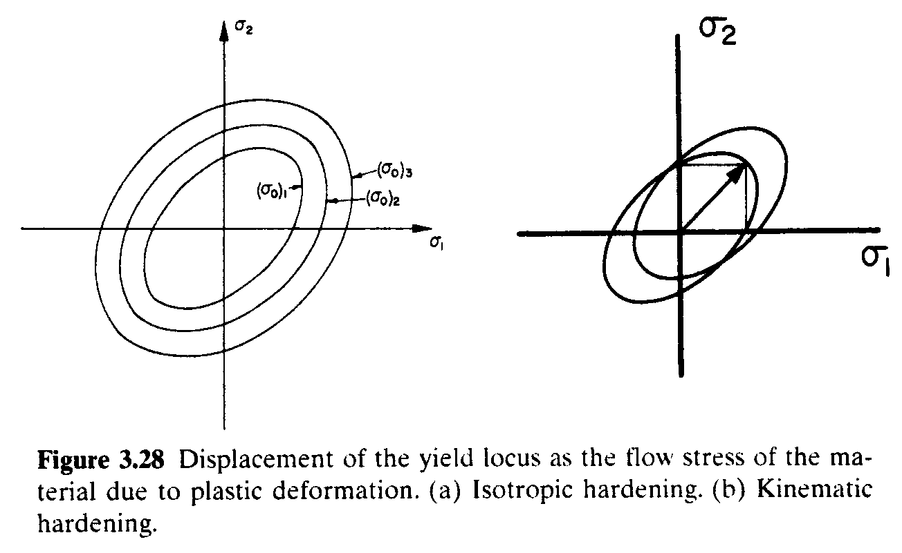
Work-hardening
Efeito do encruamento
Pode ser isotrópico ou não. Mais comumente o maior encruamento ocorre na direção do carregamento, o que é relevante em operações de conformação e é conhecido com encruamento cinemático.

Slide 35
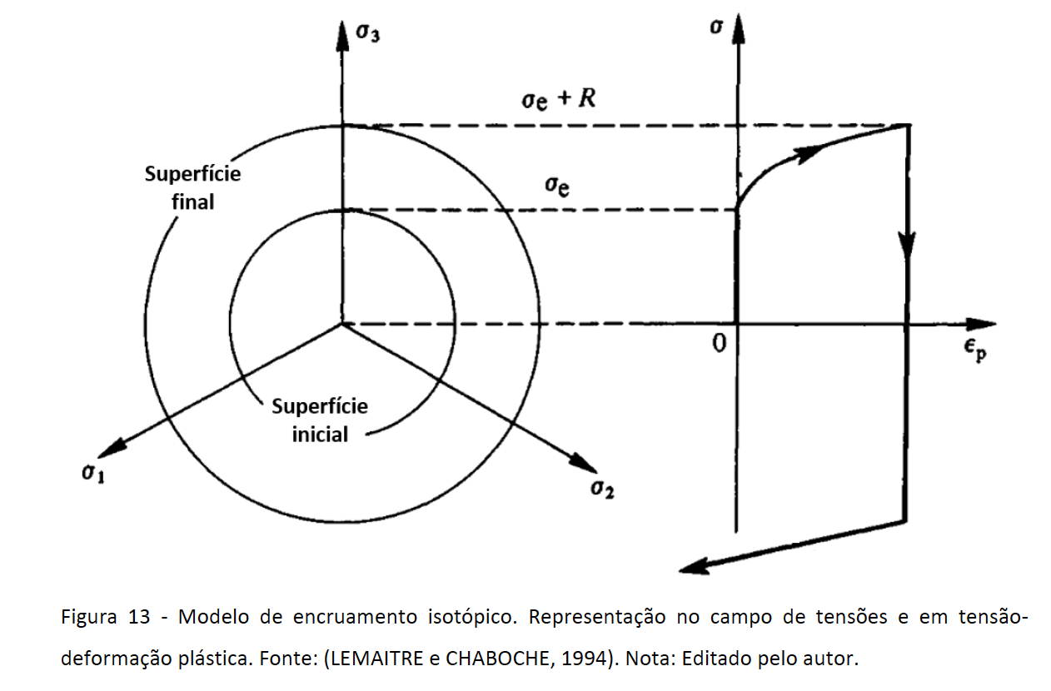
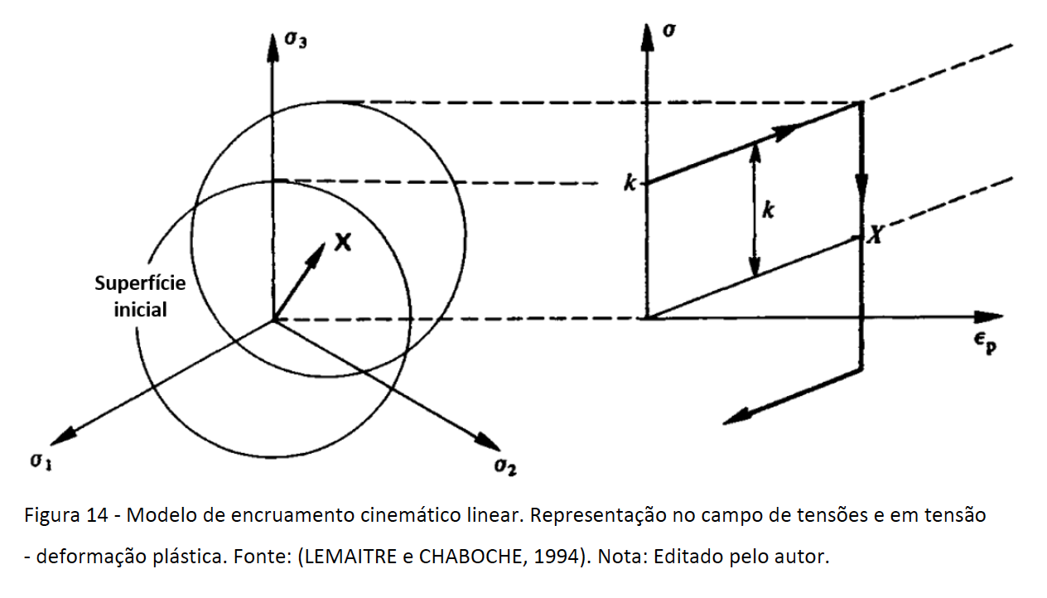
Work-hardening

Slide 36
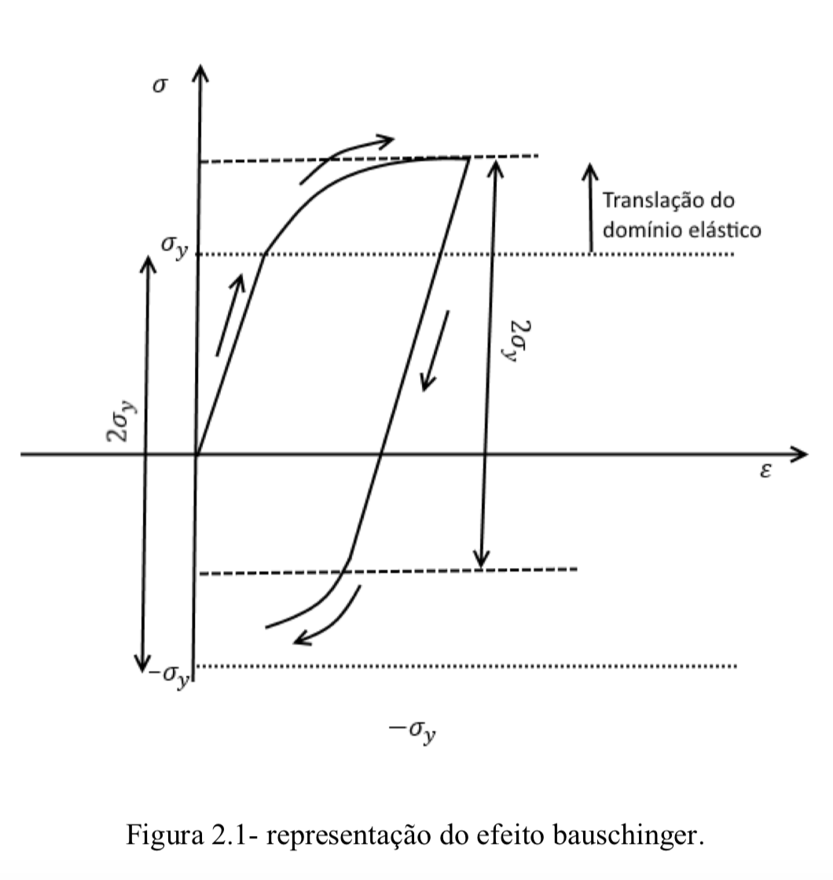
Efeito Bauschinger
Work-hardening
A deformação plástica em uma direção irá afetar a resposta na outra direção. A translação da elipse de Von Mises afeta esta relação (encruamento cinemático) . A elipse irá se movimentar na direção que o material está sendo tensionado . Com isso o material que colocado em condições de tensão , terá uma redução na resistência à compressão

Slide 37
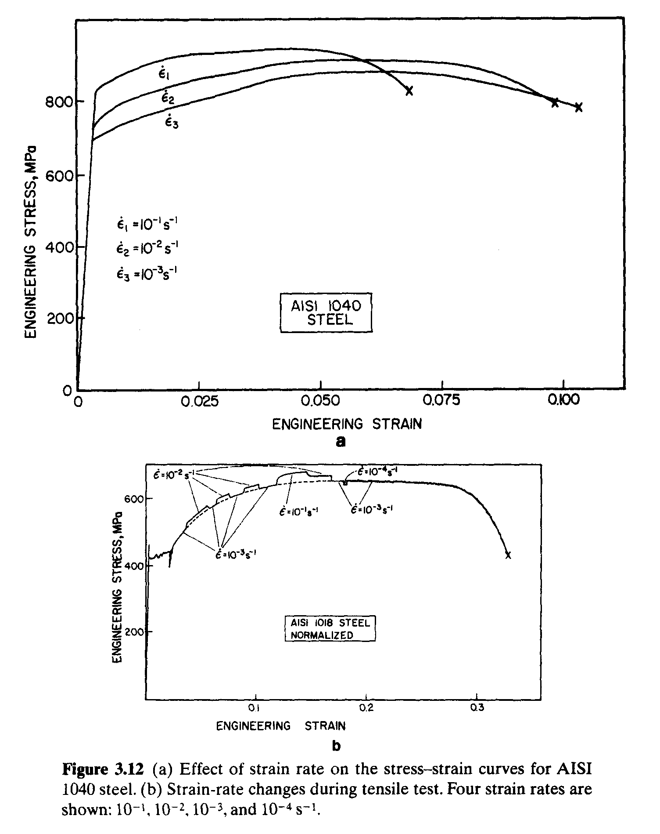
Strain rate

Slide 38
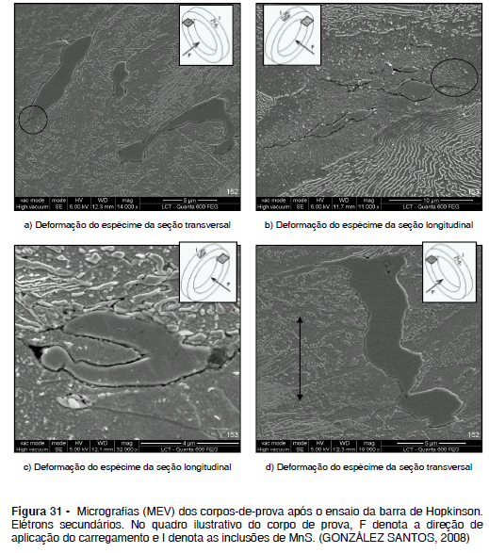
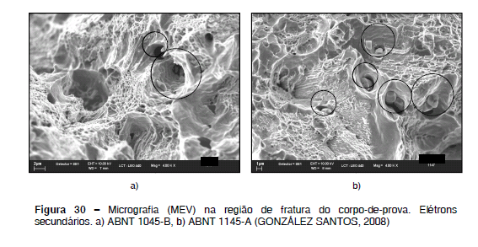
Strain rate
- Comparação entre os ensaios de tração e barra de Hopkinson (GONZÁLEZ SANTOS, 2008)

Slide 39
Relações mais gerais que relacionam a taxa de deformação com efeitos térmicos podem ser descritas, que são chamadas equações constitutivas (relacionam tensão e deformação).
onde: K, C, n e m são parâmetros empíricos do material; Tr é a temperatura
de referência e Tm é a temperatura de fusão. Taxa de deformação de
referência e taxa de deformação.

Slide 40
Efeito da taxa de deformação
Os materiais são sensíveis às taxas de deformação. As menores taxas
correspondem à fluência e testes de relaxação
Em taxas da ordem de 10²s⁻¹ corresponde à taxa de propagação de uma onde de choque através do material (propagação de trincas).
m é chamado de sensibilidade à taxa de deformação e K é uma constante diferente da de Hollomon.
https://www.youtube.com/watch?v=442doLwgyps

Slide 41
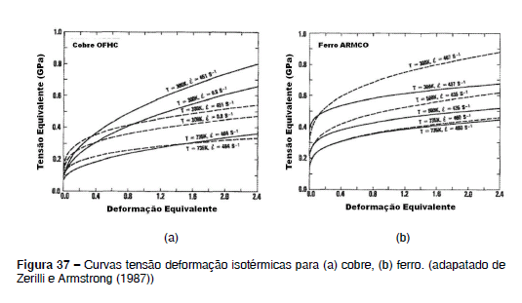

Slide 42
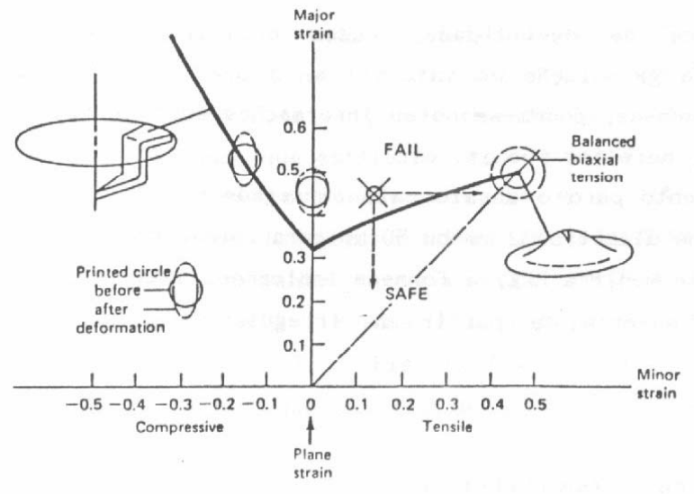
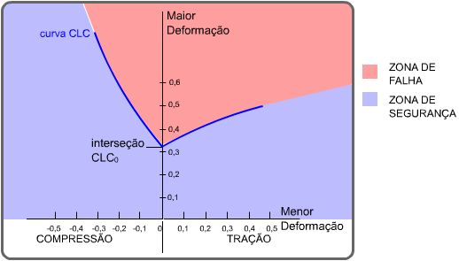
Conformabilidade com função da deformação, taxa de deformação, temperatura e microestrutura (curvas limite de conformação)

Slide 43
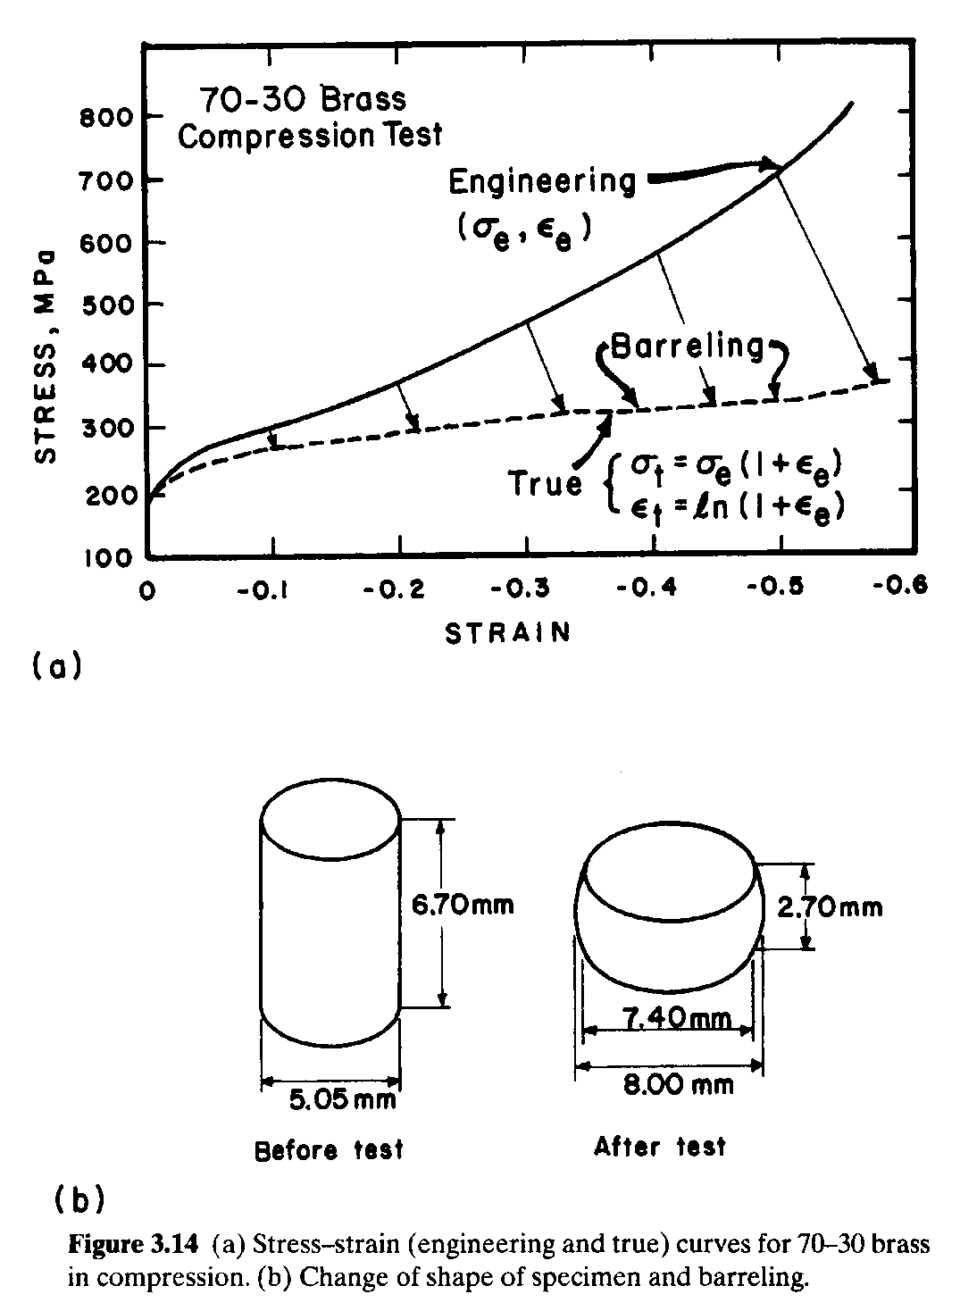
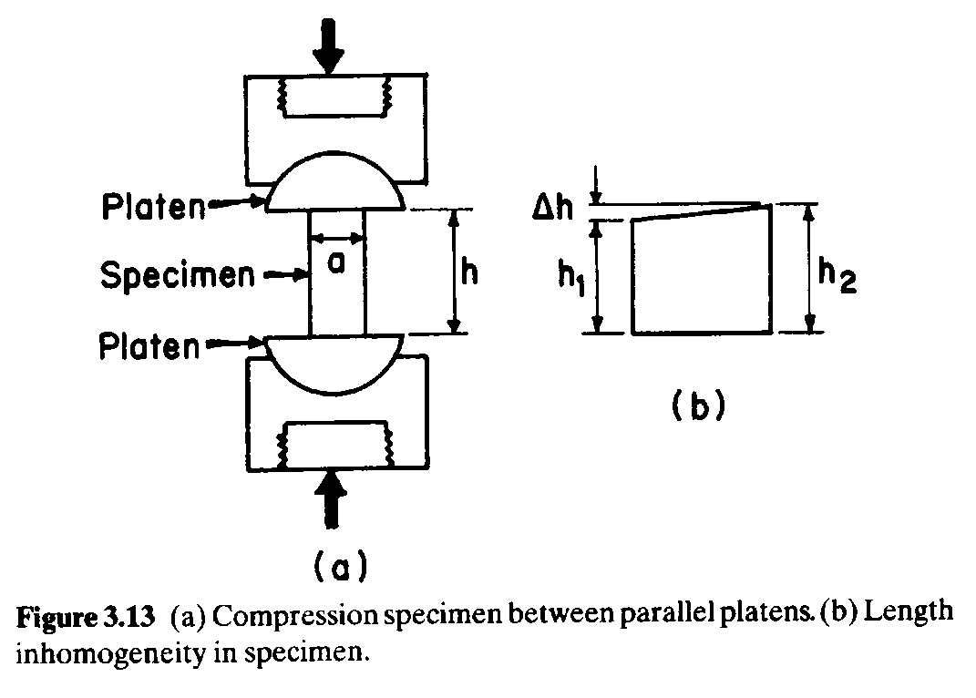
Compressão
Importância da lubrificação-efeito do atrito

Slide 44
Operação de recalque: (a-) disposição de um tarugo entre duas matrizes; (b-) deformação da peça sem a presença de atrito na interface; (c-) deformação da peça com a presença de atrito na interface. Simbologia: D=matriz; B= tarugo; F= força aplicada. (ASM INTERNATIONAL, 1995)

Slide 45
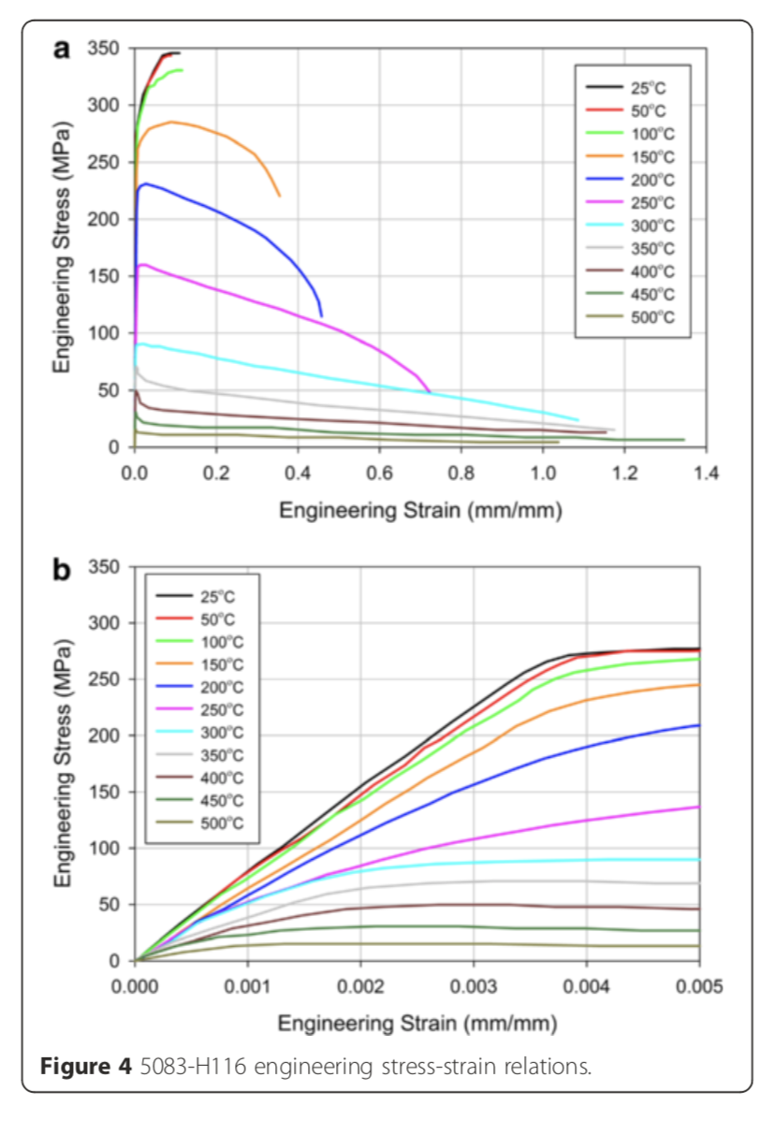
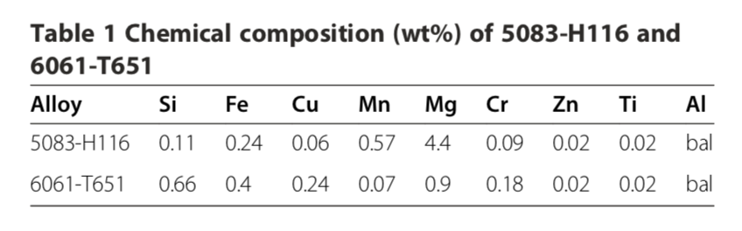
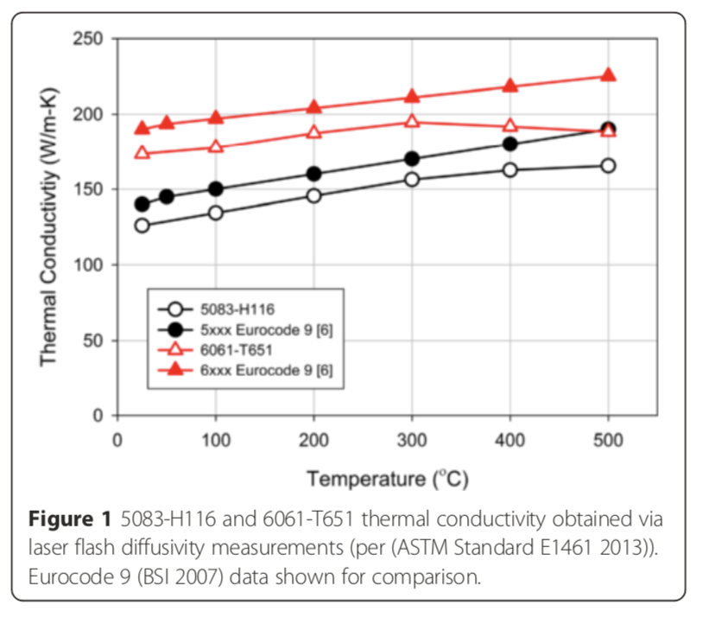
Temperature
DOI 10.1186/s40038-015-0007-5

Slide 46
Creep and Superplasticity
All of these temperatures are in the range (0.4--0.65) Tm, where Tm is
the melting point of the material in kelvin.
The degradation undergone by materials in these extreme conditions
can be classified into two groups:
1. Mechanical degradation. In spite of initially resisting the applied
loads, the material undergoes anelastic deformation; its dimensions
change with time.
2. Chemical degradation. This is due to the reaction of the material
with the chemical environment and to the diffusion of external
elements into the materials. Chlorination (which affects the properties
of superalloys used in jet turbines) and internal oxidation
are examples of chemical degradation.
Diffusion
Time

Slide 47
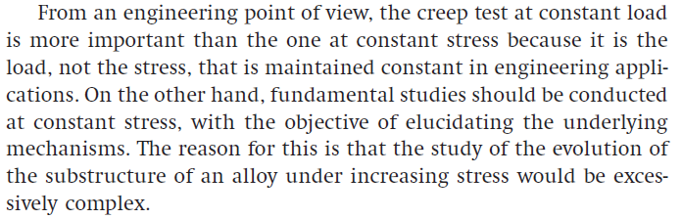
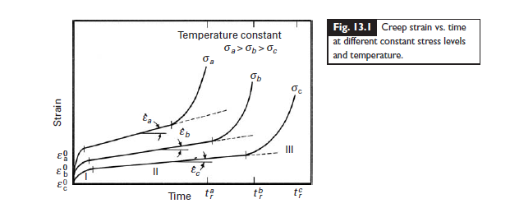
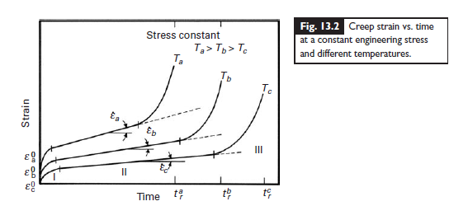

Slide 48



Slide 49


Slide 50



Slide 51




Slide 52


Slide 53


Slide 54
FADIGA
Fadiga pode ser definida como uma degradação das propriedades mecânicas do material levando à falha do material ou componente em carregamento cíclico. Este fenômeno atinge muito componentes estruturais ou partes móveis ou em condições de variação de temperatura. Existe a estimativa de que 90% dos componentes que falham em serviço estão ligados à ocorrência de fadiga.

Slide 55

One can divide the study of cyclic behavior of materials into the following three classes:
Stress-life approach
Strain-life approach
Fracture mechanics approach.

Slide 56

We first define some important parameters that will be useful in the subsequent discussion of fatigue.
cyclic stress range σ = σmax − σmin ,
cyclic stress amplitude σa = (σmax − σmin)/2,
mean stress σm = (σmax + σmin)/2,
stress ratio R = σmin/σmax,

Slide 57




Na verdade essas curvas descrevem uma probabilidade de falha.

Slide 58


Slide 60



Palmgren – Miner

Slide 61




Slide 62

Stress constrains that can cause failure!
How can we connect all possible mechanisms and conditions ???
Knowledge, characterization, experiments models and computational tools …
And the effect stress constraints influence on damage

Slide 63

Mechanical Approach X Metallurgical/Materials Approach
Materials are usually considereded homogenous and isotropic
Plastic deformation is based on tension tests
Failure is based on the onset of deformation (Von Mises criteria) – Principal stresses
State of strain and stress are evalueted
Strain rate and constitutive equations such as Johson-Cook are importante to describe the mechanical behavior
Damage is mainly evaluated during crack growth - Macro
Focus on Design of components
Materials are usually considereded heterogeneuos and anysotropic
Plastic deformation is based on dislocations teory, crystaline structure
State of strain and stress were not usually considered
Damage are based on ductile or fragile behavior (nucleation)
Microstructural Characterization (Nano and Micro levels) is an important tool
Mechanical behavior (mechanical properties and processing) – Micro
Focus on Design of Materials

Slide 64
Manufacturing

Slide 65





Ligas metálicas
Esferas de aço
https://www.youtube.com/watch?v=19duYMdiXi0

Slide 66





Ligas metálicas
Esferas de aço
https://www.youtube.com/watch?v=19duYMdiXi0

Slide 67





Ligas metálicas
Esferas de aço
https://www.youtube.com/watch?v=19duYMdiXi0

Slide 68
Ligas metálicas
Memória de forma
https://www.sciencedirect.com/science/article/pii/B9781845695507500033
Aircraft morphing technologies
W.W. Huebsch, ... R.W. Guiler, in Innovation in Aeronautics, 2012
3.5.4 Shape memory materials
Shape memory alloys (SMA) are metallic alloys that are able to undergo large reversible deformations under loading/thermal cycles and are able to generate high thermal–mechanical driving forces. The behavior of SMA is due to their native capability to undergo reversible changes of the crystallographic structure, depending on temperature and state of stress. These changes can be interpreted as reversible martensitic transformations between a crystallographic more-ordered parent phase, the austenite (A), to a crystallographic less-ordered product phase, the martensite (M). SMA can be produced as both wire and sheet (Auricchio and Sacco, 2000). Passing a voltage through the SMA wire or sheet generates the temperature change needed to produce a shape change. When the voltage is removed, the heat dissipates and the material returns to its original shape. SMA can be used alone as an actuator or incorporated into the matrix of a composite structure. Composites incorporating SMA are often referred to as smart composites. SMA use in smart composites is fairly new and is currently being studied by many research groups.

Slide 69



https://www.youtube.com/watch?v=bvw7_a2gU24
Ligas metálicas
Efeito memória

Slide 70



https://www.youtube.com/watch?v=wI-qAxKJoSU
Ligas metálicas
Efeito memória

Slide 71

https://www.youtube.com/watch?v=wI-qAxKJoSU
Ligas metálicas
Efeito memória

Slide 72



https://www.youtube.com/watch?v=wI-qAxKJoSU
Ligas metálicas
Efeito memória

Slide 73


A fibra óptica proporciona alta qualidade, velocidade e capacidade de tráfego de informações, sendo assim, o meio de transmissão de dados mais eficiente utilizado pelo sistema de telecomunicações na atualidade.
Fabricação do bastão de pré-forma
Estiramento (ou Puxamento)
Tipos de material usados na fabricação de fibra óptica
As fibras ópticas podem ser fabricadas com os seguintes materiais:
Sílica pura
Sílica dopada
Vidro composto
Plástico
Porém, fibras fabricadas a partir de sílica pura ou dopada apresentam melhores características de transmissão
https://www.fibracem.com/curiosidades/como-e-feita-a-fabricacao-de-fibra-optica/

Slide 74





https://www.youtube.com/watch?v=AS95A8pvclk

Slide 75


https://www.sciencedirect.com/topics/engineering/carbon-allotrope

Slide 76
https://www.britannica.com/science/carbon-chemical-element/Structure-of-carbon-allotropes
Structure Of Carbon Allotropes
When an element exists in more than one crystalline form, those forms are called allotropes; the two most common allotropes of carbon are Diamond and graphite. The crystal structure of diamond is an infinite three-dimensional array of carbon atoms, each of which forms a structure in which each of the bonds makes equal angles with its neighbours. If the ends of the bonds are connected, the structure is that of a tetrahedron, a three-sided pyramid of four faces (including the base). Every carbon atom is covalently bonded at the four corners of the tetrahedron to four other carbon atoms. The distance between carbon atoms along the bond is 1.54 × 10⁻⁸ cm, and this is called the single-bond length. The space lattice of the diamond can be visualized as carbon atoms in puckered hexagonal (six-sided) rings that lie roughly in one plane, the natural cleavage plane of the crystal; and these sheets of hexagonal, puckered rings are stacked in such a way that the atoms in every fourth layer lie in the same position as those in the first layer. The layer arrangement sequence is thus ABCABCA…. Such a crystal structure can be destroyed only by the rupture of many strong bonds. Thus, the extreme hardness, the high sublimation temperature, the presumed extremely high melting point (extrapolated from known behaviour), and the reduced chemical reactivity and insulating properties are all reasonable consequences of the crystal structure. Because of both the sense and the direction of the tetrahedral axis, four spatial orientations of carbon atoms exist, leading to two tetrahedral and two octahedral (eight-faced) forms of diamond.

Slide 77

https://www.britannica.com/science/carbon-chemical-element/Structure-of-carbon-allotropes

Slide 78


References

