Slide 1
Capturing learning from innovation
Joseph tidd and John Bessant

Slide 2
Autores:

Slide 3
What have we learned about innovation?
In order to succeed organizations also need effective implementation mechanisms to move innovations from idea or opportunity through to reality.
Innovation depends on having a supporting organizational context in which creative ideas can emerge and be effectively deployed
Organizational conditions are a critical part of innovation management, and involve working with structures, work organization arrangements, training and development, reward and recognition systems and communication arrangements.
A learning organization begin to operate, with shared problem identification and solving and with the ability to capture and accumulate learning about technology and about management of the innovation process.

Slide 4
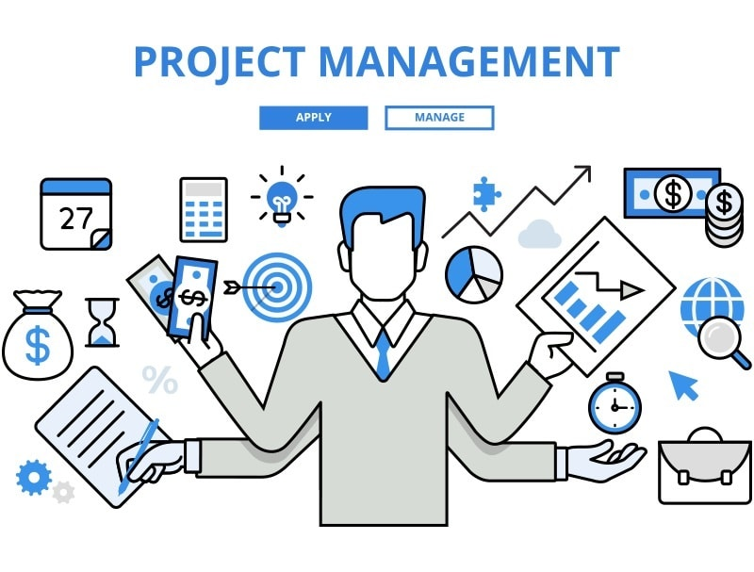
How can we continue to learn to manage innovation?
Changing environment
Innovation process (innovation capability)
Innovation Managment Skills
Technical skills
Dynamic capability

Slide 5
Learning to manage innovation.....
Effective learning from and about innovation management depends on establishing a learning cycle around these themes.

Slide 6
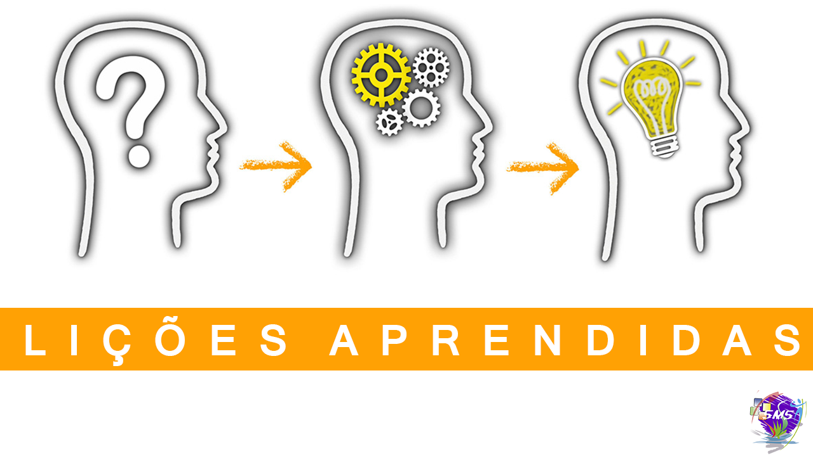
Tools to help capturing learning.....
Post-project reviews (PPRs) are structured attempts to capture learning at the end of an innovation project – for example, in a project debrief.
Benchmarking is the general name given to a range of techniques which involve comparisons

Slide 7
Innovation auditing.....
Such capability/maturity auditing offers another structured way of reflecting on the process of innovation and how it is managed.
Measure innovation

Slide 8
Developing innovation managing capability.....
Assesment

Slide 9
Developing innovation managing capability.....

Slide 10
Final comments
We have repeatedly said that innovation is complex, uncertain and almost (but not quite) impossible to manage.
Ther is no such thing as the perfect organization for innovation management; there will always be opportunities for experimentation and continuous improvement.
In the end innovation management is not an exact or predictable science but a craft, a reflective practice in which the key skill lies in reviewing and configuring to develop dynamic capability.

Slide 11
The innovation life cycle – different emphasis over time

