Slide 1
How are foresight methods selected?
Artigo de Rafael Popper
SEP5848-2020 Camila Castro

Slide 2
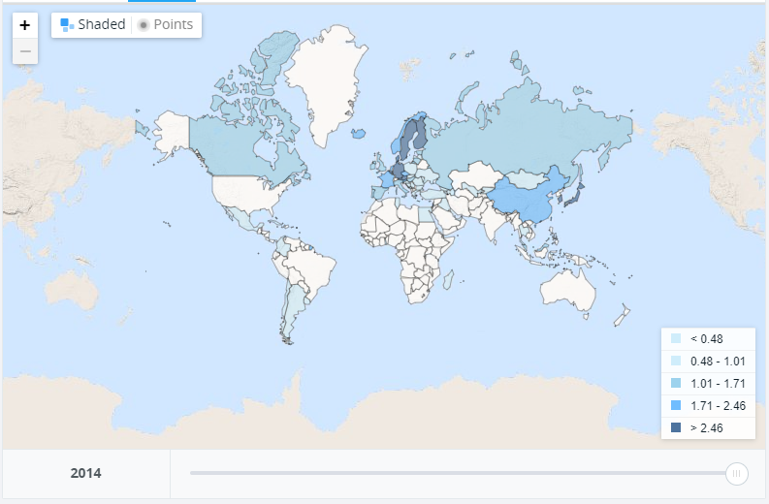
583 casos da europa.
313 casos de países > 2,4% do PIB em P&D
313 casos 1,5% - 2,2% do PIB em P&D
224 Casos <1,5% do PIB em P&D
https://data.worldbank.org/indicator/GB.XPD.RSDV.GD.ZS?view=map&year=2014

Slide 3
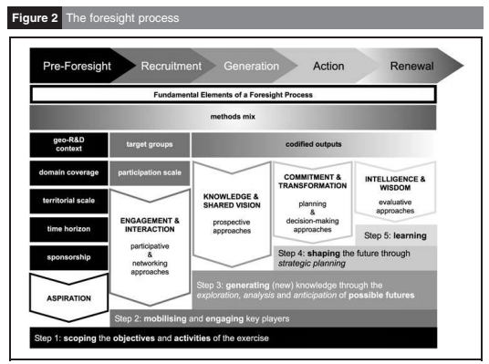

Slide 4
1. How is selection influenced by the nature of methods?
2. How is selection influenced by the capabilities of methods?
1. How is selection influenced by the geo-R&D context?
2. How is selection influenced by the domain coverage?
3. How is selection influenced by the territorial scale?
4. How is selection influenced by the time horizon?
5. How is selection influenced by the sponsorship?
6. How is selection influenced by the target groups?
7. How is selection influenced by the participation scale?
8. How is selection influenced by the codified outputs?
9. How is selection influenced by the methods mix?
Atributos
Processos

Slide 5
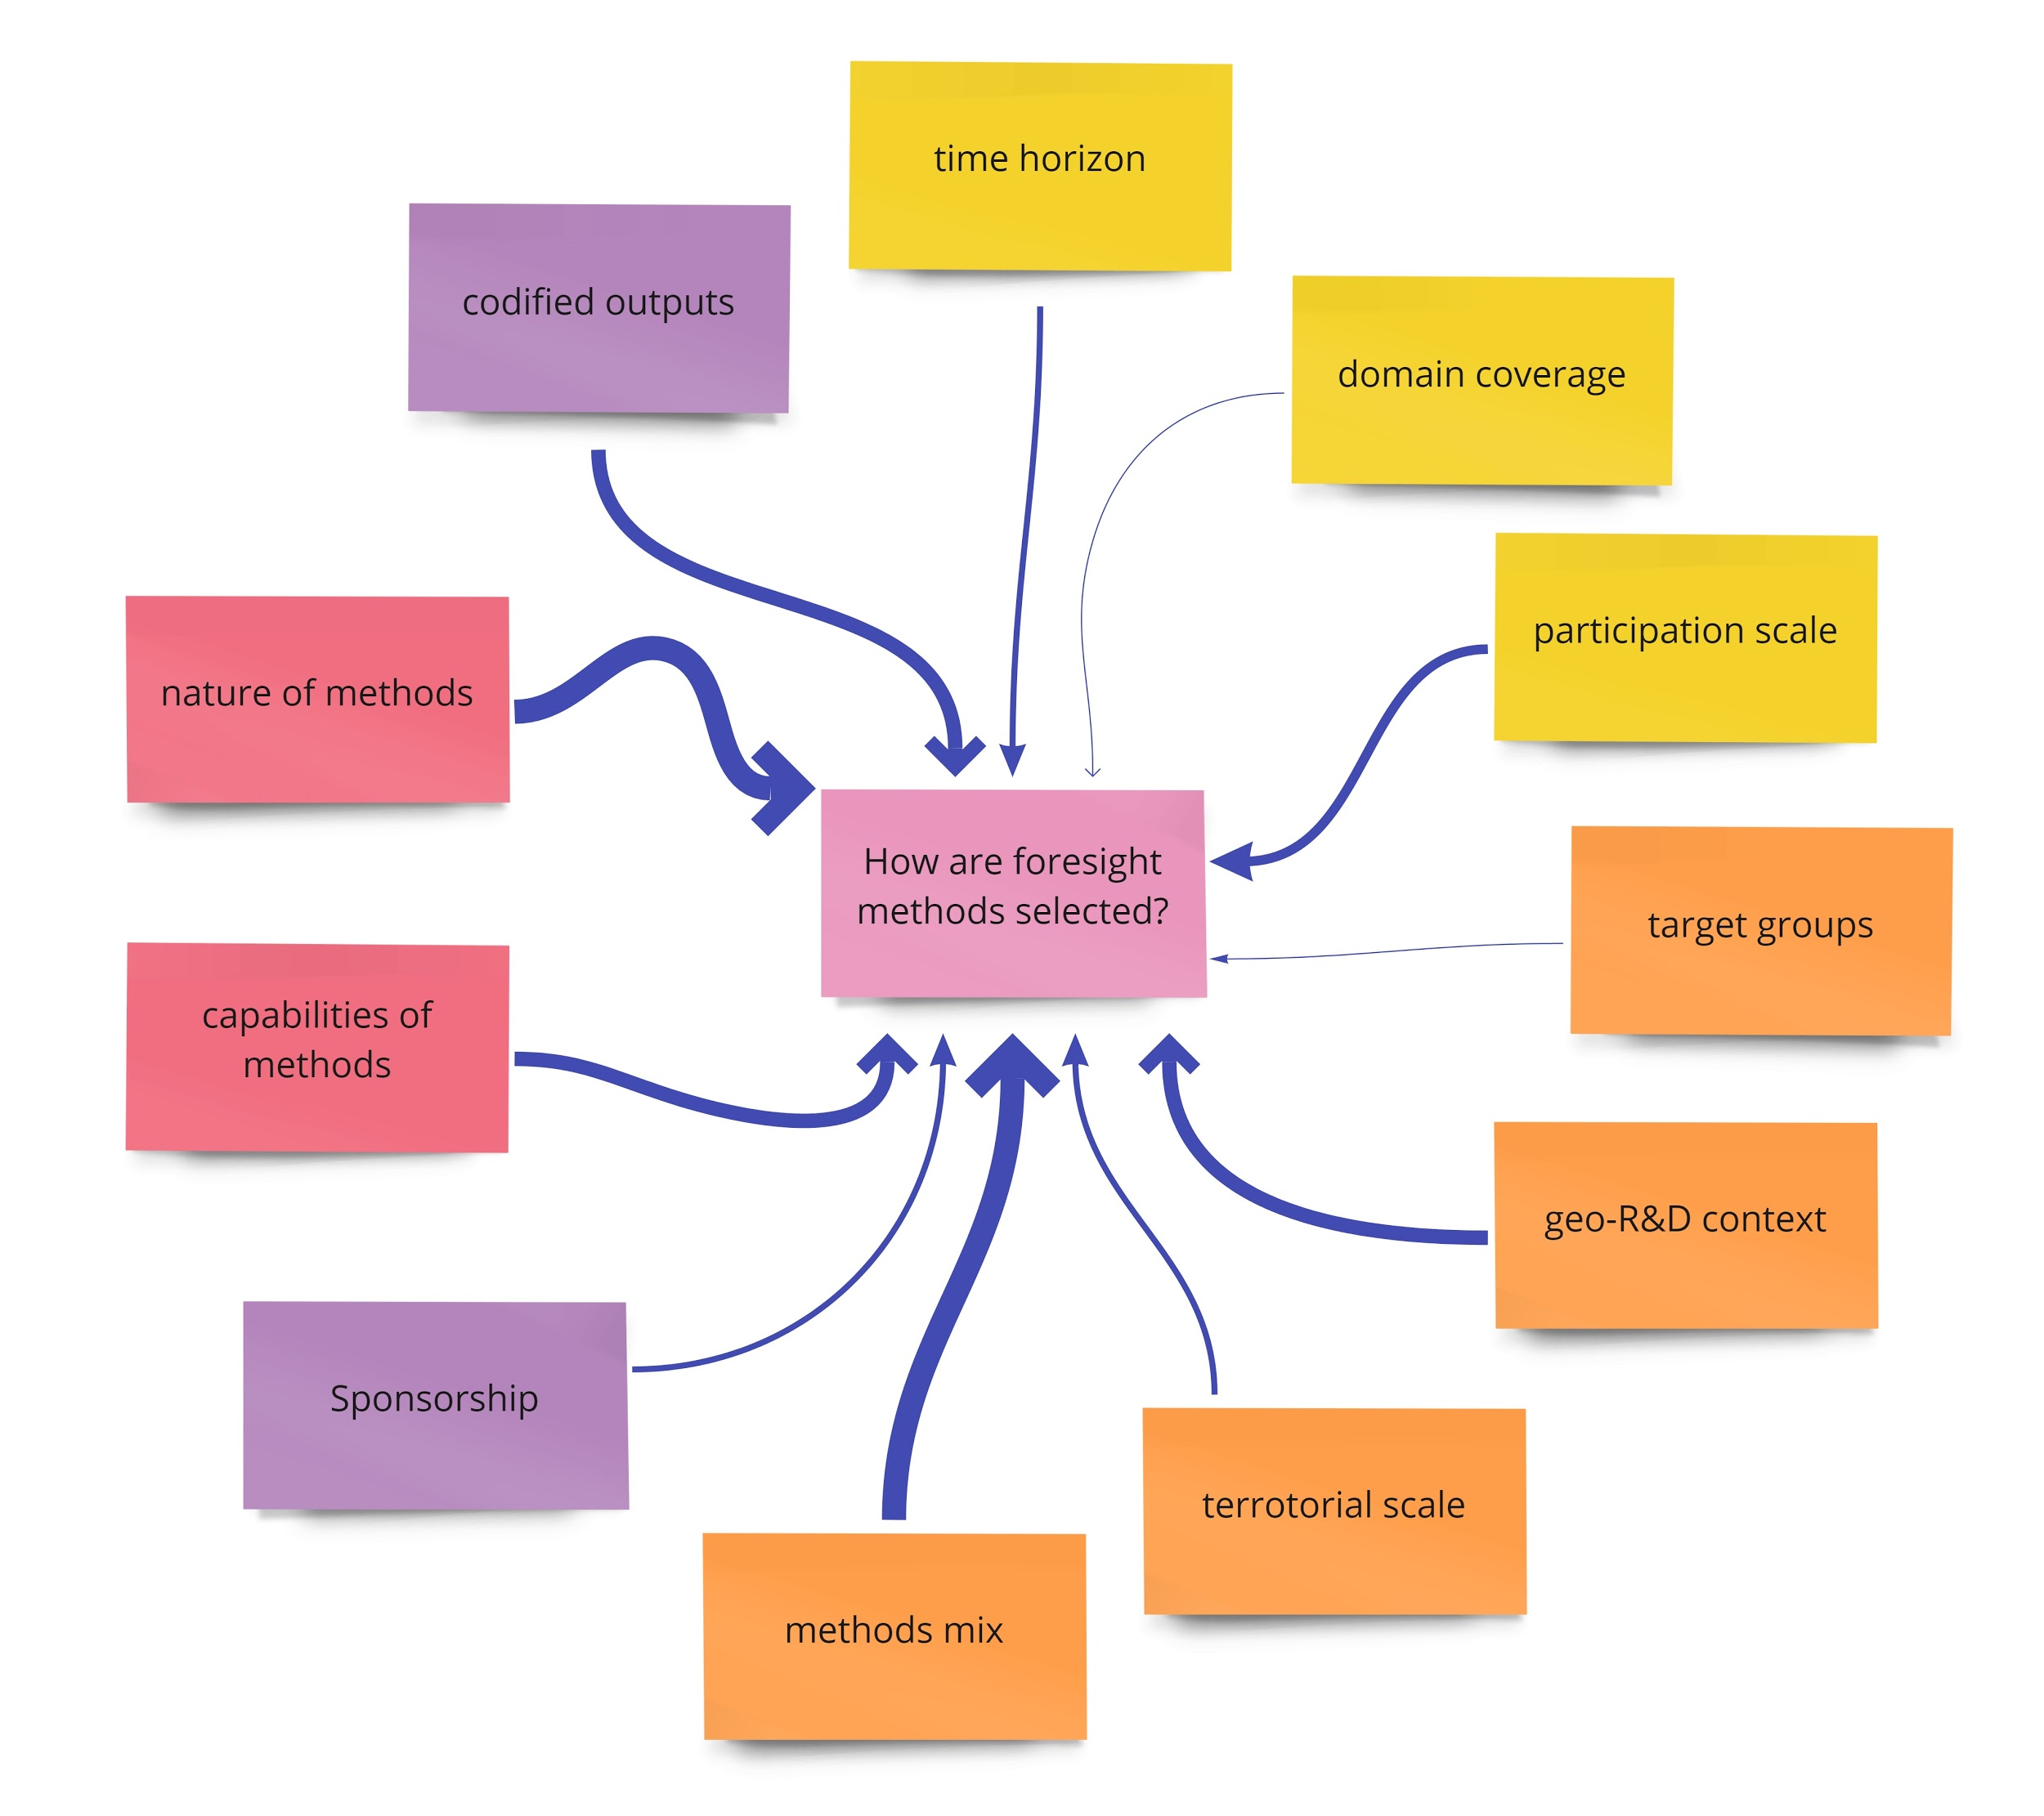

Slide 6
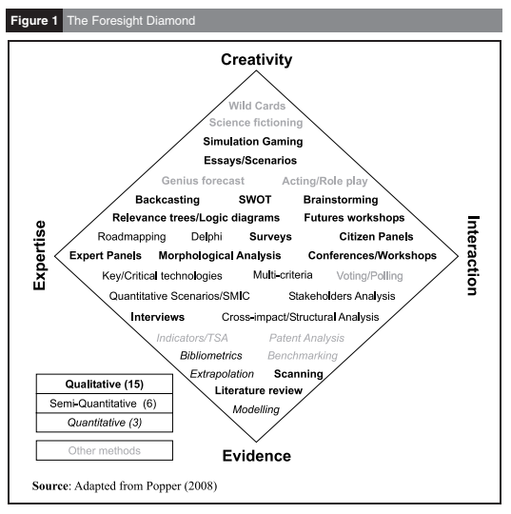
Natureza do método

Slide 7
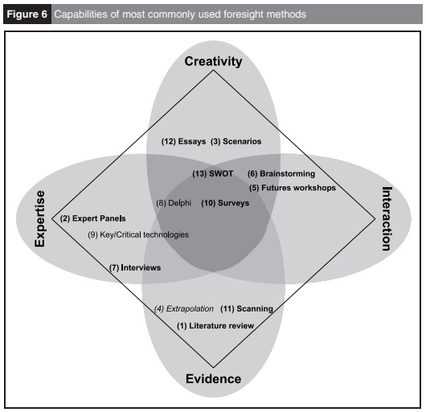
Capacidade do método

Slide 8
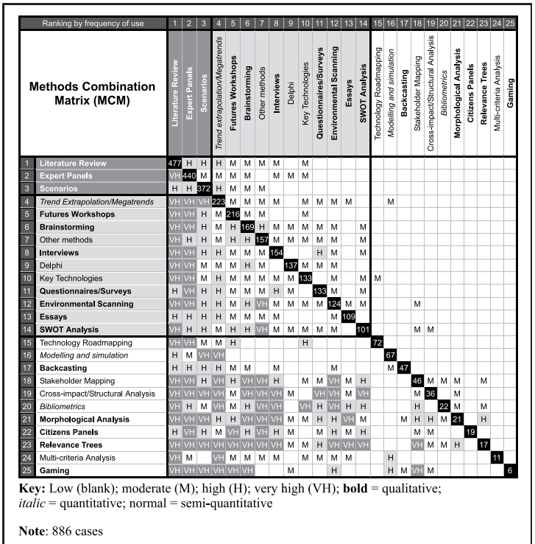
Método Mix

Slide 9
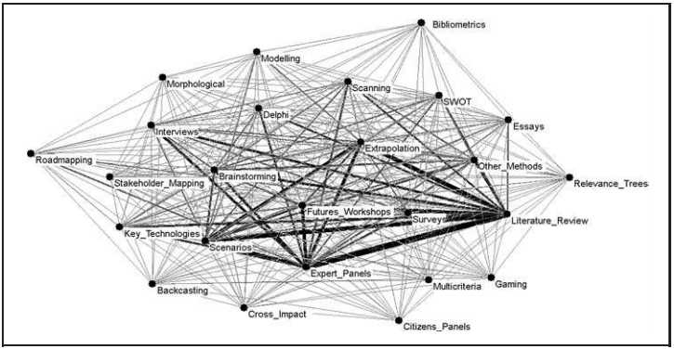
Método Mix

Slide 10
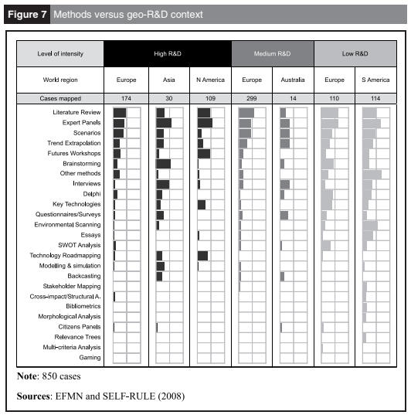
Contexto geo-P&D

Slide 11
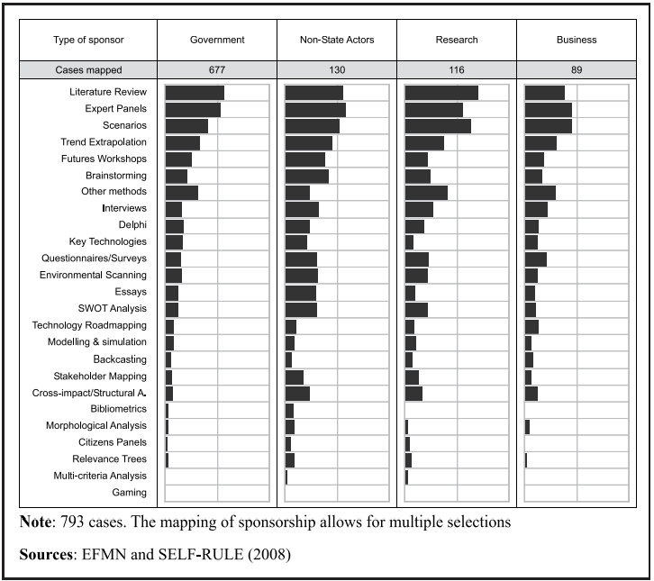
Patrocinador

Slide 12
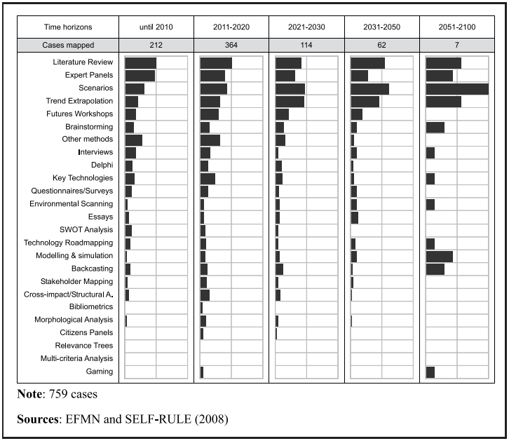
Horizonte

Slide 13
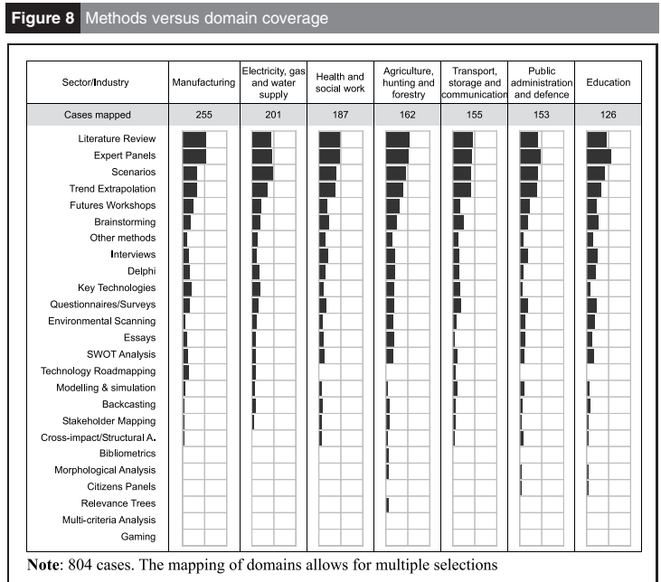
Setor

Slide 14
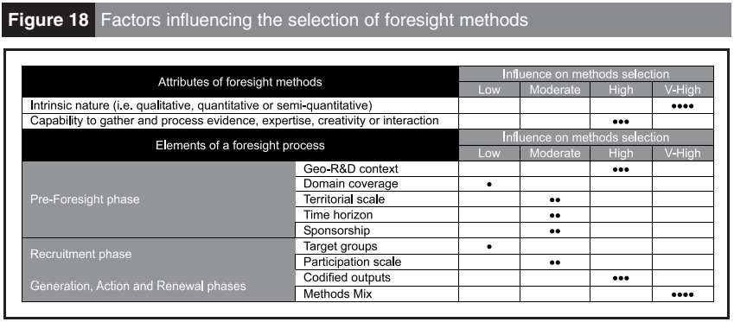
Conclusão

Slide 15
