Slide 1
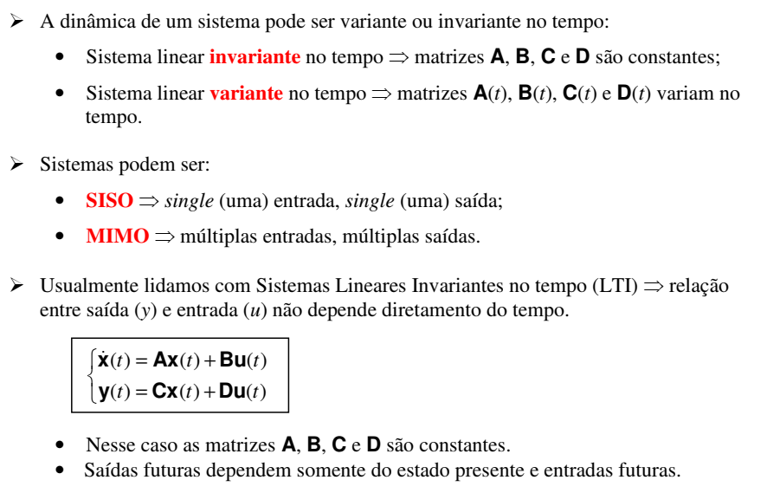
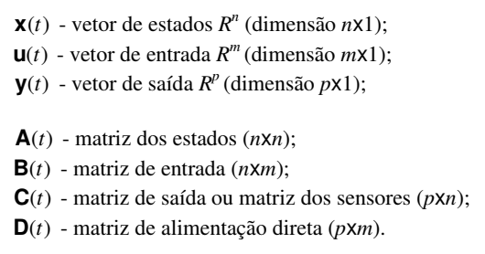
Créditos dos Slides: Prof. Eduardo L. Cabral

Slide 2
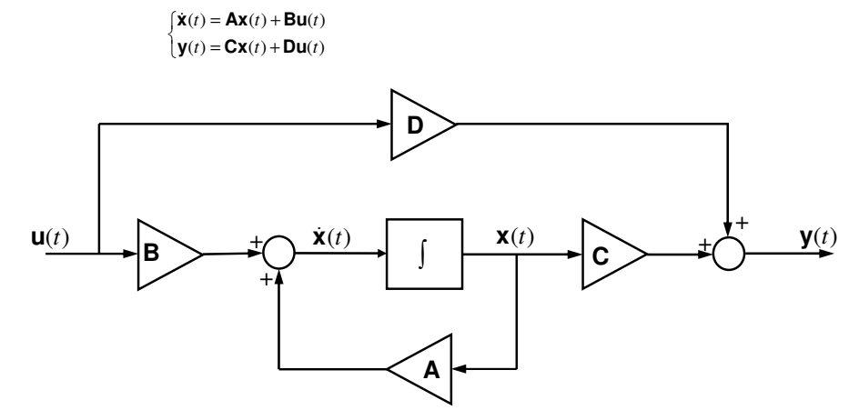
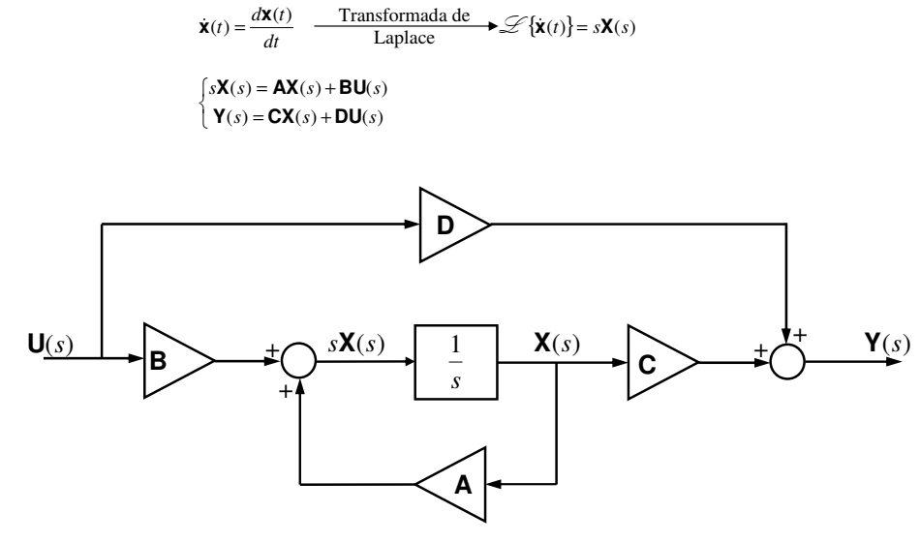

Slide 4
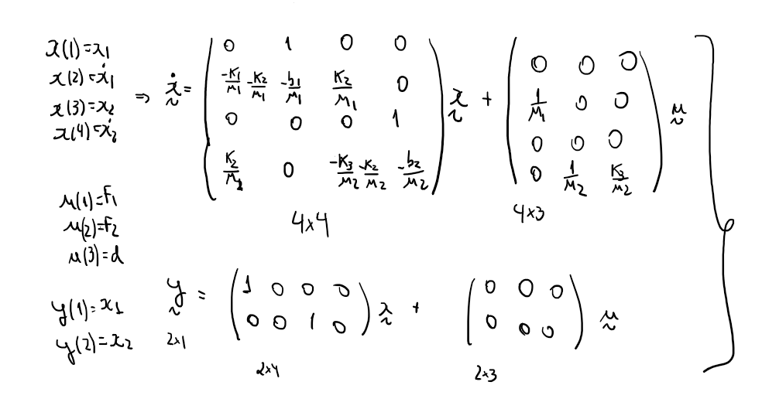

Slide 5
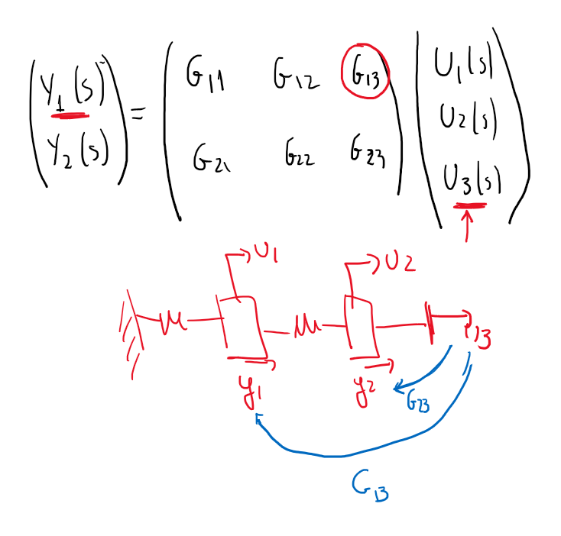

Slide 6
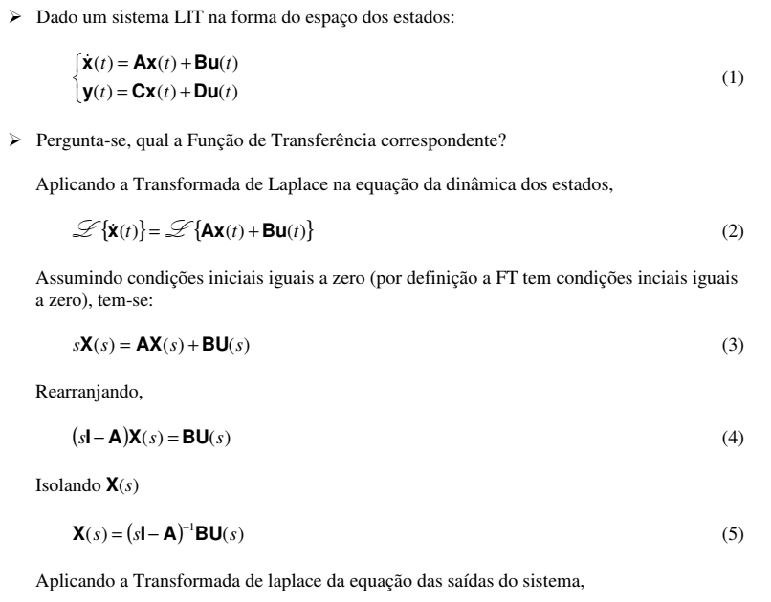
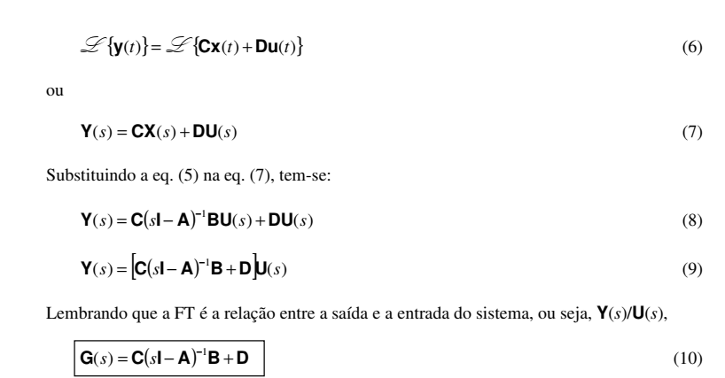
Transformação SS - TF

Slide 7
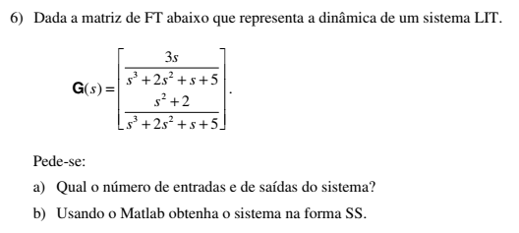
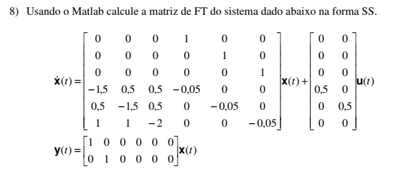
Transformação SS - TF

Slide 8
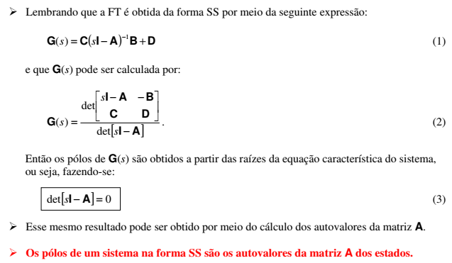
Polos

Slide 9
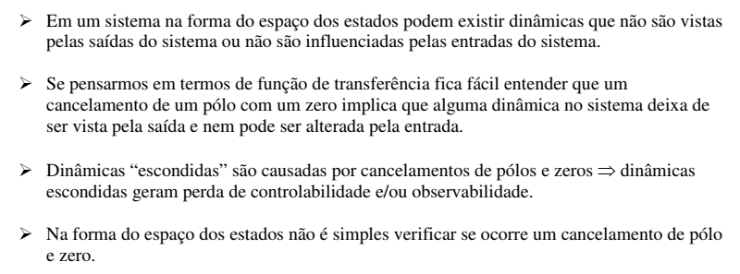
Controlabilidade e Observabilidade

Slide 10
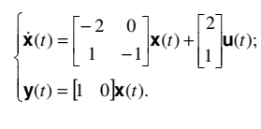
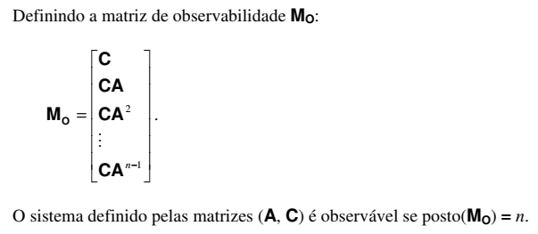
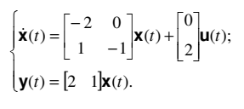
Controlabilidade e Observabilidade

Slide 11
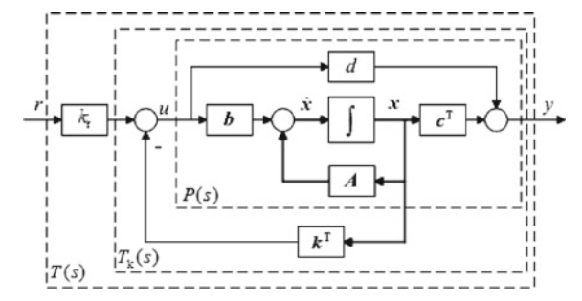
Controle por alocação de pólos
Caso SISO
Requisitos de malha fechada:
Erro em regime nulo
Malha fechada

Slide 12
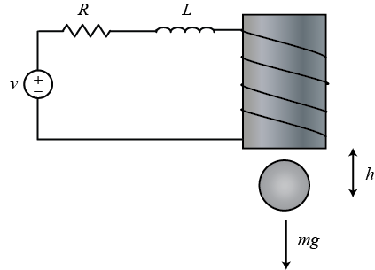
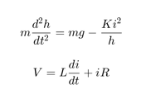
http://ctms.engin.umich.edu/CTMS/index.php?example=Introduction&section=ControlStateSpace

Slide 13
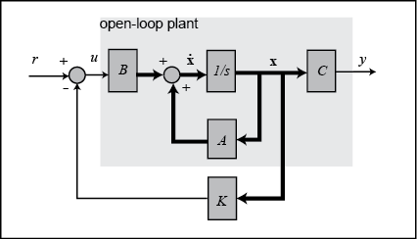
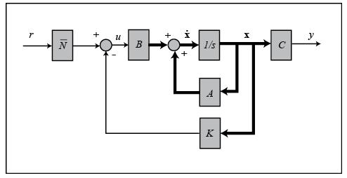
+r
+Br
Suppose the criteria for the controller were settling time < 0.5 sec and overshoot < 5%, then we might try to place the two dominant poles at -10 +/- 10i (at zeta = 0.7 or 45 degrees with sigma = 10 > 4.6*2). The third pole we might place at -50 to start (so that it is sufficiently fast that it won't have much effect on the response)

Slide 14
Controle ótimo

