Slide 1
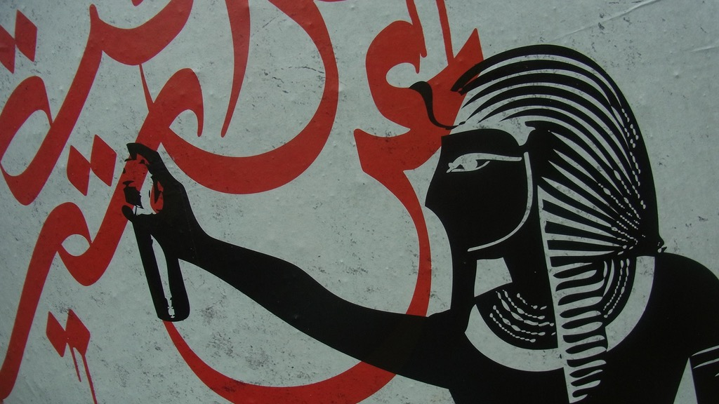
Major Themes in Contemporary Middle East
LECTURE 13.
REGIONALISM AND EXTERNAL POWERS IN THE 21ST CENTURY

Slide 2
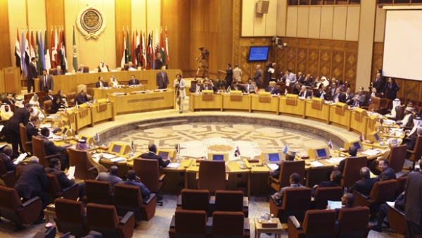
Regionalism in the Middle East

Slide 3
Regions and Regionalism
Region: From a geographic reality-–a continent, a cluster of states or territories sharing a common space on the globe—to a more imagined community held together by common experience, identity and custom.
Regionalism: A conscious, coherent and top-down policy of states, as well as sub-state and non-state actors, coordinating arrangements and activities in a particular part of the world → Institution-building
Regionalisation: A spontaneous, complex, bottom-up and often haphazard process of socio-economic interdependence within a loosely defined geographic area → family links, migration patterns, trade and capital flows, cross border media usage, etc.

Slide 4
Regionalism
Institution-building
Interdependence
Regionalisation

Slide 5
Regions and Regionalism
Why do states build regional alliances?
Realist: It is in their self-interest to do so. Regional groups are security maximisers. Strong states are often key agents in this process, although weaker states also seek alliances to consolidate strength or balance opposing powers.
Liberal Institutionalists: Cooperation rewards all involved actors, allows states to overcome large problems collectively, creates positive norms.
Constructivists: Shared values and identities promote regionalism (and in turn are boosted by it)

Slide 6
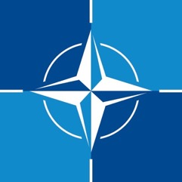
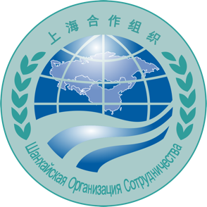
Regions and Regionalism
Regional Organisations

Slide 7
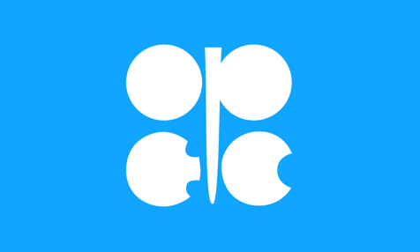
Regional cooperation in the M.E.
Regional Organisations in the Middle East

Slide 8
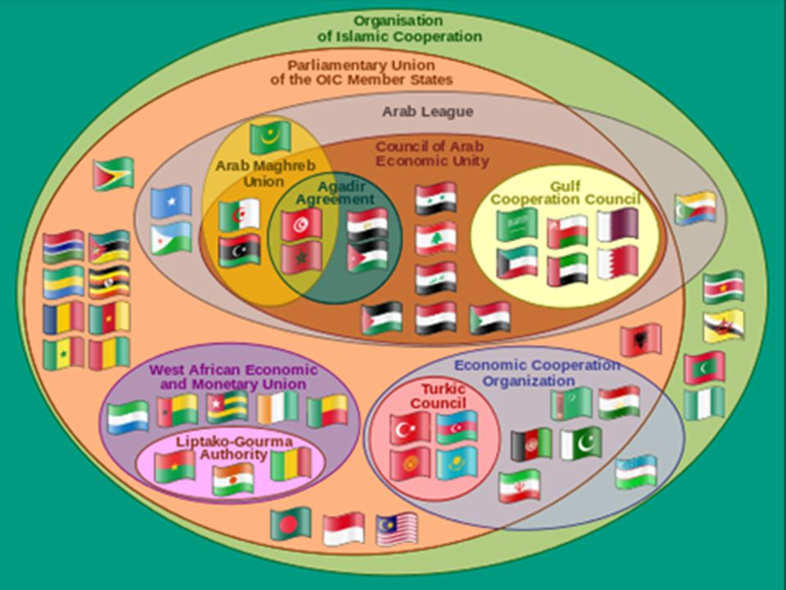
How important are they?

Slide 9
Regional cooperation in the M.E.
Regionalism has been historically weak in the Middle East.
Emphasis on bilateral relations and transient alliances rather than institutionalised multilateral/regional arrangements.
There is no Middle East equivalent of the EU, AU, ASEAN or OAS.
Limited free trade agreements, no common security framework or a core community of shared ideals.
Why?

Slide 10
Regional cooperation in the M.E.
Why is there no Middle East Union?
Middle East (or MENA) an ambiguous (externally defined) region
Low level of interdependence (esp. low interregional trade)
No hegemons
Persistent rivalries (competing agendas, identities and regime types)
Regime insecurity (weak legitimacy, fear of losing sovereignty)
Wealth disparities (energy-rich vs. energy-poor countries)
External actors imposing their security agendas, deepening divisions
Intra-MENA trade less than 10%
Mostly focused energy imports/exports
Intra-EU trade more than 60%
Main trade partners abroad
Traditionally Europe, increasingly China
Asia 55% of region’s trade (up from 40% in 1999)

Slide 11
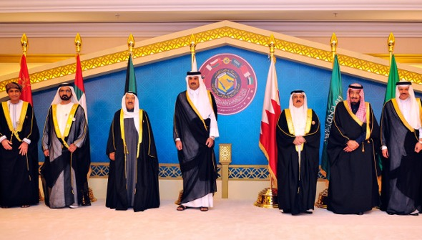
Regional cooperation in the M.E.
Gulf Cooperation Council (GCC)
An exception to the rule?
Founded in 1981. Survived both Gulf Wars, the end of Cold War, the Oslo Accords and the Arab Spring.
Members: Saudi, UAE, Kuwait, Bahrain, Qatar, Oman.
Customs Union in 2002; GCC Union proposed in 2012.

Slide 12
Regional cooperation in the M.E.
Gulf Cooperation Council (GCC)
A hegemon (Saudi Arabia)
Shared identities (Sunni Arab tribal families)
Shared regime types (conservative monarchies, rentier states)
Shared interests (trade maximisation, energy exports, good relations with the US)
Shared insecurities (Iraq under Saddam, Iran, popular uprisings)

Slide 13
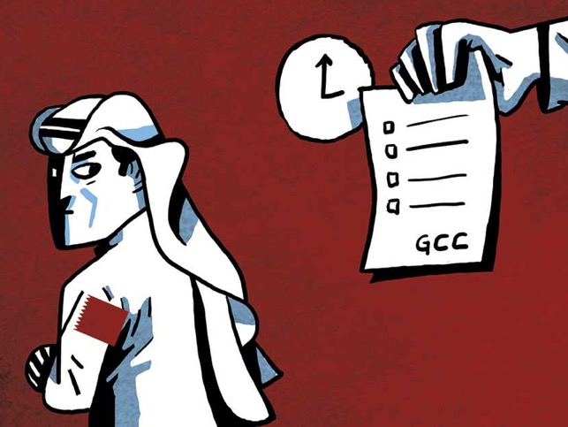
Regional cooperation in the M.E.
Gulf Cooperation Council (GCC)
An intra-GCC crisis
Qatar’s independent foreign policy ambitions, alliance with Turkey, support for Muslim Brotherhood and improved ties with Iran challenge Saudi (and UAE) hegemony and interests.
GCC members (except Oman) + Egypt, Jordan, Libya, Yemen) cut off diplomatic ties, issued sanctions and a blockade in 2017
Qatar rejected Saudi—UAE ultimatum. Kuwait offered mediation. Standstill continues.

Slide 14
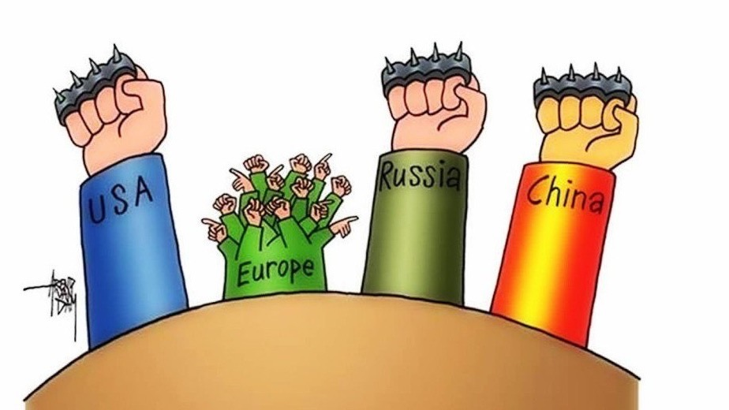
External actors and the Middle East

Slide 15
United States
Pre-WWII
“Trusted Foreigner”
No colonial history
Wilson Principles
Howard Baskerville in Iran
Cold War
Indirect pursuit of strategic interests
Containing USSR
Truman Doctrine, NATO
Support for coups
Oil interests
Support for Israel
Post-Cold War
Bush Sr. to Bush Jr.
Liberal triumphalism
”The American Century”
Democracy by force
Influence of Evangelicals, Neo-Cons, Gulf & Israeli lobbies
Direct military involvement:
Iraq 1991
Somalia 1992
Afghanistan 2002
Iraq 2003
Conflict w/ Iran
Post-2009
Obama years
Withdrawal due to costly wars + energy independence
Negotiation with Iran
Ambiguous role in Arab Spring
NATO operation in Libya
Reluctance in Syria
Support for Sisi coup in Egypt
Post-2016
Trump years = Unpredictability
Return of the Evangelical + Neo-Con coalition
Extreme Pro-Netanyahu & MBS
No clear strategy in Syria
Withdrawal from 2015 nuclear deal
War with Iran?

Slide 16
Europe
Pre-WWII
History of colonisation
Role in the making of the post-Ottoman M.E.
Continued resentments and legacy
Cold War
End of the European colonial era → Suez Canal Crisis
Europe a divided front of CW itself
Limited impact on the region
Post-Cold War
EU rising as a western alternative to the US
Soft Power: trade, culture, education, good gov., regional integration
EU Neighborhood Policy
1995: Euro-Mediterranean Partnership
2008: Union for the Mediterranean
Lack of common foreign and security policy
Divisions over Turkey’s membership; Iraq War 2003
Post-2008
Europe turning inwards
Socio-economic crisis since 2008
Refugee inflows & terror attacks trigger deep identity crises
Rise of the populist right
Brexit

Slide 17
For the United States, the Middle East is primarily a strategic issue.
Geographic distance, limited demographic exchange
Limited popular exposure, knowledge and prejudice
Part of foreign policy agenda (Iraq, Afghanistan)
(Exception: Israel)
For Europe, it is a popular and emotional issue:
Geographic proximity, deep running historical ties cultural and demographic exchange
Greater popular exposure, knowledge and prejudice
Part of domestic political agenda (refugees, minorities, European identity)

Slide 18
Russia
Imperial Russia
Legacy of imperial expansion
Attempts to reach the Mediterranean
Wars with Iran, Ottoman Empire
Cold War
Interest in southern border (TR, IR, AFG)
Ideological influence
Limited direct involvement (except: occupation of Afghanistan 1979)
Allies but no proxies (except South Yemen)
No energy interests
Soviet military advisors and weapons sales
1990s
Post-Cold War withdrawal
Support for First Gulf War 1991
Maintain military base in Syria
21st Century
Resurgent under Putin
Trade links with Turkey, Iran, Gulf states
Energy cooperation & arms deals
Direct role in Syrian war
Disrupter rather than hegemon: Limited economic capacity to replace the US
Used by M.E. states as alternative to the West

Slide 19
China
Historical ties
The Silk Road started in China ended in the Middle East
Mao years
Limited involvement
Ideological alternative to the USSR
Post-Mao
1978 – 1991
First diplomatic relations
Modest trade ties
1991 – 2008
Chinese growth sets off
Thirst for oil
Post-2008
Massive economic footprint in the Middle East
Need for oil and markets for its products
Benefiting from the US withdrawal
First military base in Djibouti (Red Sea) to protect energy interests
Belt and Road Initiative (BRI) a.k.a. “the New Silk Road”
Most ambitious global plan since the Marshall Fund
Massive investment in infrastructure, construction, technology
Only in 2018, $23 billion in aid and loans to Arab countries + $28 billion in investment
Non-interference principle: Aid without strings
Appealing to autocrats
Allows China to deal with regional rivals (Saudi, Qatar, Iran, Israel all do business with China)

Slide 20
Looking ahead…
US: Unpredictable, unreliable, too deeply involved, unpopular
Europe: Dazed and confused
Russia: Limited capacity
China: the next hegemon?
Chinese-style authoritarian capitalism: a role model to the region?
Is the policy of non-interference sustainable?
China’s own horrendous treatment of Muslims an obstacle? (Seemingly not)

Slide 21
THANK YOU!!!

