Slide 1
Major Themes in Contemporary Middle East
LECTURE 6.
ISRAELI – PALESTINIAN CONFLICT

Slide 2
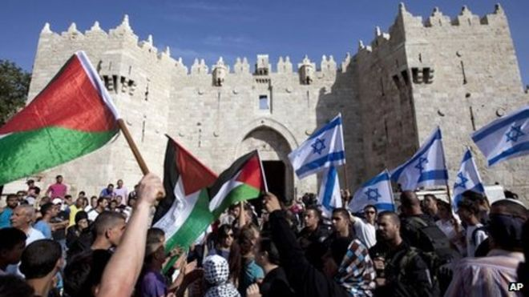
Israel & Palestine

Slide 3
Israel & Palestine
Explain to an alien the Israeli-Palestinian issue in ONE SENTENCE?
Now write down what it is about in ONE WORD…

Slide 4
Israel & Palestine
Religion
Nationalism
Ideology
Colonialism
Recognition
Resources
Demographics
Refugees
Outside powers
…above all:
LAND
Explain to an alien the Israeli-Palestinian issue in ONE SENTENCE?
Now write down what it is about in ONE WORD…

Slide 5
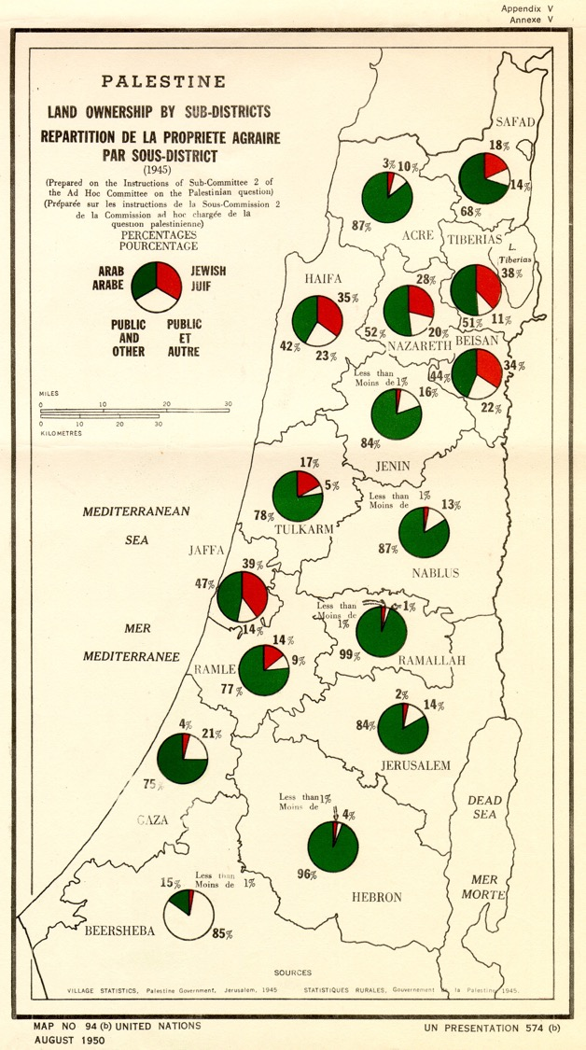
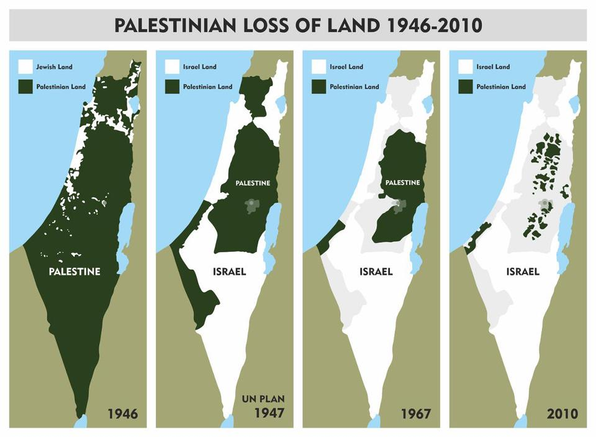
A Land Dispute

Slide 6
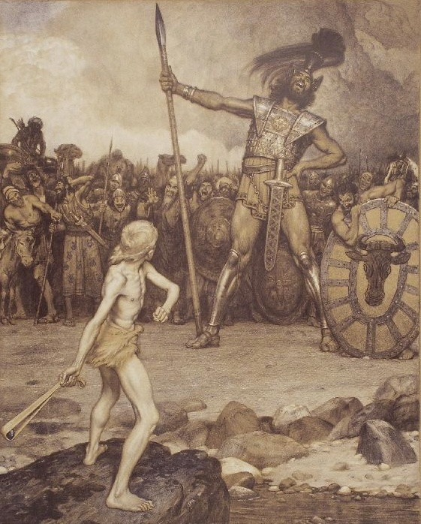
A Clash of Narratives
Who is David, who is Goliath?
Pre- and post-1967 narratives
Orientalism
Lewis vs Said
“David and Goliath”
Osman Schindler (1888)

Slide 7
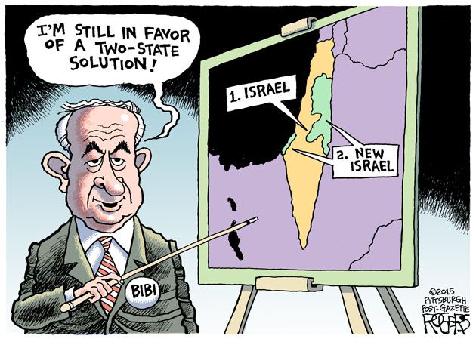
Israel & Palestine
What are the proposed solutions?
Two state solution
One state solution?
Status Quo…

Slide 8
The Israeli Trilemma
Jewish
state
Status Quo
“Apartheid State”
Two State Solution
Control over all Land
Democracy
One State Solution

Slide 9
Arab (Palestinian) fragmentation
SECULAR RELIGIOUS
Ottoman Palestine | British Palestine | Arab – Israeli Wars | Sub-state conflicts | Oslo Accords | Post Oslo Status Quo
1917 1897 | 1947 1920 | 1973 1967 1956 1948 | 1987 1985 – 2000 1978 1975 – 90 1974 | 2000 1995 1994 1993 1991 1990 | 2017 - … 2014 2012 2010 - … 2009 - 16 2008 – 09 2007 2006 2005 2003 2002 2001 2000 - 05
Balfour Declaration The World Zionist Org. | UN Partition Plan British Mandate | Yom Kippur War Six-Day War + UN Res 242 Suez Crisis First Arab Israeli War | First Intifada + Hamas est. Israeli occupation of Lebanon Egypt – Israel Peace Lebanese Civil War Arab League Summit (Rabat) | Failure at Camp David OSLO II Jordan – Israel Peace OSLO I Madrid Conference End of CW + Gulf War | Trump presidency Gaza War Gaza War Arab Spring + Syrian war Obama presidency Gaza War Blockade of Gaza Hamas wins Gaza elections Unilateral Gaza withdrawal US invasion of Iraq Building of Separation Wall 9/11 + “War on Terror” Second (’al Aqsa’) Intifada

Slide 10
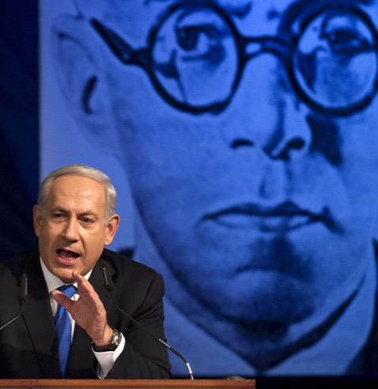
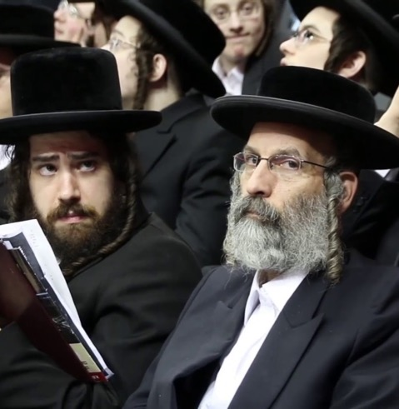
Actors & Ideologies
SECULAR RELIGIOUS
ISRAEL | Labor Zionism Kibbutzim Socialist economy “Two-State solution” Urban bourgeoisie | 1977 Likud victory 1973 Likud established 1967 Six Day War | Revisionist Zionism Ze’ev Jabotinsky Market economy Territorial Maximalism No deal with Palestinians | Ultra-orthodox Judaism Extreme social conservatism Settlements Rapid population growth

Slide 11
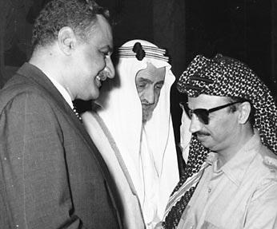
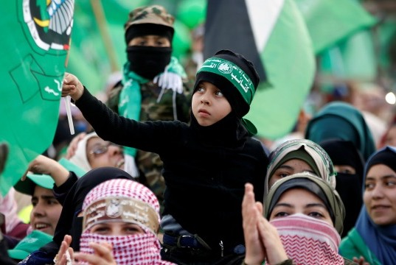
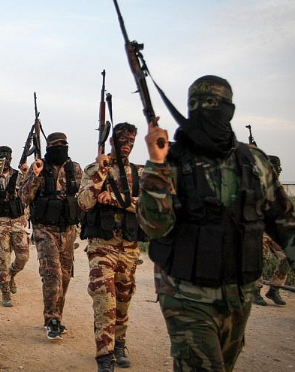
Actors & Ideologies
SECULAR RELIGIOUS
ISRAEL | Labor Zionism | Revisionist Zionism | Ultra-orthodox Judaism
PALESTINE | Arab Socialism Egypt (Nasser) Syria (Baath) PLO (Arafat) | 1979 Islamic Revolution 1967 Six Day War | Islamism Hamas (Muslim Bros.) Iran Turkey (AKP) | 2011 Syria war 2003 Iraq invasion 2001 War on Terror | Salafi Jihadism Islamic Jihad Al-Qaeda Islamic State

Slide 12
Actors & Ideologies
SECULAR RELIGIOUS
ISRAEL | Labor Zionism | Revisionist Zionism | Ultra-orthodox Judaism
PAL | Arab Socialism | Islamism | Salafi Jihadism
USA | Even handed approach Importance of Arab oil Suspicions of “Socialist Israel” Suez Crisis (1956) | 2001 War on Terror 1978 Islamic Revolution | Rise of Christian Zionism Unconditional support to Israel “Israel as a Biblical prophecy” + Israel Lobby
1967 Six Day War
Why is the Six Day War such an important turning point?

Slide 13
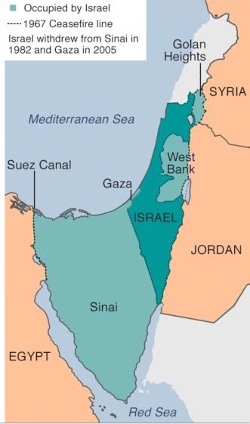
UN Resolution 242
Security Council Resolution drafted by the British in the aftermath of the Six Day War
Establishes the “Land for Peace” formula that forms the basis of future negotiations
Egypt (1978)
Jordan (1994)
PLO (1993, 1995)
Ambiguous wording:
“(i) Withdrawal of Israeli armed forces from territories occupied in the recent conflict;”
Not “from the territories” or “from all territories”

Slide 14
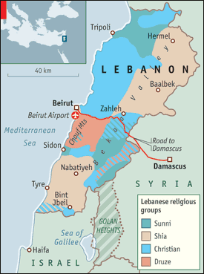
Lebanese Civil War (1975 - 1990)
Lebanon a microcosm of the Middle East
Ethnic and religious diversity, cause of instability in a nation-state framework
Under French mandate: Minority Christian Maronites empowered, majority Shias disempowered
Today: Communitarian democracy
President: Maronite Christian
Prime Minister: Sunni Muslim
Speaker of Parliament: Shia Muslim

Slide 15
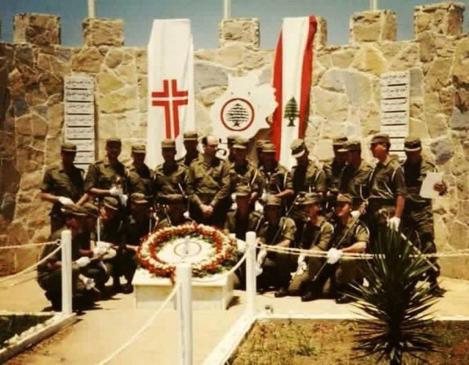
Lebanese Civil War (1975 - 1990)
Phalangist militias
PLO’s relocation from Jordan and presence of Palestinian refugees source of instability
Creation of Maronite militias (Phalange Party) in alliance with Israel against PLO
Maronite leader Bashir Gemayel’s presidential ambitions
Israeli desire to curb PLO influence in West Bank
Massacres at Sabra & Shatila refugee camps (1982)
Israel occupies South Lebanon (1985 – 2000)
Hizbullah est. in response to occupation (1985)
Waltz with Bashir (2008)

Slide 16
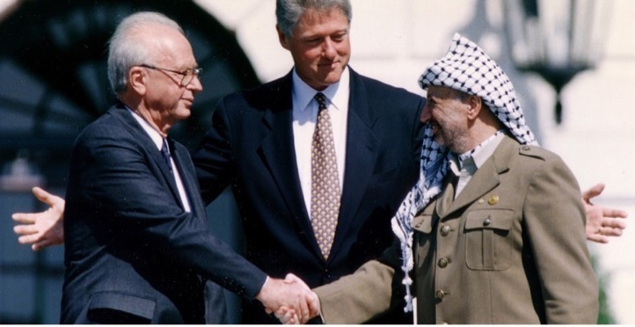
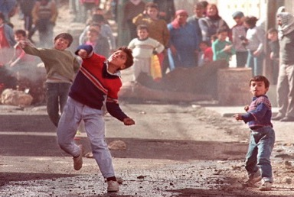
Oslo Accords (1990 - 2000)
Rabin, Clinton & Arafat (1993)
Why now?
What’s on the table?
What happened?
Why did they collapse?
First Palestinian Intifada

Slide 17
Oslo Accords (1990 - 2000)
Rabin, Clinton & Arafat (1993)
Why now?
End of the Cold War
Arab, Israeli cooperation w/ US against Saddam Hussein in 1990
Madrid Conference 1991
The First Palestinian Intifada (1987 – 1993)
Uprising or “Shuddering”
https://www.youtube.com/watch?v=xTZTY_1y2w8
Return of Labor (Rabin & Peres) in 1992
“Demographic time bomb”
Two State Solution
First Palestinian Intifada

Slide 18
Oslo Accords (1990 - 2000)
Rabin, Clinton & Arafat (1993)
What’s on the table?
Recognition
Status of Jerusalem
Right to return of refugees
Border issues
Settlements in occupied territories
First Palestinian Intifada

Slide 19
Oslo Accords (1990 - 2000)
What happened?
Oslo I (1993)
Mutual recognition
Legitimacy to Israel and PLO
Vision of a two-state solution
No concrete agreements
Vital issues delayed
Timeline for further agreements
The Logic
“Land for Peace”
Two Track negotiations
Israeli-Arab
With Syria over Golan (progress; no outcome)
With Jordan over West Bank (1994 peace deal)
With Lebanon
Israeli-Palestinian
Officially w/ Palestinian reps.
Unofficially with PLO in the backdoor
Oslo II (1995)
Greater promise of Palestinian autonomy
Division of Palestine to three categories: A, B, C
1/3 of occupied territory yielded to PLO
Palestinian elections
Limited withdrawal of IDF
Camp David (2000)
Barak offers concessions beyond Israeli “red lines” but short of full Palestinian sovereignty
”Take it or Leave it”
Arafat refuses the offer
Talks collapse

Slide 20
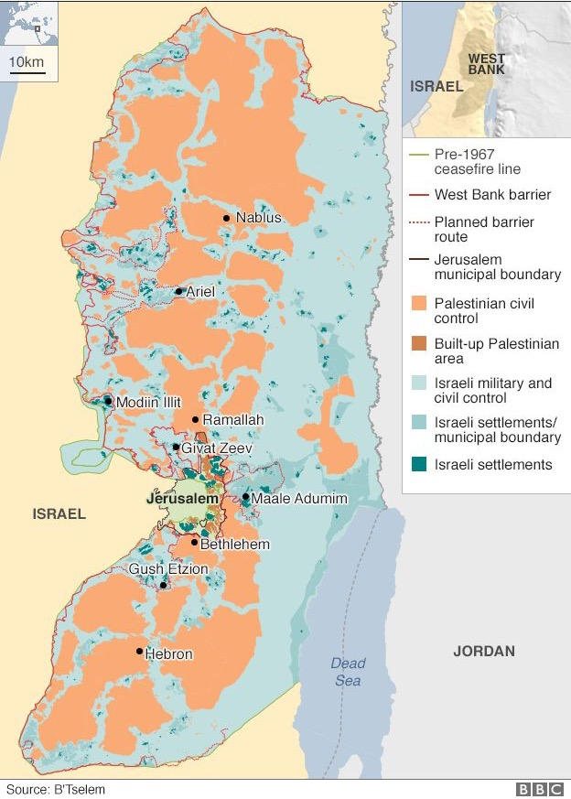
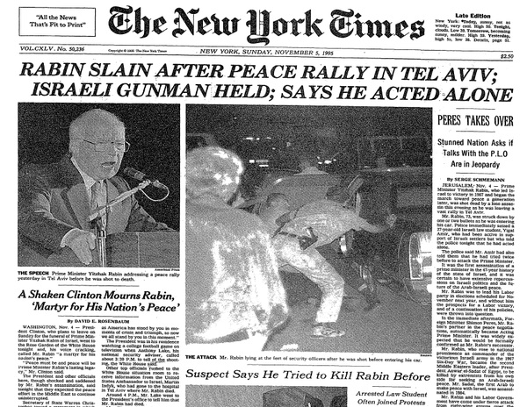
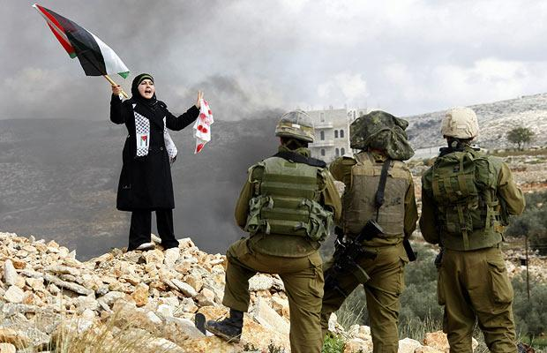
Oslo Accords (1990 - 2000)
Why did they collapse?
Opposition
Likud, Hamas, Islamic Jihad
Rabin and Arafat declared traitors
Rabin assassinated in 1995
Popular support wanes over the years
Continued Settlement building
https://www.youtube.com/watch?v=E0uLbeQlwjw
Imbalance of Powers
Little incentive for Israel to make concession
Limited ability of Palestinians to force concessions
Role of regional/global actors

Slide 21
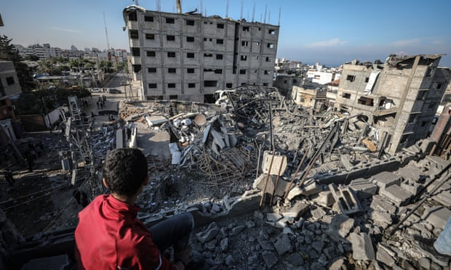
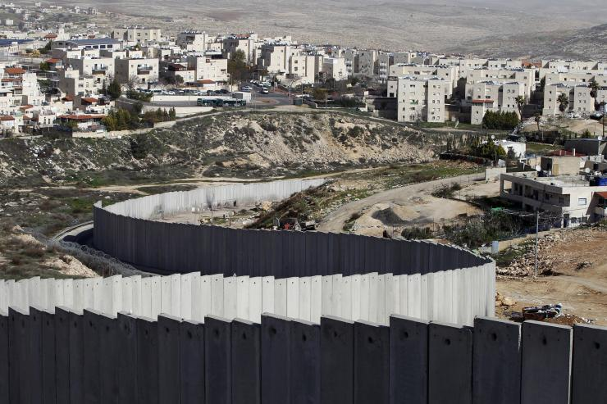
Post-Oslo Status Quo
Local
Context
Diminished hope for a resolution on both sides
Occupation a source of resentment, radicalisation & violence for both sides
Gaza, under blockade and repeatedly bombarded since 2007, an “open air prison”
Regional
Context
International Context
Destruction in Gaza
Israeli Wall of Separation (West Bank)
2003

Slide 22
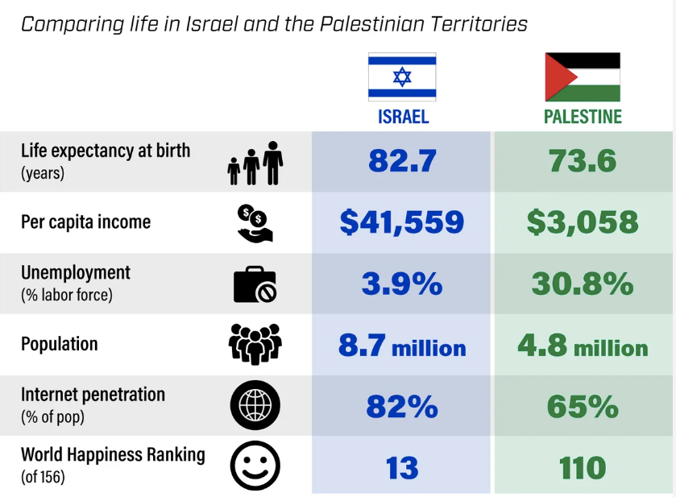
Post-Oslo Status Quo
Local
Context
Regional
Context
gzeromedia.com
Sources: WB, IMF, World Happiness Index, International Telecom Union
International Context

Slide 23
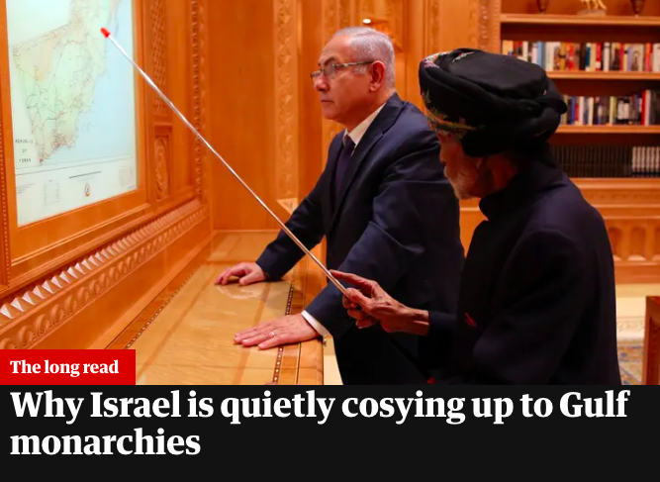
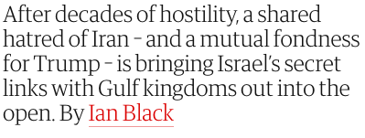
Post-Oslo Status Quo
Local
Context
Source of regional instability and conflict
Overshadowed by “Arab Spring” divisions, Iran – Saudi rivalry
Regional
Context
International
Context

Slide 24
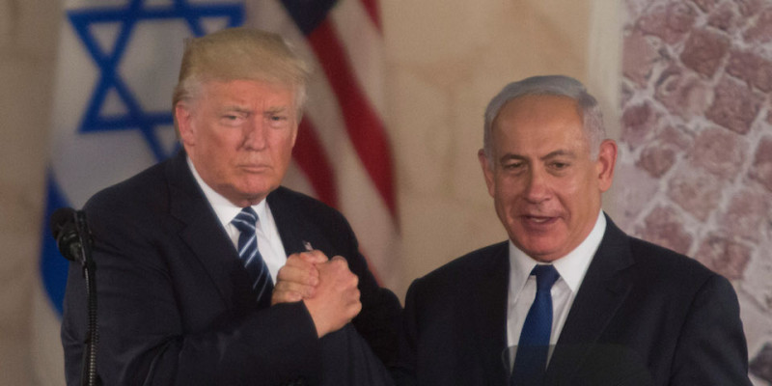
Post-Oslo Status Quo
Local
Context
Unquestioning support for Israel in the US Congress
Undermined Obama efforts to stop settlements, make deal with Iran
Trump, Evangelicals, extend unconditional support to Netanyahu
Regional
Context
International
Context

Slide 25
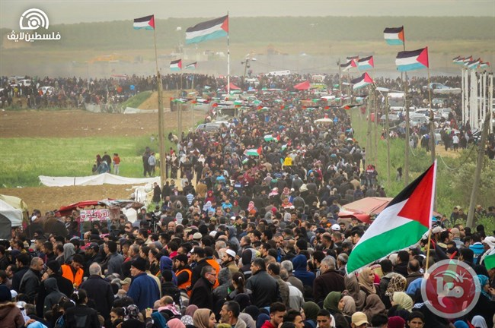
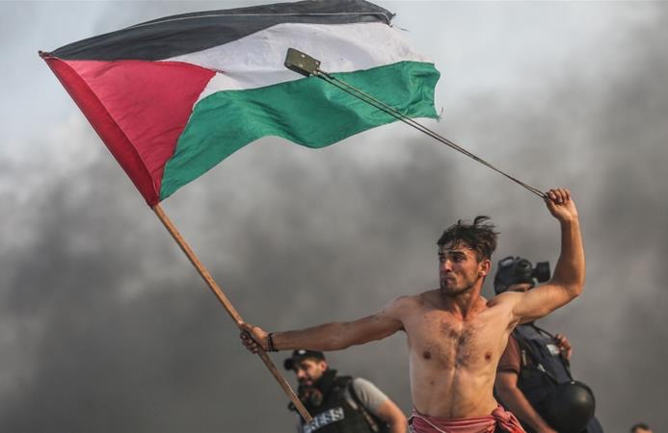
How to change the status quo?
Violence vs. non-violence: What’s right; what’s effective?
“The Great March of Return”

Slide 26
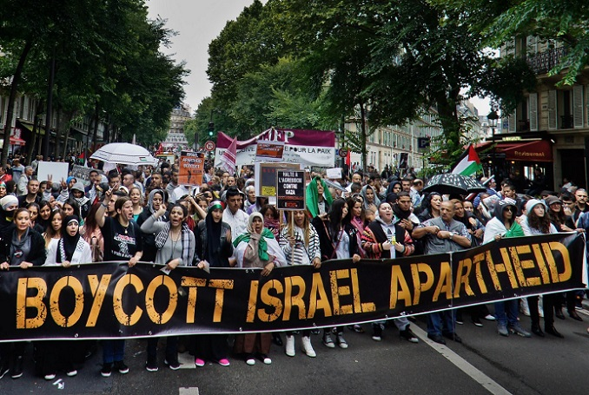
How to change the status quo?
Violence vs. non-violence: What’s right; what’s effective?
Boycott, Divestment and Sanctions (BDS) Movement

Slide 27
Response paper # 1
”In your view, what is a just and sustainable solution to the Israeli-Palestinian conflict and the most effective way to achieve it?”
1,000 word essay
To be submitted next week before class (i.e. 13h00, 17 April)
Be careful about:
Structure (Intro, Body, Conclusion)
Referencing

Slide 28
https://www.youtube.com/watch?v=rH_d_L33V2s

