Slide 1


Molecular Mechanisms
of Learning and Memory
INTRODUCTION PROCEDURAL LEARNING
NONASSOCIATIVE LEARNING
Habituation Sensitization
ASSOCIATIVE LEARNING
Classical Conditioning Instrumental Conditioning
SIMPLE SYSTEMS:INVERTEBRATE MODELS OF LEARNING
NONASSOCIATIVE LEARNING IN APLYSIA
Habituation of the Gill-Withdrawal Reflex Sensitization of the Gill-Withdrawal Reflex
ASSOCIATIVE LEARNING IN APLYS IA
VERTEBRATE MODELS OF LEARNING
SYNAPTIC PLASTICITY IN THE CEREBELLAR CORTEX
Anatomy of the Cerebellar Cortex
Long-Term Depression in the Cerebellar Cortex M echanisms of Cerebellar LTD
SYNAPTIC PLASTICITY IN THE HIPPOCAMPUS
Anatomy of the Hippocam pus Properties of LTP in CA I
M echanisms of LTP in CA I
Box 25.1 Brain Food : Synaptic Plasticity: Timing Is Everything
Long-Term Depression in CA I
LTP, LTD, and Glutamate Receptor Trafficking LTP, LTD, and M emory
Box 25.2 Of Special Interest: Memory Mutants
THE MOLECULAR BASIS OF LONG-TERM MEMORY
PERSISTENTLY ACTIVE PROTEIN KINASES
CaM Kll and LTP
Box 25.3 Path of Discovery: A Memorable Walk on the Beach, by John E. Lisman
PROTEIN SYNTHESIS
Protein Synthesis and M emory Consolidation CREB and M emory
Structural Plasticity and M emory
CONCLUDING REMARKS

Slide 2
Molecular Mechanisms
of Learning and Memory
APRENDIZADO NÃO ASSOCIATIVO
HABITUAÇÃO
SENSITIZAÇÃO
APRENDIZADO ASSOCIATIVO
CONDICIONAMENTO CLÁSSICO
CONDICIONAMENTO OPERANTE

Slide 3
762
C H A P T E R 2 5
MOLECULAR MECHANISMS OF LEARNING AND MEMORY
'Y INTRODUCTION
An important first step in understanding the neurobiology of memory is identif ying where different types of informa tion are stored. As we saw in Chapter 24, answers to this question are beginning to yield to basic neuro­ scientific research. However, an equally important question concerns how information is stored. As Hebb pointed out (and as research using computer models has amply confirmed), memories can result from subtle alterations in synapses, and these alterations can be widely distribu ted in the brain. This helps narrow the search for a physical basis of memory-synaptic modifica tions-bu t it also raises a dilemma. The synaptic modifica tions that underlie memory may be too small and too widely distributed to be observed and studied experimentally.
These considerations inspired some resea rchers to study the nervous systems of simple invertebra te animals for insights about the molecular mechanisms of memory. Although such animals obviously aren't going to remember the definition of an isosceles triangle, they do display certain types of simple procedural memory. Invertebrate research has clearly shown that Hebb was right: Memories can reside in synaptic alterations. Moreover, it has been possible to identify some of the molecular mechanisms that lead to this synaptic plasticity. Although nonsynaptic changes have also been found that may account for some types of memory, invertebrate research leaves little doubt tha t the synapse is an important site of informa tion storage.
It would be disappointing if the best we could do was u nderstand how a sea slug learns. We really want to know how our own brain forms memories. Hope for this understanding now comes from the study of synaptic plastic­ ity in regions of the mammalian brain associated with diff erent types of memory. Theoretical work and invertebrate studies point to lasting alter­ ations in the effectiveness of synapses in the brain as a basis for memory. Therefore, researchers have used electrical stimulation of the brain to pro­ duce measurable synaptic alterations whose mechanisms can be studied. One of the interesting conclusions of this research is tha t the mechanisms of activity-dependent synaptic plasticity in the adult brain have much in common with those opera ting during development for wiring the brain. Another conclusion is that the basic molecular mechanisms in the mam­ malian brain tha t alter synaptic effectiveness are quite similar to memory forma tion mechanisms in invertebrates.
There is a growing sense of optimism among neuroscientists that we may soon know the physical basis of memory. This investigation has benefited
from the combined approaches of researchers in disciplines ranging from psychology to molecular biology. In this chapter, we take a look at some of their discoveries.
'Y PROCEDURAL LEARNING
Recall tha t declarative memories have a certain ethereal quality. They are easily formed and easily forgotten, and they may result from small modifi­ cations of synapses that are widely distributed in the brain. These charac­ teristics make this type of memory particularly challenging to study at the synaptic level. However, procedural memories have characteristics that make them more amenable to investiga tion. Besides the fact that these memo­ ries are particularly robust, they can be formed along simple reflex path­ ways tha t link sensations to movements. Proced ural learning involves learning a motor response (procedu re) in reaction to a sensory input, and

Slide 4
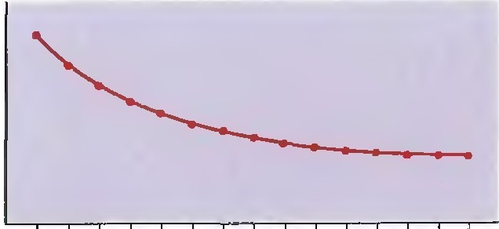

T" PROCEDURAL LEARNI NG
763
it is typically broken down into two categories: nonassocia tive learning and associative learning.
Q)
(/)
c:
0
Cl.
(/)
Nonassociative Learning
Nonassociative learning describes the change in the behavioral response that occurs over time in response to a single type of stimulus. There are two types: habitua tion and sensitization.
Q)
a:
(a)
5 10
Stimulus number
15
Habituation. Suppose you live in a house with a single telephone. When the phone rings, you run to answer it. But every time you do, the call is for someone else. Over time, you stop reacting to the ringing of the phone and eventually no longer even hear it. This type of learning, habituation, is learning to ignore a stimulus that lacks meaning (Figure 25. la). You are habituated to a lot of stimuli. Perhaps as you read this sentence, cars and trucks are passing by outside, a dog is ba rking, your roommate is playing U2 for the hund redth time-and all this goes on without you r really noticing. You have habitua ted to these stimuli.
Q)
(/)
c:
0
Cl.
(/)
Q)
t
a:
5
10
15
(b) Stimulus number
FIGURE 25.1
Types of nonassociative learning.
(a) In habituation. repeated presentation of
the same stimulus produces a progressively smaller response. (b) In sensitization, a strong stimulus (arrow) results in an exaggerated response to all subsequent stimuli.
Sensitization. Suppose you're walking down the sidewalk on a well-lit city street at night, and suddenly there is a blackou t. You hear footsteps behind you, and though normally this wouldn't disturb you, now you nearly jump out of your skin. Car headlights appear, and you react by side­ stepping away from the street. The strong sensory stimulus ( the blackou t) caused sensitization, learning to intensif y your response to all stimuli, even ones that previously evoked little or no reaction ( Figure 25.l b).
Associative Learning
During associative learning, we form associations between events. Two types are usually distinguished: classical conditioning and instrumental conditioning.
Classical Conditioning . This type of learning was discovered and charac­ terized in dogs by the famous Russian physiologist Ivan Pavlov around the tum of the nineteenth century. Classical conditioning involves associat­ ing a stimulus tha t evokes a measura ble response with a second stimulus that norma lly does not evoke this response. The first type of stimulus, the one that normally evokes the response, is called the unconditional stimulus ( US) because no training (conditioning) is required for it to yield a response. In Pavlov's experiments, the US was the sight of a piece of mea t, and the response was salivation by the dog. The second type of stimulus, the one that normally does not evoke this same response, is called the conditional stimulus (CS) because this one req uires training (conditioning) before it will yield this response. In Pavlov's experiments, the CS was an auditory stimu­ lus, such as the sound of a bell. Training consisted of repeatedly pairing the sound with the presenta tion of the mea t ( Figure 25.2a ). Af ter ma ny of these pairings, the mea t was withheld, and the animal salivated to the sound alone. The dog had learned an associa tion between the sound (CS) and the presenta tion of mea t (US); the dog learned that the sound predicted the meat (Figure 25.2b). The learned response to the conditioned stimulus is called the conditioned response (CR).
It is importa nt to u ndersta nd tha t there are certain timing req uirements in successful classical conditioning. Conditioning will occur if the US and CS are presented simultaneously, or if the CS precedes the US by a short
Não condicionante
Condicionante

Slide 5
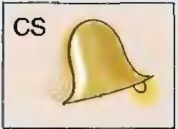



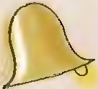
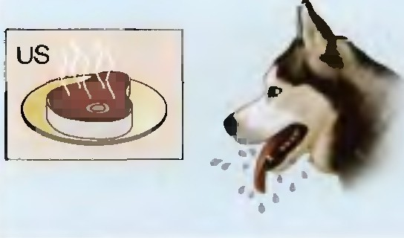
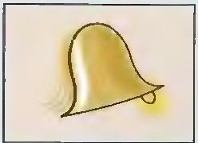

764
C H A P T E R 2 5 •
MOLECULAR MECHANISMS OF LEARNING AND MEMORY
Stimulus Response
Before conditioning
Stimulus
Response
Conditioning
+
After conditioning CR
(a)
(b)
FIGURE 25.2
Classical conditioning. (a) Before conditioning. the sound of a bell (the conditional stim­ ulus, CS) elicits no response. in sharp contrast to the response elicited by the sight of a piece of meat (the unconditioned stimulus, US). (b) Conditioning entails pairing the sound of the bell with the sight of the meat. The dog learns that the bell predicts the meat.
interval. However, if the CS precedes the US by too much, the conditioning will be much weaker or absent. Conditioning typically does not occur if the CS follows the US. The synaptic mechanism of classical conditioning will have to account for these stringent timing req uirements.
Instrumental Conditioning. This type of associative learning was dis­ covered and studied by Columbia University psychologist Edward Thorndike early in the last century. In instrumental conditioning, an individual learns to associate a response, a motor act with a meaningf ul stimulus, typically a reward such as food. As an example, consider what happens when a hungry rat is placed in a box with a lever that dispenses food. In the course of exploring the box, the rat bumps the lever, and out pops a piece of food. After this happy accident occurs a few more times, the rat learns tha t pressing the lever leads to a food reward. The rat will then work the lever (and eat the food) until it is no longer hungry. This should sound familiar. Recall from previous chapters experiments in which monkeys were trained to make responses as subtle as saccadic eye movements in order to receive a juice reward. Behavioral neurophysiology makes use of instrumental learning. The reward need not be food or drink, either. Re­ member that rats will Lever-press for a cocaine reward or for electrical stim­ ulation of the medial forebrain bu ndle. Instrumental conditioning will also occur if a response, instead of evoking a rewarding stimulus, prevents the occurrence of an aversive stimulus, such as a foot shock.
As in classical conditioning, a predictive relationship is learned during instrumental conditioning. In classical conditioning, the subject learns that one stimulus (CS) predicts another stimulus (US). In instrumental condi­
tioning, the subject learns that a particular behavior is associated with a particular conseq uence. Also like classical conditioning, timing is important.
Condicionamento
operante

Slide 6
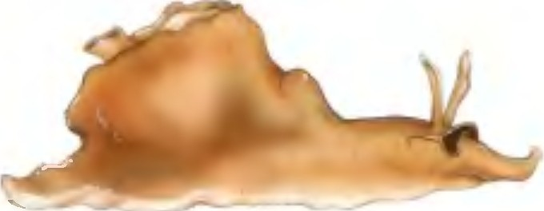
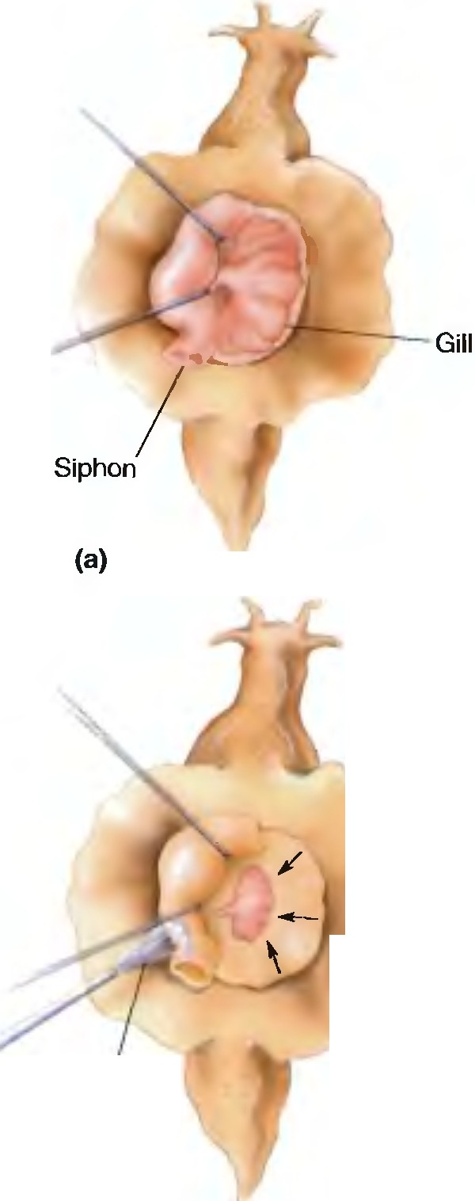
'Y SIMPLE SYSTEMS: INVERTEBRATE MODELS OF LEARNING 765
Successf ul instrumental conditioning requires the stimulus to occur shortly after the response.
Because motiva tion plays such a large pa rt in instrumental conditioning (af ter all, only a hungry ra t will lever-press for a food reward), the under­
lying neural circuits are considerably more complex than those involved in simple classical conditioning. Therefore, we'll leave instrumental condi­ tioning to focus on the simpler forms of lea rning and memory whose mechanisms have been identified in the nervous system of an invertebrate animal.
FIGURE 25.3
Apl ysia californica. One cool sea slug, used for neurobiolog1cal studies of learning and
memory.
Lesma do mar
'Y SIMPLE SYSTEMS:
INVERTEBRATE MODELS OF LEARNING
Over the course of neuroscience history, a large menagerie of invertebrate creatures has been used for experimenta tion. You are already familia r with the squid and the contribu tion of its giant axon and giant synapse to our u nderstanding of cellular neurophysiology (see Chapters 4 and 5). Other invertebra te species tha t have been used include cockroaches, flies, bees, leeches, and nematode worms. The reason is tha t invertebra te nervous systems offer some important experimental advantages:
Small nervous systems. Neu rons in invertebrate nervous systems number as few as a thousand, roughly 10 million times less tha n in the huma n brain.
Large neurons. Many invertebrate neurons are very large, making them easy to study electrophysiologically.
Identifiable neurons. Neurons in invertebrates can be classified according to size, location, and electrophysiological properties and can therefore be identified from individual to individual.
Identifiable circuits. Identifiable neurons make the same connections with one another from individual to individual.
Simple genetics. The small genomes and rapid life cycles of some inverte­ bra tes (such as flies and nema todes) make them ideal for studies of the genetic and molecular biological basis of learning.
Invertebrates can be particularly useful for analyzing the neural basis of behavior. Granted, the behavioral repertoire of the average invertebrate is rather limited. Nonetheless, many invertebrate species exhibit the simple forms of learning we discussed above: habituation, sensitization, and classical conditioning. One species in pa rticular has been used to study the neuro­ biology of learning, the sea slug Aplysia californica (Figure 25.3).
C. Elegans
302 neurônios
brânquias
Nonassociative Learning in Apl ysia
If someone blows gently a t your eye, you blink. Eventually, however, you will habituate (assuming that the air puff is not painf ul). Similarly, if a jet of water is squirted onto a fleshy region of Aplysia called the siphon, the gill will retract (Figure 25.4). This is called the gill-withdrawal reflex. Like the eye blink, the gill-withdrawal reflex displays ha bituation af ter repea ted presentation of the wa ter jet. In a pioneering series of experiments begin­ ning in the 1960s, Eric Kandel and his colleagues at Columbia University set out to determine where this proced ural memory resides and how it is formed. Kandel's accomplishments were recently recognized with the 2004 Nobel Prize in Medicine.
Water jet
(b)
FIGURE 25.4
The gill-withdrawal reflex in Aplysia.
(a) The mantle is held aside to show the gill in its normal position. (b) The gill retracts
when water is sprayed on the siphon. This reflex is an example of habituation.

Slide 7
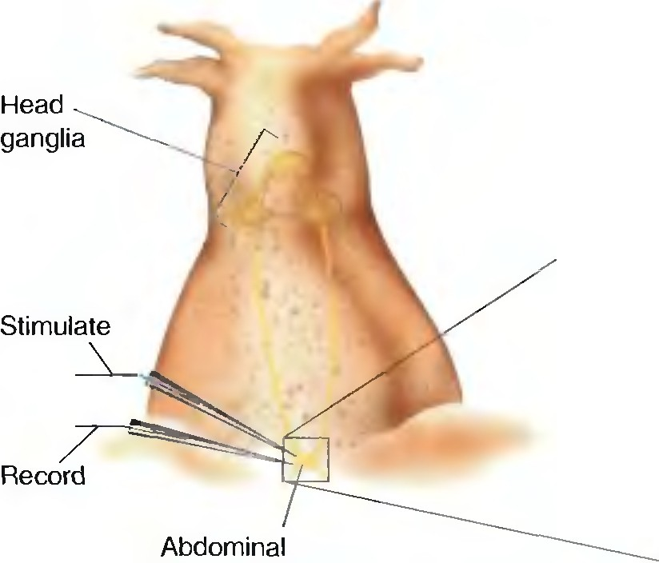
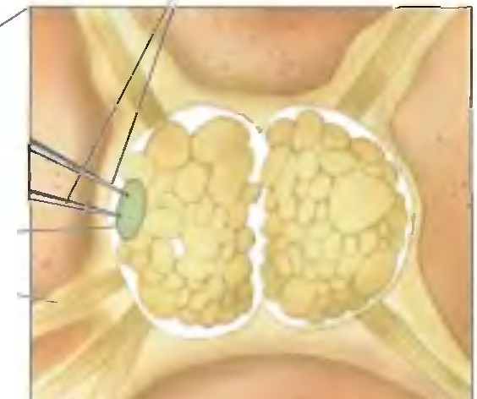
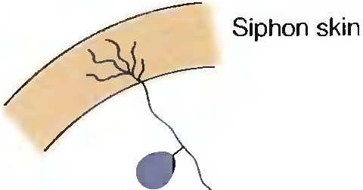
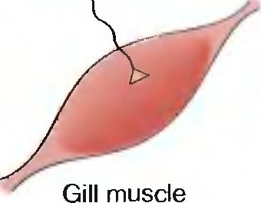
766
C H A P T E R 2 5
MOLECULAR MECHANISMS OF LEARNING AND MEMORY
Electrodes
'
L7-­
Siphon -_ nerve
ganglion
FIGURE 25.5
The abdominal ganglion of Apl ysia. The gill-withdrawal reflex involves neurons within the abdominal ganglion that can be dissected and studied electrophys 1ologically.
Habituation of the Gill-Withdrawal Reflex. Sensory informa tion from the siphon tra vels along a nerve until it en ters a region of the Aplysia nervous system called the abdominal ganglion (Figure 25.5). Here the infor­ ma tion is d istributed to motor neurons and to interneurons. One of the motor neurons tha t receives direct monosynaptic sensory input from the siphon is identified as L7. and this cell innerva tes the muscles that produce gill withd rawal. Therefore, resea rch has focused on u nd erstanding how this simple monosynaptic reflex arc changes d u ring habitua tion.
The first importa n t question concerns where the ha bitua tion occurs. Figu re 25.6 shows a simplified wiring diagra m of the gill-withd ra wal reflex. Repeated stimula tion of the siphon skin leads to progressively less contrac­ tion of the gill-withd rawal muscles. The change underlying this habitua tion could occu r ( I ) at the sensory nerve end ings in the skin. maki ng them less sensitive to the squirt of wa ter; (2) at the muscle, making it less responsive to synaptic stimulation by the motor neu ron; or ( 3) at the synapse between the sensory neu ron and the motor neu ron.
The first possibility was ruled out by ma king microelectrode record ings
f rom the sensory neu ron as ha bit ua tion occurred. The sensory neu ron continued to fire action potentials in response to skin stimu lation, even as the motor response decreased. Similarly, the t hird possibility was ruled out by electrically stimulati ng the motor neuron (L7) and showing tha t it always evoked the same amou nt of muscle contraction. This lef t the second possi­ bility: tha t habitua tion occurs at the synapse joining the sensory input to the motor neuron. Indeed, simply giving repetitive electrical stimulation to the sensory neu ron was sufficient to ca use a progressive decrease in the size of the postsynaptic EPSP (Figure 25.7).
Id entif ying a synaptic modification as a possible basis for ha bitua tion still leaves u na nswered the question of where the synapse is modified. Let's consider the possibil ities. Af ter habitua tion, there cou ld be ( I ) less neu rotra nsmitter release by the presyna ptic axon or (2) decreased post­ synaptic responsiveness to the transmitter (perhaps caused by fewer recep­ tors). Recall from Chapter 5 tha t tra nsmitter molecules are released in d is­ crete packets called quanta, bel ieved to correspond to the contents of individual synaptic vesicles. Fu rther analysis revealed tha t after habitua­ tion. there are fewer quanta released per action potential. The sensitivity of the
2nd
Sensory neuron
Motor
( neuron L7
3rd
FIGURE 25.6
A simple wiring diagram for the
gill-withdrawal reflex. The sensory neuron
that detects stimuli applied to the skin of the siphon synapses directly on the motor neuron
that causes the gill to withdraw.

Slide 8
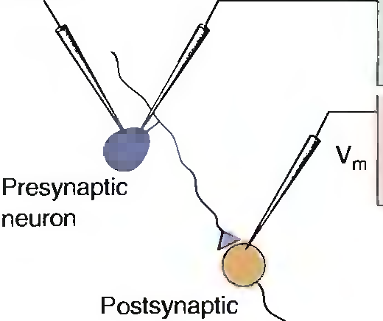
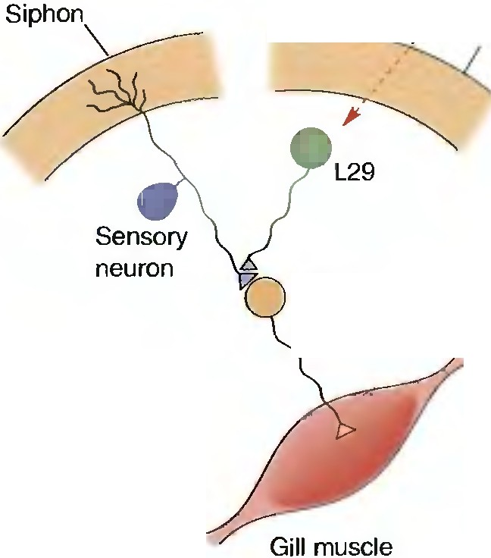
'Y SIMPLE SYSTEMS: INVERTEBRATE MODELS OF LEARNI NG 767
Record from presynaptic neuron
Stimulate
Record from postsynaptic neuron
;----
;- r-
10 15
Stimulus number
5
20
neuron
FIGURE 25.7
Habituation at the cellular level. Repeated electrical stimulation of a sensory neuron leads to a progressively smaller EPSP in the postsynaptic motor neuron.
postsynaptic cell to neurotransmitter did not change. In other words, ha­ bitua tion of the gill-withd rawal reflex is associated with a presyna ptic modification.
Why is neurotra nsmitter release reduced af ter repea ted stimulation of
the sensory nerve terminal? Recall the sequence of events tha t couples the arrival of the action potential in the terminal with the release of neuro­ transmitter. A critical step is the entry of Ca ² + into the terminal, which is mediated by voltage-gated calcium channels. In the nerve terminal of the sensory neuron, it appears that these channels become progressively and persistently less eff ective followi ng ha bitua tion. However, despite the apparent simplicity of this type of learning, how this change occurs is still unknown.
Sensitizing
G[Ca]
Sensitization of the Gill-Withdrawal Reflex. To cause sensitiza tion of the gill-withdrawal reflex, Kandel and his colleagues applied a brief elec­ trical shock to the head of Aplysia. This resulted in exaggera ted gill with­ drawal in response to stimulation of the siphon. Using the strategy outlined above, they identified a site of plasticity showing changes tha t correla te with the behavior. Once again, it turned out to be a modifica tion of trans­ mitter release in the sensory nerve terminal.
How might stimulation of the head lead to sensitiza tion of the gill­ withdrawal reflex? Understanding the answer to this question req uires adding a third neu ron to the wiring diagram (Figure 25.8). This third cell,
L29, is activa ted by the hea d shock and ma kes a synapse on the axon ter­ minal of the sensory neuron. The neu rotransmitter released by L29 is sero­ tonin ( 5-HT), which sets in motion a molecular cascade tha t sensitizes the sensory axon terminal so that it lets in more Ca² + per action potential. The serotonin receptor on the sensory axon terminal is a G-protein-coupled metabotropic receptor. Stimulation of this receptor leads to the prod uction of intracellula r second messengers. In the case of the Aplysia sensory nerve terminal, this second messenger is cyclic AM P (cAMP) prod u ced from ATP by the enzyme adenylyl cyclase (Figure 25.9). Recall from Chapters 5 and 6 that cAMP activates protein kinase A, and this enzyme phosphoryla tes (at­ taches phosphate groups to) various proteins. In the sensory nerve termi­ nal, one of these proteins is a potassiu m channel, and phosphoryla tion of
slimulud
·---- F
Head
Motor neuron
FIGURE 25.8
A wiring diagram for sensitization of the gill-withdrawal reflex. A sensitizing
stimulus to the head of Aplys1a indirectly activates an interneuron, L29, which makes
an axoaxonic synapse on the terminal of the sensory neuron.

Slide 9
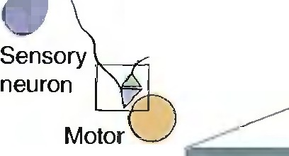
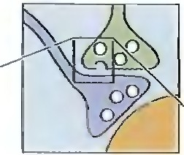
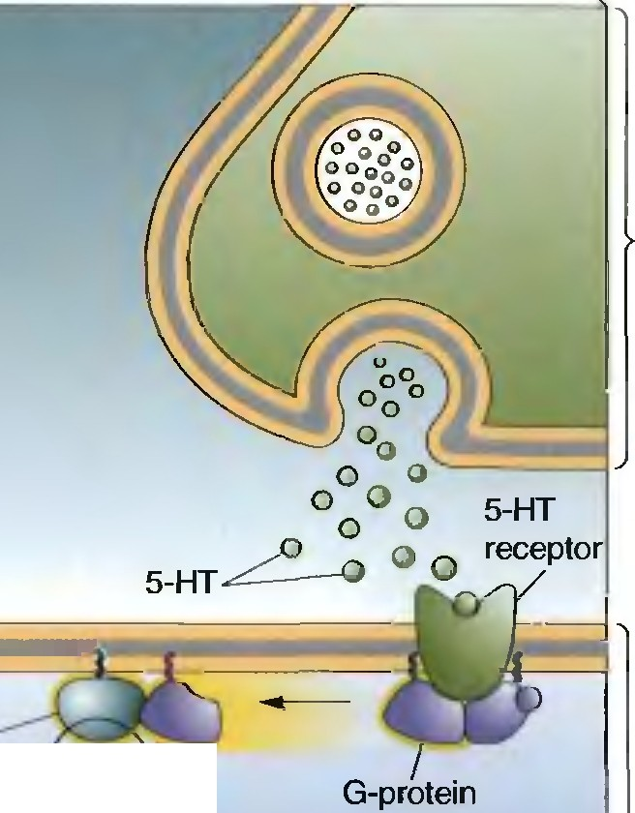
768
C H A P T E R 2 5
MOLECULAR MECHANISMS OF LEARNING AND MEMORY
L29
·
neuron
L29 axon terminal
Adenylyl
cy
cAMP
Sensory neuron
axon terminal
Protein kinase A (active)
Protein J
kinase A
(inactive) l
FIGURE 25.9
A mechanism for sensitization of the gill-withdrawal reflex. Serotonin (S-HT) released by L29 in response to the head shock leads to G-protein-coupled activation of adenylyl cyclase in the sensory axon terminal. Activation of this enzyme leads to the produc­ tion of cyclic AMP. which in turn activates protein kinase A. Protein kinase A attaches phos­ phate groups to a potassium channel, causing it to close.
this channel causes it to close. The closure of potassium channels in the axon terminal leads to a prolonga tion of the presynaptic action potential. This results in more Ca2+ entry through voltage-ga ted calcium channels during the action potential, and therefore more quanta of neu rotra nsmit­ ter are released (Figure 25.10).
Recent research suggests tha t this "simple" story is incomplete, however.
In addition to presynaptic modifica tions, persistent sensitization is associ­ ated with increased postsynaptic responses to the neu rotransmitter released by the sensory nerve. This neu rotra nsmitter is glutama te, and sensitization is pa rtly explained by the d el ivery of new glu tama te receptors to the synapse. We will retu rn to glutama te receptor delivery and removal as a substra te for memory when we d iscuss vertebra te models of lea rning shortly.
Associative Learning in Apl ysia
In the 1980s, resea rchers discovered tha t Aplysia also could be classically cond itioned. Again, the response measured was the withdrawal of the gill. The US was a strong shock to the tail. The CS was stimulation of the siphon tha t was so gentle tha t it d id not ca use much of a response. If stim-
gK→ 0
(1)
(2)
See Figure 25.10 ahead

Slide 10
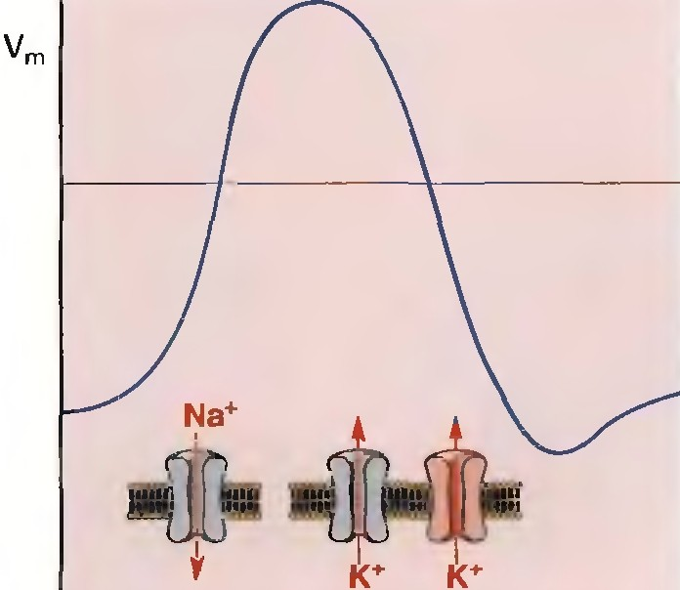
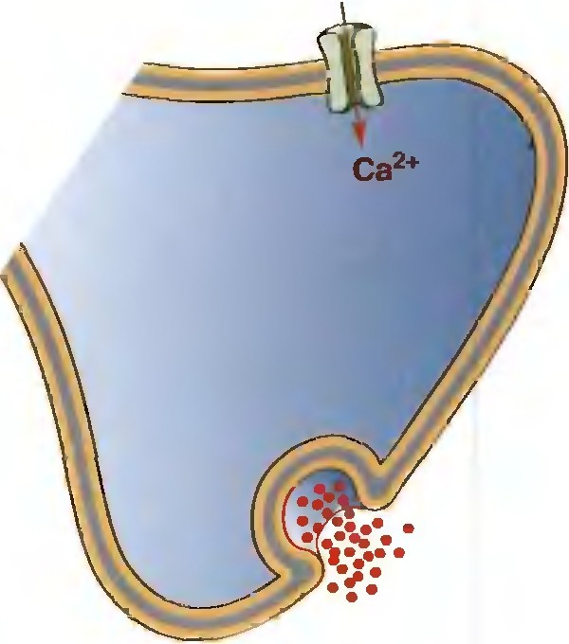
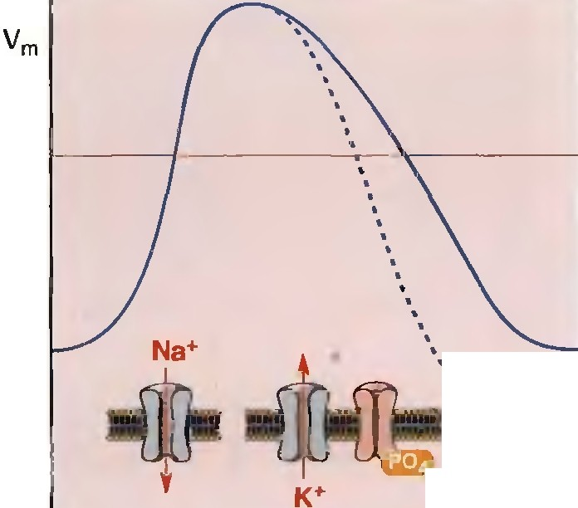
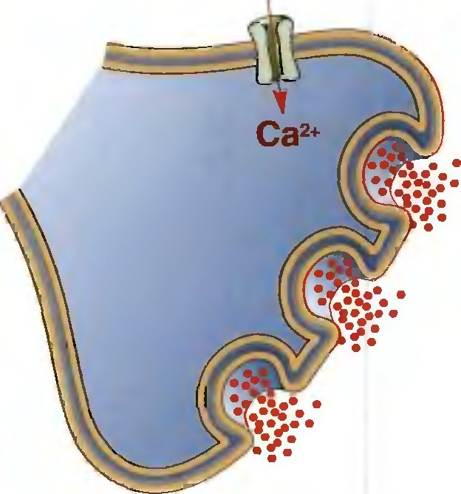
T SIMPLE SYSTEMS: INVERTEBRATE MODELS OF LEARNING 769
(a)
(b)
·.
Protein '- kinase A
(c) (d)
FIGURE 25.10
The effect of decreased potassium conductance in the sensory axon terminal.
(a) The trace shows membrane voltage changes during an action potential. The rising phase is caused by the opening of voltage-gated sodium channels, and the falling phase is
caused by the closing of the sodium channels and the opening of potassium channels. In the
axon terminal. voltage-gated calcium channels stay open as long as the membrane voltage exceeds a threshold value, indicated by the red line. (b) The resulting entry of Ca²+ stimu­ lates the release of neurotransmitter. (c) A decrease in K+ conductance after sensitization prolongs the action potential. (d) The voltage-gated calcium channels stay open longer, thereby admitting more Ca² + into the terminal. This causes more transmitter to be released per action potential.
ulation of the tail (US) was paired with stimulation of the siphon (CS), the subsequent response to siphon stimulation alone ( CR) was much greater than what could be accounted for by sensitization (Figure 25.11). As in Pavlov's experiments, timing was critical. Conditioning occurred only if the CS (siphon stimulus) preceded the US ( tail stimulus) by s0.5 second.
Once again, a critical modification occurs at the synapse between the sensory and motor neu ron. To understand how this comes about, we need to focus on what is happening at that synapse during the CS-US pairing. At the cellular level, the CS is represented by the arrival of an action poten­ tial in the sensory axon terminal, and the US is represented by the release of serotonin by L29 (activated by the tail shock) . At the molecular level, the CS is represented by the influx of Ca ² +, and the US is represented by

