Slide 1
The Brazilian contribution: targets and future perspectives
RICARDO M. TERRA, MD, PhD, MPH
Associate Professor of Thoracic Surgery
University of Sao Paulo
Scientific Secretary
Brazilian Society of Thoracic Surgery

Slide 2
Conflicts of interest
Advisory Board:
Johnson&Johnson
Medtronic
Pfizer
Research Support
Medela
CareFusion

Slide 3
Conception of the Database
Board meeting in Salvador 2013
Absolute lack of data
Benchmarking and quality control
Trend analysis
Thoracic surgery advocacy
Designing educational and scientific
activities
We needed a National Database

Slide 4
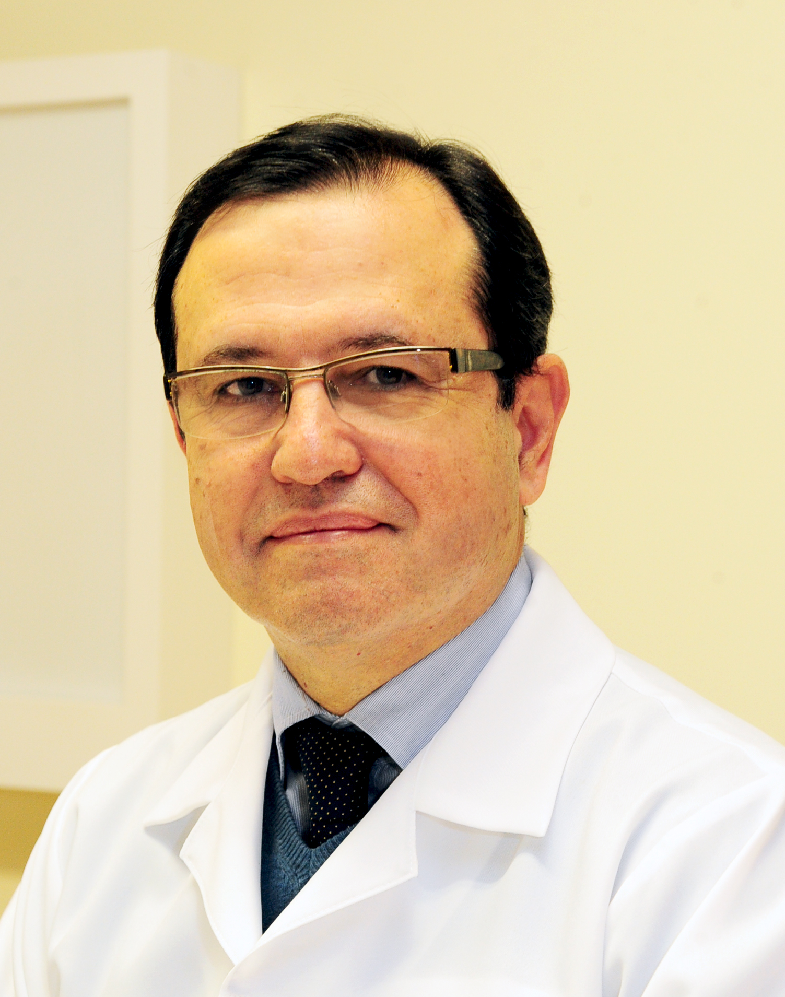
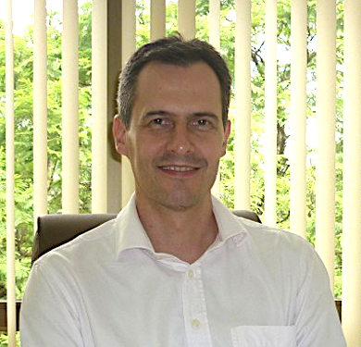
Database Committee
Ricardo Terra
São Paulo
Leticia Lauricella
São Paulo
Darcy Pinto
Caxias do Sul
Humberto Oliveira
Brasilia
M. Teresa Tsukazan
Porto Alegre
Spencer Camargo
Porto Alegre
Gustavo Fortunato
Salvador

Slide 5
Partnering with ESTS
Well established platform
Modern vision
Indisputably international
Excellent technical support: Dendrite-KData (Stefano and Danilo)
We were warmly welcomed (Falcoz and ESTS Board of Directors)

Slide 6
The Plan
Start small and escalate gradually
Phase 1: Implementation
Phase 2: Escalation
Phase 3: Open to all members
Set milestones
Apply for grants - funding

Slide 7
Phase 1
Establish Database Committee
5 Institutions
Retrospective data 2014 and 2015 (1st semester)
Prospective data 2015 (2nd semester)
Test and translate platform into Portuguese
Milestone: present abstract at ESTS meeting with the outcomes of some 1000 anatomic resections

Slide 8
Phase 1
Establish Database Committee
5 Institutions
Retrospective data 2014 and 2015 (1st semester)
Prospective data 2015 (2nd semester)
Test and translate platform into Portuguese
Milestone: present abstract at ESTS meeting with the outcomes of some 1000 anatomic resections
(F-056) Outcomes of Anatomic Lung Resection in Brazil: Results of a National (BSTS) Database
Oral Presentation – May 30th at 17:30

Slide 9
ESTS 2016/Naples
Database Session
Foto: Dr. Carlos Alberto Araujo

Slide 10
Phase 2
Include more centers
Invite 10 centers
Retrospective dataset (2014-2015) – Anatomic lung resections
Apply for research grants
Elaborate an Annual Report
Milestone: present 4 papers at BSTS meeting (2017) with the first outcome analysis and at least one in Innsbruck

Slide 11
Phase 2
Include more centers
Invite 10 centers
Retrospective dataset (2014-2015) – Anatomic lung resections Seven eventually included
Apply for research grants Johnson&Johnson
Elaborate an Annual Report
Milestone: present 4 papers at BSTS meeting (2017) with the first outcome analysis and at least one in Innsbruck
Young investigator award !

Slide 12
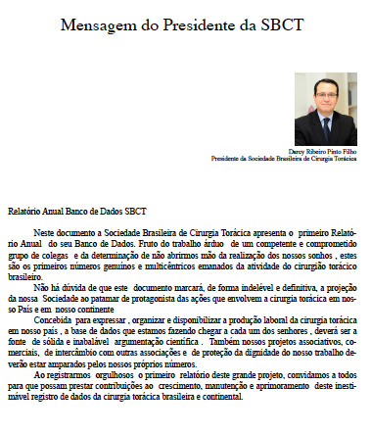
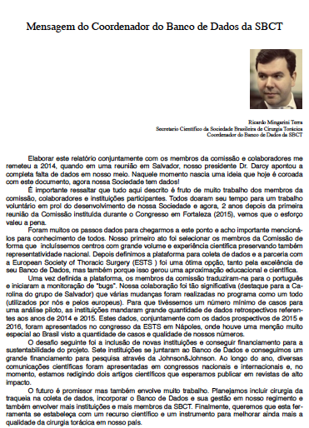
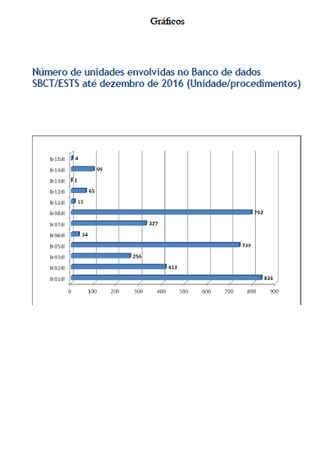
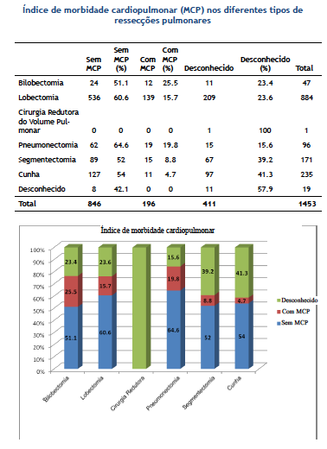
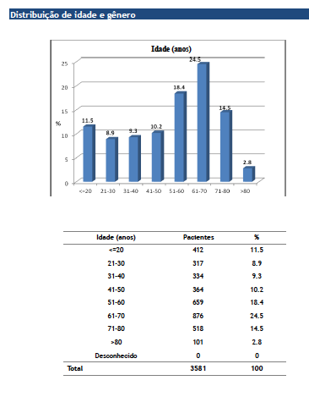
Annual Report 2016
Distributed in the National Meeting in Rio May/2017

Slide 13
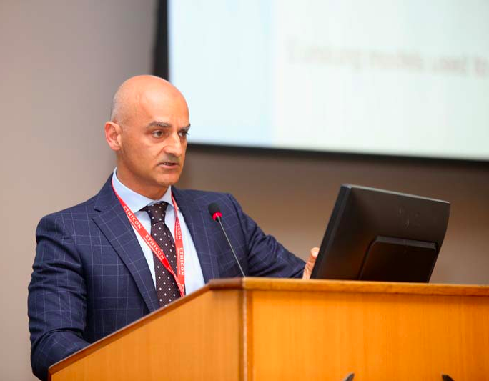
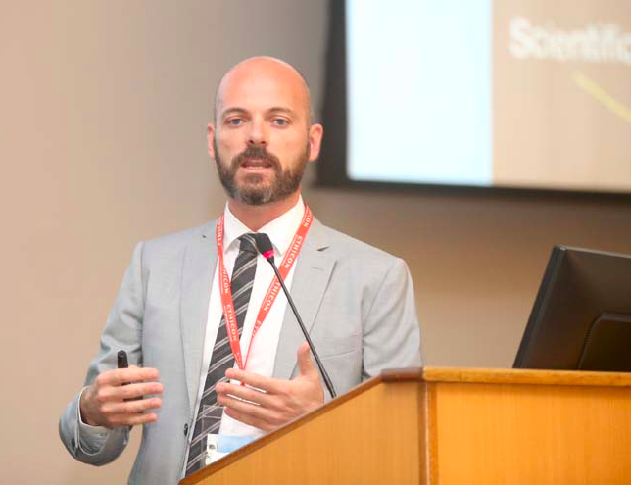
BSTS/RIO 2017
Database Meeting – Early Riser Session (full house – 65 participants)
4 oral presentations
BSTS/ESTS session on Databases and Accreditation

Slide 14
N= 1232 patients

Slide 16
Where do we stand?

Slide 17
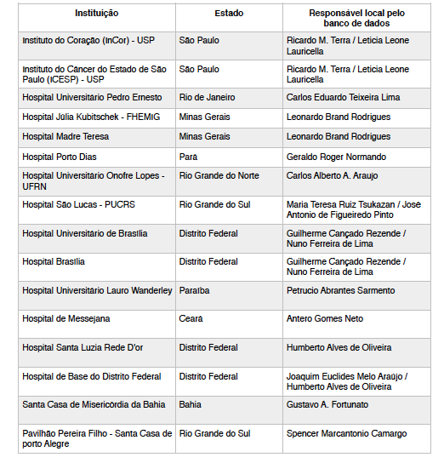
Current Participants
16 Institutions
6 applying

Slide 18
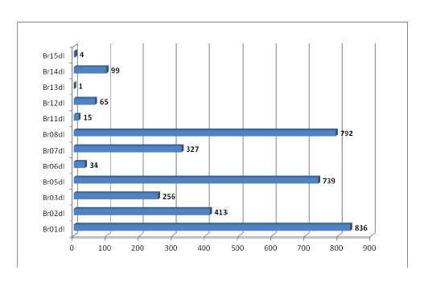
Casos Registrados

Slide 19
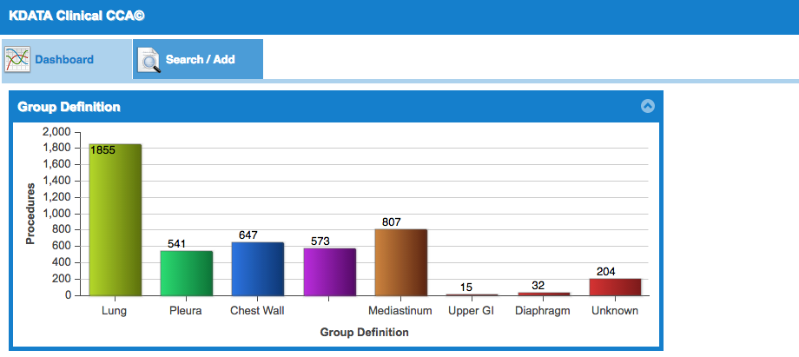
Number of cases
Total: 4054 cases
Total: 4177 procedures
May 26th, 2017

Slide 20
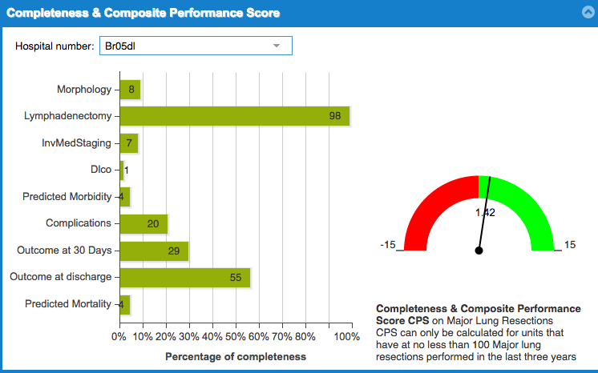
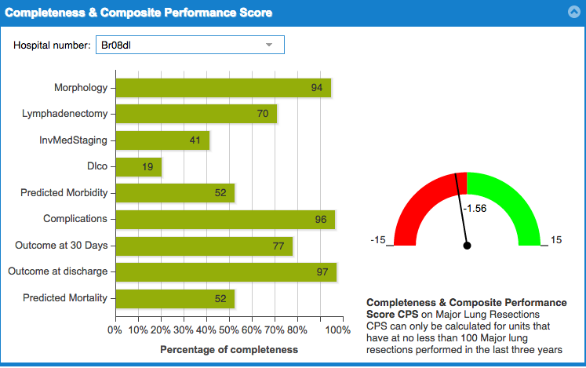

Slide 21
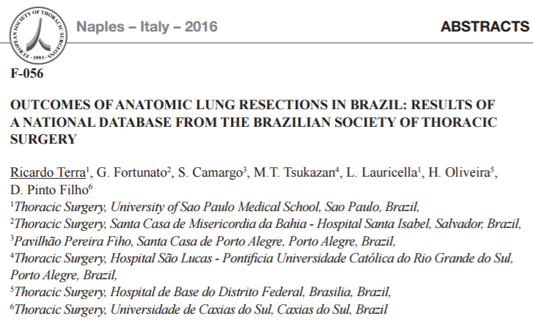
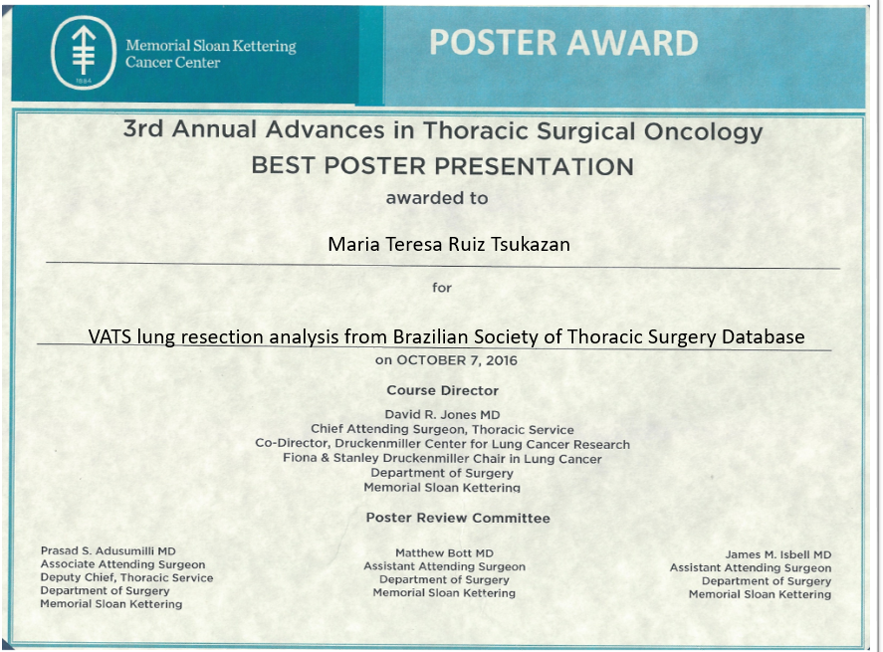
Scientific Activities
P1.08-058 VATS Lung Resection Analysis from Brazilian Society of Thoracic Surgery Database: Topic: Minimal Invasive Surgery
Maria Teresa Ruiz Tsukazan, Ricardo Terra, Gustavo Fortunato, Spencer Camargo, Humberto De Oliveira, Letícia Lauricella, Darcy Pinto
Journal of Thoracic Oncology, Vol. 12, Issue 1, S766–S767
Published in issue: January 2017

Slide 22
Future directions

Slide 23
Phase 3
Priorities to 2017
Open to all interested members and extend participation to other Latin American Countries
Governance and Constitution
Website and communication
Improve quality of data

Slide 24
Governance and Constitution
Define rules and include in our constitution
Use of data
Scientific publications and authorship
Participation
Composition of the committee
Relations with the companies (IT and supporters)
Support to new members

Slide 25
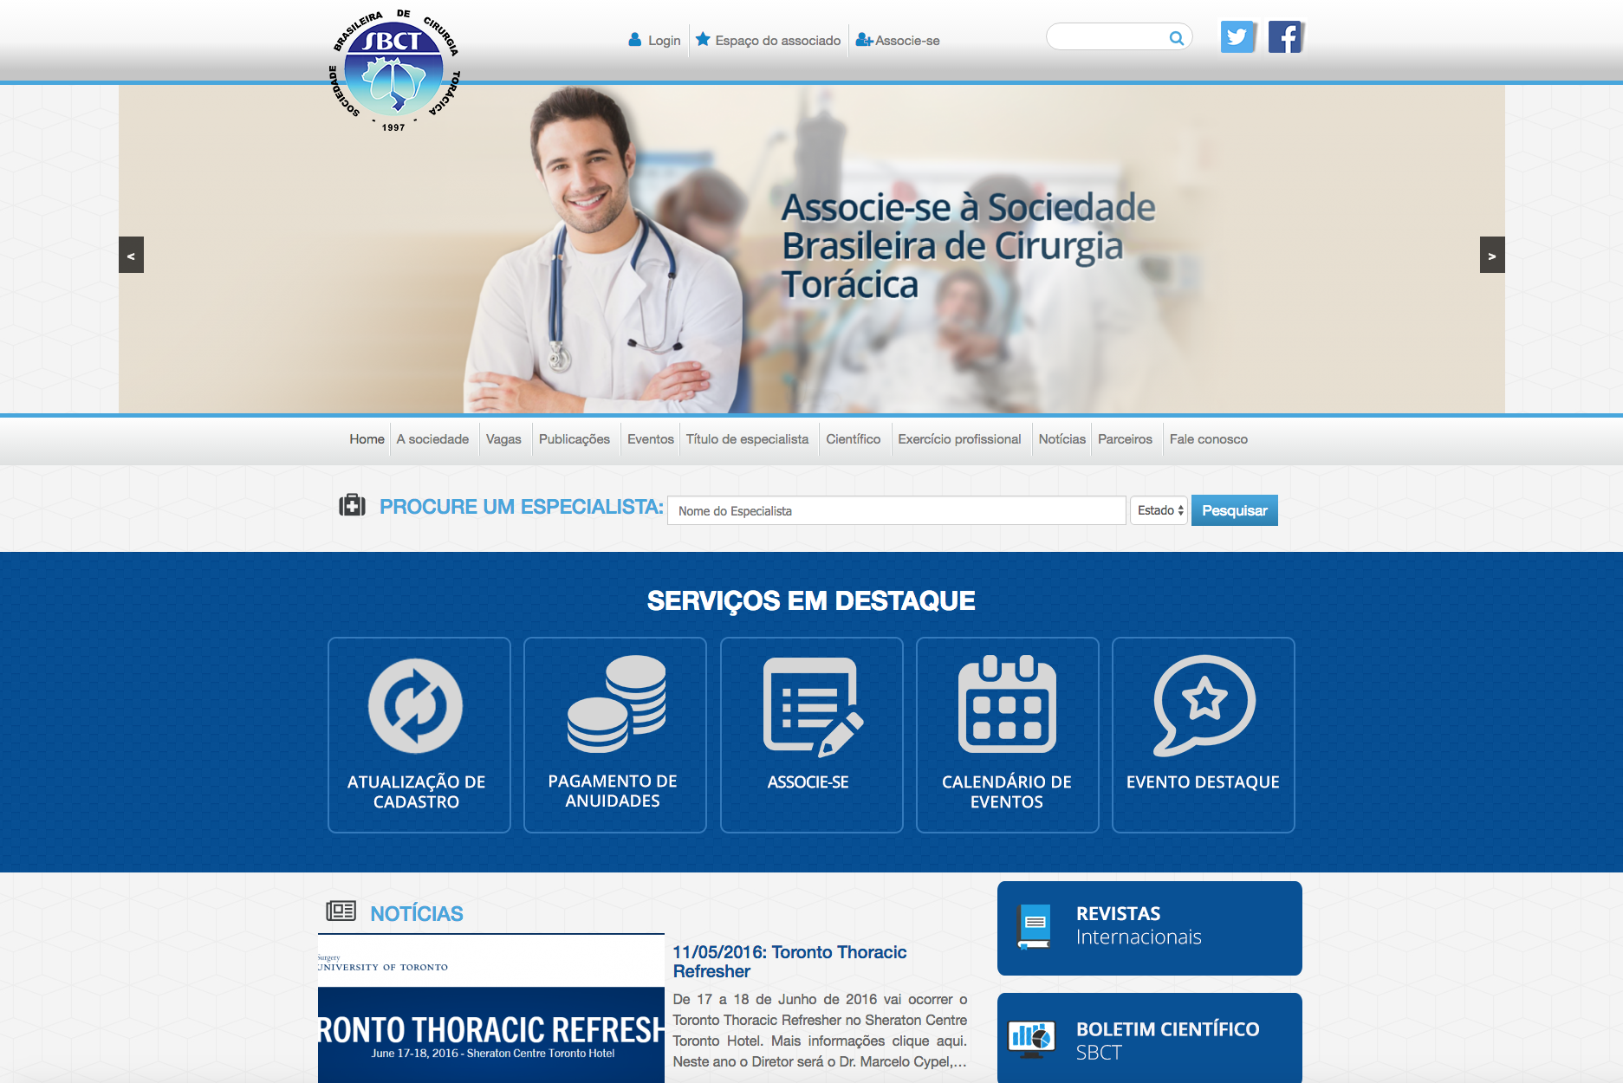
Website and Communication
Design and keep a dedicated page in BSTS website
Increase awareness and make information available
Improve information provided in the Annual Report

Slide 26
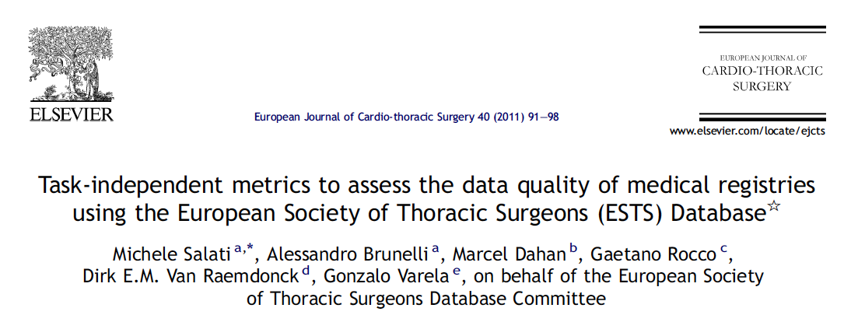
Quality of Data
Review quality of data
Propose actions to promote improvement

Slide 27
Phase 3
Priorities to 2018
Financial sustainability
New dataset: Tracheal diseases
Education (Databases and quality improvement)
Task Force to discuss Accreditation

Slide 28
Education
Basic training for new members
Annual live committee meeting
Database and Quality improvement courses

Slide 29
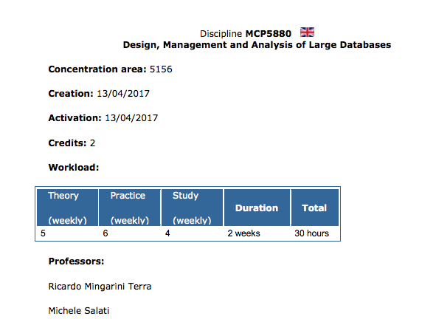
Education
Basic training for new members
Annual live committee meeting
Database and Quality improvement courses

Slide 30
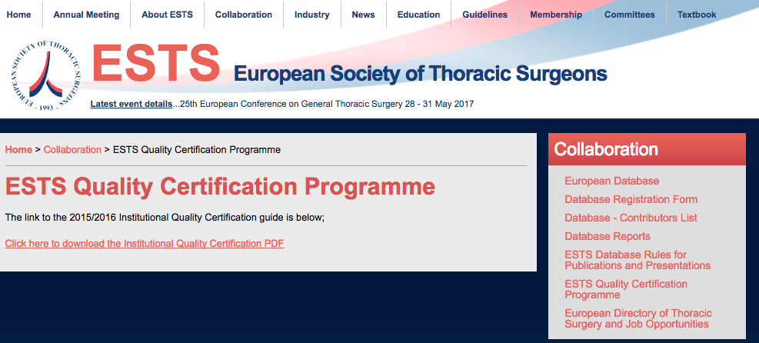
Accreditation
Awareness phase
Task force to put up an action plan

Slide 31
Landmarks
2 papers published in High-Impact Journals by 2018
ALAT meeting 2018
Present 2 abstracts with other LATAM countries
ESTS meeting
Present a paper in collaboration with European countries but proposed by BSTS
BSTS meeting in Belo Horizonte - 2019
Approve Constitution changes in the Assembly
Present a proposal of an Accreditation program

Slide 32
Convocação
Banco de Dados da SBCT
Foto do tio Sam
rmterra@uol.com.br

Slide 33
Ricardo Terra
rmterra@uol.com.br

