Slide 1
Certificate in EMI Skills Module 4 Part 1 Language for Tutorials and Supervision
Luciana Carvalho Fonseca & John Corbett

Slide 2
Session outcomes
To discuss and share ideas for best practice in tutorials and supervision
To contrast different types of language used in different approaches to the supervisory process
To identify stages of a tutorial and appropriate language for each stage

Slide 3
Activity 1: Warm-up questions
What does a tutorial mean to you?
Did you have them as a student?
Do you use them as a prof?

Slide 4
Activity 1: Warm-up questions
In this module we define tutorials as
“part of the supervision process, when tutors meet students to discuss assignments, research, progress and general questions.”
Do you recognise this activity?
Do you (plan to) do it in English? Why (not)?
How often do you meet with students?
What are the tutorials usually about?
How long do they usually last?

Slide 5
Activity 1 Good practice questionnaire

Slide 6
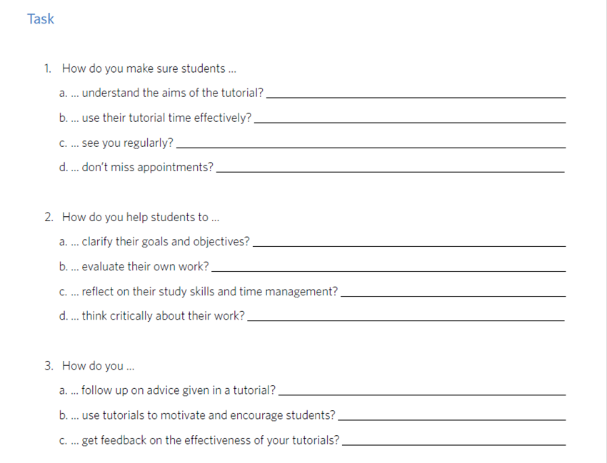
Activity 1 Good practice questionnaire
What answers are particularly worth sharing?

Slide 7
Activity 2: Responding to different student personalities
How prescriptive are you when directing students?
How collaborative?
How much autonomy do you give students?
How do you deal with disagreements?
Role-play: student issues.

Slide 8
Activity 2: Directing students

Slide 9
Activity 2: Directing students
Prescriptive prompts
You should …
You need to …
You have to …
Which do you prefer as a prof/student?
Open ended prompts
How are you going to …?
How could you …?
Tell me how/what/why …

Slide 10
Activity 3: The stages of a tutorial
Form groups of four with two pairs in each group.
One pair in each group will receive descriptions of stages of a tutorial
The other pair will receive examples of language spoken by a tutor at those stages.
For all pairs, the task is to put them in the best sequence.
Then pairs compare their sequences to see if they match up.

Slide 11
Activity

Slide 12
Activity 3: Suggested answers

Slide 13
Reflection
Which of these seminar stages do you always/sometimes/rarely/never include in your tutorials? Say why.
Next session:
language for dealing with problems and encouraging learner independence.

Slide 14
CAE Cert in EMI Skills EMI@USP
Thanks for your participation!

