Slide 1
PHONETICS & PHONOLOGY: English as a lingua franca
Prof. Dr. Daniel Ferraz

Slide 2
Outline:
Brief interview
SHORT VIDEOS ON ELF
DISCUSSION 1 – WHAT IS ELF?
DISCUSSION 2 – GLOCAL LANGUAGES, WORLD ENGLISHES
In the classroom?
Back to interview

Slide 3
BRIEF INTERVIEW
INTERVIEW A CLASSMATE
WRITE SHORT ANSWERS (SUMMARIZE)
EXCHANGE THE QUESTIONNAIRES

Slide 4
Langfocus: What is a Lingua Franca? https://www.youtube.com/watch?v=a9ZdC6wZnks

Slide 5
ELF (English as a Lingua Franca): Jenkins https://www.youtube.com/watch?v=ZvWCqvxK9Hg

Slide 6
CONTEXT (Ferraz, 2019, p. 189)

Slide 7
EFL by JENKINS (2003)
RATIONALE: because a language item differs from the way it is produced by Inner Circle speakers, it cannot be assumed to be an error but may be an example of contingent creativity and adaptation, or even of language contact and change in progress (p.42)

Slide 8
What does that mean?
Challenges the unbalance between “NATIVE” and “NON NATIVE” speakers (inner x outer circles)
RECOGNIZES divesity with English
ENCOURADGES AND EMPHACIZES MULTILINGUALISM

Slide 9
ELF - definitions
“English as it is used as a contact language among speakers from different first languages” (Jenkins)
“any use of English among speakers of different first languages for whom English is the communicative medium of choice, and often the only option” (Seidlhofer)

Slide 10
What is ELF?
“more fluid and flexible kinds of English use that transcend geographical boundaries.” (p. 42)”
“ELF, in common with other lingua francas, is essentially hybrid and plurilingual in nature” (ibid).

Slide 11
IN practice: Pronunciation features
all the consonant sounds except voiceless ‘th’ /θ/, voiced ‘th’ /d/, and dark ‘l’ [. . .]
❑ vowel length contrasts (e.g. the difference between the vowel sounds in ‘pitch’ and peach’)
❑ avoidance of consonant deletion at the beginnings of words (e.g. the cri- in ‘crisp’),
❑ production and placement of nuclear (tonic) stress (the major stress in a group of words). Determine X determine; vegetable x vegetable;

Slide 12
In PRACTICE (II)

Slide 13
Handout: “Quem quer falar inglês na China?”
Texto veiculado na Internet
What does TANJOOBERRYMUTTS mean in English language?
Room Service : "Morrin. Roon sirbees." Guest : "Sorry, I thought I dialed room-service." Room Service: " Rye . Roon sirbees...morrin ! Joowish to oddor sunteen ???" Guest: "Uh..... Yes, I'd like to order bacon and eggs." Room Service: "Ow ulai den ?" Guest: ".....What ??" Room Service: "Ow ulai den ?!?... Pryed, boyud, pochd ?" Guest: "Oh, the eggs ! How do I like them ? Sorry.. Scrambled, please." Room Service: "Ow ulai dee bayken ? Creepse ?" Guest: "Crisp will be fine." Room Service: "Hokay.. An sahn toes ?" Guest: "What ?“
(…)
Duboc & Ferraz (2011)

Slide 14
(…)
Room Service: "An toes.. ulai sahn toes ?" Guest: "I.... Don't think so.." Room Service: "No? Udo wan sahn toes ???" Guest: "I feel really bad about this, but I don't know what 'udo wan sahn toes' means." Room Service: "Toes! Toes! Why Uoo don wan toes ? Ow bow Anglish moppin we botter ?" Guest: "Oh, English muffin !!! I've got it ! You were saying 'toast'... Fine...Yes, an English muffin will be fine." Room Service: "We botter ?" Guest: "No, just put the botter on the side." Room Service: "Wad ?!?" Guest: "I mean butter... Just put the butter on the side." Room Service: "Copy ?" Guest: "Excuse me ?" Room Service: "Copy...tea.. meel ?" Guest: "Yes. Coffee, please... And that's everything." Room Service: "One Minnie. Scramah egg, creepse bayken , Anglish moppin, we botter on sigh and copy ... Rye ??" Guest: "Whatever you say." RoomService: "Tanjooberrymutts." Guest: "You're welcome"

Slide 15
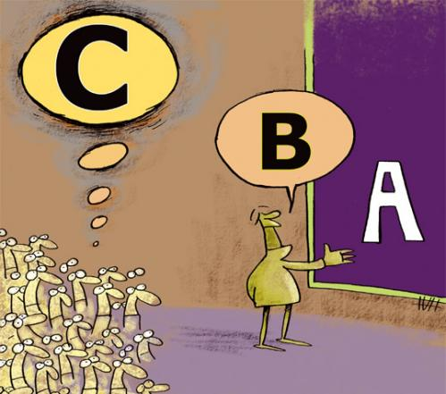
PART 1:
Where does the dialogue take place?
Who are the people?
Where are the people from?
What do they want?
PART 2:
What is the conflict in the dialogue?
Which terms caused the confusion?
Does any of them show any kind of resistance?
PART 3:
Um dos falantes deve se adaptar à linguagem do outro? Se sim, qual deles?
Pode-se dizer que um dos falantes fala “errado”? Se sim, qual dos dois?
Você acha que um dos falantes deve corrigir o outro? Por que (não)?
Você já passou por alguma situação parecida? Como foi?
Baseado em:
Monte Mór, W. Caderno de Orientações Didáticas para EJA – Inglês. São Paulo: Secretaria Municipal de Educação, 2010. Disponível em <http://portalsme.prefeitura.sp.gov.br/Projetos/BibliPed/Documentos/publicacoes/orienta_ing_portal.pdf>
Acesso 15 Abril 2011.

Slide 16
Other perspectives: GLOCAL LANGUAGES

Slide 17
DISCUSSIONS ON ELF IN BRAZIL/USP

Slide 18
GUILHERME ‘ s critique

Slide 19
1. TOP DOWN
This echoes in our students’ perception of English as a Lingua Franca/International language.
What is left for our students is to come to terms with this hegemonic perspective and rush to learn the language
“I have to get there! I will speak perfect English, with no accent and no mistakes. If I do that, I’ll get a better job.”

Slide 20
IN EDUCATION... IN THE CLASSROOM
NON CONTEXTUALIZED PRACTICES
PRONUNCIATION FOR PRONUNCIATION
MEMORIZATION
MECHANIC
NON CONTEXTUAL...
NOT MEANINGFUL
STUDENTS WILL FORGET RIGHT AFTER CLASS

Slide 21
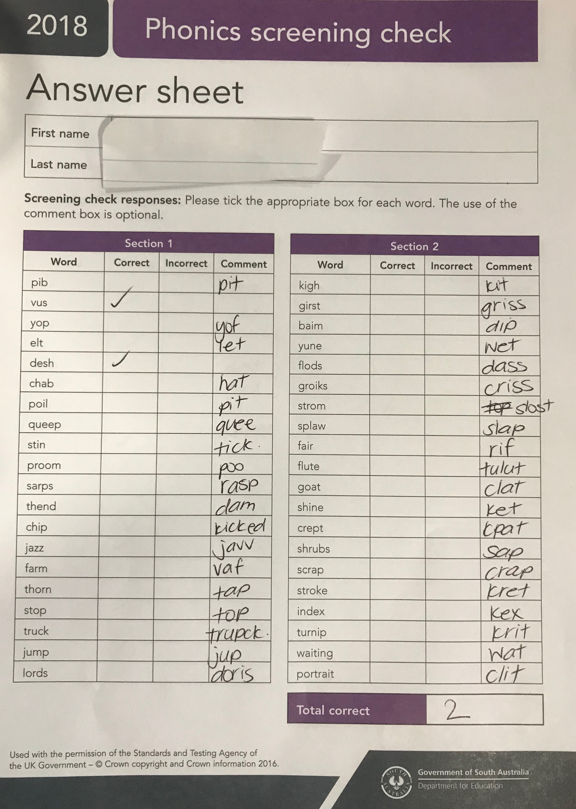
Let’s start by having you take a phonics test…

Slide 22
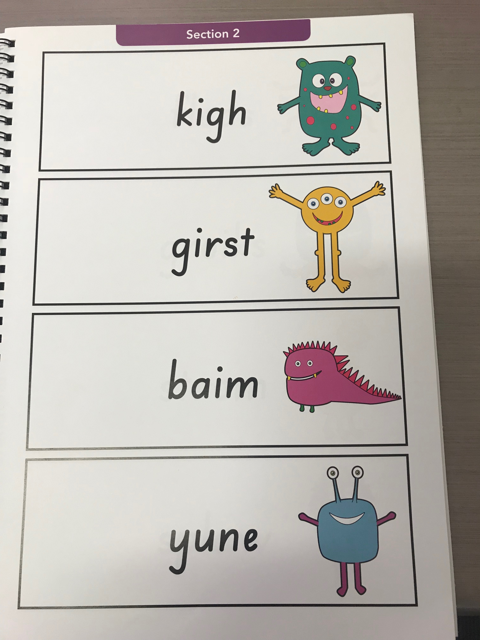
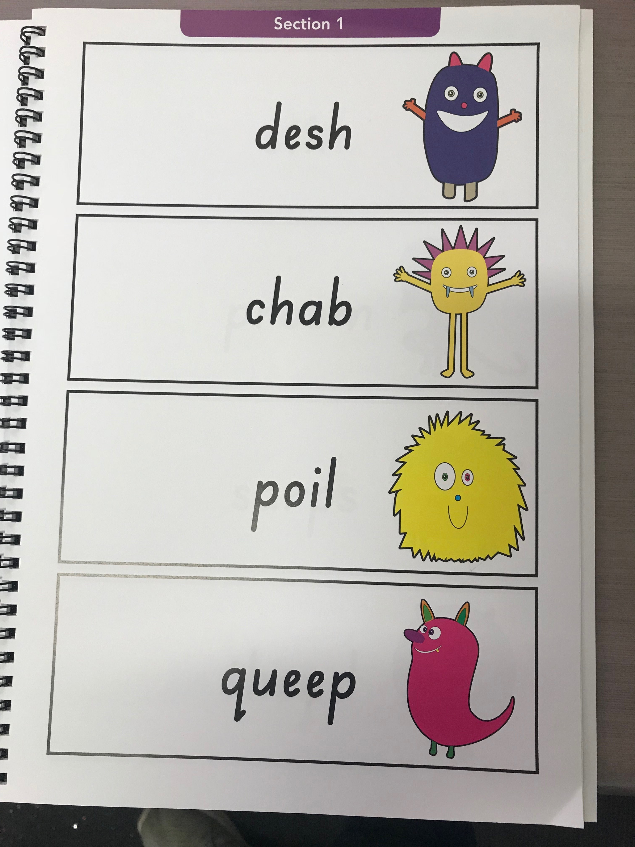
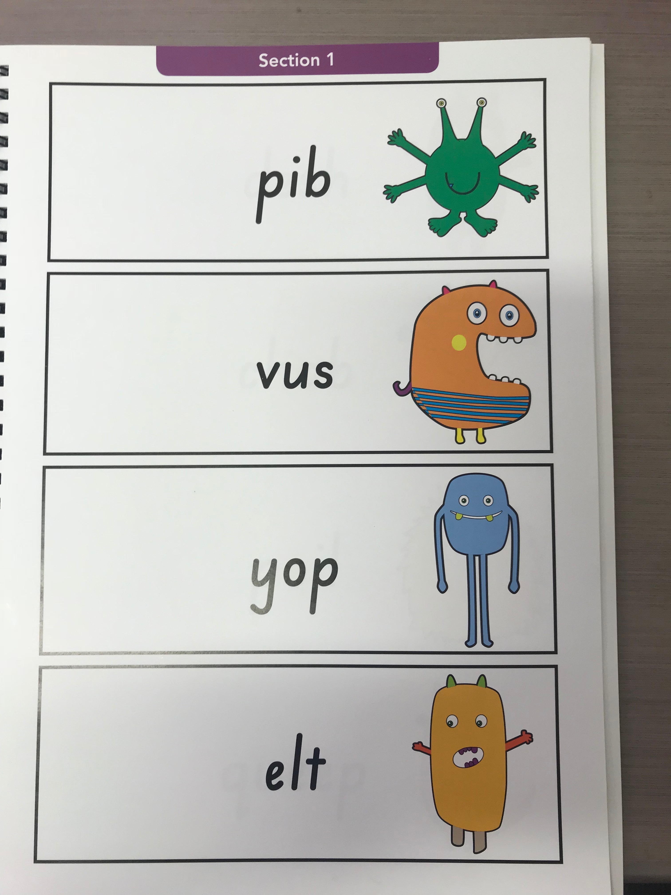
Now let’s learn phonics so we can pass that test.

Slide 23
Putting the words into sentences, now

Slide 24
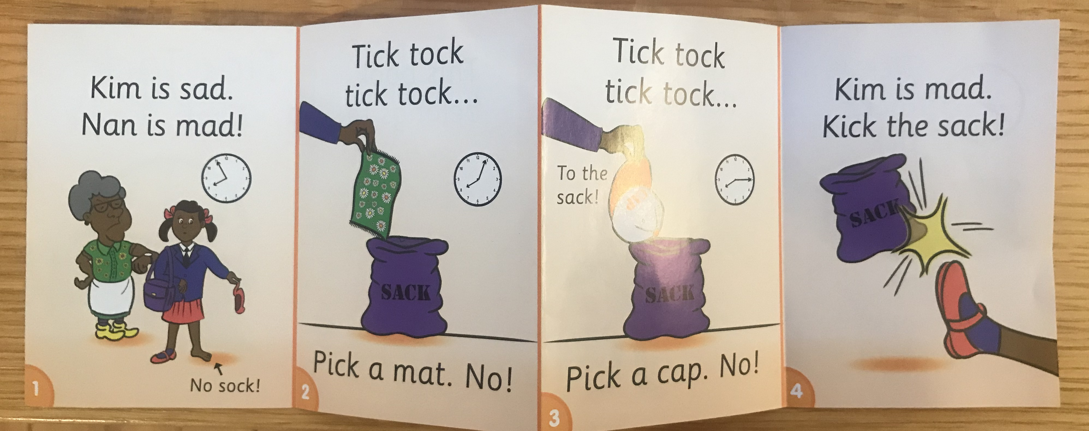

Slide 26
Back to the interviews (or have a look at it at home)...

Slide 27
Some events (invitation)
GEELLE

Slide 28
End notes
danielferrazusp@gmail.com
www.ACADEMIA.EDU/Daniel Ferraz

Slide 29
THANK YOU!!!

