Slide 1
Topics in Phonetics & Phonology
John Corbett: USP-CAPES International Fellow
Session 8: Brazilian Englishes

Slide 2
Course structure
Introduction: Review of IPA & lexical sets
Review: Transcribing connected speech
Accents of English 1: Reference accents (RP and GenAm)
Revisiting English as a lingua franca
Accents of English 2: American accents
Accents of English 3: British Accents
Accents of English 4: Accents of World English
Accents of English 5: Brazilian English accents

Slide 3
Course structure
Acoustic phonetics: Using WASP
Rhythms of English: Poetic metre
Rhythms of English: Rhythm in speech
Discourse intonation 1
Discourse intonation 2
Course review

Slide 4
This session
Two Brazilian English accents: NSS and NS.
NSS: Comparative phonology
NS: The ‘Confederados’

Slide 5
Source of information

Slide 6
General
Vowels
RP English has 12 vowels and 10 diphthongs
Brazilian Portuguese has 8 vowels and 6 diphthongs
When pronouncing English the red vowels can cause problems.
The unshaded vowels have near equivalents or equivalents in Portuguese.
i: | ɪ | ɛ | æ | eɪ | aɪ | ɔɪ
ɑ: | ɒ | ɔ: | ʊ | aʊ | əʊ | ɪə
u: | ʌ | ɜ: | ə | eə | ʊə | aɪə
 |  |  |  |  |  | aʊə

Slide 7
/i:/ versus /ɪ/
/i:/ is shortened by Portuguese speakers and can be confused with /ɪ/
Minimal pairs:
rich reach
hit heat
live leave
bin bean
Tim team
i: | ɪ | ɛ | æ | eɪ | aɪ | ɔɪ
ɑ: | ɒ | ɔ: | ʊ | aʊ | əʊ | ɪə
u: | ʌ | ɜ: | ə | eə | ʊə | aɪə
 |  |  |  |  |  | aʊə

Slide 8
/ɛ/ versus /æ/
/ɛ/ can be confused with /æ/
Minimal pairs:
beg bag
head had
leg lag
bread Brad
ten tan
i: | ɪ | ɛ | æ | eɪ | aɪ | ɔɪ
ɑ: | ɒ | ɔ: | ʊ | aʊ | əʊ | ɪə
u: | ʌ | ɜ: | ə | eə | ʊə | aɪə
 |  |  |  |  |  | aʊə

Slide 9
/ɑ:/ versus /æ/
/ɑ:/ is shortened by Portuguese speakers and can be confused with /æ/
(This happens in Scotland too!)
Minimal pairs:
aunt ant
hard had
bard bad
heart hat
art at
i: | ɪ | ɛ | æ | eɪ | aɪ | ɔɪ
ɑ: | ɒ | ɔ: | ʊ | aʊ | əʊ | ɪə
u: | ʌ | ɜ: | ə | eə | ʊə | aɪə
 |  |  |  |  |  | aʊə

Slide 10
/ɔ:/ versus /ɒ/ and /ʌ/
/ɔ:/ can be confused with /ɒ/, or sometimes /ʌ/
(Again, this happens in Scotland too!)
Minimal pairs:
caught cot cut
sport spot
hot hut
corn con
fawn fun
i: | ɪ | ɛ | æ | eɪ | aɪ | ɔɪ
ɑ: | ɒ | ɔ: | ʊ | aʊ | əʊ | ɪə
u: | ʌ | ɜ: | ə | eə | ʊə | aɪə
 |  |  |  |  |  | aʊə

Slide 11
/u:/ versus /ʊ/
/u:/ can be confused with /ʊ/
Minimal pairs (in some pronunciations...ie without /j/ in Luke, suit):
fool full
Luke look
pool pull
shooed should
suit soot
i: | ɪ | ɛ | æ | eɪ | aɪ | ɔɪ
ɑ: | ɒ | ɔ: | ʊ | aʊ | əʊ | ɪə
u: | ʌ | ɜ: | ə | eə | ʊə | aɪə
 |  |  |  |  |  | aʊə

Slide 12
/ʌ/ versus /æ/ and sometimes /u:/
/ʌ/can be confused with /æ/, or sometimes /u:/ because of the spelling.
Minimal pairs:
hut hat hoot
mud mad mood
ton tan
run ran
fun fan
i: | ɪ | ɛ | æ | eɪ | aɪ | ɔɪ
ɑ: | ɒ | ɔ: | ʊ | aʊ | əʊ | ɪə
u: | ʌ | ɜ: | ə | eə | ʊə | aɪə
 |  |  |  |  |  | aʊə

Slide 13
Unstressed vowels
Unstressed vowels are often given their full value by speakers of syllable-timed languages like Portuguese. This affects the pronunciation of weak forms:
Non-contrastive (unstressed) Contrastive (stressed)
the woman the woman
an awful mistake an awful mistake
a text ´A´ is for ´apple´
i: | ɪ | ɛ | æ | eɪ | aɪ | ɔɪ
ɑ: | ɒ | ɔ: | ʊ | aʊ | əʊ | ɪə
u: | ʌ | ɜ: | ə | eə | ʊə | aɪə
 |  |  |  |  |  | aʊə

Slide 14
Unstressed vowels
It is common to add an intrusive unstressed vowel (‘epenthetic’ vowel) to separate consonants when they are doubled, or when there is a consonant cluster:
Juncture issues
this stop
at that time
you have space
I speak Spanish
http://www.youtube.com/watch?v=xe8_aka_qlw
i: | ɪ | ɛ | æ | eɪ | aɪ | ɔɪ
ɑ: | ɒ | ɔ: | ʊ | aʊ | əʊ | ɪə
u: | ʌ | ɜ: | ə | eə | ʊə | aɪə
 |  |  |  |  |  | aʊə

Slide 15
Diphthongs, especially /ɪə/ and /eə/
There are fewer diphthongs in Portuguese than in English. The main problems are usually with those diphthongs used before silent /r/ in non-rhotic RP:
Minimal pairs
fear fair/fare
beer bear/bare
deer/dear dare
hear hair/hare
i: | ɪ | ɛ | æ | eɪ | aɪ | ɔɪ
ɑ: | ɒ | ɔ: | ʊ | aʊ | əʊ | ɪə
u: | ʌ | ɜ: | ə | eə | ʊə | aɪə
 |  |  |  |  |  | aʊə

Slide 16
General
Consonants
RP English has 24 consonants
The unshaded consonants have near equivalents or equivalents in Brazilian Portuguese.
When pronouncing English the red consonants can cause most problems, though others can raise issues.
p | b | f | v | θ | ð | t | d
s | z | ʃ | ʒ | ʧ | ʤ | k | ɡ
m | n | ŋ | l | r | j | w | h

Slide 17
/θ/ and /ð/
When pronouncing English the red consonants can cause most problems, though others can raise issues.
/θ/ and /ð/ are pronounced /s/ and /z/ or /t/ and /d/.
Try saying... think sink
thinker tinker
breathes breeds
breathes breezes
p | b | f | v | θ | ð | t | d
s | z | ʃ | ʒ | ʧ | ʤ | k | ɡ
m | n | ŋ | l | r | j | w | h

Slide 18
/ʧ/ and /ʤ/
When pronouncing English the red consonants can cause most problems, though others can raise issues.
/ʧ/ and /ʤ/ can be realised as /ʃ/ or /ʒ/
Initial /t/ and /d/ before /i:/ or /ɪ/ or /ɛ/ may be pronounced /ʧ/ or /ʤ/
Try saying... chair share
pledger pleasure
tease cheese
Deans jeans
p | b | f | v | θ | ð | t | d
s | z | ʃ | ʒ | ʧ | ʤ | k | ɡ
m | n | ŋ | l | r | j | w | h

Slide 19
/r/ and /h/
When pronouncing English the red consonants can cause most problems, though others can raise issues.
An initial /r/ in Portuguse can be realised as an unvoiced trill and can be confused with the fricative /h/.
Initial /h/ in English has no Portuguese equivalent and is often elided. Sometimes it is added unnecessariy (eg ham for am)
Try saying: read head
right height
heat eat
p | b | f | v | θ | ð | t | d
s | z | ʃ | ʒ | ʧ | ʤ | k | ɡ
m | n | ŋ | l | r | j | w | h

Slide 20
Other issues
In Brazilian Portuguese, final /s/ and /z/ are generally pronounced /s/.
Try saying: rice rise
dross draws
peace peas
Note that in Europe (and Rio) final /s/ and /z/ can be / s/ or /ʃ/
p | b | f | v | θ | ð | t | d
s | z | ʃ | ʒ | ʧ | ʤ | k | ɡ
m | n | ŋ | l | r | j | w | h

Slide 21
Other issues
Vowels before /m/, /n/, /ŋ/ are nasalised, and so the consonant itself may be practically elided.
Try saying: John
calm
ring
p | b | f | v | θ | ð | t | d
s | z | ʃ | ʒ | ʧ | ʤ | k | ɡ
m | n | ŋ | l | r | j | w | h

Slide 22
Other issues
Dark /l/ in final position or before a consonant is often vocalised, that is, it becomes a vowel like /ʊ/. This happens in some English accents (eg in London) too.
Try saying: milk
bottle
heel
p | b | f | v | θ | ð | t | d
s | z | ʃ | ʒ | ʧ | ʤ | k | ɡ
m | n | ŋ | l | r | j | w | h

Slide 23
Consonant clusters (especially with /s/) & juncture
The range of consonant clusters in English is much wider than it is in Portuguese and so epenthetic or ‘extra’ unstressed vowels might be added, especially in clusters with initial /s/. This also happens when the same consonant ends one word and starts another (juncture)
Try saying:
I need space. I need a nice big steak.
I get off at this stop. At that time we’ll be ready.
Initial clusters that don’t occur at all in Portuguese are /str/, /skr/, /spl/ and /spr/.
Try saying:
We’re going to be on strike.
It makes me want to scream.
There was an almighty splash!
I won’t see her again until spring.

Slide 24
Rhythm
English and European Portuguese are stress-timed languages. Brazilian Portuguese (and some World Englishes) are syllable-timed. This has effects such as:
Misplacement of stress on compound nouns, such as a tea cup.
Misplacement of stress on longer words, e.g. demonstrators.
More weight is given to weak forms, sometimes suggesting unintended emphasis or aggression, e.g. I wanted his book, not his bag.

Slide 25
Brazilian speaker

Slide 26
Sao Paulo NNS
http://accent.gmu.edu/searchsaa.php?function=detail&speakerid=290
Things to note:
variably rhotic
final obstruent devoicing: things, with, peas, five, kids
some non-aspiration, plastic
nasal vowels: things, spoons, for, and, can, train, station

Slide 27
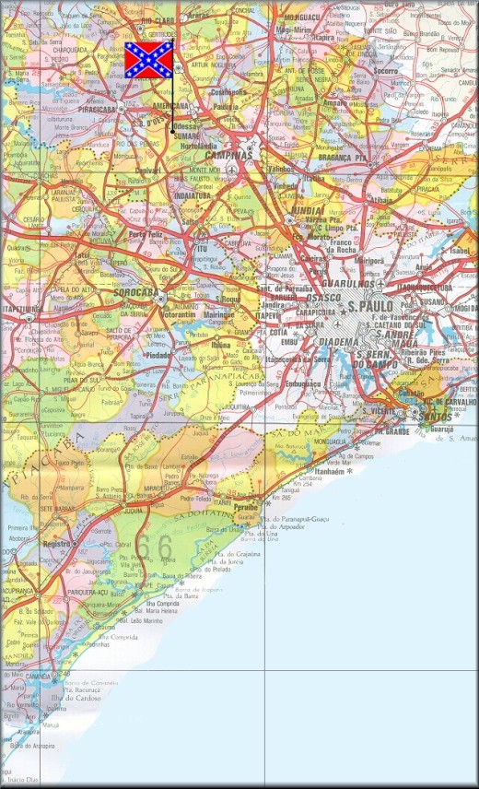
Native speaker Brazilian English: The Confederados

Slide 28
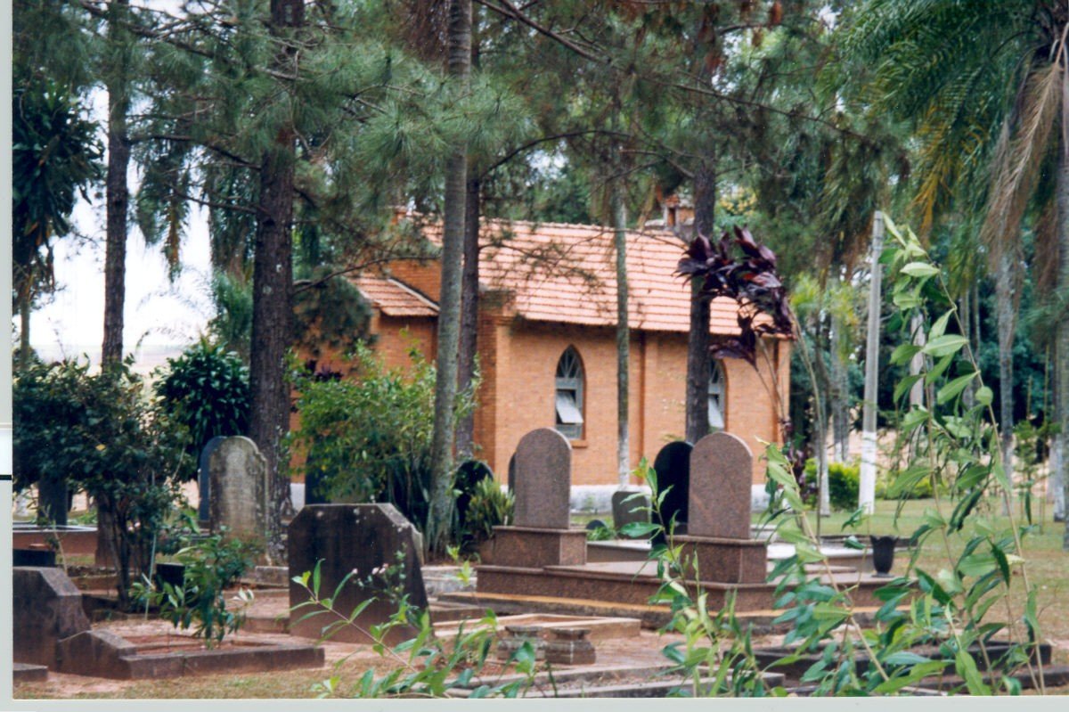
O cemitério do campo

Slide 29
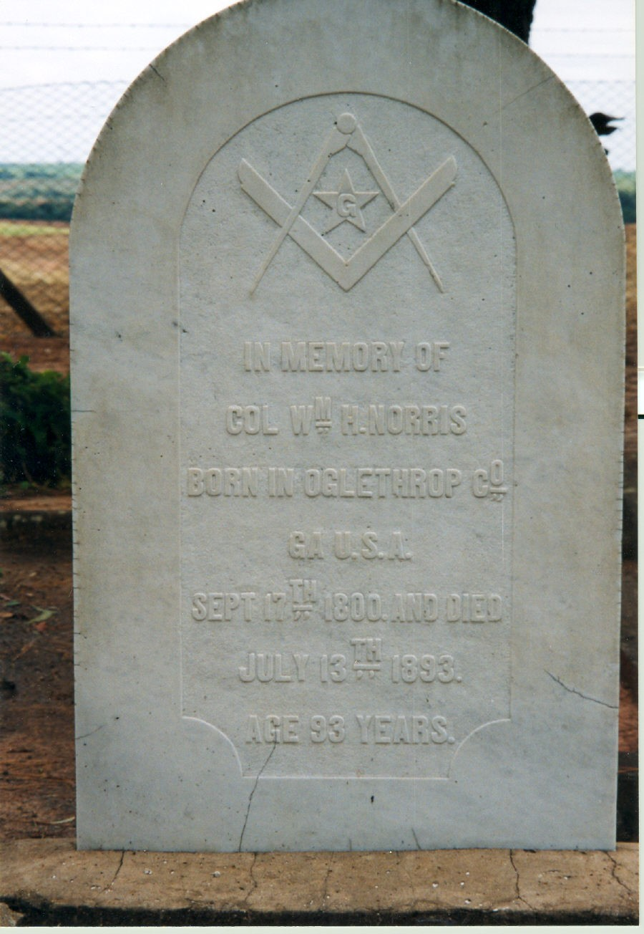
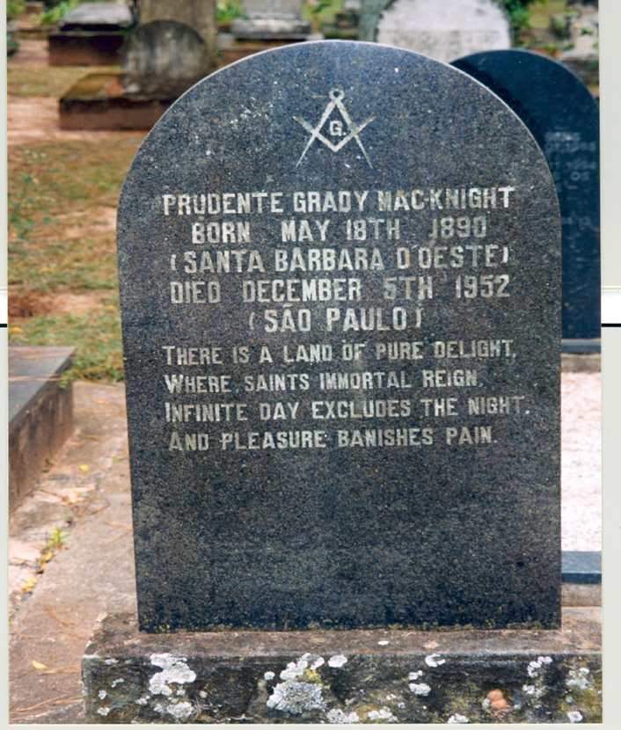
O cemitério do campo

Slide 30
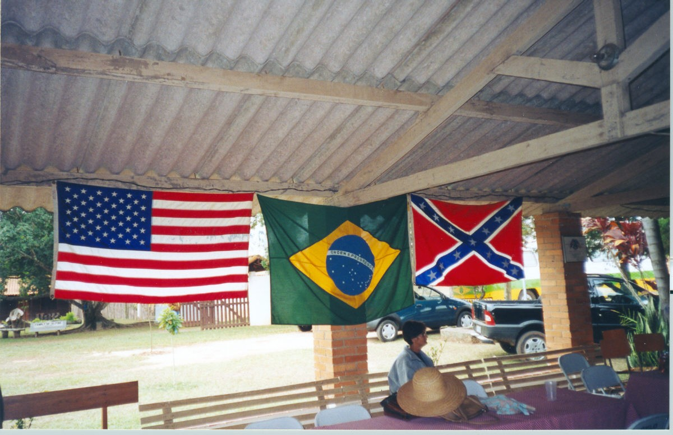
Claiming mutiple identity

Slide 31
Some Confederados narratives
Emigrant’s Guide to Brazil (1845)
Brazil, the Home for Southerners (1866)
Hunting a Home in Brazil (1867)
Ten Months in Brazil (1867)
Soldado Descansa! (1967)
The Lost Colony of the Confederacy (1985)
The Elusive Eden (1987)

Slide 32
A confederado speaks (Compare with the Southern States of the USA accent)
A: what I call the immigrants
and which are my ancestors
they just wanted to get the hell out of there they
because it couldn’t put up with Yankee domination
especially with what started happening after Lincoln’s uh execution
A: we say Lincoln’s execution yeh
B: I noticed that
A: executed
but anyway after he he was executed
uh things got very very bad very bad bad
you don’t find anybody talking about the reconstruction

Slide 33
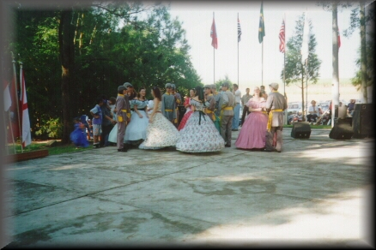
Performing Confederados identity

Slide 34
Next week
Acoustic phonetics!

