Slide 1
Topics in Phonetics & Phonology
John Corbett: USP-CAPES International Fellow
Session 7: World Englishes– West Indies and India

Slide 2
Course structure
Introduction: Review of IPA & lexical sets
Review: Transcribing connected speech
Accents of English 1: Reference accents (RP and GenAm)
Revisiting English as a lingua franca
Accents of English 2: American accents
Accents of English 3: British Accents
Accents of English 4: Accents of World English
Accents of English 5: Brazilian English accents

Slide 3
Course structure
Acoustic phonetics: Using WASP
Rhythms of English: Poetic metre
Rhythms of English: Rhythm in speech
Discourse intonation 1
Discourse intonation 2
Course review

Slide 4
This session
Two sets of World English accents:
What is their history?
What are their indexical features?
Can you distinguish a Jamaican from an Indian speaker?
Can you switch from Jamaican to Indian?

Slide 5
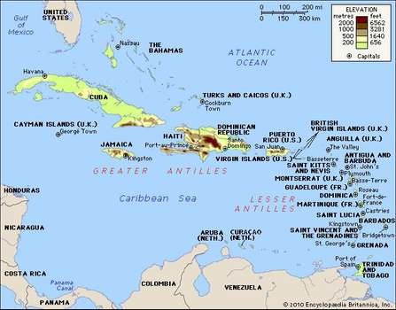
The West Indies: Context
Language contact: African languages and English, Spanish, French & Dutch
Creole basilects and prestige (‘standard educated’) acrolect
Largest population of English speakers in Jamaica (2 million +).
History of colonialism: British-based phonology.

Slide 6
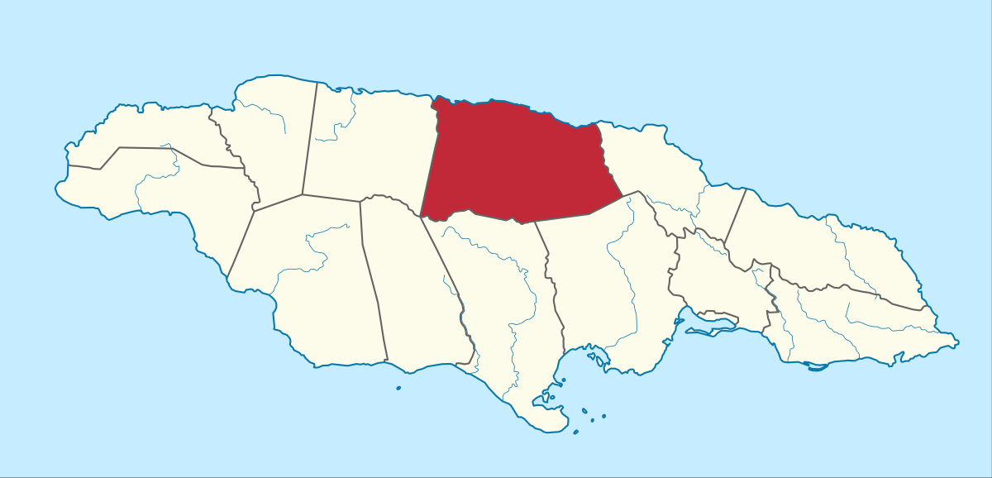
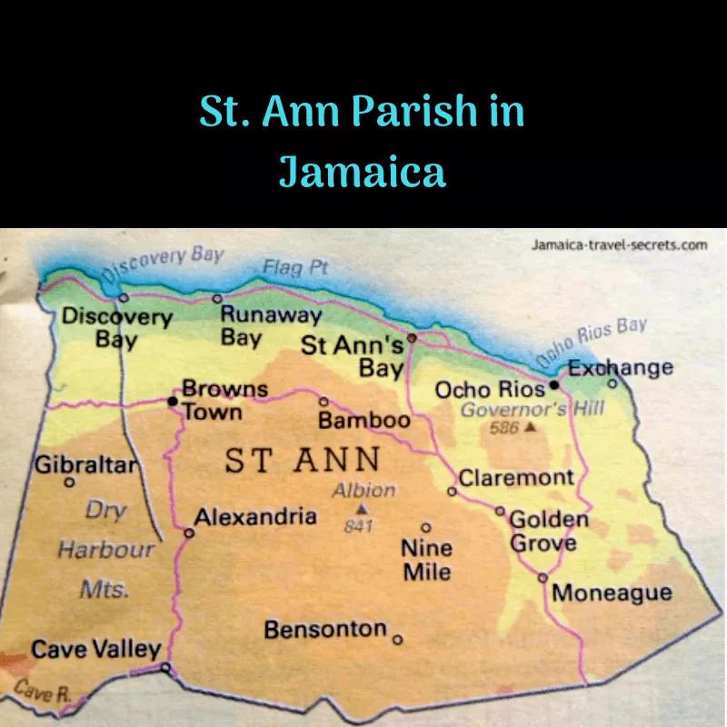
Example of a Jamaican accent
Speech accent archive
Jamaican creole speaker from Cave Valley

Slide 7
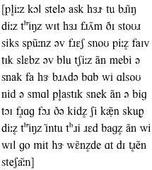
Example of a Jamaican accent: What do you notice?

Slide 8
Example of a Jamaican accent
http://accent.gmu.edu/searchsaa.php?function=detail&speakerid=967

Slide 9
West Indies: Indexical features
Consonantal features:
TH-stopping /θ, ð/ > /t, d/ things, brother
Variable rhoticity /r/ sometimes present, sometimes omitted

Slide 10
West Indies: Indexical features
Vowel features:
Frequency of /a:/ vowel, in words like
BATH PALM
CLOTH THOUGHT
START NORTH
Merger of FORCE-CURE vowels: /o:r/
Relatively few unstressed vowels: look at the realisation of her, also, into, station

Slide 11
Standard lexical sets Jamaican and RP

Slide 12
West Indies: Indexical features versus an actual Jamaican speaker
TH-stopping, eg these things, brother.
Frequency of /a:/ vowel, in words like
BATH PALM snack, bag, ask
CLOTH THOUGHT frog, Bob
This speaker has /ɑ/ for some of these items, frog/Bob
Merger of FORCE-CURE vowels: /o:r/
This speaker is diphthongising store.
Relatively few unstressed vowels: look at the realisation of her, also, into, station, for. But there are some weak forms, eg of, a.

Slide 13
Stress placement in certain words:
rea’lize
cele’brate
agri’culture
‘kitchen

Slide 14
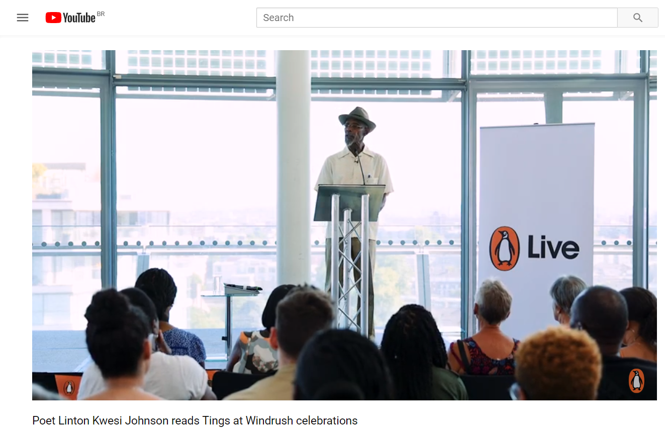
Jamaican English in England
Linton Kwesi Johnson reads ‘Tings’
https://www.youtube.com/watch?v=M6hcMRjCOxo

Slide 15
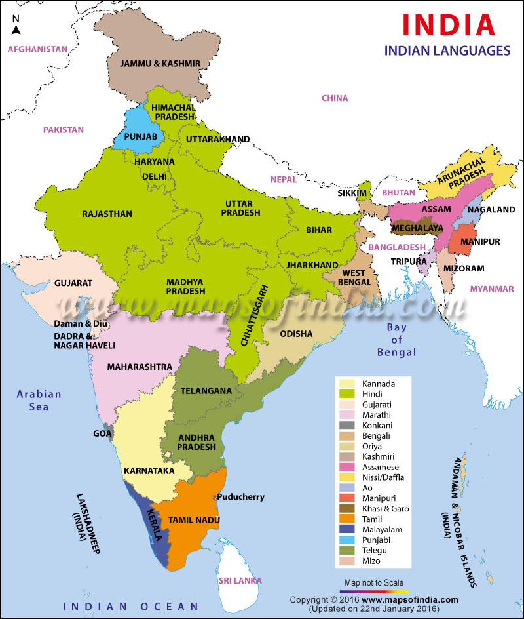
Language in India
Languages in India
English as an administrative lingua franc in post-colonial India

Slide 16
IDEA

Slide 17
IDEA: https://www.dialectsarchive.com/

Slide 18
Indian English: Vowels: some features
Variably non-rhotic. Examples of this include flower pronounced as /flaʊ.ə/, never as /nevə/, water as /wɔːtə/, etc.
Rhoticity and r-coloured vowels, have been gaining influence on Indian English in recent years as cultural and economic ties increase between India and the United States.
Indian English speakers merge /ɒ/ and /ɔː/ COT-CAUGHT
Diphthong /eɪ/ is pronounced as /eː/
Diphthong /əʊ/ is pronounced as /oː/
/ɑː/ may be more front /a/
The following are the variations in Indian English resulting from inability to articulate few vowels
Pronunciation of /ɔ/ as /o/
Pronunciation of /æ/ and /ɛ/ as /e/
Pronunciation of /ɔ/ and /ɒ/ as /a/

Slide 19
Indian English: consonantal features
The voiceless plosives /p/, /t/, /k/ are always unaspirated in Indian English
The alveolar stops English /d/, /t/ are often retroflex [ɖ], [ʈ], especially in the South of India.
All major native languages of India lack the dental fricatives /θ/ and /ð/ Usually, the aspirated voiceless dental plosive [t̪ʰ] is substituted for /θ/ in the north (it would be unaspirated in the south) and the unaspirated voiced dental plosive [d̪], or possibly the aspirated version [d̪ʱ], is substituted for /ð/.
For example, "thin" would be realised as [t̪ʰɪn] instead of /θɪn/ for North Indian speakers, whereas it would be pronounced unaspirated in the south.

Slide 20
Next week
Brazilian English accents

