Slide 1
Topics in Phonetics & Phonology
John Corbett: USP-CAPES International Fellow
Session 5: American accents – NY and the Southern States

Slide 2
Course structure
Introduction: Review of IPA & lexical sets
Review: Transcribing connected speech
Accents of English 1: Reference accents (RP and GenAm)
Revisiting English as a lingua franca
Accents of English 2: American accents
Accents of English 3: British Accents
Accents of English 4: Accents of World English
Accents of English 5: Brazilian English accents

Slide 3
Course structure
Acoustic phonetics: Using WASP
Rhythms of English: Poetic metre
Rhythms of English: Rhythm in speech
Discourse intonation 1
Discourse intonation 2
Course review

Slide 4
This session
New York city and the Southern States:
What is their history?
What are their indexical features?
Can you distinguish a New Yorker from a Southern US speaker?
Can you switch from a New York to a Southern accent?

Slide 5
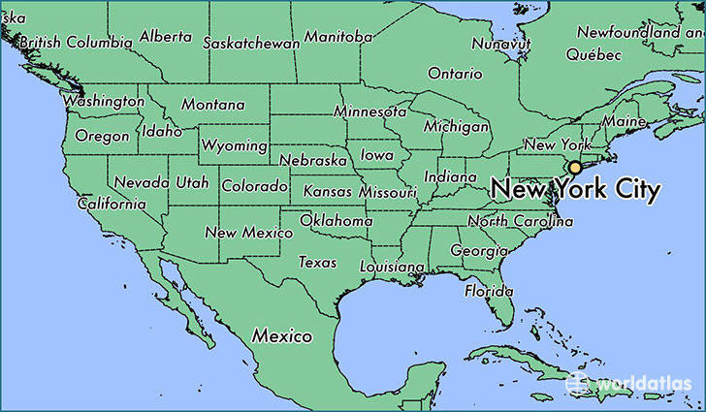
Example of a Brooklyn accent
http://accent.gmu.edu/searchsaa.php?function=detail&speakerid=121

Slide 6
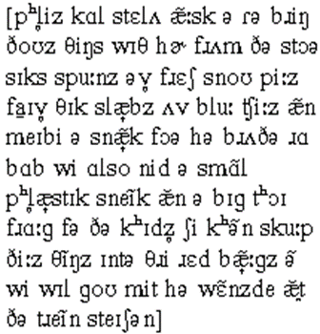
Talking Brooklyn
In pairs, read aloud in your best Brooklyn accent…

Slide 7
New York accents
One of the most populous anglophone cities in the world
Melting pot of different people, cultures and languages
Diverse accents, clearly socially stratified: “the pronunciation of two New Yorkers, both of them born and bred in the city, may exhibit far greater divergences than those that distinguish the speech of Wisconsin, let us say, from that of Oregon” (Hubbell 1950, quoted in JC Wells, 1982, p.502)
‘Brooklynese’ is recognised as a particular working-class NY accent but it exhibits few differences from the accents of other boroughs, such as Queens and the Bronx.

Slide 8
New York Indexical features
Variable non-rhoticity
Quality of the TRAP-BATH, CLOTH-THOUGHT and NURSE vowels
Realisations of /t, d, θ, ð/

Slide 9
Variable non-rhoticity
NY often regarded as a non-rhotic accent, eg:
/nɪə/ /skwɛə/ /stɑət/ /nɔəθ/
Possibly under pressure from GenAm, there is /r/ restoration:
/nɪər/ /skwɛər/ /stɑərt/ /nɔərθ/

Slide 10
William Labov’s famous 1960s experiment
Labov visited 3 department stores, one in a low-status area (Klein’s), one in an intermediate status neighbourhood (Macy’s) and one in a prestige neighbourhood (Sak’s).
He asked 200 sales staff questions that would elicit the answer ‘the fourth floor.’
He recorded the answers and analysed the results.
Rhoticity was shown to be variable in all contexts.
In Klein’s non-rhotic was the norm, though older and younger staff did have prevocalic /r/.
In Macy’s rhoticity was more prevalent and it increased with age.
In Sak’s rhoticity was also more prevalent but it decreased with age.
Rhoticity was favoured, especially by younger users (in the 1960s) in formal styles of speech, but non-rhoticity remained the norm in casual styles of speech.

Slide 11
New Yor:k Indexical Vowels
NURSE
New York | ɜɪ ~ ɜ(r) | closing diphthong moving to open-mid central monophthong | hurt, lurk, urge, burst, jerk, term
GenAm | ɜ(r) | open-mid central
TRAP
New York | æ ~ æə ~ ɛə | raised open front unrounded moving to centering diphthong | tap, back, badge, scalp, hand, cancel
GenAm | æ | raised open front unrounded
BATH
New York | æə ~ ɛə | centering dipthong | staff, brass, ask, dance, sample, calf
GenAm | æ | raised open front unrounded
CLOTH
New York | ɔə | centering diphthong | cough, broth, cross, long, Boston
GenAm | ɔ | open-mid back rounded
THOUGHT
New York | ɔə | centering diphthong | taught, sauce, hawk, jaw, broad
GenAm | ɔː | long open-mid back rounded

Slide 12
More about NY vowels
The NURSE vowel is conservatively /ɜɪ / but moved towards /ɜ(r)/ as it was socially stigmatised. This diphthong is also sometimes found in CHOICE words, so <oil> and <earl> can be homophones.
The move from an open front unrounded vowel /æ/ to a centering diphthong /æə/ is known as BATH-raising. This usually happens in particular phonetic environments, eg before a final voiced plosive, as in ‘Call me a cab!’ Obviously there is a merger with the TRAP vowel.
The diphthongisation of THOUGHT-CLOTH vowels is called THOUGHT-CLOTH raising. It is found in words like <shore> /ʃɔə/.
The non-rhoticity and diphthongisation marks out the NY accent.

Slide 13
Other features of the NY accent
Alveolar consonants /t, d, n, l/ are pronounced with the blade of the tongue, not the tip.
Glottal stops are used more commonly than in other American accents.
/θ, ð/ are often pronounced as affricates or plosives: [tθ, dð] or simply [t̪ , d̪ ] though the plosives would be dental and so distinct from alveolar /t, d/.

Slide 14
Back to Brooklyn
http://accent.gmu.edu/searchsaa.php?function=detail&speakerid=121
This is a non-rhotic accent: store, for, brother, etc.
The arrows indicate raising of the BATH-TRAP vowels: slabs, snack, bags.
The THOUGHT vowel is evident in store

Slide 15
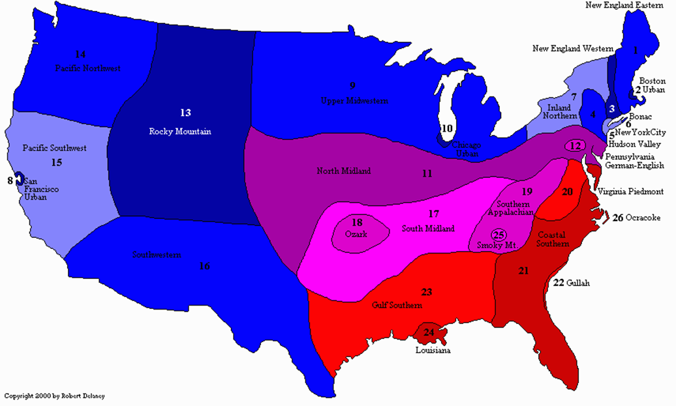
The Southern States

Slide 16
Southern accents in context
The linguistic South of the USA includes Virginia, North & South Carolina, Georgia, Alabama, Mississippi, Florida, Arkansas, Louisiana, and Texas.
There is a wide diversity of accent in this area, as the second map shows. Some point to up to 3o subvarieties.
Historically, there is language contact between numerous language groups: Scots-Irish, African-American, Hispanic…
Expect variation!

Slide 17
Vowels of Southern accents

Slide 18
Things to notice
Variable rhoticity: blacks and upper-class whites tend to be non-rhotic. Other groups tend to pronounce preconsonantal and final /r/ or have /r/-coloured (rhoticised) vowels.
Short (lax) vowels tend to be lengthened or diphthongised, eg BATH /bæɪθ/, GOAT /goʊt/, FORCE /foəs/ or r-coloured /foɚs/
PRICE may become a long monophthong /pra:s/
NORTH and CURE vowels are merged: poor would be /poə/

Slide 19
Try pronouncing Arkansas English (note the diphthongs)

Slide 20
Arkansas English
http://accent.gmu.edu/searchsaa.php?function=detail&speakerid=107
Diphthongs for lax vowels: call, spoons, peas, cheese, small, frog, kids, red
Monophthong for PRICE vowel: five
Rhoticity: her, store, for

Slide 21
Moodle quiz & next week’s session
More transcription practice
Two British English accents

