Slide 1
Topics in Phonetics & Phonology
John Corbett: USP-CAPES International Fellow
Session 3: Normative accents: RP and GenAm

Slide 2
Course structure
Introduction: Review of IPA & lexical sets
Review: Transcribing connected speech
Accents of English 1: Reference accents (RP and GenAm)
Revisiting English as a lingua franca
Accents of English 2: Two American accents
Accents of English 3: Two British Accents
Accents of English 4: Accents of World English
Accents of English 5: Brazilian English accents

Slide 3
Course structure
Acoustic phonetics: Using WASP
Rhythms of English: Poetic metre
Rhythms of English: Rhythm in speech
Discourse intonation 1
Discourse intonation 2
Course review

Slide 4
This session
RP and GenAm as normative accents:
What is their history?
Why are they normative?
What are their indexical features?
Can you distinguish an RP from a GenAm speaker?
Can you switch from RP to GenAm?

Slide 5
What is a ‘normative’ accent
A normative accent is used as a point of reference for users, whether overseas learners or native speakers.
For English the ‘normative’ accents are Received Pronunciation (for the UK, Australia, New Zealand, South Africa) and GenAm for the USA.
RP is associated with the elite class (‘Queen’s English), education (‘Oxford English’) and serious institutional usages (‘BBC English’).
GenAm is a disputed term, sometimes used to refer to a relatively regionless form of American pronunciation outside New England, New York and the Southern States.
Both RP and GenAm are spoken by only a minority of native speakers, but their social prestige and regionally unmarked nature makes them widely intelligible and attractive as learner models.
Though they are relatively unmarked for region, there are varieties of RP and GenAm and they do change over time!

Slide 6
RP in context
Developed as a model for middle-class speech in England, deriving probably from the accent spoken at court and by scholars at Oxford and Cambridge. Disseminated by the elite public school system (ie private education).
By the early 20th century it was recognisable enough to be codified by the phonetician, Daniel Jones, who called it ‘Public School Pronunciation’ and then ‘RP’.
It was adopted by the BBC when it was established in the 1920s and radio, and then television, promoted its wider dissemination and added to its prestige. It was the standard model of BBC pronunciation until the 1960s.
Still used as the basis for English language textbooks produced in the UK for international learners.

Slide 7
RP: Indexical features
RP is non-rhotic, ie, /r/ is only pronounced preceding a vowel. It is not articulated before consonants or word-finally.
car /kɑ:/
bar /bɑ:/
rare /reə/
/r/ is used to link vowels in sequences like /reər i:glz/ (rare eagles)
Intrusive /r/ is heard in sequences like /lɔːrən ɔːdə/ (law and order)

Slide 8
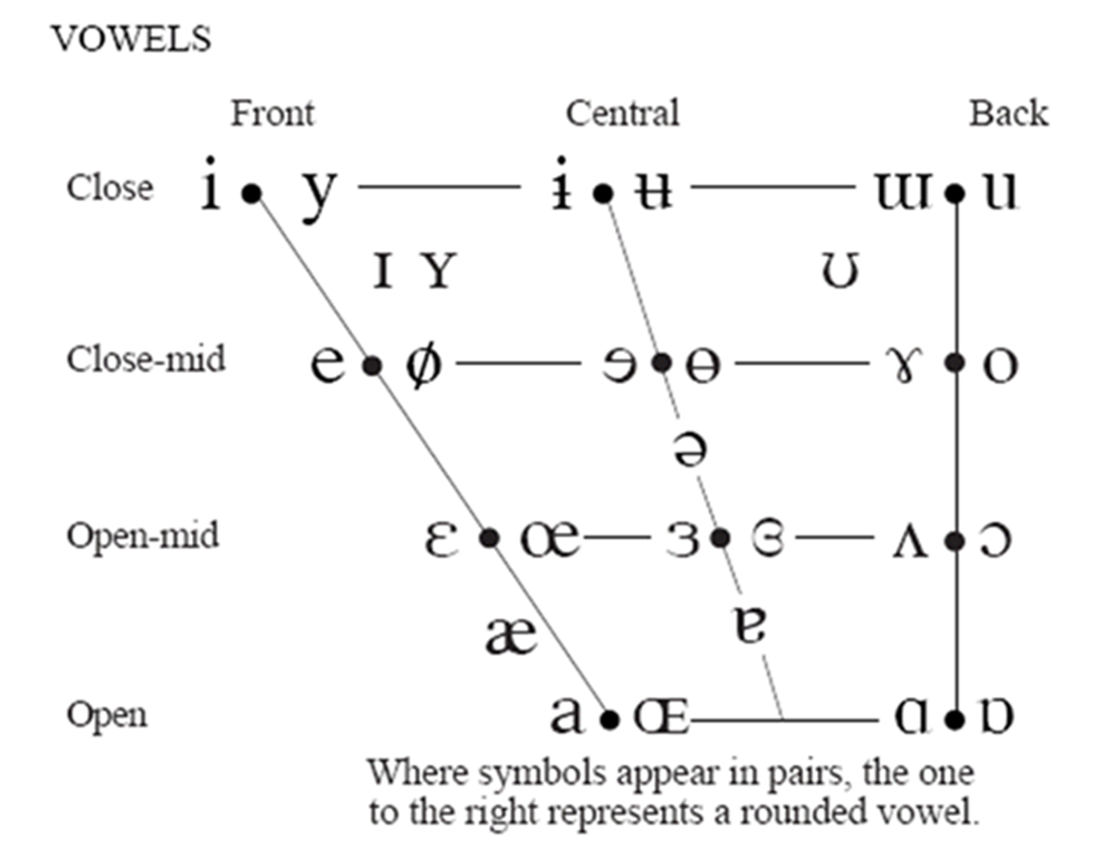
RP: Indexical features
Vowel contrasts:
LOT versus THOUGHT
/ɒ/ /ɔː/
TRAP versus BATH
/æ/ /ɑː/
FOOT versus GOOSE
/ʊ/ /u:/
short long
lax tense

Slide 9
Short or long? Lax or tense?
Can you group the following words as short or long?
Short: LOT/TRAP/FOOT
Long: THOUGHT/BATH/GOOSE
pull | sock | hand | palm | sauce | father
taught | back | broad | possible | good | shoot
put | huge | view | cancel | quality | ask

Slide 10
Short or long? Lax or tense?
Can you group the following words as short or long?
Short/lax: LOT/TRAP/FOOT
Long/tense: THOUGHT/BATH/GOOSE
pull | sock | hand | palm | sauce | father
taught | back | broad | possible | good | shoot
put | huge | view | cancel | quality | ask

Slide 11
Can you speak RP?

Slide 12
Listening to RP
http://accent.gmu.edu/searchsaa.php?function=detail&speakerid=70

Slide 13
GenAm in context
GenAm coined by George P. Krapp (1924) in The English Language in America. The validity of the term is disputed.
Accepted by JC Wells in Accents of English (1982) as a form of English pronunciation spoken by Americans outside the Eastern and Southern States of the USA.
Like RP, associated with broadcasting (‘Network Standard’)
Used in American textbooks as a model for English pronunciation for second language learners.

Slide 14
USA: Speech Areas
The term ‘General American’ distinguishes the rhotic American accents from the non-rhotic varieties of the Eastern and Southern States.

Slide 15
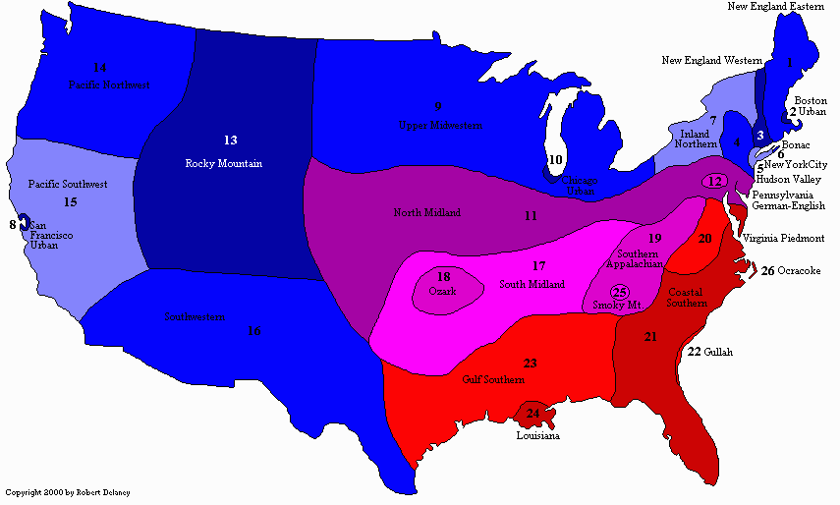
USA: Speech Areas
A more detailed representation of US speech areas

Slide 16
Indexical features of GenAm
GenAm is rhotic - /r/ is pronounced in all contexts, though the /r/ articulation might be an ‘r-coloured vowel’ (eg /ɜʴ/)
car RP /kɑ:/ GenAm /kær/
bar RP /bɑ:/ GenAm /bær/
rare RP /reə/ GenAm /rɛr/
GenAm tends to reduce the number of vowels in the context /___r/.
/ir ~ ɪr/ merge as /ɪr/ near, spirit
/eɪr ~ ɛr ~ ær/ merge as /ɛr/ fairy, ferry, marry
/ɑr/ (START, LOT) bar, sorry
/ɔr ~ or/ merge as /ɔr / war, bore, orange
/ʌr ~ ɜr/ merge as / ɜʴ/ current, furry

Slide 17
GenAm vowels: tendency to diphthongize
The short monophthongs /ɪ ɛ ʊ ʌ/ may become centring diphthongs when stressed and preceding a final voiced consonant, eg
He´s wearing a bib! /bɪəb/
Let’s go to bed! /bɛəd/
Your so good! /gʊəd/
Give me a rub! /rʌəb/
Before /ʒ/ and /ʃ/, certain vowels may diphthongize towards /ɪ/, e.g.
[mɛɪʒəʴ] /splæɪʃ/ /pʊɪʃ/ /wɔɪʃ/
Before final /l/ there may be diphthongization of /i/ and /u/ e.g.
[fiəɫ] [riəɫ] [ruəɫ] [skuəɫ]

Slide 18
Other consonantal features of GenAm
Yod-dropping: /tun/ /nu/ /duk/ /dud/
Hypercorrection /njun/
T-voicing: /bʌɾəʴ/ voiced alveolar tap

Slide 19
Pronouncing GenAm (Utah)

Slide 20
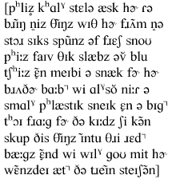
Listening to GenAm (Utah)
http://accent.gmu.edu/searchsaa.php?function=detail&speakerid=124

Slide 21
This week’s moodle quiz
Comparing RP and GenAm

Slide 22
Next week
Revisiting ELF with Daniel Ferraz

