Slide 1
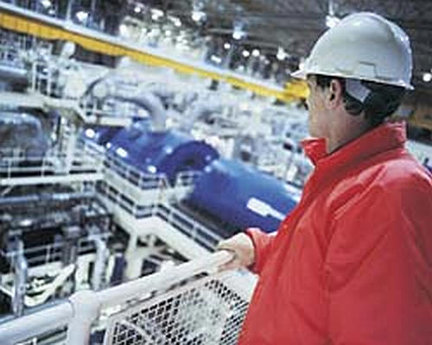
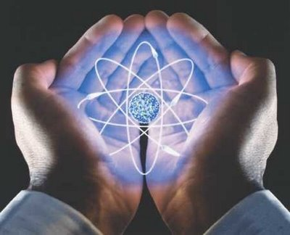
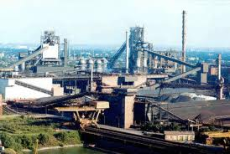
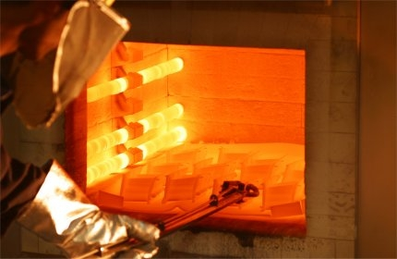
Termodinâmica dos Materiais

Slide 2
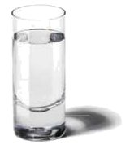
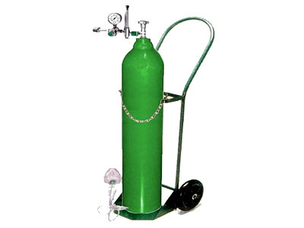
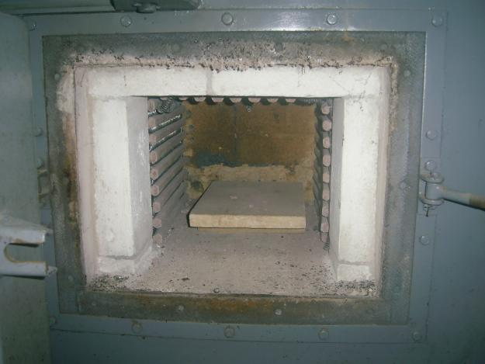
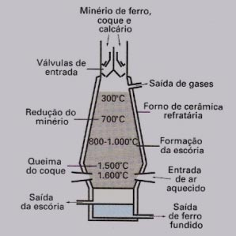
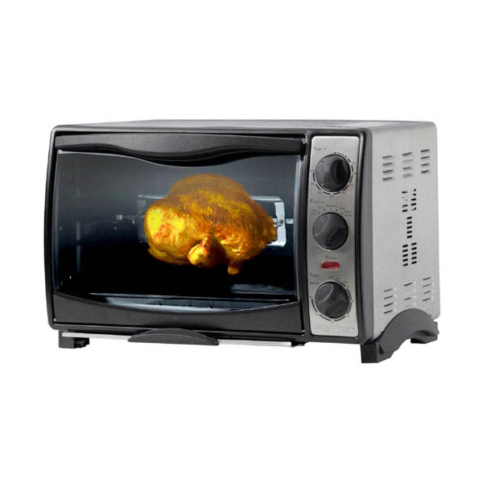
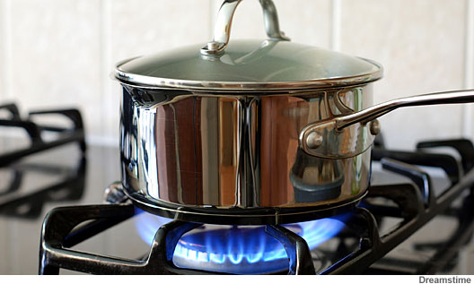
Thermodynamic Basic Concepts:
Systems

Slide 3
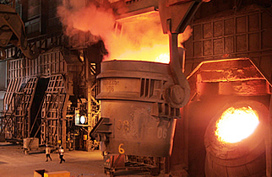
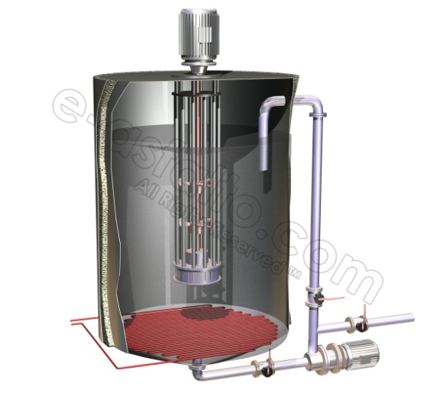
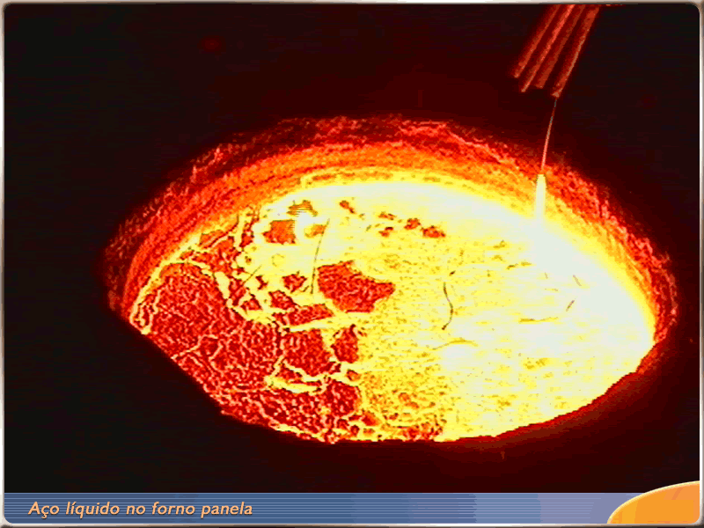
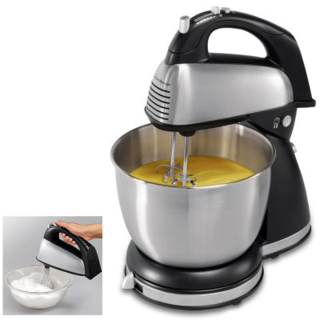
Thermodynamic Basic Concepts:
Systems

Slide 4
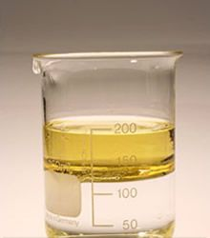
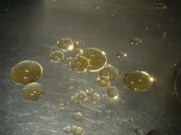
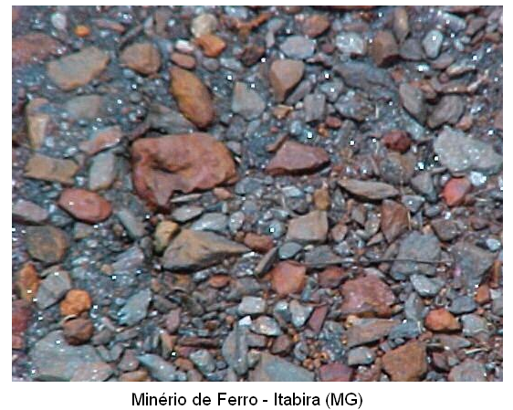
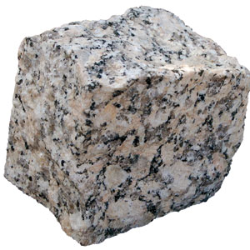
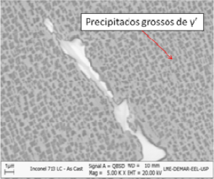
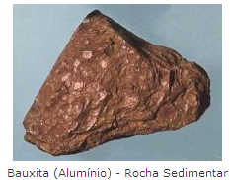
Thermodynamic Basic Concepts:
Phases

Slide 5
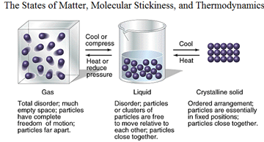
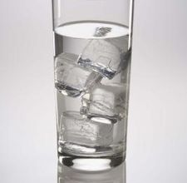
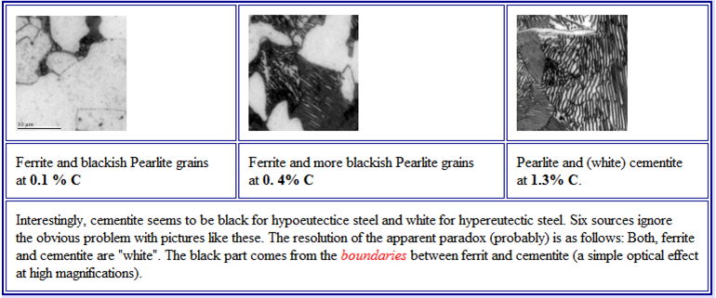
Thermodynamic Basic Concepts:
Phases

Slide 6
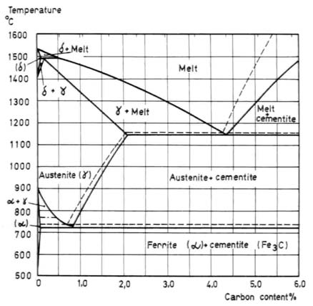
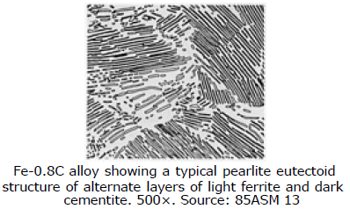
Thermodynamic Basic Concepts:
Phases

Slide 7
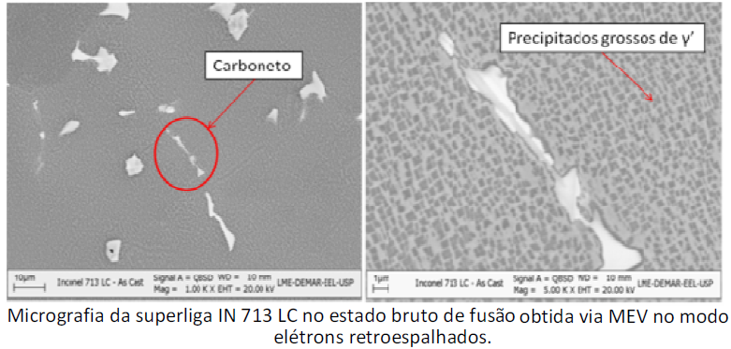
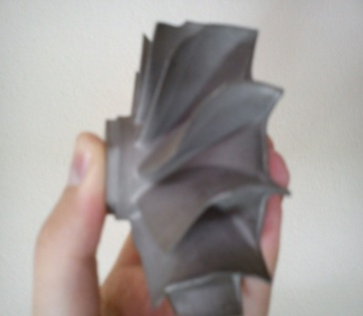
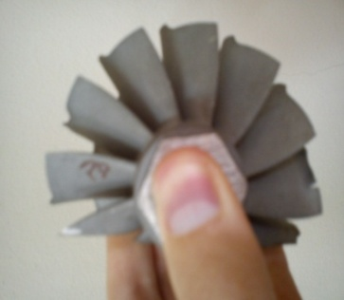
Thermodynamic Basic Concepts:
Microstructure of materials
Evolução microestrutural em função da mudança de composição das ligas

Slide 8
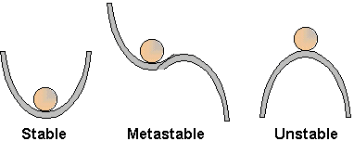
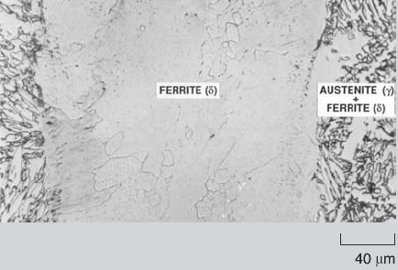
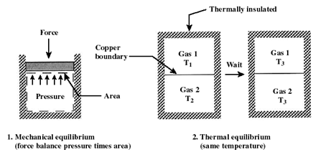
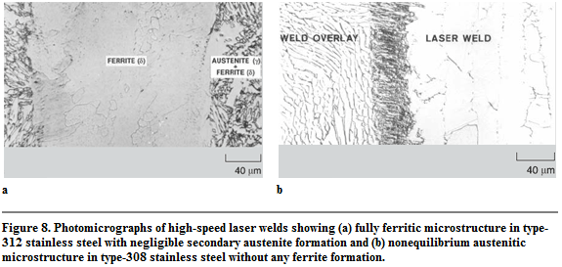
Thermodynamic Basic Concepts:
Equilibrium
Equilíbrio Termodinâmico = Eq. Térmico + Eq. Mecânico + Eq. Químico

Slide 9
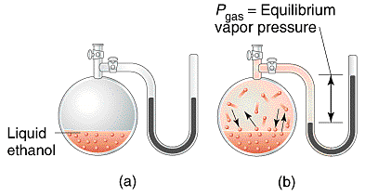
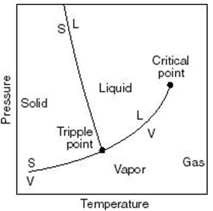
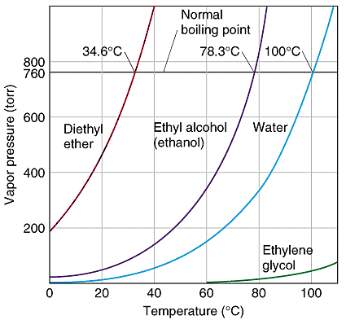
Thermodynamic Basic Concepts:
Liquid - Vapor Equilibrium

Slide 10
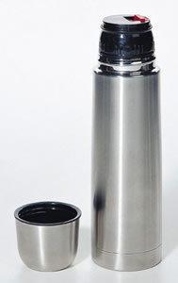
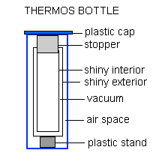
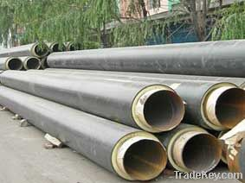
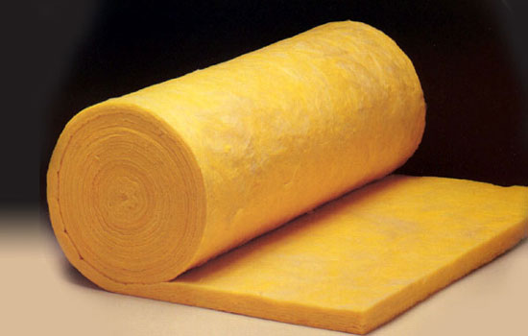
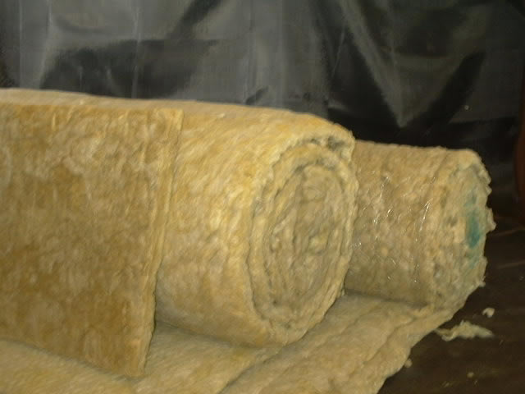
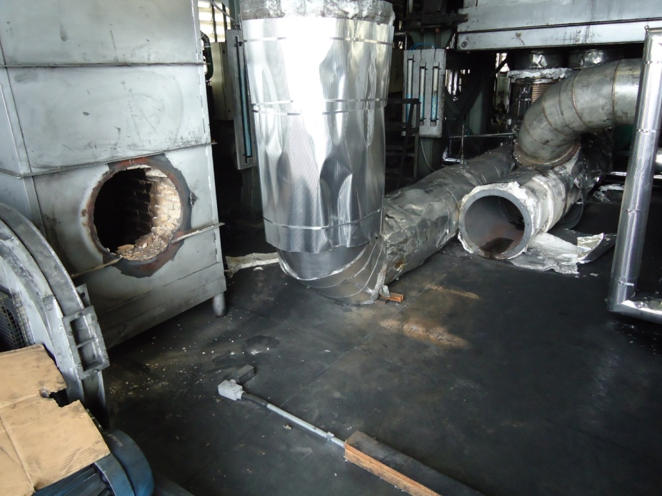
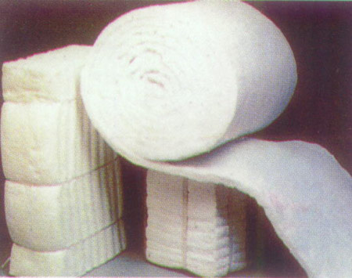
Thermodynamic Basic Concepts:
Adiabatic Process
Glass Wool Insulation
Rock Wool Insulation
Ceramic Fiber Insulation

Slide 11
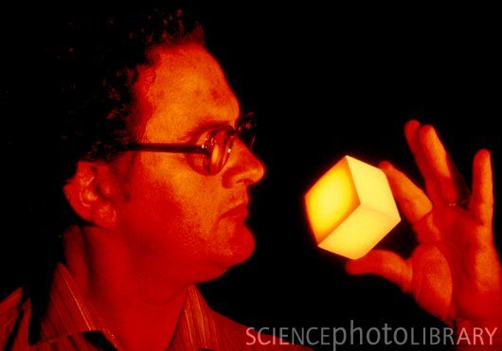
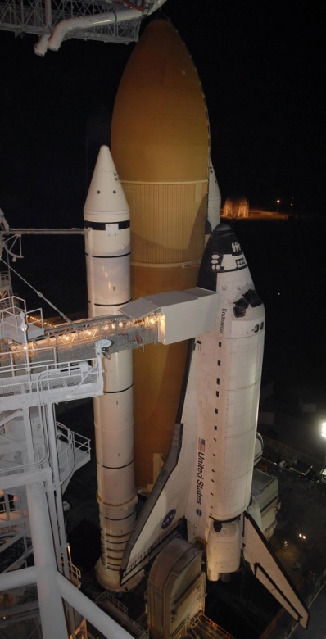
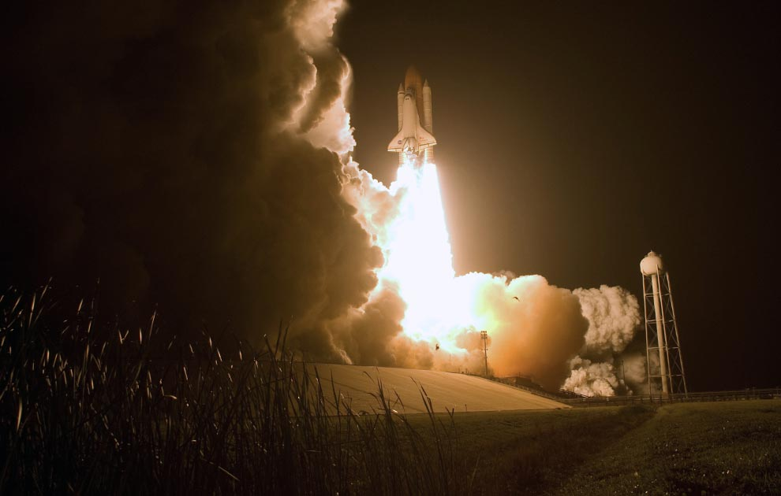
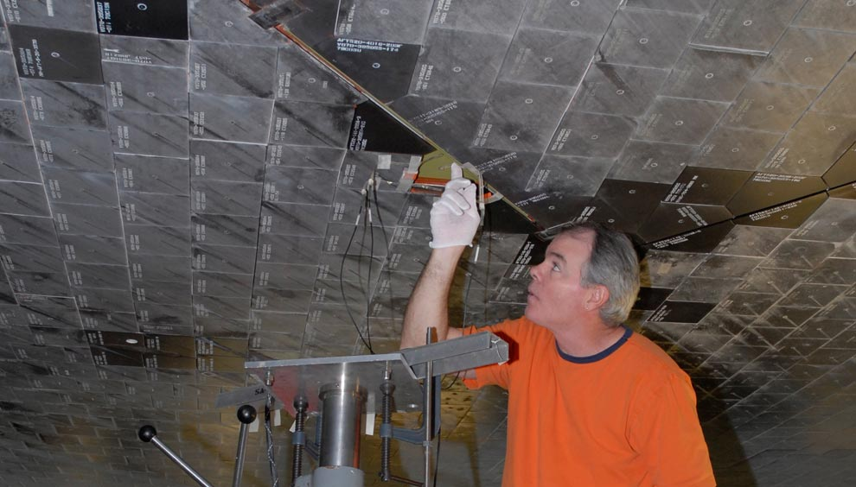
Thermodynamic Basic Concepts:
Adiabatic Process
A technician holding a silica fibre thermal insulation tile, seconds after being removed from a furnace at 1300 Celsius. The tiles lose 90% of their heat within moments. Such tiles are used on the underbody, wings and other areas of the Space Shuttle where the highest temperatures are generated during re-entry into the Earth's atmosphere.
Thermal Insulation of Space Shuttle

Slide 12
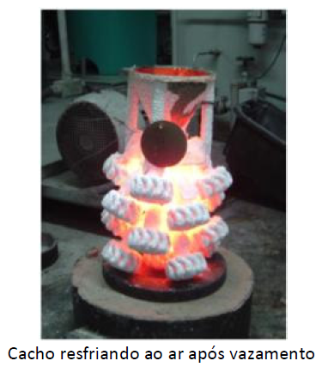
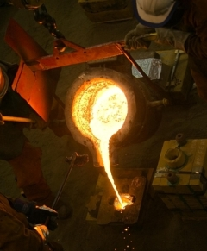
Thermodynamic Basic Concepts:
Diathermic Process
Die Casting Process
Die casting is a technique for mass-producing metal products and components. Mold design is one of the most important steps in the process because the shape and attributes of the mold will directly affect the final product. The die casting procedure forces molten metal into molds using high pressure and it requires a mold with exact specifications to achieve the task.

Slide 13
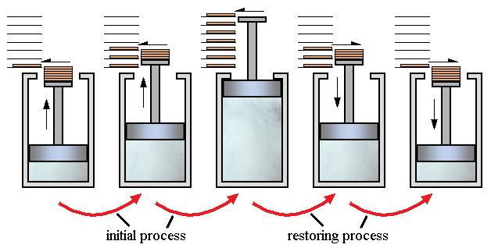
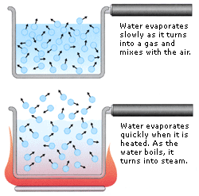
Thermodynamic Concepts:
Reversible Process
Melting Glacier - Desgelo dos Pólos

Slide 14
Thermodynamic Concepts:
Irreversible Process

Slide 15
Thermodynamic Concepts:
Equation of State
P= f(T, V, m)

Slide 16
Thermodynamic Concepts:
Equation of State
P= f(T, V, m)

Slide 17
A steam turbine is a mechanical device that extracts thermal energy from pressurized steam, and converts it into rotary motion. Its modern manifestation was invented by Sir Charles Parsons in 1884.
Condensing turbines are most commonly found in electrical power plants. These turbines exhaust steam in a partially condensed state, typically of a quality near 90%, at a pressure well below atmospheric to a condenser.

