Slide 1
Controle de conversores
Laboratório de Fontes Alternativas e Processamento de Energia – LAFAPE
Autor: Ricardo Q. Machado
Email: rquadros@sc.usp.br

Slide 2
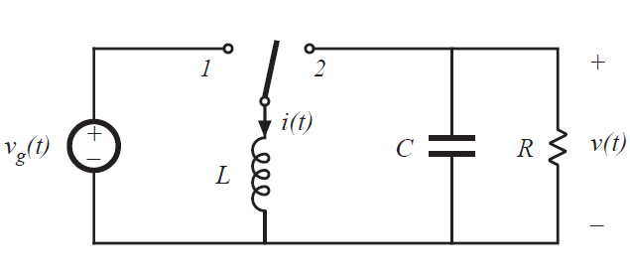
Exemplo

Slide 3
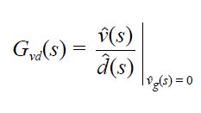
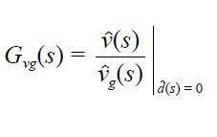
Exemplo

Slide 4
Exemplo
Estrutura de controle 2 – controle da corrente do indutor
Isolar $\hat{v}(s)$ como função de $\hat{i}(s)$e $\hat{d}(s)$;
$$\hat{v}\left(s\right)=\frac{−D^{′}\hat{i}(s) }{\left(sC+1/R\right)}+\frac{I\hat{d}(s)}{\left(sC+1/R\right)}$$

Slide 5
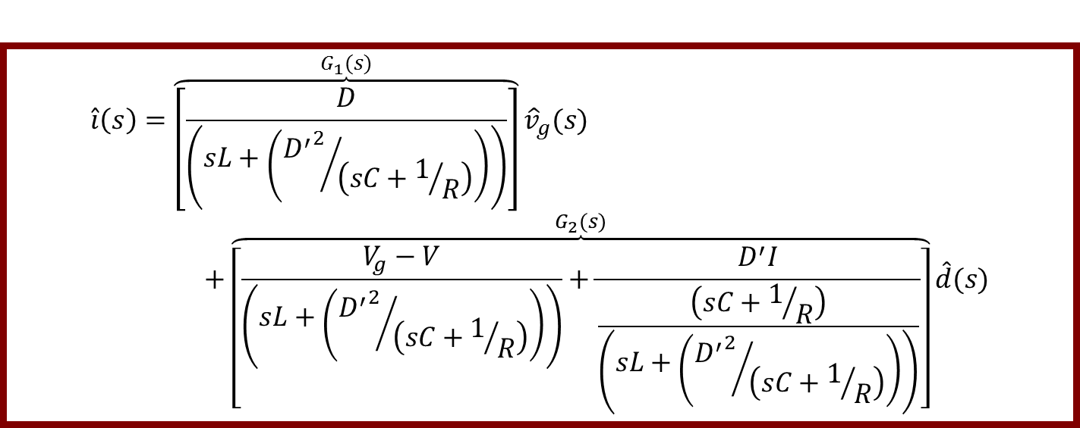
Exemplo
$$\hat{v}\left(s\right)=\frac{−D^{′}\hat{i}(s) }{\left(sC+1/R\right)}+\frac{I\hat{d}(s)}{\left(sC+1/R\right)}$$
$$\hat{i}\left(s\right)=\overset{G_{1}(s)}{\overbrace{\left[\frac{D}{\left(sL+\left({{D^{′}}^{2}}/{\left(sC+1/R\right)}\right)\right)}\right]}}{\hat{v}}_{g}(s)+\overset{G_{2}(s)}{\overbrace{\left[\frac{V_{g}−V}{\left(sL+\left({{D^{′}}^{2}}/{\left(sC+1/R\right)}\right)\right)}+\frac{D^{′}I}{\frac{\left(sC+1/R\right)}{\left(sL+\left({{D^{′}}^{2}}/{\left(sC+1/R\right)}\right)\right)}}\right]}}\hat{d}(s)$$

Slide 6
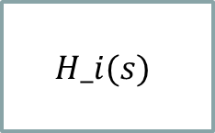
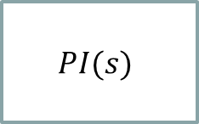
Exemplo
$$\hat{i}\left(s\right)=G_{1}(s){\hat{v}}_{g}(s)+G_{2}(s)\hat{d}(s)$$
$${\hat{v}}_{g}(s)$$
$$G_{2}$$
$$G_{1}(s)$$
$$PI(s)$$
$$PWM$$
$$\hat{d}(s)$$
$$G_{2}$$
+
$${\hat{i}}^{∗}\left(s\right)$$
+
$$\hat{i}\left(s\right)$$
+
$$G_{2}(s)$$
-
$$H_i(s)$$

Slide 7
Exemplo
Estrutura de controle 3 – controle em cascata da corrente do indutor e tensão do capacitor
Isolar $\hat{v}(s)$ como função de $\hat{i}(s)$e $\hat{i}(s)$como função de $\hat{d}\left(s\right).$

Slide 8
Exemplo
$$\hat{i}\left(s\right)={G′}_{1}(s){\hat{v}}_{g}(s)+{G′}_{2}\hat{d}(s)$$
$$\hat{v}\left(s\right)={G′}_{3}(s){\hat{v}}_{g}(s)+{G′}_{4}\hat{i}(s)$$
$${\hat{v}}_{g}(s)$$
$${\hat{v}}_{g}(s)$$
$$G_{2}$$
$$G_{2}$$
$${G′}_{1}(s)$$
$${G′}_{3}(s)$$
$${\hat{v}}^{∗}\left(s\right)$$
$${\hat{i}}^{∗}\left(s\right)$$
$$\hat{d}(s)$$
+
+
+
$$PI_v(s)$$
+
$$PI_i(s)$$
$$PWM$$
$$G_{2}$$
+
+
$$\hat{v}\left(s\right)$$
$${G′}_{2}(s)$$
$${G′}_{4}(s)$$
-
-
$$\hat{i}\left(s\right)$$
$$H′_i(s)$$
$$H′_v(s)$$

