Slide 1
Phonetics & Phonology
John Corbett: USP-CAPES International Fellow
Session 7: Contrastive analysis: consonants

Slide 2
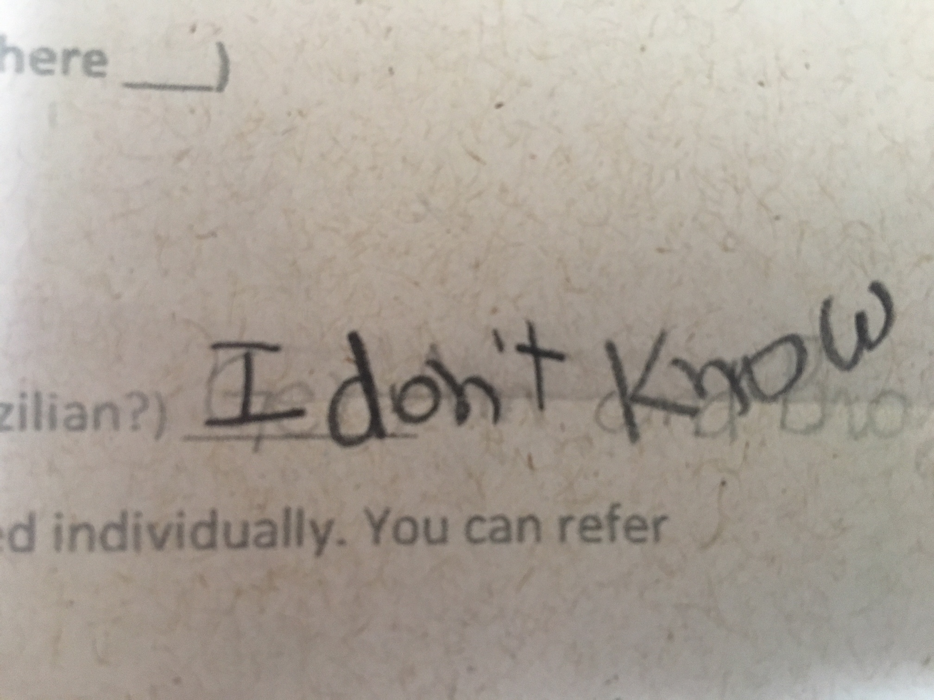
What is my accent?

Slide 3
Today´s session
This session:
English and Brazilian phonological systems
Vowels

Slide 4
Source of information

Slide 5
General
Vowels
RP English has 12 vowels and 10 diphthongs
Brazilian Portuguese has 8 vowels and 6 diphthongs
When pronouncing English the red vowels can cause problems.
The unshaded vowels have near equivalents or equivalents in Portuguese.
i: | ɪ | ɛ | æ | eɪ | aɪ | ɔɪ
ɑ: | ɒ | ɔ: | ʊ | aʊ | əʊ | ɪə
u: | ʌ | ɜ: | ə | eə | ʊə | aɪə
 |  |  |  |  |  | aʊə

Slide 6
/i:/ versus /ɪ/
/i:/ is shortened by Portuguese speakers and can be confused with /ɪ/
Minimal pairs:
rich reach
hit heat
live leave
bin bean
Tim team
i: | ɪ | ɛ | æ | eɪ | aɪ | ɔɪ
ɑ: | ɒ | ɔ: | ʊ | aʊ | əʊ | ɪə
u: | ʌ | ɜ: | ə | eə | ʊə | aɪə
 |  |  |  |  |  | aʊə

Slide 7
/ɛ/ versus /æ/
/ɛ/ can be confused with /æ/
Minimal pairs:
beg bag
head had
leg lag
bread Brad
ten tan
i: | ɪ | ɛ | æ | eɪ | aɪ | ɔɪ
ɑ: | ɒ | ɔ: | ʊ | aʊ | əʊ | ɪə
u: | ʌ | ɜ: | ə | eə | ʊə | aɪə
 |  |  |  |  |  | aʊə

Slide 8
/ɑ:/ versus /æ/
/ɑ:/ is shortened by Portuguese speakers and can be confused with /æ/
(This happens in Scotland too!)
Minimal pairs:
aunt ant
hard had
bard bad
heart hat
art at
i: | ɪ | ɛ | æ | eɪ | aɪ | ɔɪ
ɑ: | ɒ | ɔ: | ʊ | aʊ | əʊ | ɪə
u: | ʌ | ɜ: | ə | eə | ʊə | aɪə
 |  |  |  |  |  | aʊə

Slide 9
/ɔ:/ versus /ɒ/ and /ʌ/
/ɔ:/ can be confused with /ɒ/, or sometimes /ʌ/
(Again, this happens in Scotland too!)
Minimal pairs:
caught cot cut
sport spot
hot hut
corn con
fawn fun
i: | ɪ | ɛ | æ | eɪ | aɪ | ɔɪ
ɑ: | ɒ | ɔ: | ʊ | aʊ | əʊ | ɪə
u: | ʌ | ɜ: | ə | eə | ʊə | aɪə
 |  |  |  |  |  | aʊə

Slide 10
/u:/ versus /ʊ/
/u:/ can be confused with /ʊ/
Minimal pairs (in some pronunciations...ie without /j/ in Luke, suit):
fool full
Luke look
pool pull
shooed should
suit soot
i: | ɪ | ɛ | æ | eɪ | aɪ | ɔɪ
ɑ: | ɒ | ɔ: | ʊ | aʊ | əʊ | ɪə
u: | ʌ | ɜ: | ə | eə | ʊə | aɪə
 |  |  |  |  |  | aʊə

Slide 11
/ʌ/ versus /æ/ and sometimes /u:/
/ʌ/can be confused with /æ/, or sometimes /u:/ because of the spelling.
Minimal pairs:
hut hat hoot
mud mad mood
ton tan
run ran
fun fan
i: | ɪ | ɛ | æ | eɪ | aɪ | ɔɪ
ɑ: | ɒ | ɔ: | ʊ | aʊ | əʊ | ɪə
u: | ʌ | ɜ: | ə | eə | ʊə | aɪə
 |  |  |  |  |  | aʊə

Slide 12
Unstressed vowels
Unstressed vowels are often given their full value by speakers of syllable-timed languages like Portuguese. This affects the pronunciation of weak forms:
Non-contrastive (unstressed) Contrastive (stressed)
the woman the woman
an awful mistake an awful mistake
a text ´A´ is for ´apple´
i: | ɪ | ɛ | æ | eɪ | aɪ | ɔɪ
ɑ: | ɒ | ɔ: | ʊ | aʊ | əʊ | ɪə
u: | ʌ | ɜ: | ə | eə | ʊə | aɪə
 |  |  |  |  |  | aʊə

Slide 13
Unstressed vowels
It is common to add an intrusive unstressed vowel (‘epenthetic’ vowel) to separate consonants when they are doubled, or when there is a consonant cluster:
Juncture issues
this stop
at that time
you have space
I speak Spanish
http://www.youtube.com/watch?v=xe8_aka_qlw
i: | ɪ | ɛ | æ | eɪ | aɪ | ɔɪ
ɑ: | ɒ | ɔ: | ʊ | aʊ | əʊ | ɪə
u: | ʌ | ɜ: | ə | eə | ʊə | aɪə
 |  |  |  |  |  | aʊə

Slide 14
Diphthongs, especially /ɪə/ and /eə/
There are fewer diphthongs in Portuguese than in English. The main problems are usually with those diphthongs used before silent /r/ in non-rhotic RP:
Minimal pairs
fear fair/fare
beer bear/bare
deer/dear dare
hear hair/hare
i: | ɪ | ɛ | æ | eɪ | aɪ | ɔɪ
ɑ: | ɒ | ɔ: | ʊ | aʊ | əʊ | ɪə
u: | ʌ | ɜ: | ə | eə | ʊə | aɪə
 |  |  |  |  |  | aʊə

Slide 16
Advice on difficult vowels
Discovery activity (Underhill, pp.18-19)
1. Say the following words.
/bi:t/ beat
/bi:d/ bead
Say them quickly as well as drawn out. Can you notice any difference in length? If not, then shorten the duration you give to each vowel until you found a point when one of them still sounds acceptable while the other has become too short to be identifiable. Which is which?

Slide 17
Consciousness raising activities
Discovery activity (Underhill, pp.18-19)
1. Say the following words.
/bi:t/ beat
/bi:d/ bead
Say them quickly as well as drawn out. Can you notice any difference in length. If not, then shorten the duration you give to each vowel until you found a point when one of them still sounds acceptable while the other has become too short to be identifiable. Which is which?
What you might observe is that /i:/ in bead tends (or needs) to be a little longer than /i:/ in beat. Don’t be put off by the fact that you can give them both the same length.

Slide 18
Consciousness raising activities
Discovery activity (Underhill, pp.18-19)
2. Here is the same experiment with /ɪ/
/bɪt/ bit
/bɪd/ bid
Say each aloud and whispered. Can you notice any difference in length? If not, then shorten the duration you give to each vowel until you found a point when one of them still sounds acceptable while the other has become too short to be identifiable. Which is which?

Slide 19
Consciousness raising activities
Discovery activity (Underhill, pp.18-19)
2. Here is the same experiment with /ɪ/
/bɪt/ bit
/bɪd/ bid
Say each aloud and whispered. Can you notice any difference in length? If not, then shorten the duration you give to each vowel until you found a point when one of them still sounds acceptable while the other has become too short to be identifiable. Which is which?
Even if you can´t find any difference, the action of trying to observe length more accurately will help develop y0ur sensitivity to the variables of sound production. In my [ie Adrian Underhill´s] opinion it is your sensitivity rather than your accuracy that ultimately facilitates your learners´ learning.

Slide 20
Consciousness raising activities
Discovery activity (Underhill, pp.18-19)
3. Now compare the relative length of /i:/ and /ɪ/ in this context:
/bi:t/ beat
/bɪd/ bid

Slide 21
Consciousness raising activities
Discovery activity (Underhill, pp.18-19)
3. Now compare the relative length of /i:/ and /ɪ/ in this context:
/bi:t/ beat
/bɪd/ bid
Here you may find that the ‘long’ and the ‘short’ vowel are in fact roughly the same length. So what is going on?

Slide 22
Consciousness raising activities
Discovery activity (Underhill, pp.18-19)
Commentary
The general tendency you may have observed in these examples is that vowels are shortened in stressed syllables closed by a fortis [unvoiced] consonant, e.g. /p, t, ʧ, k, f, θ, s, ʃ/ and are given more length in stressed syllables closed by a lenis [voiced] consonant, eg /b, d, ʤ, ɡ, v, ð, z, ʒ/.
(Fortis, meaning ‘Strong’, describes consonants characteristically produced with strong breath force. In English, these are coincidentally the unvoiced consonants. Lenis, meaning ‘gentle’,describes consonants characteristically produced with weaker breath force. In English these are coincidentally the voiced consonants.)

Slide 23
Consciousness raising activities
Discovery activity (Underhill, pp.18-19)
Commentary
This tendency (and it is a tendency, not a rule) operates on both long and short vowels (ie with and without length marks), so that in the previous activity, you may have found that a long vowel /i:/ before an unvoiced consonant can be approximately the same length as a short vowel /ɪ/ before a voiced consonant.
Length marks do not indicate that a vowel is absolutely longer all the time. Length is quite a variable matter, depending particularly on whether the syllable is stressed or not [...] and on the quality of the neighbouring sounds.

Slide 24
For your own practice
They try to make you comfortable, they try to put you in a quite nice situation, with the standard food, that looks more like dog food, than food proper for wild animals, all right? If you try to compare, the situations and the environment that we live in here with the environment that we live in Brazil, there is a big difference. Here, you live in a very small place with all the technological advances possible. You have... eh... everything sorted out, double glazing, you know, your heating, and everything. In Brazil - but you don't have space! In Brazil you have space although you don't have all this technological, you know, double glazing and things like that... ...you know... but you have space and... eh... we need space to live, we need space to feel that we are part of the world, not a kind of, a piece of object in a box!
http://www.youtube.com/watch?v=xe8_aka_qlw

Slide 25
Take home messages
Today we have looked at those vowels that are known to cause particular difficulties for Portuguese speakers, because of the differences in the two phonemic systems.
It is assumed by most teachers/phoneticians that we can use contrastive activities (often based on minimal pairs) to do ´ear training´ - that is, to improve your perception of the slight differences in quality and length of vowels in the target system.
Ear training raises your sensitivity or consciousness of phonemic contrasts by systematic and repeated exposure to phonemes in contrasting contexts.
It is further assumed that as your perception of phonemic contrasts improves, your production of those contrasts will also improve.

