Slide 1
Phonetics & Phonology
John Corbett: USP-CAPES International Fellow
Session 6: Transcription test and review (evening class)

Slide 2
Today´s session
This session:
Transcription test (30 mins)
Review of the course so far

Slide 3
Peer marking
Exchange your test with a partner
Look at the correct answer on the slide.
Deduct 1/4 (0.25) mark for each error in transcription, eg
CHEESE AND BISCUITS ˈʧi:s ən ˈbɪskɪtz - 1/2
If you are in doubt, either ASK or put ‘ ? ’
At the end, count up the marks deducted and subtract from 12.

Slide 4
SYNTAX
ˈsɪntæks
Acceptable alternative: ˈsɪntaks

Slide 5
WE’LL VISIT THEM IN MAY
wi:l ˈvɪzɪt ðəm ɪn ˈmeɪ
Possible variant weak form of ‘we’ll’:
wəl ˈvɪzɪt ðəm ɪn ˈmeɪ

Slide 6
HOPEFULLY
ˈhəʊpf(ə)li (RP)
ˈh0ʊpf(ə)li (Gen AM)
Notes:
Unstressed vowel in second syllable – could be elided to syllabic /l/
There are different possible realisations of the final short unstressed vowel

Slide 7
DON’T PUSH
Careful pronunciation: ˈdəʊnt ˈpʊʃ
Fast versions: ˈdəʊn ˈpʊʃ
ˈdəʊm ˈpʊʃ

Slide 8
RAN QUICKLY
Careful pronunciation:ˈræn ˈkwɪkli
Fast pronunciation: ˈræŋ ˈkwɪkli

Slide 9
STATIONARY CYCLE
ˈsteɪʃ(ə)n(ə)ri ˈsaɪk(ə)l
American pronunciation would be
ˈsteɪʃ(ə)nˌeriˈsaɪk(ə)l/

Slide 10
AT THE SEMINARY OF SAINT GEORGE
RP
ət ðə ˈsemɪnəri əv ˈseɪnt ˈʤɔ:ʤ
ət ðə ˈsemɪnəri əv sən(t) ˈʤɔ:ʤ
USA
ət ðə ˈsemɪˌneri əv ˈseɪnt ˈʤɔrʤ
ət ðə ˈsemɪˌneri əv sən(t) ˈʤɔrʤ

Slide 11
What was all that about...?
The quizzes and transcription exercises are to check your progress in becoming familiar with the IPA symbols – but the real reason is to sensitize you to the sounds they represent.
This part of the course is now coming to and end...but we’ll still be using the IPA symbols for convenience, and the assumption is that you will continue to improve your awareness of English sounds.
We now turn to more pedagogical and practical concerns
your pronunciation of English
issues particularly affecting Brazilian learners of English
the teaching of pronunication

Slide 12
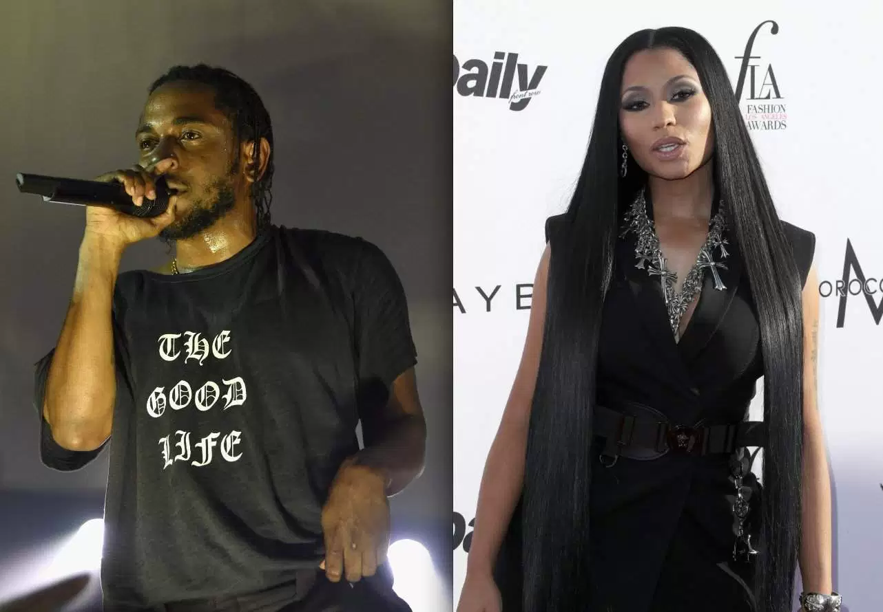
But first a diversion... Performance: rap
Last week a class member asked about the ‘prosody’ of English. Arguably there is a standard four beat unit underlying much English speech (and poetry, dramatic verse and song). Genres like rap ‘impose’ this structure of four strong stresses on the song line. A number of unstressed syllables come in between the main stresses, even – in songs – on important lexical items where – in everyday speech – you would stress them. So where would you put the strong stresses/beats?

Slide 13
But first a diversion... Performance: rap
Where would you put the stress when performing this song (extract from Kendrick Lamar, ‘Poetic Justice’)?
You live life on an everyday basis With poetic justice, poetic justice If I told you that a flower bloomed
In a dark room would you trust it? I mean, I write poems in these songs dedicated to you when You're in the mood for empathy, there's blood in my pen Better yet, where your friends and 'em? I really wanna know you all I really wanna show you off

Slide 14
Performance: rap: 4-beat lines (with some variation)
Where would you put the stress when performing this song (extract from Kendrick Lamar, ‘Poetic Justice’)?
You live life on an everyday basis With poetic justice, poetic justice If I told you that a flower bloomed
In a dark room would you trust it? I mean, I write poems in these songs dedicated to you when You're in the mood for empathy, there's blood in my pen Better yet, where your friends and 'em? I really wanna know you all I really wanna show you off
http://www.youtube.com/watch?v=ux1lVI0YNqA (Explicit)

Slide 15
Performance: rap: where do put your four (or two) main beats?
Where would you put the stress when performing this song (extract from Nicki Minaj, ‘Truffle Butter’)?
Yo, thinkin' out loud
I must have about a milli on me right now
And I ain't talkin' about that Lil Wayne record
I'm still the highest sellin' female rapper, for the record
Man, this a sixty five million single sold
I ain't gotta compete with a single soul
I'm good with the ballpoint game, finger roll
Ask me how to do it, I don't tell a single soul

Slide 16
Performance: rap
Yo, thinkin' out loud
I must have about a milli on me right now
And I ain't talkin' about that Lil Wayne record
I'm still the highest sellin' female rapper, for the record
Man, this a sixty five million single sold
I ain't gotta compete with a single soul
I'm good with the ballpoint game, finger roll
Ask me how to do it, I don't tell a single soul
http://www.youtube.com/watch?v=L1JJe7ng9SI (Very explicit...)

Slide 17
See you next week…

