Slide 1
Phonetics & Phonology
John Corbett: USP-CAPES International Fellow
Session 2: Phonemes and allophones

Slide 2
Today’s session
Review of IPA symbols: transcription test
Phonemes and allophones
Minimal pairs
Variations in sound

Slide 3
Review: consonants and vowels
The articulation of consonants usually involves an obstruction (or near obstruction) of the air flow.
We can therefore classify consonants partly by where the obstruction occurs and how the air gets out. (Place and manner of articulation).
With vowels, however there is no obstruction in the airflow.
We classify vowels with reference to the where the tongue is highest in the vowel space and the spreading/rounding of the lips.

Slide 4
Phonemes & minimal pairs
Vowels and consonants are ‘units of sound’ or phonemes.
Each spoken language has its own inventory of phonemes.
We identify the phonemes of any given language by asking – for any given sequence of sounds – what changes in pronunciation cause a change in meaning?
Minimal pairs:
bill pill
bill bull
bill bin

Slide 5
The uses of minimal pairs
Minimal pairs are used by phoneticians to identify which units of sound (phonemes) are contrastive in any language.
Minimal pairs are used by language teachers to raise learners awareness of the second language’s phonemic system.
Problematical minimal pairs for different learners of English
bear pair (Arabic L1)
rung lung (Japanese L1)
sink think or with wit (Portuguese L1)

Slide 6
Hours of harmless fun

Slide 7
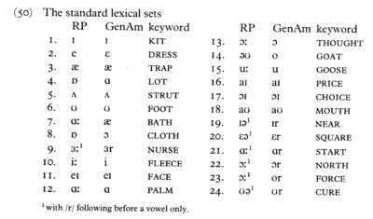
The RP and Gen Am inventory of vowels
John Wells, Accents of English, vol. 1 (CUP, 1982)

Slide 8
Minimal pairs that will drive you crazy
Find a willing partner (or two). One person chooses a word from Column A or B and says it aloud to the partner(s). The partner(s) must identify the correct row & column, e.g. ‘tin’ is 1A.
 | A | B
1 | tin | Tim
2 | teen | team
3 | sin | thin
4 | scene | seem

Slide 9
Quick concept check
Which if these is NOT a minimal pair? Why not?
TIN v TIM
TEEN v TEAM
THIN v SIN
SCENE v SEEM
SIN v SEEM

Slide 10
Quick concept check
Which if these is NOT a minimal pair? Why not?
TIN v TIM tɪn tɪm
TEEN v TEAM tin tim
THIN v SIN θɪn sɪn
SCENE v SEEM sin sim
SIN v SEEM sɪn sim

Slide 11
Which minimal pair is causing problems here?

Slide 12
Which minimal pair is causing problems here?
chips v ships
/tʃɪps/ /ʃɪps/

Slide 13
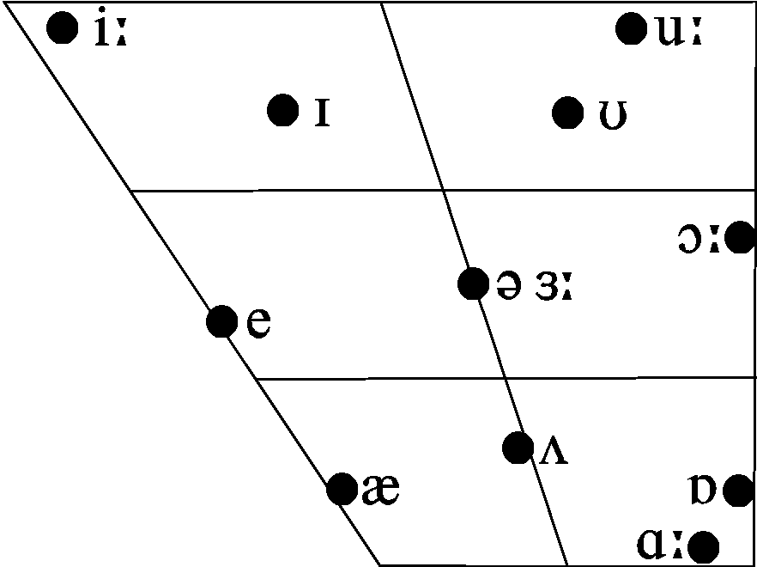
Phonemic differences between accents of English: two close back rounded vowels
pull
FOOT vowel: /ʊ/
pool
GOOSE vowel: /u:, u/

Slide 14
The story so far
Units of sound are called phonemes.
Each language uses a different set of phonemes to distinguish meaning.
We use minimal pairs to identify the phonemes in each language (its phonemic inventory).
Minimal pairs are also used in language teaching.
BUT
Not all accents of a language have the same phonemic inventory.

Slide 15
Variations in the articulations of phonemes
Try saying ‘light’ and hold the /l/ sound.
Try saying ‘milk’ and hold the /l/ sound.
Alternate between the /l/ of ‘light’ & ‘milk’.
Try saying ‘light’ but use the /l/ sound from ‘milk’.
Now you’re Irish.

Slide 16
Variations in the articulations of phonemes
Use the /l/ from ‘milk’ to say all the /l/s in:
If you are looking for ransom I can tell you I don't have money, but what I do have are a very particular set of skills. Skills I have acquired over a very long career. Skills that make me a nightmare for people like you. If you let my daughter go now, that'll be the end of it. I will not look for you, I will not pursue you. But if you don't, I will look for you, I will find you, and I will kill you.
http://youtu.be/KgmO32IdwuE

Slide 17
What is happening in my mouth??
For the /l/ in ‘milk,’ the back of the tongue is raised towards the velum (soft palate) because that is where the next sound /k/ will be articulated.
This is ‘velar /l/’ or ‘dark /l/’
The /l/ in ‘light’ or ‘skill’ etc is ‘clear /l/.
Dark and clear /l/ have different distributions in different accents.

Slide 18
Phonemes and allophones
English does NOT use the difference in sound between light and dark /l/ to change meaning.
You can, if you want, say ‘light’ with a dark /l/ and ‘milk’ with a clear or light /l/.
Therefore, dark and clear /l/ are NOT phonemes but allophones, ie variations in the production of the same ‘unit of sound’.
We show phonemes with slash brackets /l/
We show allophones with square brackets [l] and [ɫ].
Therefore /l/ includes [l] and [ɫ]

Slide 19
Distribution of clear and dark /l/ in RP
Some words with clear /l/:
leaf [lif] black [blæk] lose [luz]
Some words with dark /l/:
pool [puɫ] milk [mɪɫk] full [fʊɫ]
Some words with both kinds of /l/:
lull [lʌɫ] flail [fleɫ] little [lɪtɫ]
In RP…
the clear allophone is used before vowels when they are in the same syllable,
the dark allophone is used when the /l/ precedes a consonant or is in syllable-final position before silence.

Slide 20
Some other allophones in English: aspirated voiceless plosives
Voiceless plosives /p, k, t/ are aspirated when they are word-initial in English and when they begin a stressed syllable within a word.
In Portuguese they aren’t.
Take a piece of paper and put it in front of your lips.
Compare pin [pʰɪn] and spin [spɪn]
If you don’t aspirate, people sometimes hear your voiceless plosives as voiced.
tie v die
peg v beg
Kate v gate

Slide 21
Some other allophones in English: 2. different types of /t/
How do you pronounce the phoneme /t/ in these words?
stop
top
button
cat

Slide 22
Some other allophones in English: 2. different types of /t/
How do you pronounce the phoneme /t/ in these words?
stop [t]
top [tʰ] aspirated
button [ʔ] glottal stop
cat [ t̚ ] unreleased /t/
These allophones are all found in one accent in complementary distribution
Dental [t̪ ] is found in some accents of English instead of alveolar [t].

Slide 23
Some other allophones in English: 3. different types of /r/
How do speakers of different accents pronounce /r/ in these words?
right
arrow
card

Slide 24
Some other allophones in English: 3. different types of /r/
How do speakers of different accents pronounce /r/ in these words?
right
arrow
card (NOT pronounced in non-rhotic accents)
Depending on accent, /r/ can be articulated in a number of ways, e.g.:
postalveolar approximant [ɹ̠] (RP and General American)
retroflex approximant [ɻ] (most Irish and some American accents)
labiodental approximant [ʋ] (some London accents; r-labialization)
alveolar trill [r] (conservative Scottish accents)

Slide 25
Too much information?

Slide 26
Take home messages
Different languages have different phonemic inventories.
So do different accents of the same language.
We use minimal pairs to identify phonemes (units of sound that distinguish meanings in a given language)
But phonemes are really ‘sets’ that have different ‘members’ (allophones)
Allophones don’t change the meanings of words, but they do impact upon perception and they indicate different social and geographical accents. Distribution of allophones might also make a speaker sound more or less ‘foreign’.

Slide 27
Friendly advice
To manage the information you need to process, focus on the accent you want to use as your model and learn the symbols (mainly the phonemes and perhaps a few key allophones) that are relevant to the articulations in that accent.
/si ju nɛkst wik/

