Slide 1
Phonetics & Phonology
John Corbett: USP-CAPES International Fellow
Session 2: Vowels and Diphthongs

Slide 2
Today’s session
Review of consonants: IPA symbols
The vowels of English
Monophthongs and diphthongs
Vowels in different accents of English

Slide 3
What is the difference between a consonant and a vowel?
The articulation of consonants usually involves an obstruction (or near obstruction) of the air flow.
We can therefore classify consonants partly by where the obstruction occurs and how the air gets out. (Place and manner of articulation).
With vowels, however there is no obstruction in the airflow.

Slide 4
Q: So how do we classify vowels if there is no obstruction? A: (i) Plot where the tongue is at its highest (=closest to the palate) in the vowel space & (ii) lip rounding.

Slide 5
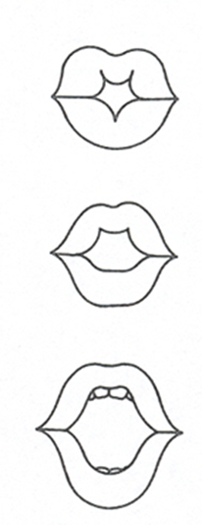
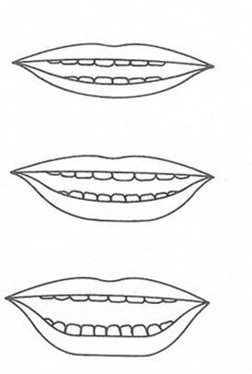
Lip rounding
Lips SPREAD
needy
knit
Lips ROUNDED
naughty
knot

Slide 6
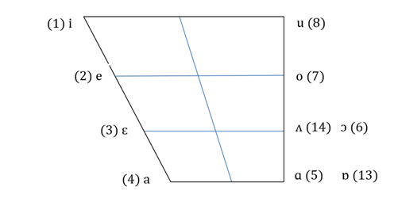
Points of Reference: The Cardinal Vowels
Cardinal 1: [i] front close unrounded vowel
Cardinal 5: [ɑ] open back unrounded vowel
Cardinal 7: [o] back close-mid unrounded vowel
Cardinal 3: [ɛ] front open-mid unrounded vowel

Slide 7
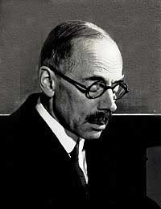
The Cardinal Vowels
The Cardinal Vowels:
abstract system of reference vowels
which we use to help us describe the vowels of any accent or language
18 cardinal vowels
8 ‘primary’ & 10 ‘secondary’
at the extreme edges of the vowel space

Slide 8
The Cardinal Vowels & Daniel Jones
A system of abstract reference vowels
Not the actual vowels of any language
Not the vowels of English
Not ‘more important’ than any other vowels

Slide 9
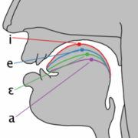
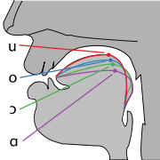
Tongue positions for the 8 Primary Cardinal Vowels
Recordings by Daniel Jones, at age 75

Slide 10
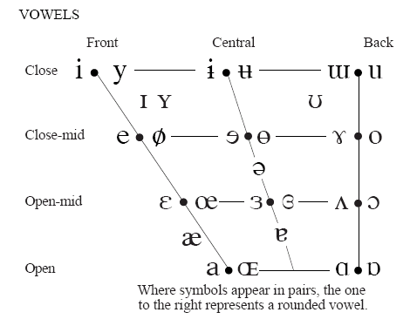
The Vowel Quadrilateral showing the 8 Primary Cardinal Vowels
1
8
7
2
6
3
4
5

Slide 11
For home study http://www.youtube.com/watch?v=6UIAe4p2I74
Notes:
For your personal use later on at home.

Slide 12
In the real world: Actual vowels in the vowel space…
This chart shows the position of 10 vowels available in a Scottish accent, in the context h____t.

Slide 13
‘Float’ vowel symbols.
The way that individuals pronounce vowels varies considerably. Some ‘float’ vowels occupy a potentially large territory in the vowel space.

Slide 14
Types of vowel
Monophthongs and diphthongs
Say ‘boo!’ then ‘boy’.
Pay attention to tongue movement.
Diphthongs are often called ‘glides’.
Short and long monophthongs
Say ‘grid’ and then ‘greed’
Scottish ‘greed’ versus ‘agreed’
Stressed and unstressed vowels
Say ‘apple’ and then ‘agreed’
Say ‘eat’ and ‘it’ and ‘day’ and then ‘happy’

Slide 15
Monophthongs & diphthongs in different accents

Slide 16
Monophthongs in different accents: seven & eleven in a Central Scotttish accent
http://www.youtube.com/watch?v=sAz_UvnUeuU
22 tokens of “eleven”
2 speakers, 4 “accents”
None of them are pronounced in exactly the same way
But all mean the same thing

Slide 17
More diphthongs in different accents
Closing diphthongs: the tongue moves upwards (‘tied’)
Centring diphthongs: the tongue moves towards the centre (‘boy’, dear’)
OR
Falling diphthongs: the opening vowel is louder than the concluding (‘tied’, ‘house’)
Rising diphthongs: the opening vowel is quieter than the concluding (Scottish ‘tide’)

Slide 18
Unstressed vowels in different accents

Slide 19
Long vowels in RP
The long vowels in RP are:
SEAT /i:/
FOOL /u:/
PALM /ɑ:/
BIRTH, BERTH /ɜː/
CAUGHT, HORSE, HOARSE, /ɔː/

Slide 20
Short and long vowels in RP
The short vowels in RP are
SIT /ɪ/
FULL /ʊ/
SEVER, SEVEN /ɛ/ [Some phoneticians use /e/ for this vowel in RP]
CUT /ʌ/
PAM /a/ [Some phoneticians use /æ/]
AGO, FATHER, CHINA, PITIED /ə/ ‘schwa’
HAPPY /i/ ‘unstressed’
COT /ɒ/

Slide 21
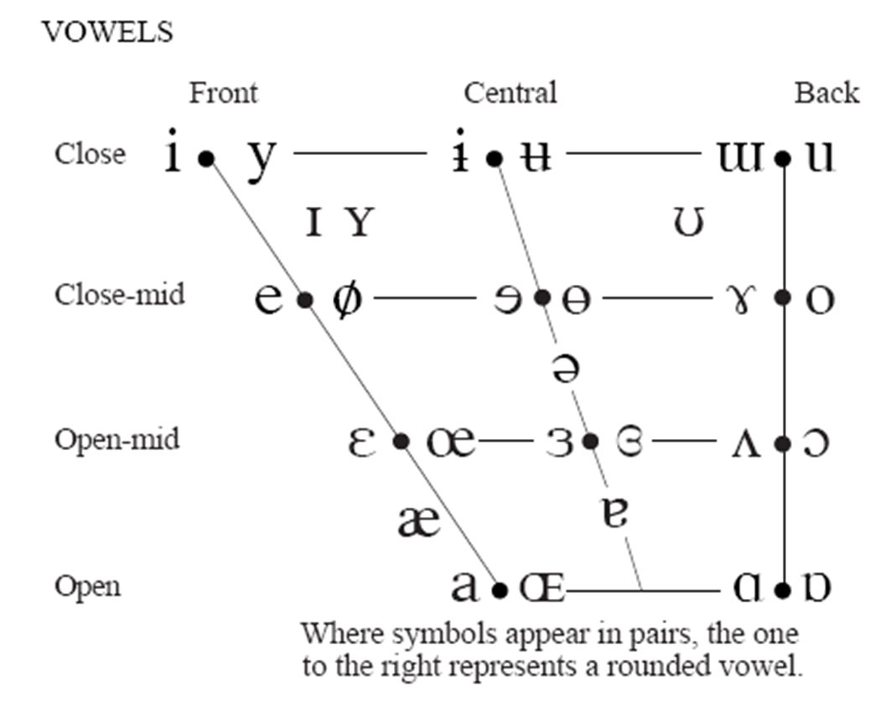
Don’t panic!

Slide 22
Making it easy (or easier…) on yourself…
You don’t need to learn all the IPA symbols. But it helps a lot of you learn the common ones for a standard reference accent (eg RP or GenAm).
I am NOT going to test you on other accents. Not even Scottish.
With practice, these symbols are easily learned. Most of them derive from standard English orthography, slightly adapted.
For fun, there will be a transcription test next week. I will supply you with a list of IPA symbols for vowels and consonants. The purpose of this is not to make you suffer…but also to help you become familiar with the symbols.
A practice transcription test is on moodle.

Slide 23
Thanks!
/si ju nɛkst wik/
Contact info: jcorbett@usp.br
Make sure you can access moodle!
Next week…transcription test!!

