Slide 1
Índice
Introdução aos fundamentos do planeamento de transportes e ao Visum
Modelo de rede em Visum – estrutura e processamento. Explicação dos objetos de rede e correlação entre os elementos básicos.
Verificação da rede e validação
Importar dados de rede a partir de outras aplicações (importar shape files)
Parâmetros gráficos do Visum – introdução.
Procedimentos de alocação – modelação da decisão na escolha de caminhos para o transporte privado
Funções de degradação da velocidade
Funções de impedância
Procedimentos de alocação em detalhe: Incremental, Equilíbrio, Equilíbrio LUCE, Equilíbrio Lohse
Vista genérica dos outros procedimentos: Estocástica, Equilíbrio Dinâmico do Utilizador, Estocástica Dinâmica
Procedimentos simples de alocação de transporte coletivo
Gestão de Cenários (definição de projeto)
Definição de caso de aplicação básica
Geração de cenários e descrição de dependências
Apresentação de resultados em Visum
Visualizações gráficas das alocações (flow bundles, isócronas, volumes de viragem e visualização de diferenças)
Layout de mapas e planos
Matrizes skim – tempo de viagem, distância de viagem, tempos de acesso e egresso
Classificação de matrizes - Distribuições de tempos de viagem e de distâncias de viagem
Correção de matrizes com o TFlowFuzzy
Avaliação de cenários
Impressão de resultados

Slide 2
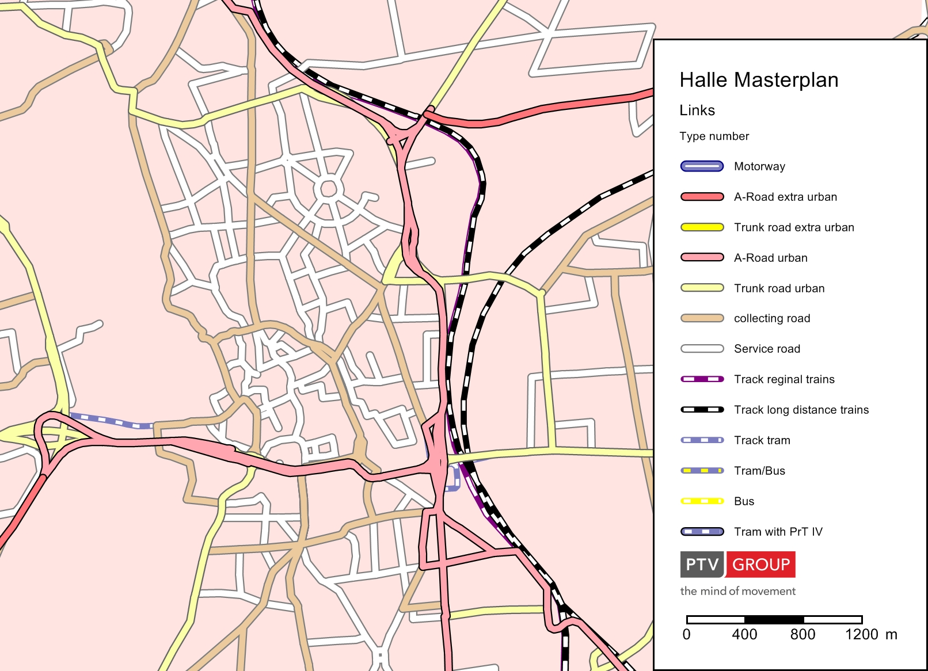
Notes:
Vamos olhar para as possibilidades de layout do Visum.
Depois iremos ver as caraterísticas dos modelos, a correção de matrizes, a avaliação de cenários e, por fim, a questão da impressão de resultados.

Slide 3
Índice
Apresentação de resultados
Análises gráficas
Matrizes Skim (Indicadores)
Correção de matrizes
Avaliação de cenários
Impressão
Notes:
Apresentação de resultados – Como posso representar o que estive a calcular?
Matrizes Skim – Como posso caraterizar quantidades como tempo, distâncias resultantes dos cálculos?
Correção de matrizes – Corrigir matrizes com base nos valores observados.
Avaliação de cenários – Que métodos posso utilizar para comparar os resultados de cenários?
Impressão de resultados – Layouts atrativos são a base da compreensão.

Slide 4
Apresentação de resultados
Notes:
1-6 Apresentação de Resultados

Slide 5
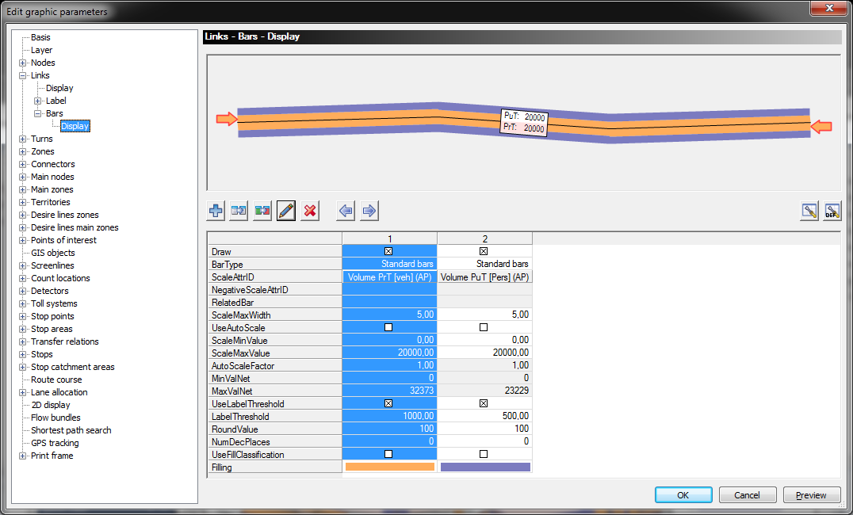
Visualização de volumes de tráfego
Notes:
1-8 Visualização de volumes de tráfego
Estabeleça as diretorias de projeto e abra 01_08_Halle_Analysis_2012.ver
O resultado de uma alocação pode ser visualizado de várias formas. A mais comum é a visualização dos volumes de tráfego como uma barra.
Para definir os parâmetros gráficos para um objeto de rede existem várias possibilidades:
Clicar no menu Graphics -> Edit graphics parameter... E selecionar o objeto de rede que se pretende no Navigator. Clicar em Links→ Bars → Display.
Pode abrir-se a mesma janela de diálogo com a combinação [Ctrl] + [G]
Clicar com o botão direito do mouse na janela Network editor (este processo depende do objeto de rede selecionado). Este procedimento abre um menu no qual se seleciona Graphics parameters →Bars
Clicar com o botão direito do mouse na janela Network em cima do objeto de rede pretendido (neste caso: links)

Slide 6
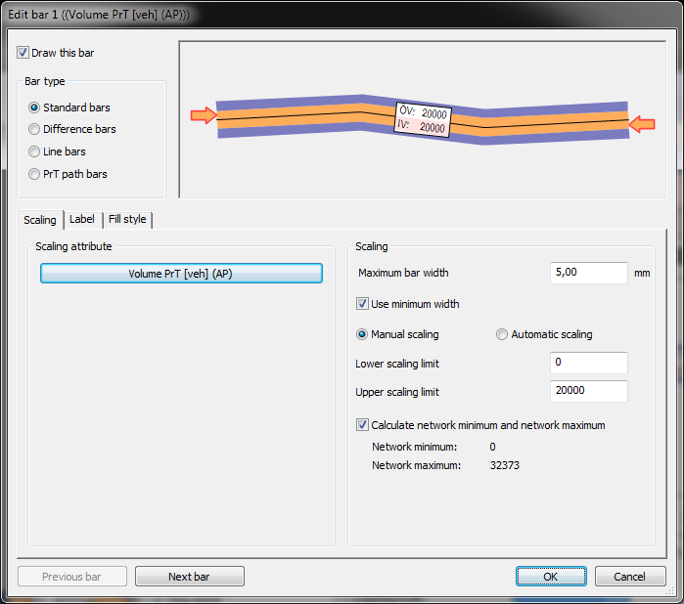
Escalar barras de volumes
Notes:
Escalar barras de volumes
Clicar no icon do lápis (editar as propriedades da barra).
Na folha scaling pode selecionar-se o atributo para escalar. Vamos colocar volume PrT (veh) (AP) pelo que estamos a representar o volume de veículos PrT no período de análise. A largura máxima da barra será de 5.00 mm. Ativar a opção use minimum width. Desta forma, as barras de volume serão todas visualizadas, mesmo as que tivessem menos de 1 pixel (por via da escala). O escalar é feito manualmente. Especificar os valores inferior e superior da escala. Todas as barras serão escaladas entre eles proporcionalmente. As barras acima do limite superior terão a espessura máxima. Com a opção calculate network minimum and network maximum é possível obter logo informação sobre os dois valores extremos na rede.

Slide 7
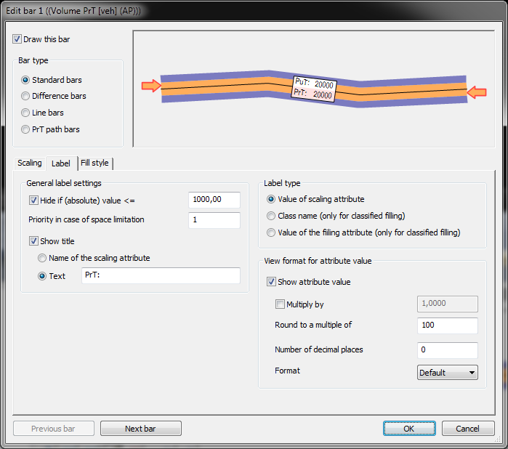
Barras de volumes - Etiquetas
Notes:
Barras de Volume Etiquetas
Em General label settings especifica-se o valor a partir do qual se quer visualizar a etiqueta.
Priority in case of space limitation
Inserir o número que indica a prioridade da etiqueta. No caso de se querer visualizar várias etiquetas próximas ao longo de um polyline que é demasiado curta para visualizar todas, a etiqueta com menor valor será preterida.
Show title
Se ativar esta opção outro texto será acrescentado à etiqueta:
Nome do atributo de escala ou outro texto definido.

Slide 8
Barras de volumes – Tipos de Etiqueta
Notes:
Barras de Volume Etiquetas
Value of scaling attribute
Se esta opção está selecionada, o valor do atributo escolhido para escalar a barra é mostrado (ver folha Scaling).
Class name (only for classified fill style)
Se esta opção está selecionada, o nome da classe selecionada para o estilo de enchimento é mostrado (ver folha Fill style).
Value of the filling attribute (only for classified fill style)
Se esta opção está selecionada, o valor do atributo selecionado para o estilo de enchimento é mostrado (ver folha Scaling).

Slide 9
Barras de volumes – Tipos de Etiqueta
Notes:
Barras de Volume Etiquetas
Show attribute value
Se esta opção está selecionada, o valor do atributo é mostrado.
Nota – Definições adicionais nesta secção dependem do formato do valor selecionado para a etiqueta. Todas as definições referem-se apenas as etiquetas das barras, não se referem aos valores atuais.
Multiply by
Fator pelo qual os valores do atributo são multiplicados para visualização.
Round to the multiple of
Arredondar os valores para os visualização.
Notas – Se escolher 100, por exemple, os valores são arredondados para a centena mais próxima.
Apenas os valores dos atributos são arredondados – Os limites e os valores de classe não são.
Number of decimal places
Number of decimal places of displayed attribute values
Format
Via this selection list you define the format for the display of values.
Show unit
If this option has been checked, the unit is added to the attribute value.

Slide 10
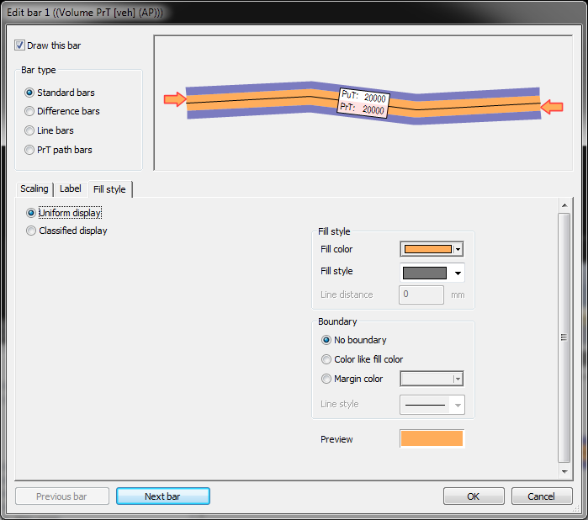
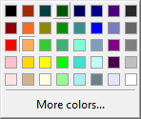
Barras de volumes – Estilos de enchimento
Notes:
Barras de Volume Tipos de enchimento
Uniform display
If this option has been checked, all bars are drawn with identical color and identical boundary. In the section on the right side, specify how the bars are drawn .
Fill color
Use the drop-down list to select a fill color.
Fill style
Select the desired fill style pattern.
Line distance
Specify the desired line distance of the fill style pattern in mm.
No boundary
If the option has been selected, no boundary is displayed .
Color like fill color
If this option has been selected, the color of the filling is also used for the boundary

Slide 11
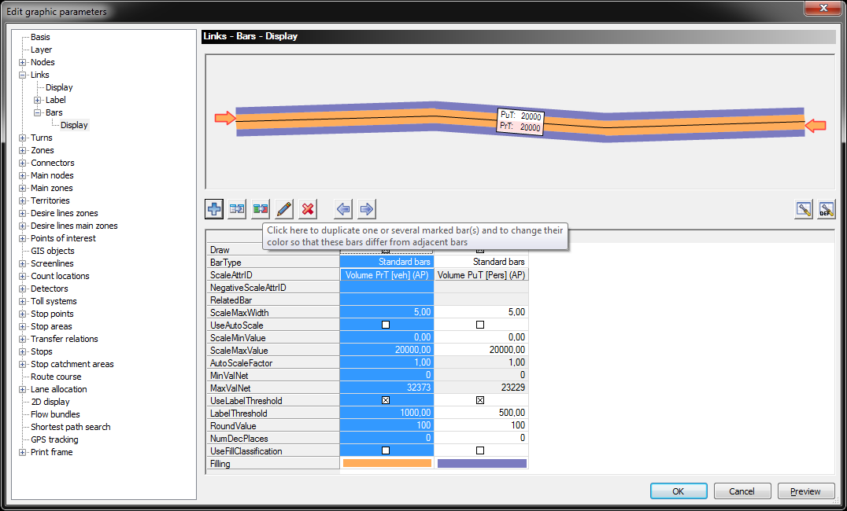
Barras de volumes – Duplicar uma barra
Notes:
Duas opções:
Duplicação simples / Duplicação e alteração da cor para distinguir da original.

Slide 12
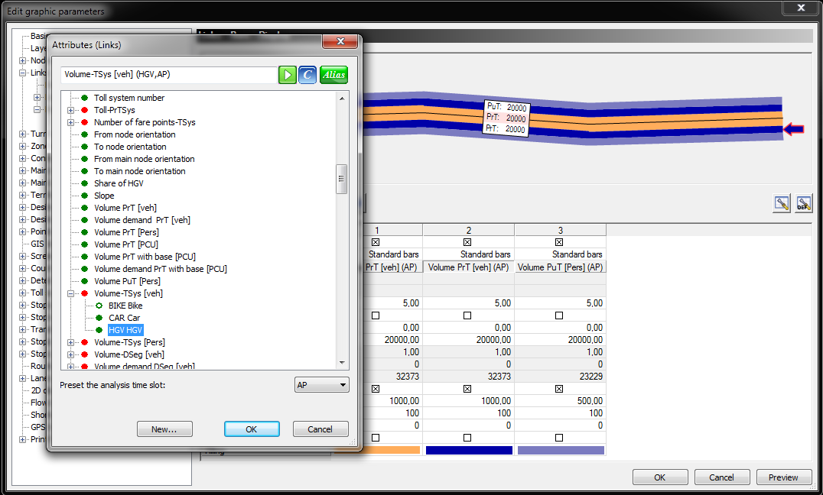
Barras de volumes – Definir uma nova
Notes:
Definir uma nova Barra de Volume
Criar uma nova barra de volume para os volumes of HGV. Definir a cor e escolher quais os limites.
Não esquecer de definir também uma identificação adequada.
Salvar os parâmetros gráficos, por exemplo com 01_08_Volume_bars_with_HGV.gpa

Slide 13
Análises Gráficas

Slide 14
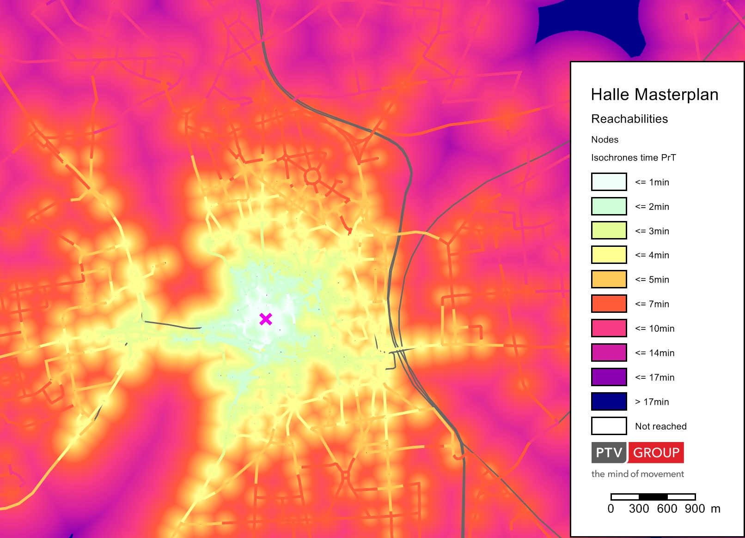
Isócronas
Notes:
Isócronas
2D-Display
Para objetos pontuais (nós ou paragens) a visualização 2D (extrapolada) pode ser ativada para visualizar a distribuição dos valores dos atributos. Qualquer atributo numérico pode ser selecionado para visualização de valores extrapolados.
O valor do atributo do objeto pontual é extrapolado sobre a totalidade da área da rede. Para visualizações em 2D podem definir-se até 10 intervalos de valores com uma cor específica atribuída a cada um.

Slide 15
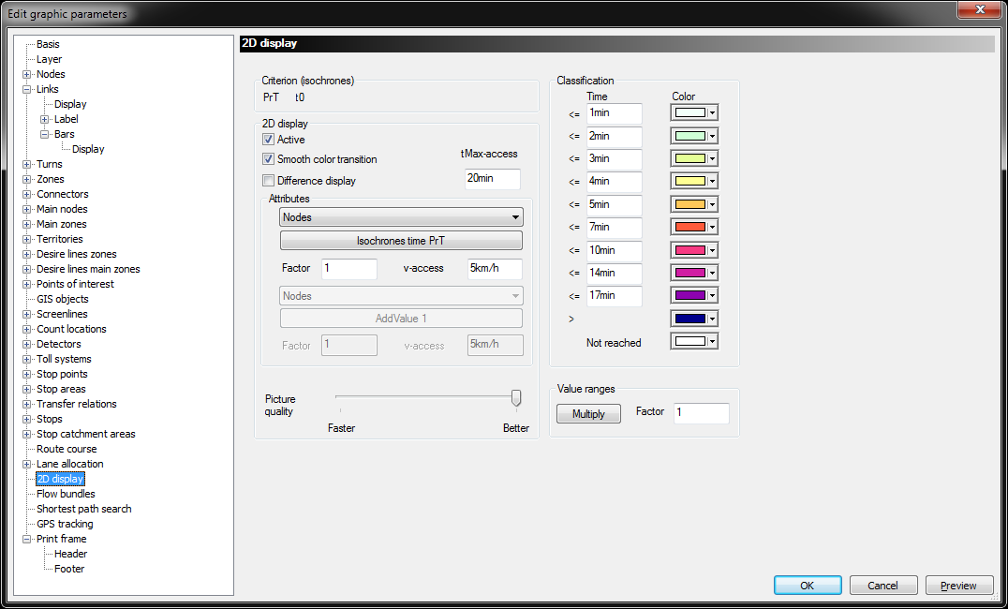
Visualização 2D
Notes:
2D-Display
Enable the option Active and Smooth color transition.
If the option has been selected, smooth color transitions visualize increasing or decreasing attribute values.
v-access
Extrapolation speed for the calculation of the attribute values of point objects along virtual lines to each point in the network.
tMax-access (access time)
For attribute values with an extrapolated attribute value > tMax-access, the program uses the color specified for the class Not reached.
Difference display
If the option has been selected, for each network object the difference between the selected attributes is calculated and displayed according to the current classification settings.
Attributes
Drop-down list for network object type
Here you select the network object type whose attribute values you want to use for the display of isochrones. The isochrones are drawn around the network objects of this type. With the button you select the attribute you need. To display the accessibility select one of the following attributes: Isochrones time PrT, Isochrones time PuT or Isochrones number of transfers PuT.
Factor
Prior to the extrapolation, the source attribute values of the point objects are multiplied by this factor.
See 01_08_Isochrones_PrT.gpa and 01_08_Isochrone_PuT.gpa

Slide 16
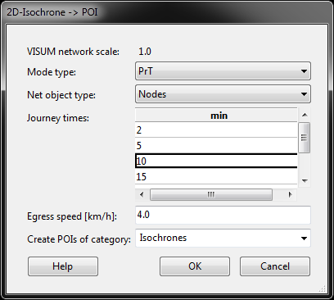
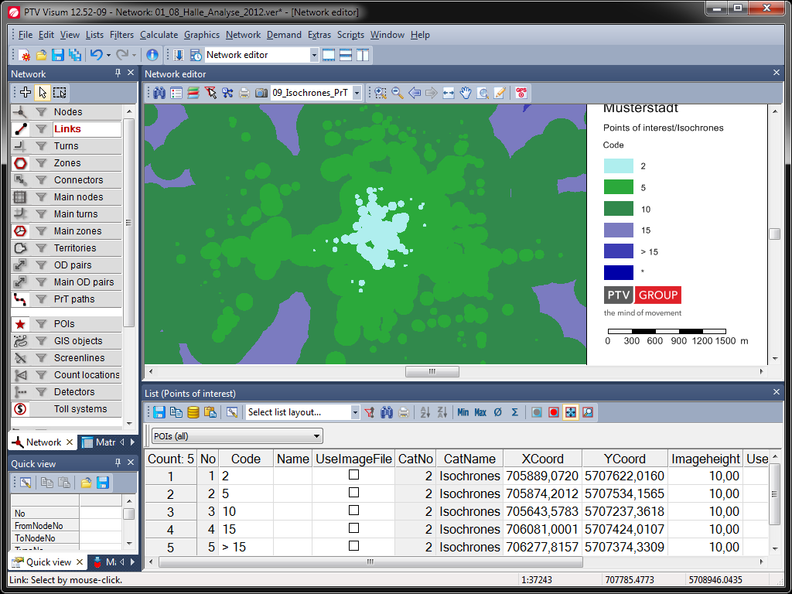
Add-In Isócrona -> POI
Notes:
AddIn 2D-Isochrone -> POI
In Visum there are some useful Add-in.
On the example of isochrones in areas POI you can test this now.
Click in he menu Scripts and then VisumAddIn. Select 2D-Ischrone -> POI from GIS-Scripts.
In the background is started as a scripting language Python. After that, the window opens shown above. Please enter the values ​​as listed above and confirm your entry with OK.
The new POIs can then be shown in the network editor using appropriate graphic parameters or can be exported as shape files for other evaluations.

Slide 17
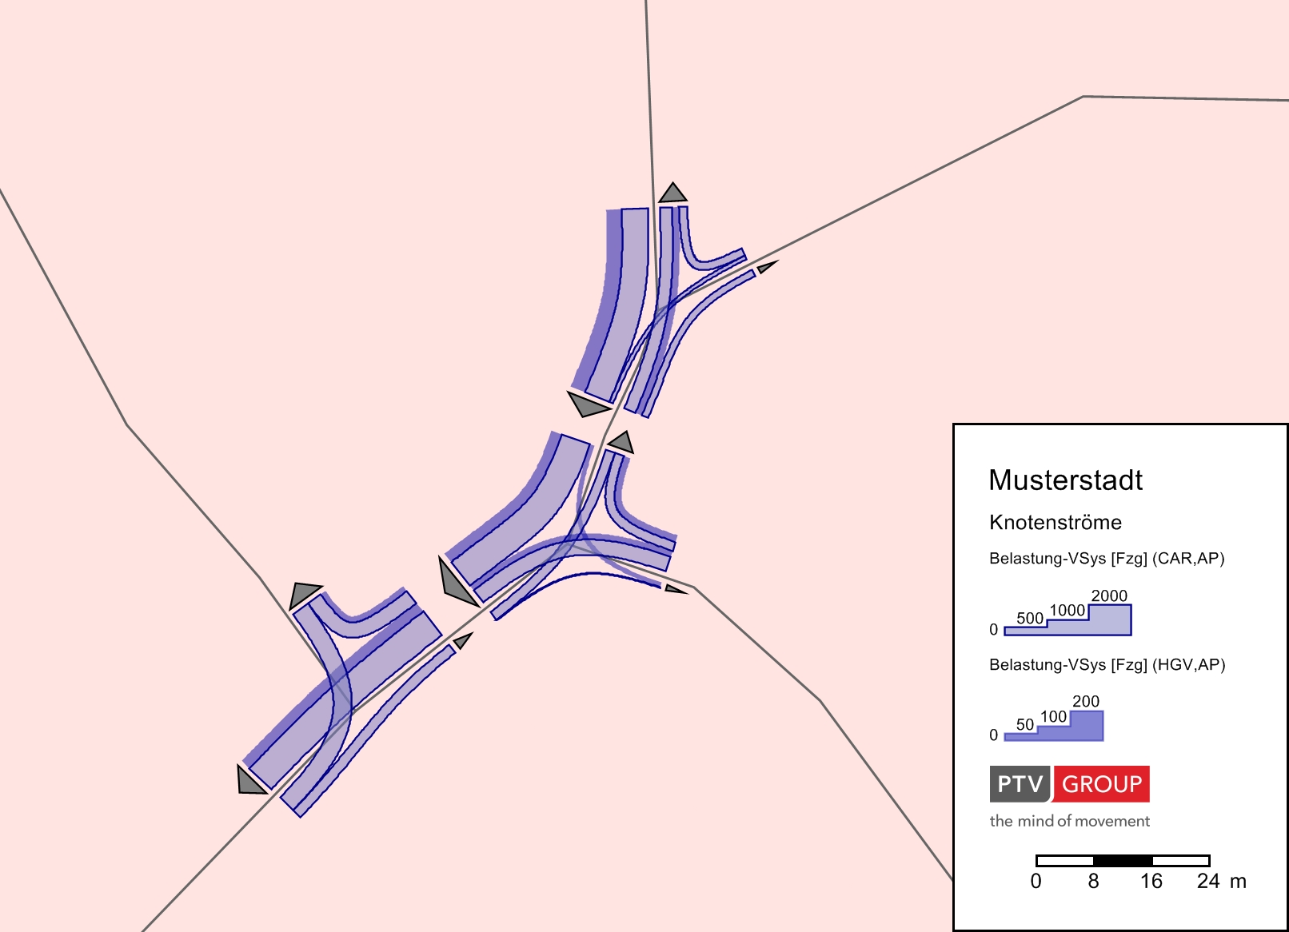
Volume de viragens
Notes:
Volumes de Viragens
Abrir os parâmetros gráficos 01_09_Turn_volumes.gpa.
Com estas definições pode visualizar-se qualquer volume de viragem. Para mostrar ou não um volume de viragem num nó, clicar em Graphics → Turn volumes.
Para editar os parâmetros gráficos clicar no botão open graphic parameters.

Slide 18
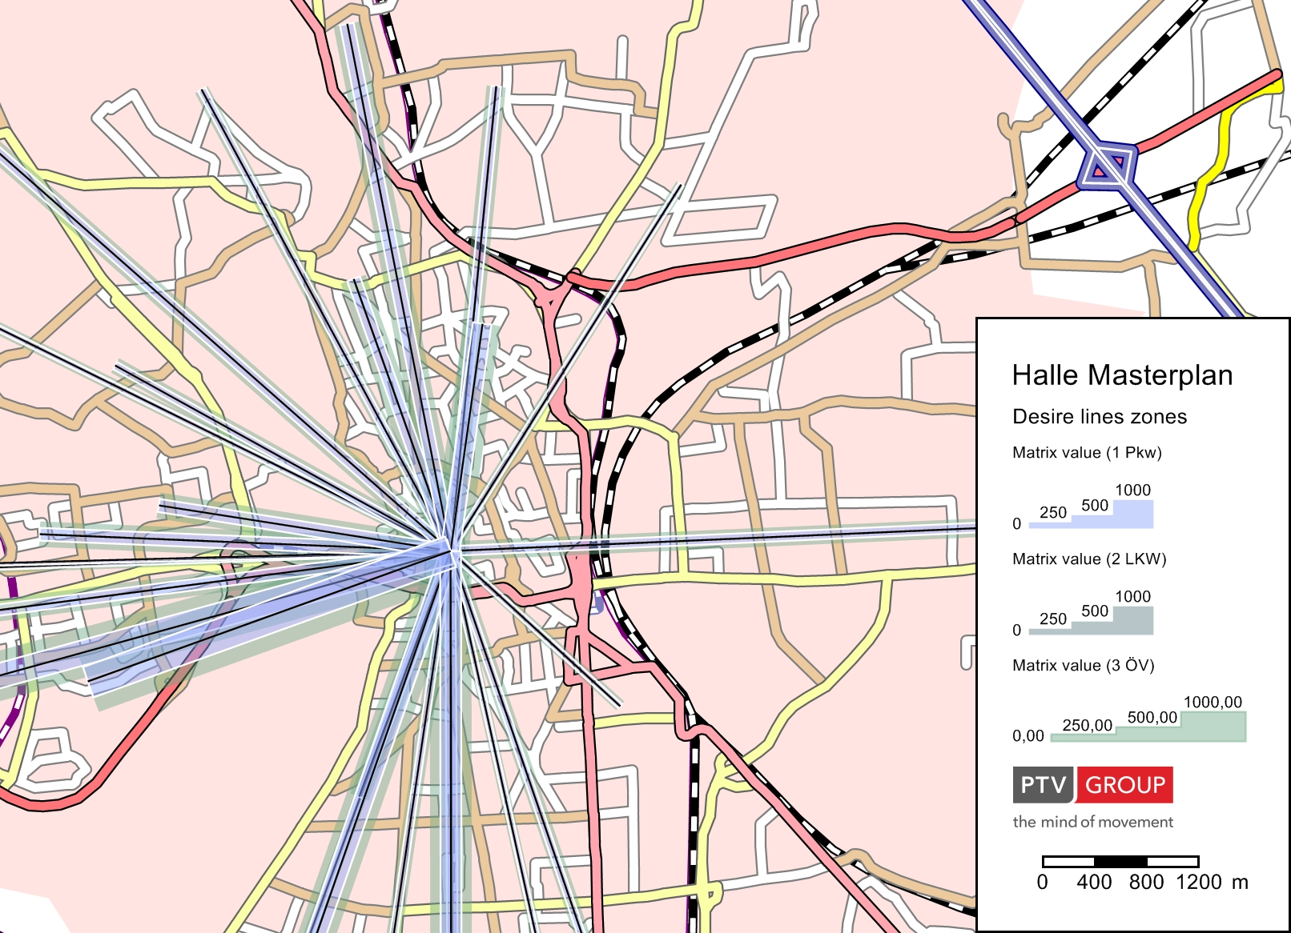
Linhas de desejo
Notes:
Linhas de Desejo
Abrir os parâmetros gráficos parameter 01_09_Desire_lines_zones.gpa
Ativar o filtro para pares OD clicando no icon do filtro no objeto de rede OD-pairs.
The settings of the graphic parameters for desire lines zones you can edit in the menu Graphics → Edit graphic parameters… and then edit desire lines zones.
Ver também flow bundles:
01_09_OD_Flow_bundle_PrT.gpa
01_09_OD_Flow_bundle_PuT.gpa
01_09_Flow_bundle.gpa

Slide 19
Matrizes Skim (Indicadores)

Slide 20
Matrizes Skim do PrT
t0-PrTSys (TT0) | TSys-specific travel time t₀ in unloaded network
tCur-PrTSys (TTC) | TSys-specific travel time t_{Cur} in loaded network
AddValue1..3 (AD1 - AD3) | Sum of AddValue
Trip distance (DIS) | Distance covered from origin to destination
Direct distance(DID) | Direct distance between origin and destination zone
Speed v0-PrTSys (VP0) | TSys-specific speed v₀ in unloaded network
Speed vCur-PrTSys (VPC) | TSys-specific speed v_{Cur} in loaded network
Toll(TOL) | Toll of traversed links
Impedamce-PrtSys (IMP) | TSys-specific impedance in unloaded network
AddValue-TSys (ADS) | Sum of TSys-AddValue data
Useer-defined (UDS) | Flexible calculation of a mean attribute value per OD pair, the linkage of attributes of different traversed network objects is also possible
Notes:
PrT Skims
Através do procedimento Calculate PrT skim matrix procedure as skim PrT listadas podem ser calculadas. As abreviações entre parêntesis indicam a extensão do ficheiro usadas por defeito para as skims quando integradas num ficheiro de versão.

Slide 21
Categorias de Matrizes Skim do PuT
Tempo
Comprimento
Skims Monetarias
Skims de Frequência
Skims de dados de atributos
Skims derivadas
Notes:
PuT skim categories
The skims can be divided into six categories.
Skims of time Access time, Egress time, Origin wait time, Transfer wait time, In-vehicle time, Walk time, Journey time, Ride time, ...
Skims of length Access distance, Egress distance, In-vehicle distance, In-vehicle distance per TSys, PuT-Aux distance, Walk distance, Journey distance, Ride distance, Direct distance
Monetary skims Fare
Frequency skims Number of transfers, Service frequency, Number of operator changes, Number of fare zones
Skims of attribute data Path leg attribute
Derived skims Impedance in a time interval, Journey speed, Direct distance speed, In-vehicle distance as percentage by TSys, Equivalent journey time, …

Slide 22
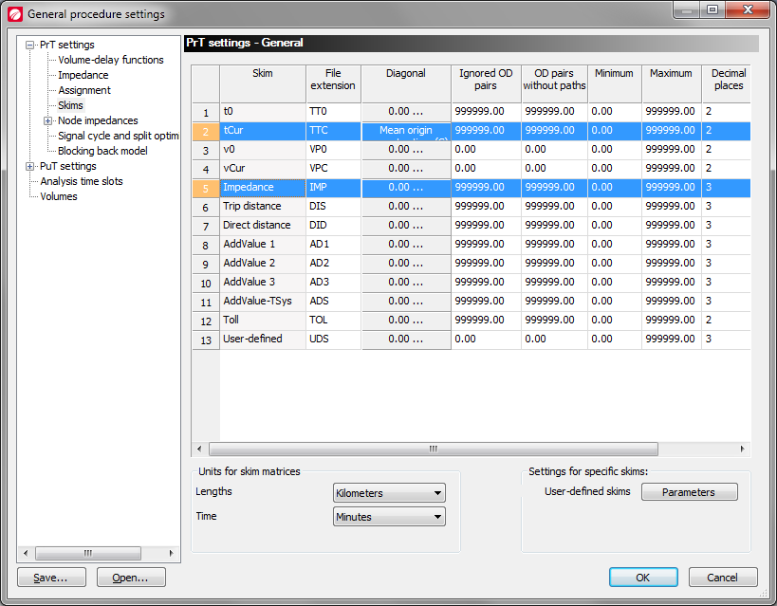
Matrizes Skim do PrT
Notes:
Configuração do cálculo de matrizes skim do PrT
Clicar no menu Calculate e, em seguida, em General procedure settings.
Abrir o navegador PrT-Settings
Clicar em Skims
Alterar as configurações para o cálculo da diagonal principal do tempo de viagem t_{Cur}: Selecionar from attribute e escolher Mean origin connector time (Car).
Como factor inserir 0.02 (Os resultados da velocidade são em m/s e da distância em metros. O resultado é em minutos)
Fazer o mesmo para a Trip distance. Factor é 0.01 (Resultado em km).

Slide 23
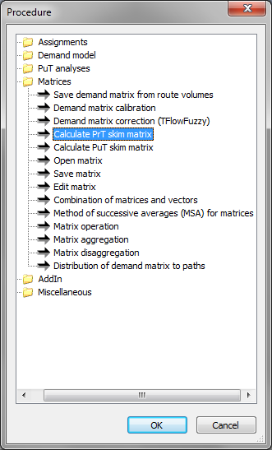
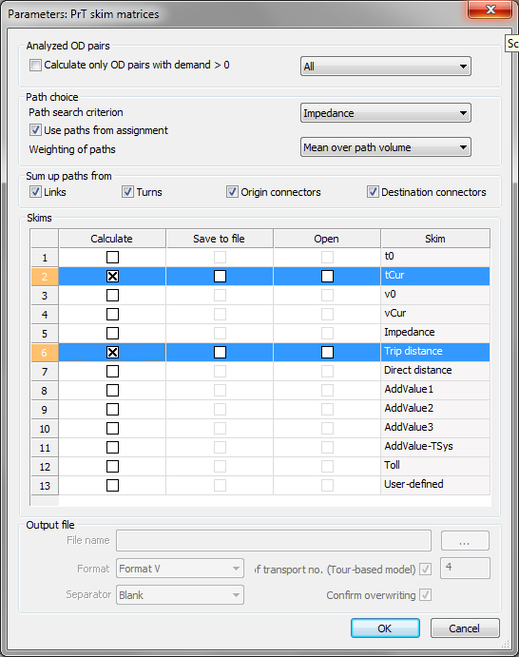
Matrizes Skim do PrT
Notes:
Inserir o procedimento Calculate PrT skim matrix
Add a new procedure step.
Select as procedure Calculate PrT skim matrix.
Choose CAR as reference object
Click Edit in procedure sequence
Please enable the following settings:
Use path from assignment (there is already any assignment active in the example)
Sum up paths from: Links, Turns, Origin connectors, Destination connectors
Calculate the skims tCur and Trip distance.
Run the procedure.

Slide 24
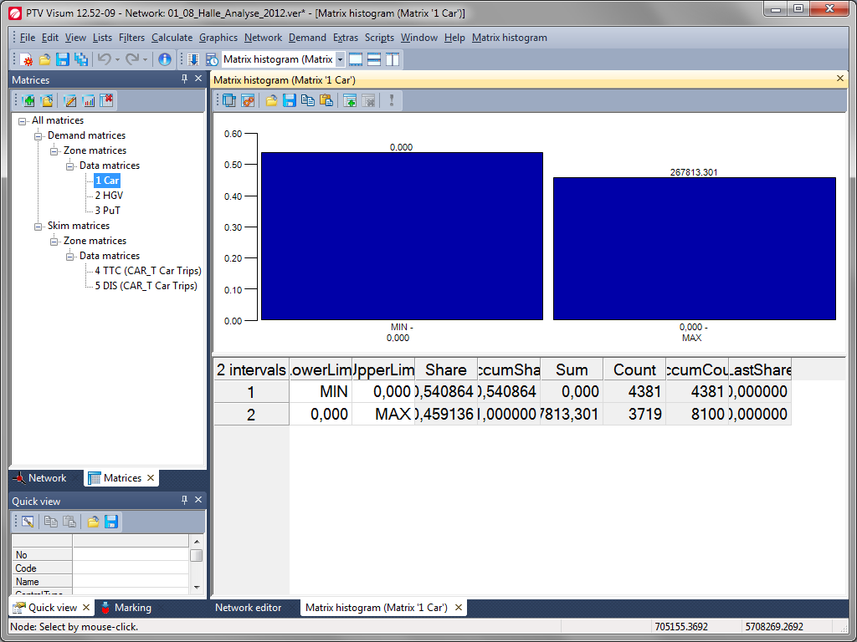
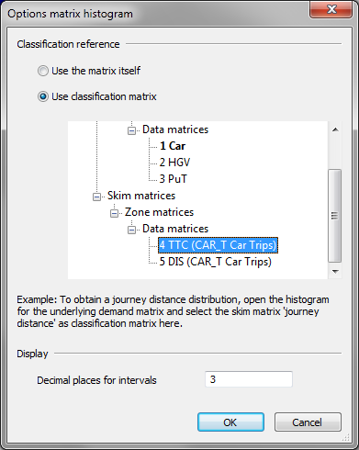
Notes:
Distribuição dos tempos de viagem
Click in the window matrices to the matrix 1 Car.
Click in the menu bar of the window matrices on the icon create histogram or use the context menu (right mouse click).
Select both interval and click Delete in the menu bar of Matrix histogram to the symbol delete marked intervals.
On the same menu bar, click the icon View options and then select 4 TTC (CAR_T Car Trips) as classification matrix
Confirm your entry with OK

Slide 25
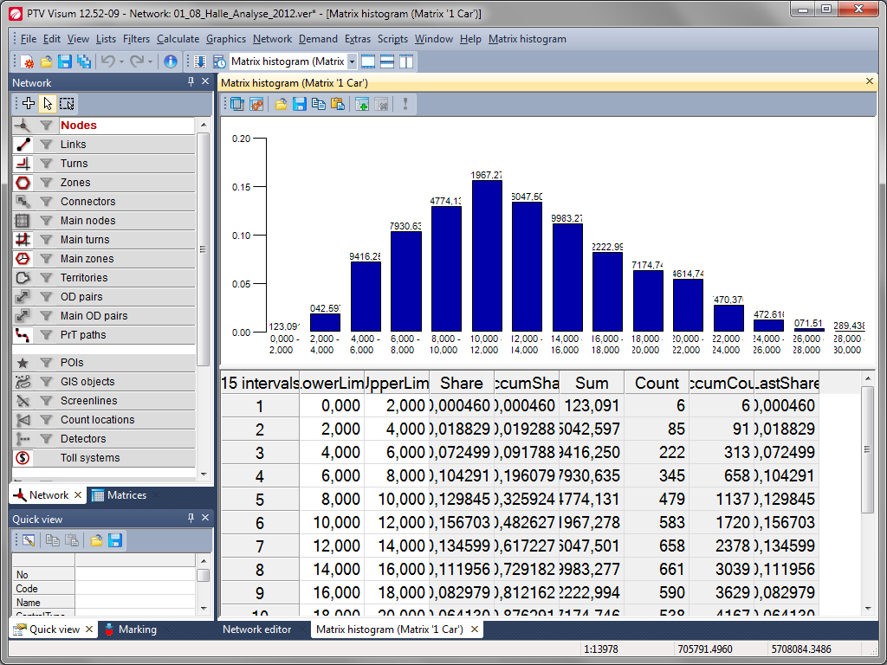
Notes:
Distribuição dos tempos de viagem
Click in the menu bar the icon with the green plus-symbol (Insert new intervals)
Enter as lower limit 0 and as upper limit 30 (30 minutes)
Number of intervals is 15
Confirm your entry with OK
Click now the symbol ! (Recalculate classification)
You now get the classified presentation of the travel time distributions in your network model.
Save the version under the name 09_MatrixHistogram.ver

Slide 26
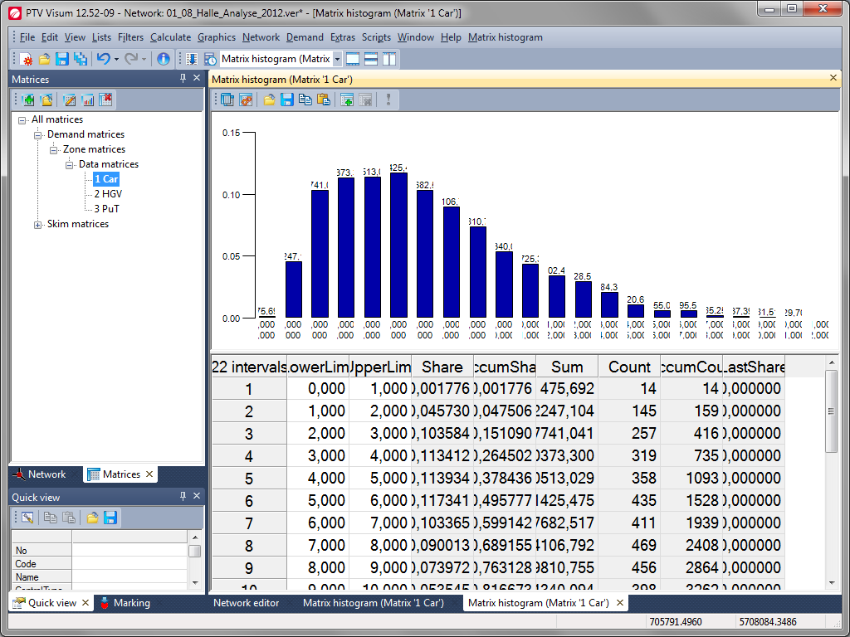
Notes:
Distribuição das distâncias de viagem
In the same way, you can also calculate a trip length distribution and display.
Click in the window matrices to the matrix 1 Car.
Click in the menu bar of the window matrices on the icon create histogram.
Select both interval and click Delete in the menu bar of Matrix histogram to the symbol delete marked intervals.
On the same menu bar, click the icon Edit options and then select from the following:
Use classification matrix
5 DIS (CAR_T Car Trips)
Confirm your entry with OK
Click in the menu bar of Matrix histogram the icon with the green plus-symbol (Insert new intervals)
Enter as lower limit 0 and as upper limit 22 (22 km)
Number of intervals is 22
Confirm your entry with OK
Click now the symbol ! (Recalculate classification)
You now get the classified presentation of the trip length distributions in your network model.
You can store the version under the same name again.

Slide 27
Correção de Matrizes

Slide 28
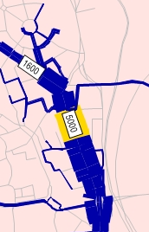
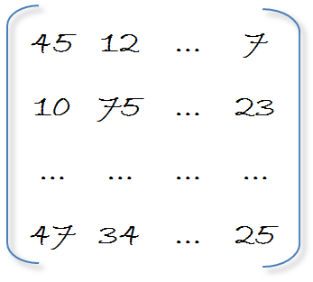
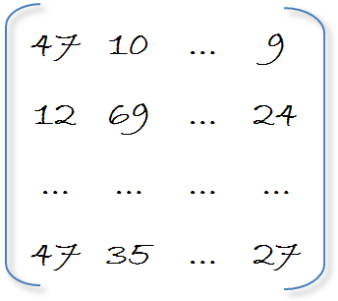
Correção de Matrizes com o TFlow-Fuzzy
Notes:
Matrix correction with AddOn modul TFlow-Fuzzy
Matrix calibration is an important step in developing traffic models. The objective is to achieve a better match with traffic counts such as detector data. Another important requirement is that the given trip length distribution (TLD) must be met, and/or must not be distorted by adjustments made to an Origin Destination (OD) matrix. The TLD shows the percentage of trips falling into one of the pre-defined intervals within the skim matrix (e.g. travel time, distance, impedance etc.).
We will use TFlowFuzzy for two examples:
Using traffic counts as input
Using trip length distribution as input
For the purpose of training the examples will be independent, in real-life projects you will often combine traffic counts and distributions as input for TFlowFuzzy.

Slide 29
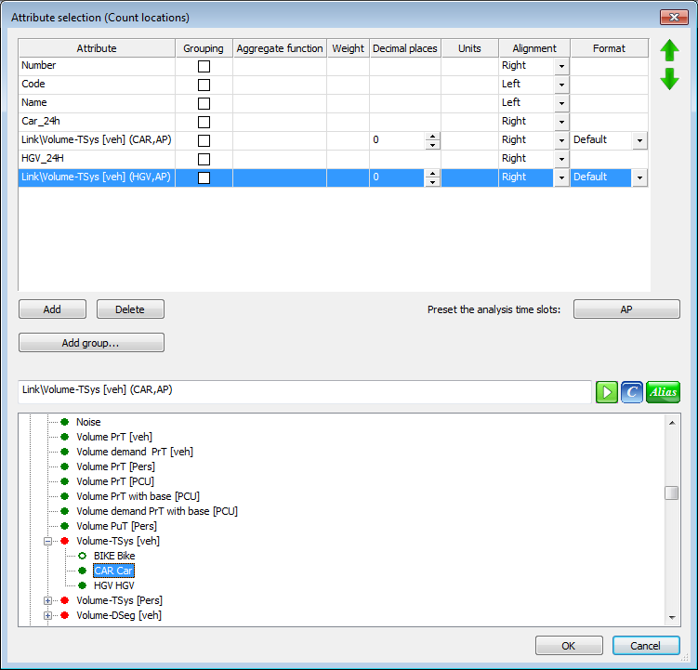
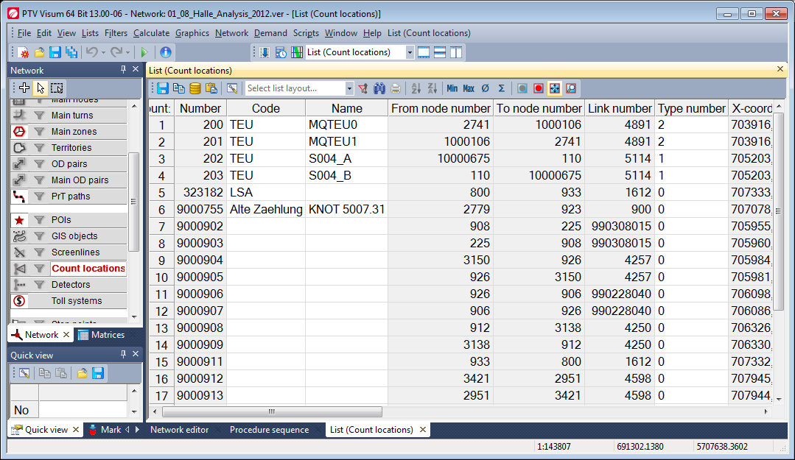
Correção de Matrizes com o TFlow-Fuzzy usando contagens
Notes:
TFlow-Fuzzy – traffic counts
Proceed with your previously used version or re-open 01_08_Halle_Analysis_2012.ver
First, we want to have a look at traffic count data
Open a list of count locations (either via the menu Lists or with right-mouse click on Count locations in the Network object menu)
Edit the attribute selection an create a list as shown above.
We now need a user-defined attribute for the whole traffic volume. Go to Network -> User-defined attributes, choose count locations as network object and create an attribute Total_24h as formula: [CAR_24H]+[HGV_24H]
Add the attribute Total_24h and the indirect attribute Link\Volume PrT [veh] (AP) to the list of count locations.
Save the list layout using the quick save functionality (or load the prepared layout 01_10_Counts.lla)
Compare the quality of the match from observed and modeled data (e.g. in Excel).

Slide 30
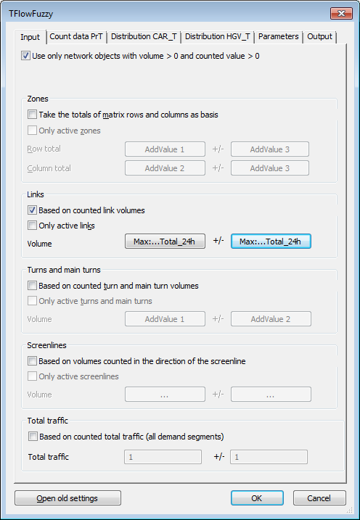
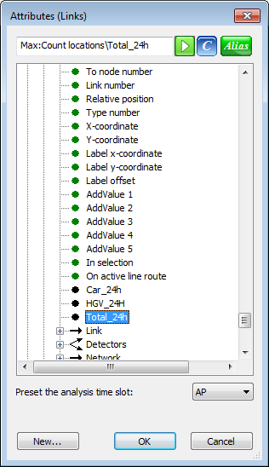
Correção de Matrizes com o TFlow-Fuzzy usando contagens
Notes:
TFlow-Fuzzy – traffic counts
Second, we add some more procedure steps to the procedure sequence
As forth step we add TFlowFuzzy with CAR and HGV as reference objects
As fifth step we use a duplicated second step (PrT assignment)
Now we edit the TFlowFuzzy procedure:
Tab input: For Link we enter the Total24h attribute as value and tolerance (note that we had to use the Max-indirect attribute, as there could be several count locations on one link)
Tab parameter:
Note that we recalculate the flow matrix each time (we could save it for saving computation time)
Note the possibilities for extensive Protocol and further analyses (they are very helpful to identify problematic input data.
Tab Output: Note that we overwrite the existing demand matrix.
Now we can run the forth and fifth step of the procedure flow. It is important to run the assignment again, because only then we can observe changes in the traffic counts!
No we can go back to the list of count locations. We will observe better match than before, but not a perfect match, as route choice is changing due to changed OD demand.
Save version as 10_Halle_Analysis_2012_TFlowCount.ver

Slide 31
Correção de Matrizes com o TFlow-Fuzzy
Notes:
Matrix correction with AddOn modul TFlow-Fuzzy - Distribution
This example demonstrates two applications of using TFlowFuzzy for distributions.
First, an OD matrix is adjusted to match a pre-defined trip length distribution for which shares per intervals are defined (see steps 1 to 16 below).
Second, an OD matrix is adjusted to meet the distribution of observed trips. Observations can be represented, for example, by data of Road Site Interviews (RSI), or data of household surveys.
These data are available in matrix format. Additionally, the class limits for intervals must be defined (see steps 1 to 3, 16 – 22 below).
Additionally, the steps include instructions of how to create trips length distributions (histograms) (e.g. steps 5 to 9 below).

Slide 32
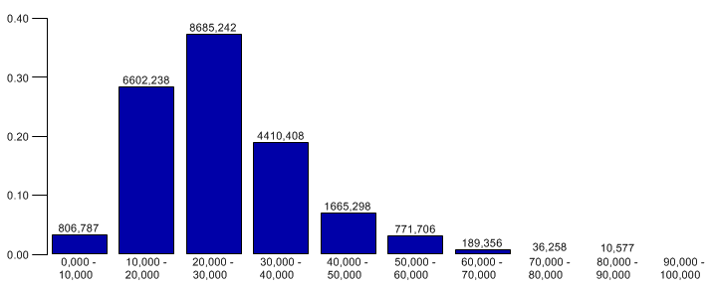
Distribuição classificada das distâncias de viagem
Notes:
Classification matrix trip length distribution
Open the version file 01_10_02_TFlowFuzzy_Start.ver
Look at the procedure flow, steps 5 + 6 calculate skim matrices.
Execute the procedures as defined
After the assignment, the TLD for the external car matrix (Car_extern) is examined to compare these results with observed data. To obtain the corresponding histogram change to the window Matrices and mark demand matrix 12 (Car_extern).
Click menu item Create histogram, and click then the push button Edit options
Choose the option Use classification matrix and select the skim matrix travel time 23 TTC (CX Car extern), press OK
Select both interval and click Delete in the menu bar of Matrix histogram to the symbol delete marked intervals.
Add 10 new intervals between 0 und 100
Press the button RECALCULATE CLASSIFICATION

Slide 33
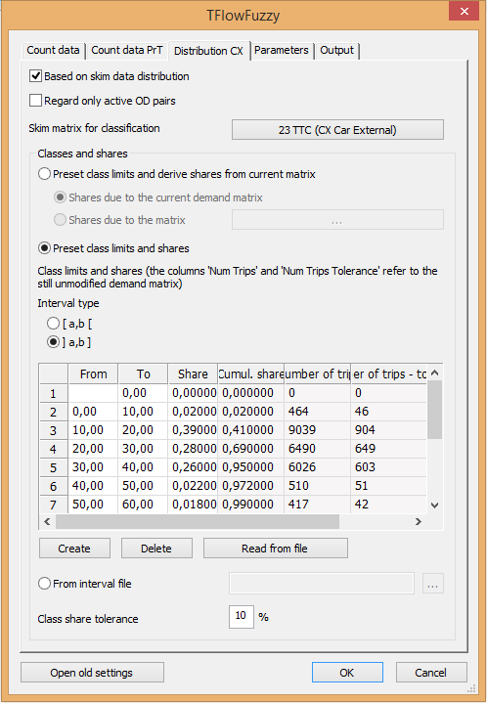
TFlow-Fuzzy – janela Distribution CX
Notes:
TFlow-Fuzzy – Distribution CX
Load procedure parameter file 01_10_Halle_Par_TFF.par.
Edit operation 1 and change to the Tab Distribution CX
Select the skim matrix 23 TTC for CX under Skim matrix for classification
Data of the observed distribution, namely interval limits and shares, are defined in the grid
Execute operation 1
The matrix histogram is updated and shows the TLD using the adjusted matrix no 12 . Alternatively to the use of a pre-defined distribution (i.e. definition of class limits and shares) a matrix with observed data can be used.

Slide 34
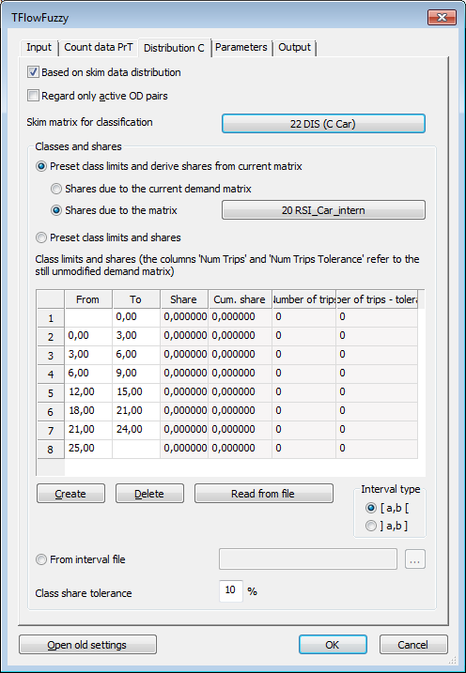
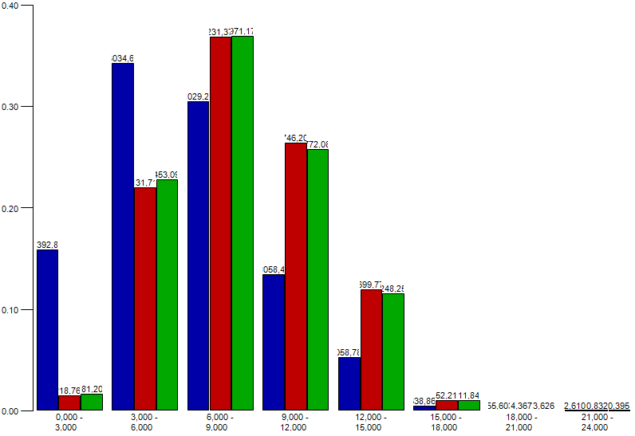
TFlow-Fuzzy – janela Distribution CX
Notes:
You can also use an existing matrix as input for the distribution:
Change to the procedures, and create another Demand matrix correction with the reference object Car and to the Tab [DISTRIBUTION C]
Select the skim matrix 22 DIS (C Car) under Skim matrix for classification
Select the matrix No 20 RSI Car_intern under Shares due to matrix (The matrix represents observed data from Road Site Interviews.)
Define class limits in the grid (use an interval length of 3 units) from 0 to 24 plus 2 intervals for the lower / upper class)
Activate operation 2 and execute the procedures.
Compare the two histograms using the car matrix before TFF (No 20), the adjusted car matrix after TFF (No 11), and the corresponding skim matrix (No 22)
First, create the histogram by following the instructions of steps 5 to 9 using the demand matrix 1 (car before TFF) and skim matrix No 22.
Second, add demand matrices for comparison using the button SELECT MATRICES…; press CREATE and select matrices No 20 (RSI) and No 11 (updated car matrix) ; press OK to confirm the selection
The matrix histogram shows the results for 3 demand matrices side by side
Save the version as 10_03_TFlowFuzzy_TripLength.ver

Slide 35
Avaliação de Cenários

Slide 36
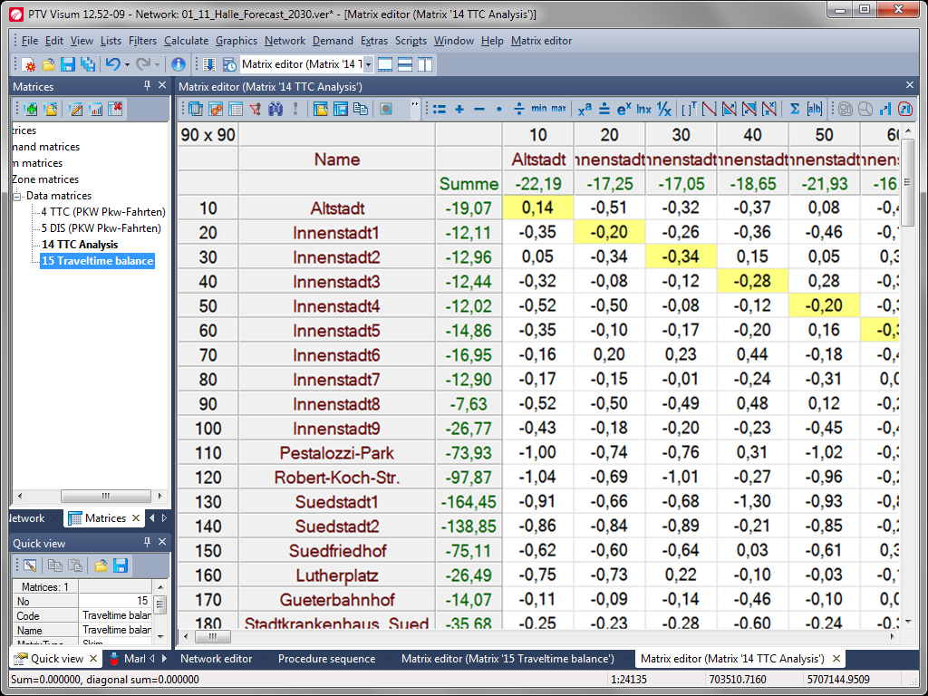
Notes:
Evaluation of scenarios – Travel time balance
For the evaluation of scenarios, the differences between a planning zero case or the case analysis and a scenario or case plan can be formed initially straight.
Open version 01_11_Halle_Forecast_2030.ver
Choose the window Matrices
Create a new matrix – make sure that you insert a skim matrix
Give the new matrix the number 14 and the name TTC Analysis
Click the symbol Read matrix content from file
Open the travel time matrix of the Analysis 01_09_5 TTC (CAR_T Car Trips).mtx
Create a new skim matrix with number 15 and name Traveltime balance
Click in matrix editor the symbol := Set value(s)
Choose first the values of matrix 4 TTC (Values of the forecast)
Click now the symbol – Subtract and subtract matrix 14 TTC Analysis (alternatively this can be done as procedure or as formula matrix)
The result now shows relations to which travel time increases (+) or travel time decreases (-) are expected.

Slide 37
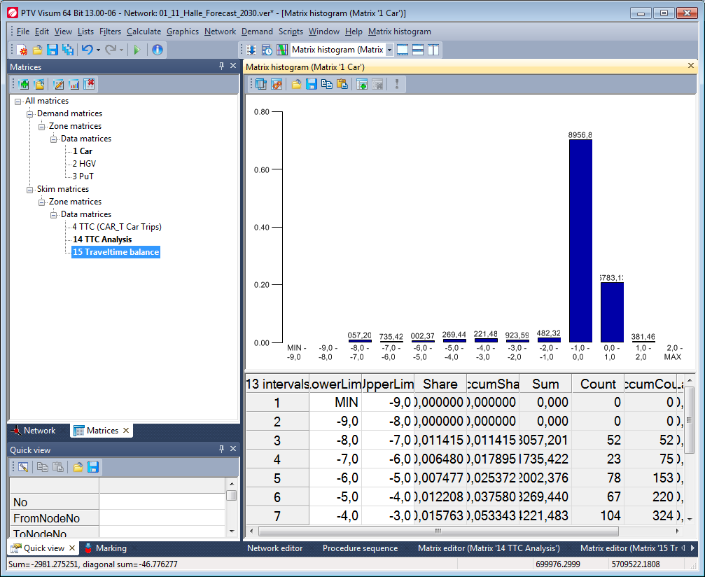
Equilíbrio do tempo de viagem
Notes:
Evaluation of scenarios – Travel time balance
You can also display a graphical representation of the travel time increases and travel time decreases again with the help of the histogram.
Create histogram for matrix 1 with matrix 15 as classification matrix
It might appear, for example, as shown above.
From the diagram above we can deduce that more than 70% of all trips with have reduced travels times (only few more than 1 minute though). However, still 20% even have a slight increase of travel times.

Slide 38
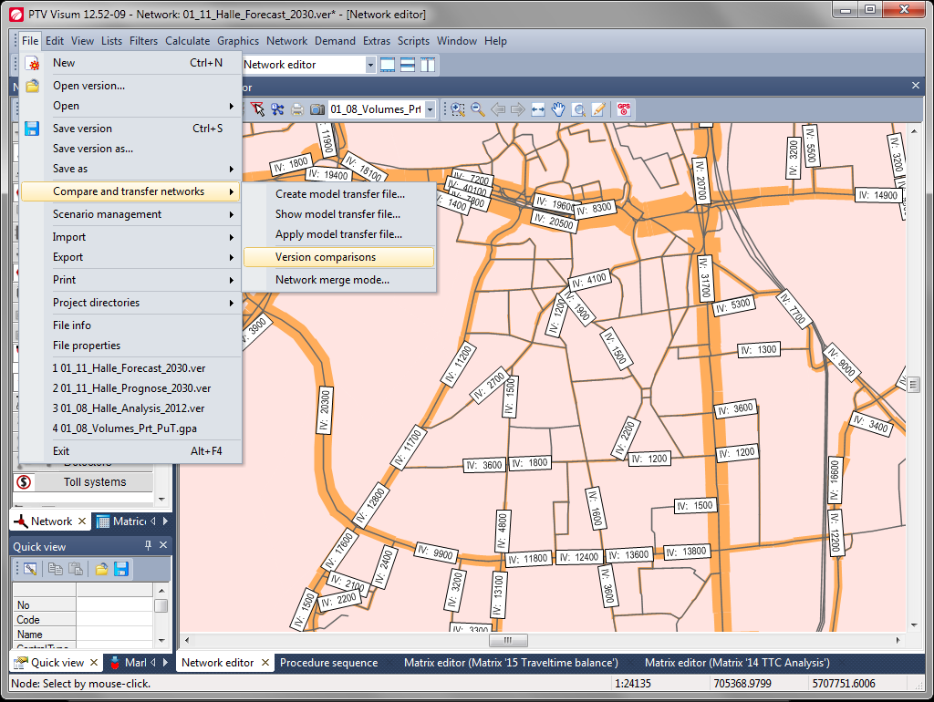
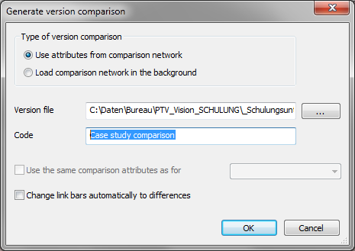
Notes:
Difference between the two scenarios / case plan
With menu File → Compare and transfer networks → Version comparisons you can display the differences in volume bars and many other attributes.
Generate a Version comparison between 01_11_Halle_Forecast_2030.ver und 01_08_Halle_Analysis_2012.ver
Name your comparison Case study comparison.
Confirm your entry with OK in all windows and close the window Version comparison

Slide 39
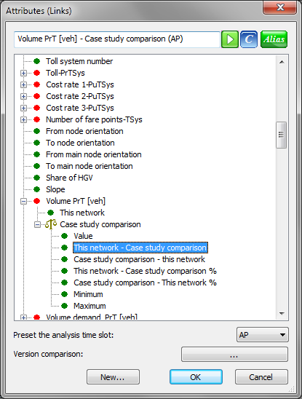
Comparação de barras de volumes em diferentes versões
Notes:
Volume bars version comparison
Select in the Graphic parameters in link bars for displaying the first volume bar Volumes PrT [veh] This network – Case study comparison

Slide 40
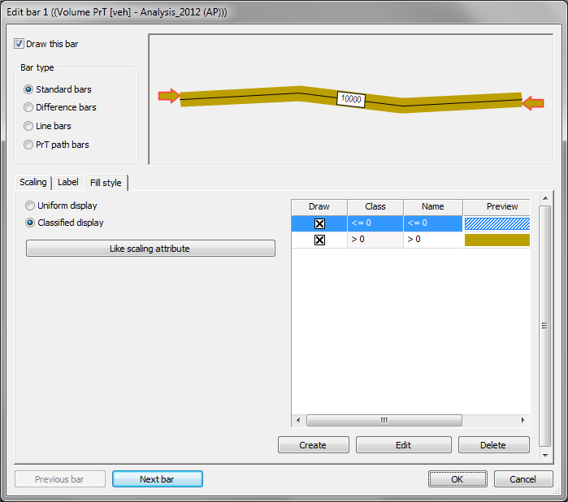
Visualização classificada
Notes:
Classified display of volume bars
Edit the graphics parameters for the display so that values ​​<= 0 in blue, hachured and values ​​> 0 are shown in darken gold.
Look at the min- and max values of this volume bars and if necessary correct the settings (10,000 as maximum is sufficiently)
Confirm your entry with OK

Slide 41
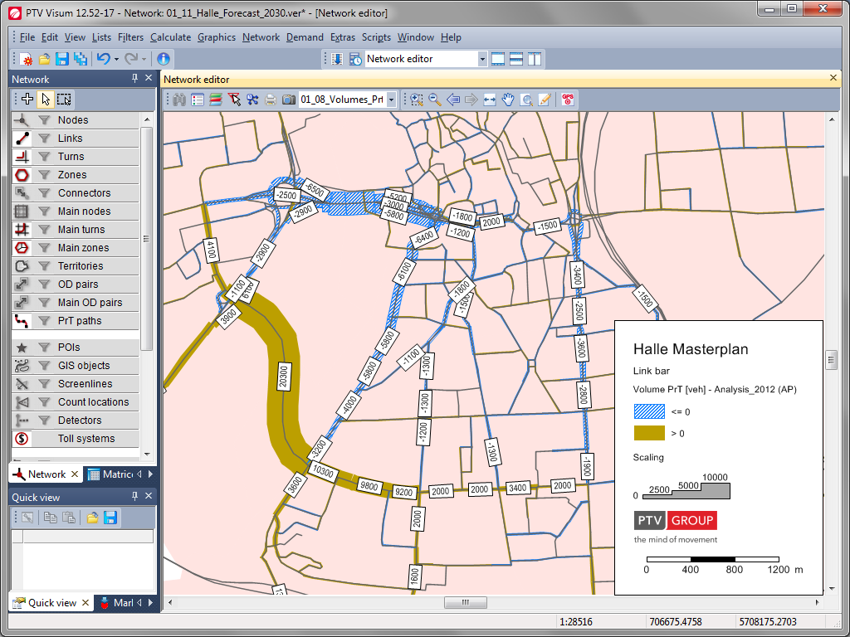
Notes:
Classified display of volume bars
Traffic increases are now displayed in purple, traffic declines in green.
Along with the travel time balance thus arising a few basics for the evaluation of scenarios.

Slide 42
Impressão
Notes:
1-6 Apresentação de Resultados

Slide 43
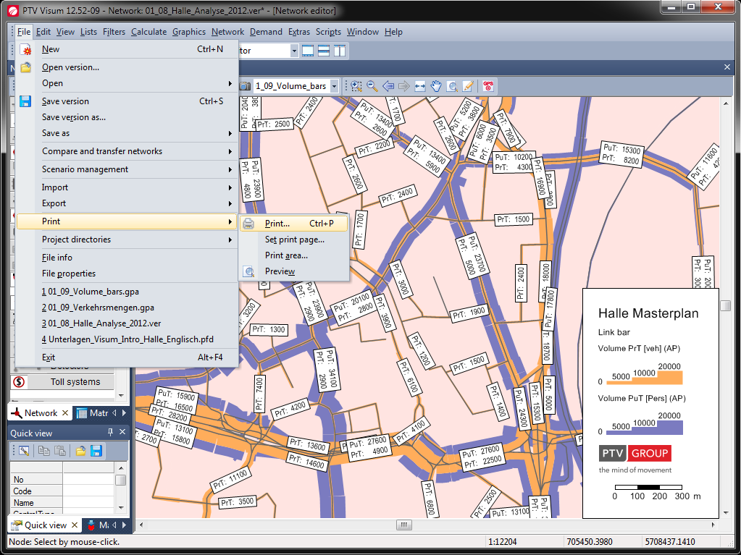
Notes:
Preparing for Printing
Click on the menu File and select Set Print Page

Slide 44
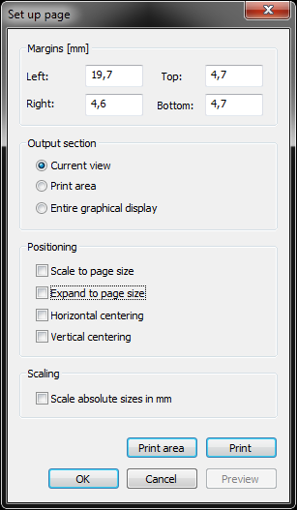
Preparar a página
Notes:
Set print page
First we open „Set Print Page“
Scale to page size
If this option is selected, the output range is scaled to the printable area. The output range is either horizontally or vertically scaled so that it completely fills the printable range in either direction. In this case, the selected scale is adjusted (both reduced and enlarged).
Expand to page size
If this option is selected, the output range is extended to the entire printable area (extended). The upper left corner of the output range is fixed there. The horizontal and vertical extent is adjusted to the printable area. The selected scale is maintained. If the output field at the selected scale in vertical or horizontal direction is larger than the printable area, the options cut off at page edges, Scale to page size and print tiles are available for printing.
Notes The functionality expand to page size you can also select in the window print area. Just click on the button To page size. You will find the window print area under the menu item File, and then Print. Click here to Print Area. If both options scale to page size and expand to page size are selected, the output range is first scaled and then extended in the direction of the printable area which is not filled. The selected scale is adjusted again.
horizontal centering/vertical centering
With these options, you can adjust the output area horizontally and / or vertically within the printable area.
Notes
If neither option is selected, the output range is aligned to the top left corner of the printable area.
Scaling
Scale absolute sizes in mm option in the print image is almost identical to the view printed on the screen (receiving the proportionality of the bar width to the overall image).

Slide 45
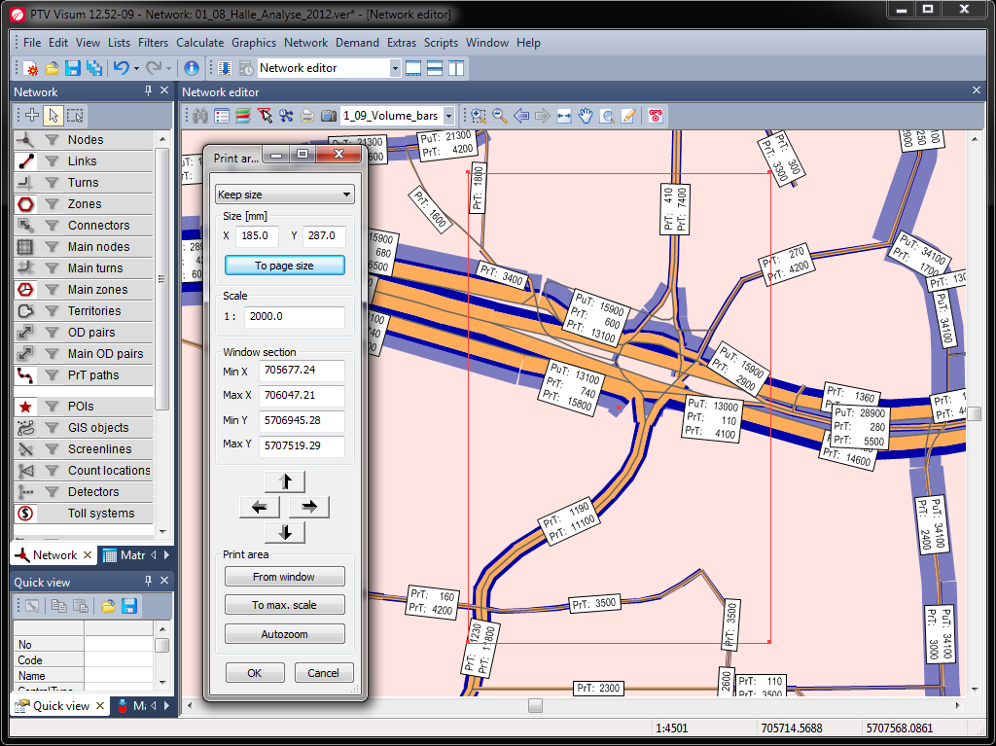
Notes:
Set Print area
Click in the menu File and Print and select Print area.
Once the Print area window is open, you can increase or decrease the displayed rectangle in the network view using the mouse.
Keep size
If the option has been selected, the scale does not change when editing the print area.
If you enlarge the print area with the mouse pointer, you might exceed the available paper size. This is indicated by red values in the Size section.
Keep size
If the option has been selected, the height and the width of the printable area remain unchanged when editing the print area with the mouse. The scale is adjusted accordingly.
Size [mm]
Width and height of the print area in mm
If the values are red, the print area exceeds the available paper size.
To page size
You can expand the print area to the specified page format by clicking on this button.
Scale
Enter the scale
If the Keep size option has been selected, a different section of the network will be displayed when editing the scale. If the Keep scale option has been selected, the width and the height change when editing the scale.

Slide 46
Notes:
Set Print area
Window section
Here you can define the print area by entering co-ordinates.
You can click the arrows to shift the print area. The print area will then be shifted by the size of the print area in the direction of the arrow.

Slide 47
Notes:
Set Print area
Print area from window
Use this button to set the print area to the size of the current Visum window.
To max. scale
Use this button to maximize the scale for the network display of the set print area in such a way, that the print area fits the printable area of the print page.
autozoom
Use the button to zoom into the print area. The entire print area is displayed on screen.
This way you can for different output sizes (A4, A3, ...) and for different paper orientation (portrait, landscape) save your own graphics parameters. Put as, for example, the typical format determined that you need for your daily work or for reports.

Slide 48
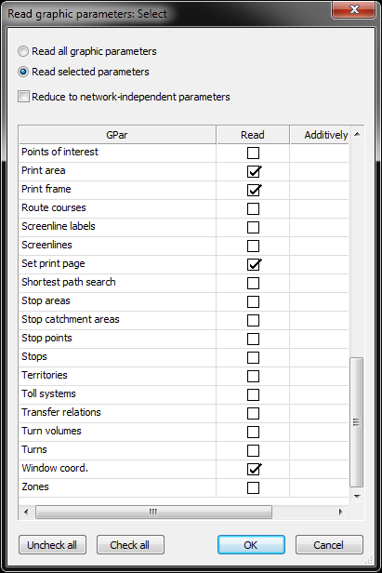
Abrir os parâmetros gráficos
Notes:
Open Graphic parameters
Click on File → Open→ Graphic parameters… and select the file 01_08_A4_Print_Frame.gpa.
Select then the option Read selected parameters and click first on the push button Uncheck all. In the next step enable the following graphic parameters:
Print area
Print frame
Set print page
Window coord.
You can open this A4_Print_frame to all other graphic parameters additionally.

Slide 49
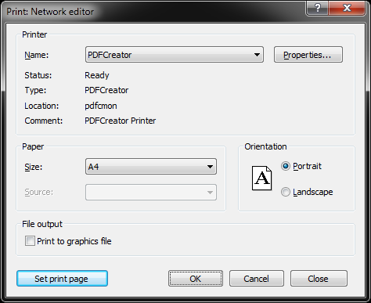
Imprimir
Notes:
Print
First choose the printer, you want to use. In our example we use the PDFCreator.
Select the paper size and orientation. Finally, click Ok.

