Slide 1
Topics in research
Dr John Corbett
USP-CAPES International Fellow

Slide 2
APA style guide

Slide 3
Proper citation: Journal
When you want to use other people’s work, use proper citation practice, eg:
Zhang (2016, p. 588) argues that “The distribution and representation of languages in the posters construct discourse and social practice on the basis of different institutional or organizational contexts and are indicative of language status, ideologies, and social power.”

Slide 4
Multiple citations
When two or more works are cited within the same parentheses, arrange them into
the same order in which they appear in the reference list:
(Brown, 1980; Dawson & Briggs, 1974; Dawson & Jones, 1974; A. L. Smith, 1978;
G. T. Smith, 1978; Smith et al., 1978; Tyndall et al., 1978; Willis, 1978)
An exception to this rule is that a major citation may be separated from other
citations within parentheses using a phrase such as “see also”:
(Willis, 1978; see also Brown, 1980; Dawson & Briggs, 1974; Dawson & Jones,
1974; A. L. Smith, 1978; G. T. Smith, 1978; Smith et al., 1978; Tyndall et al., 1978)

Slide 5
Quoting material with errors
What do you do if the source you are quoting contains a slight error (eg lack of definite article before ‘English as a Foreign Language’ here)?
Engku Haliza, Engku Ibrahim, Mohamed Ismail Ahamad Shah, & Najwa Tgk. Armia. (2013). Code-Switching in English as a Foreign Language Classroom : Teachers’ Attitudes. English Language Teaching, 6 (7), 139-150.

Slide 6
Quoting material with errors
You can use the expression [sic] to indicate that the error is in the original text:
Engku Haliza Engku Ibrahim, Mohamed Ismail Ahamad Shah, & Najwa Tgk. Armia. (2013). Code-Switching in English as a Foreign Language Classroom [sic]: Teachers’ Attitudes. English Language Teaching, 6 (7), 139-150.

Slide 7
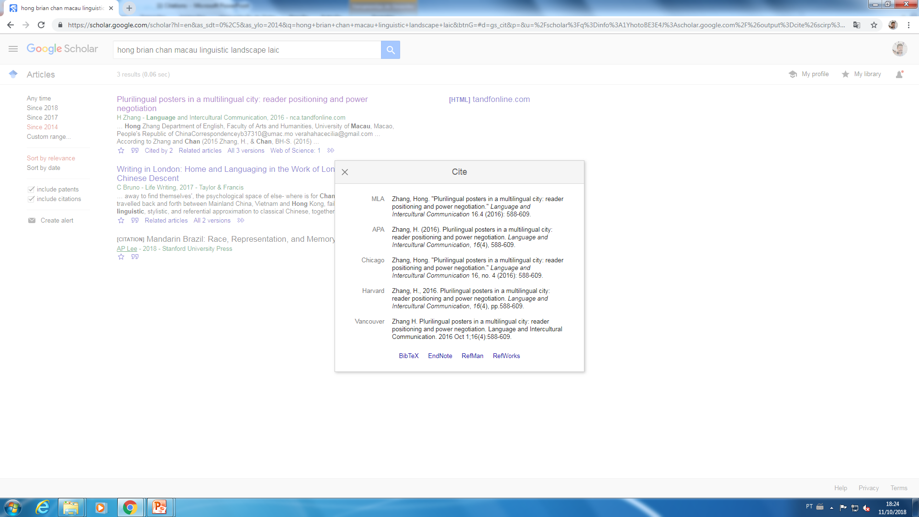
Your life…made easy

Slide 8
What is wrong with this list of references?
Muchnik, M. & Stavans, A. (2009). Telling the Same Story to Your Child: Mothers’ versus Fathers’ Storytelling Interactions. Women & Language 32(1), 60-69.
Chao, M. R. (2011). Family Interaction Relationship Types And Differences in Parent-Child Interactions Social Behavior & Personality:An International Journal, 39(7).
Roger, K. M., Rinaldi, C. M., & Howe, N. (2012). Mothers' and Fathers' Internal State Language with Their Young Children: An Examination of Gender Differences During an Emotions Task. Infant and Child Development, 21(6), 646-666.

Slide 9
What is wrong with this list of references?
1. REORDER ALPHABETICALLY BY SURNAME OF FIRST AUTHOR
Chao, M. R. (2011). Family Interaction Relationship Types And Differences in Parent-Child Interactions Social Behavior & Personality:An International Journal, 39(7). 2. MISSING PAGE RANGE
Muchnik, M. & Stavans, A. (2009). Telling the Same Story to Your Child: Mothers’ versus Fathers’ Storytelling Interactions. Women & Language 32(1), 60-69.
Roger, K. M., Rinaldi, C. M., & Howe, N. (2012). Mothers' and Fathers' Internal State Language with Their Young Children: An Examination of Gender Differences During an Emotions Task. Infant and Child Development, 21(6), 646-666.

Slide 10
General advice
Get into the habit of using a consistent style (eg APA, MLA, Chicago…)
Keep a note of the source of all quotations you use.
Build up a list of references in alphabetical order.
Do not totally trust Google Scholar! Check for missing information (often page runs).

