Slide 1
Topics in research
Dr John Corbett
USP-CAPES International Fellow

Slide 2
Two types of plagiarism
Citation without acknowledgement.
Citation with acknowledgement (but not in the right place).

Slide 3
Citation without acknowledgement
This is when you use a source text and do not credit the author. This kind of plagiarism involves taking ideas from the source text and/or copying text from the source text without acknowledging the author.

Slide 4
Example

Slide 6
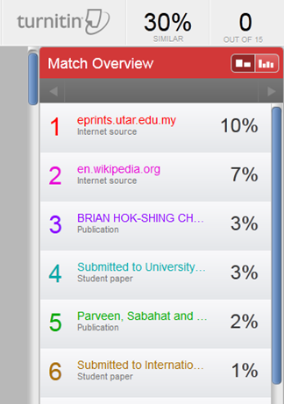

Slide 9
Why is this plagiarism?
The source is unacknowledged – the source is not mentioned in the body of the text or the bibliography.
The submission quotes directly from the source, changing only a few phrases slightly. The direct quotations are not acknowledged.

Slide 10
Second type of plagiarism
The source is acknowledged in the text, but the submission quotes directly from the source without indicating that this is being done.

Slide 15
Why is this plagiarism?
The source text has been acknowledged (in the bibliography).
BUT there is no indication in the body of the submission that the source text has been directly quoted.

Slide 16
A non-plagiarised text

Slide 17
Take home message: Ethical quotation
Acknowledge ALL sources.
Paraphrase ideas in your own words where possible.
If you are quoting a source directly, indicate the words taken from the source with quotation marks.
Any questions?

