Slide 1
Topics in research
Dr John Corbett
USP-CAPES International Fellow

Slide 2
From signs to viewers
1. Review of this week’s reading
2. What can we steal?
3. Tasks for the coming week

Slide 3
(relatively) unique selling point
* Researcher-generated data (Chinatown article)
* Respondent-generated data (Memphis article)
A study of ‘cognitive and emotional verbal responses elicited and triggered [by LL]’ (p. 254)

Slide 4
respondent-generated data
If you do not generate the data, who should?
What would be the advantages/disadvantages of devolving this task?
What research questions would you now be asking?
What ethical issues are raised by this research strategy?
“Empirical researchers involved with human subjects are powerful and make key decisions throughout a study that impact on the quality of the data generated. No matter how empowering or inclusive researchers are, the primary agency and responsibility for the conduct of a study remains with them.” -- Prosser & Loxley, (2008: 19)

Slide 5
Research questions
* How do individual residents understand, interpret and interact with the LL in their communities?
* What are their thoughts and feelings about multilingualism and changes in the LL?
* How is the LL related to residents’ social and psychological identities?

Slide 6
Materials and methods: the site
* LL of Memphis, Tennessee, as a stimulus or emotional trigger
* Selected streets with multilingual street signs were identified and signs photographed.
* An ‘inventory’ of street signs/languages was made (Table 14.1)
A set of ‘Walking tours’ was mapped.

Slide 7
Materials and methods: the viewers
* Two sets of viewers: longstanding residents of Memphis and recent migrants
* ‘Walking tour interviews’ with ‘participant-readers’
* Selection of participants by leaflets, and interviews
* 5 males, 5 females aged 20-80
* 50% long-term residents, 50% migrants
* 7/10 had English as first language; 3 had Amharic (Ethiopia), Spanish (Mexico) and Khmer (Cambodia) as L1 & English as L2.
* Diverse racial/ethnic mix: 5 Caucasian, 2 African American, 1 Ethiopian, 1 Hispanic, and 1Asian.
* All were employed in public service.

Slide 8
Materials and methods: the interview
During the walking tour, subjects were asked:
* How do you feel when you see signs in languages other than English?
* When was the first time you noticed new languages present on signs in this area?
* What was your initial thought or reaction to the linguistic changes?
* Do you feel at home visiting or shopping in this area? If yes, why? If not, why not?
* Do you go into stores and shops that advertise in languages other than English?
* Does or did this place have a special meaning or memory for you?
* What do you think the languages on the signs say about the people or groups in this area?

Slide 9
Materials and methods: follow up and analysis
* Questions were asked of the participants at specific points on the tour
* Field notes were taken during the tour
* Follow-up meetings were held during which participants were given transcripts of their interviews and invited to clarify/add to the points made during the tour.
Analysis: Positive and negative responses were counted.
Interviews were analysed to find recurrent themes.

Slide 10
Findings: quantitative
How do you feel when you see signs in other languages?
30% positive
20% negative
10% mixed feelings
40% neutral

Slide 11
Findings: Qualitative
Participant 2 (Ethiopian) notes that he would not be deterred by a Chinese or Spanish sign if he wanted to go to a Chinese or Mexican restaurant but might avoid a car maintenance shop if it only had descriptions written in Spanish.
-- neutral detached position

Slide 12
Findings: Qualitative
Participant 6 (Mexican) noted that the growing number of Spanish signs indicate the increasing strength and importance of the Hispanic community in the area.
-- affiliated, engaged position (identity strengthened by LL)

Slide 13
Findings: qualitative
Variety of responses to the icon and message on the base of the statue
* Interpretations based on viewers’ beliefs, backgrounds and attitudes
* Icon and message decoded independently
* Triggered strong emotions

Slide 14
Findings: Qualitative
* Signs elicited attitudes to immigration, race, language policy, ethnic identity (eg expression of concerns over illegal immigration from Mexico)
* On occasion, subject and interviewer engaged in conversation to co-construct the meaning of a place (eg subject explains significance of parts of Cambodian temple for the interviewer, who partially leads the dialogue.

Slide 15
Discussion [Could you use any of this?]
The article offers other researchers a methodology to elicit responses to LL.
It attempts to link these responses to various factors:
personal stance towards languages in local LL
how different backgrounds can lead to different interpretations
LL as a trigger to broader social attitudes to the communities whose languages the LL represents
how interviewer and subject co-construct meaning of LL.

Slide 16
Become an active researcher
Developing your own reading list for an essay or research topic:
Access online databases
Choose a relevant database – a good general one is JSTOR
Enter keywords (e.g. from an essay title) in SEARCH and play around with the results.

Slide 17
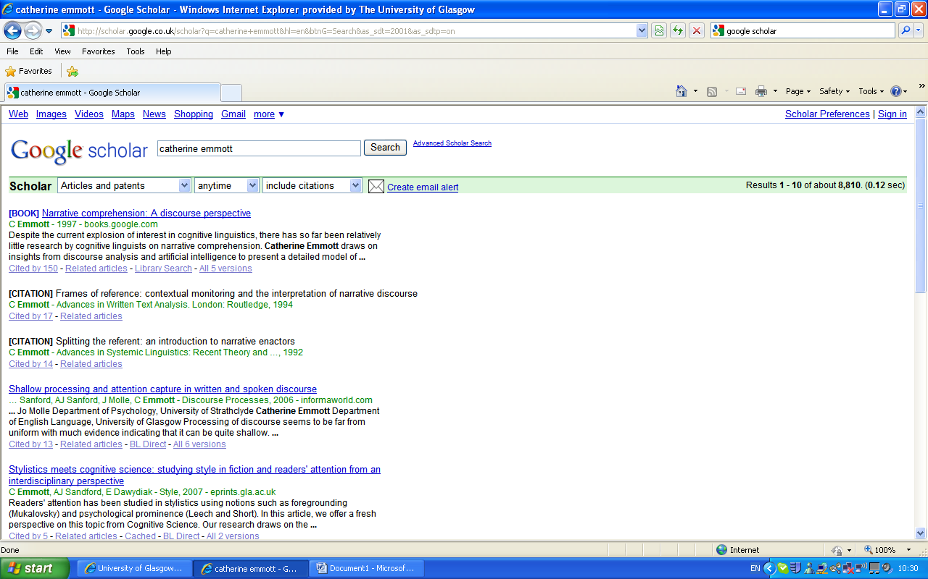
Use Google Scholar strategically…

Slide 18
Again, follow the trail…

Slide 19
Check out who’s cited your reference and where…

Slide 20
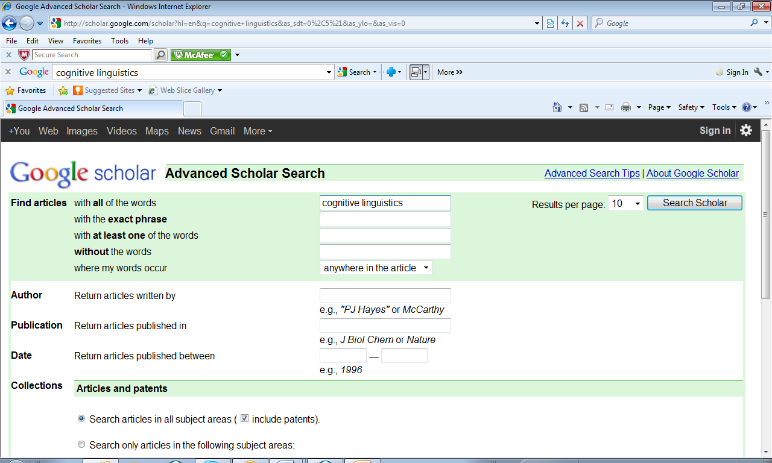
Advanced search

Slide 21
Research is a developing conversation…
Use your reading to:
Find out relevant information
Find out methods of research
Find models of argumentation
Situate yourself in/against a tradition
Critical reading demands:
Familiarity with the field of research & key issues/debates
Ability to synthesise and evaluate reading
Understanding of the real problems of doing research

Slide 22
Some tips for database searches
Use synonyms: LL, linguistic landscaping, cityscapes….
Use different databases
Balance specificity and breadth in keywords
Familiarise yourself with different database formats: JSTOR, LLBA, Oxford Journals online…

Slide 23
Tasks for the coming week
1. Reflect on this week’s session in your learning blog.
2. Do a literature search for linguistic landscape and select an article of interest to you.
4. Read it and be prepared to talk about it in class next week. What can you steal from it?
The articles we are reading will become the basis of our literature review. How do we synthesise the articles that we read? Nearly all the articles and chapters you read will do some synthesis of their own. How will you do yours?

