Slide 1
Conference Presentations
Mirroring techniques to improve your pronunciation

Slide 2
Today´s session
Techniques for pronunciation: ‘mirroring’

Slide 3
Procedures
Choose your own model to copy. It needs to be appropriate (ie intelligible) but should be your choice. The monologue will contribute to your developing L2 identity.
Start by watching the video of your model with the sound off. Pay attention to the gestures, facial expressions and other features of non-verbal communication
Possible sources for models are TED talks or websites like http://www.monologuedb.com 1-3 minutes is sufficient!
Revise the transcript of the video into thought groups, with primary stresses marked.
Record a trial version, but look up at the camera to deliver the thought groups. Get feedback from your teacher and colleagues.
Practise and practise until you have memorised the monologue. Focus systematically on issues like rhythm, intonation, emotion.
If you struggle to express the emotion, use method acting – think of or imagine a time when you felt this way.
If you struggle to memorise the script accurately – improvise.

Slide 4
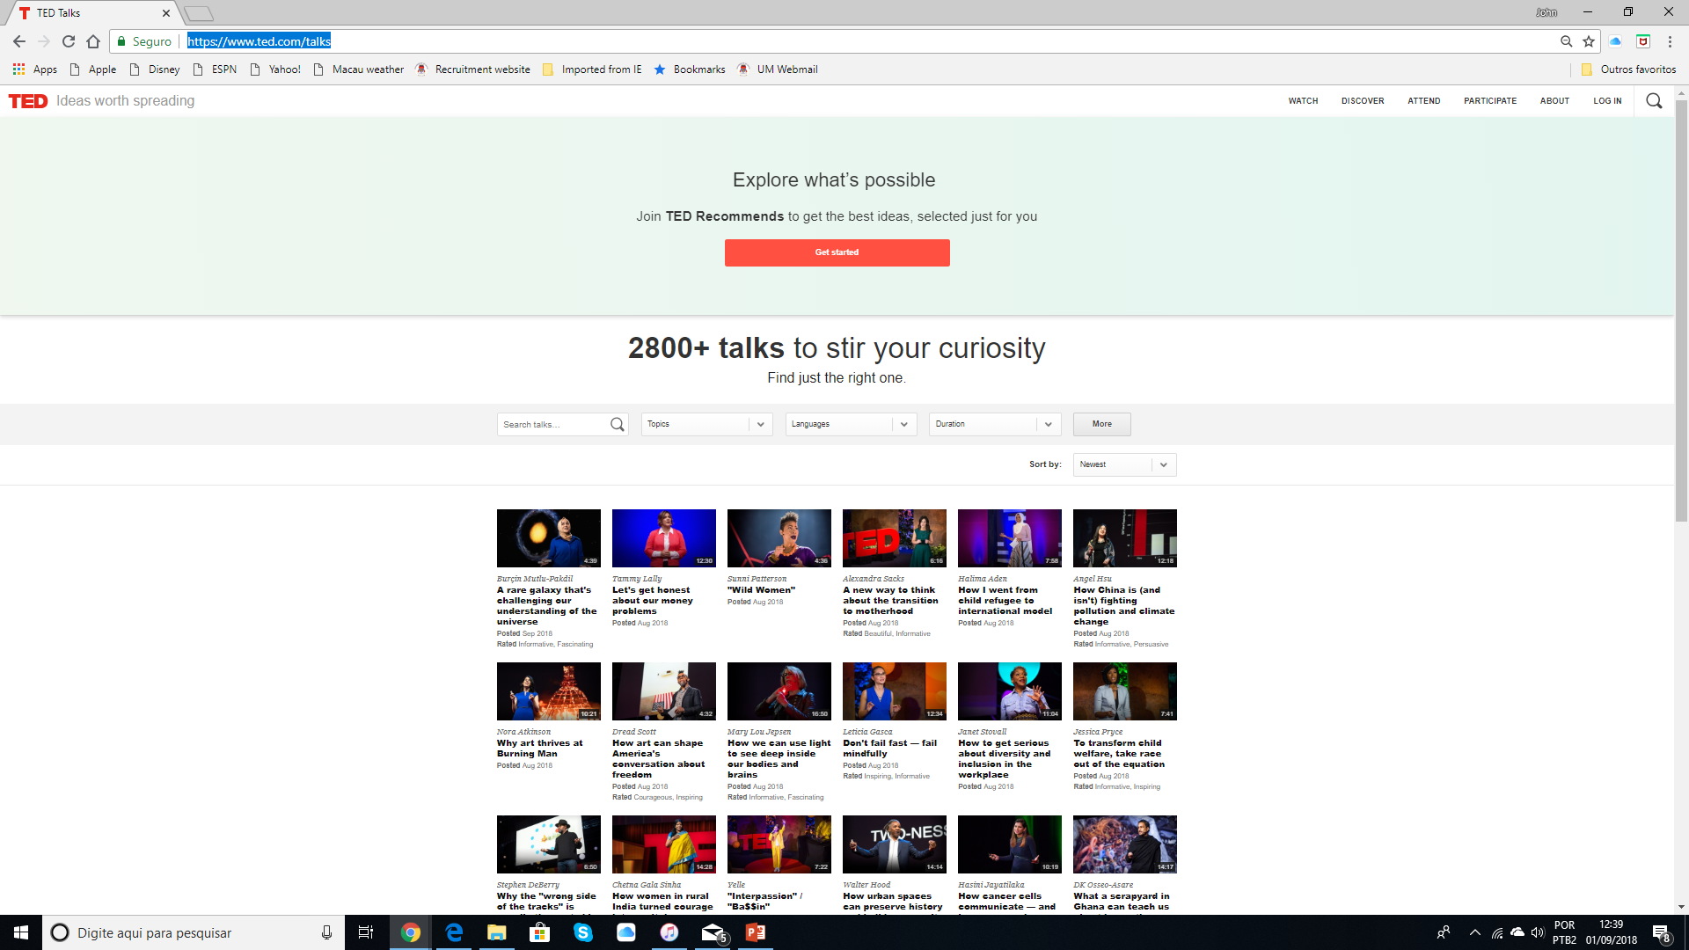
A possible source of monologues (1)
https://www.ted.com/talks

Slide 5
A possible source of monologues (2)
http://www.monologuedb.com

Slide 6
2 Classic film monologues (male & female)
I can’t go on with this scene, I’m too happy. Mr. DeMille do you mind if I say a few words? Thank you. I just want to tell you all how happy I am to be back in the studio making a picture again. You don’t know how much I’ve missed all of you. And I promise you I’ll never desert you again because after ‘Salome’ we’ll make another picture and another picture. You see, this is my life. It always will be. There’s nothing else. Just us, the cameras, and those wonderful people out there in the dark!… All right, Mr. DeMille, I’m ready for my close-up.
You know what you look like to me with your good bag and your cheap shoes? You look like a rube. A well scrubbed, hustling rube with a little taste. Good nutrition has given you some length of bone, but you’re not more than one generation from poor white trash, are you Agent Starling? And that accent you’re trying so desperately to shed – pure West Virginia. What was your father, dear? Was he a coal miner? Did he stink of the lamp? And oh, how quickly the boys found you. All those tedious, sticky fumblings, in the back seats of cars, while you could only dream of getting out. Getting anywhere. Getting all the way to the F.B.I.
Rube: (slang) an awkward unsophisticated person : rustic; a naive or inexperienced person

Slide 7
Do you know the characters? What is the mood of each monologue?
Hannibal Lecter
Norma Desmond

Slide 8
Watch without sound. Pay attention to facial expression and gesture
1. From The Silence of the Lambs
http://youtu.be/G4qblq0uahw
2 From Sunset Boulevard
https://youtu.be/eOLypkY8LMc

Slide 9
Watch with sound. Pay attention to thought groups & main beats (stressed syllables)
1. From The Silence of the Lambs
http://youtu.be/G4qblq0uahw
2 From Sunset Boulevard
https://youtu.be/eOLypkY8LMc

Slide 10
Now practise with a partner. (You can choose either model – it’s up to you)
1. From The Silence of the Lambs
http://youtu.be/G4qblq0uahw
2 From Sunset Boulevard
https://youtu.be/eOLypkY8LMc

Slide 11
Mirroring phase: practise without the original. Shadowing phase: practise at the same time as the original.
1. From The Silence of the Lambs
http://youtu.be/G4qblq0uahw
2 From Sunset Boulevard
https://youtu.be/eOLypkY8LMc

Slide 12
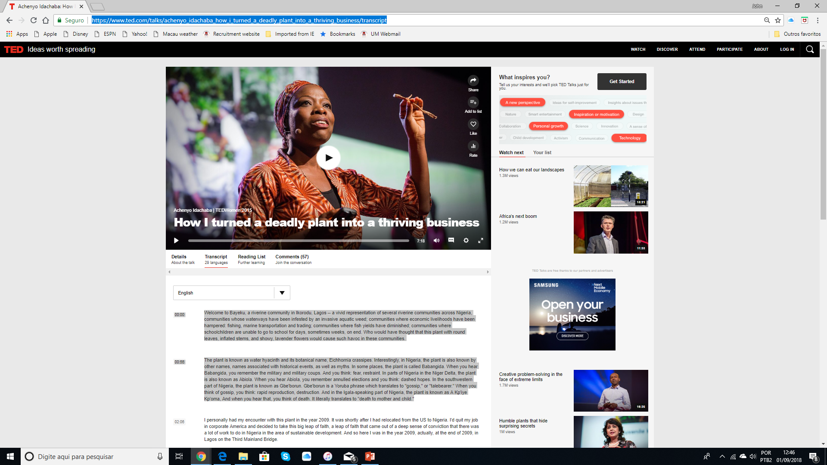
TED talk on agriculture
https://www.ted.com/talks/achenyo_idachaba_how_i_turned_a_deadly_plant_into_a_thriving_business/transcript

Slide 13
Using the transcript
Welcome to Bayeku, a riverine community in Ikorodu, Lagos -- a vivid representation of several riverine communities across Nigeria, communities whose waterways have been infested by an invasive aquatic weed; communities where economic livelihoods have been hampered: fishing, marine transportation and trading; communities where fish yields have diminished; communities where schoolchildren are unable to go to school for days, sometimes weeks, on end. Who would have thought that this plant with round leaves, inflated stems, and showy, lavender flowers would cause such havoc in these communities.
The plant is known as water hyacinth and its botanical name, Eichhornia crassipes. Interestingly, in Nigeria, the plant is also known by other names, names associated with historical events, as well as myths. In some places, the plant is called Babangida. When you hear Babangida, you remember the military and military coups. And you think: fear, restraint. In parts of Nigeria in the Niger Delta, the plant is also known as Abiola. When you hear Abiola, you remember annulled elections and you think: dashed hopes. In the southwestern part of Nigeria, the plant is known as Gbe'borun. Gbe'borun is a Yoruba phrase which translates to "gossip," or "talebearer." When you think of gossip, you think: rapid reproduction, destruction. And in the Igala-speaking part of Nigeria, the plant is known as A Kp'iye Kp'oma, And when you hear that, you think of death. It literally translates to "death to mother and child."

Slide 14
Your homework
Select a new monologue of your own choice (1 or 2 mins)
Go through the mirroring procedure.

Slide 15
A lecture on a mirroring project (53 mins)
https://youtu.be/G4qblq0uahw

