Slide 1
Topics in research Session 2: chinatown, Washington DC
Dr John Corbett
USP-CAPES International Fellow

Slide 2
Report on home activities
1. Buy the notebook.
Start looking around and taking notes of interesting signs, official & unofficial.
Note your thoughts, comments, questions, feelings.
2. Read the first coursework article.
3. Write c.200 words about your observations, reading, thoughts & expectations in the moodle blog by next Sunday.
4. Come to class on Monday next, ready to discuss the article and also to talk about your initial ideas for your own fieldwork.

Slide 3
Recap: General questions
How is the public space linguistically/symbolically constructed?
What is the interplay between the languages on display?
How do the languages mediate power? (institutional, linguistic, economic…?)
How do the languages attract/serve viewers’ interests (eg advertising/public service?)
How do the languages on display help construct viewers’ identity?
How do the viewers interpret the languages on display?
What kinds of evidence would help answer these questions?
What kind of methods would you use to analyse the evidence?

Slide 4
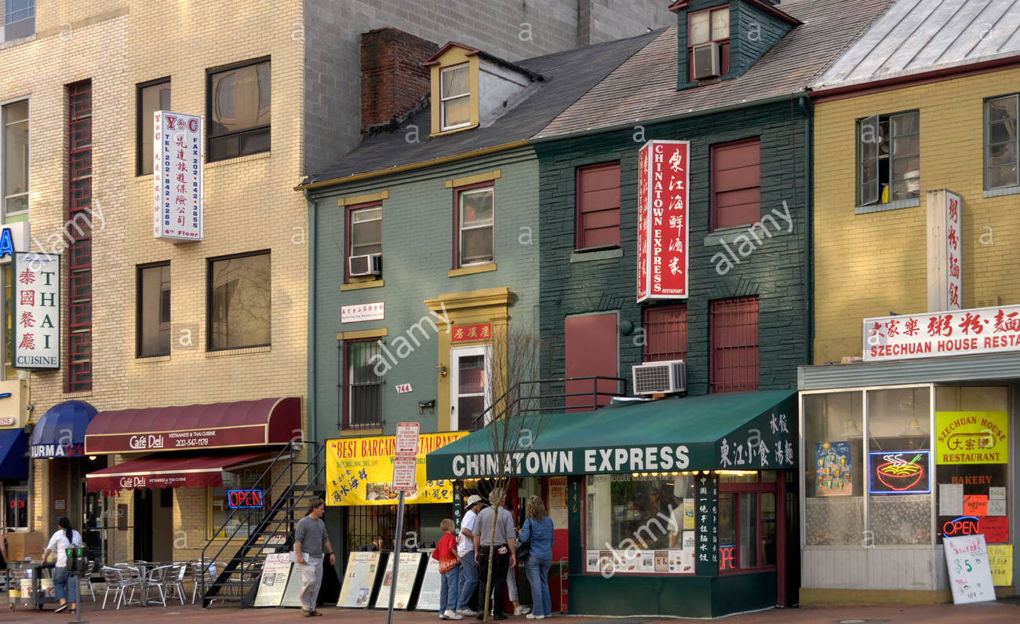
chinatown, Washington dc

Slide 5
Introduction
How do the authors introduce the topic?
How do they characterise earlier research?
How do they establish their stance towards the previous research?
What will their own contribution to the research area be?

Slide 6
Literature review
How does the literature review establish a framework for the current research?
What are the key concepts in the literature review?
How do the present researchers take a stance with respect to the previous research?
Challenge it?
Extend it?

Slide 7
Previous research concerns
LL as an indicator of linguistic ‘power’ (Quebec, Jerusalem, Tokyo)
LL as a manifestation of state/civic authority vs private/individual agency
Commercialization of ‘the public sphere’ (cf Habermas)

Slide 8
Previous methodologies
Quantitative (count the manifestations of each language in the environment)
Correlate LL with sociolinguistic facts/attitudes of inhabitants (cf Macau)
Interpret the symbolic function of some languages (eg English = modernity)
Lack of content analysis (what do the signs advertise/convey?)
Lack of attention to ‘communicative force’ (relative salience of signs)
Lack of attention to function of signs (to inform, give sense of authenticity…)
Ignore issues such as the ‘language’ of commercial logos.

Slide 9
The present article`s methodology/approach
They argue that LL should be understood in terms of the symbolic functions of language that allow people to use language to index identity and present a certain image of self, that support actors’ rational self-interests in attracting clients, and that are borne out of power relations among different groups. Like these researchers, we stress that the symbolic functions of language help to shape geographical spaces into social spaces.

Slide 10
Key concept & AIM
“Landscape is both a place and a ‘way of seeing’ ... [It] is additionally a form of ideology. It is a way of carefully selecting and representing the world so as to give it a particular meaning. Landscape is thus an important ingredient in constructing consent and identity – in organizing a receptive audience – for the projects and desires of powerful social interests.” (Mitchell 2000:100)
…
Thus, the representation that is inherent in the concept of landscape both reflects and promotes not just particular perspectives, but material interests. In other words, the structuring of landscapes has material consequences. It is this notion that we seek to emphasize in the investigation of LLs.

Slide 11
background
Historical contextualization (1) : Areas of cities as sites of service/retail. Civic authorities promote urban spaces as sites of culture to promote consumption.
In the case of Washington DC’s Chinatown, the state and private enterprise use symbols of Chinese ethnicity and culture, including language, graphics, and forms, to turn Chinatown into a commodity, marketing it and the things in it for consumption. As we will show, material manifestations of Chinese language in Washington DC’s Chinatown are an important tool in the symbolic economy.

Slide 12
background
Historical contextualization (2): The commodification of ethnicity
…individual ethnicities and ethnic neighborhoods are often reconfigured and ‘repurposed’; having once been enclaves resulting from racism and marginalization, especially since the 1980s they have been turned into vibrant tourist attractions offering ‘authentic’ experiences. These attractions are often targeted towards the middle class, and often exclude the very ethnic groups being represented and commodified.

Slide 13
Methods (1)
In order to fully understand the story of the Chinatown landscape, we examined all municipal planning rules and regulations regarding Chinatown in effect at the time of the study, documents related to the redevelopment process that began in the 1970s, newspaper accounts of Chinatown over the past four decades, demographic data from the U.S. Census Bureau, and all signs in the STA [Special Treatment Area].

Slide 14
Meth0ds (2)
We visited the neighborhood in September 2006 and walked along both sides
of every street, taking detailed notes on the material manifestations of language
inside and outside of every establishment, as well as on street signs and flyers
and advertisements posted on walls, poles, bus stops, and the like. We carefully
recorded the languages used and the kinds of information conveyed in each
language, as well as the relative size and placement of different languages. As a
complement to our field notes, we took numerous photographs.

Slide 15
Methods (3)
We worked with four Chinese-reading informants who translated the Chinese language texts. We also gathered information about the establishments where language was displayed; for example, we kept track of whether they were public, private, or non-profit, whether businesses were individually-owned or part of a chain, and when they were established. Because most of the signs in Chinatown are on the neighborhood’s two commercial corridors (Seventh Street NW and H Street NW), those streets were the source of the vast majority of our data

Slide 16
categorization
After collecting and reviewing our data, we developed a classification system
to categorize signs according the following criteria:
• language (Chinese or English);
• types of symbolic and ideational meanings communicated;
• time period that a business or institution was established (during the first or
second wave of gentrification); and
• type of institution (business, non-profit, or government organization, Chinese-oriented goods/services or not, chain or independently owned).

Slide 17
Results (1)
In the early stages, use of Chinese signage ‘marks Chinese territory’ an ethnic neighbourhood (1930s-1970s) caused by displacement from other neighbourhoods being concentrated on what was to become ‘Chinatown’
Redevelopment and community activism (1970s-80s) resulting in new buildings visually identified through their architecture with Chinese culture (eg Wah Luck House, built as social housing to relocate Chinese residents displaced by new DC Convention Center)
Beginning of commodification of Chinese culture to attract outsiders (1986 ‘Friendship Arch’ inscribed in Chinese). Addition of ‘Chinatown’ to the metro station name, ‘Gallery Place’.

Slide 18
Friendship arch

Slide 19
Results (2)
1990s: Further redevelopment threatens small businesses. ‘Corporate gentrification’ and a visual harmony were promoted by public-private partnerships and civic regulations such as the following:
Signage and Chinese characters are important design elements. Liberal use of Chinese characters in signage and decoration will provide needed Chinese ambiance in Chinatown. (Section 6.91 Chinatown Design Guidelines 1989: 42)
2000s: Redevelopment intensifies along the given guidelines:
Essentially all new businesses and residential construction display Chinese elements, with Chinese writing on everything from the Starbucks coffee shop to the Bed, Bath and Beyond housewares store and the new luxury condominiums.
However, Chinese ethnic population decreases and number of Chinese-American owned businesses in the area decreases.

Slide 20
Discussion (1): ideational & symbolic uses of language
LL in the First Wave: ‘Chinese language linked to Chineseness’
Chinese inside as well as outside shops; Chinese more prominent than English; diversity of functions: informative (ideational). But also early commodification and symbolic use of Chinese to mark Chinese territory & advertise Chinese goods/services
LL in the Second Wave: Appropriation of Chinese by Public and Corporate agents
Chinese largely outside shops; Chinese largely decorative (symbolic) in function; English more prominent (ideational).

Slide 21
Discussion (2): commodification & detachment of ethnicity
[…] the Chinese language becoming a floating signifier that can be used to signify, or to sell not just things Chinese but anything at all. This branding has resulted in a commodification of ethnicity as well as the delinking of Chinese writing from Chinese people, culture, or history. This is especially clear in the case of the ethnic (non-Chinese) restaurants that have recently opened in the neighborhood, such as La Tasca tapas restaurant […] and Matchstick Pizza.

Slide 22
Qualifications
There is still a Chinese community, and there are still Chinese businesses & institutions (eg churches) and so some Chinese ideational discourse in Chinatown DC.
There is involvement and support within the Chinese-American community in Chinatown for the corporate/public developments.
The Office of Planning must walk a thin line between creating a future for the neighborhood as a cultural anchor that facilitates the creation of community and meets community needs, and a Disneyfied landscape that simply promotes consumerism.

Slide 23
Conclusion (1) summary of findings and discussion
[…] language revitalization, substantive multilingualism, and empowerment of language minorities are not the goals of the Chinatown language policies. These policies provide no opportunities or encouragement for using Chinese as a means of communication. They do not portray Chinese language as a valuable cultural element worthy of preservation in its owncright, nor do they construct it as a tool to empower language minorities or promote interaction and community building – as would be the case with a city-funded bilingual school or a policy encouraging business owners to hire Chinese-speaking employees.

Slide 24
Conclusion (2) revisiting methods
In our analysis we have expanded on the predominant framework of linguistic
landscape by taking a qualitative and historicized approach, one which is
sensitive to context and function. We have also emphasized the importance of
attending to the increasingly commercial nature of the contemporary public
sphere in the U.S. urban context (a phenomenon present in many other
urban settings) and we have shown that, in such settings, a top-down/bottomup
distinction cannot easily be maintained. Our approach allows a deeper
understanding of the ideological and material processes of gentrification, as
well as the ways that commodification is part and parcel of these processes.

Slide 25
Reviewing research article structure
Use the introduction to create a research space
Use the literature review to frame your own research
Outline your general procedures
Explain your methods
Describe your results
Discuss the meaning and implications of your results
Conclude by summarising your results and discussion and reviewing the strengths and weaknesses of your methods (in relation, again, to earlier research).

Slide 26
Relevance to sao Paulo?
Chineseness works as spectacle, on display largely for the benefit of outgroup individuals and the linguistic landscape is a key site of this commodified display of ethnicity. The promotion of Chinese on everything from Starbucks to the MCI/Verizon Center has largely divorced the language from a community of Chinese speakers. In DC’s Chinatown, Chinese writing has become less and less a means of communication and social interaction, and more and more a symbolic design element, an ornament in the commodified landscape.

Slide 27
Next week’s tasks
You will be asked to read part of a general review of visual research methods.
You should read your part and be prepared to share it in class next week.
You should also say if you learned anything useful from the review that you might use in your own ethnographic research.

