Slide 1
Intercultural Language Education
Professor john Corbett: capes-usp international fellow
University of sao Paulo

Slide 2
Course content
• Models for understanding intercultural communication
• Globalisation, power, identity, migration and sojourning (eg study abroad)
• Negotiating and managing intercultural conflict; issues of citizenship, human rights, and social justice.
• Constructing models of intercultural communicative competence
• Reconceptualising multilingualism

Slide 3
Aims of the course
By the end of the course, students will:
• Demonstrate through written work and/or oral presentation their critical understanding of theories, approaches, and practices of intercultural communication and intercultural language education.
• Demonstrate through written work and/or oral presentation their critical understanding and application of these theories, approaches, and practices to communicative events and educational contexts.
• Demonstrate through written work and/or oral presentation their ability to give a critical evaluation of key scholarly research in the field of intercultural studies.
• Demonstrate through written work and/or oral presentation their ability to articulate and employ key terminology/concepts in the field of intercultural communication and intercultural language education.
• Demonstrate through written work and/or oral presentation their ability to address problems, issues and challenges in relation to intercultural communication and intercultural language education.

Slide 4
But how…?
The course has been designed as a 6-week ‘blended learning’ programme, consisting of the equivalent of 24 contact hours:
Introduction to intercultural language education (f2f lecture and discussion)
Ethnographic approaches 1: fieldwork (online reading and activities)
Ethnographic approaches 2: telecollaboration (online reading and activities)
CEFR and ILE 1: institutionalising ILE (online reading and activities)
CEFR and ILE 2: exporting a curricular framework (online reading and activities)
Feedback and critical approaches to ILE (f2f lecture and discussion)
The follow-up course looks at more practical classroom approaches to ILE, eg class projects & materials design.

Slide 5
Expectations of you…
As part of the online learning phase, you are expected to:
Watch videos posted on moodle
Read relevant literature
Do suggested activities by deadlines
Be prepared to participate in online discussions
You are also invited to experience an online telecollaboration project (‘The Hemispheres Project’) as a participant-observer.
Course assessment will be by a portfolio of reflections posted on moodle.

Slide 6
What makes language education ‘intercultural’?
We encounter an increasing number of people from different backgrounds and values.
With global mobility, we find ourselves in communities whose members’ background, assumptions and beliefs may be different from our own.
Differences in value and belief may result in behaviour that we find unusual or even unacceptable.
How do we learn to cope in these situations?

Slide 7
From the Common European Framework of Reference for Languages
“In an intercultural approach, it is a central objective of language learning to promote the favourable development of the learner’s whole personality and sense of identity in response to the enriching experience of otherness in language and culture.”
(Council of Europe 2001, p.1)

Slide 8
From the Common European Framework of Reference for Languages
“In an intercultural approach, it is a central objective of language learning to promote the favourable development of the learner’s whole personality and sense of identity in response to the enriching experience of otherness in language and culture.”
(Council of Europe 2001, p.1)
How would you describe ‘your whole personality and sense of identity’ to a stranger? What makes you you?
Who is the ‘other’ for you?
What aspects of ‘otherness’ do you expect to encounter through the context of language education? How do you respond to that ‘otherness’?

Slide 9
Ways of thinking about culture & identity
In Liquid Modernity, Zygmunt Bauman attempted to characterise what was new about the developed world as it entered the 21st century.
He argued that there is a new kind of ‘liquid’ modernity, that has implications about the way we conceptualise various aspects of culture and identity. He writes about liquid modernity in terms of:
* emancipation/freedom
* the individual
* time and space
* work
* the community
The following quotes can be seen as points of departure for an inquiry into aspects of ‘intercultural being’.

Slide 10
Ways of thinking about culture & identity
“Two features … make our situation – our form of modernity – novel and different.
The first is the gradual collapse and swift decline of early modern illusion: of the belief that there is an end to the road along which we proceed … a state of perfection to be reached tomorrow, next year or next millennium, some sort of good society, just society and conflict-free society … of steady equilibrium between supply and demand an satisfaction of all needs …
The second seminal change is the deregulation and privatization of the modernizing tasks and duties. What used to be considered a job to be performed by human reason seen as the collective endowment and property of the human species has been fragmented (‘individualized’), assigned to individual guts and stamina, and left to individuals’ management and individually administered resources.” (29)

Slide 11
Individual identities
“Identities seem fixed and solid only when seen, in a flash, from outside. Whatever solidity they might have when contemplated from the inside of one’s own biographical experience appears fragile, vulnerable, and constantly torn apart by shearing forces which lay bare its fluidity and by cross-currents which threaten to rend in pieces and carry away any form they might have acquired.
…
Given the intrinsic volatility and unfixity of all or most identities, it is the ability to ‘shop around’ in the supermarket of identities, the degree of genuine or putative consumer freedom to select one’s identity and to hold to it as long as desired, that becomes the royal road to the fulfilment of identity fantasies. Having the ability, one is free to make and unmake identities at will. Or so it seems.” (83)

Slide 12
Time/space
Liquid modernity is characterised by the collapse of time and space, and in its characterisation of an instantaneous world of temporary contacts, Bauman anticipates a digitally connected world of social media, which his book antedates. Bauman nevertheless writes of ‘non-places’ where strangers may meet, but not develop long-term relationships and warns of their dangers.
“Non-places do not require a mastery of the sophisticated and hard-to-study art of civility, since they reduce behaviour in public to a few and easy-to-grasp precepts. Because of that simplification, they are not schools of civility either. And since these days they ‘occupy so much space’, since they colonize ever larger chunks of public space and refashion them in their own likeness, the occasion to learn the art of civility are fewer and further between.” (102-3)

Slide 13
Work
“Nigel Thrift in his brilliant essay on what he has chosen to call ‘soft capitalism’ notices the remarkable change of vocabulary and the cognitive frame which mark the new global and extraterritorial elite. To convey the gist of their own actins, they use metaphors of ‘dancing’, or ‘surfing’; they speak no longer of ‘engineering’, but instead of cultures and networks, teams and coalitions, and of influences rather than control, leadership and management. They are concerned with looser forms of organization which could be put together, dismantled and reassembled at short notice or without notice; it is such a flued form of assembly which fits their view of the surrounding world as ‘multiple, complex, and fast-moving, and therefore “ambiguous”, “fuzzy” and “plastic”’, ‘uncertain, paradoxical, even chaotic’. Today’s business organization has an element of disorganization deliberately built into it; the less solid and the more fluid it is, the better.” (154)
Citing Nigel Thrift, ‘The rise of soft capitalism’, in Cultural Values, April 1997, p.52

Slide 14
Community
“As Eric Hobsbawm caustically remarked, ‘Never was the word “community” used more indiscriminately and emptily than in the decades when communities in a sociological sense became hard to find in real life.’ ‘Men and women look for groups to which they can belong, certainly and forever, in a world in which all else is moving and shifting, in which nothing else is certain.’ Jock Young supplies a succinct summary to Hobsbawm’s observation: ‘Just as community collapses, identity is invented.’ (171)
Citing Eric Hobsbawm, The Age of Extremes (London: Michael Joseph, 1994), p.428; ‘The cult of identity politics’, in The New Left Review, 217 (1998) p.40; & Jock Young, The Exclusive Society (London: Sage, 1999), p,164.

Slide 15
So….?
“In an intercultural approach, it is a central objective of language learning to promote the favourable development of the learner’s whole personality and sense of identity in response to the enriching experience of otherness in language and culture.”
(Council of Europe 2001, p.1)
How do we approach the CoE objectives sympathetically but critically?
What can we learn from critical perspectives such as that of Bauman?

Slide 16
Towards a critical intercultural language education
Approach intercultural language education from the perspective of an ethnographer (ie a participant-observer in a physical or online ‘community’)
Acknowledge attempts to formalise an intercultural language curriculum as an institutional artefact, but look upon them as a critically reflective practitioner.

Slide 17
Preview of weeks 2-5.
Look at the moodle site
Preview the activities
Questions?

Slide 18
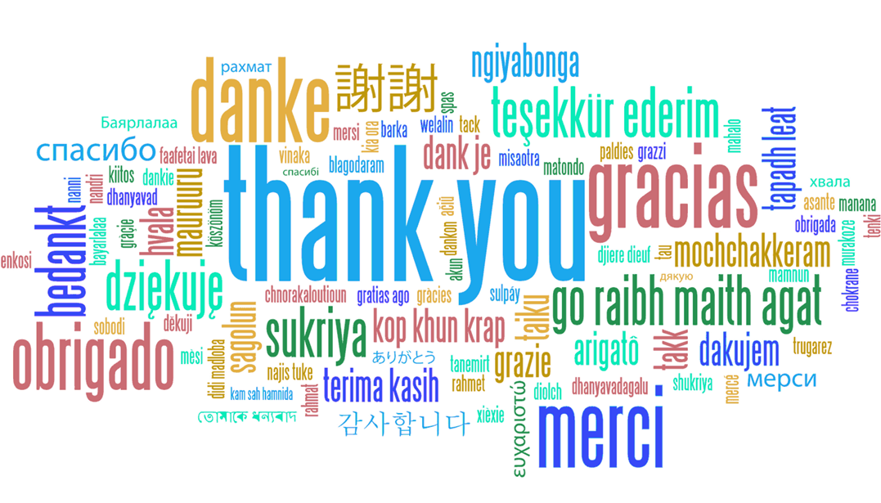
jcorbett@usp.br

