Slide 1
Topics in research
Dr John Corbett
USP-CAPES International Fellow

Slide 2
Introductory session
1. Getting to know you
2. Explanation of the course structure, aims & expectations
3. Introduction to ethnographic practices
4. Introduction to linguistic landscapes as a research area
5. Tasks for next week

Slide 3
1. Getting to know you
1. Year of study
2. Subjects studied so far
3. Experience of linguistic (or other research)
4. Attitude to writing
5. Attitude to collaboration and group assessment
6. Where do you live?
7. Do you work as well as study?
8. Are you a native of SP (the capital)?

Slide 4
2. Explanation of the course structure, aims & expectations
1. This is an experiential course. We will learn about research by doing some.
2. The course will involve us all participating in
literature review
developing research questions in relation to the research literature
gathering, analysing & discussing data
workshopping it, presenting it, writing it up, and peer editing it
polishing it until it is in a publishable format

Slide 5
2. Explanation of the course structure, aims & expectations
3. The methodology we’ll adopt in this course is ethnographic, specifically visual ethnography (but this might develop as the course progresses). So we will learn about ethnographic data collection and analysis and think critically about its strengths and weaknesses as a research method in linguistics.
4. The object of study will be Sao Paulo (or parts of it) – unless you live outside SP when the object of study could be your local neighbourhood.
5. The research tradition that we will contribute to is the relatively new area of linguistic landscaping. We´ll learn about this area of study, and by the end of the course we will aim to have a relatively rich set of articles on aspects of the linguistic landscape of Sao Paulo (and maybe its environs).
6. We will publish these articles, eg in an online journal/website that we construct.

Slide 6
Jogo de cintura…

Slide 7
2. Explanation of the course structure, aims & expectations
7. I expect you to …
Do the course reading and be prepared for class discussions. Supplement the course reading if you can with your own reading on the topic
Buy a small notebook and get into the habit of writing observations, feelings, notes and comments about the project as it develops.
Edit and write up your notes on a weekly basis in a brief, public moodle blog (you can self-censor) [c. 200 words per week] This will be assessed (40% ungraded).
Gather data from your chosen site of interest (probably via photos, possibly via recording/interviews)
Analyse and discuss your data in class, and ultimately in the form of a research article that we will draft, edit and revise over the duration of the course [c.4000 words]. This will be assessed too. (60% graded on final version).
Any questions?

Slide 8
What do you understand by ethnography?
Ethnography is…

Slide 9
What do you understand by ethnography?
Ethnography is…
A description of a culture (or aspects of it) through observation and participation
Involves structured observation through fieldwork practices
Aims at a ‘thick’ qualitative account of the patterns of attitude and belief underlying behaviour (including language)

Slide 10
Linguistic landscapes
Linguistic landscape (LL) is the study of…
“the scene where the public space is symbolically constructed. […] The means of this construction are the marking of objects – material and immaterial – with linguistic tokens.”
Ben Rafael, Shohamy & Barni, 2010, xi.

Slide 11
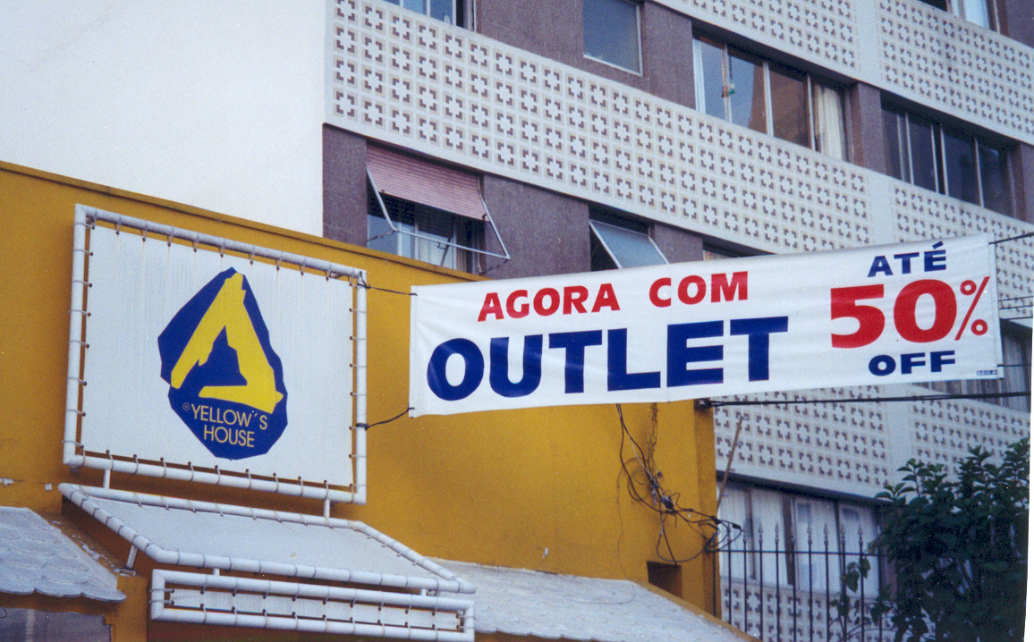
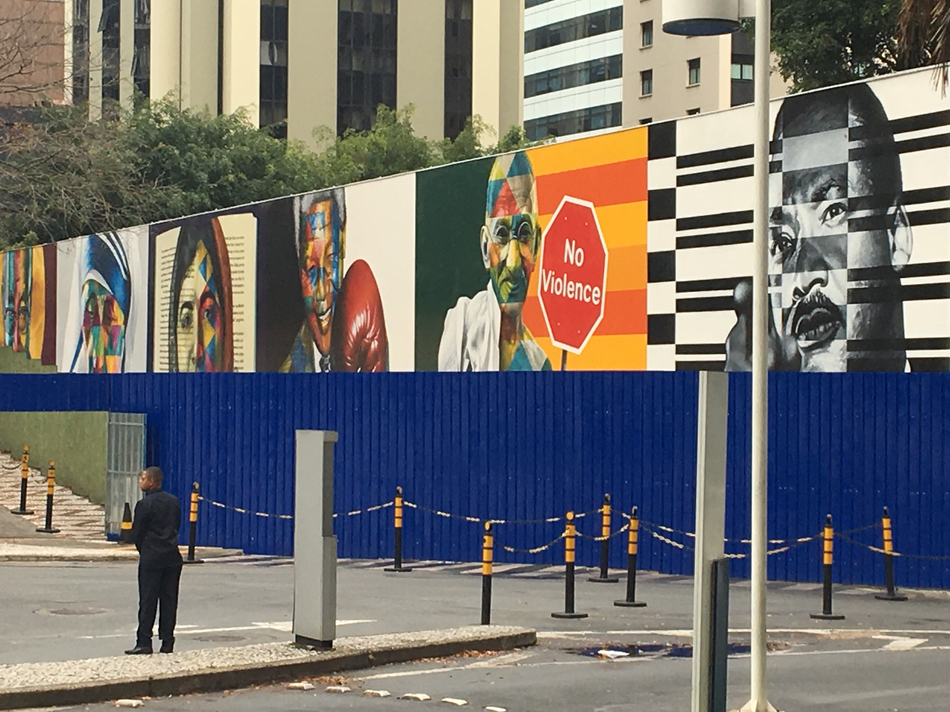
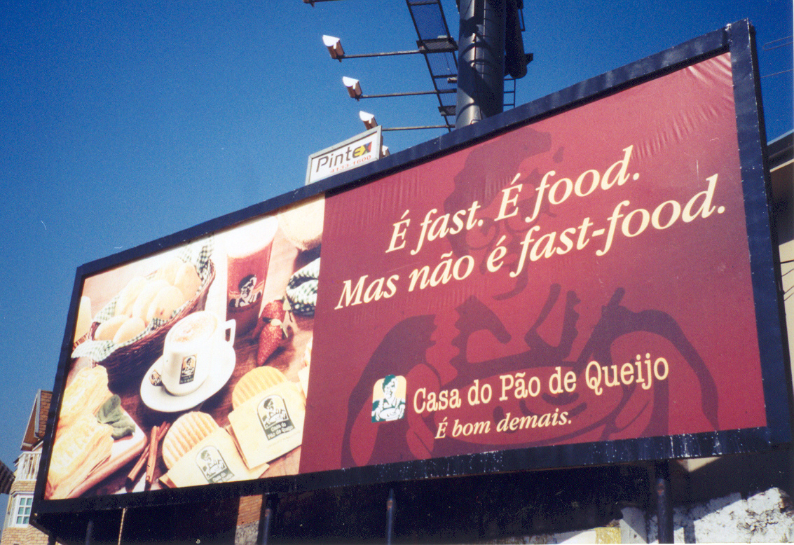
In and around sao paulo

Slide 12
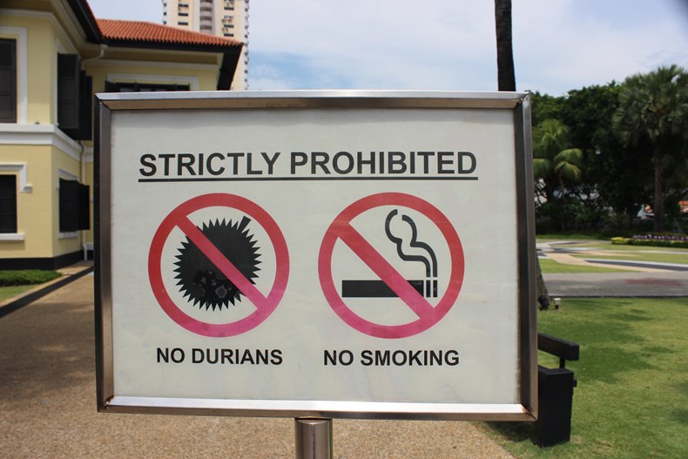
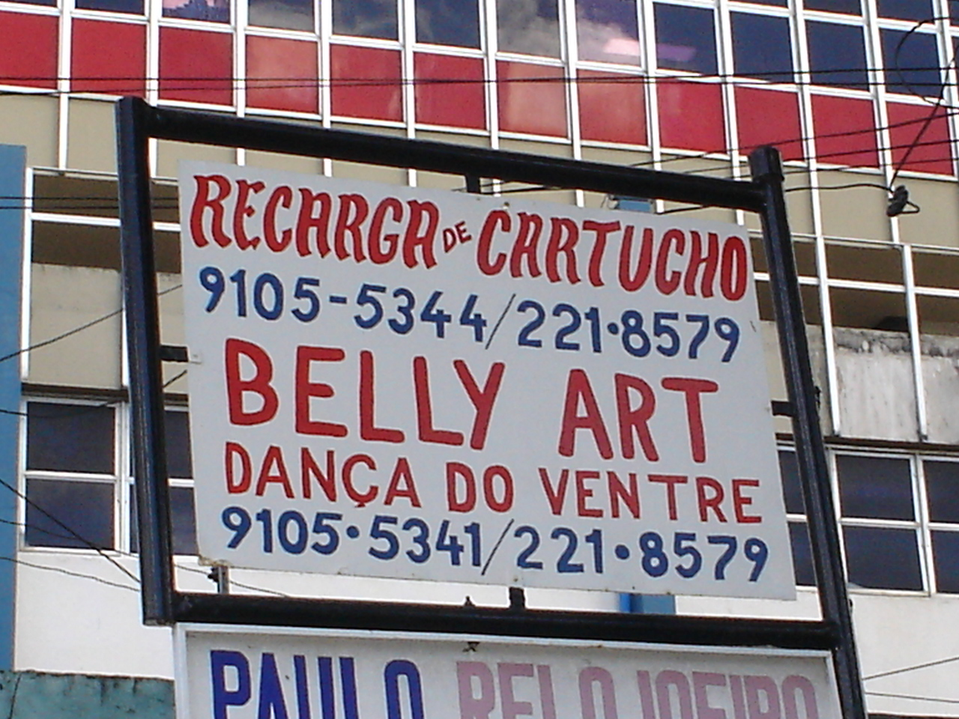
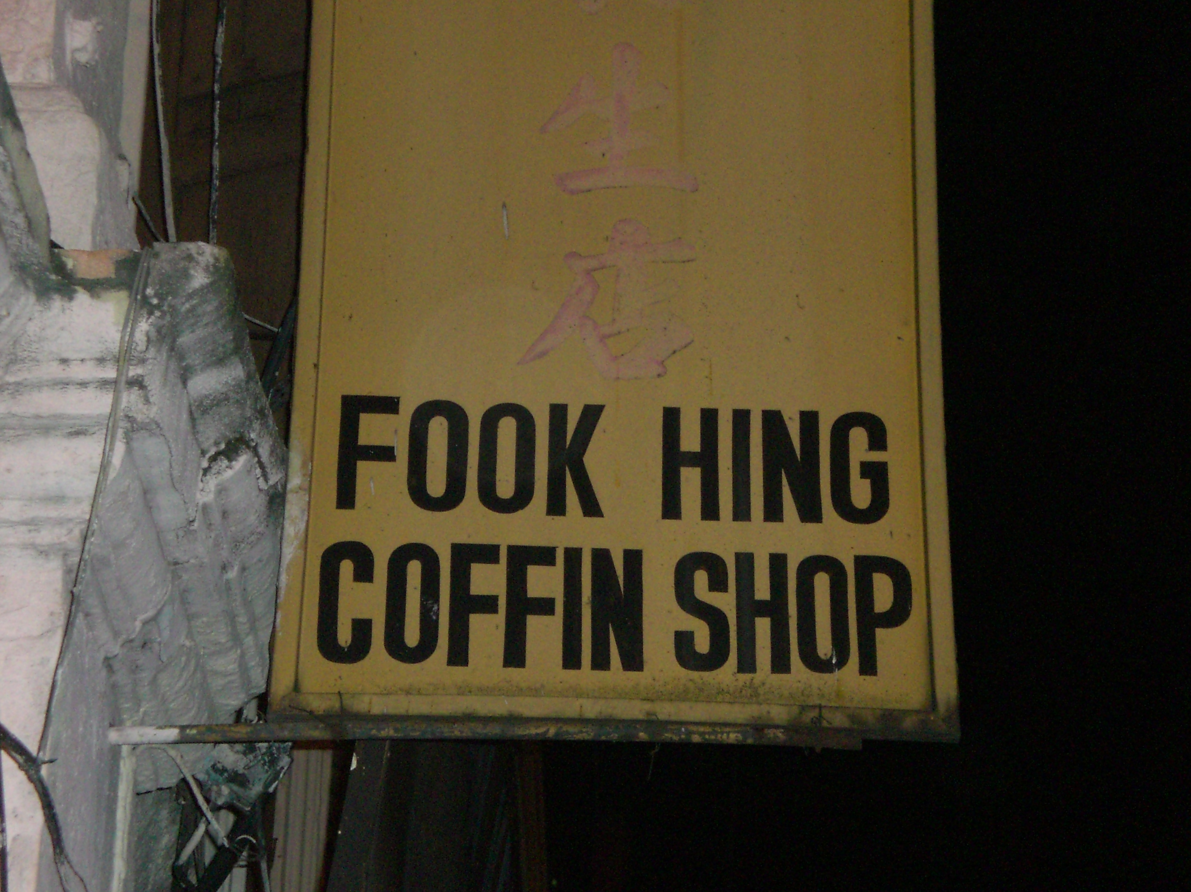
Further afield
Singapore, 2016 Joao Pessoa 2011 Kuala Lumpur 2007

Slide 13
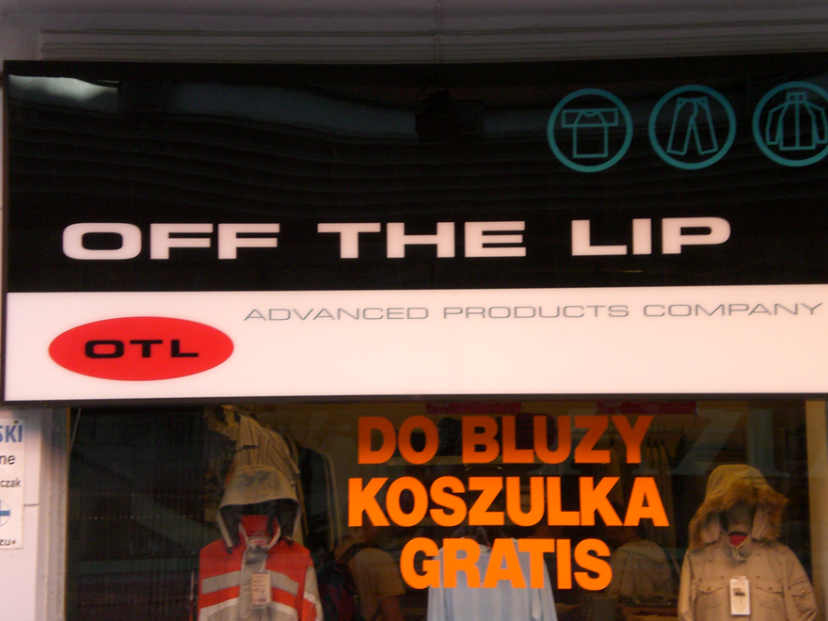
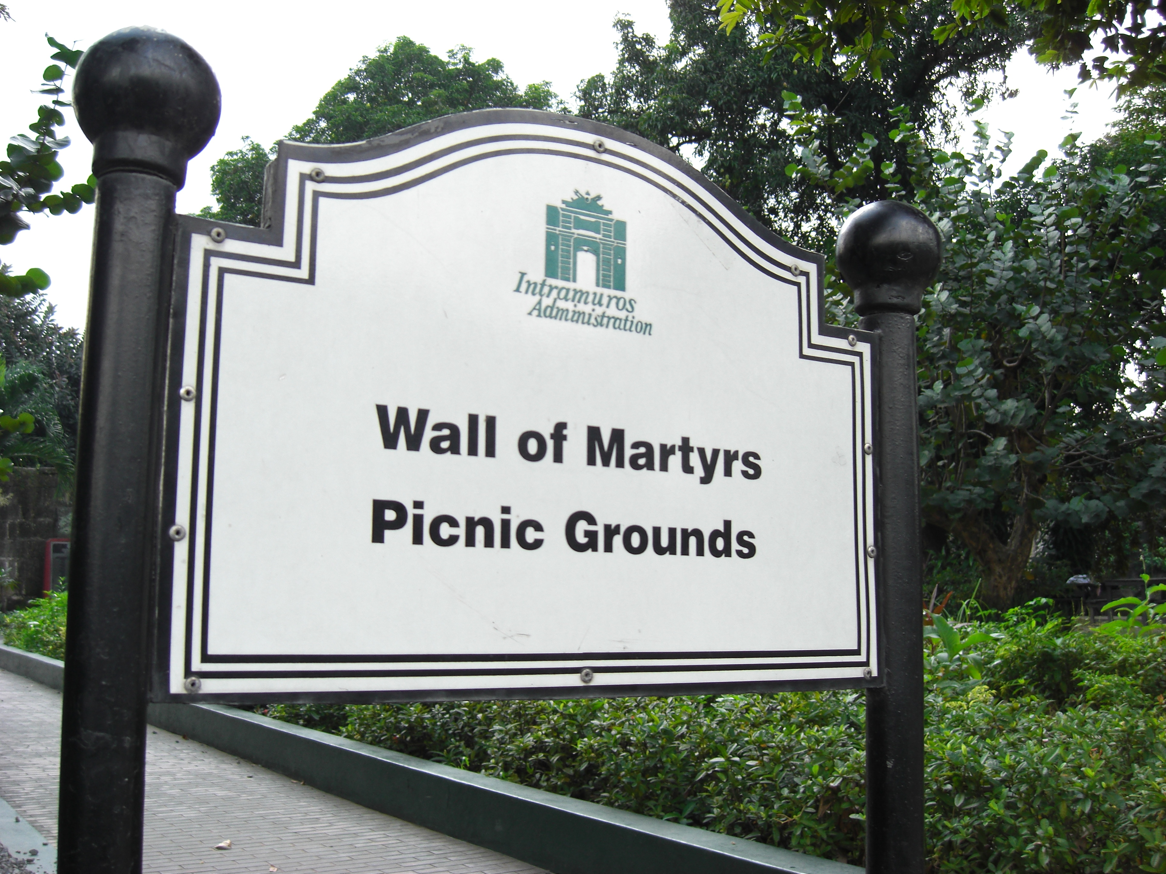
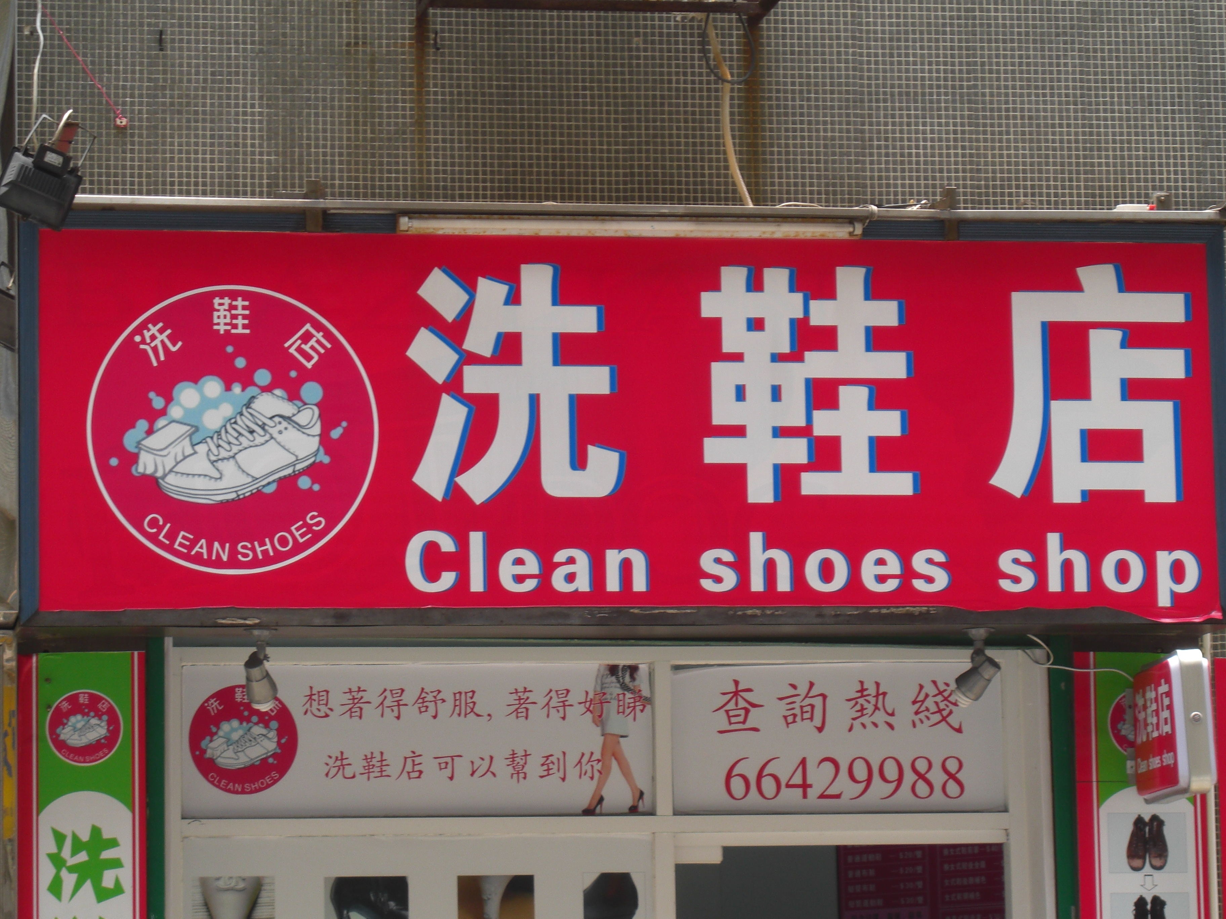
Further afield
Poznan, Poland, 2006 Manila, 2008 Macau 2011

Slide 14
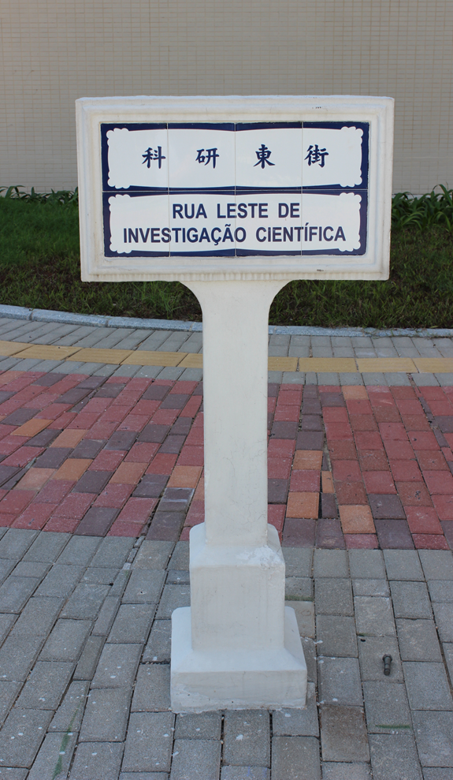
Who’s on top?
University of Macau New Campus 2014

Slide 15
General questions
How is the public space linguistically/symbolically constructed?
What is the interplay between the languages on display?
How do the languages mediate power? (institutional, linguistic, economic…?)
How do the languages attract/serve viewers’ interests (eg advertising/public service?)
How do the languages on display help construct viewers’ identity?
How do the viewers interpret the languages on display?
What kinds of evidence would help answer these questions?
What kind of methods would you use to analyse the evidence?

Slide 16
Beginnings…
What kind of sites in SP (or around SP) would you be interested in investigating? What kind of languages would you expect to find?

Slide 17
Beginnings…
What kind of sites in SP (or around SP) would you be interested in investigating? What kind of languages would you expect to find?
A shopping centre A tourist area (Ibirapuera)
A language school A museum/gallery
USP (or parts of it) A church
A particular region (eg Liberdades, downtown) A football stadium
A particular store (FNAC, Livraria Cultura) A street (Teodoro Sampaio)
Graffiti tours (eg Vila Madalena)
etc etc etc

Slide 18
Your mission…
1. Buy the notebook.
Start looking around and taking notes of interesting signs, official & unofficial.
Note your thoughts, comments, questions, feelings.
2. Read the first coursework article.
3. Write c.200 words about your observations, reading, thoughts & expectations in the moodle blog by next Sunday.
4. Come to class on Monday next, ready to discuss the article and also to talk about your initial ideas for your own fieldwork.

