Slide 1
DRAMA CONVENCIONAL
(ações em progressão são assistidas no presente)
ÉPICO (ações já realizadas no passado são narradas e comentadas)
DRAMA MODERNO (ações presentes lançam luz sobre motivações passadas ou sobre a esfera interior dos personagens)
TRAGÉDIA MODERNA (Para sobreviver diante de sua consciência ou valores, o protagonista é destruído pelo sistema social dominante. Sua compreensão crítica do passado vem tardiamente no presente.)

Slide 2
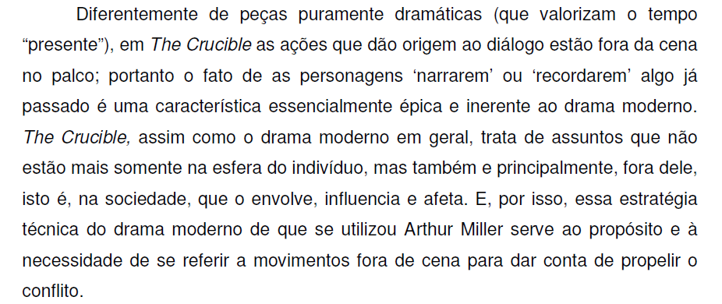
Viviane Maria Leme, A concepção da Tragédia Moderna em “The Crucible” e em “A View from the Bridge”, de Arthur Miller. FFLCH-USP,
Dissertação de Mestrado, 2006.

Slide 3
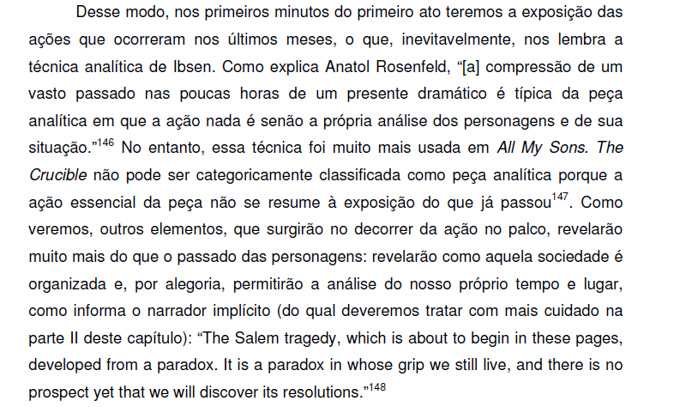
Viviane Maria Leme, A concepção da Tragédia Moderna em “The Crucible” e em “A View from the Bridge”, de Arthur Miller. FFLCH-USP,
Dissertação de Mestrado, 2006.

Slide 4
LIFE AND LETTERS about the inspiration for and influence of Miller's play, "The Crucible," a reflection of the Communist witchhunts of its time. Miller recalled the source of his creation while watching the filming of the new movie of "The Crucible." When he wrote it, Senator Joseph McCarthy and the House Comittee on Un- American Activites were prosecuting alleged Communists from the State Department to Hollywood; the Red hunt was becoming the dominant fixation of the American psyche. Miller did not know how to deal with the enormities of the situation in a play. "The Crucible" was an act of desperation; Miller was fearful of being identified as a covert Communist if he should protest too strongly. He could not find a point of moral reference in contemporary society.
The New Yorker, October 21, 1996 P. 158

Slide 5
Miller found his subject while reading Charles W. Upham's 1867 two-volume study of the 1692 Salem witch trials, which shed light on the personal relationships behind the trials. Miller went to Salem in 1952 and read transcripts. He began to reconstruct the relationship between John and Elizabeth Proctor and Abigail Williams, who would become the central characters in "The Crucible." He related to John Proctor, who, in spite of an imperfect character, was able to fight the madness around him. The Salem court had moved to admit "spectral evidence" as proof of guilt; as in 1952, the question was not the acts of an accused but his thoughts and intentions.
The New Yorker, October 21, 1996 P. 158

Slide 6
Miller on tragedy in the modern age (1949)
In this age few tragedies are written. It has often been held that the lack is due to a paucity of heroes among us, or else that modern man has had the blood drawn out of his organs of belief by the skepticism of science, and the heroic attack on life cannot feed on an attitude of reserve and circumspection. For one reason or another, we are often held to be below tragedy-or tragedy above us. The inevitable conclusion is, of course, that the tragic mode is archaic, fit only for the very highly placed, the kings or the kingly, and where this admission is not made in so many words it is most often implied.
I believe that the common man is as apt a subject for tragedy in its highest sense as kings were. On the face of it this ought to be obvious in the light of modern psychiatry, which bases its analysis upon classic formulations, such as the Oedipus and Orestes complexes, for instance, which were enacted by royal beings, but which apply to everyone in similar emotional situations.
Arthur Miller, "Tragedy and the Common Man," from The Theater Essays of Arthur Miller (Viking Press, 1978) pp. 3-7. Copyright 1949, Copyright renewed 1977 by Arthur Miller. Reprint (by permission of Viking Penguin, Inc.)

Slide 7
Miller on tragedy (cont.)
The tragic night is a condition of life, a condition in which the human personality is able to flower and realize itself. The wrong is the condition which suppresses man, perverts the flowing out of his love and creative instinct. Tragedy enlightens and it must, in that it points the heroic finger at the enemy of man's freedom. The thrust for freedom is the quality in tragedy which exalts. The revolutionary questioning of the stable environment is what terrifies. In no way is the common man debarred from such thoughts or such actions.
[….]
There is a misconception of tragedy with which I have been struck in review after review, and in many conversations with writers and readers alike. It is the idea that tragedy is of necessity allied to pessimism. Even the dictionary says nothing more about the word than that it means a story with a sad or unhappy ending. This impression is so firmly fixed that I almost hesitate to claim that in truth tragedy implies more optimism in its author than does comedy, and that its final result ought to be the reinforcement of the onlooker's brightest opinions of the human animal.
Arthur Miller, "Tragedy and the Common Man," from The Theater Essays of Arthur Miller (Viking Press, 1978) pp. 3-7. Copyright 1949, Copyright 0 renewed 1977 by Arthur Miller. Reprint(by permission of Viking Penguin, Inc. All rights reserved.

Slide 8
Raymond Williams’ ideas on Modern Tragedy
Our age has witnessed the rise and fall of liberal tragedy. The crucial question is the one of understanding its structure of feeling.
Liberal tragedy shows the peak and the limitations of the forces of the protagonist. The protagonist aspires to something and is destroyed by the energies liberated by his/her own aspiration.
What makes this kind of tragedy liberal: the emphasis upon individuality
What makes it tragic: the recognition of defeat
For four centuries (from the Renaissance to the contemporary period) tragedy was the result of the struggle of the individual against the obstacles (the forces that prevent him/her from fulfilling his/her objectives)
As time passed, the tension of this struggle gradually absorbed other characteristics, and as a result, the tragic protagonist was transformed into the tragic victim: the individual confronts the forces that destroy him/her.
This particular characteristic had never been observed in classical tragedy, but we, modern people, tend to interpret classical tragedies as if this had also been observable in their plots and protagonists. This is how we tend to interpret tragedy in general.
We (contemporary people) tend to treat tragedies in general from a psychological point of view: we try to detect the central motif of tragedies in the individual, but for the Greeks, tragic action was based on history, and not on the individual psychology.

Slide 9
The energetic drive of classical tragedy came from the relationship of the protagonist in a world that overwhelmed and transcended him.
In the beginning of the XVIII century there was an attempt to adapt tragedy to the bourgeois worldview, and the emphasis falls upon piety. The idea of the correspondence between the power of the rulers and the order of universe is rejected. The private level of life is the center of attention. Humanitarianism is the underlying ideology, and it excluded any possible focus on society from the collective point of view: solidarity was regarded as resulting from individuals and individual actions only. Solidarity is expressed in face of individual, private misfortunes. The existing social order is ratified, and the struggle for money replaces the struggle for power.
Bourgeois tragedy was accused of not having given the social and public dimension of life enough emphasis because it excluded the universal aspects that had emerged in the Renaissance (in the humanist tragedy).
Bourgeois tragedy concentrated its attention on the individual and on the individual energies. Desire always aimed at something forbidden, against the social conventions (society was the enemy of desire).
In romanticism, the tragic protagonist was “guilty” for being himself. There is the emergence of the individual liberator, who acts by himself and as the result of his/her own will and thus became a type of hero/heroine. This heroism derived from the character’s aspirations.

Slide 10
Liberal tragedies appear with Ibsen, and shown false relationships in a false society, where the character struggles against hypocrisy.
Ibsen’s protagonists struggle against social conventions and aim at liberating themselves from falsehood. To transform a morally sick society into a sane one is the result of individual action. Desire leads the protagonist to be separated from the other people he/she wanted to be with.
The main current of tragedies in this context is the one that shows a world imprisoned in itself, where individuals are isolated and guilty.
Arthur Miller revitalized liberal tragedy by exposing the social aspects of private, personal crimes (the characters experience a feeling of responsibility as the result of a retrospect of their actions throughout life, but in a moment when it is too late to change something.
Examples: Death of a Salesman (Willy Loman had lived according to patterns and values that prove to be false and hypocritical), A View from the Bridge ((the “I “ who desires destroys the “I” that lives in society; the rejection of desire leads to destruction).
In order to “survive” socially, one has to accept dominant social values in detriment of his/her own desires, but by doing so, he/she is destroyed.

