Slide 1
Produção de raios-X
10-100 keV
Feixe de elétrons
Alvo de Au
detector

Slide 2
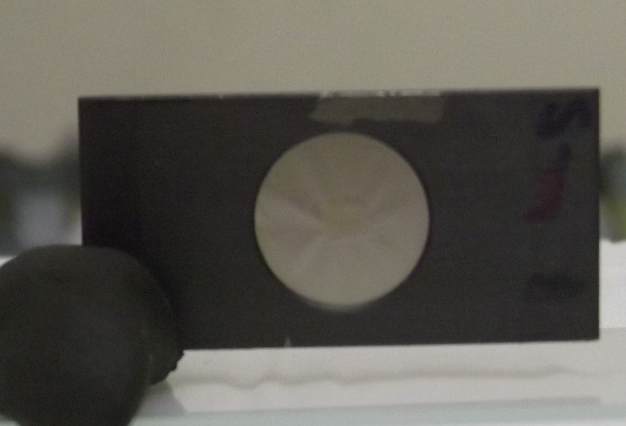

targets
Target with 2-50 μg/cm²
Physical vapour deposition (Te)
Sputtering (Ta)
frame made on 0.3 mm thick carbon fiber
Hole 10 mm in diameter
10 μg/cm² C film
target evaporated/deposited
through a 8 mm mask

Slide 3
Elétrons de 98 keV em Ag (Z=47)

Slide 4
Elétrons de 98 keV em Ag e Te (Z=47, 52)

Slide 5
Elétrons de 98 keV em Ag, Pd e Te (Z=47, 48, 52)

Slide 6
Elétrons de E=25,41,60,79 keV em Ag

Slide 7
Elétrons de E=25,41,60,79,98 keV em Ag

Slide 8
Electron interactions
Electrons scatter and generate radiation along their path in matter
E− R
E
E
θ
E
θ
θ_{a}
R− U
elastic scattering
inelastic scattering
E₊
F
E
θ
E
θ
E− F
bremsstrahlung emission
E₋
positron annihilation
target (atom or electron)
particle (electron, positron)
Nice diagrams from PENELOPE manual by Salvat, Fernández-Varea, Sempau

Slide 9
Photon interactions
E− R
E
E
θ
E
θ
θ_{a}
~ R
Elastic scattering
Inelastic scattering
~ E− U
E₊
E
θ
E
θ
θ_{a}
θ₋
~ 0
Photoelectric effect
E₋
target (atom, electron)
pair formation
E = E₊ + E₋ + 2m_{o}c²
photon
Notice the reciprocal character of:
Photoelectric effect × bremsstrahlung
Pair formation × positron annihilation

