Slide 1
Complemento - Dados sobre população mundial Débora Casagrande Santos Dados sobre população mundial Fontes: http://esa.un.org/unpd/wpp/Graphs/ http://esa.un.org/unpd/wpp/

Slide 2
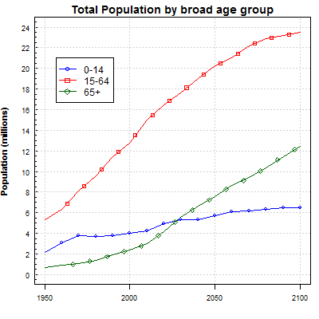
AUSTRALIA

Slide 3
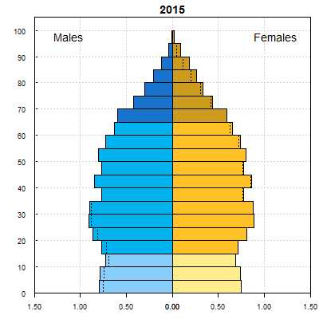
AUSTRALIA

Slide 4
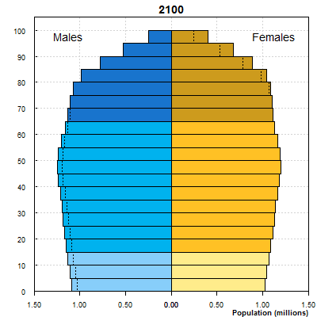
AUSTRALIA

Slide 5
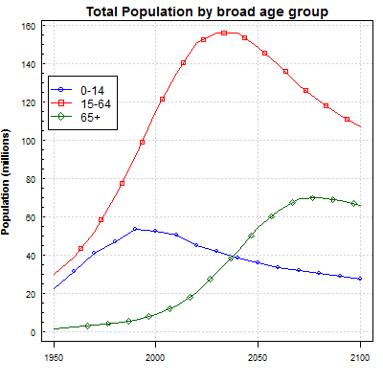
BRASIL

Slide 6
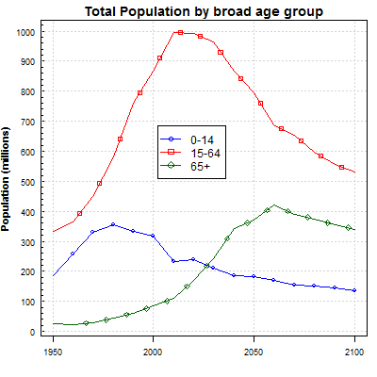
CHINA

Slide 7
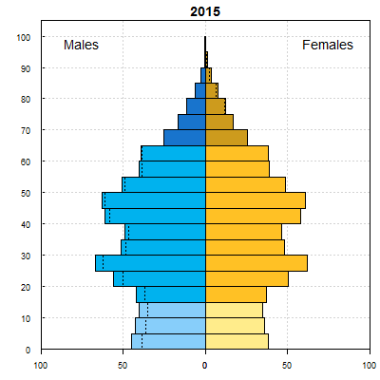
CHINA

Slide 8
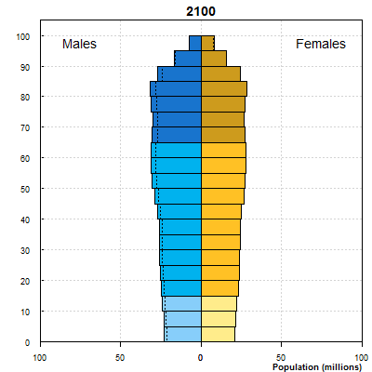
CHINA

Slide 9
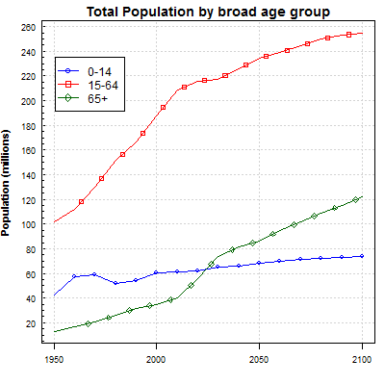
UNITED STATES OF AMERICA

Slide 10
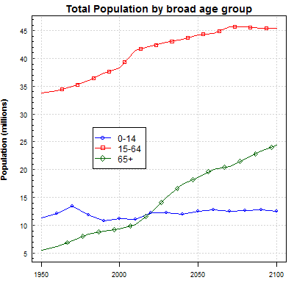
UNITED KINGDOM

Slide 11
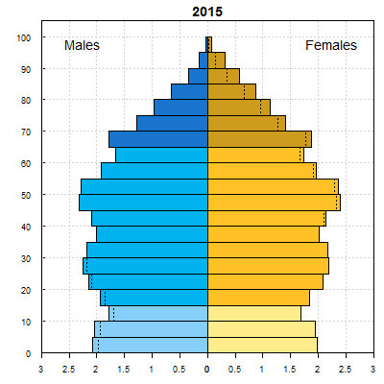
UNITED KINGDOM

Slide 12
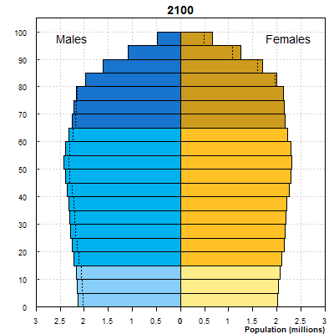
UNITED KINGDOM

Slide 13
Adaptação feita a partir de: TABLE S.1. TOTAL POPULATION BY SEX IN 2015 AND SEX RATIO BY COUNTRY IN 2015 United Nations Department of Economic and Social Affairs/Population Division World Population Prospects: The 2015 Revision, Key Findings and Advance Tables Fonte: http://esa.un.org/unpd/wpp/Publications/Files/Key_Findings_WPP_2015.pdf
Country or area Population (thousands) male female
World 7 349 472 3 707 206 3 642 266
Brazil 207 848 102 201 105 647
Faeroe Islands 48 ----- -----
China 1376 049 708 977 667 072
India 1311 051 679 548 631 502
United States
of America 321 774 159 494 162 280
Zambia 16 212 8 094 8 118

Slide 14
Adaptação feita a partir de: TABLE S.6. PERCENTAGE DISTRIBUTION OF THE POPULATION IN SELECTED AGE GROUPS BY COUNTRY, 2015, 2050 AND 2100 (MEDIUM VARIANT) United Nations Department of Economic and Social Affairs/Population Division World Population Prospects: The 2015 Revision, Key Findings and Advance Tables Fonte: http://esa.un.org/unpd/wpp/Publications/Files/Key_Findings_WPP_2015.pdf
2015 2050 2100
0-14 15-59 60+ 80+ 0-14 15-59 60+ 80+ 0-14 15-59 60+ 80+
World
26.1 61.7 12.3 1.7 21.3 57.2 21.5 4.5 17.7 54.0 28.3 8.4
Brazil
23.0 65.2 11.7 1.5 15.0 55.7 29.3 6.7 13.8 47.4 38.8 15.1
China
17.2 67.6 15.2 1.6 13.5 50.0 36.5 8.9 13.4 46.9 39.6 16.5
United
Kingdom
17.8 59.2 23.0 4.7 16.6 52.7 30.7 9.7 15.2 49.7 35.1 13.7
India
28.8 62.3 8.9 0.9 19.1 61.5 19.4 2.8 14.7 51.2 34.1 10.3

