Slide 1
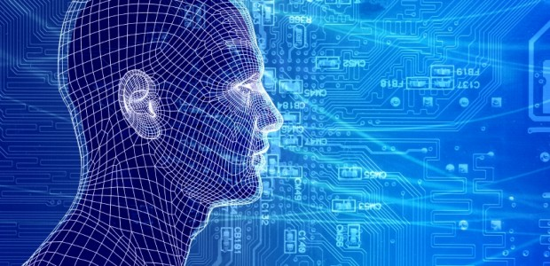
CALL
Applied Linguistics Assignment
based on the Chapter 25 – Computer Assisted Language Learning (CALL) by Paul Gruba
Published on The Handbook of Applied Linguistics – Alan Davies
COMPUTER-ASSISTED LANGUAGE LEARNING
Professor Paul Gruba
Melbourne University
WEIDER ANGELO

Slide 2
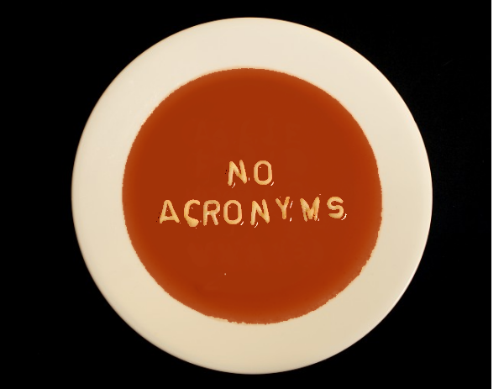
CALL
Computer Assisted Language Learning
CAI
CAL
CELL
TELL
ICALL
WELL
ICT4LT
NBLT
PrOCALL
CASLA
CALT
CASLR
Computer Aided Instruction
Computer Assisted Learning
Computer Enhanced Language Learning
Technology Enhanced Language Learning
Intelligent Computer Assisted Learning
Web Enhanced Language Learning
Information and Communication for Language Teachers
Network Based Language Teaching
Project Oriented Computer Assisted Language Learning
Computer Applications in Second Language Acquisition
Computer Assisted Language Assessment
Computer Assisted Second Language Acquisition Research

Slide 3
CALL – OVERVIEW – LEVY (1997)
Applied Linguistics
CALL
Psycology
Programmed Instructions
And Cognition
Artificial
Intelligence
Human-Computer
Interaction
Computational
Linguistics
Instructional
Technology
Machine Translation
Natural Language processing
Concordance

Slide 4
CALL – OVERVIEW – CHAPELLE (2001)
Applied Linguistics
CALL
Educational
Technology
Computer
Assisted
Assessment
Computer
Supported
Collaborative
Learning
Corpus
Linguistics
Artificial
Intelligence
Computational
Linguistics

Slide 5
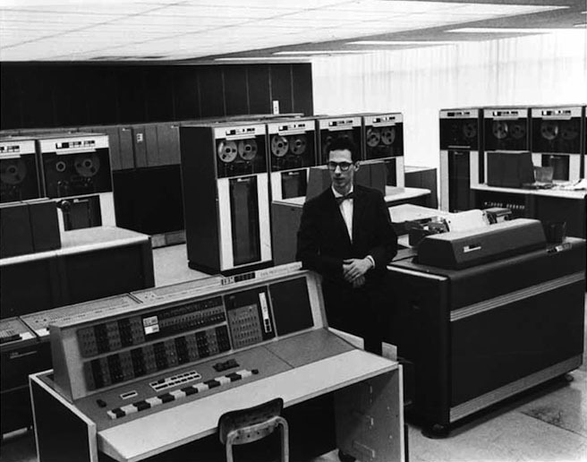
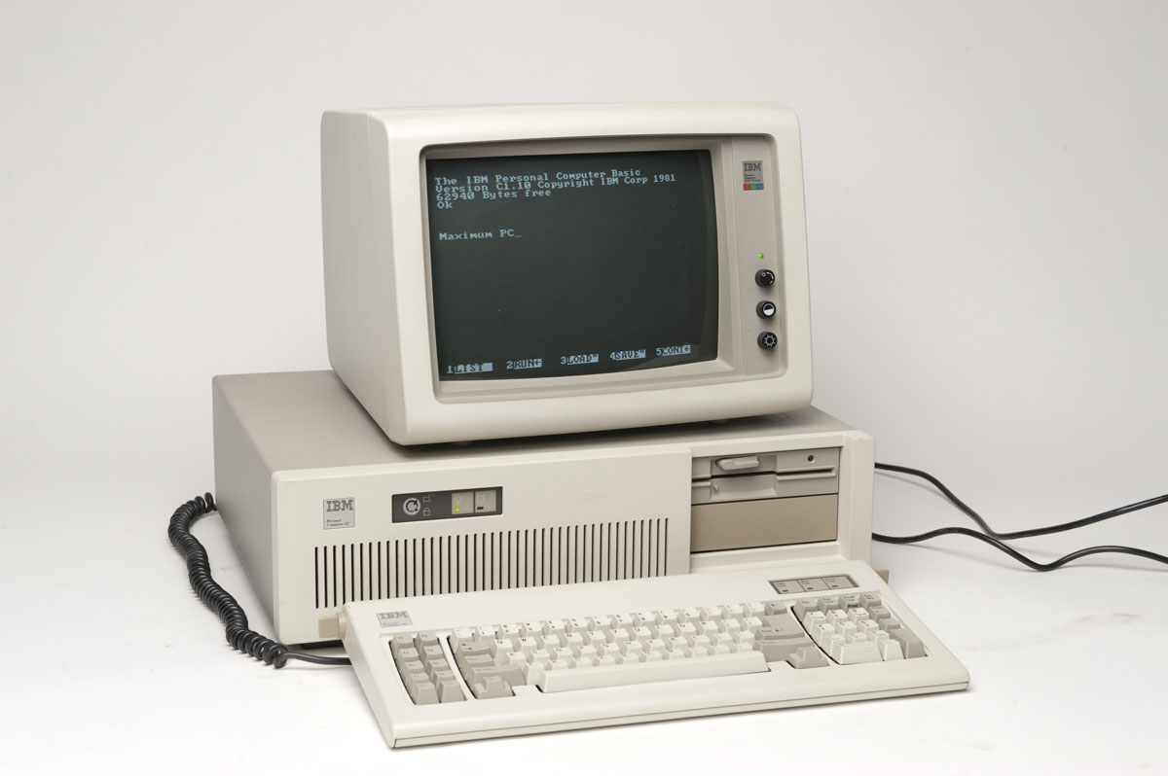
CALL – BRIEF HISTORY
History highlights from AHMAD (1985) Studied from 1965-85 and LEVY (1995):
1960-70 - MAINFRAME
Stanford University – Slavic Language Self-Learning created by Staff (Mainframe Technology)
University of Illinois – PLATO (Programmed Logic for Automated Teaching Operations) – Russian-English Translation
During the period the 1960 -70 – the limitation was the high cost of Mainframe
In 1971 the first multimedia innitiative at Brigham Young University
In the lates 1970, the arrival of Microcomputer Boom and the attention phased out from Mainframe to PC
1980-90 – PERSONAL COMPUTERS
From the Early 1980, growing interest in CALL, teachers were able to write small programs
Materials were designed as single activities like, gap-filling, text reconstruction, speed reading and vocabulary games
1990-Nowadays – INTERNET
The Internet arrival prompted CALL educators to adopt SOCIO-COLLABORATIVE modes of learning
Critics by Academia (Chapelle 1997) ”...has been fragmented, frequently idiosyncratic, topic oriented...”
Chapelle (2001) “a time of idiosyncratic learning, quirky software, and naive experimentation”

Slide 6
Topics
Period
Focus
Communicative
(1980-90)
Workstation; as a "pupil"
Integrative
21st Century
Unified information management system; as a "toolbox"
Structural
(1970-80)
Instructional efficacy, competence
Information carrier; as a “tutor”
Materials delivery
Behaviorist
Programmed Instruction; assimilation
Structural (a formal system)
Grammar-translation & audiolingual
Dependant
Drill and practice
Accuracy
Principal Learning Objective
Model and process of instruction
View of 2nd language acquisition
Dominant approaches to 2nd Language acquisition
Learner Status
Principal use of CALL
Instructional transfer; learner proficiency
Cognitive augmentation
Information processing theory; cognitive constructivist
Interactive, discovery-based learning; interaction
Cognitive (a mentally constructed system)
Communicative language teaching
Independent
Communicative exercises
And fluency
Group orchestration
Sociocultural theories of learning
Collaborative learning; "intra-action"
Socio-cognitive (developed in social interaction)
Content based; specific purposes
Collaborative
Authentic discourse
And agency
Instruction as enacted practice, team "coeficiency"
Theory of Learning
Primary Research Concern
CALL – Major Theoretical Perspectives

Slide 7
CALL – Challenges and Responsabilities
COMPUTERS
Need for evaluation CALL projects and activities (Chapelle 2001)
Constructively Responsive (Pressley & Afflerbach 1995)
Research Media Attributes (Wetzel 1994)
Embracing a more sociopolitical approach is more efficient (Salaberry 1999)
SLA Research (Second language acquisition)
Researcher
Sociocultural theories of learning
Consider the sociopolitical impact of computer usage beyond the classroom (Warschauer, 1998, 2002)
Assist students to overcome anxieties fostered by extensive computer usage (Lewis & Atzert, 2000)
Instructors must adapt and evolve
INSTRUCTOR
Learners in control of their pace - risks and benefits
Integrative - collaborative use
Communicative - interactive work with applications
Sctructured - On his own, grammar, fill gap exercises
LEARNER
Students with special needs
KRAMSCH and ANDERSON (1999) - Access to authentc discourses - dream of every teacher
CUBAN (2001): "Computers in Education are oversold and underused"
Integrative - Toolbox to create a social space with authentic discourses
Communicative - Conversation among small groups
Structural - Unique Tutor
Speech technologies are quickly improving with visual feedback, improving verbal efficiency
Acquire electronic literacy skills (Bickerton 1999)

Slide 8
CALL – Final Discussions
RELEVANCE OF CALL
” Anyone concerned with second language teaching and learning in 21st century needs to grasp the nature of the unique technology-mediated tasks learners can engae in for language acquisition and how such tasks can be used for assessment “ - CHAPELLE (2001)
PEDAGOCIC TASKS SHOULD NOT IGNORE THE ROLE OF COMPUTER
“The absence of technology in such discussions limits the insights about task design and research solely to tradition classrooms”. (GRUBA)
A STRONGER CRITIQUE OF TECHNOLOGIES WILL ONLY STRENGHTEN CALL

Slide 9
CALL – Beyond the article – Real life suggestions
COMPUTER-CENTRIC TOOLS
ROSETTA STONE – A listening and interacting state of art computer-centric tutorial (Perfect for initial stages)
MY ENGLISH ONLINE – USP provides this English course
Online Dictionaries:
LONGMAN: http://www.ldoceonline.com/
OXFORD:
WEBSTER:
AMAZON.COM – Immediate access to Millions of different titles in the E-Book format
AUDIBLE.COM – Audiobooks to read and listen using KINDLE
RADIO – It is possible to virtually listen to most of the Radio Stations in the World and practise listening and comprehension on live
COLABORATIVE APPROACH (Authentic Discourses)
A COLABORATIVE REFERENCE BASED ON BILINGUAL AUTHENTIC DISCOURSE - www.linguee.com.br
PODCASTS – There are hundreds of podcasts to be signed and followed, like BBC or CNN
SOCIAL MEDIAS – (Facebook, Twitter, Instagram, Skype, Messenger, WhatsApp) – we can connect to people all around the world

