Slide 1
PSI5120 Aula 06
PAAS Web Applications
Sergio Takeo Kofuji
14/07/2015

Slide 2
Scalable Cloud Web Application
From: IQBAL HOSSAIN. Dynamic scaling of a web-based application in a Cloud Architecture.KTH. Master’s Thesis.
https://people.kth.se/~maguire/DEGREE-PROJECT-REPORTS/140228-Md._Iqbal_Hossain_and_Md._Iqbal_Hossain-with-cover.pdf

Slide 3
From: IQBAL HOSSAIN. Dynamic scaling of a web-based application in a Cloud Architecture.KTH. Master’s Thesis. 2014

Slide 4
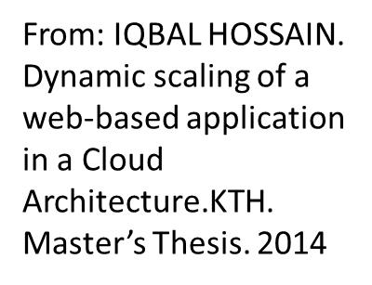

Slide 7
From: IQBAL HOSSAIN. Dynamic scaling of a web-based application in a Cloud Architecture.KTH. Master’s Thesis.

Slide 10
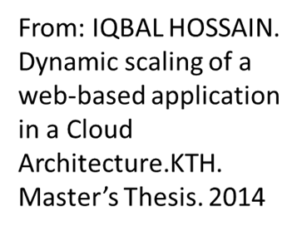

Slide 11
From: IQBAL HOSSAIN. Dynamic scaling of a web-based application in a Cloud Architecture.KTH. Master’s Thesis.

Slide 12
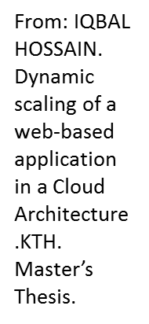

Slide 19
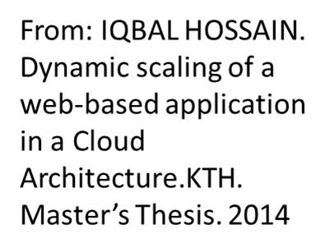

Slide 27
Resumo

Slide 28
Perguntas?

