Slide 1
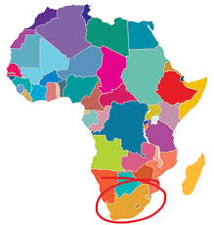
The right to education

Slide 2
Prof Marius Smit, B Com LLM PhD marius.smit@nwu.ac.za North-West University South Africa

Slide 3
Brief historic background of South Africa’s legal system
1652 – Dutch colony at the Cape of Good Hope
Legal system was Roman-Dutch Law (Civil law system of European mainland)
Renowned jurists like Grotius (Hugo de Groot – the “father” of International law), Johannes Voet (Commentarius ad Pandectas), Van der Keesel (Mercantile Law) etc. – modernised and developed Roman Law-Dutch Law to suit the age of colonisation - commercial and scientific advancements.
1806 – British annexation of Cape Colony - Some principles and traditions of the English Law (Common Law legal system) recepted into the Roman-Dutch system
1935 -1860 - Mass emigration by Boer pioneers to hinterland – 2 Boer republics (Transvaal and Free State) established - Roman-Dutch Law as its common law.
1910 – Union of South Africa – only Whites vote – independent self-governing country – part of British Common Wealth – hybrid South African legal system
1948 – Apartheid system (statutory racial segregation) – National Party
1961 – Republic of South Africa – break away from British Common Wealth
1994 – Full democracy (all ethnic groups) – Interim Constitution of 1993
1996 – “Final” Constitution of South Africa, 1996

Slide 4
Constitution of South Africa, 1996
Adopted after approx. 3,5 years of negotiations between former antagonists (National Party, ANC and others).
South Africa is a unified democracy founded on the values of human dignity, equality, freedom, non-racialism, non-sexism, supremacy of the Constitution, the rule of law, and democratic political rights, with tripartite partition of government powers.
Section 2 – Supremacy of the Constitution (i.e. Constitutional democracy).
11 official languages – e.g. English, Afrikaans, isiZulu, isiXhosa, etc.
CHAPTER 2 – Bill of Rights – entrenches fundamental rights:
human dignity; equality (non-discrimination); life; freedom and security of person; no slavery; privacy; freedom of religion; freedom of expression; right to peaceful assembly petition and demonstration; free association; political rights (vote, regular elections, political office, etc.); citizenship; freedom of movement; freedom of trade and occupation; fair labour relations; protection of the environment; protection and security of property rights; right to housing, right to health care, food, water and sanitation; protection of children’s rights; right to education; right to language and culture; rights of cultural, religious and language communities; access to information, right to just administrative action.
Section 36 – General Limitation Clause – Fundamental rights may be limited under certain conditions
Interpretation of the Bill of Rights – International law must be considered; foreign law may be considered.
CHAPTER 3 - Co-operative Government ; CHAPTER 4 – Parliament;
CHAPTER 5 - The President and National Executive; CHAPTER 6 - Nine Provinces;
CHAPTER 7 - Local Government; CHAPTER 8 - Courts and Administration of Justice;
CHAPTER 9 - State Institutions Supporting Constitutional Democracy; CHAPTER 10 - Public Administration; CHAPTER 11 - Security Services; CHAPTER 12 - Traditional Leaders; CHAPTER 13 - Finance.

Slide 5
The right to education – SA Constitution
Section 29 Education
(1) Everyone has the right-
(a) to a basic education, including adult basic education; and
(b) to further education, which the state, through reasonable measures, must make progressively available and accessible.
(2) Everyone has the right to receive education in the official language or languages of their choice in public educational institutions where that education is reasonably practicable. In order to ensure the effective access to, and implementation of, this right, the state must consider all reasonable educational alternatives, including single medium institutions, taking into account-
(a) equity;
(b) practicability; and
(c) the need to redress the results of past racially discriminatory laws and practices.
(3) Everyone has the right to establish and maintain, at their own expense, independent educational institutions that-
(a) do not discriminate on the basis of race;
(b) are registered with the state; and
(c) maintain standards that are not inferior to standards at comparable public educational institutions.
(4) Subsection (3) does not preclude state subsidies for independent educational institutions.

Slide 6
Availability and Accessibility = good

Slide 7
Public & independent schools Local school governance
Public-private partnership
Public Private
Quintile 1
Quintile 2
Quintile 3
Quintile 4
Quintile 5
Independent (subsidised)
Independent
NO FEE SCHOOLS
SEMI-PRIVATE
PRIVATE
STATE-AIDED SCHOOLS

Slide 8
SA schools have been performing very poorly in international evaluations
TIMSS (Maths & Science), PIRLS (Langauge & literacy), SACMEC, ANA's
± 80% schools in SA are dysfunctional
World Economic Forum:
Global Competitiveness Index SA education 120th out of 140
General quality of basic education in SA is very poor

Slide 10
Quality education? – Unesco 4 A’s Scheme
Acceptability

Slide 11
Elements and factors to determine quality of education

Slide 12
AVAILABILITY
Funding / economic barriers
Classrooms & learning facilities
School & admin buildings
Teaching staff
Support staff
Learning material
Sport facilities
Extra-curricular facilities

Slide 13
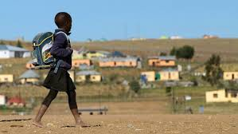
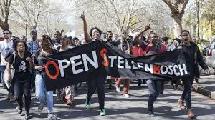
Accessibility

Slide 14
ACCESSIBILITY
Physical barriers to access
Time (optimal use of …)
Proximity & transport
Enrolment levels
Barriers to admissions
Barriers of learning
Learner participation
Parent participation

Slide 15
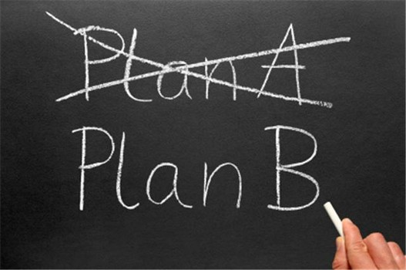
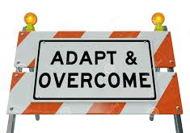
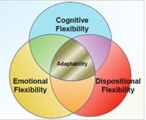
Adaptability

Slide 16
ADAPTABILITY
Curriculum adaptation/improvement
Subject choice/variety
General education -
Further education – progressive realisation
Specialisation – focus schools (e.g. academic/ agriculture/arts & drama/ technical schools)
Modernity – socio-cultural norms of modern era
Technology – use of internet, electronic media
Pedagogy – adapt teaching-learning methods according to prevailing theories/best practices

Slide 17
Acceptability
ON PAR

Slide 18
ACCEPTABILITY
Quality of labour (competence, capacity, commitment, discipline of educator staff)
Pedagogy (methods, teaching practice, LOLT)
Subject & curricular content
Academic results (Pass rate, completion rate, throughput rate)
Learner competence (knowledge skills, resilience)
Learner behaviour (values, attitudes & discipline)
Academic outcomes (employability of learners, sufficiently trained workforce)
Financial outcomes (return on investment, value for money, cost-benefit)
Competitiveness (comparative rating according to international tests/evaluations)

Slide 19
Research design Qualitative phenomenological study.
EDUCATION QUALITY INDEX
Table 1: EDUCATION QUALITY INDEX
ELEMENTs | FACTORS | SCALE 1-7
 |  | Extremely poor | Very poor | Inadequate | Adequate | Average | Good | Excellent
 |  | <30% | < 40% | 40%-49% | >50% | >60% | >70% | >80%
AVAILABILITY | Funding / economic barriers
 | Classrooms & learning facilities
 | School & admin buildings
 | Teaching staff
 | Support staff
 | Learning material
 | Sport facilities
 | Extra-curricular facilities
ACCESSIBILITY | Physical barriers to access
 | Time (optimal use of …)
 | Proximity & transport
 | Enrolment levels
 | Barriers to admissions
 | Barriers of learning
 | Learner participation
 | Parent participation
ADAPTABILITY | Curriculum
 | Subject choice/variety
 | General education
 | Further education
 | Specialisation
 | Modernity
 | Technology
 | Pedagogy
ACCEPTABILITY | Quality of labour (competence, capacity, commitment, discipline)
 | Pedagogy (methods, teaching practice, LOLT)
 | Subject & curricular content
 | Academic results (Pass rate, completion rate, throughput rate)
 | Learner competence (knowledge skills, resilience)
 | Learner behaviour (values, attitudes & discipline)
 | Academic outcomes (employability of learners, sufficiently trained workforce)
 | Financial outcomes (return on investment, value for money, cost-benefit)
 | Competitiveness
Purposive sampling – selection of participants
Data collection: semi-structured interviews
Analysis of the data: inductive and deductive coding

Slide 20
Case law on the right to education
Governing Body of the Juma Musjid Primary School & Others v Essay N.O. and Others 2011 8 BCLR 761 (CC)
Basic education is a right that is immediately realisable
the aim of fully developing the personality and talents of children as under article 29(1) of the Convention of Children's Rights should therefore be the primary agenda of section 29 of the Constitution.
Matukane v Laerskool Potgietersrus 1997 JOL 102 (T)
No discrimination based on race – Race may not be used to deny access to schools. Black learners given access to formerly white-only public school.
Western Cape Forum for Intellectual Disability v Government of the Republic of South Africa 2011 (5) SA 87 (WCC)
the state has a duty to provide equally for the education of all children, including those with severe and profound disabilities.
education is broader than classroom education with examinable outcomes. Rather, education includes the development of a child’s potential, personality, talents and creativity.
Madzodzo v Minister of Basic Education (2144/2012) [2014] ZAECMHC 5
- Right to basic education – Education department was in breach of the constitutional right of learners in public schools in the Eastern Cape Province to basic education as provided by section 29 of the Constitution, by failing to provide adequate, age and grade appropriate furniture which will enable each child to have his or her own reading and writing space.

Slide 21
Right to education – case law
Section 27 v Minister of Education 2013 (2) SA 40 (GNP)
The right to basic education – Department’s failure to provide textbooks is a violation of the right to basic education- Limpopo Department of Education; alternatively Department of Basic Education directed to provide textbooks.
Centre for Child Law and Others v MEC for Education, Gauteng, and Others 2008
The court held that the prevailing circumstances at the Luckhoff -school hostel run by the Gauteng Department of Education compromised the dignity of the children.
"Levelling-up" principle – state should not lower standards, but should improve standards, especially if a learner's dignity is at stake. Department directed to rectify the squalid conditions at an “Industrial school” (prison school for juvenile delinquents
Centre for Child Law and 7 others v Government of the Eastern Cape Province and others, Eastern Cape High Court, Bhisho, Case no 504/10.
The right to basic education – Department’s failure to provide school buildings is a violation of the right to basic education- Eastern Cape Department of Education; alternatively Department of Basic Education directed to build schools to replace the dilapidated “mud” schools of the province.

Slide 22
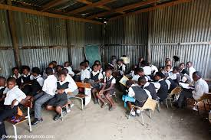
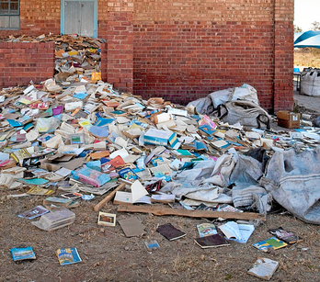

Slide 23
Discussion
Unavailability of schools/education opportunities
Inadequate access to education /schools or places to learn
Curriculum and teaching methods not adaptable
Insufficient financial and administrative support
Incompetent or inadequately trained educators
Unacceptable standards / poor quality of education
Is he failure to ensure the right to education a violation of the rights of learners equality, human dignity and freedom?

Slide 24
Recommendations
The state has a constitutional obligation to ensure the right to basic education
The right to basic education is immediately realizable – in other words, in most circumstances it trumps other competing fundamental rights – funds and opportunities must be made available for education first
Further education should be made progressively realizable – core minimum content and quality should become available – optimal use of state finances
The right to education implies the provision of “quality” education – 4 A’s: Availability, Accessibility, Adaptability, Acceptability.
The state should develop and implement quality-assurance processes that address the difficulties experienced by schools and learners.
Education departments have a legal duty and obligation to ensure adequate quality education by “levelling-up” the academic standards of schools.
The acceptability of academic standards at such schools can be improved, supported and enhanced by:
allocating additional funds to finance the accessibility and availability of schools / further education
appointing additional competent educators and personnel to improve the quality of the labour force

