Slide 1
Chapter 7 The Nature and Sources of Competitive Advantage
Prof. Luciano Thomé e Castro

Slide 2
© 2013 Robert M. Grant
www.contemporarystrategyanalysis.com

Slide 3
The Nature and Sources of Competitive Advantage
OUTLINE
How competitive advantage emerges and is sustained
Types of competitive advantage: cost and differentiation
Cost analysis
Differentiation analysis
Implementing cost and differentiation strategies
© 2013 Robert M. Grant
www.contemporarystrategyanalysis.com

Slide 4
How Competitive Advantage
Emerges and is Sustained
© 2013 Robert M. Grant
www.contemporarystrategyanalysis.com

Slide 5
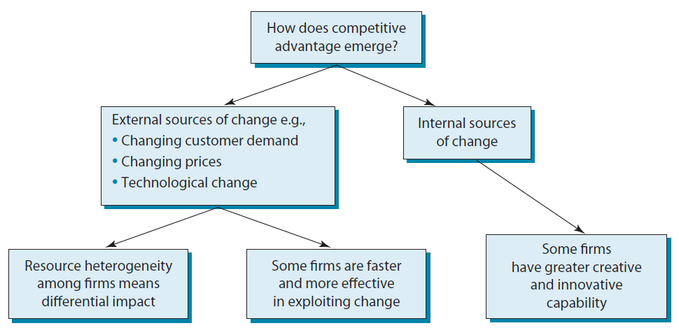
The Emergence of Competitive Advantages
© 2013 Robert M. Grant
www.contemporarystrategyanalysis.com

Slide 6
Competitive Advantage from Internally-Generated Change: Strategic Innovation
Strategic innovation – Creating customer value from new products, experiences or modes of product delivery
Innovatory strategies may include:
Creating whole new markets/industries: My Space & Facebook in social networking
Creating new customer segments: AirAsia in low-cost air travel in SE Asia; Nintendo’s Wii games console
New sources of competitive advantage
Reconfiguring the value chain: Zara in fashion clothing, IKEA in furniture
Reconceptualizing the product: Cirque de Soleil in circuses, Apple in computers (iPad)
New performance combinations: Low prices and style (Primark, H&M)
© 2013 Robert M. Grant
www.contemporarystrategyanalysis.com

Slide 7
Sustaining Competitive Advantage Against Imitation
Requirement for Imitation | Isolating Mechanism
Identification | Obscure superior performance
Incentives for imitation | Deterrence: Signal aggressive intentions to imitators Pre-emption: Exploit all available investment opportunities
Diagnosis | Rely upon multiple sources of competitive advantages to create “casual ambiguity”
Resource acquisition | Base competitive advantage upon resources and capabilities that are immobile and difficult to replicate
© 2013 Robert M. Grant
www.contemporarystrategyanalysis.com

Slide 8
Competitive Advantage in Different Industry Settings: Trading Markets and Production Markets
 | Source of imperfection of competition | Opportunity for competitive advantage
Trading markets | None (efficient markets) Imperfect information Transaction costs Systematic behavioural trends Overshooting | None Inside trading Cost minimization Superior diagnosis (e.g. chart analysis) Contrarianism
Production Markets | Barriers to imitation Barriers to innovation | Identify potential barriers to imitation (e.g. deterrence, pre-emption, casual ambiguity, resource immobility, etc.) & base strategy upon them Difficult to influence or exploit
© 2013 Robert M. Grant
www.contemporarystrategyanalysis.com

Slide 9
Types of Competitive Advantage:
Cost and Differentiation
© 2013 Robert M. Grant
www.contemporarystrategyanalysis.com

Slide 10
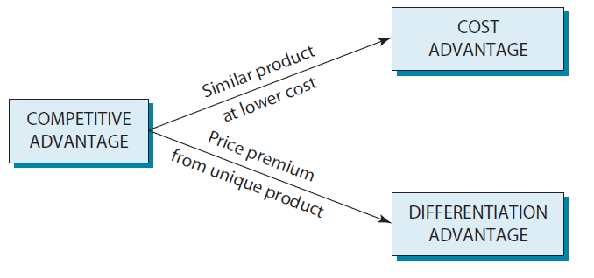
Sources of Competitive Advantage
© 2013 Robert M. Grant
www.contemporarystrategyanalysis.com

Slide 11
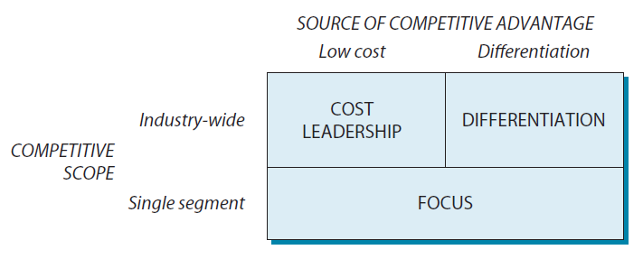
Porter’s Generic Strategies
© 2013 Robert M. Grant
www.contemporarystrategyanalysis.com

Slide 12
Cost Analysis
© 2013 Robert M. Grant
www.contemporarystrategyanalysis.com

Slide 13
The Experience Curve
The “Law of Experience”
The unit cost of value added for a standard product declines by a constant proportion (typically 20-30%) each time cumulative output doubles.
2000
2002
2004
Cost per unit of output (in real $)
2006
2008
2010
2012
Cumulative Output
© 2013 Robert M. Grant
www.contemporarystrategyanalysis.com

Slide 14
Examples of Experience Curves
Japanese clocks & watches, 1962-72
UK refrigerators, 1957-71
1960 Yen
15K 20K 30K
Price Index
50 100 200 300
75%
70% slope
100K 200K 500K 1,000K 5 10 50
Accumulated unit production Accumulated units
(millions) (millions)
© 2013 Robert M. Grant
www.contemporarystrategyanalysis.com

Slide 15
The Importance of Market Share
If all firms in an industry have the same experience curve, then:
Change in relative costs over time = f(market share)
This implies that market share is linked to profitability. This is confirmed by PIMS data:
BUT:
Association does not imply causation
Costs of acquiring market share offset the returns to market share
ROS (%)
-2 0 5 10
0-10 10-20 20-30 30-40 over 40
Market Share (%)
© 2013 Robert M. Grant
www.contemporarystrategyanalysis.com

Slide 16
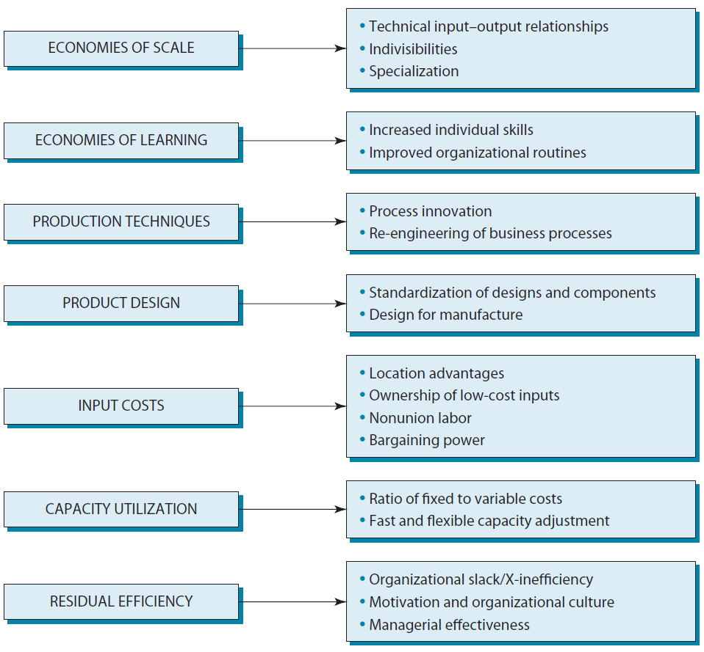
Drivers of Cost Advantage
© 2013 Robert M. Grant
www.contemporarystrategyanalysis.com

Slide 17
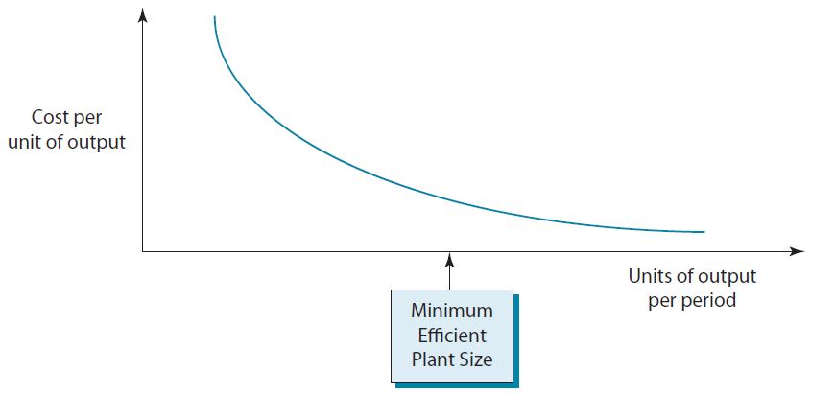
Economies of Scale:
The Long-Term Cost Curve for a Plant
© 2013 Robert M. Grant
www.contemporarystrategyanalysis.com

Slide 18
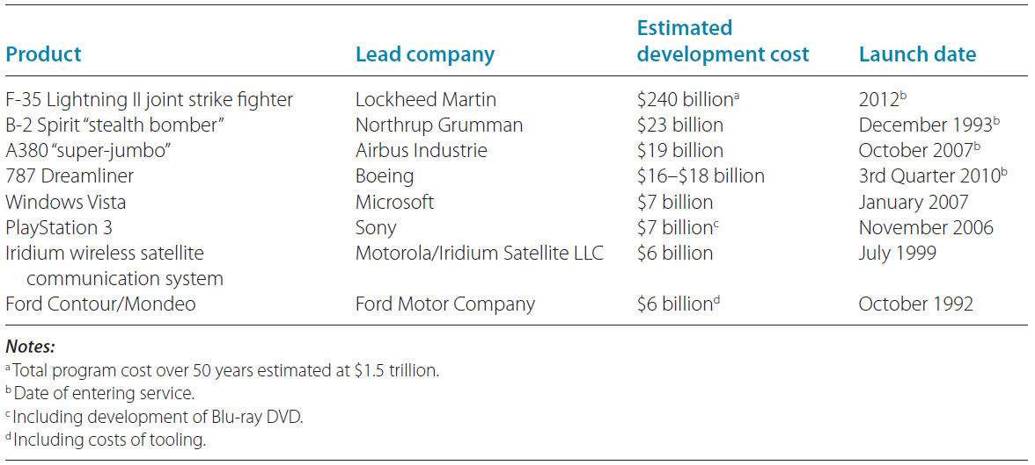
Some of the World’s Most Expensive new Product Development Projects
© 2013 Robert M. Grant
www.contemporarystrategyanalysis.com

Slide 19
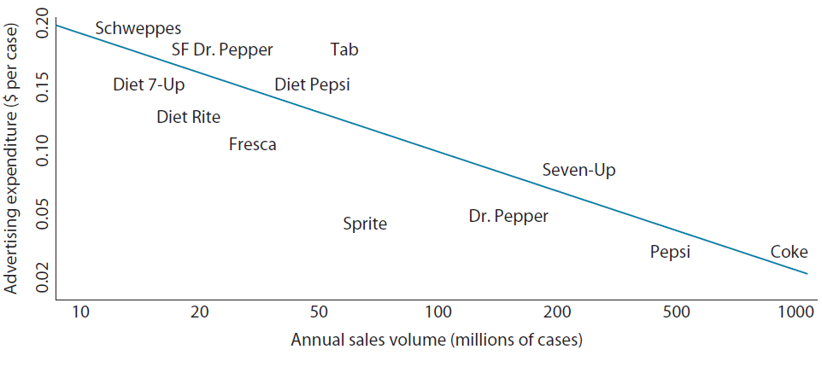
Scale Economies in Advertising:
US Soft Drinks
© 2013 Robert M. Grant
www.contemporarystrategyanalysis.com

Slide 20
Using the Value Chain for Cost Analysis:
Automobile Manufacture
Purchasing
R&D
Design Engineering
Component manu-facture
Assembly
Testing Quality control
Sales
Marketing
Distribution
Dealer support Customer service
Stages of the analysis:
Identify the main value chain activities
Allocate total costs between value chain activities
Identify the cost drivers at each stage of the value chain
Identify linkage between activities
Identify opportunities for cost reduction
© 2013 Robert M. Grant
www.contemporarystrategyanalysis.com

Slide 21
Differentiation Analysis
© 2013 Robert M. Grant
www.contemporarystrategyanalysis.com

Slide 22
The Nature of Differentiation
DEFINITION: “Providing something unique that is valuable to the buyer beyond simply offering a low price”
(M. Porter)
KEY ISSUE: Creating value for the customer
TANGIBLE DIFFERENTIATION
Observable, product characteristics:
Size, color, materials, etc.
Performance
Packaging
Complementary services
INTANGIBLE DIFFERENTIATION
Unobservable and subjective characteristics that appeal to the customer’s image, status, identity and desire for exclusivity
TOTAL CUSTOMER RESPONSIVENESS
Differentiation not just about the product, it embraces the whole relationship between the supplier and the customer.
© 2013 Robert M. Grant
www.contemporarystrategyanalysis.com

Slide 23
The Nature of Differentiation: Differentiation and Segmentation
Differentiation: Concerns choices of how a firm distinguishes its offerings from those of its competitors (i.e. How the firm competes)
Segmentation: Concerns choices of which customers, needs, localities a firm targets (i.e. Where the firm competes
Does differentiation imply segmentation?
Not necessarily, depends upon the differentiation strategy
Broad Scope Differentiation – Appealing to what is common between different customers (McDonalds, Honda, Gillette)
Focused Differentiation – Appealing to what distinguishes different customer groups (MTV, Harley-Davison, Armani
© 2013 Robert M. Grant
www.contemporarystrategyanalysis.com

Slide 24
The Nature of Differentiation: Differentiation and Segmentation
What needs does it satisfy?
What are the key attributes?
FORMULATE DIFFERENTIATION STRATEGY
Select product positioning in relation to product attributes
Select target customer group
Ensure customer/ product compatibility
Evaluate costs and benefits of differentiation
THE PRODUCT
Relates patterns of customer preference to product attributes
By what criteria do they choose?
What price premiums do product attributes command?
THE CUSTOMER
What are the demographic, sociological, psychological correlates of customer behaviour?
What motivates them?
© 2013 Robert M. Grant
www.contemporarystrategyanalysis.com

Slide 25
Techniques for Analysing Product Attributes and Positioning
Multidimensional Scaling: Maps consumer perceptions of competing products along key differentiating variables
Conjunct Analysis: Uses estimates of consumer preferences for particular product attributes to forecast demand for new products that comprise different bundles of product attributes
Hedonic Price Analysis: Estimates the price that consumers will pay for particular product attributes
Value Curve Analysis: Maps competing products according to bundles of attributers in order to identify opportunities for new products with a different combination of attributes
© 2013 Robert M. Grant
www.contemporarystrategyanalysis.com

Slide 26
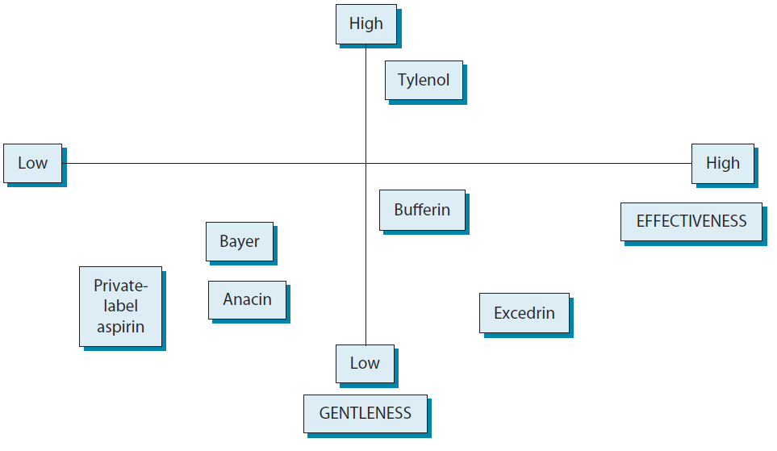
Differentiation in Pain Relievers: Multidimensional Scaling of Competing Products
© 2013 Robert M. Grant
www.contemporarystrategyanalysis.com

Slide 27
Analyzing Differentiation
on the Supply Side
Sources of uniqueness:
Product features and product performance
Complementary services (such as credit, delivery, repair)
Intensity of marketing activities (advertising; promotion)
Technology embodied in design and manufacture
Quality of purchased inputs
Procedures that impact the customer experience (e.g. the, rigor of quality control, service procedures, frequency of sales visits)
Skill and experience of employees
Location (for example, with retail stores)
Degree of vertical integration (allow control over inputs and intermediate processes)
© 2013 Robert M. Grant
www.contemporarystrategyanalysis.com

Slide 28
Product Integrity
Key to differentiation is consistency of all aspects of the firm’s relationship with its customers
Product integrity: The total balance of product features
Internal integrity – Consistency between the function and structure
External integrity – Fit between the product and consumers’ objectives, values and lifestyle
Key to successful differentiation strategy: Consistency of internal and external integrity (e.g. Harley-Davidson, Apple, Danone
© 2013 Robert M. Grant
www.contemporarystrategyanalysis.com

Slide 29
Using Value Chains Linkages to Identify Differentiation Opportunities: Can Manufacture
Distinctive can design can assist canners’ marketing activities
High manufacturing tolerances can avoid breakdowns in customer’s canning lines
Frequent, reliable delivery can permit canner to adopt JIT can supply
Efficient order processing system can reduce customers’ ordering costs
Competent technical support can increase canner’s efficiency of plant utilization
© 2013 Robert M. Grant
www.contemporarystrategyanalysis.com

Slide 30
Implementing Cost and
Differentiation Strategies
© 2013 Robert M. Grant
www.contemporarystrategyanalysis.com

Slide 31
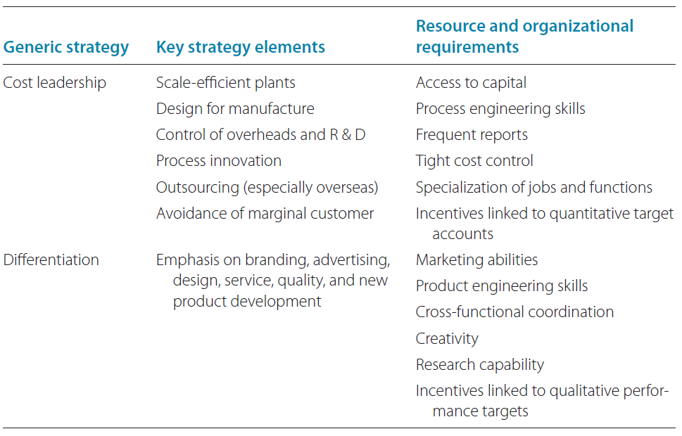
Features of Cost Leadership & Differentiation Strategies
© 2013 Robert M. Grant
www.contemporarystrategyanalysis.com

