Slide 1
500 Years of Scottish Literature
15 Edwin Morgan and the 1960s

Slide 2
Revisiting Poet’s Pub

Slide 3
Focus on Edwin Morgan
1920-2010
Born and raised in Glasgow
Served in Middle East in WWII
Returned to Glasgow University where he became a lecturer, and later Professor
Begins publishing poetry and translations in 1950s with his version of Beowulf (1952)

Slide 4
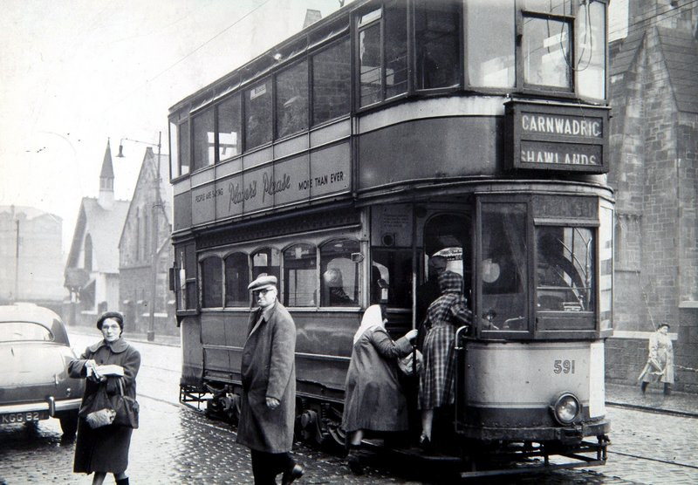
From ‘Seven Decades’: the 1950s
http://edwinmorgan.scottishpoetrylibrary.org.uk/poems/seven_decades.html
At thirty I thought life had passed me by,
translated Beowulf for want of love.
And one night stands in city centre lanes –
they were dark in those days – were wild but bleak.
Sydney Graham in London said, 'you know
I always thought so', kissed me on the cheek.
And I translated Rilke's Loneliness
is like a rain, and week after week after week
strained to unbind myself,
sweated to speak.

Slide 5
‘Seven Decades’ contd.: 1960s
At forty I woke up, saw it was day,
found there was love, heard a new beat, heard Beats,
sent airmail solidarity to Saõ
Paulo's poetic-concrete revolution,
knew Glasgow – what? – knew Glasgow new – somehow –
new with me, with John, with cranes, diffusion
of another concrete revolution, not bad,
not good, but new. And new was no illusion:
a spring of words, a sloughing,
an ablution.

Slide 6
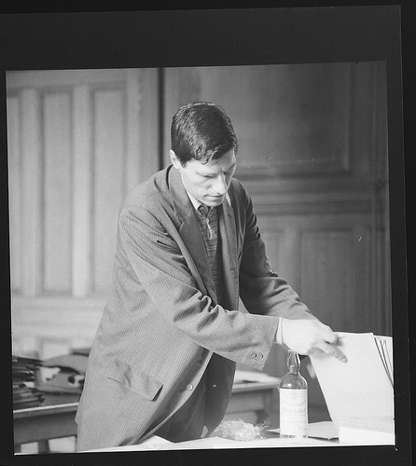
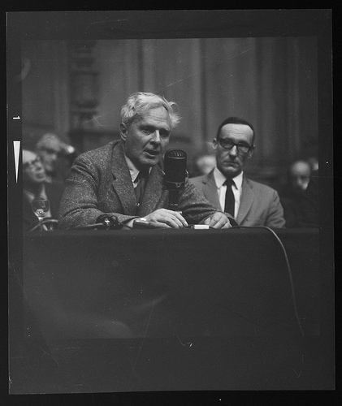
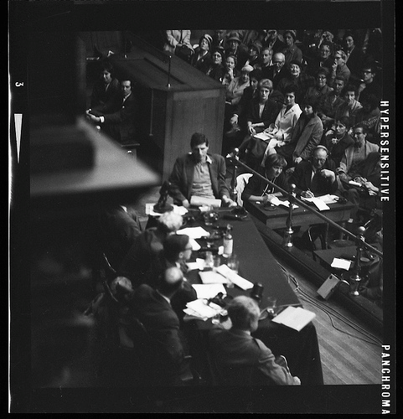
Edinburgh Writers’ Conference 1962
Alexander Trocchi Stephen Spender
& William Burroughs

Slide 7
Mary McCarthy’s impressions
“People jumping up to confess they were homosexuals; a registered heroin addict leading the young Scottish opposition to the literary tyranny of the communist Hugh MacDiarmid… An English woman novelist describing her communications with her dead daughter, a Dutch homosexual, former male nurse, now a Catholic convert, seeking someone to baptize him; a bearded Sikh with hair down to his waist declaring on the platform that homosexuals were incapable of love, just as (he said) hermaphrodites were incapable of orgasm (Stephen Spender, in the chair, murmured that he should have thought they could have two)…”
Excerpt from a letter Mary McCarthy wrote to Hannah Arendt describing the 1962 International Writers’ Conference in Edinburgh (28/09/62)

Slide 8
Rift in Scottish Letters…
“Trocchi attacked MacDiarmid for encouraging an old-fashioned and reactionary view of Scottish literature – he called it ‘turgid petty provincial stale cold-porridge Bible-clasping nonsense’, and he said MacDiarmid’s opinions, especially his scorn for the novel, were just ‘too crummy to be commented on. Of course, MacDiarmid was furious about this and replied that Scottish literature wasn’t provincial and even if it was this was better than submitting to wicked American influences represented by people like Trocchi (or me) …”
-- Edwin Morgan, Talk to Rutherglen Rotary Club (1962)

Slide 9
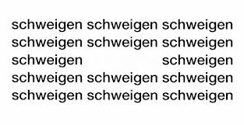
International contacts
1960s Visiting professor at University of Freiburg
Encounters work of German concrete poet Eugen Gomringer and the Austrian sound poet Ernst Jandl
http://www.ubu.com/sound/jandl.html

Slide 10
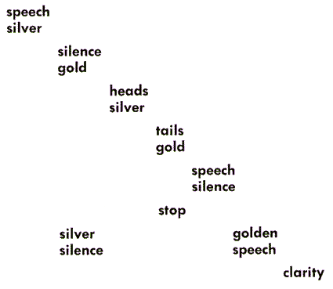
Web resource on concrete poetry
http://www.ubu.com/papers/solt/index.html
Haroldo de Campos (1962),
Trans. Edwin Morgan

Slide 11
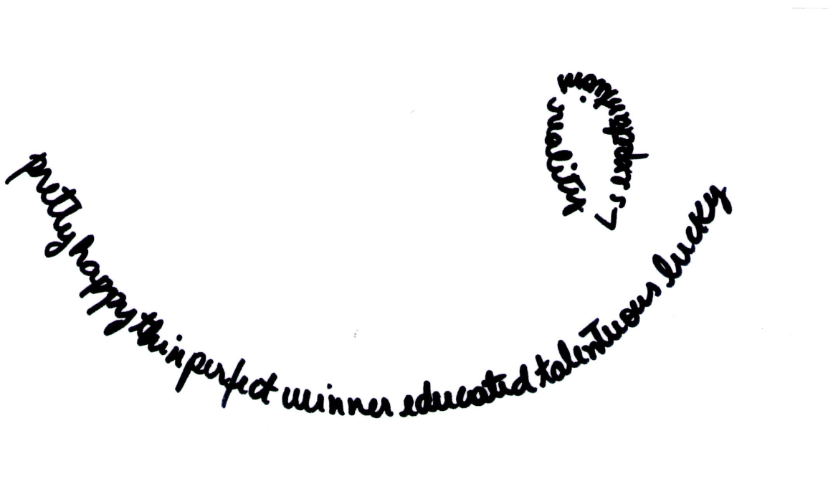
Your concrete poetry

Slide 12
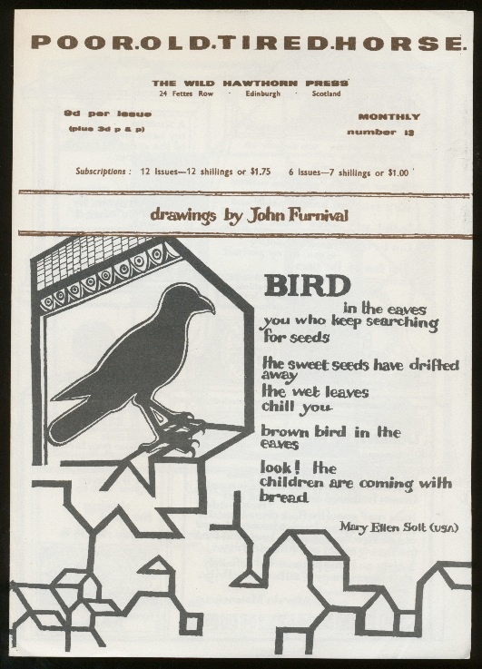
McConcretismo
Ian Hamilton Finlay, Poor. Old. Tired. Horse. (1963)

Slide 13
Social networking
Ian Hamilton Finlay Eugen Gorminger
De Campos brothers Edwin Morgan
Gael Turnbull Black Mountain poets

Slide 14
Ian Hamilton Finlay (1925-2006)
“On the one hand, Finlay, beginning with with his early experiments with concrete poetry, has always been acutely sensitive to the formalist concerns (colour, shape, scale, texture, composition) of literary and artistic modernism. On the other hand, Finlay, a committed poet and student of classical philosophy, has also always recognised the power of language and art to shape our perceptions of the world and even to incite us to action. Fused in his work is thus a certain formalist purity and an insistent polemical edge, "the terse economy of concrete poetry and the elegant [and speaking] simplicity of the classical inscription." Formalist devices are themselves shown to be never without meaning, and they are ingeniously deployed by Finlay to arm his works with an ever more evocative content.”
-- Prudence Carlson http://www.ubu.com/historical/finlay/index.html

Slide 15
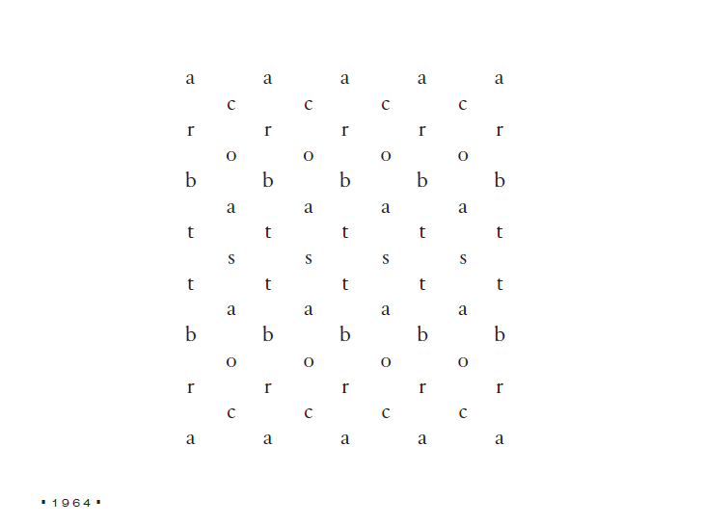

Slide 16
Morgan on concrete poetry
“ […] there is a great range of effects in concrete poetry from ‘warm’ to ‘cold’. Some of it is outgoing, joyous, humorous, witty; some of it is stark, hermetic, forbidding; some is political; some is religious; some is mathematical; some is sculptural; some is two-dimensional, some three-dimensional; some abstracts concrete forms such as animals, some concretises abstract forms such as grammatical relationships. I myself incline to the ‘warm’ rather than the ‘cold’ end, but I realise that there are other points of view.”
-- Letter to a Swiss scholar from Neuchâtel University, 1968

Slide 17
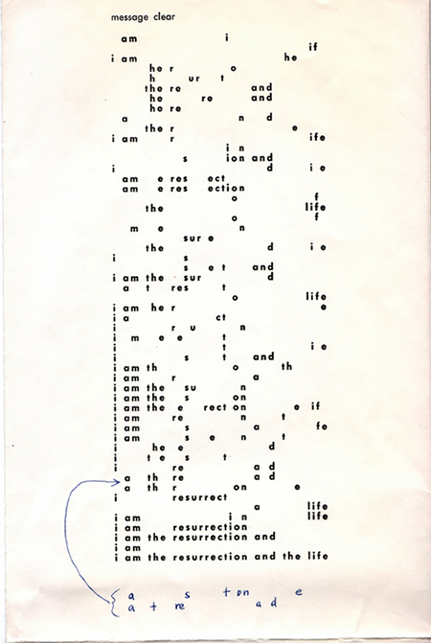
Message Clear
Christ’s statement in St John’s gospel
Permutations of meaning
Completed on a bus journey home from visiting his dying father in hospital (1965) and published in January 1966 (TLS).

Slide 18
Morgan and Brazil
1965: Receives letter from Haroldo de Campos, re. concrete poetry published in Ferlinghetti’s City Lights. Morgan translates some of de Campos for the magazine.
Continue to correspond: e.g. de Campos introduces Morgan to Chuvash poet, Gennadiy Aygi’s work. Morgan translates work by Aygi too.

Slide 20
Edwin Morgan’s translation

Slide 21
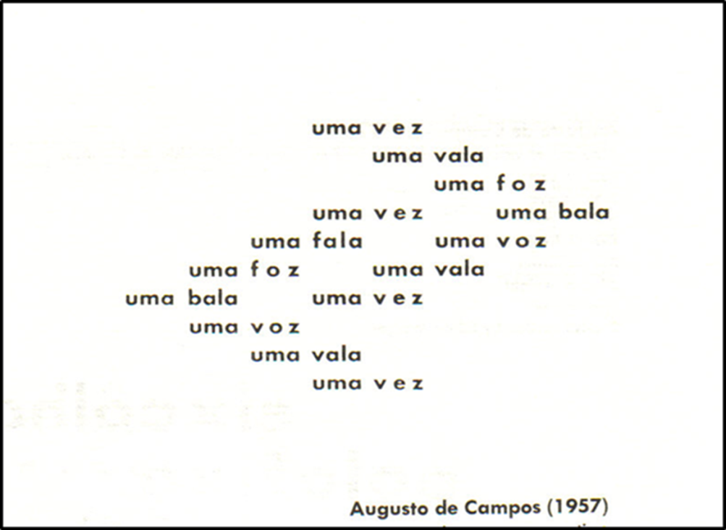
Issues in translation…

Slide 22
MacDiarmid on concrete poetry
I had heard with delight about the EUP Poetry Scotland and will of course be glad to send stuff when I know the date by which you should receive it. There is one thing however about which I must be absolutely frank. I deplore Edwin Morgan’s association with you and George Bruce in the editorship. Morgan’s prominence in connection with ‘Concrete Poetry’ and with Ian Hamilton Finlay rules him out completely as far as I am concerned. I will not agree to work of mine appearing in any anthology or periodical that uses rubbish of that sort, which I regard as an utter debasement of standards but also as a very serious matter involving the very identity of poetry. These spatial arrangements of isolated letters and geometrically placed phrases, etc. has nothing with poetry – no more than mud pies can be called a form of architecture.
-- Letter to Maurice Lindsay, 1965

Slide 23
Morgan to Augusto de Campos (1963)
Dear Augusto de Campos
Many thanks indeed for sending Invenção No.2 and Noigandres 5 which reached me safely, also for your letter of 8 July. Your little vocabulary was helpful, and I have too a small Portuguese dictionary and am at present working my way through some of the poems. I am struck by the great variety of approach, from the most abstract and ‘patterned’ to the committed (I like very much your Cuba Sim Ianque Nao). It is good to keep the concrete method capable of doing different things, from effects of pure place, relation, and movement to effects of satire, irony, and direct comment. The American poet Jonathan Williams, who has been in this country recently, has done some interesting work (you may know it) which uses certain aspects of concrete technique to comment on the Negro problem in the American South.

Slide 24
Morgan to Augusto de Campos (1963)
I am enclosing a few poems and translations in the hope that they will reach you this time! Two translations of poems by yourself – which I am trying to get into print, together with some other versions, in our Times Literary Supplement, a somewhat conservative organ – but we shall see.
I shall look forward very much to seeing the translations of Pound and Cummings you refer to – particularly as I am gathering material for a book on the translation of poetry.
With all best wishes
Yours sincerely
EM
Edwin Morgan

Slide 25
A later letter from Edwin to Augusto (1963)
Dear Augusto
Very many thanks for your letter of 25 August and for the three books which have now reached me safely: Invenção No.3, Pound’s Cantares, and Cumming’s 10 Poemas. It will take me more time to look more closely at the latter two translations, but my first eager glance has found both of them a remarkable achievement; the Cummings poems in particular seem to bear out my belief that there is much less in poetry that ‘cannot’ be translated than most people like to suppose. I like best so far the ‘grasshopper’ and ‘fog’ poems, which you have done brilliantly.

Slide 26
Contd.
I am glad you liked my versions of your two poems, and I am enclosing a version I have just made of ‘ovonovelo’ (from Poesia Concreta). If it meets with your approval you are welcome to use them all in The Plumed Horn (a magazine which I have seen recently for the first time).

Slide 27
Contd.
Jonathan Williams has just published Lullabies Twisters Gibbers Drags (Nantahala Foundation, Highlands, North Carolina, 1963, $1.00); these are poems I think you would enjoy. They are semi-concrete poems about segregation. I liked your own Bhite & Wlack – as also the Bestiary (you certainly don’t need to apologize over the ‘English’; on p.2 your query on or upon the thin stripe… I would put upon as it goes better with thin; further down on the same page, you couldn’t make your chameleon a salamander? since salamanders lived in flame).
I forgot also to thank you for the Cubagramma. I look forward to the Finnegans Wake translations and Haroldo’s Mayakovsky.
All best wishes
Edwin

Slide 28
Concrete solidarity
Affirmation of the emotional and political range of concrete poetry
Language advice and support (suggestions, provision of glossaries, dictionaries)
Mutual translation (of each other – or of others)

Slide 29
Towards a research proposal…
Can the avant garde be mapped?
How might we visualise (in concrete terms) the international concrete poetry movement?
Can we draw upon other projects & tools in the digital humanities to help us to map the concrete connections?

Slide 30
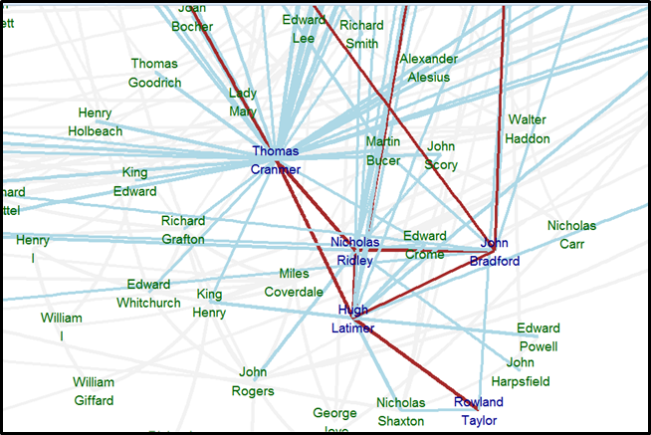
Other mapping projects
Six Degrees of Francis Bacon:
Mapping the early modern social network

Slide 31
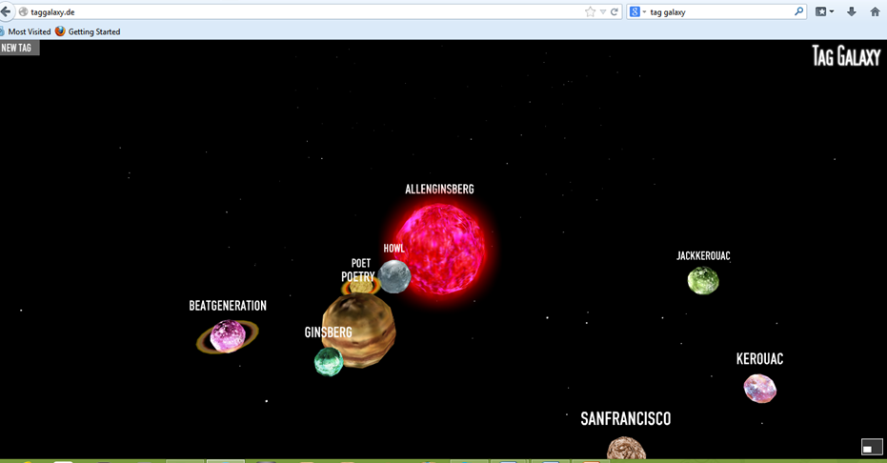
Visualisation tools
Tag Galaxy

Slide 32
Metadata for a database
1. Letters: who was writing to whom?
2. Content: who was mentioned in the letters?
3. Translations: who was translating whom?
4. Publications: who was publishing with whom?
5. Biographical: who was living with/working with/related to whom?

Slide 33
Basic metadata for a database
1. Letters: who was writing to whom?
2. Content: who was mentioned in the letters?
3. Translations: who was translating whom?
4. Publications: who was publishing with whom?
5. Biographical: who was living with/working with/related to whom?

Slide 34
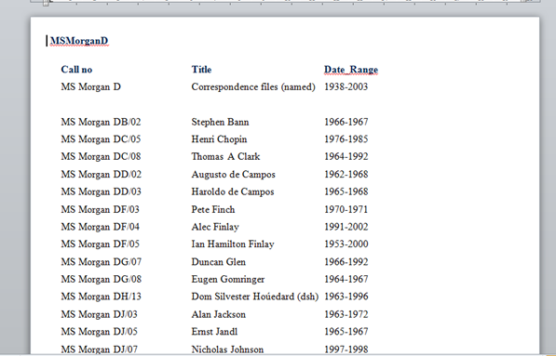
Where to look?
Archives of correspondence
Bibliography of Scottish Literature in Translation (BOSLIT)

Slide 35
Initial maps: Morgan’s Collected Translations

Slide 36
Initial maps: Morgan’s Collected Translations

Slide 37
What would we learn?
Remapping literary influences across borders?
Learning how correspondence and translation shaped literary production?
Understand how literary movements progress and define themselves between and across cultures and generations?

Slide 38
Sound poetry by Edwin Morgan

Slide 39
Can sound poetry be translated?
A Canção do Monstro do Lago Ness Tradução: Virna Teixeira
Hhhnnnuuuhffffff? Hnnhuffl hhnnnfl hnfl hfl? Glgoblboblhobngbl gbl gl g g g g glogl. Drablhaflablhaflubhafgabhaflhafl fl fl - gm grummmmm grf grumf umfgh grum gm. Bavoplodom-doplodavom-plavodocon-doplodaconh? Sepgram cof cof sppgranhanchgrablgrabl cof selcof! Agra crg gra fff! Gruf graff ghaf? Gombl mbl bl - blu plb, blu plb, blu plb, blb

Slide 40
Sound, poetry, Scots…
1961

Slide 41
Younger generation: Tom Leonard
Born Glasgow 1944
Educated Glasgow University
Joined writing group around
Philip Hobsbaum, Morgan’s
colleague
Publishes Six Glasgow Poems
in 1969.

Slide 42
The Good Thief
heh jimmy
yawright ih
stull wayiz urryi
ih
heh jimmy
ma right insane yirra pape
ma right insane yirwanny us jimmy
see it nyir eyes
wanny uz
heh
heh jimmy
lookslik wirgonny miss thi gemm
gonny miss thi GEMM jimmy
nearly three a cloke thinoo
dork init
good jobe theyve gote the lights

Slide 43
O Bom Ladrão: Tradução Virna Teixeira
O Bom Ladrão
aí mano
suave aê
inda tá na área
aê
aí mano
viajei cê é pastor
viajei cêtá nu bonde mano
tô ligado
nu bonde
aí
aí mano
parece que nóisvamo perdê o jogu
vamo perdê o JOGU mano
quaiz quatro hora
tá iscuro né
ligaro a luz é nóis
http://papelderascunho.net/

Slide 44
Take home message
The social revolution of the 1960s sparked a (heated) reappraisal of the ‘renaissance’ of the first half of the 20th century.
Scottish poets became more open to international influences (particularly from the USA but also the European and S American avant garde)
Avant garde forms (visual, sound) were adapted to Scottish themes and concerns.

Slide 45
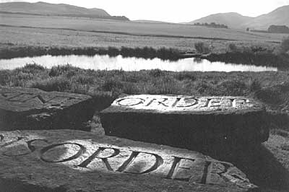
At Little Sparta, Ian Hamilton Finlay
'The present order is the disorder of the future', a quotation form the French Revolutionary, Sainte-Just (1983)

Slide 46
Next week….
The final lecture: Between Referenda…Scottish Literature Today.

Slide 47
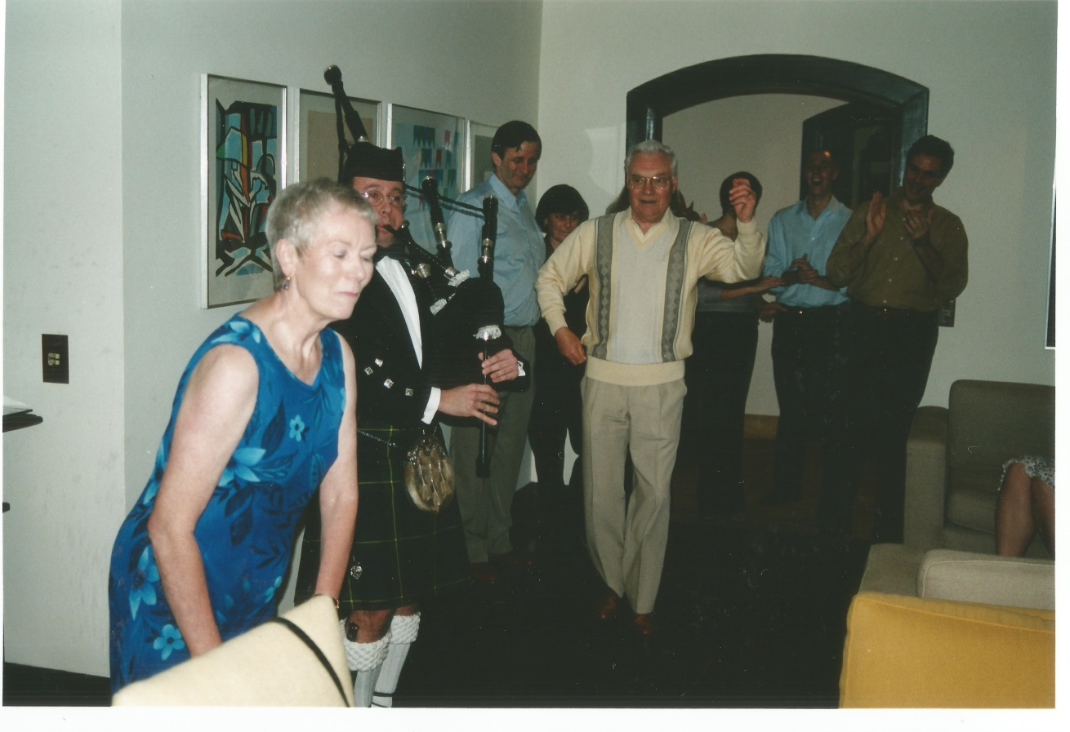
Optional bonus
Tuesday 10th December – 7.30-9.00 pm
Casa de Cultura Japonesa

