Slide 1
500 Years of Scottish Literature
12 Kailyard & Tartanry

Slide 2
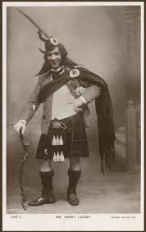
Today’s session
The rise of ‘kailyard’ fiction and drama towards the end of the 19th century
Analysing stereotypes of kailyard and tartanry in 20th century Scottish culture

Slide 3
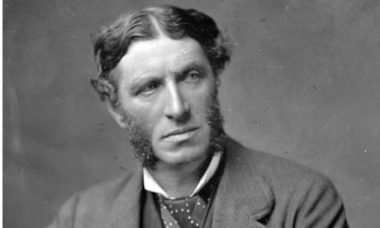
Culture and Anarchy (1869)
Matthew Arnold (1822-1888)
English poet and cultural critic
"Culture [...] is a study of perfection [… It] seeks to do away with classes; to make the best that has been thought and known in the world current everywhere; to make all men live in an atmosphere of sweetness and light [...]".

Slide 4
Universalism versus regionalism
“Arnold’s formulation of Culture as a transcendent value is a crucial development, because it drove a wedge between regionalism and culture, stigmatising the one as enfeebled provincialism, and raising the other above the claims of time and place.”
-- Gilmour, Robin. 1989. ‘Regional and Provincial in Victorian Literature.’ in The Literature of Region and Nation ed. RP Draper, Basingstoke: Macmillan, p. 57

Slide 5
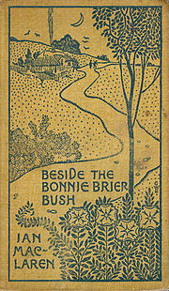
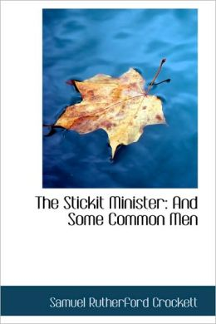
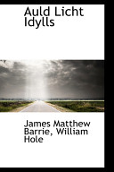
The Kailyard School
Ian McLaren SR Crockett JM Barrie

Slide 6
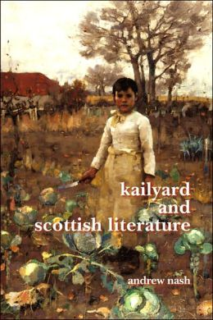
Kailyard
Attributes Representatives
domesticity the minister
rusticity the dominie
humour the doctor
humility the lawyer
modesty etc
decency
piety
poverty
canniness
etc

Slide 7
Oliphant on regionalism
“The books called “Carlowrie”, “Aldersyde”, “Blinkbonny,” “Glenairlie” &c are cheap books, perfectly well adapted, with their mild love stories and abundant marriages, for the simpler classes, especially of women whose visions are bounded by the parish, who know nothing higher in society than the minister and his wife, and believe that all the world lieth in wickedness except Scotland. […] It is sad to be told that these productions are regarded as representatives of a national school and attain their popularity by dint of their dialect and by the very narrowness of their aim.”
-- Margaret Oliphant (1889) “The Old Saloon” in Blackwood’s Magazine, August, pp. 265-6

Slide 8
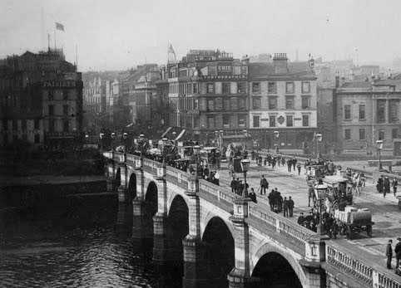
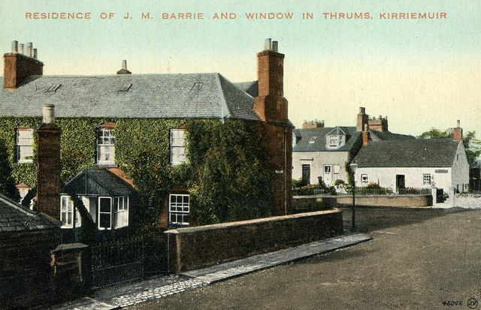
Escape from industrial reality

Slide 9
JM Barrie (1860-1937)
Born Kirriemuir, Angus
Death of brother, David, when Barrie is 6 yrs old
Developed interest in storytelling as a child
Studied literature at Edinburgh University, also writing drama criticism for local newspaper
Worked as journalist before taking up writing full-time
First novels, Auld Licht Idylls (1888), A Window in Thrums (1890), and The Little Minister (1891) are in the Kailyard style, based on Kirriemuir (Thrums). Popular successes. Begins to work in drama.
1904: Stage version of Peter Pan produced in London. Other successful plays follow.

Slide 10
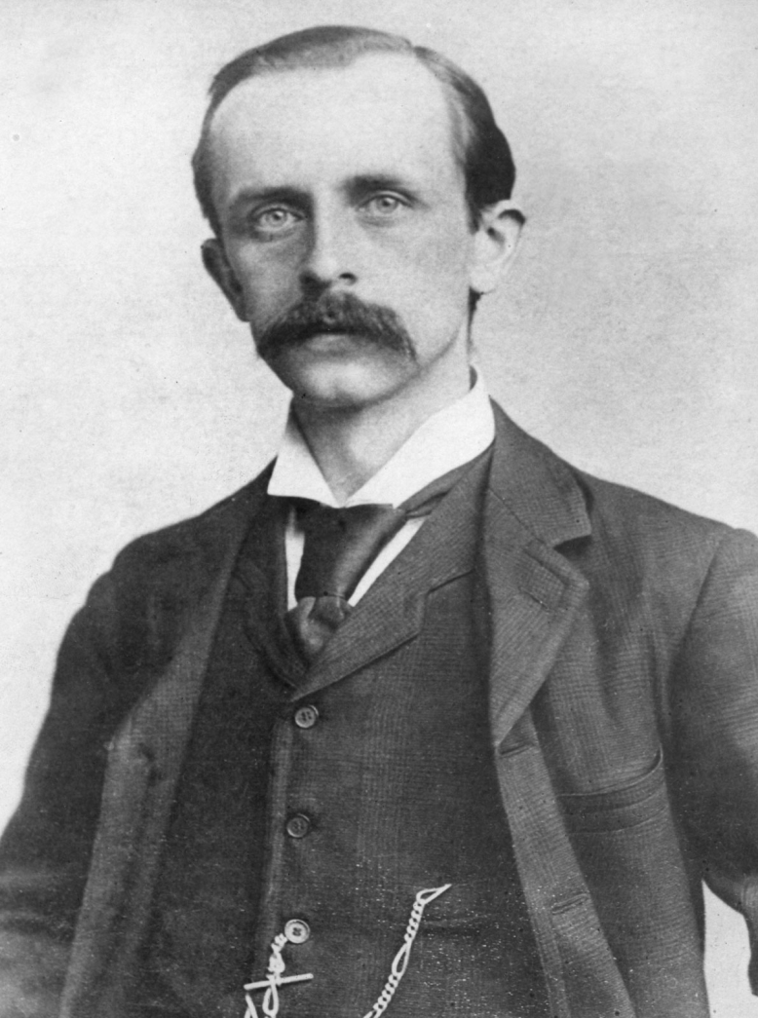
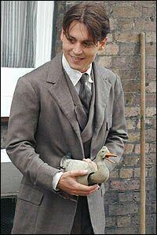
The boy who wouldn’t grow up?

Slide 11
From emotive to creative?
“At this stage of his career [A Window in Thrums], he uses the narrator to try and convince the reader of the realism and veracity of the story, and of Jess and her family and the emotions involved in it. As his fictional career progressed, however, he became more interested in the role of the narrator and in the act of creating illusions of reality. His later novels are characterised by an intense interest in the creative mind; with storytelling and illusory realities.”
-- Andrew Nash (2007) Kailyard and Scottish Literature. Amsterdam: Rodopi, p. 71

Slide 12
From Scots…
"Ay," he said, thoughtfully, "them 'at's gone canna be brocht back. Weel, my idea is 'at a Home should be built for geniuses at the public expense, whaur they could all live thegither, an be decently looked after. Na, no in London; that's no my plan, but I would hae't within an hour's distance o' London, say five mile frae the market-place, an' standin' in a bit garden, whaur the geniuses could walk aboot arm-in-arm, composin' their minds."

Slide 13
…to Caipira?
“Éeh,” ele disse, pensativo, “aqueles que se foram não podem mais voltarrr. Bah (Bom), minha ideia é que um Larrr para gênios deve serrr construído com recurrrsos públicos, onde todos eles pudessem viverrr juntos e fossem tratados deçaintemente (decentemente). Nah, em Londres não; esse não é meu plano, mas não seria há mais de uma hora de Londres, digamos cinco milhas do mercado, e parando em um jardim, onde os gênios poderiam caminharrr de braços dados, unindo suas mentes.”
Sabrina Palladino Simas

Slide 14
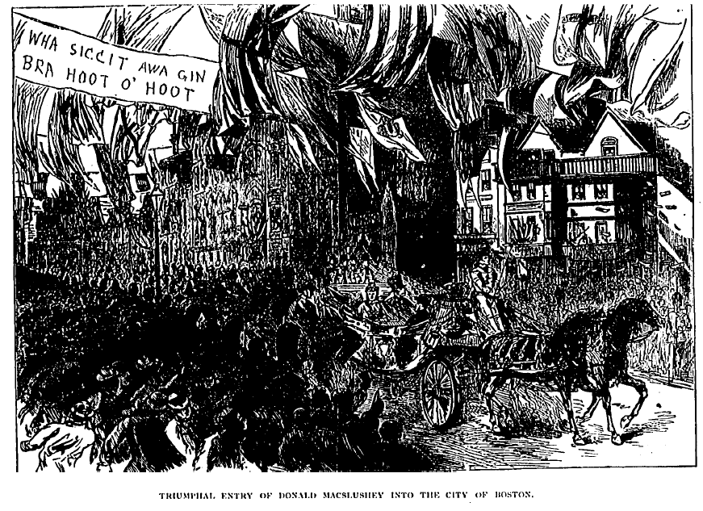
International success (?)
Cartoon in Life, Jan 14th 1897: “Donald MacSlushey”

Slide 15
Barrie parodied…

Slide 16
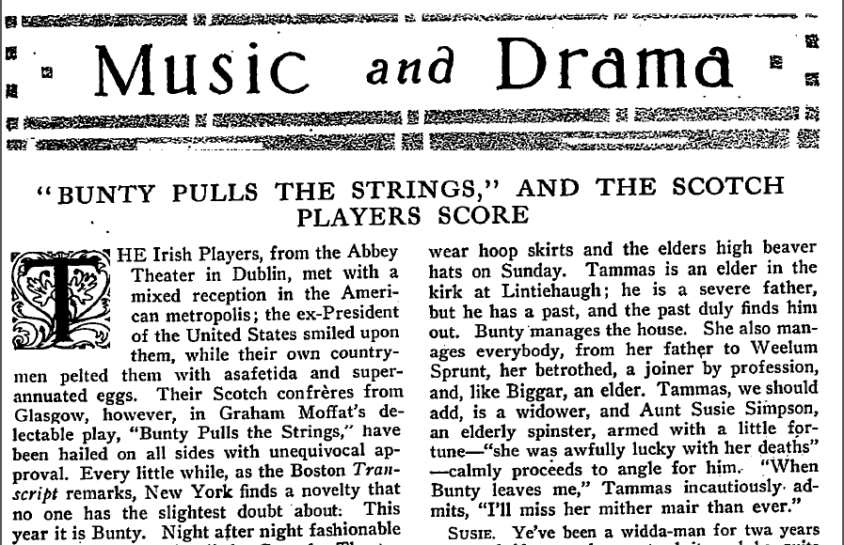
A long line of heirs…
Review in Current Literature, 52:1. Jan 1912

Slide 17
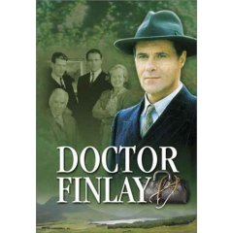
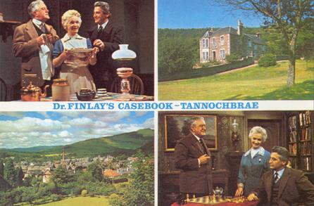
Dr Finlay’s Casebook
Novella Country Doctor AJ Cronin (1935)
First TV series (1962-71)
Revived 1993-6

Slide 18
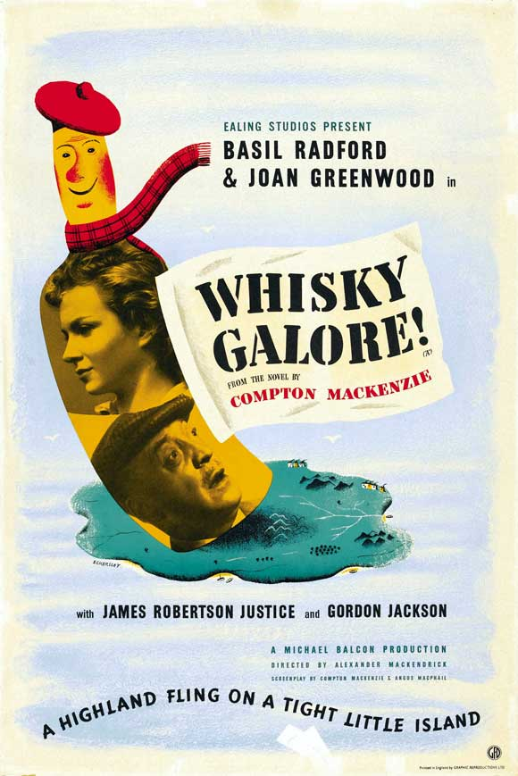
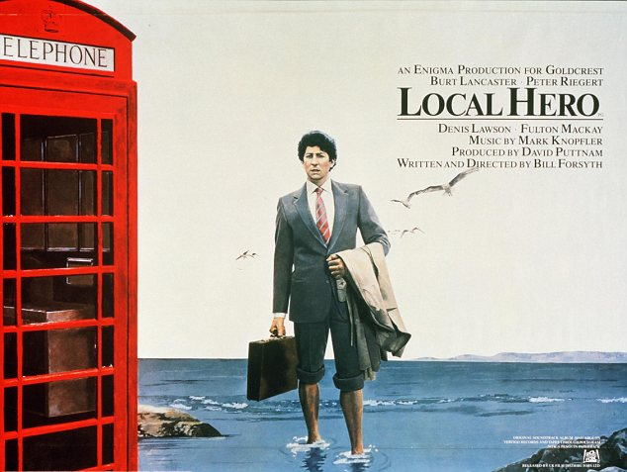
Ironising the stereotypes: kailyard on film
http://www.youtube.com/watch?v=Nh0ja-BTpbk

Slide 19
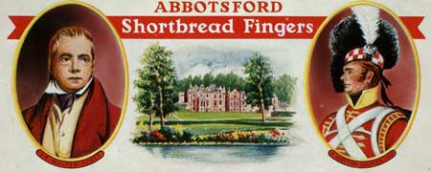
Tartanry: Kailyard’s visual counterpart
Attributes Representatives
patriotism Highland soldier
nobility "noble savage"
romanticism Scottish football fans
Highland ancestry Sir Harry Lauder
Sentimental Jacobitism Mel Gibson/’Braveheart’
etc etc

Slide 20
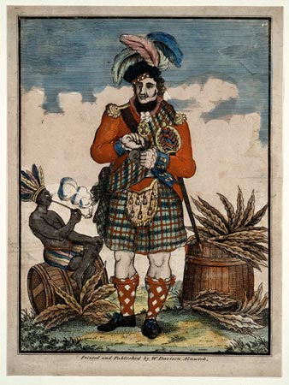
Tobacco advertisement (1790)

Slide 21
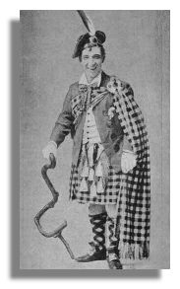
Sir Harry Lauder (1870-1950)

Slide 22
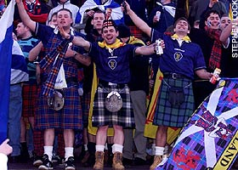
Scottish football fans

Slide 23
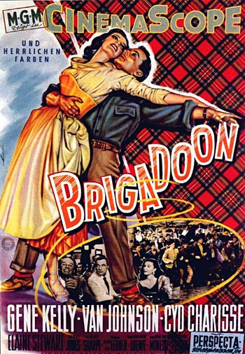
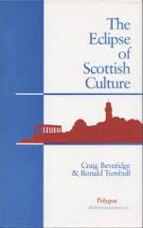
Scottish inferiorism?
http://www.youtube.com/watch?v=61MEKyAQSpg

Slide 24
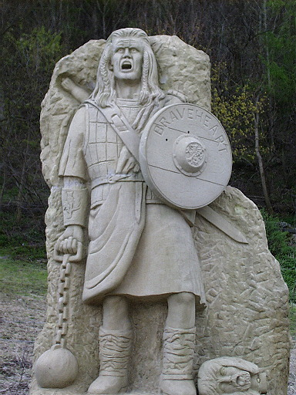
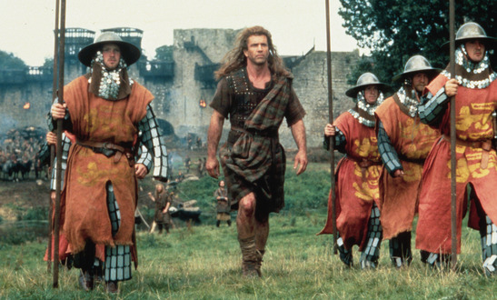
Mel Gibson as William Wallace
On film and in stone
(Wallace Monument,
Stirling)

Slide 25
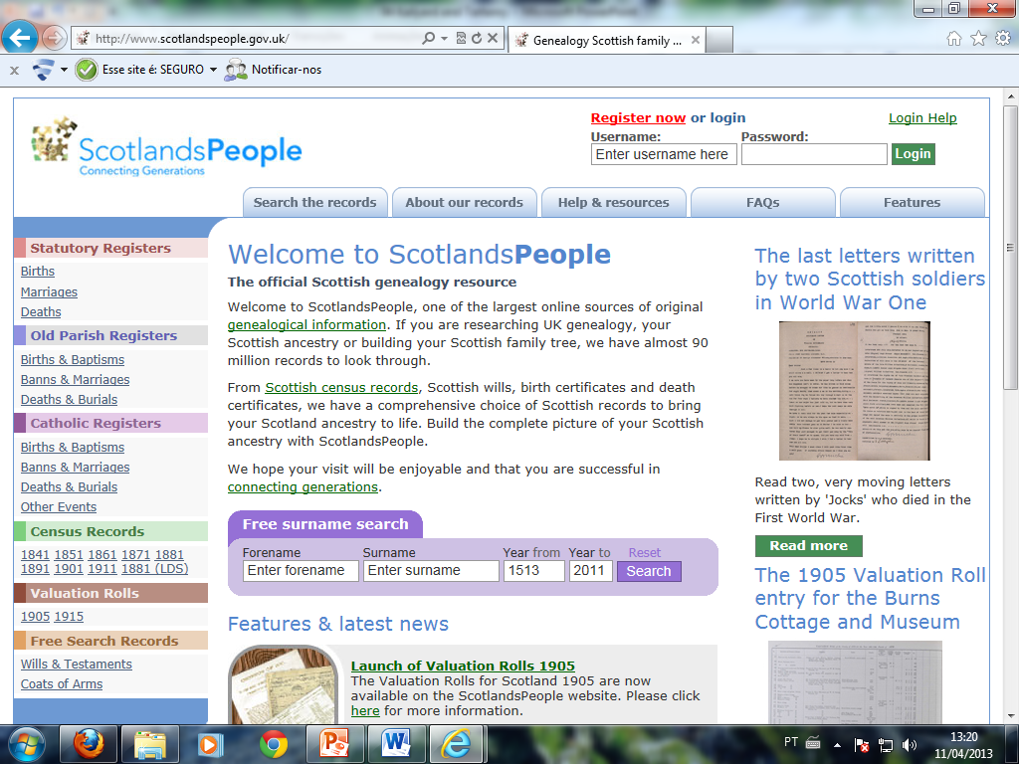
The heritage industry

Slide 26
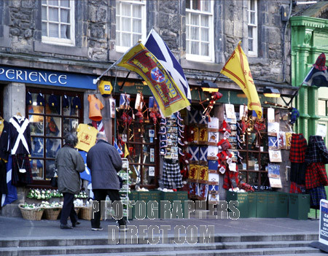
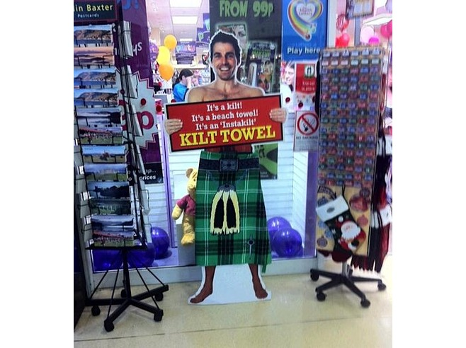
Scottish tourist shops

Slide 27
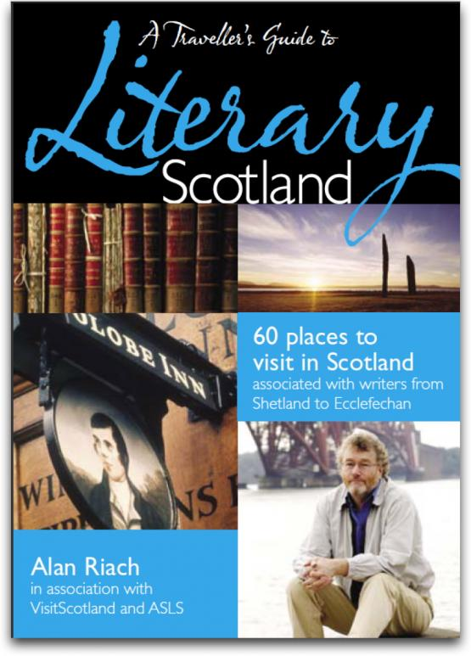
Full circle: literary tourism

Slide 28
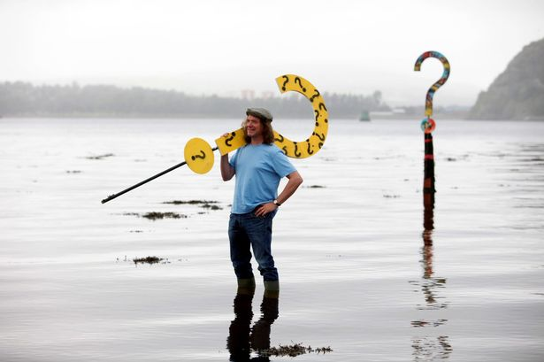
Issues around kailyard and tartanry
Who is in control of the representations?
Whose interests do they serve?
Turning Scottish culture and identity into a product for consumption (by readers, viewers, tourists…)
Anti-realist and therefore false?
Populist & kitsch (and therefore irredeemable?)

Slide 29
The final lap…
The 20th century literary renaissance – MacDiarmid, Muir and Maclean
Duality revisited: Muriel Spark’s The Prime of Miss Jean Brodie.
Concrete revolutions: Edwin Morgan and the avant garde
Choose Life: into the 21st century with Welsh, Lochhead, Warner and Kay…

Slide 30
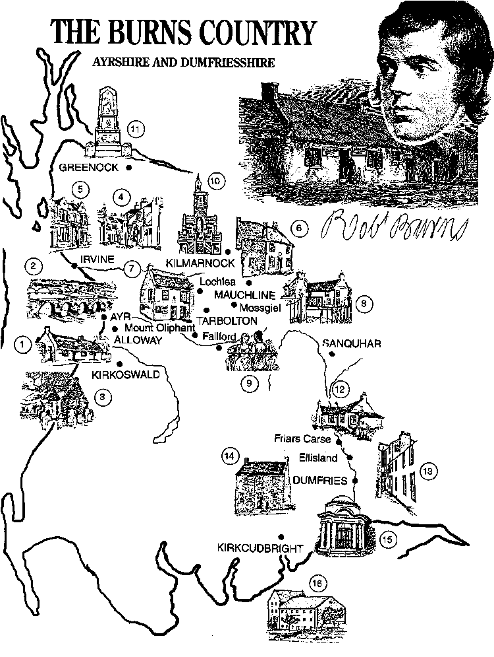
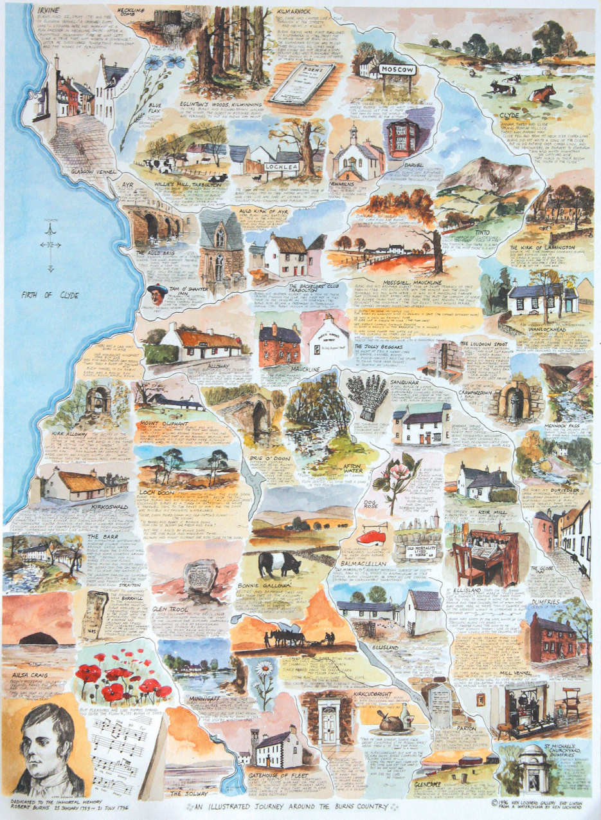
Thank you!

