Slide 1
500 years of Scottish Literature
04 Poetry and the Court of James VI

Slide 2
A Satire of the Three Estates: Film now available on the website
Gude Counsel
Flatterie
Scene 3

Slide 3
The end of the 16th century…
1554 – second performance of A Satire in Edinburgh, before Mary of Guise, Queen Regent
1558 – Mary’s daughter (also Mary) marries young Francis , the Dauphin of France. The Protestant Queen Elizabeth I accedes to the English throne.
1560 – Mary of Guise dies. Protestant Lords demand the right to call the Scottish parliament, and when this is accepted, they move to abolish Catholicism as the state religion of Scotland. The young Francis II dies in France.
1561 – Mary, now Queen of Scots, returns to Scotland from France and to opposition from the Protestant Lords. Remarries and bears a son, James VI in 1566.
1568 – Mary is forced to flee Scotland, and James VI becomes king at the age of 2. He is raised as a Protestant. Mary is kept under house arrest in England for 19 years where she plots to take control of Scotland (and England).
1583 – At the age of 17, James VI takes personal control of Scotland.
1584 – James VI publishes Some Reulis and Cautelis.
1585 – Mary, Queen of Scots, is executed in England.
1603 – Elizabeth I dies and is succeeded by James VI…and I of the United Kingdom.

Slide 4
Today’s session
Consider a brief treatise on the writing of poetry by the young James VI of Scotland.
Consider how the advice in the treatise relates to the poetry of his Scottish court (and to yours).
Reflect on the meanings of form in poetry.

Slide 5
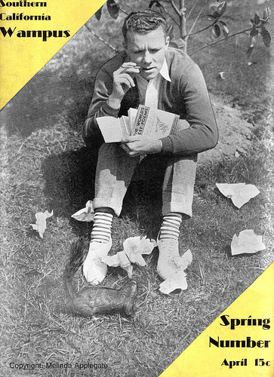
Before we start
From some of your sonnets…

Slide 6
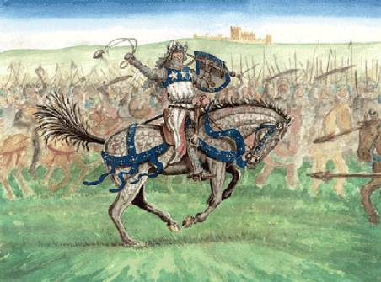
Stephanie Cerqueira Leite Fernandes
In a wintry dawn I first awake,
never to stain mail ‘n’ soil with my blood,
never to break nor forsake nor ache,
whence safeguarded by the Lord Judd.
I have built the thickest, reddest walls
against traitors, false kings and the South.
I have brought justice, strength and squalls,
Numerous deeds you know by word of mouth.
Above the chaos of impending ills,
fled my body, began a crusade.
Now while vermin such torso fills,
in Jerusalem, I raise a blade.
For I am Robert the Brus, his Heart,
and not even Death shall see me depart.

Slide 7
Smoothing the metre
nevER to STAIN mail ‘N’ soil WITH my BLOOD (10)
nevER to BREAK nor FORsake NOR ache (9)
NevER to STAIN my MAIL or SOIL with BLOOD (10)
(NEver)
neVER to BREAK ah NO! ForSAKE nor ACHE (10)

Slide 8
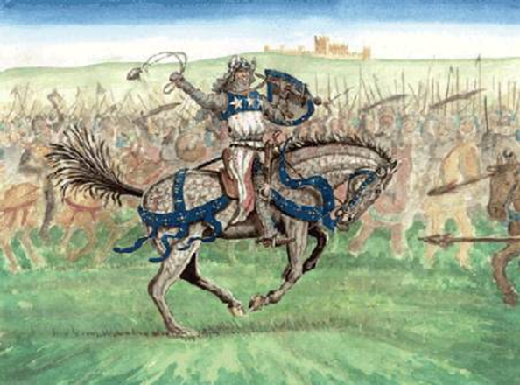
Revised version
In a wintry dawn I first awake,
never to stain my mail or soil with blood,
never to break – ah no! forsake nor ache;
I’m kept in safest guard by the Lord Judd.
I’ve built the thickest, reddest sure defence
’gainst traitors, lying kings and –yes! - the South.
I’ve brought you justice, strength and common sense,
Numerous deeds you know by word of mouth.
Above the chaos of impending ills,
I fled my body, joined in a crusade.
And now while vermin my old torso fills,
in th’Holy Land, I raise a Scottish blade.
For I am Robert Bruce, his noble Heart,
and not ev’n Death shall see me now depart!

Slide 9
Reflections on your own lines…
How easy is it to organise your thoughts into lines of 10 syllables with five regular beats?
Did you consciously attend to any other formal literary features?
Rhyme?
Alliteration?
Interesting placement of caesura?
End-stopping or enjambment?

Slide 10
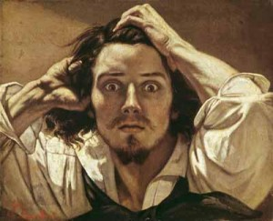
Thierri Vieira dos Santos
Composing sonnets terrify my head.
Because I ain no gift to rhyme or tell
how for a bonnie lass my heart has bled
an’ metrics are as difficult as hell.
Professors always scream to students’ ear:
“Iambic pentameter is the thing!”.
All English Poetry class is like this! Oh, dear!
So I get crabbit when professors sing:
“ba BUM ba BUM ba BUM ba BUM ba BUM!”
This should make any sense at all to me?
It always makes me wanna leave the room.
Metre is easy like trigonometry!
ba BUM ba BUM ba BUM ba BUM ba BUM!
Contempt against the iamb is my sole doom.

Slide 12
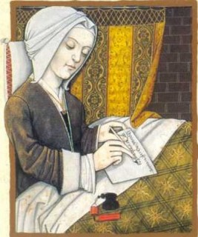
A bit of formal history…
Where did these formal features of poetry (metre, rhyme, alliteration, etc) come from?
When did they enter verse in English (or Scots)?

Slide 13
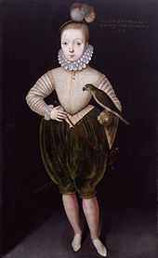
James VI of Scotland (1567 - 1625)
Ane Schort Treatise
Conteining Some
Reulis and Cautelis
to be Observit and
Eschewit in Scottis
Poesie (1584)

Slide 14
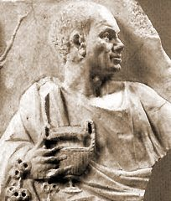
Horace, Ars Poetica (c. 18 BC)
89-98
The subject matter of comedy does not wish to find expression in tragic verses. […] Let each genre keep to the appropriate place allotted to it.

Slide 15
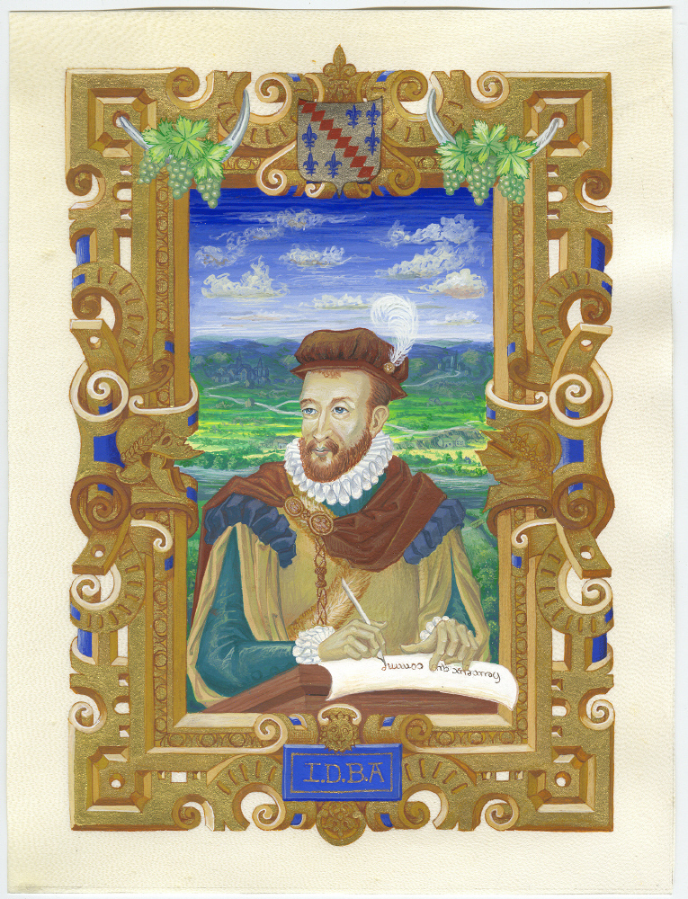
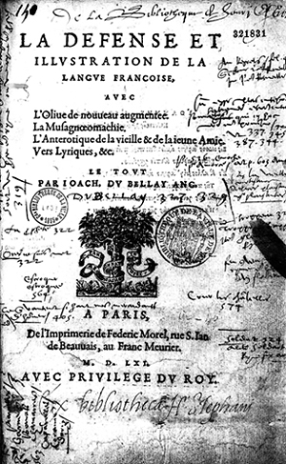
Influences: Joachim du Bellay (1549)

Slide 16
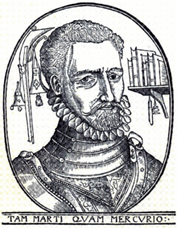
George Gascoigne, Certayne Notes of Instruction (1575)

Slide 17
From the Preface to the Reulis
The uther cause [of writing this essay] is that for thame that hes writtin in it [i.e. about poetic composition] of late, there hes never ane of thame writtin in our language. For albeit sindrie hes written of it in English, quhilk is lykest to our language, yit we differ from thame in sindrie reulis of poesie, as ye will find be experience.

Slide 18
Contents
Preface – James’ reasons for writing
1: poetic rhythm
2: quantity and length of syllables
3: appropriate vocabulary
4: figures of speech
5: repetition
6: originality
7: proper subjects for poetry/translation
8: rhyme schemes

Slide 19
From Chapter III (vocabulary)
Ye man also take heid to frame your wordis and sentencis according to the mater: as in flyting and invectives, your words be cuttit short and hurland over heuch. For thais quhilkis are cuttit short, I meane be sic wordis as thir,
Iis neir cair
for ‘I sall nevir cair,’ gif your subject were of love or tragedies, because in thame your words man be drawin lang, quhilkis in flyting man be short.

Slide 20
From Chapter III
Ye man lykewayis tak heid, that ye waill your wordis according to the purpose: as in ane heich and learnit purpose to use hiech, pithie and learnit wordis.
Gif your purpose be of love: to use commoun language with some passionate wordis.
Gif your purpose be of tragicall materis: to use lamentable wordis, with some hiech, as ravisht in admiratioun.

Slide 21
From Chapter III
Gif your purpose be of landwart effairis: to use corruptit and uplandis wordis.
And finally, quhatsumever be your subject, to use vocabula artis, quhairby ye may the mair vivelie represent that persoun quhais pairt ye paint out.
This is lykewayis neidfull to be usit in sentences, alsweill as in wordis: as, gif your subject be heich and learnit, to use learnit and infallible reasonis, provin be necessities

Slide 22
From Chapter III
Gif your subject be of love: to use wilfull reasonis, proceeding rather from passion nor reasoun.
Gif your subject be of landwart effaris; to use sklender reasonis mixt with grosse ignorance, nather keiping forme nor ordour. And sa furth, ever framing your reasons according to the quality of your subject.

Slide 23
From Chapter III
Let all your verse be literall, sa far as may be, quhatsumever kynde they be of, but specially tumbling verse for flyting. By ‘literall’, I meane that the maist pairt of your lyne sall rynne upon a letter, as this tumbling lyne rynnis upon ‘f’.
Fetching fude for to feid it fast furth of the farie.

Slide 24
Ana Paula Alves Patrocinio da Silva
Thy drame just like the cald of wynd goes by,
Thene life becums a darkly painful sore,
Jow rwn, jow bend, jow blede and so jow crye,
Jow wish and wait for houp to schow the dore.
[Your dream passes just like a cold wind/Then life becomes a darkly painful sore/You run, you bend, you bleed, and so you cry/You wish and wait for hope to show the door…]

Slide 25
‘Literall’ and decorous verse
He sees ane christall revere douce distell
About the bordour of ane medow fair,
Quhair flouris fresche maist savouruslie did smell
And monie seimlie frondise trie preclair
Obumbrat all this situation rair.
(John Stewart of Baldynneis, Roland Furious)

Slide 26
Chapter V (Repetition)
It is also meit for the better decoratioun of the verse to use sumtyme the figure of repetitioun, as:
Quhylis joy rang,
Quhylis noy rang. etc.
Ye sie this word ‘quhylis’ is repetit heir. This forme of repetitioun, sometyme usit, decoris the verse very mekle. Yea, quhen it cummis to purpose, it will be cumly to repete sic a word aucht or nyne tymes in a verse.

Slide 27
Chapter V
It is also meit for the better decoratioun of the verse to use sumtyme the figure of repetitioun, as:
Quhylis joy rang,
Quhylis noy rang. etc.
Ye sie this word ‘quhylis’ is repetit heir. This forme of repetitioun, sometyme usit, decoris the verse very mekle. Yea, quhen it cummis to purpose, it will be cumly to repete sic a word aucht or nyne tymes in a verse.

Slide 28
Chapter V
It is also meit for the better decoratioun of the verse to use sumtyme the figure of repetitioun, as:
Quhylis [whiles] joy rang,
Quhylis noy rang. etc.
Ye sie this word ‘quhylis’ is repetit [repeated] heir [here]. This forme of repetitioun, sometyme usit, decoris the verse very mekle. Yea, quhen [when] it cummis [cometh] to purpose, it will be cumly to repete sic [such] a word aucht [eight] or nyne tymes in a verse.

Slide 29
Chapter V in Action: Repetition
Haill, mirthfull May, the moneth full of joye!
Haill mother milde of hartsume herbes and floweres!
Haill fostrer faire of everie sporte and toye
And of Auroras dewis and summer showres!
Haill friend to Phoebus and his glancing [shining] houres!
Haill sister scheine [bright] to Nature breeding all…
(James VI)

Slide 30
From Chapter VII
Ye man also be war of wryting anything of materis of common weill or uther sic grave sene subjectis (except metaphorically; of manifest truth opinly knawin; yit nochtwithstanding using it very seindil) because nocht onely ye essay nocht your awin inventioun, as I spak before, bot lykewayis they are to grave materis for a poet to mell in…

Slide 31
From Chapter VII (Proper subjects)
Bot sen invention is ane of the cheif vertewis in a poete, it is best that ye invent your awin subject your self and not to compose of sene subjectis. Especially, translating of any thing out of uther language, quhilk doing, ye not only assay not your awin ingyne of inventioun, bot be the same meanes ye are bound as to a staik to follow that buikis phrasis, quhilk ye translate.

Slide 32
Amanda Cristina do Prado Silva
Urashima Taro
Are tales of ane fisherman in Japan
who lead ane modest life by the cold sea.
With just his old mother and older house
he lived his days in joyfully earned pece.
There was ane day when walking by the shore
Taro saved ane turtle from boys’ teasings,
and grateful was the sorry creature such
that in reward took him under the sea.

Slide 33
John Stewart of Baldynneis
SIR, haifing red Ʒour maiesteis maist prudent Precepts in the deuyn art of poesie, I haif assayit my Sempill spreit to becum Ʒour hienes scholler; Not that I am onnywais vorthie, Bot to gif vthers occasion (seing My Inexpertnes) to publiss thair better leirnyng. I grant In deid I haif mekill errit, Not onlie in electing of ane So small and fectless subiect, As als be the Inept orthographie
And Inlegebill scribling of my Imprompt pen, Bot maist of All in pithles and vnplesand framyng of the sam, Quhairin I haif playit the part of ane Ʒoung and Imperfyt prentes Quho at his first Interprys of schaiping takith not in
Hand the fynnest stuff Bot rather sum slycht cloth to Susteine the sklents and manks of his cunnyngles clipping; Remitting all to the courtassie, correction, and protection, of Ʒour maiesteis visdome, Not doutting bot Ʒour grace Vill accept this my vitles vork of Ʒour grayt clementie As my maist gratius Maister and chiefest lod Star…

Slide 34
Masculine Rhymes
That blessed houre, when first was broght to light
Our earthlie June and our gratious Queene,
Three goddesses how soone they had her seene
Contended who protect her shoulde by right.
(James VI)
Guid day, madam, with humyll thanks also,
That me unto your ludgeing lairge did gyd
Yea, skairs I knew quhan I thairin did go
Quhair I sould wend, the wallis war so wyd.
(John Stewart of Baldynneis)

Slide 35
‘Flowing’
First, ye man understand that all syllabis are devydit in thrie kindes: that is, some are schort, some lang and some indifferent. Be ‘indifferent’, I meane that quhilk are ather lang or schort, according as ye place thame.

Slide 36
‘Flowing’
The forme of placeing syllabes in verse is this. That your first syllabe in the lyne be short, the second lang, the thrid short, the fourt lang, the fyft short, the sixt lang and sa furth to the end of the lyne. Alwayis tak heid that the nomber of your fete in every lyne be evin and nocht odde: as four, six, aucht or ten: and nocht thrie, fyve, sevin or nyne, except it be broken verse, quhilkis are out of reul and daylie inventit be dyvers poetis. But gif ye wald ask me the reulis, quhairby to knaw every ane of thir thre forsaidis syllabes, I answer, ‘Your eare man be the onley judge and discerner thairof.’

Slide 37
Regular metre (‘flowing’)
Awake my muse and leave to dreame of loves,
Shake off soft fancies chaines || I must be free!
Ile perch no more upon the mirtle tree
Nor glide through th’aire with beauties sacred doves;
But with Jove’s stately bird || Ile leave my nest
And try my sight against Appolloes raies.
(Sir William Alexander)

Slide 38
Alexander Montgomerie
A Baxters bird, a bluiter beggar borne,
Ane ill heud huirsone lyk a barkit hyde,
A saulles swinger, sevintie tymes mensworne,
A peltrie pultron poyson’d up with pryde,
A treuthles tongue that turnes with eviry tyde,
A double deillar with dissait indeud,
A luikar bak whare he was bund to byde,
A retrospicien whom the Lord outspeud,
A brybour baird that mekle baill hes breud
Ane hypocrit, ane ydill atheist als,
A skurvie skybell for to be escheu’d
A faithles, fekles, fingerles and fals,
A Turk that tint Tranent for the Tolbuith.
Quha reids this riddil he is sharp forsuith

Slide 39
Alexander Montgomerie: ‘Flyting sonnet’
A Baxters bird, a bluiter beggar borne,
Ane ill heud huirsone lyk a barkit hyde,
A saulles swinger, sevintie tymes mensworne,
A peltrie pultron poyson’d up with pryde,
A treuthles tongue that turnes with eviry tyde,
A double deillar with dissait indeud,
A luikar bak whare he was bund to byde,
A retrospicien whom the Lord outspeud,
A brybour baird that mekle baill hes breud
Ane hypocrit, ane ydill atheist als,
A skurvie skybell for to be escheu’d
A faithles, fekles, fingerles and fals,
A Turk that tint Tranent for the Tolbuith.
Quha reids this riddil he is sharp forsuith

Slide 40
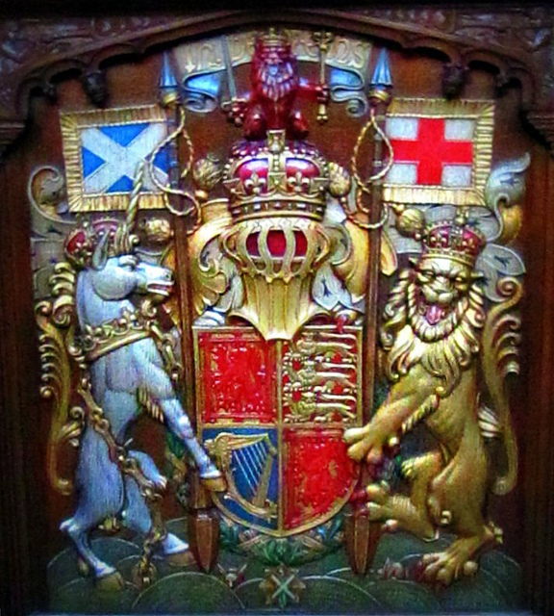
1603 and all that…

Slide 41
From ‘Forth Feasting’ (1617) William Drummond of Hawthornden
Ah why should Isis only see Thee shine?
Is not Thy FORTH, as well as Isis Thine?
Though Isis vaunt shee hath more Wealth in store,
Let it suffice Thy FORTH doth love Thee more:
Though Shee for Beautie may compare with Seine,
For Swannes and Sea-Nymphes with Imperiall Rhene,
Yet in the Title may bee claim'd in Thee,
Nor Shee, nor all the World, can match with mee.

Slide 42
Take home messages
In a time of deep political and religious strife, the young James VI takes time to compose a book of instruction on writing poetry.
We can read this as a bid to exert ‘soft power’, ie affirm cultural status for his own language and literature.
He draws upon various models (mainly French) for his formal theories.
He also seeks to constrain content – privileging ‘invention’ over political content or translation.
The result is a court literature that is generally quite mannered and conventional – but there are exceptions.
This flowering of renaissance literature in Scots is cut short by James VI’s accession to the throne of England.

Slide 43
Next task (Sept 8th)
EITHER
Write five characteristics of a Universal Language in a pleasingly baroque style.
OR
Write a short Scottish ballad (or part of one).
Further instructions are on moodle.

