Slide 1
500 years of Scottish Literature
02 William Dunbar & Robert Henryson

Slide 2
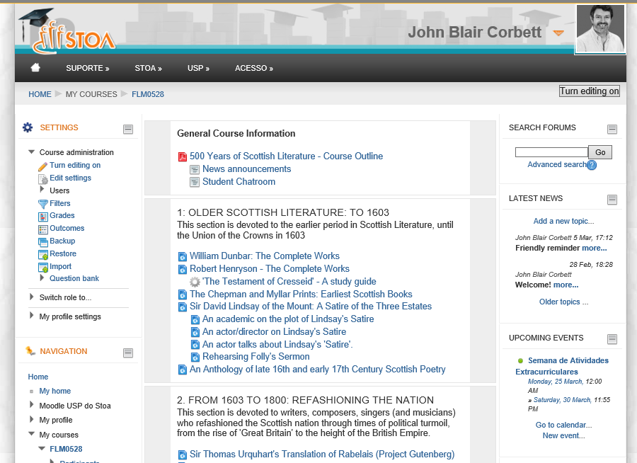
Are you moodled?

Slide 3
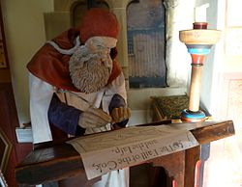
Today’s session
Getting used to the language of Older Scots
Using the online Dictionary of the Scots Language
Focus on two late 15th and early 16th century Scottish poets (or ‘makars’):
William Dunbar (c1459-c1517)
Cleric; poet at the court of James IV of Scotland
Robert Henryson (c1460-c1500)
Schoolmaster in Dunfermline

Slide 4
Goals of today’s session
Give you a taste of Older Scots poetry in different styles (high, plain & low)
Look closely at the Older Scots language, and resources to help you cope with its challenges.
Think about the function of poetry in Scotland before the Union of the Crowns (1603).

Slide 5
Do you recognise this story?
The samyn tyme happynnit ane wounderfull thing. Quhen Makbeth and Banquho war passand to Forress, quhair King Duncan wes for þe tyme, thai mett be þe gaitt thre weird sisteris or wiches, quhilk come to þame with elrege clething.
The first of þame sayid to Makbeth: ‘Haill, Thayne of Glammys!’ Þe secund sayid: ‘Hayill, Thayn of Cawder!’ The thrid sayid: ‘Haill, Makbeth, þat salbe sum tyme King of Scotland!’

Slide 6
Þan said Banquho: ‘Quhat wemen be ʒe, quhilkis bene sa vnmercifull to me and sa propiciant to my companʒeoun, gevand him nocht onlie landis and grete rentis bot als triumphand kingdome, and gevis me nocht?’

Slide 7
To this ansuerit þe first of þir wiches: ‘Wee schaw mair feliciteis appering to the þan to him; for þocht he happin to be ane king, ʒite his empyre sall end vnhappely, and nane of his blude sall eftir him succede.

Slide 8
Be contrair, þou sall neuer be king, bot of þe sall cum mony kingis, quhilkis with lang and anciant lynage sall reioise þe crovun of Scotland.’ Thir wourdis beand sayid, þai suddanlye evanyst oute of þair sycht.
[The Chronicles of Scotland, Compiled by Hector Boece, translated into Scots by John Bellenden, 1531; Book XII]

Slide 9
The Scottish Play (Act 1, Sc 3)
MACBETH So foul and fair a day I have not seen.
BANQUO
How far is't call'd to Forres? What are these So wither'd and so wild in their attire, That look not like the inhabitants o' the earth, And yet are on't? Live you? or are you aught That man may question? You seem to
understand me, By each at once her chappy finger laying Upon her skinny lips: you should be women, And yet your beards forbid me to interpret That you are so.

Slide 10
The Scottish Play (Act 1, Sc 3)
FIRST WITCH All hail, Macbeth! hail to thee, thane of Glamis!
SECOND WITCH All hail, Macbeth, hail to thee, thane of Cawdor!
THIRD WITCH All hail, Macbeth, thou shalt be king hereafter!

Slide 11
The story so far…
Early literature in many languages: Gaelic, Latin, Cumbric, Old English, Old Norse
From 1375, a literature in ‘Older Scots’ emerges – northern cousin of Middle English. Co-exists with literature in Latin & Gaelic
Older Scots becomes the dominant language of lowland Scotland. Its writers call it ‘Inglis’.

Slide 12
William Dunbar
Poet and cleric at the court of James IV
Writes for a court audience:
Religious celebrations, religious fantasies
Poems to mark special occasions (marriage)
Poems that satirise court life
Poems that satirise love & marriage
Poems of vitriolic and obscene abuse (flyting)
Poems asking the king for favours
A few meditative poems (headache, death)

Slide 13
Three styles in Middle Scots poetry
High style, eg poems of courtly celebration
Low style, eg satires, comic poems
Plain style, eg petitions, moralities
How is each style linguistically signalled? What would contemporary listeners/readers have picked up on?

Slide 14
From “Ane Ballat of Our Lady”
Hale, sterne superne, hale in eterne,
In Godis sicht to schyne,
Lucerne in derne for to discerne
Be glory and grace devyne,
Hodiern, modern, sempitern,
Angelicall regyne,
Our tern inferne for to dispern
Help, rialest rosyne.
Ave Maria gracia plena.
Haile, fresche floure femynyne,
Yerne us guberne, virgin matern,
Of reuth baith rute and ryne.

Slide 15
From “Ane Ballat of Our Lady”
Hale, sterne superne, hale in eterne,
In Godis sicht to schyne,
Lucerne in derne for to discerne Lamp in darkness, to see by
Be glory and grace devyne,
Hodiern, modern, sempitern, For this day, now, and forever
Angelicall regyne,
Our tern inferne for to dispern To ward off our pain in hell
Help, rialest rosyne.
Ave Maria gracia plena.
Haile, fresche floure femynyne,
Yerne us guberne, virgin matern, Govern us well, maternal virgin
Of reuth baith rute and ryne.

Slide 16
Analysing lexis (vocabulary)
What is the origin of the words? Pay particular attention to the presence of latinisms, northernisms, and words whose origins are obscure (ie slang).
What semantic areas do the words fall into? Are the areas largely positive (eg HOLINESS, PURITY, LIGHT) or negative (eg VICE, DARKNESS, etc)?
Do the words increase the semantic density of the language (ie are they decorative?) or do they increase its semantic range (ie are they learned, technical?)?
As far as we can gather from references (eg www.dsl.ac.uk ) were the words new and surprising or common and everyday?

Slide 17
Statistics…
Average frequency of latinisms in Dunbar’s poetry: 12.9%
Frequency of latinisms in “Ane Ballat of Our Lady”: 31.1%
However, the type of latinism used is at least as important as the frequency of use.

Slide 18
Semantic range and depth
Latinisms used to introduce new concepts to Scots increase the semantic range of Scots.
Latinisms used for decorative purposes, where a native Scots (OE/ON) term is available, increase its semantic depth.
How would you describe ‘regyne’?

Slide 19
Aureate vocabulary
Aureate (golden/gilded) vocabulary is often latinate in origin
Aureate vocabulary includes native (OE/ON) terms that have positive associations, of light, beauty, wealth, etc, eg ‘sterne’ (star; ON stjarna)

Slide 20
Grammar as a style indicator
What is the relationship of the poetic line to the grammatical sentence?
Are long and complex sentences markers of the high style?
Are short, simple sentences markers of the low style?

Slide 21
“The Thrissil and the Rois”
Quhen Merche wes with variand windis past,
And Appryll had with hir silver schouris
Tane leif at Nature with ane orient blast,
And lusty May, that muddir is of flouris,
Had maid the birdis to begyn thair houris 5
Amang the tendir odouris reid and quhyt,
Quhois armony to heir it wes delyt:
In bed at morrow, sleiping as I lay,
Me thocht Aurora with hir cristall ene
In at the window lukit by the day 10
And halsit me, with visage paill and grene;
On quhois hand a lork sang fro the splene,
“Awalk, luvaris, out of your slomering!
Se how the lusty morow dois up spring.”

Slide 22
Parallelism
“A characteristic of high style was the use of parallelism – the repetition of a grammatical structure expecially within a stanza.”
-- Alex Agutter (1988: 20)

Slide 23
Parallelism: ‘The Thrissil and the Rois’
This awfull beist full terrible wes of cheir,
Persing of luke and stout of countenance,
Rycht strong of corpis, of fassoun fair but feir,
Lusty of schaip, lycht of deliverance,
Reid of his cullour as is the ruby glance.
On feild of gold he stude full mychtely,
With flour delycis sirculit lustely.

Slide 24
Parallelism: ‘The Thrissil and the Rois’
This awfull beist A wes of B,
C of D and E of F,
Rycht G of H; of I, J but [= without] K,
L of M, N of O,
P of his Q as is R.
On feild of gold he stude full mychtely,
With flour delycis sirculit lustely.

Slide 25
Are parallelisms really a style marker?
We find them in high style poems
We find them in plain style meditations
We find them in low style flyting…
…so no, parallelism is a marker of Dunbar’s style throughout his oeuvre.

Slide 26
Other high style markers
Anglicisation, eg ‘lork’ (lark) in ‘The Thrissil and the Rois’ (hypercorrection on the analogy of ‘from’<‘fra’)
Rhyme schemes (high style complex; plain and low styles, simpler)
Topic: fitting of style to subject matter as matter of rhetorical appropriacy (cf Horace through to James VI)

Slide 27
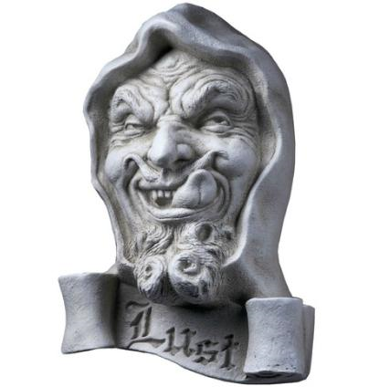
Low style: ‘The Dance of the Sevin Deidly Sins’
Than Lichery, that lathly cors,
Come berand lyk a bagit hors,
And Lythenes did him leid.
Thair wes with him ane ugly sort
And mony stynkand fowll tramort
That had in syn bene deid.

Slide 28
Low style: “Dance of the Sevin Deidly Sins”
Average frequency of latinisms in Dunbar’s poetry: 12.9%
Frequency of latinisms in “Dance of the Sevin Deidly Sins”: 6.3%
Those latinisms present have negative associations (yre, malyce, dissymlit, fals, vice, monstir, unsasiable…)
Some latinisms would have been common and increased semantic range, eg ‘monstir’

Slide 29
Northernisms in ‘The Dance’
High frequency of northernisms (ON), eg
graith (prepare, ON greida)
rumpillis (tails, from ME rump, of Scand origin)
ockeraris (usurers, from ME; cf Scand okr, usury)
midding (midden, ME from ON mykidlyngja)

Slide 30
Grammar
Some features of ellipsis (omission of grammatical elements, eg verb, pronoun)
Than Lichery that lathly cors
Berand lyk an bagit hors
And Lythness did him leid.

Slide 31
Grammar
Some features of ellipsis (omission of grammatical elements, eg verb, pronoun)
Than Lichery that lathly cors [entered]
Berand [himself] lyk an bagit hors
And Lythness did him leid.

Slide 32
Grammar
But complex constructions are evident too:
Na menstrallis playit to thame but dowt
For glemen they were halden owt
Be day and eik by nicht –
Except a menstrall that slew a man;
Swa till his heritage he wan
And enterit be breif of richt.

Slide 33
Other markers of low style
Absence of anglicisation
Simple rhyme schemes, eg ‘Dance of Sevin Deidly Sins’ has aabaab, allowing two line couplet plus comment on ‘b’ rhymes:

Slide 34
Rhyme scheme & discourse structure
Full mony a waistless wallydrag
With wamys unweildable did furth wag
In creische they did incres:
Drynk! ay thay cryit, with mony a gaip –
The feyndis gaif thame hait leid to laip –
Their lovery wes na les.

Slide 35
The Plain Style
“a dustbin for the residue from other more clearly definable styles” (Macafee 1981: 368)
Often described in terms of absences (no ornate latinisms, few obvious northernisms, little slang…)
But substantial in number: petitionary poems amount to about 25% of Dunbar’s surviving work

Slide 36
The Plain Style
Plain style poetry can be characterised positively in terms of the rhetorical strategies used to convey:
directness
authority
Two plain style poems: ‘Of Discretioun in Geving’ and ‘Of Discretioun in Asking’

Slide 37
Discretioun in Asking
[In asking sowld discretioun be] Of every asking followis nocht Rewaird, bot gif sum caus war wrocht; And quhair caus is, men weill ma sie, And quhair nane is, it wil be thocht: In asking sowld discretioun be.

Slide 38
Discretioun in Geving
[In geving sowld discretioun be] To speik of gift or almous deidis: Sum gevis for mereit and for meidis, Sum, warldly honour to uphie, Gevis to thame that nothing neidis. In geving sowld discretioun be.

Slide 39
Vocabulary
Average frequency of latinisms in Dunbar’s poetry: 12.9%
Frequency of latinisms in “Of Discretioun in Geving”: 26.1%
But…the latinisms mainly increase semantic range, eg discretioun, caus, service, convenient, cure, honour, suppois, remedy, fortoun Associations are legal/ecclesiastical

Slide 40
Northernisms
Common, everyday northernisms, eg crakkis [boasts], hudpyk [miser], tynes [loses]
Combination of learned latinisms and blunt everyday vocabulary give an air of authority and directness.

Slide 41
Grammar: parallelisms again
Sum gevis for pryd and glory vane, Sum gevis with grugeing and with pane, Sum gevis, in practik, for supplé, Sum gevis for twyis als gud agane. In geving sowld discretioun be.

Slide 42
Other markers of plain style
Short, tetrameter lines
Simple rhyme schemes

Slide 43
Need for negotiation of authority
Sum givis to strangeris with faces new, That yisterday fra Flanderis flew, And to awld servandis list not se, War thay nevir of sa grit vertew. In geving sowld discretioun be.
What kind of authority is being negotiated between poet, patron and (court) audience?

Slide 44
Summary: Things to pay attention to…
Vocabulary (Latinate/French, Germanic?)
Grammar…with caution
Rhyme schemes
Degree of Anglicisation
How style is matched to topic.

Slide 45
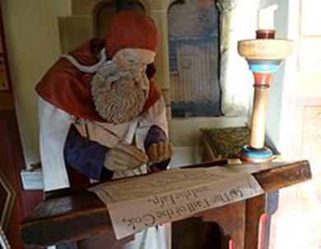
Part 2: Robert Henryson
‘Maister’ Robert Henryson
Taught at Glasgow University
Schoolmaster in Dunfermline
Notary public
Writes for a different set of audiences:
Versions of Aesop’s fables
Neo-classical tragedies (Orpheus, Cresseid)

Slide 46
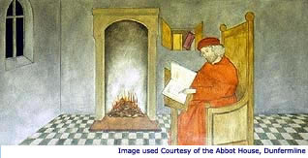
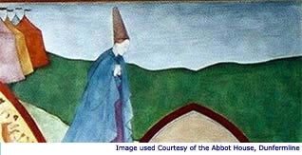
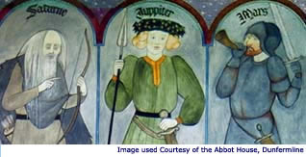
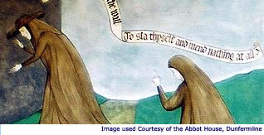
‘The Testament of Cresseid’: the plot

Slide 47
Paying attention to the language
Ane doolie sessoun to ane cairfull dyte
Suld correspond and be equivalent:
Richt sa it wes quhen I began to wryte
This tragedie: the wedder richt fervent,
Quhen Aries, in the middis of Lent,
Schouris of haill gart fra the north discend,
That scantlie fra the cauld I micht defend.

Slide 48
Patterning of romance terms
Formal, ‘legalistic’ or ‘technical’ terms
Fairly well-established in the language before Henryson
That is, not decorative, ‘aureate’ vocabulary or neologisms.
Note switch to monosyllabic ‘everyday’ words in the third line.

Slide 49
Rhyme Royal
Ane doolie sessoun to ane cairfull dyte
Suld correspond and be equivalent:
Richt sa it wes quhen I began to wryte
This tragedie: the wedder richt fervent,
Quhen Aries, in the middis of Lent,
Schouris of haill gart fra the north discend,
That scantlie fra the cauld I micht defend.
ababbcc: rhyme royal

Slide 50
Intertextuality through rhyme
Rhyme royal is the stanza form used in:
Chaucer’s Troilus and Cressida
James I’s The Kingis Quair (Boethian theme)

Slide 51
George Gascoigne (1575) on ‘rhythm royal’
Rythme royall is a verse of tenne sillables, and seuen such verses make a staffe, whereof of the first and thirde lines do aunswer (acrosse) in like terminations and rime, the second, fourth, and fifth do likewise answere eche other in terminations, and the two last do combine and shut vp the Sentence: this hath bene called Rithme royall, and surely it is a royall kinde of verse, seruing best for graue discourses.
Certayn Notes of Instruction concerning the Making of Verse or Rime in English

Slide 52
Note the change in metre in Cresseid’s ‘Complaint’
‘O sop of sorrow, sonkin into cair!
O cative Cresseid, now and ever mair,
Gane is thy joy and all thy mirth in eird;
Of all thy blythnes now art thou blaiknit bair.
Thair is na salve may saif or sound thy sair.
Fell is thy fortoun, wickit is thy weird.
Thy blys is baneist and thy baill on breird.
Under the eirth, God, gif I gravin wer,
Quhair nane of Grece nor yit of Troy micht heird!
‘Complaint’ stanza: aabaabbab (59-65)

Slide 53
Intertextuality through rhyme II: Other complaints
Chaucer, eg ‘The Complaint to Pity’
Other complaints, eg ‘The Lufaris Complaint’ (in same MS collection as ‘The Kingis Quair’)
"The Lufaris Complaynt" is a complaint in the tradition of such poems, whose matter originated in the forms of legal complaint. These poems became so common that the term "Complaint" came to be used for a lyric or verse form practiced in both France and England in the Middle Ages…
-- http://www.lib.rochester.edu/camelot/teams/lcintro.htm

Slide 54
Rhetorical shifts in the poem
Frame narrative
Cresseid’s ‘backstory’ & return home
Judgement of the gods
Cresseid’s sickness & departure
Cresseid’s complaint
Encounter between Cresseid and Troilus
The testament of Cresseid

Slide 55
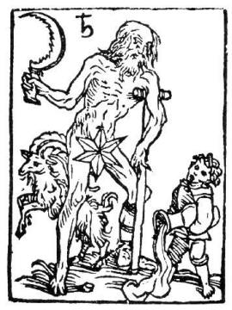
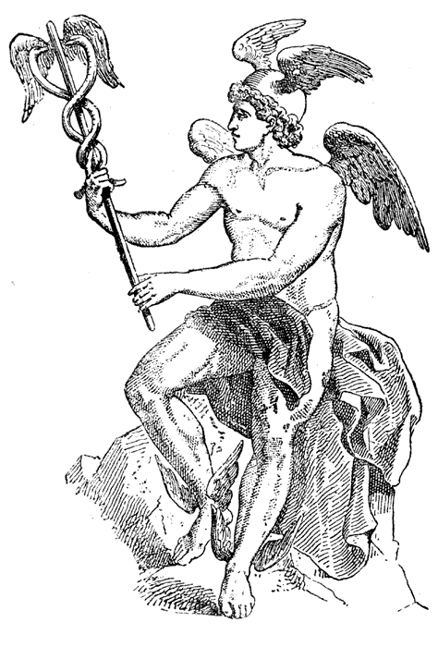
Two of the gods: Saturn and Mercury

Slide 56
The judgement of the gods: a rhetorical tour de force
Saturn, oldest of the Gods:
His face fronsit, his lyre was lyke the leid, wrinkled, complexion
His teith chatterit and cheverit with the chin, shivered
His ene drowpit, how sonkin in his heid, eyes
Out of his nois the meldrop fast can rin; mucous
With lippis bla and cheikis leine and thin, blue
The ice shoklis that fra his hair doun hang icicles
Was wonder greit and as ane spear als lang.

Slide 57
Switching styles: the portrait of Mercury
With buik in hand than come Mercurius,
Richt eloquent and full of rhetorie
With polite termis and delicious,
With pen and ink, to report all reddie
Setting sangis and singand merrilie;
His hude was reid, heklit atouir his croun
Lyke to a poeit of the auld fassoun.

Slide 58
Switching styles: the portrait of Mercury
Thus quhen thay gadderit war thir goddes sevin,
Mercurius thay cheisit with ane assent
To be foirspeikar in the parliament.
Quha had bene thair and liken for to heir
His facound toung and termis exquisite,
Off rhetorik the prettick he micht leir
In breif sermone ane pregnant sentence wryte.

Slide 59
The portrait of an eloquent poet-god
Thus quhen thay gadderit war thir goddes sevin,
Mercurius thay cheisit with ane assent
To be foirspeikar in the parliament.
Quha had bene thair and liken for to heir
His facound toung and termis exquisite,
Off rhetorik the prettick he micht leir
In breif sermone and pregnant sentence wryte.

Slide 60
Summary
It has been argued that Henryson’s stylistic technique in this poem accords with his portrait of Mercury:
Learned
Eloquent
Brief (‘concise’)
Witty
But it has also been noted that Mercury, the spokesman of the gods, is a dubious figure (a doctor…or quack?) who is charged with delivering the verdict on Cresseid.

Slide 61
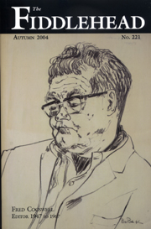
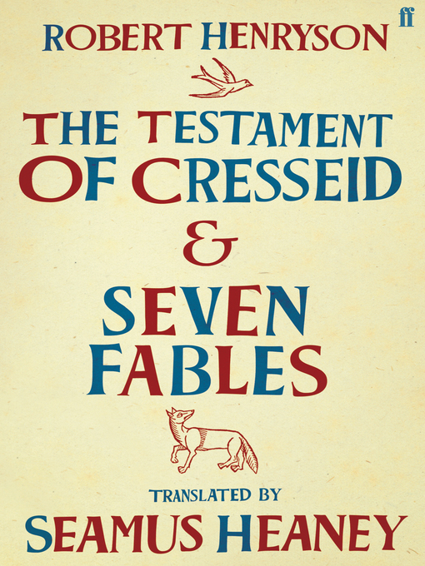
Translating ‘The Testament’

Slide 62
The Testament of Cresseid
“I change thy mirth into Melancholy
Quhilk is the Mother of all pensivenes
Thy Moisture and thy heit in cald and dry
Thyne Insolence, thy play and wantones
To greit diseis; thy Pomp and thy riches
In mortall neid; and greit penuritie
Thou suffer sall, and as ane beggar die.”

Slide 63
The Testament of Cresseid
O cruell Saturne! Fraward and angrie
Hard is thy dome, and to malitious;
On fair Cresseid quhy hes thou na mercie
Quhilk was sa sweit, gentill and amorous?
Withdraw thy sentence and be gracious
As thou was never; so schawis thow thy deid,
Ane wraikfull sentence gevin on fair Cresseid.

Slide 64
Carla Possati (2013)
I change your mirth into melancholy
Which is the mother of all thoughtfulness
Your moisture and your heat into cold and dry
Your insolence, your play and wantonness
Into great disease; your pomp and your riches
Into mortal need; and great penury
You shall suffer, and as a beggar die.

Slide 65
Micael Dattoli (2013)
"I'll turn your joy into depression
To make you think on the wrong you did
Your hydrated warm body I'll turn cold and dry
Arrogant lady, controlled by your Id,
you'll be just diseased. Your chic and rich life,
I'll transform into need and much lack,
you'll suffer and beg, and die just like that."

Slide 66
Cogswell (1957)
“Your Mirth I darkly change to Melancholy,
Which is the Mother of all thoughtfulness
Your heat and youthful blood to cold and dry;
Your insolence, your play, your wantonness
Shall all be swallowed up in sick distress;
Your pomp shall starve on crusts of beggar’s bread
And Potter’s Field shall hold you when you’re dead.”

Slide 67
Cogswell (1957)
Rough Saturn, cruel and angry God indeed,
Too hard and too malicious is your doom.
O why showed you no mercy to Cresseid
Who was so frail, so sweet, so soft a bloom?
Withdraw your verdict and give grace room
In you as never was, who by your deed
A vengeful sentence gave to fair Cresseid.

Slide 68
Heaney (2002)
“Your mirth I hereby change to melancholy
Which is the mother of all downcastness
Your moisture and your heat to cold and dry,
Your lust, presumption and your giddiness
To great disease; your pomp and show and
riches
To fatal need; and you will suffer
Penury extreme and die a beggar.”

Slide 69
Heaney (2002)
O cruel Saturn, ill natured and angry,
Your doom is hard and too malicious
Why to fair Cresseid won’t you show mercy
Who was so loving, kind and courteous?
Withdraw your sentence and be gracious –
Who never have been: it shows in what you
did,
A vengeful sentence passed on poor
Cresseid.

Slide 70
What is ‘fidelity’?
To rhyme?
To metre?
To sense (what is added/taken away)?

Slide 71
Metre
O cruell Saturne! Fraward and angrie
Hard is thy dome, and to malitious;
Rough Saturn, cruel and angry God indeed,
Too hard and too malicious is your doom.
O cruel Saturn, ill natured and angry,
Your doom is hard and too malicious

Slide 72
End rhymes
Melancholy Melancholy melancholy
pensivenes thoughtfulness downcastness
dry dry dry
wantones wantonness giddiness
riches distress riches
penuritie bread suffer
die dead beggar
ababbcc
(ababbaa)

Slide 73
End rhymes
angrie indeed angry
malitious doom malicious
mercie Cresseid mercy
amorous bloom courteous
gracious room gracious
deid deed did
Cresseid Cresseid Cresseid

Slide 74
Sense: Choosing meanings
I change thy mirth into Melancholy
Quhilk is the Mother of all pensivenes
Your Mirth I darkly change to Melancholy,
Which is the Mother of all thoughtfulness
Your mirth I hereby change to melancholy
Which is the mother of all downcastness

Slide 75
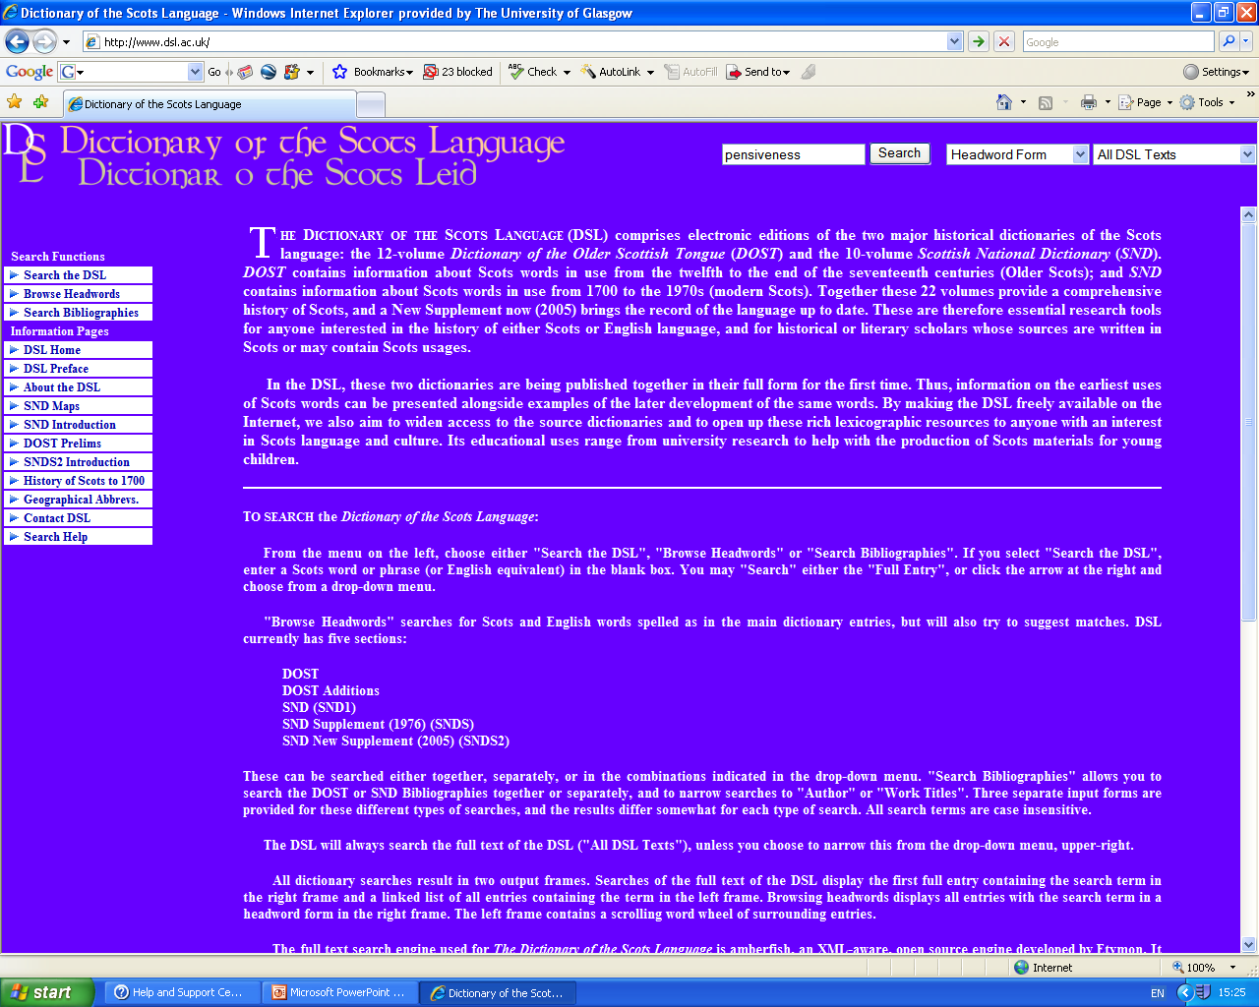

Slide 76
DSL ‘pensive’
DSL - DOST Pensive, -if, a. Also: -yve, -iwe, -iff(e, -yf(e, -eif. [ME. and e.m.E. pensyf(e (Piers Plowman), e.m.E. pensive, F. pensif, -ive f. penser, PENS v. Cf. PANSIVE.] Full of thought, thoughtful, meditative; esp., full of gloomy or anxious thoughts, mournfully serious, melancholy.

Slide 77
pensiveness
EITHER the condition of being
Full of thought, thoughtful, meditative;
OR
full of gloomy or anxious thoughts mournfully serious, melancholy.
i.e.
EITHER ‘thoughtfulness’ OR ‘downcastness’

Slide 78
Sense: Adding meaning
…and greit penuritie
Thou suffer sall, and as ane beggar die.”
Your pomp shall starve on crusts of beggar’s bread
And Potter’s Field shall hold you when you’re dead.”
and you will suffer
Penury extreme and die a beggar.”

Slide 79
Potter’s Field
Matthew Chapter 27 3 Then Judas, which had betrayed him, when he saw that he was condemned, repented himself, and brought again the thirty pieces of silver to the chief priests and elders, 4 Saying, I have sinned in that I have betrayed the innocent blood. And they said, What is that to us? see thou to that. 5 And he cast down the pieces of silver in the temple, and departed, and went and hanged himself. 6 And the chief priests took the silver pieces, and said, It is not lawful for to put them into the treasury, because it is the price of blood. 7 And they took counsel, and bought with them the potter's field, to bury strangers in. 8 Wherefore that field was called, The field of blood, unto this day.

Slide 80
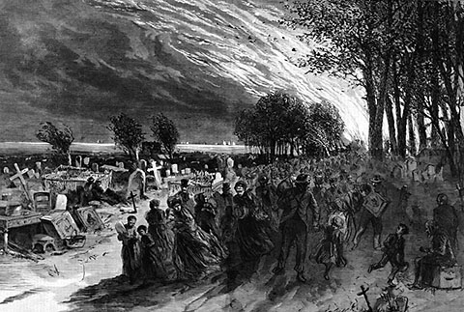
Print of Potter’s Field, Chicago (1871)

Slide 81
Thy Moisture and thy heit in cald and dry
Thyne Insolence, thy play and wantones
To greit diseis…
Your heat and youthful blood to cold and dry;
Your insolence, your play, your wantonness
Shall all be swallowed up in sick distress;
Your moisture and your heat to cold and dry,
Your lust, presumption and your giddiness
To great disease;

Slide 82
DSL on ‘moisture’
b. Designating the humid property in medieval physiology. I change ... Thy moisture and thy heit in cald and dry; Henr. Test. Cress. 318. Her natural heat and radical moisture seem to be equally balanced; Kirk Secr. Commonw. (1964) 282.

Slide 83
OED on ‘radical moisture’
1. a. radical humidity, humour, moisture, sap: In mediæval philosophy, the humour or moisture naturally inherent in all plants and animals, its presence being a necessary condition of their vitality. So radical heat.

Slide 84
And grammar…
O cruell Saturne! Fraward and angrie
Hard is thy dome, and to malitious;
On fair Cresseid quhy hes thou na mercie
Quhilk was sa sweit, gentill and amorous?
Withdraw thy sentence and be gracious
As thou was never; so schawis thow thy deid,
Ane wraikfull sentence gevin on fair Cresseid.

Slide 85
Cogswell
Rough Saturn, cruel and angry God indeed,
Too hard and too malicious is your doom.
O why showed you no mercy to Cresseid
Who was so frail, so sweet, so soft a bloom?
Withdraw your verdict and give grace room
In you as never was, who by your deed
A vengeful sentence gave to fair Cresseid.

Slide 86
Heaney
O cruel Saturn, ill natured and angry,
Your doom is hard and too malicious
Why to fair Cresseid won’t you show mercy
Who was so loving, kind and courteous?
Withdraw your sentence and be gracious –
Who never have been: it shows in what you
did,
A vengeful sentence passed on poor
Cresseid.

Slide 87
Summary
A comparison between source text and translation can focus attention on source and target cultures. We pay attention to:
Formal decisions (eg rhyme, metre)
Content (changes in meaning, references that have been added, or subtracted)
Discourse structures: how the reader is positioned with respect to the text

Slide 88
Your translations
Check out the translations of your classmates on moodle.
Did anybody handle vocabulary, rhyme and metre particularly well?

Slide 89
Follow-up resource on moodle

