Slide 1
Silage & Hay Additives
Luiz Gustavo Nussio, Professor
Department of Animal Sciences

Slide 2
Silage additives
nussio@usp.br

Slide 3
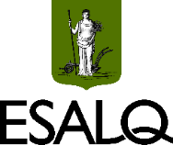

Slide 4
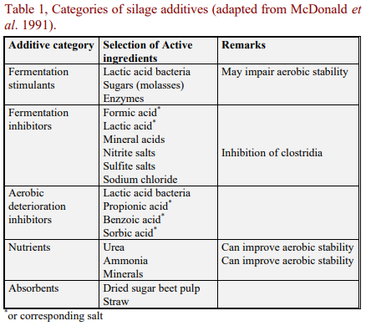
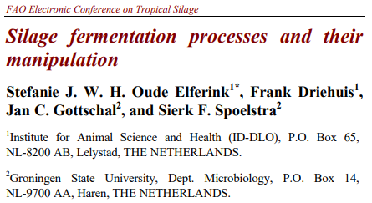

Slide 5
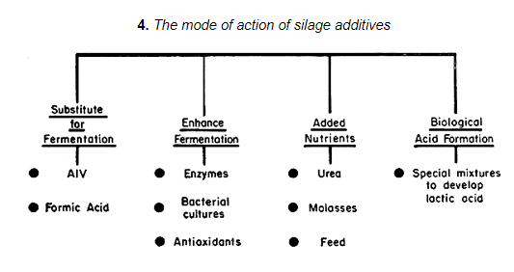

Slide 6
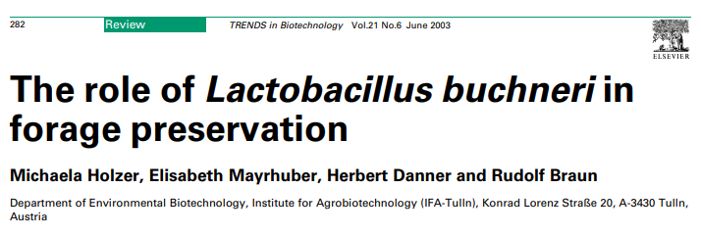
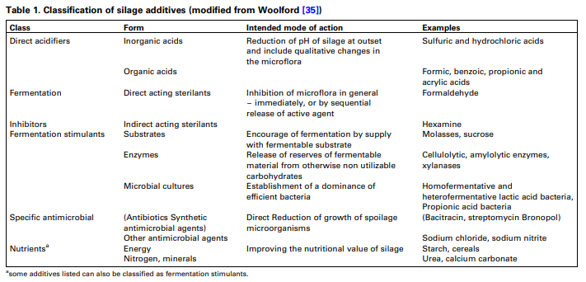

Slide 7
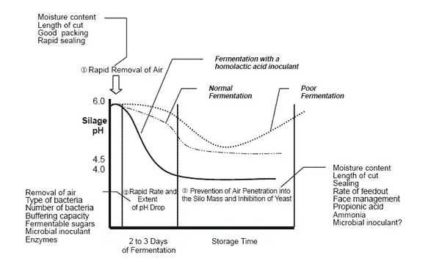

Slide 8
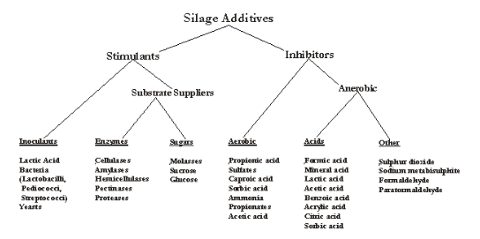

Slide 9
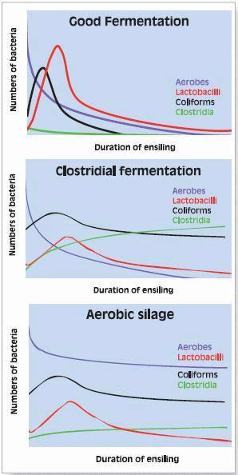

Slide 10
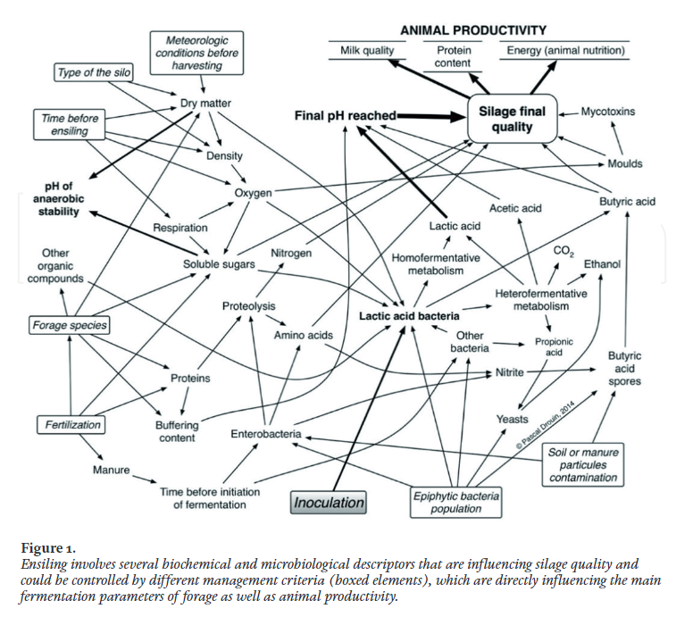
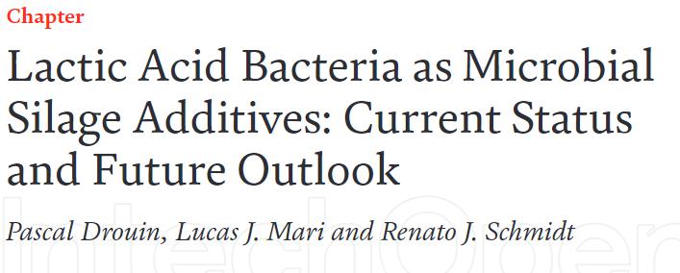

Slide 11
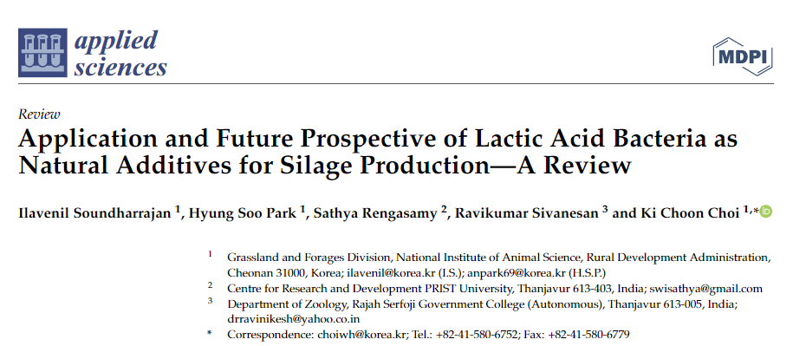

Slide 12
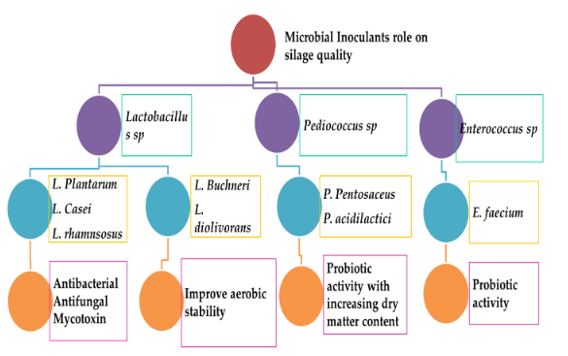

Slide 13
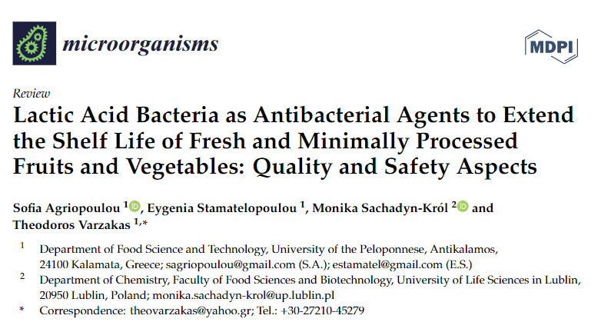

Slide 14
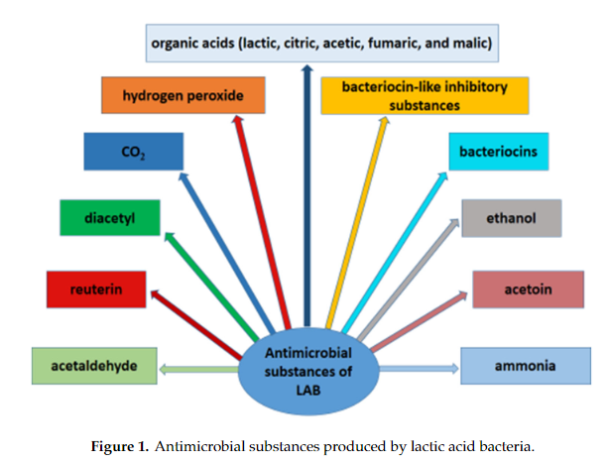

Slide 15
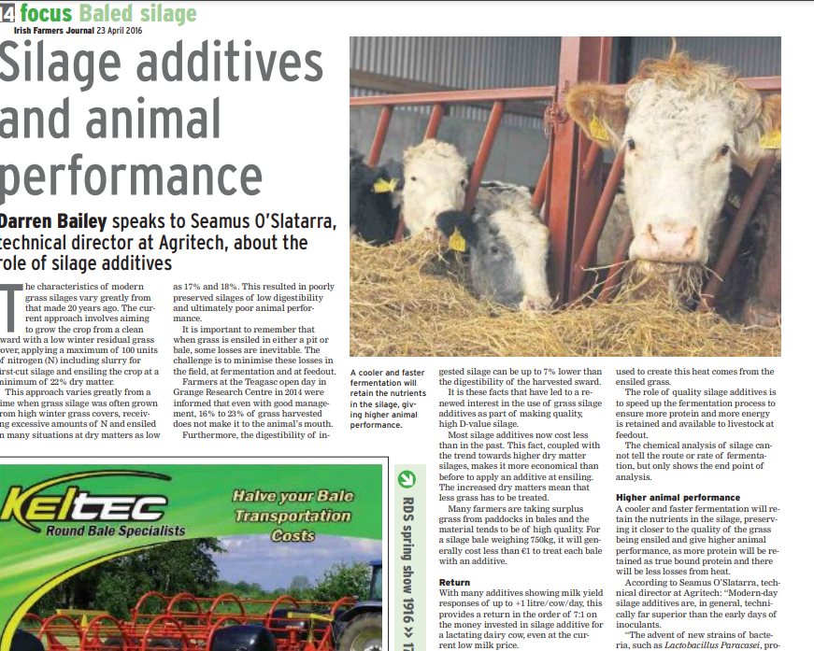

Slide 16
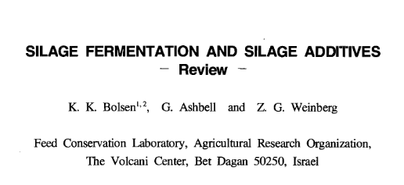
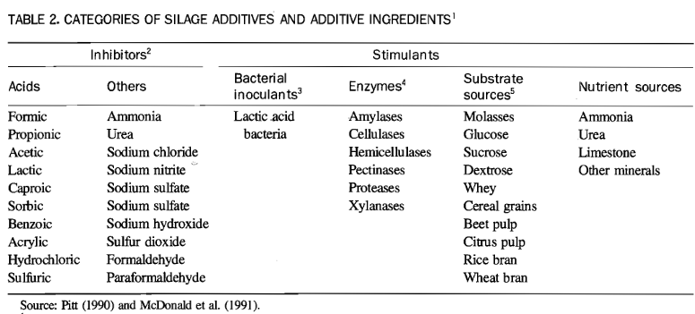

Slide 17
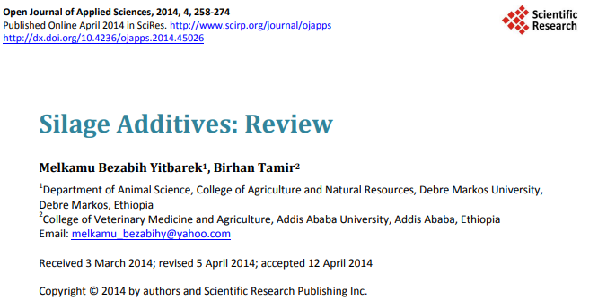
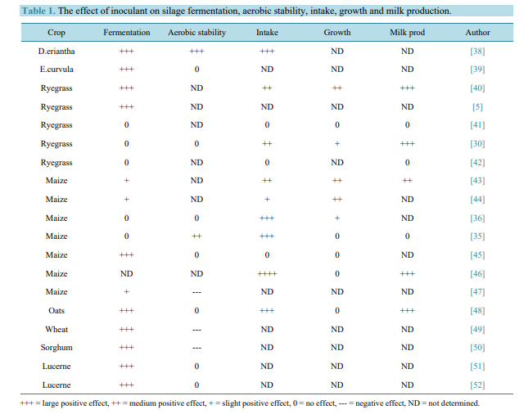

Slide 18
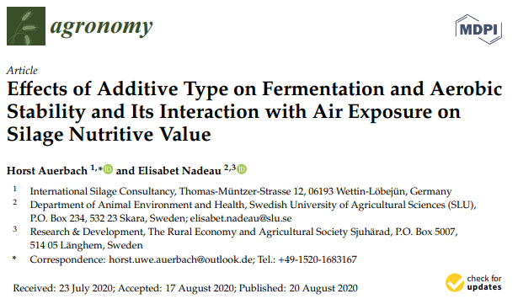
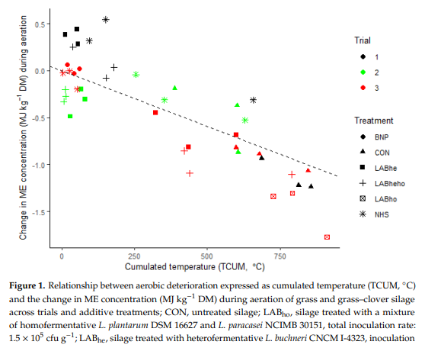

Slide 19
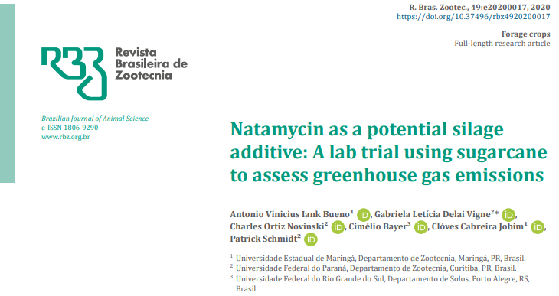
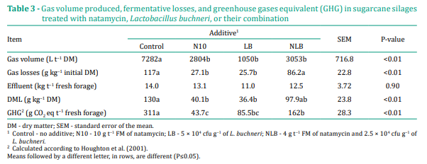

Slide 20
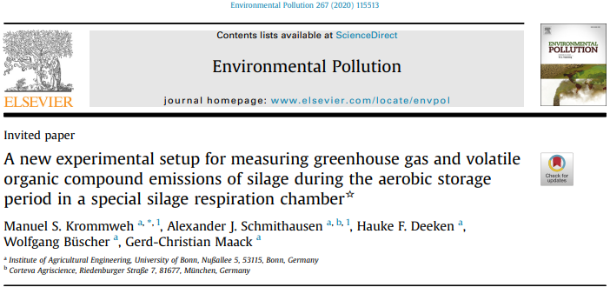
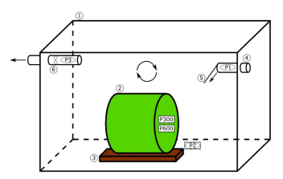
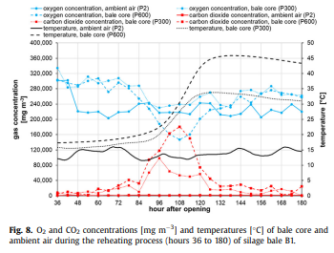

Slide 21
“Chemical additives should provide a more consistent return on investment than inoculants because chemical additives are less dependent on biological processes during ensiling. However, the higher initial cost compared with that of inoculants may be a barrier to adoption by producers.
Thus, finding new compounds or mixtures of the current ones that lower
product cost while maintaining good antifungal activity is of the greatest importance.”

Slide 22
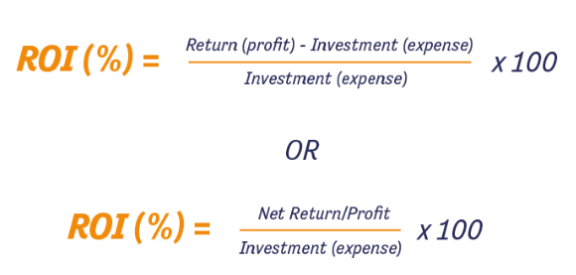

Slide 23
Silage additives = Return on investments (ROI)
Silo
Animal
Meat & Milk
Environment
Fermentation
DM recovery
Microbial and chemical profile
Volatile
Aerobic stability
DM recovery
Heat
Yeasts
ADG
Milk Yield
Health
Probiotic
Feed conversion
Mycotoxin
GHG
Carcass
Water
Fooprint
ROFC
Fat profile
FCM
Pollution
Effluent

Slide 24
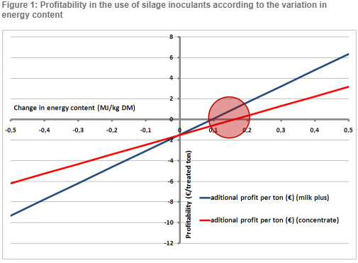

Slide 25
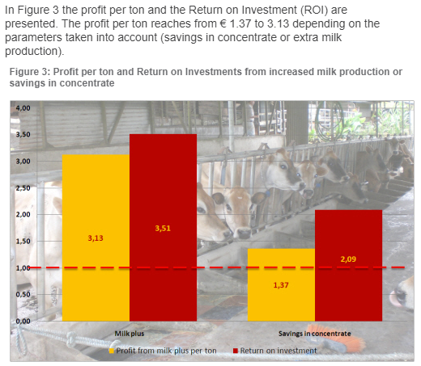

Slide 26
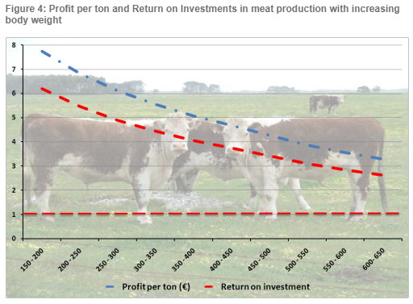

Slide 33
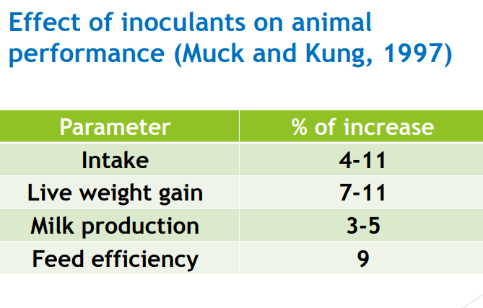

Slide 37
Hay additives/preservatives
nussio@usp.br

Slide 38
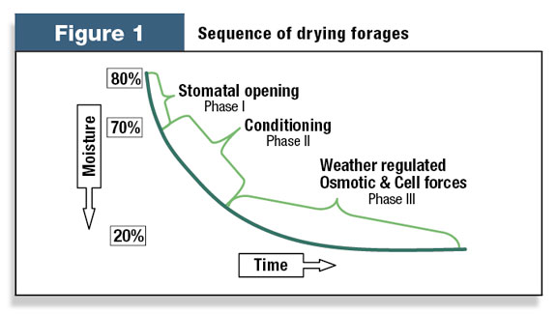
Kinetics of hay drying

Slide 39
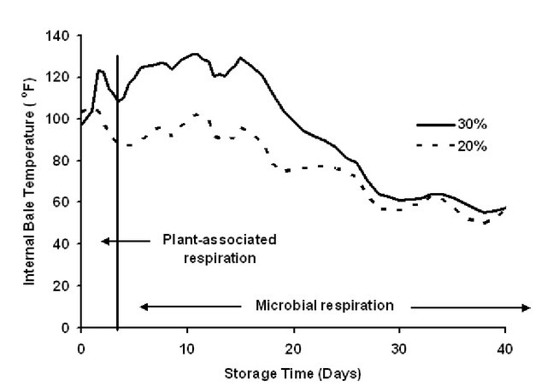

Slide 40
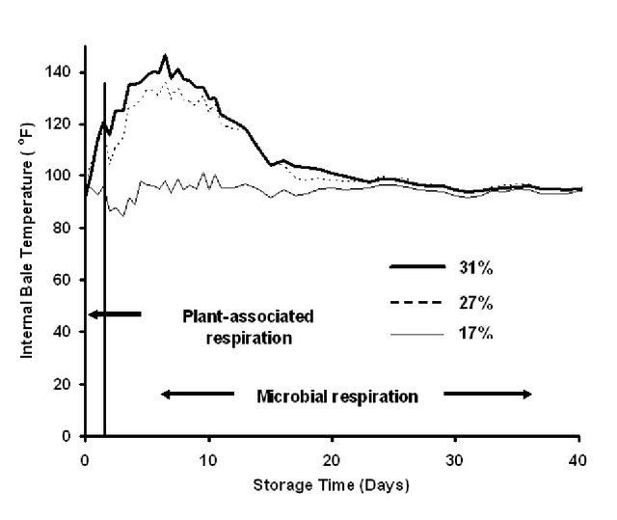

Slide 41
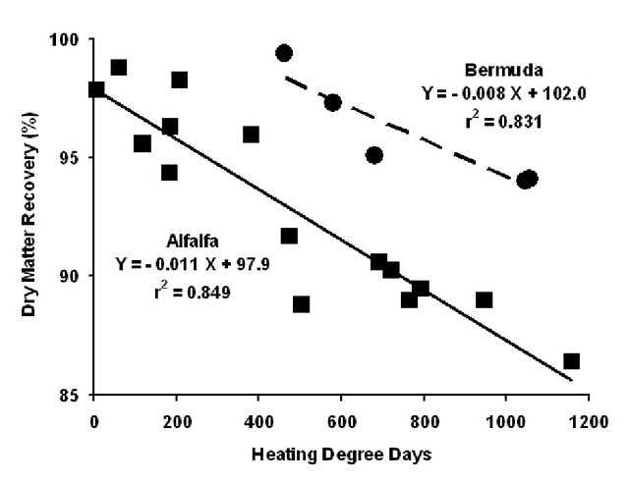

Slide 42
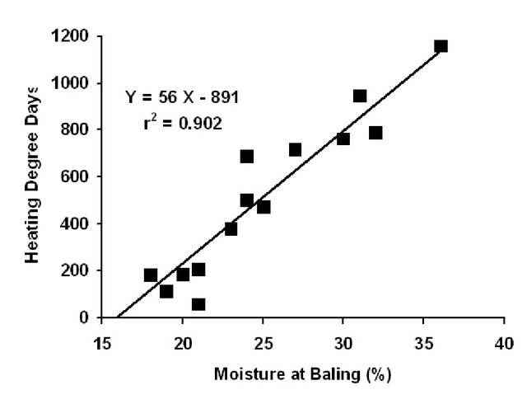

Slide 43
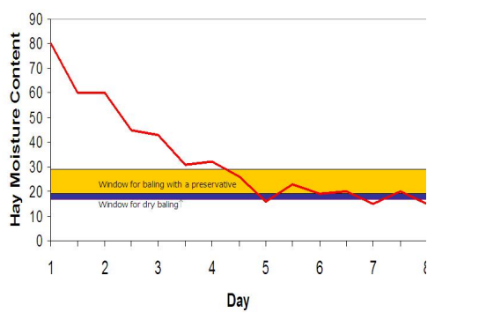
https://www.gov.mb.ca/agriculture/crops/crop-management/forages/pubs/additives_cfia_list.pdf

Slide 44
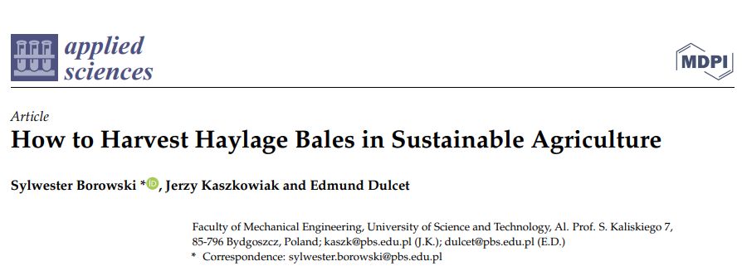

Slide 45
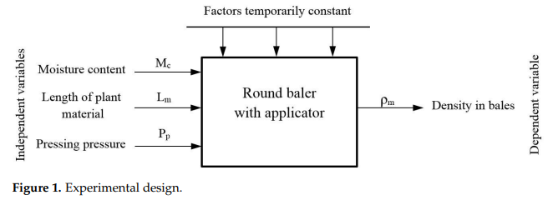

Slide 46
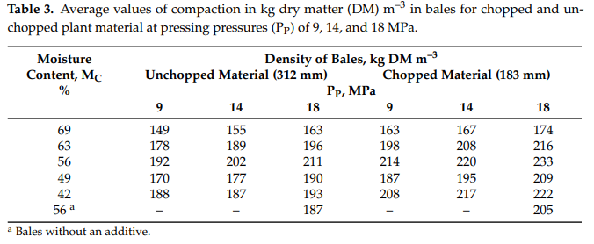

Slide 47
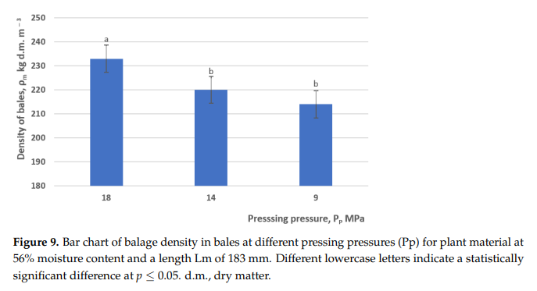
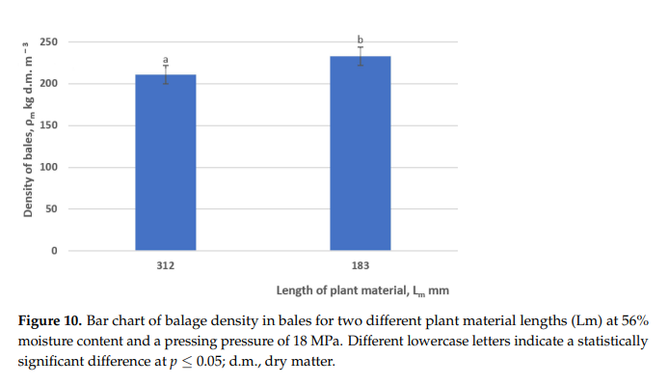

Slide 48
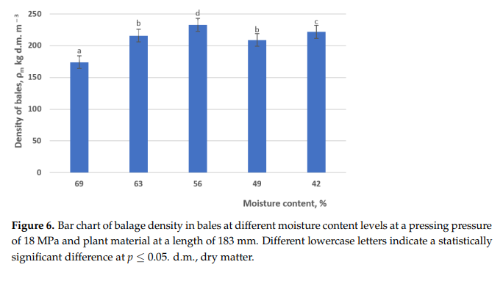

Slide 49
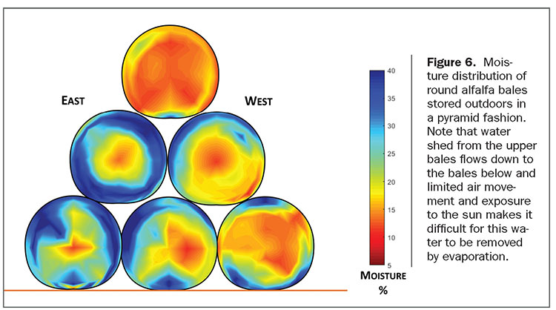

Slide 50
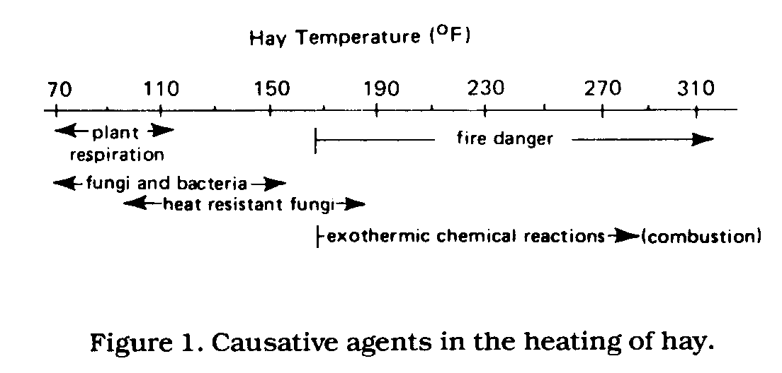
21 43 66 88 110 132 154

Slide 51
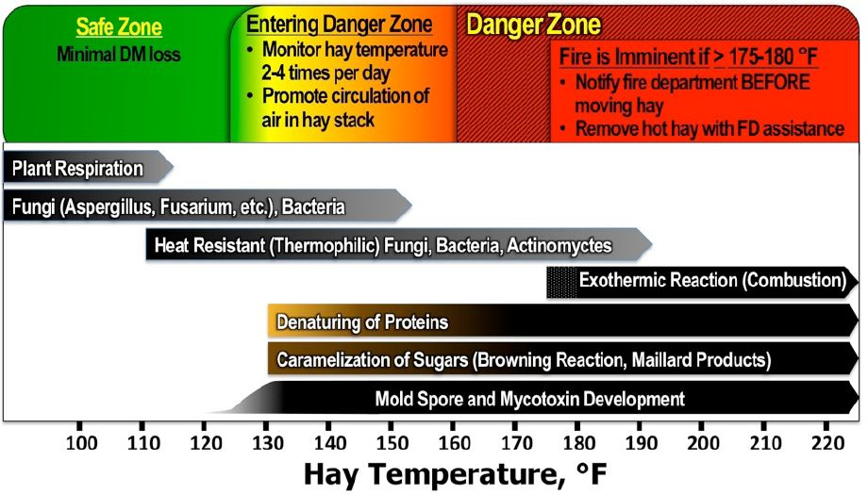

Slide 52
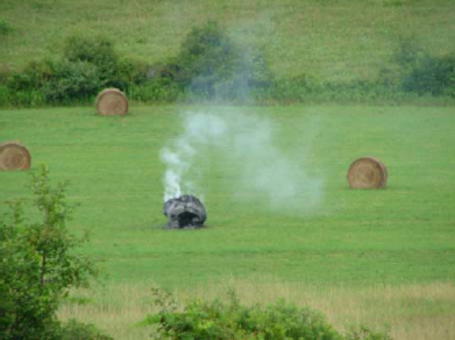
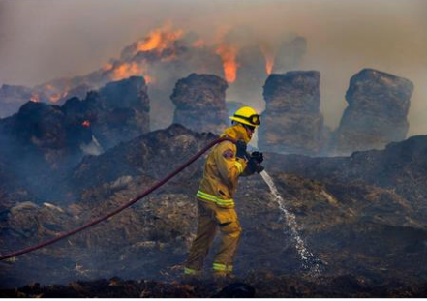
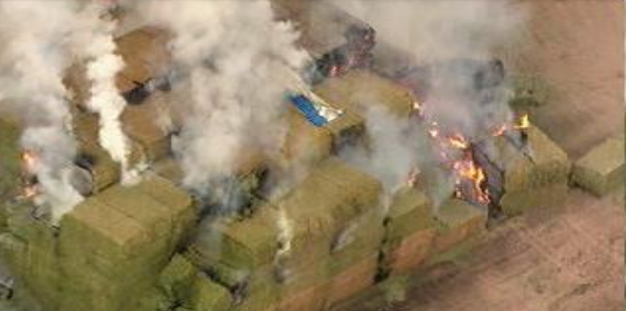

Slide 58
Return Over Investment Chemical Preservatives for Hay
https://youtu.be/5E-XBN72068

Slide 61
Treated 16% to 22% Untreated 16% to 22%
Treated 26% to 30% Untreated 26% to 30%

