Slide 1
INNOVATION: THE CLASSIC TRAPS
By Rosabeth Moss Kanter
HARVARD BUSINESS
REVIEW - (2011 )

Slide 2
Strategy
Mistakes
Remedy
Rejecting opportunities that appear too small
Focus only in new products, not new services or improvement of process
Launching too many minor product extensions that confuse customers and increase internal complexity
Example: Offering 12 sizes and flavors of crackers.
Widen your search and broaden your scope
TIME developed (or bought) 100 magazines
Not every offering was a blockbuster, but TIME learned “To get more successes, you have to be willing to risk more failures”

Slide 3
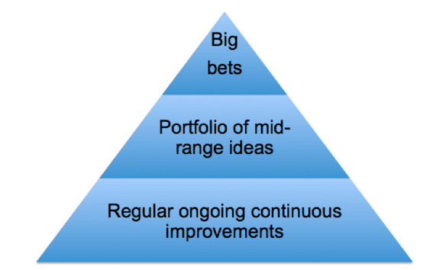
Strategy
New execution, who believed in opening the search for innovation to all employes
Veteran factory worker, approached the new execution with an idea for ending the breakage
Asked how long he had that idea, the worker replied “32 years”
Lessons
Not every innovation has to be a blockbuster
Do not focus only in new products development: transformative ideas can come from any function
Innovation Pyramid
Big bets encourage small wins heading in the same direction, but it also can flow up, because big innovation sometimes begin life as small bits of tinkering – as in the famously accidental development of 3M´s POST IT

Slide 4
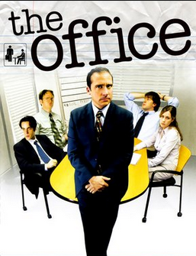
Process
Mistakes
Remedy
Innovation with the same tight planning, budgeting, and reviews applied to the existing business
Rewarding only if they do what they committed to do
Example: people got low marks for not delivering exacly what they had promised, even if they delivered something better → LED PEOPLE TO UNDERPROMISE
Add flexibility to planning and control systems
Example: Reserve special funds for unexpected opportunities
BBC→ The Office
New recruit took the initiative to use money originally allocated to other sector

Slide 5
PROCESS
Lessons
Tight controls strangle innovation.
Companies should expect deviations from the plan

Slide 6
STRUCTURE
Mistakes
Remedy
Isolating fledgling and established enterprises in separate silos
Having 2 classes of corporate citizens:
Innovators ALL THE FUN
Mainstream business managers MAKE THE MONEY
Tighten the human connections between innovators and others throughout your organization.
CBS→ Largest broadcaster and owned of the largest record company: FAILED TO INVENT MUSIC VIDEO
GILLETE→ Had toothbrush unit (ORAL B) + appliance unit (Braun) + battery unit (Duracell): lagged to introduce battery-powered toothbrush

Slide 7
STRUCTURE
Lessons
Tighten interpersonal connections between innovators and the rest
Game-changing innovations often cut across established channels or combine elements of existing capacity new ways
Don´t create 2 classes of corporate citizens, those who aren´t innovators will make every effort to crush the innovation.
The mainstream are supposed to followed the rules, meet demands, and make money while feeling like grinds and sometimes being told they are dinosaurs whose business models will soon be obsolete

Slide 8
SKILLS
Mistakes
Remedy
Allowing innovators to rotate out of teams quickly that the team won´t have chemistry
Assuming that innovation teams should be led by the best technical people
Select innovation leaders with Strong interpersonal skills
When technical experts mystify their audiences rather than enlighten them, they lose support
“no” is always an easier answer than “yes”

Slide 9
Skills
Lessons
Strong leaders with great relationship and communication skills
Members of successful innovation teams stick together through the development of an idea
Because innovations need conectors, they flourish in cultures that encourage collaboration

