Slide 1
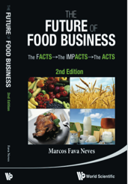
Innovation, Value Creation, Capture and Sharing
Prof. Dr. Marcos Fava Neves
Faculdade de Administraçao (FEA/RP) – Universidade de São Paulo, desde 1995
Escola de Administração de Empresas (EAESP/FGV), desde 2018
Center for Agricultural Business - Purdue University (Indiana/USA), desde 2013
PAA – FAUBA – Universidade de Buenos Aires, desde 2006
Criador da Markestrat (www.markestrat.com.br) em 2004
Especialista em planejamento estratégico no agronegócio
www.doutoragro.com

Slide 2
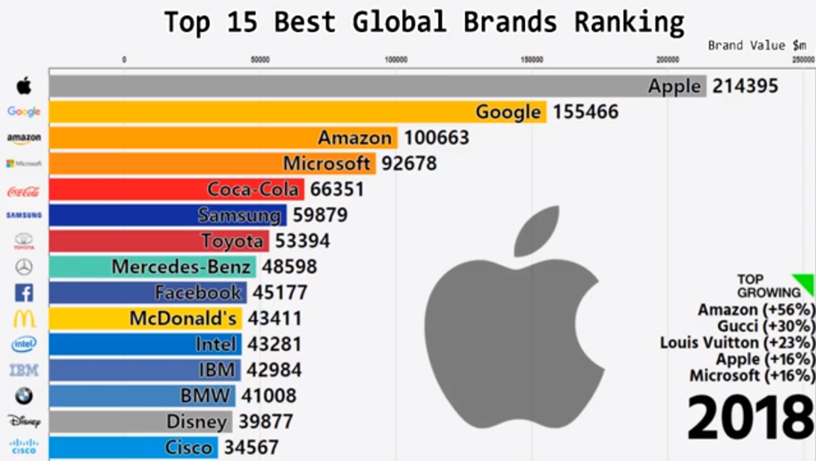
The World in the Digital Era
Notes:
https://www.youtube.com/watch?v=mLV9GMTLY8Q

Slide 3
How can we create, capture and share value in a company activity or in a food chain?

Slide 4
VALUE CREATION, CAPTURE AND SHARING IN FOOD CHAINS
DIFFERENTIATION STRATEGIES | COLLECTIVE ACTIONS STRATEGIES | COST STRATEGIES
Integrated relationship approach Innovation Lock-in strategies Products and "solutions" Brand and Image Packaging Sustainability and certifications; Intimacy and convenience; Channels Sales force Services Performance to buyer | Internal management: products/ brands/ packaging and services Collective Communication Channels Sales Pricing Horizontal and Verticals Associations Alliances, joint-ventures and other forms | Explore core competences Better use of resources and assets Strategy-scale production Quality and material costs Efficiency in labor Continuous redesign of operations and methods Technology for cost reduction Financial architecture (better financing sources) Advantage of experience effects Outsourcing (make or buy decisions) Better operational performance Overhead costs reduction Contracts governance / reduction of transaction costs Reduce bargaining power of sellers Increase importance to suppliers
Source: Prof Marcos Fava Neves

Slide 5
VALUE CREATION, CAPTURE AND SHARING IN FOOD CHAINS
DIFFERENTIATION STRATEGIES
Integrated relationship approach Innovation Lock-in strategies Products and "solutions" Brand and Image Packaging Sustainability and certifications; Intimacy and convenience; Channels Sales force Services Performance to buyer
Source: Prof Marcos Fava Neves

Slide 6
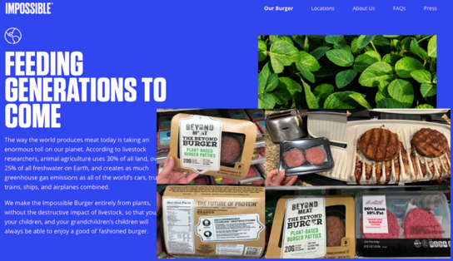
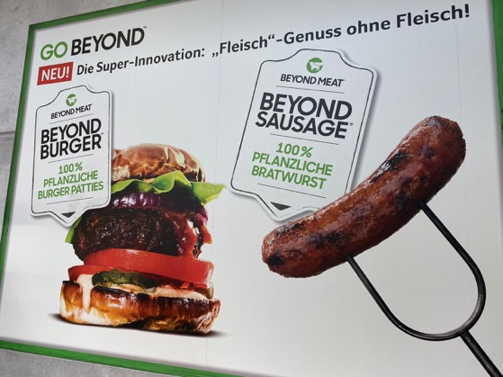
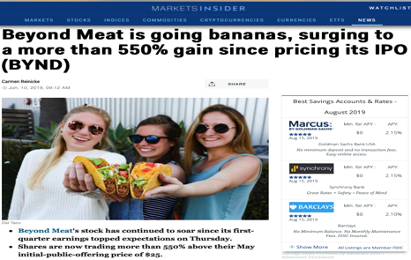
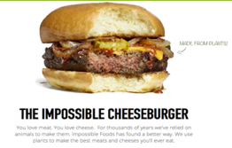
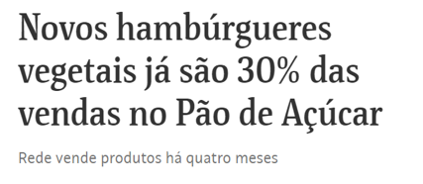

Slide 7
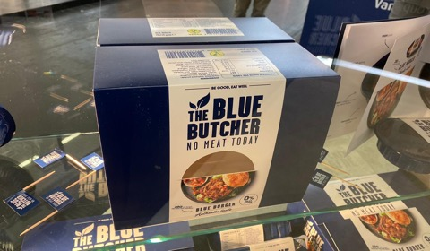
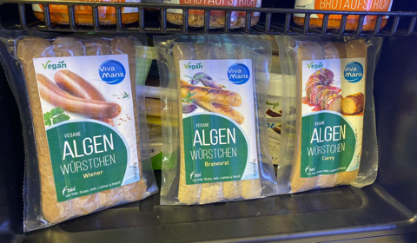
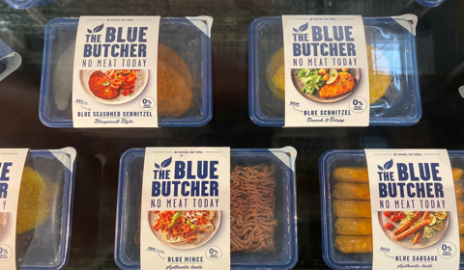
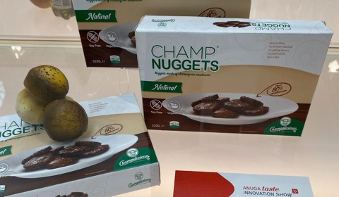

Slide 8
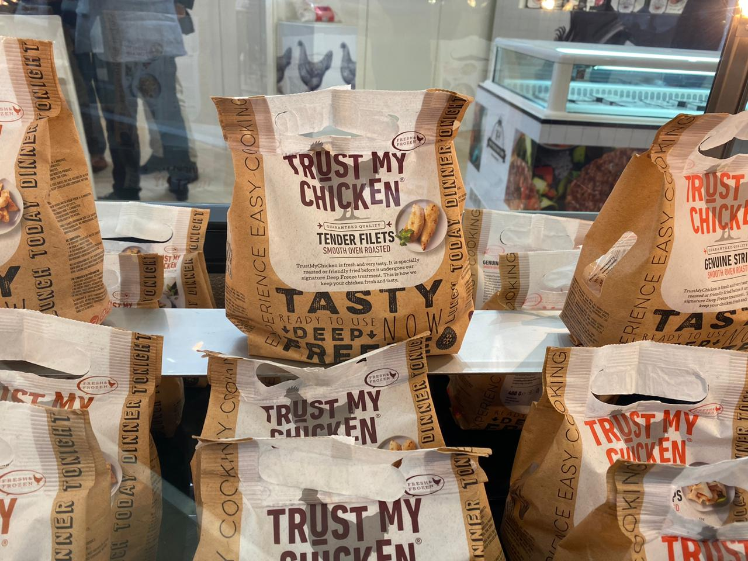

Slide 9
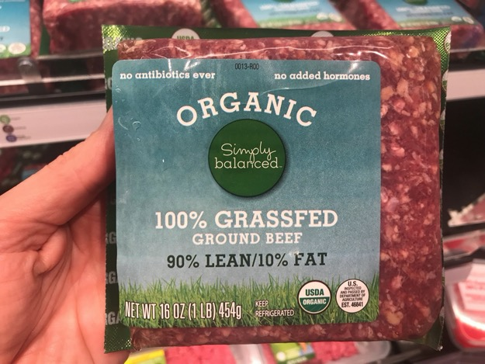
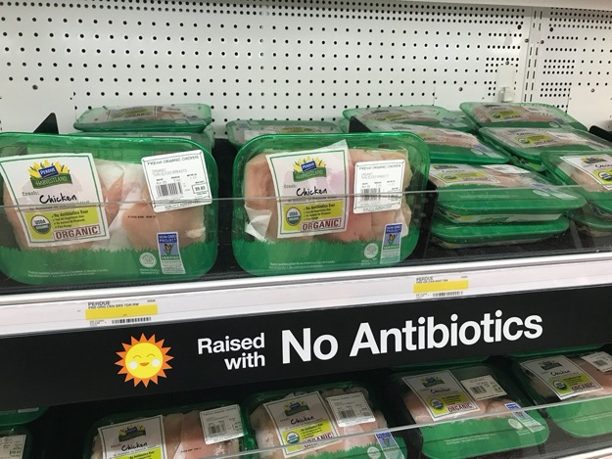

Slide 10
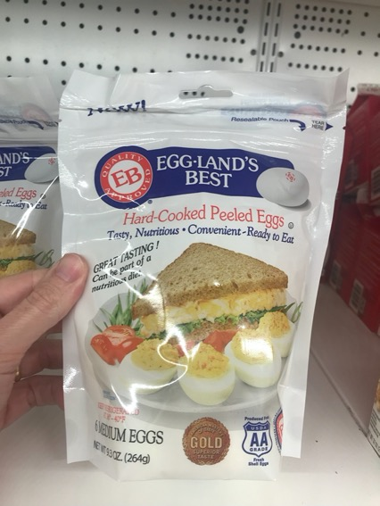
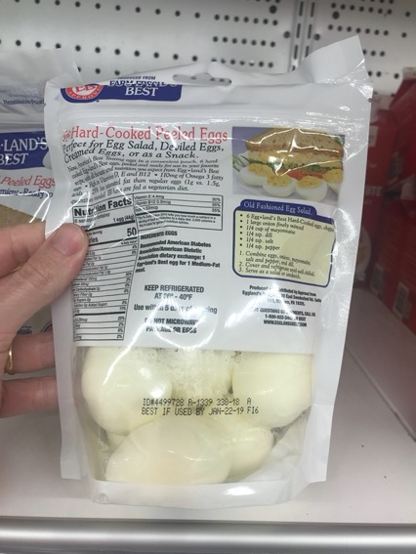

Slide 11
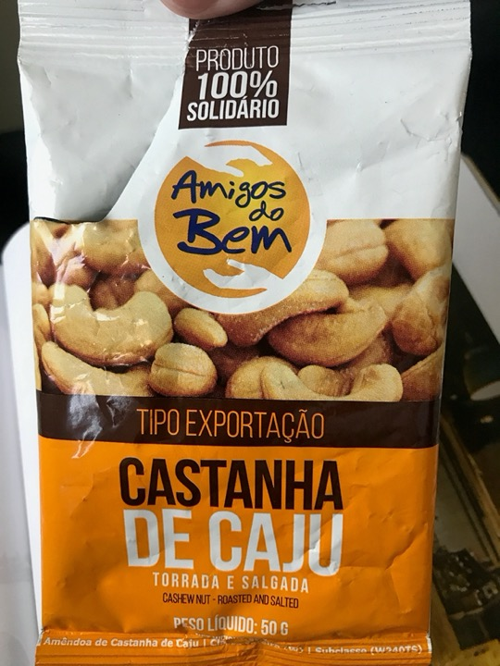

Slide 12
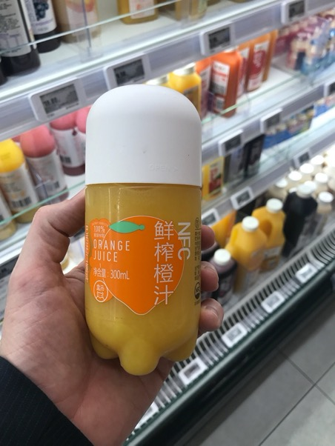
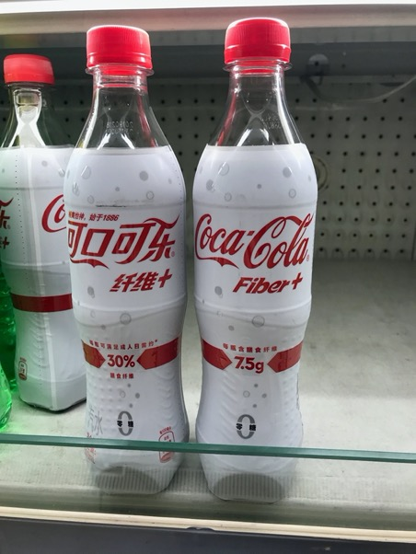

Slide 13
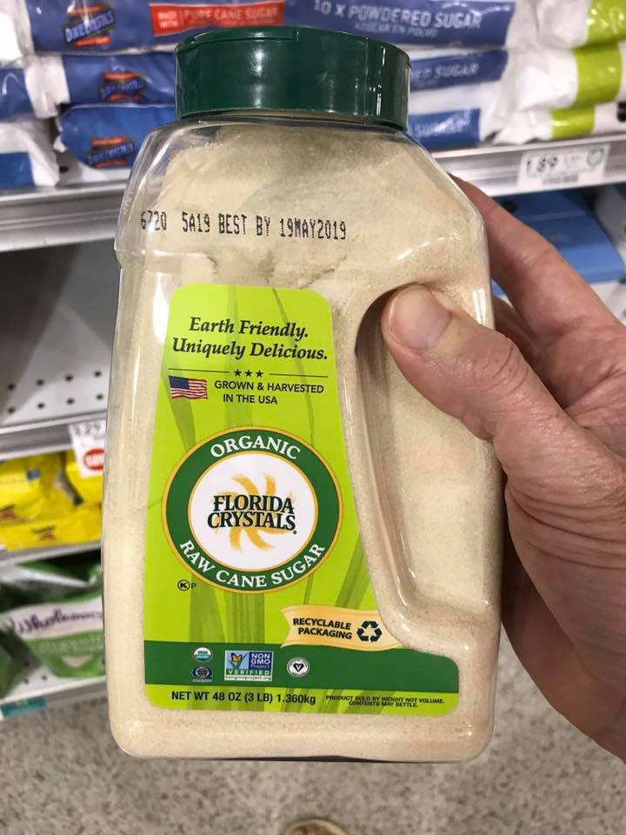
6

Slide 14
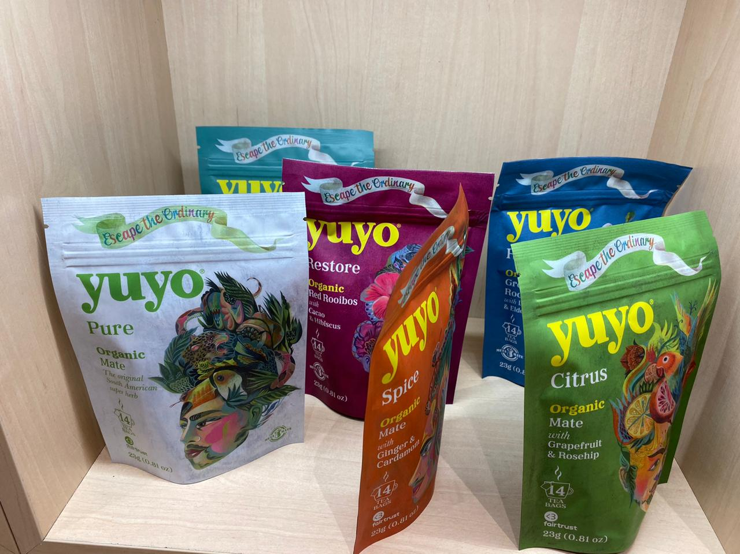

Slide 15
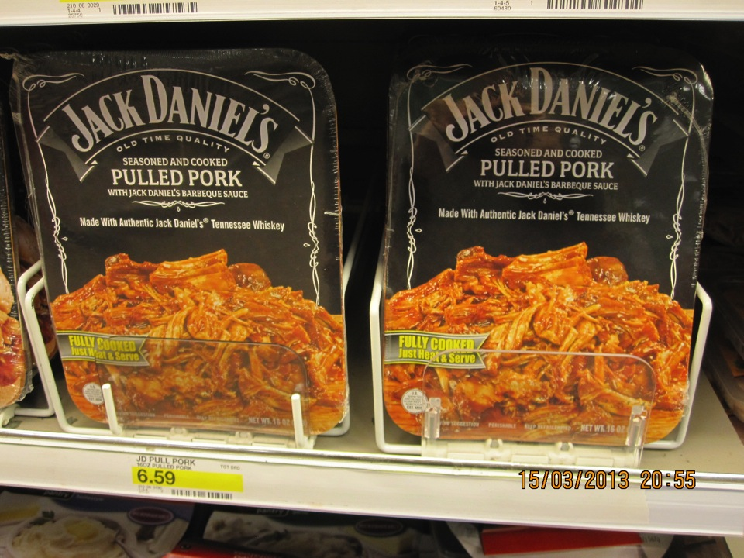

Slide 16
The Value Creation, Capture and Sharing Model: Differentiation
Activities | How the company or food chain can do it? Ideas.
Integrated relationship approach
Lock in strategies: increase buyer switching cost
Products/solutions unique to buyer
Customer service: fast, reliable, “just in time
Packaging solutions
Simplifying buyer’s decisions
Brand and image
Performance to buyer (value driven)
Source : Prof Marcos Fava Neves

Slide 17
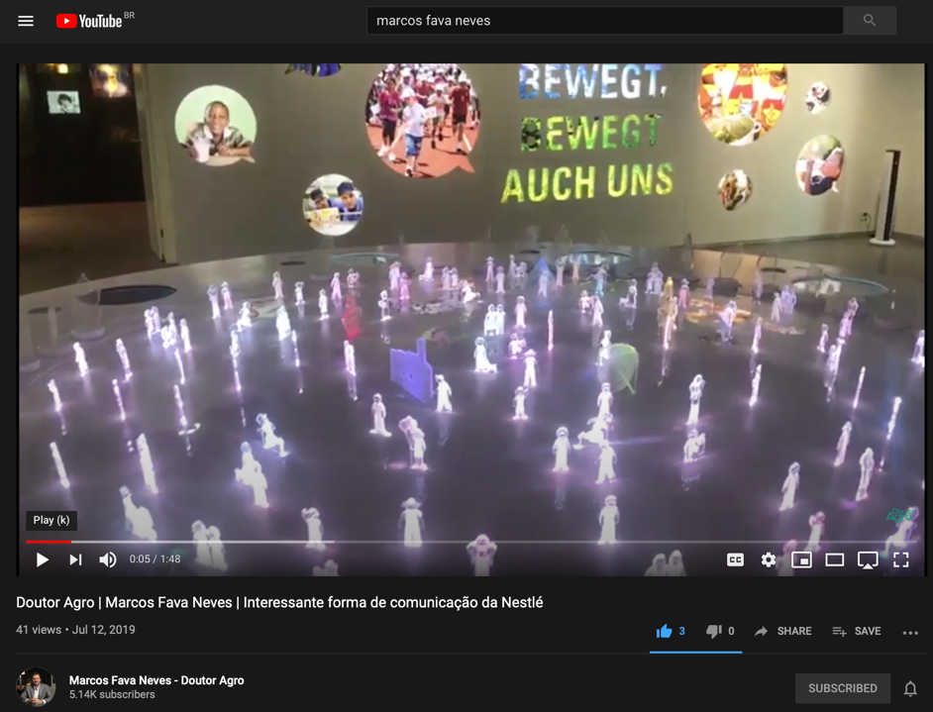

Slide 18
VALUE CREATION, CAPTURE AND SHARING IN FOOD CHAINS
COST STRATEGIES
Explore core competences Better use of resources and assets Strategy-scale production Quality and material costs Efficiency in labor Continuous redesign of operations and methods Technology for cost reduction Financial architecture (better financing sources) Advantage of experience effects Outsourcing (make or buy decisions) Better operational performance Overhead costs reduction Contracts governance / reduction of transaction costs Reduce bargaining power of sellers Increase importance to suppliers
Source: Prof Marcos Fava Neves

Slide 19
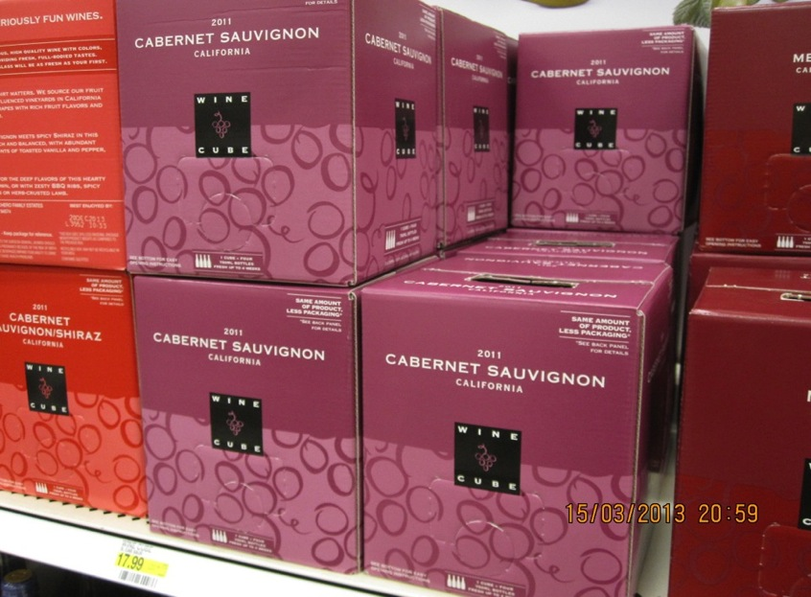

Slide 20
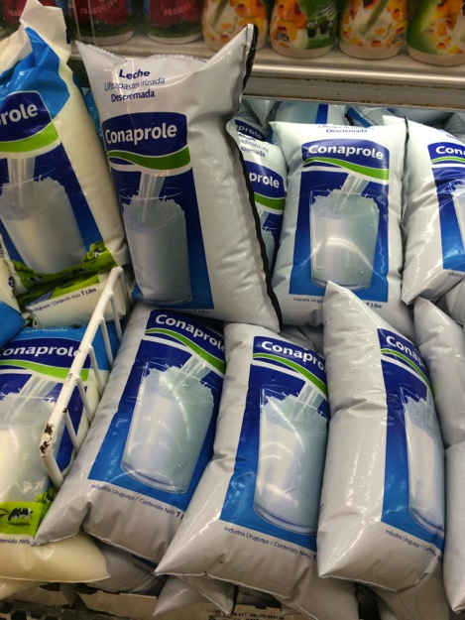

Slide 21
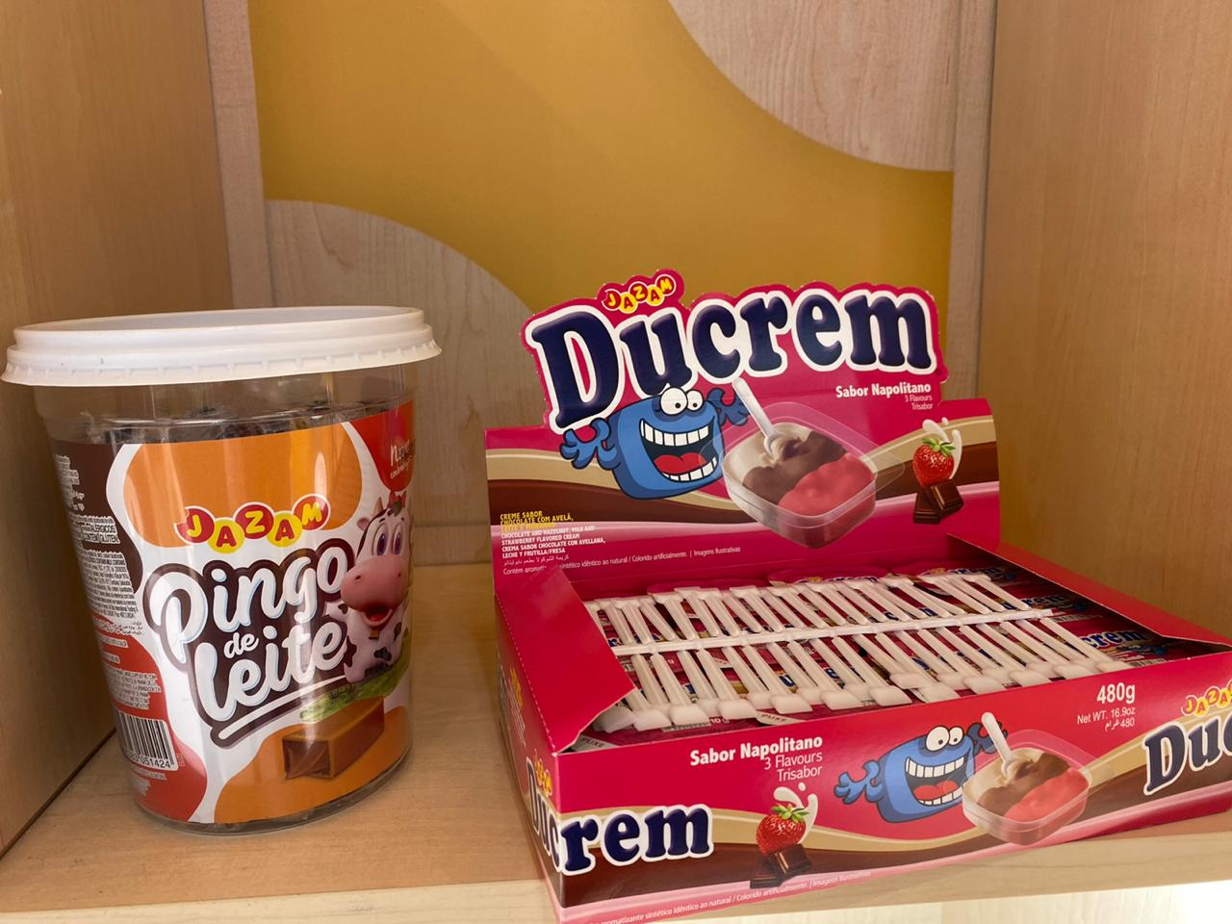

Slide 23
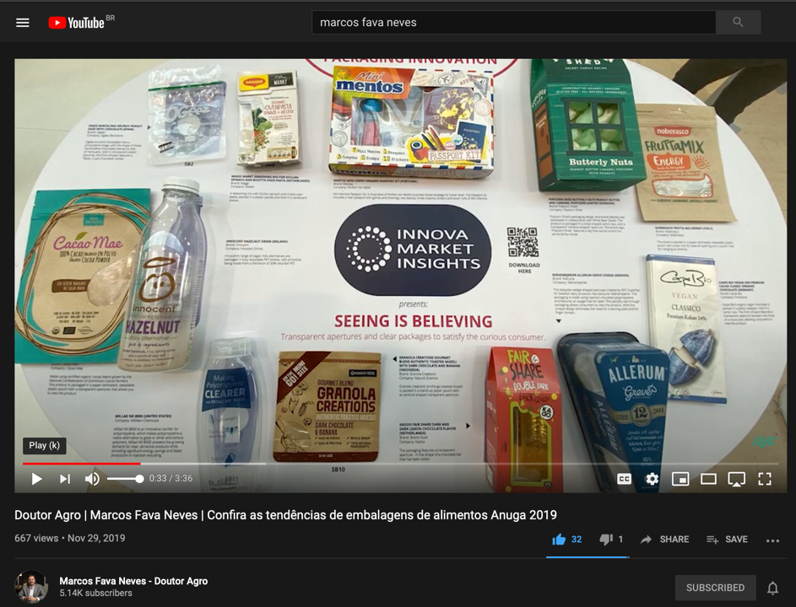

Slide 24
The Value Creation, Capture and Sharing Model: Costs
Activities | How the company or food chain can do it? Ideas.
Explore core competence to an exhaustion
Better use of all assets
Search for scale
Quality and cost of materials used in production
Efficiency in labour
Continuous redesign of operations and methods
Technology (R&D) to reduce costs
Financial architecture (better financing sources)
Source: Prof Marcos Fava Neves

Slide 25
The Value Creation, Capture and Sharing Model: Costs
Activities | How the company or food chain can do it? Ideas.
Advantages of experience effects
Perform operations better than rivals
Overhead costs reduction
Outsourcing (make of buy decisions) to reduce costs
Reduce bargaining power of sellers
Governance contracts/reduction of transaction costs
Increase your importance to suppliers
Continuous trial of substitutes/alternative inputs (imported)
Stimulate competition within a few reliable suppliers
Source: Prof Marcos Fava Neves

Slide 26
VALUE CREATION, CAPTURE AND SHARING IN FOOD CHAINS
COLLECTIVE ACTIONS STRATEGIES
Internal management: products/ brands/ packaging and services Collective Communication Channels Sales Pricing Horizontal and Verticals Associations Alliances, joint-ventures and other forms
Source: Prof Marcos Fava Neves

Slide 27
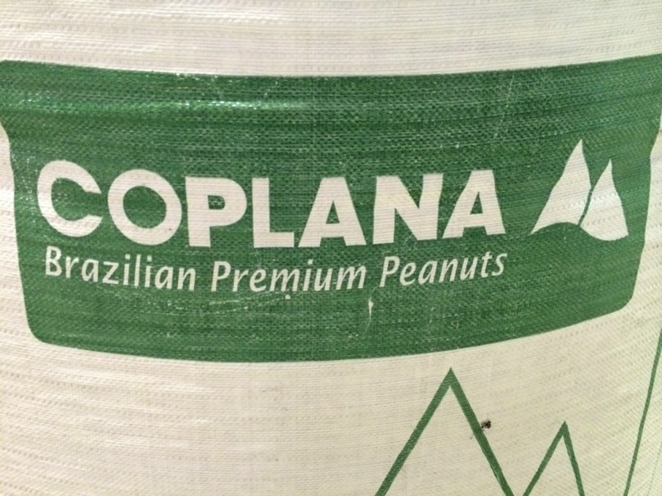

Slide 28
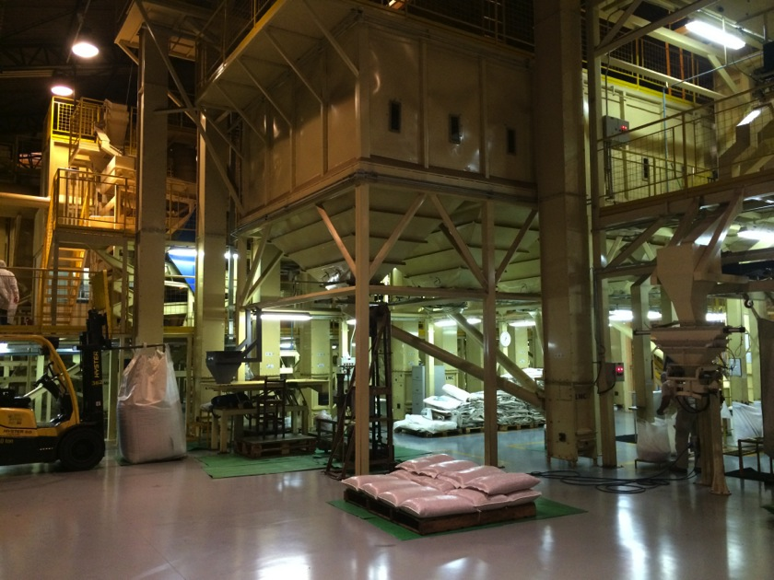

Slide 29
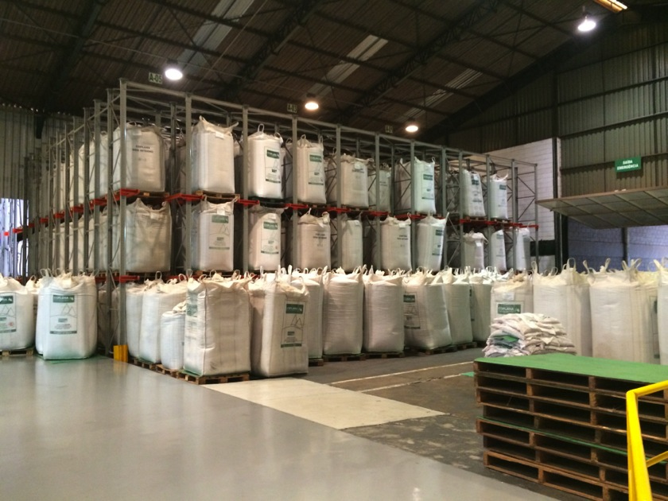

Slide 30
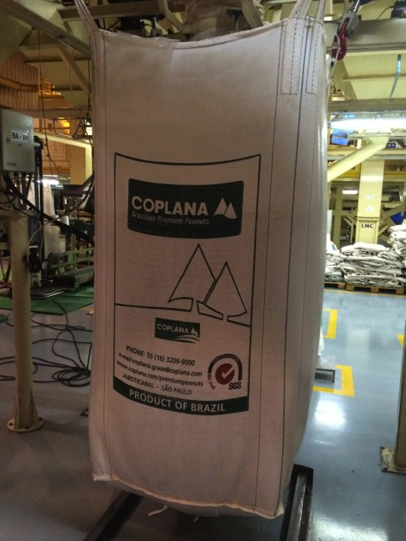

Slide 31
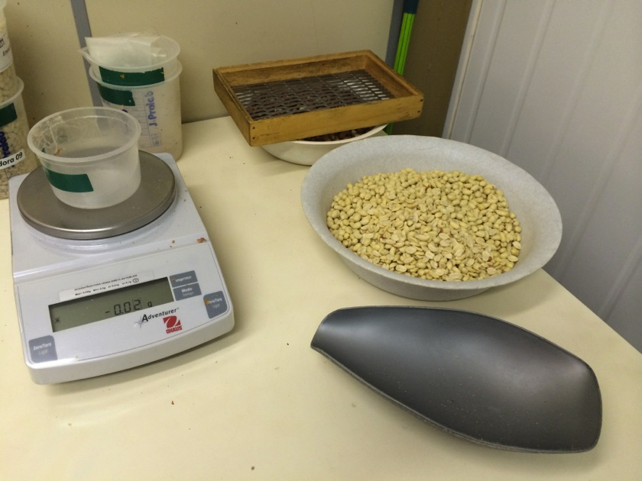

Slide 32
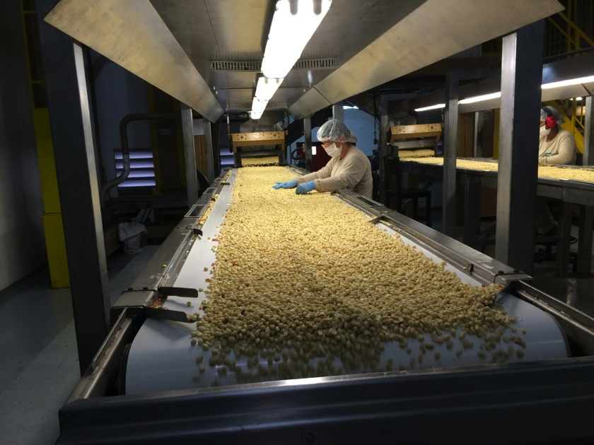

Slide 33
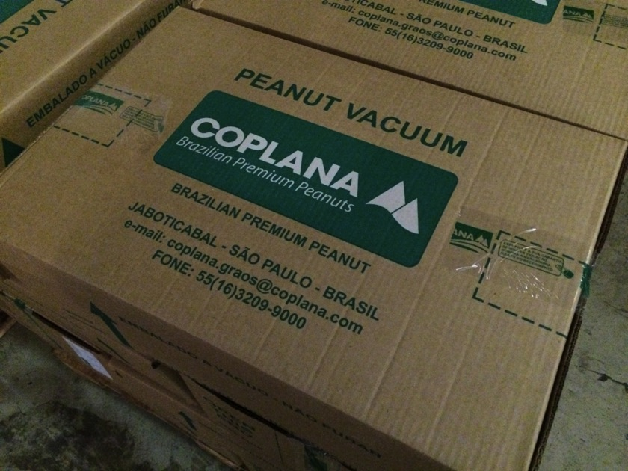

Slide 34
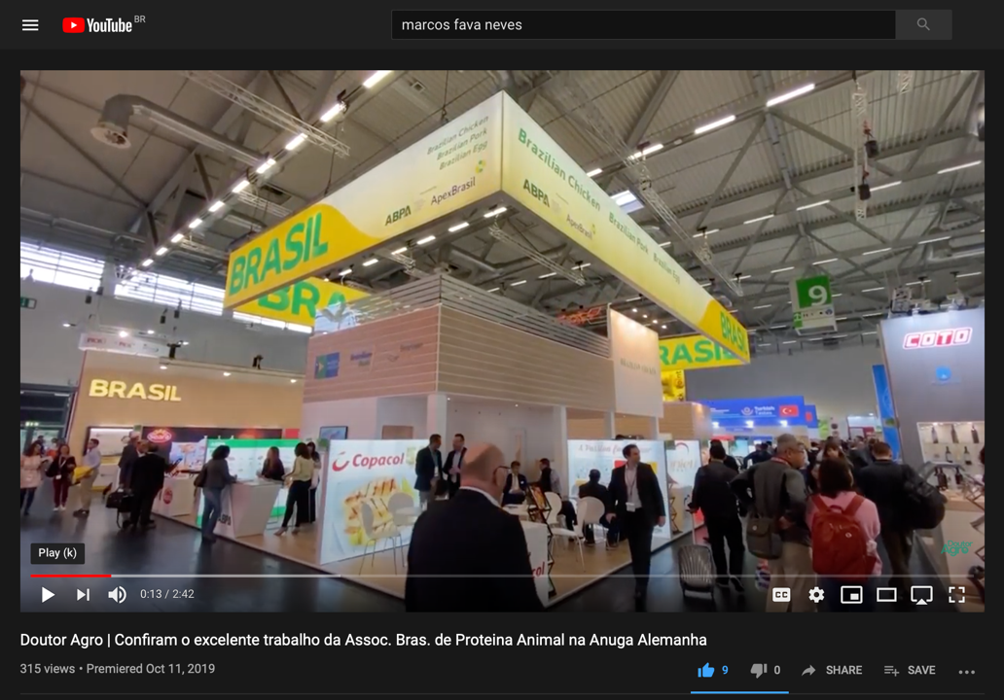

Slide 35
Value Creation Capture and Sharing: Collective Actions
Activities | How the company or food chain can do it? Ideas.
Collective actions via supply chain
Collective actions via internal management
Collective actions via products/brands/packaging/services
Collective actions via communications
Collective actions via marketing channels and sales
Collective actions via pricing
Increase your importance to suppliers
Collective actions via horizontal and vertical associations
Collective actions via strategic alliances and joint ventures
Source: Prof Marcos Fava Neves

Slide 36
Question of the Day
Imagine one case (example) of value creation, capture and sharing…
1) Differentiation,
2) Cost,
3) Collective Actions…
…and tell us the reasons you have choosen?

Slide 37
In the innovation process, lets work with 20 questions that can give insights…?

Slide 38
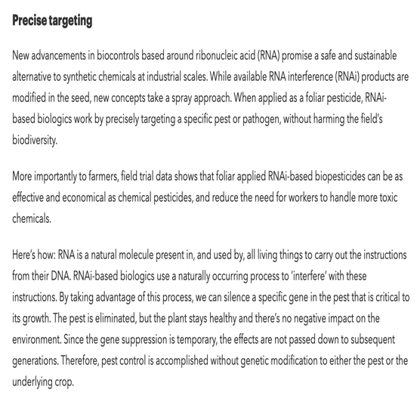

Slide 39
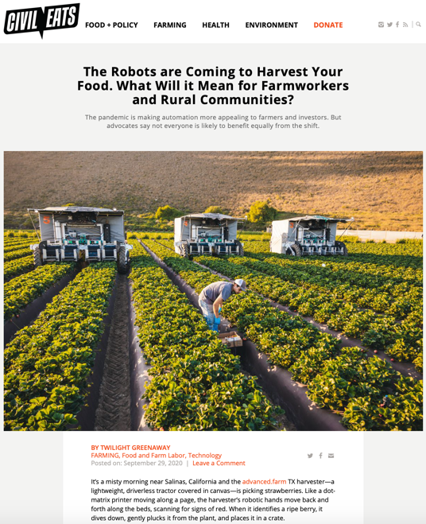

Slide 41
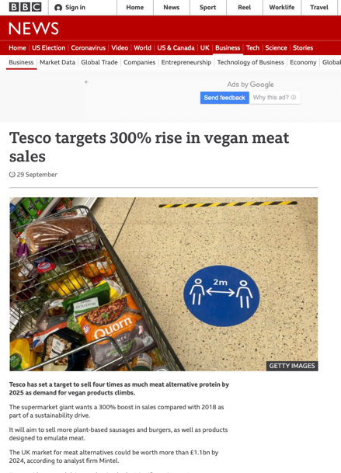

Slide 42
20 Questions to “Think Out of the Box”
1. How can a company use the concept of building relationships in its value chain and which among such relationships could be profitable to the company?
2. How to personalize (customize) the companies offer in order to satisfy individuals in a cost effective way?
3. How to organize an entire service package in a selling relationship to a particular costumer in order to make his purchasing experience interesting and also profitable for the company?
4. How to list and how to decide what will not be done by the organization, in terms of business, products, services or other activities, or even by individuals?
5. What are the 10 most relevant things we, as a company, will do next?
Source: Prof Marcos Fava Neves

Slide 43
20 Questions to “Think Out of the Box”
6. In which of these 10 relevant things should we, as a company, focus?
7. How to simplify the company’s offer to the consumer?
8. When analyzing the whole purchasing experience or the product usage process, which parts are not needed and could be removed?
9. Which alternatives would be time saving for our clients?
10. In order to understand our competitors behavior, a nice question to ask is how can we cannibalize our offer?
Source: Prof Marcos Fava Neves

Slide 44
20 Questions to “Think Out of the Box”
11. About forecasting the future, an intriguing question is how to read things that are not yet at the page?
12. In order to be more effective in our activities, or within our companies projects, how to get our minds around it (a particular activity) and do it (make it happen)?
13. How can we improve our “face to face” interactions, or the personal touch of the company?
14. In order to have, at the same time, a broader and a specific view of a particular situation or about a business, how to capture the big picture and also the details?
15. In order to promote better management with a scientific approach, what are the ideas to integrate people (humanities) to science?
Source: Prof Marcos Fava Neves

Slide 45
20 Questions to “Think Out of the Box”
16. In order to create great teams in our companies, how to recruit, maintain and motivate talents?
17. In order to improve the possible positive influence, how to use/spread personal skills of the leader within the organization?
18. Intuition may help collaborate in several decision-making process, bringing sensitivity and the human part of business, and for this to happen, how to take advantage and also to filter the effects of intuition?
19. How to transfer the admired concept and DNA of the company to the offer (product + service)?
20. How to permanently reset (innovate/rethink) the company in order to create an organization that may revolutionize people’s lives or even the business’s history in a sustainable and profitable way?
Source: Prof Marcos Fava Neves

Slide 46
Marcos Fava Neves is an international expert on global agribusiness issues and a part-time professor of planning and strategy at the School of Business (FEARP) of the University of São Paulo (USP) and FGV Business School, both in Brazil. He graduated as an agronomic engineer from ESALQ/USP - Piracicaba in 1991. He earned his master’s degree in 1995 and his doctorate in management in 1999 from the FEA/USP School of Economics and Business – São Paulo. Marcos completed postgraduate studies in European agribusiness at ESSEC-IGIA in France in 1995 and in chains/networks at Wageningen University, in the Netherlands (1998-1999). In 2013 he spent the year as a visiting international professor at Purdue University (Indiana, USA) where he maintains the linkage as a permanent International Adjunct Professor. Since 2006 he is an international professor at the University of Buenos Aires, Argentina.
He has specialized in strategic-planning processes for companies and food chains and works as a board member of both public and private organizations, being member of mor than 10 international boards since 2004. Also in 2004, he created the Markestrat think tank with other partners, today employing around 60 people and doing international projects, studies and research in strategic planning and management for more than 250 agri-food business organizations. Some of these projects were very important in suggesting public policies for food chains that were implemented in Brazil with economic and social impacts.
Also as an experience in the private sector, from 1992 to 1993 he worked in citrus juice exporter and from 1994 to 1995 in a veterinarian company. In 2008, he became CEO of Brazil’s second-largest biofuel holding company, a position he occupied until 2009, when he returned to the University of São Paulo (USP) and Markestrat.
At the academic side, since 1995 (when he was hired by USP), Marcos has advised more than 30 doctorate dissertations and master’s theses and helped to form around 1200 Bachelors in Business Administration in Brazil with around 120 courses taught to undergraduates at USP.
His writings are strongly focused on supplying simple and effective methods for business. He has published more than 100 articles in international journals and has been author and editor of 63 books by 10 different publishers in Brazil, Uruguay, Argentina, South Africa, Singapore, Netherlands, China, the United Kingdom and the United States. He is also a regular contributor for China Daily Newspaper and has written two case studies for Harvard Business School (2009/2010), one for Purdue (2013) and five for Pensa/USP in the nineties. Recognized as the Brazilian academic with the largest number of international publications about orange juice and sugar cane chain and one of the top 3 most cited Brazilian authors in the area of food and agribusiness. He has reached more than 4000 citations in Google Scholar index.
Marcos is one of the most active Brazilian speakers, having done more than 1050 lectures and presentations in 25 countries. He received around 150 recognitions from Brazilian and international organizations, and is considered a “Fellow” of the IFAMA (International Food and Agribusiness Management Association), title received in Minneapolis - 2015.
Coming from a family of farmers, he is a worldwide defender of agriculture and farmer’s role in the development of the society. In the social side, together with his parents, Marcos is one of the creators and maintainers of Mucapp, a NGO that in 20 years has built more than 450 houses for families in Brazil that face very unfavorable conditions.

