Slide 1
Why are narratives important in understanding and interpreting disease and epidemics?

Slide 2
Global Health Governance I Intellectual Property Rights vs Human Rights

Slide 3
International norms and global health: The human right to health
First International Health Conference, 1947, New York
World Health Organization, 1948
Universal Declaration of Human Rights, 1948
International Covenant on Economic, Social and Cultural Rights, 1976
→ Article 12 recognises “the right of everyone to the enjoyment of the highest attainable standard of physical and mental health“
General Comment 14, 2000
attributes full responsibility to the states in taking action to fully realise the right to health (i.e., providing primary health care, etc.)
International Health Regulations, 2005
provide and coordinate international public health responses to the international spread of disease

Slide 4
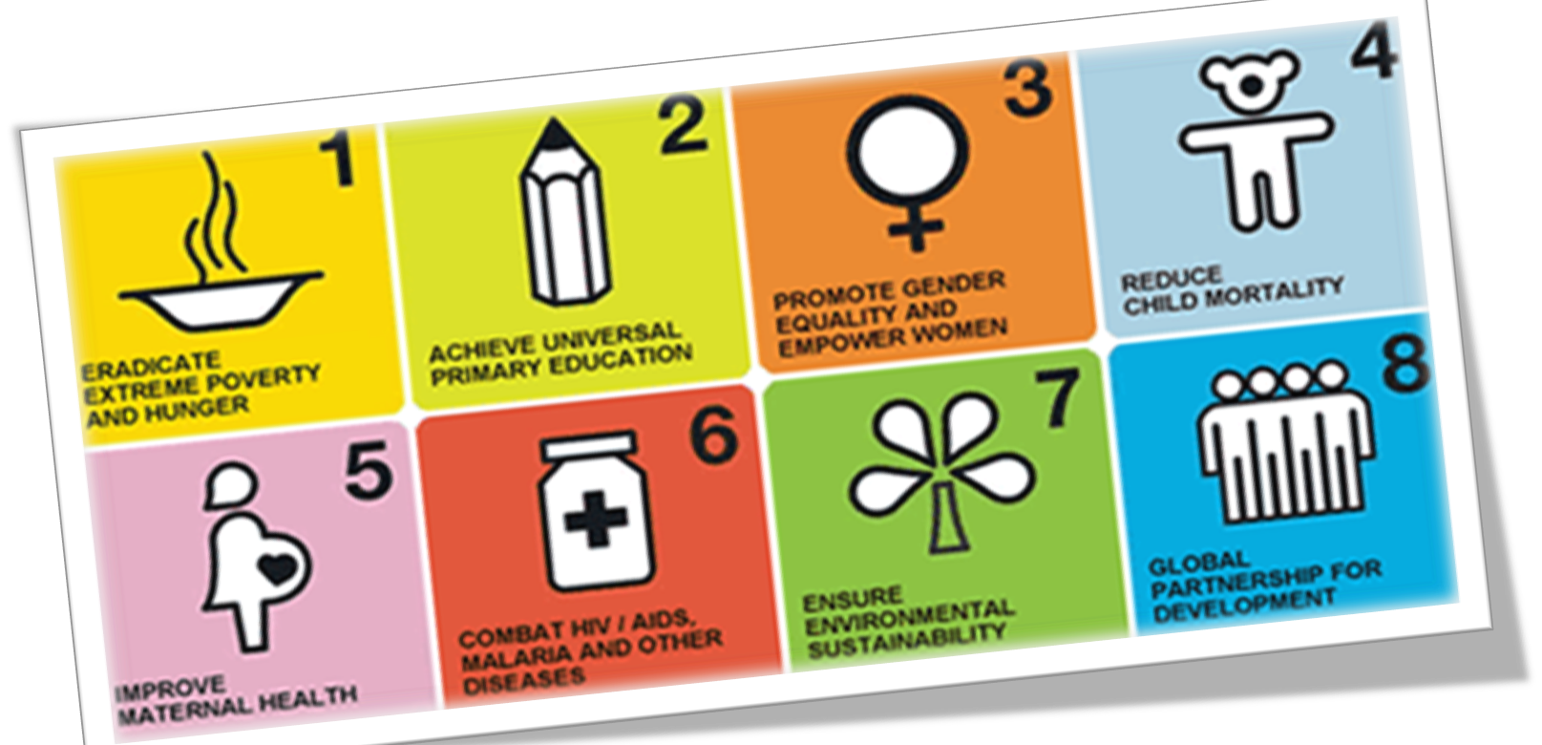
The Millennium Development Goals, 2000

Slide 5
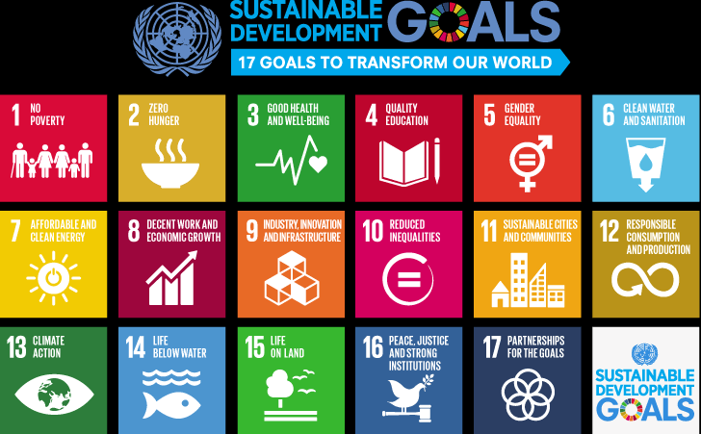

Slide 7
How to guarantee and reinforce a human right to health?
health care education
health care systems
accessibility
medicines / drugs
primary health care
Principal problem in guaranteeing the human right to health: lack of access to …

Slide 8
Intellectual property rights vs human rights
TRIPS (Trade-Related Aspects of Intellectual Property Rights) Agreement, WTO 1994
Harmonisation of intellectual property rights → respecting international copyrights and patents → binding for all WTO member states
Protecting intellectual property rights
Outlawing generic products and generic drug markets / reducing the availability of generic drugs
Ignoring human rights

Slide 9
The Doha Declaration on the TRIPS Agreement and Public Health, 2001
- concedes the use of compulsory licences in public health emergencies
- members have the right to determine what constitutes a public health emergency
- allows the use/import of generic medicines for those countries without sufficient manufacturing capacities

Slide 10
Moral Dilemma
Pharmaceutical companies and states from the developed world (intellectual property)
vs
Human beings and states from the developing world (human right to health)
Examples:
Access to vaccines, Vaccines for Pneumonia
New treaties, The Trans-Pacific Partnership Agreement

Slide 11
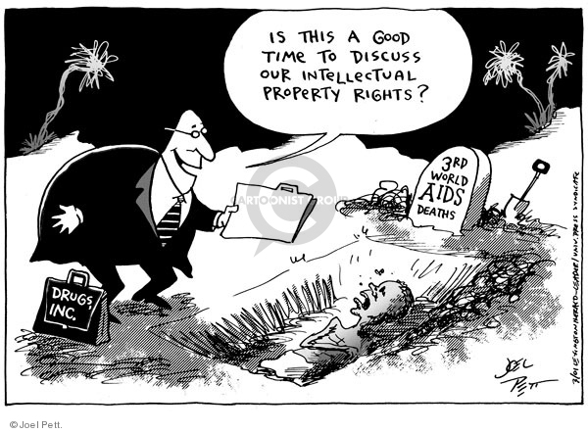
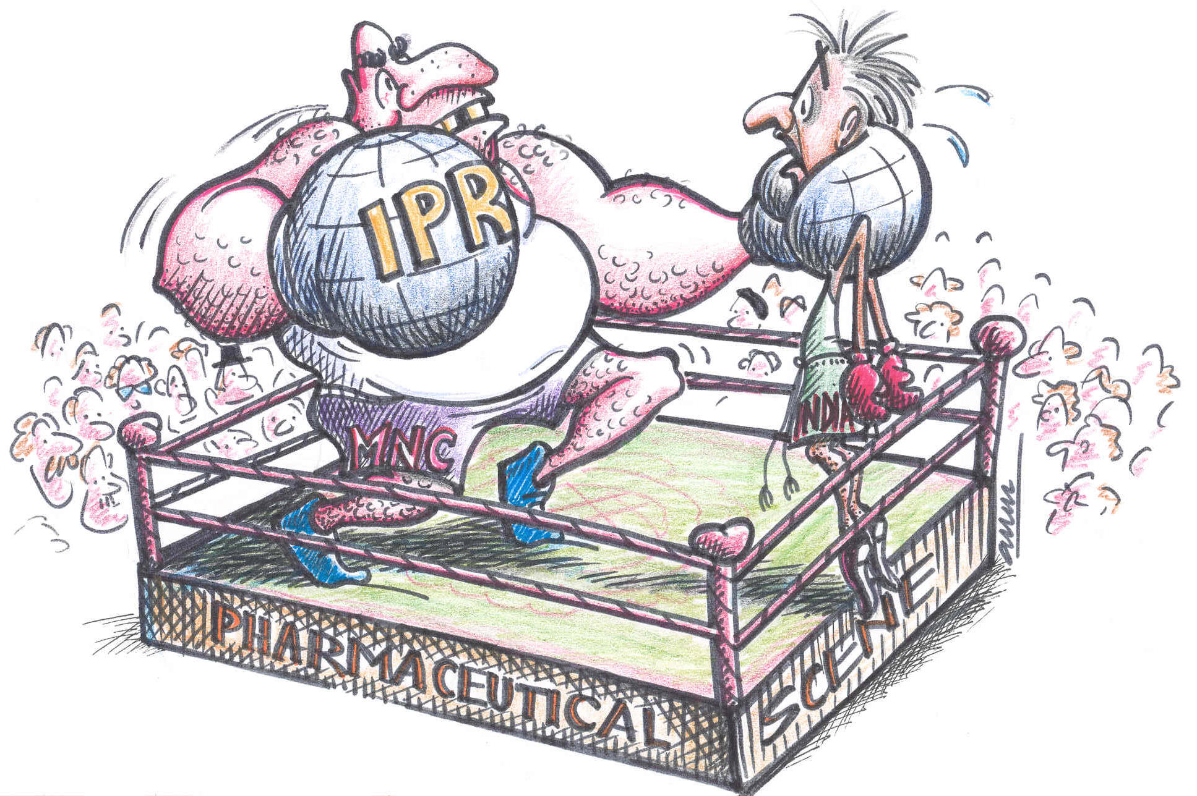
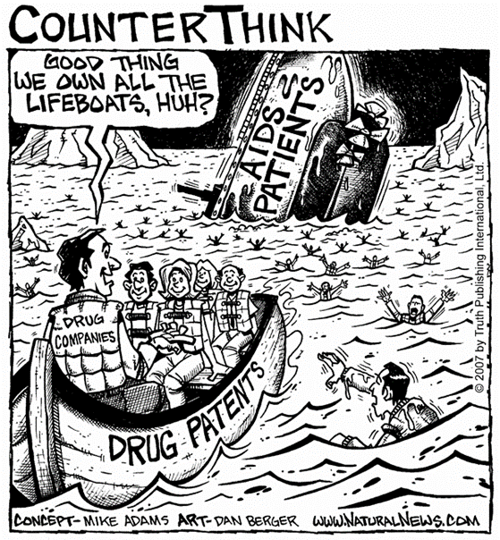
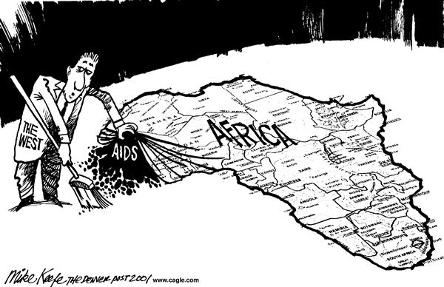
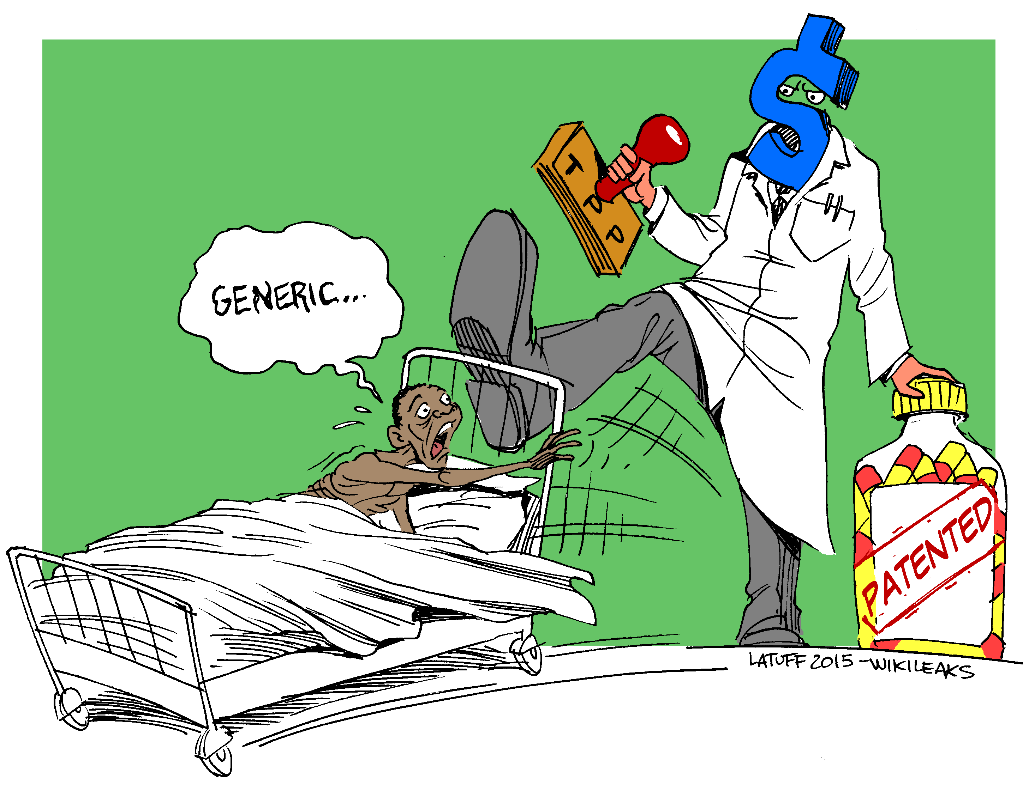

Slide 12
Solutions …?
Imagine you take part in an international conference to renegotiate the TRIPS Agreement. You are a representative of a pharmaceutical company, the US government, the government of Brazil or a transnational civil society organisation like Oxfam or Médecins Sans Frontières.
You have to present the viewpoint / argument of your organisation/government together with a workable solution that satisfies the interest of your organisation/government and that of the other actors at the international conference.
Present the main viewpoint / argument and a workable solution
to combine the respect for intellectual property rights AND human rights!
Main actors involved:
- the pharmaceutical industry (from Europe and North America)
- the US government
- the government of Brazil
- transnational civil society organisations

