Slide 1
LÓPEZ OSTRA v. SPAIN
European Court of Human Rights

Slide 2
Nature of the case
Violation of the right to respect for home, private and family life
Relationship between the right to a healthy environment and the right to respect for private life, home and family life

Slide 3
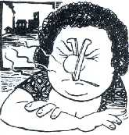
Facts
In Lorca began to operate a plant for the treatment of liquid and solid waste that caused health problems and nuisance to many Lorca people, particularly those living in the applicant's district.

Slide 4
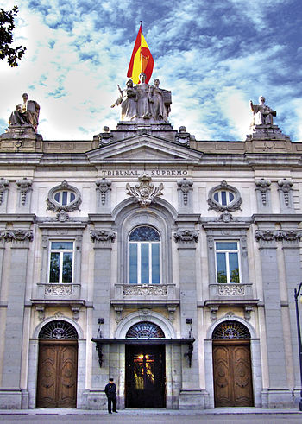
Proceedings - Supreme Court
Mrs López Ostra lodged an application with the Administrative Division of the Murcia Audiencia Territorial, seeking protection of her fundamental rights.
Audiencia Territorial held that did not infringe the fundamental rights
Supreme Court dismissed the appeal

Slide 5
Proceedings - Constitutional Court
Mrs. López Ostra lodged an appeal with the Constitutional Court, alleging violations of Article 15, Article 18 and Article 19 of Constitution
The court ruled that the appeal was inadmissible on the ground that it was manifestly ill-founded.

Slide 6
Constitutional base
Article 15
Article 18

Slide 7
Constitutional base
Article 19

Slide 8
Proceedings before the comission
Gregoria López Ostra filed a report before the European Commission on Human Rights against the Spanish State.
She alleged Spain had:
Violated her rights to physical integrity (Article 3 of ECHR)
Violated her rights to respect for the home and private life (Article 8 of ECHR)
She claimed compensation for damage and reimbursement of costs and expenses (Article 50 of ECHR)

Slide 9
European Convention
Art. 3 - Prohibition of torture
Art. 8 - Right to respect for private and family life
No one shall be subjected to torture or to inhuman or degrading treatment or punishment.
Everyone has the right to respect for his private and family life, his home and his correspondence.
There shall be no interference by a public authority with the exercise of this right except such as is in accordance with the law and is necessary in a democratic society in the interests of national security, public safety or the economic wellbeing of the country, for the prevention of disorder or crime, for the protection of health or morals, or for the protection of the rights and freedoms of others.

Slide 10
Decision of the court
Holds that there has been a breach of Article 8 of ECHR
Holds that there has been no breach of Article 3 of ECHR
Holds that the respondent State is to pay the applicant, within three months, 4.000.000 pesetas for damage and 1.500.000 pesetas

Slide 11
Significance of the Case
"severe environmental pollution may affect individuals' well-being and prevent them from enjoying their homes in such a way as to affect their private and family life adversely."

